Slide 1

B n s d a v teacher training college, giridih
Assignment on
EPC 04: UNDERSTANDING THE SELF

Slide 2
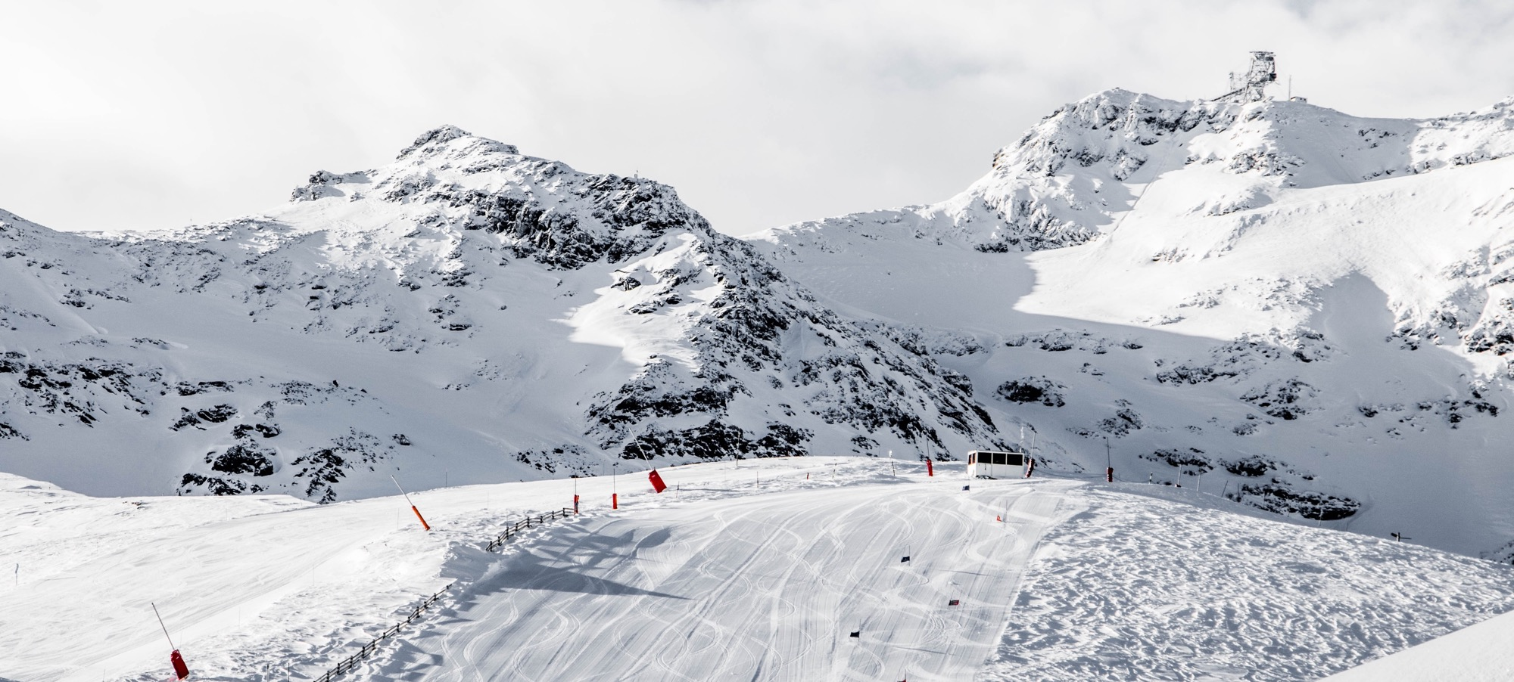
Exploring the Aim of
LifE
Notes:
© Copyright Showeet.com – Free PowerPoint Templates

Slide 3

AN AIM IN LIFE IS THE ONLY FORTUNE WORTH FINDING

Slide 4
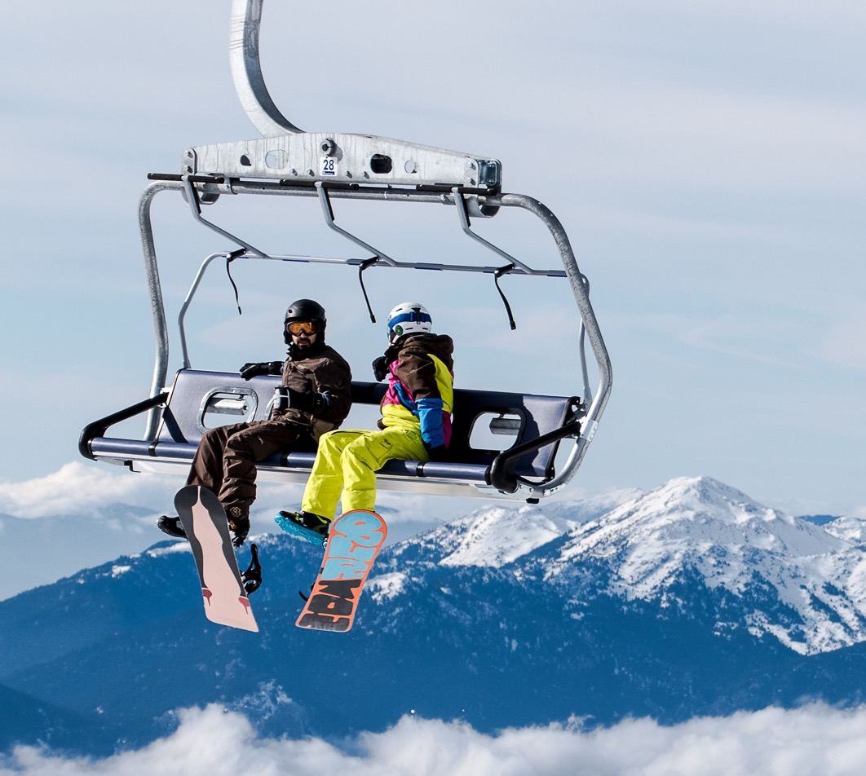
What is the Aim?
In a generic term purpose or goal is an aim. A person in his childhood might want to be a famous astronaut or a movie star or a police officer or something like that. Aim means to intend, to try, or to aspire. Each aim generally starts with a declaration of setting the goal, then breaking it into smaller pieces over a set timeline. Thus to achieve it one has to overcome many obstacles and setbacks from time to time.
Notes:
© Copyright Showeet.com – Free PowerPoint Templates

Slide 5

Importance of aim in life:
There is a popular saying that a man without an aim is like an aim without a rudder. It means a ship without a rudder faces danger. Thus similarly a man without aim cannot reach towards his goal of life. He stumbles in his way of life.
Notes:
© Copyright Showeet.com – Free PowerPoint Templates

Slide 6


So every person must have a definite aim. So, the aim of life is to give your life a purpose and meaning. Certainly, it is done by finding out what truly matters to you. Your purpose is to create more joy in life or to show others how you can live your life in the best possible manner.
Notes:
© Copyright Showeet.com – Free PowerPoint Templates

Slide 7
Primary aim in life
A person can set the aim of his life by applying various parameters in life. Some of these maybe –
To live with a specific purpose and passion every day
To live for others by helping them.
To become a great father, mother, son or daughter
To become a wildly successful entrepreneur and businessman
To live a healthy, active and fit life
To live with financial freedom in life.

Slide 8
How to Achieve the Aim in Life?
*Be Proactive
*No More Negativity
*Always be balanced
*Fully Focused
*Break it down
*Embrace failure
*Tell everyone
*Get help and guidance
*Track your progress
*Visualize the end result
*Reset the action plan based on feedback

Slide 9


Slide 10

Large Image slide
ALWAYS AIM TOWARDS FUTURE
Notes:
© Copyright Showeet.com – Free PowerPoint Templates

Slide 11
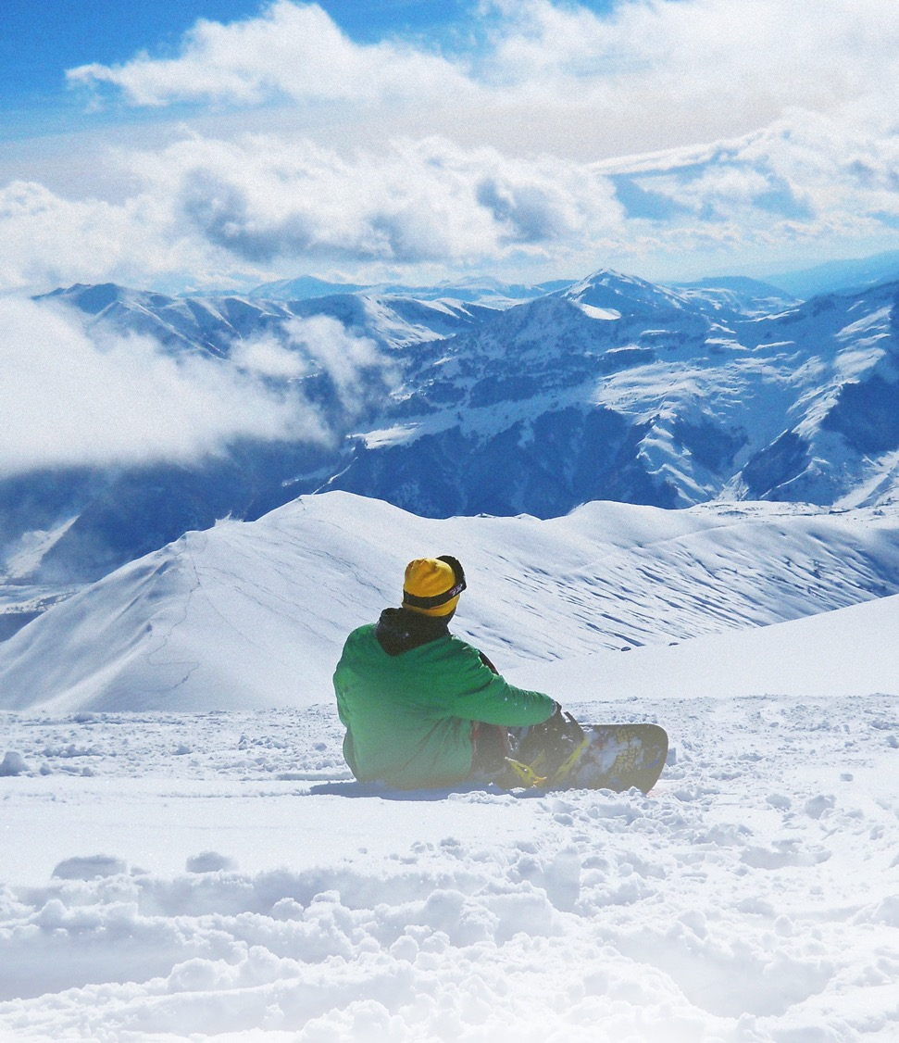
THANK
YOU
Under the guidance
of
Mr. Mukesh Mahato
professor
BNS DAV Teacher Training College,
Giridih

Slide 12

Presented by:-
Name- Ravishanker kumar singh
Roll no-32
Semester-4
Session-2020-2022

