Slide 1

BNS DAV TEACHER TRAINING COLLEGE,GIRIDIH
Assignment on
EPC 04: UNDERSTANDING THE SELF

Slide 2
PEACE,
PROGRESS
AND
HARMONY

Slide 3


PEACE
P
Peace is a concept of societal friendship and harmony in the absence of hostility and violence.

Slide 4
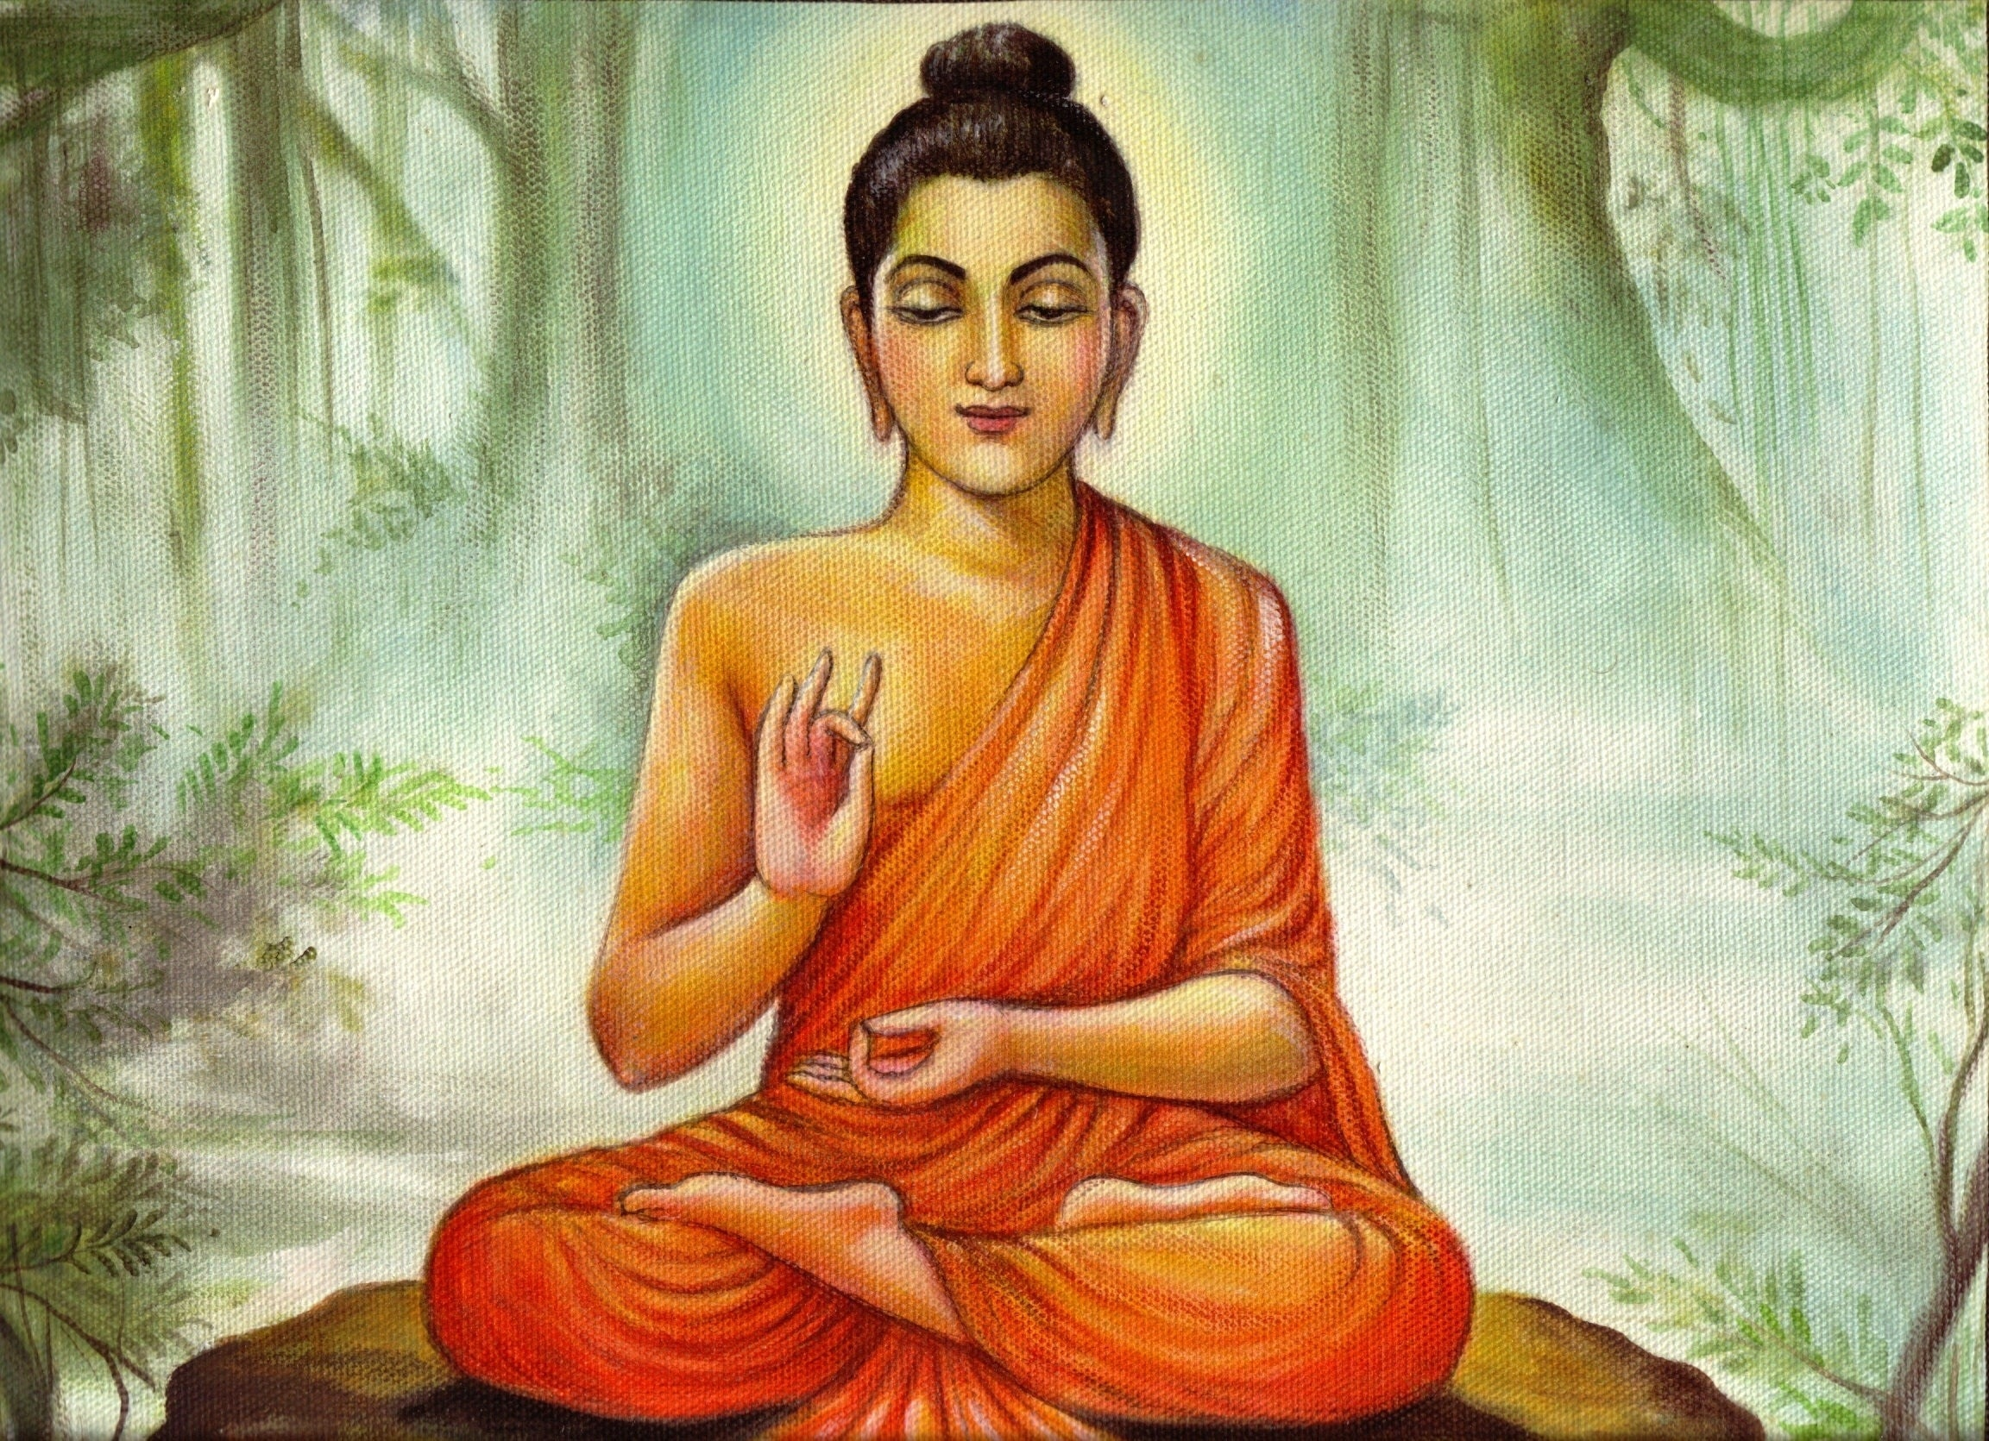
According to lord buddha:
We can never obtain PEACE in the outer world until we make PEACE with ourselves.

Slide 5
PROGRESS
Progress is defined as movement toward an improved or more developed state, or to a forward position

Slide 6
In education, progress refers to a students grasp of essential knowledge and educational skills.

Slide 7
HARMONY
H
From education aspect harmony is a healthy set of communication skills and respectful dynamic between teacher and students.

Slide 8
Need of harmony
Education has been always supposed to promote peace and harmony all over the world. The universal human values are always focused on by education in schools and colleges. Peace and Harmony are two distinct values of these universal human values that need to be developed among the human kind through education.

Slide 9
Summary
In conclusion; peace, progress and harmony are necessary, not only between peoples but also between countries, to make the world a better place for all. Learn the true meaning of friendship by respecting the values the country holds and helping them through difficult times. Even if we know the person or not, a big sincere smile is enough to build a solid relationship with someone and make their day peaceful and pleasant.

Slide 10
Thank you
Name:-Mantu Kumar
Roll no.:-33
Semester:-4
Session:-2020-2022
Under the guidance
Of
Mr. Mukesh Mahato
Professor
BNS DAV Teacher Training College, Giridih

