Slide 1
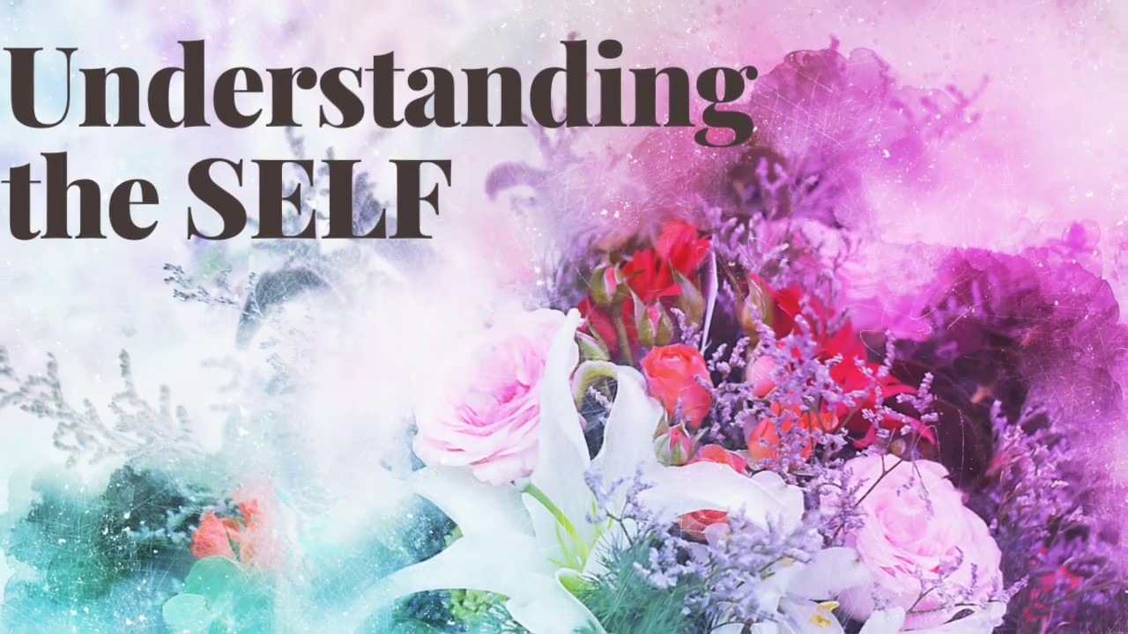
;
NAME: KUMARI MAMTA
ROLL:09
CLASS: B.Ed SEM4

Slide 2
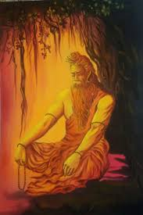
Peace, Progress and Harmony
Establishing peace within itself: Excercises of concentration and meditation
Exercises of concentration and meditation to establishing peace within oneself
Show ourselves some love with positive affirmations
Story in the moment
Mindful eating: Savor and meals
Boost our energy with exercise
Take a bath for ultimate relaxation
Feel gratitude with good night sleep
Go for a walk

Slide 3

Understanding group dynamics and communication
The social process by which people interact and behave in a group environment is called group dynamics. Group dynamics involve the influence of personality, power and behaviour on the group process.
Four things to know about group dynamics in the workplace
Strong leadership is important with a group
Recognize how personalities affect team dynamics
Understand the life cycle of a group
Communication is the key

Slide 4

1.Strong Leadership is important with a Group
This does not mean that a manager needs to bully or strong- arm the team to maintain control. A leader should guide the development of the group and the path to the goal that needs to be reached.
2.Recognize how personalities affect team dynamics
obviously, each person working in a group brings their own personality and skill set. Recognize each person’s style of work, motivation and level of apptitude can help an individual understand how that person fits in the group.

Slide 5

3.Understand the life cycle of a group
The way a group comes together can be demonstrated in five steps :-
Forming- The coming together of a group
Storming- Members of the group seek out like- minded members. At this stage conflicts between different sub-groups may arise.
Performing- The members of the group now functions as a unit, contributing to complete the task within the strands defined in the previous steps.

Slide 6

4.Norming- Members become invested in the groups as a whole and its common goal.
5.Adjourning- If the group has formed to meet a specific goal, then the group will disband after the completion of the work and any subsequent needed evaluation.

Slide 7
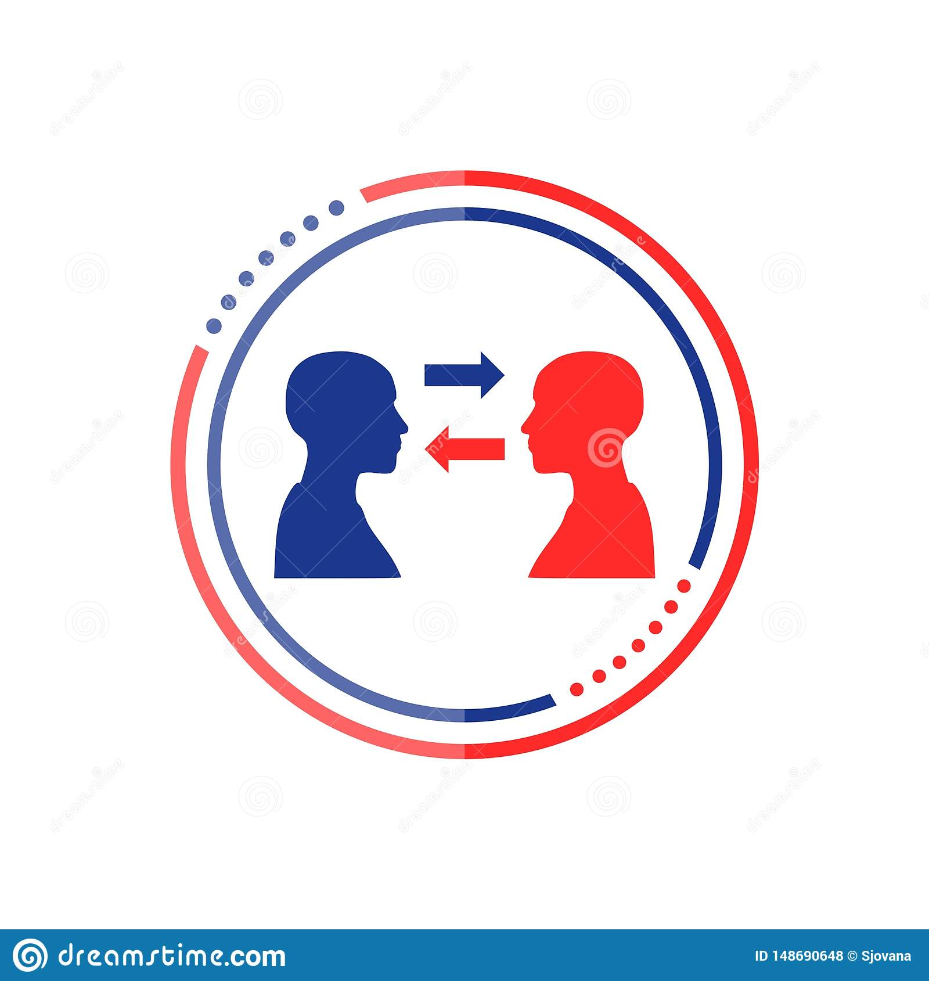
4.Communication is the key
Its imperative for all the members of a group to understand and utilize the choosen methods of communication open and transparent communication builds and maintain a sense of trust within the groups and helps maintain focus towards the goal.

Slide 8

Creating group harmony: exploring methods of creating a collective for progress and conflict resolution
Methods of conflict resolution
(i) Conflict resolution is simply a way for two or more people to agree on a peaceful solution.
(ii) Like any other problem social phychologists have developed no. of resolution of social conflicts.
Some of the main methods as follows-
Mutually beneficial goal
Compromise
Developing special norms
Prosocial behaviour

Slide 9

1.Mutually beneficial goal
Mutually beneficial goal with conflict resolution is to build the relationship between those involved. Find a solution that is mutually beneficial for everyone. Resolve the tension as quickly as possible.
2.Compromise
Coming to a compromise means funding a middle group between the two people. Both parties will likely have to end up sacrificing something but they will also gain something in return.

Slide 10

3.Developing social norms
Conflict between two warring fractions or groups may be reduced through development of special norms.
For ex- in a game, the question of who will take first turn may be settled by leaving it to the umpire.
4.Prosocial behaviour
By prosocial behaviour we mean behaviour that creates some kind of positive social influence among others.

Slide 11

Exploring the basis of social disharmony becoming agents and catalyst of change and exploring methods of facilitating change:-
Social disharmony is caused due to the incessant desire to classify each of us as a member of some racial or ethnic or cultural grouping which is dangerously divisive and disrupts the harmony that’s already prevailing in the society.

Slide 12
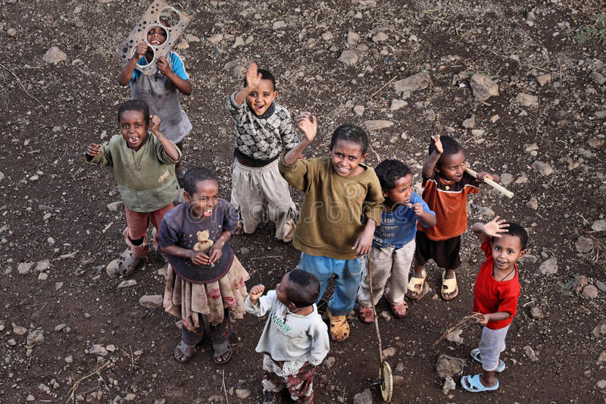
The factors responsible for social disharmony:-
Poverty
Unemployment
Gender inequality
Caste discrimination
Urbanisation
Illiteracy
Rapid growth of population
Superstitions and religious belief

