Slide 1
B.N.S D.A.V TEACHERS’ TRAINING COLLEGE, giridih
SESSION:2020-2022
PRESENTATION TOPIC:
EXPLORING THE AIM OF LIFE
Presented by:-
RAVI RANJAN MARANDI
ROLL NO:- 37

Slide 2
What is “AIM OF LIFE”?
To give your life a purpose and meaning
Your purpose is to create more joy in life.
To show others how you can live your life
in the best possible manner.
It is done by finding out what truly matters to you.

Slide 3
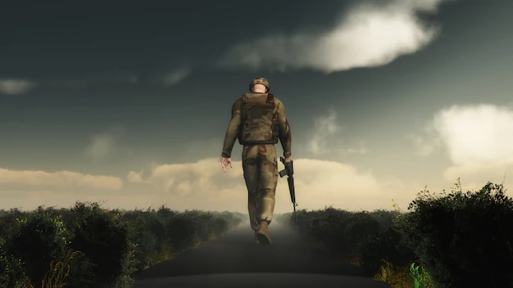
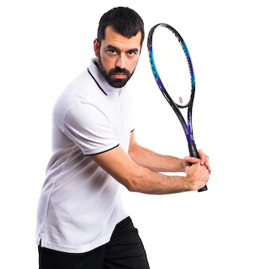
AIMS/AMBITIONS

Slide 4
How to identify CAREER skills?
1.Get to know your authentic self(strength ,
weakness ,interest , etc. )
2.Think about the talent / skills you have gained.
3.Talk to people who know you well(consulting your
teachers ,family ,friends ,career coaches ,etc. )

Slide 5
Measures to be taken for Career / Personality development
Setting life goals :- That can be career goals , such as starting
your own business , planning a well earned retirement.
2)Self - confidence :- It is an attitude about your skills
and abilities.
3)Courageous and hard working :- True success can only
be achieved through honest dedicated hard work , focused
attention , solid will power and courage.

Slide 6
Measures to be taken for Career / Personality development
4)Optimistic or positive attitude :- The practice of focusing
on the good in any given situation.
5)Time management :- Organizing and planning how to
divide your time between different activities.
6)Determination and concentration :- Since life is never
smooth, many of us fall off when we come across obstacles. But
with determination, we can overcome any type of obstacles.

Slide 7
Motivational Quote
ASK YOURSELF
IF WHAT YOU’RE DOING
TODAY IS GETTING
YOU CLOSER TO
WHERE YOU WANT
TO BE TOMORROW.

Slide 8
Thank you

