Slide 1

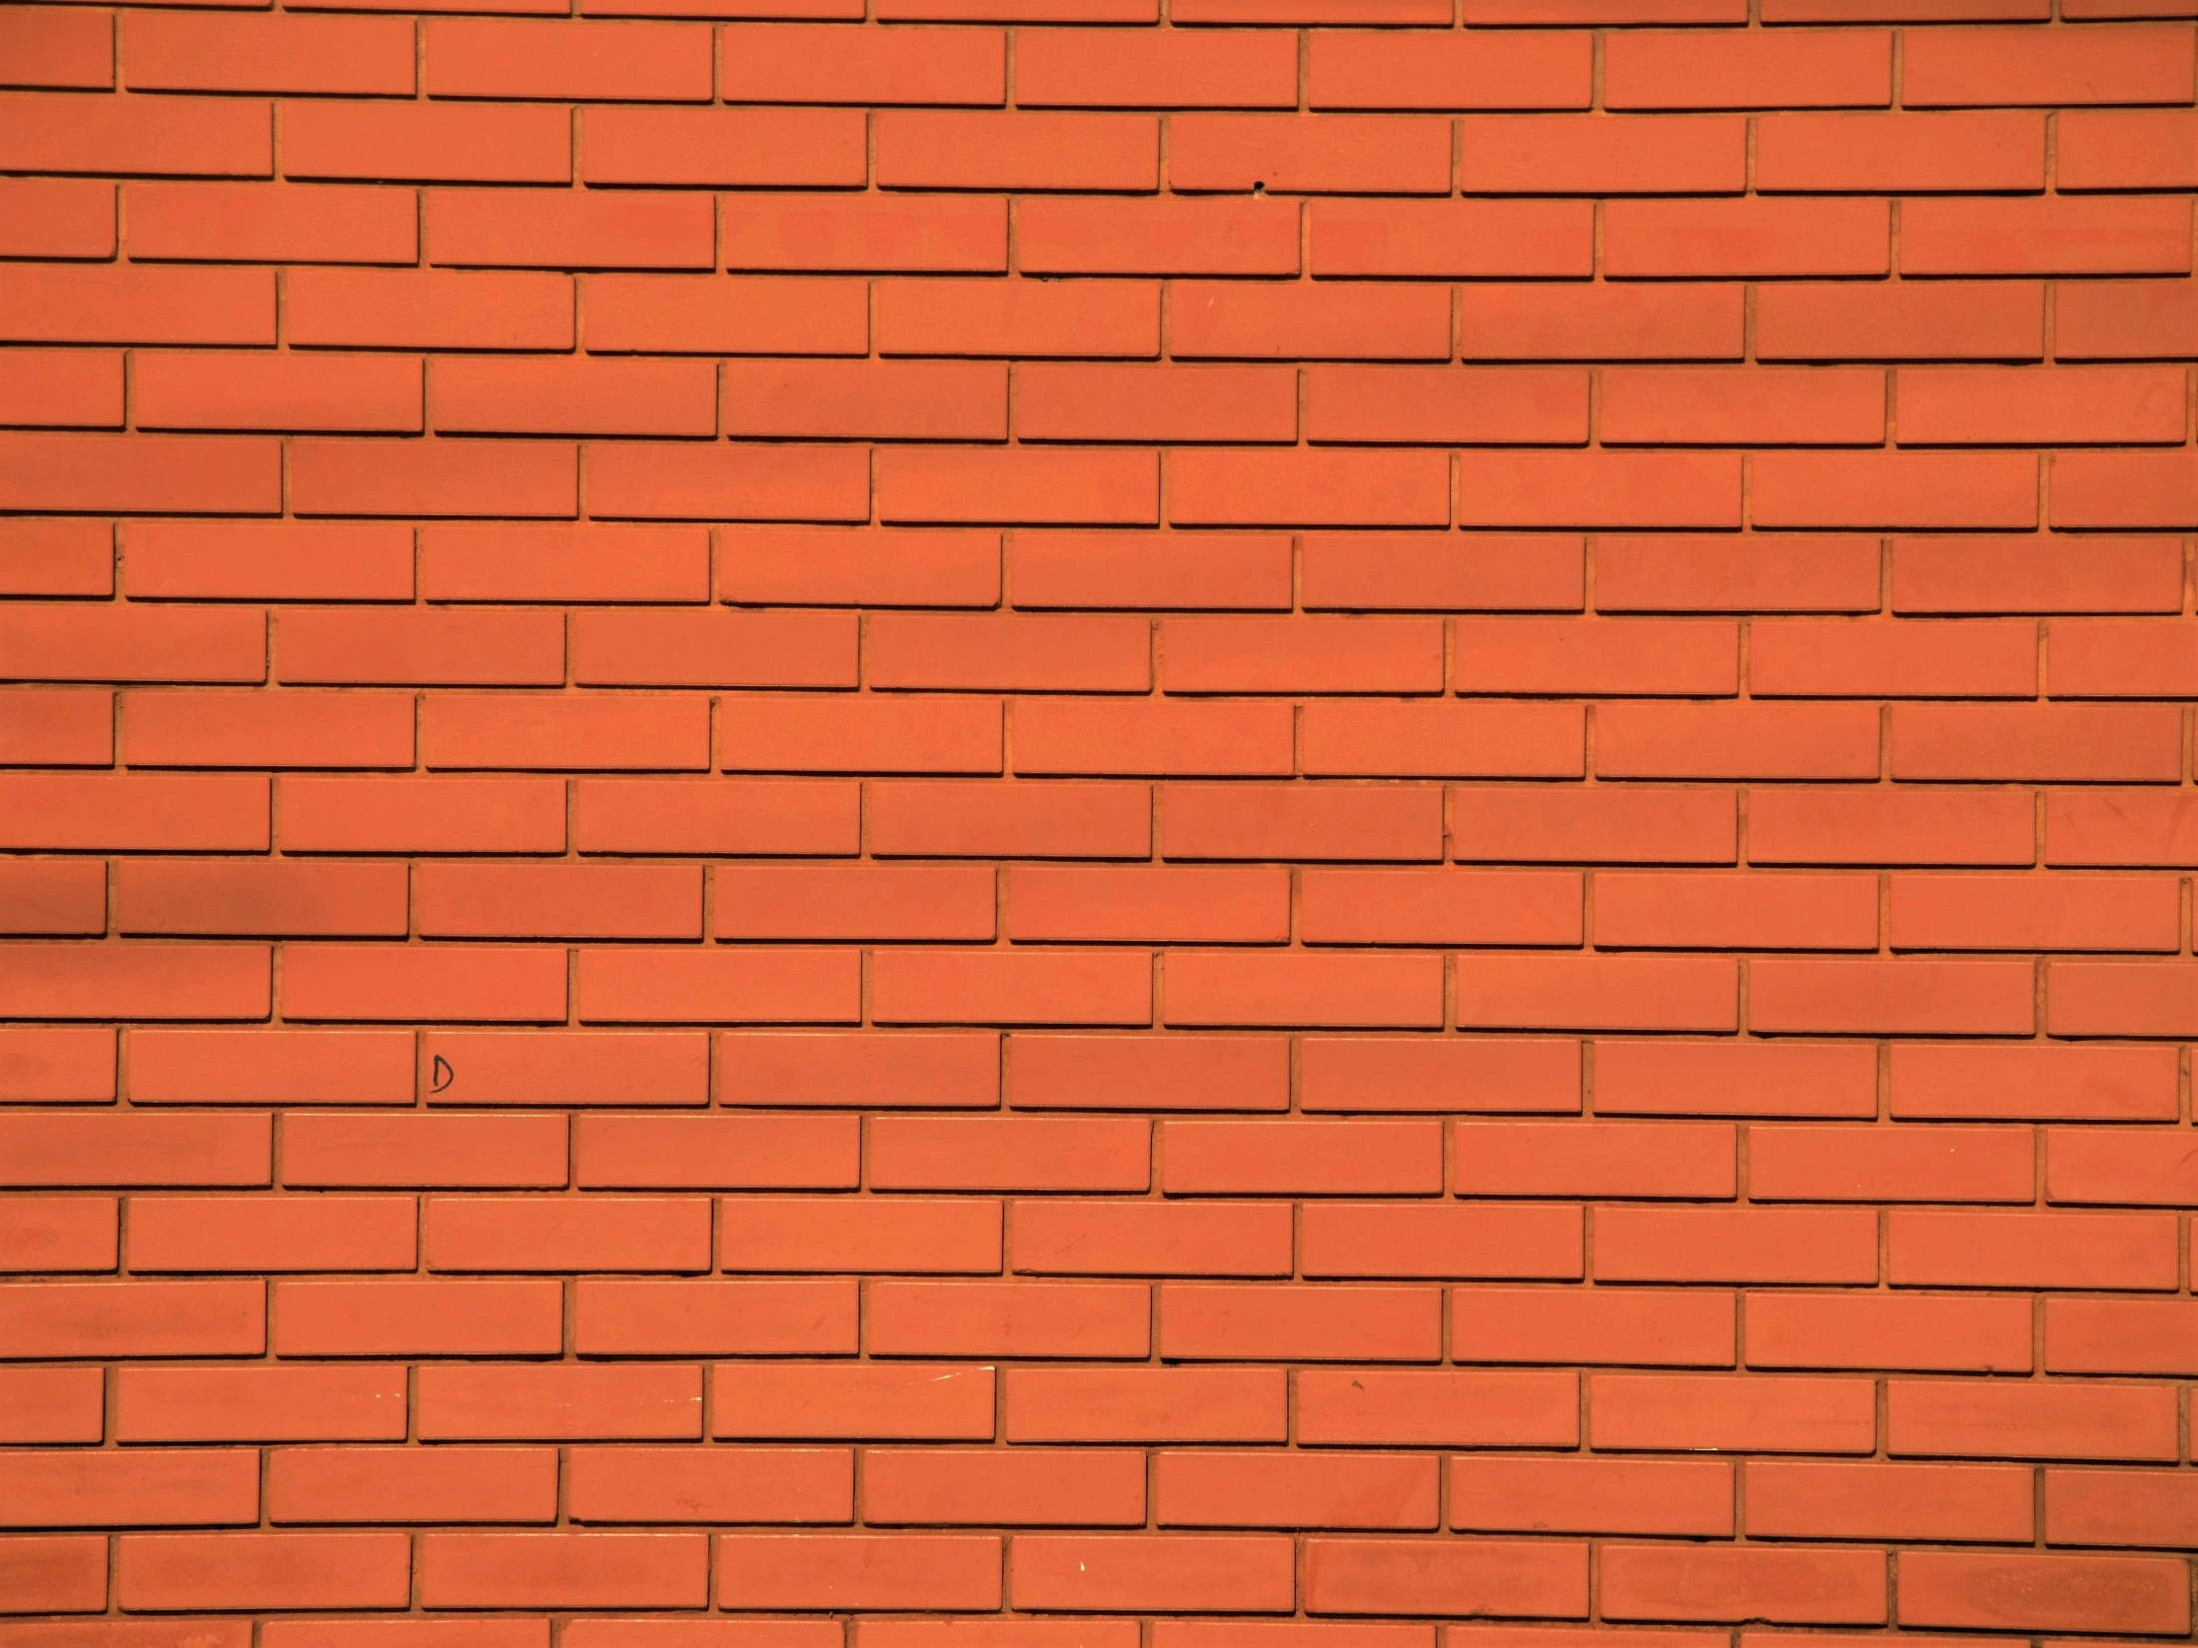
B.N.S DAV TT.COLLEGE
GIRIDIH JHARKHAND
Power Point Presentation
BY:- ABHISHEK ANAND
ROLL NO.:-90
SESSION:- 2020-22

Slide 2

PRESENTATION TOPIC:-
PEACE PROGRESS and Harmony

Slide 3
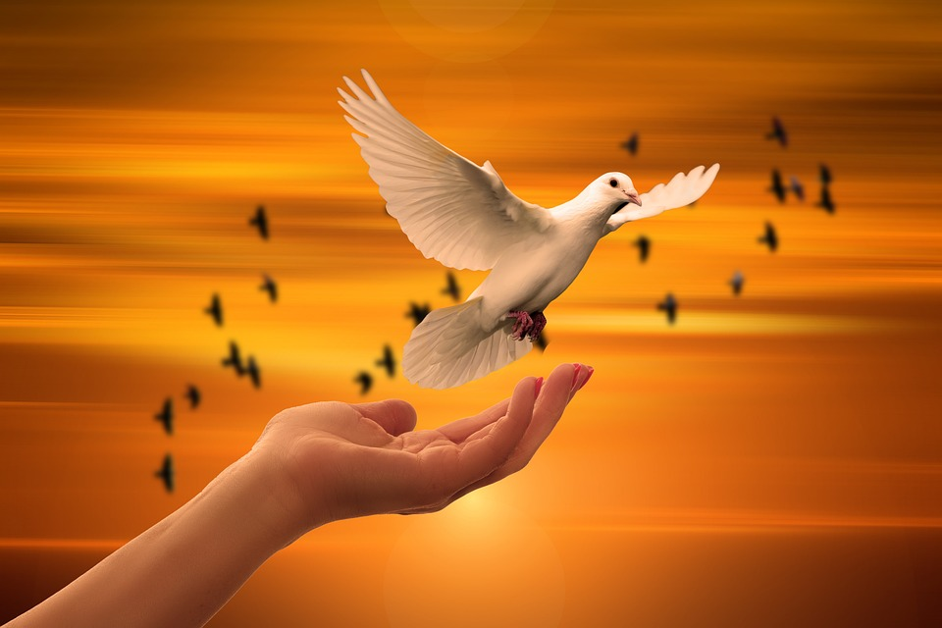
WHAT IS PEACE ?
Peace is a concept of societal friendship and harmony in the absence of hostility and violence.
Peace is the product of having respect for others, understanding one another, and accepting differences.
In words of Swami Vivekananda “Peace should not only absence of war, but also violence in all forms, such as conflicts, threat to life, social degradation, discrimination, oppression, exploitation, poverty, injustice, and so on”.

Slide 4

INNER PEACE
(It is something which we get through inner happiness)
OUTER PEACE
(It is something from which we get through outer world)
PEACE

Slide 5

PEACE
Peace with one’s self
Peace with universe
Peace with others
Peace with animals and other creatures

Slide 6
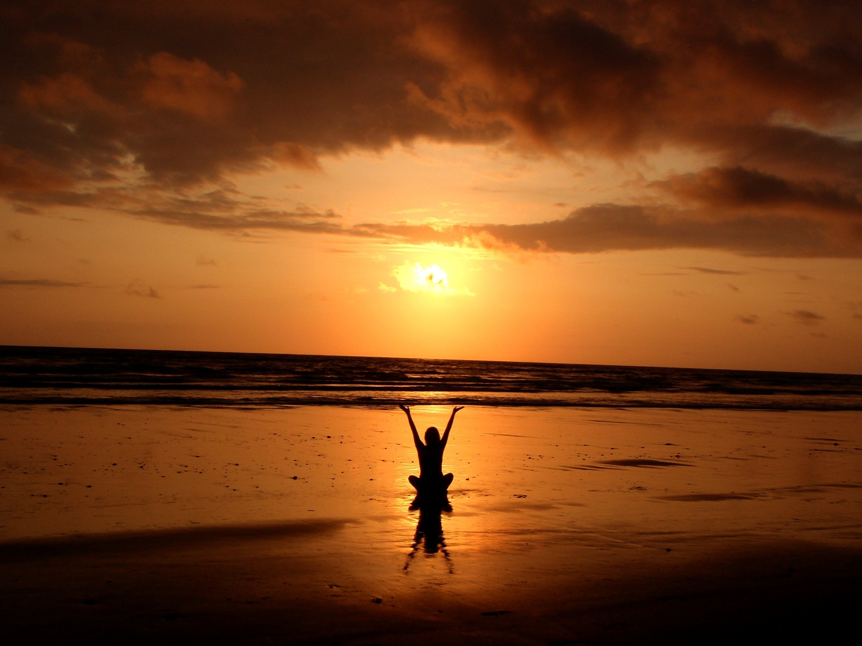
How can anyone get peace?
There are many ways of getting peace:-
Accept what you can’t change or control.
Practice forgiveness.
Practice mindfulness meditation.
Make time for yourself.
Keep a journal.
Get back to nature.

Slide 7
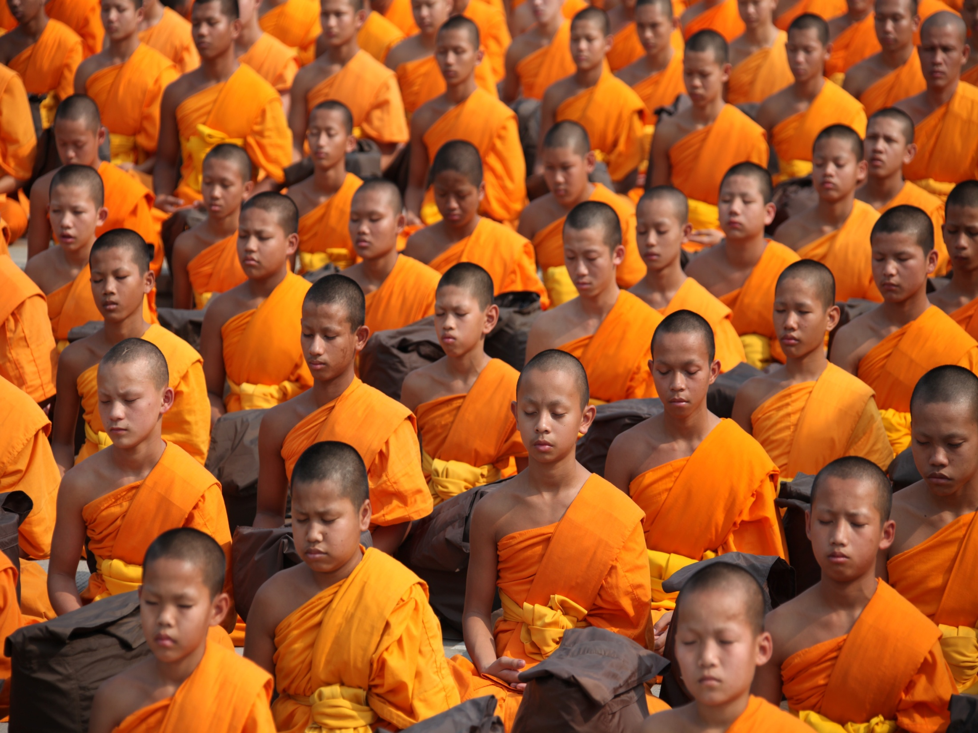
Peace through Mediation:-
Meditation increase your inner strength through increasing your inner power.

Slide 8
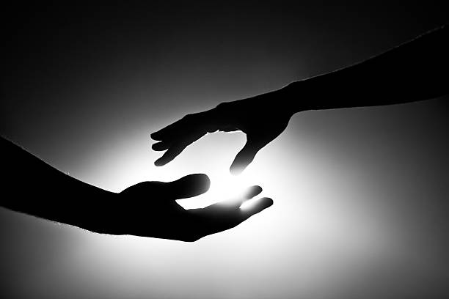
Peace by forgiveness:-
You can get your peace through forgiving others because it gives you inner satisfaction.

Slide 9

How peace is helpful to a person?
Peace helps a person in many ways some of them are:-
It helps in focus on our goals.
It helps in avoiding bad habits.
It leads to road of happiness.
Peace helps in reducing stress and anxiety.
It develops better understanding and delivering power.
It helps in boosting your health.
It has many psychological benefits too.

Slide 10
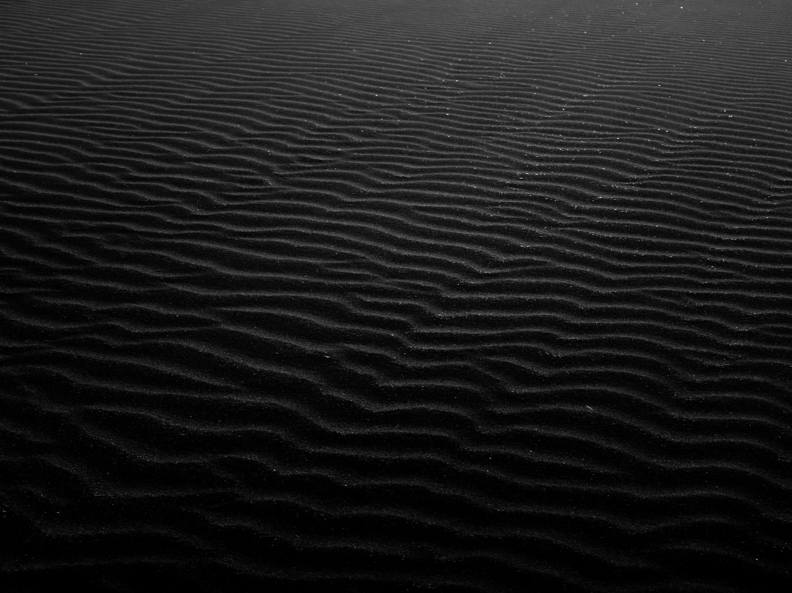
Consequences of having no Peace
War & Violence
Arms Tradees & military spending
Loss of innocent lives
Human right violation.

Slide 11

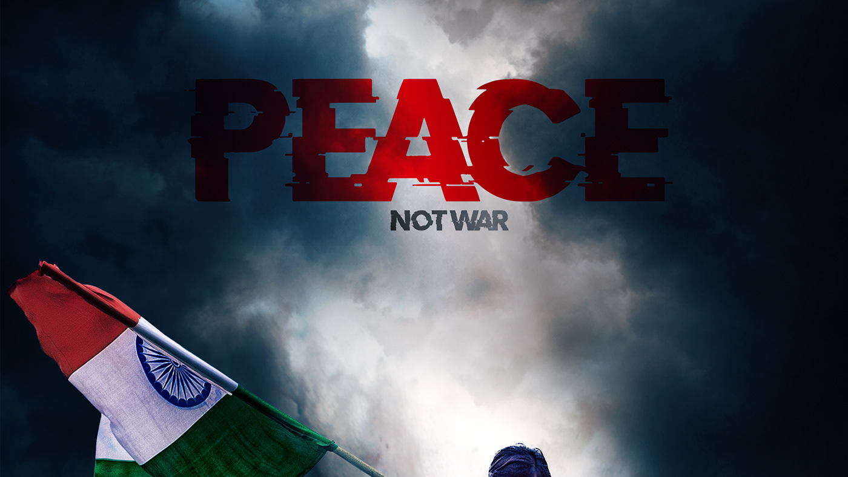
Peace

Slide 12

Progress
Progress is defined as a movement towards a refined, improved or desired state.
In education , progress refers to a student’s grasp of essential knowledge and educational skills.
In the past, a student was considered to be progressing if they were rapidly moving on to new topics and material. However, in recent years progress has been seen more in terms of a student’s ability to remember key information.

Slide 13

HARMONY
From education aspect Harmony is a healthy set of communication skills and respectful dynamic between teachers and students.
Harmony is the basic need of any nation only if a nation enjoys would be able to prosper. The constitution of our country includes laws to ensure social equality among the citizens in order to avoid clashes and maintain harmony among citizens. The world is turning to be a global village and it is very necessary to establish harmony that allows everyone to live in peaceful way.
However, our global world is facing distinct issues and serious problems that are destroying the human relations and the climate of peace and harmony. So it is everyone’s individual responsibility to create a well atmosphere where everyone can live with harmony.

Slide 14
Role of education in creating Harmony
Education is one of the most important sectors which an contribute a lot of well – being and smooth functioning of society. However, the present system of education does not cultivate the qualities of tolerance, humility, co-operation, concern for the well-being of society, and responsibility for one’s own actions.
Also students are not taught about simplicity, honesty justice, non-violence and fair play. As a result of this, even after spending so many years in a school and college or at the university, there is often a lack of gentleness, sincerity and humanism, and a goal.
The society, therefore, may have a high percentage of literates or educated people, yet there may be a commotion in different persons. Education would therefore, fulfill its noble objective only if imparts the values that create harmonious personalities, helps us maintain harmony in society, nature and our own self.

Slide 15

Peace and Harmony
Conclusion point:-
Education has always been always supposed to promote peace and harmony all over the world. Peace and Harmony are two distinct values of these universal human values that need to be developed among the human kind through education. Today both these concepts are given less importance in education and its curriculum. Today’s world is full of conflicts ,insecurities ,violence, inharmonious conduct based on political , racial, religious and ethnic factors which make a negative impact on humanity.
There is need of learning to live together with peace and harmony in today’s world and education is the only tool that can approach to this peace and harmony.

Slide 16
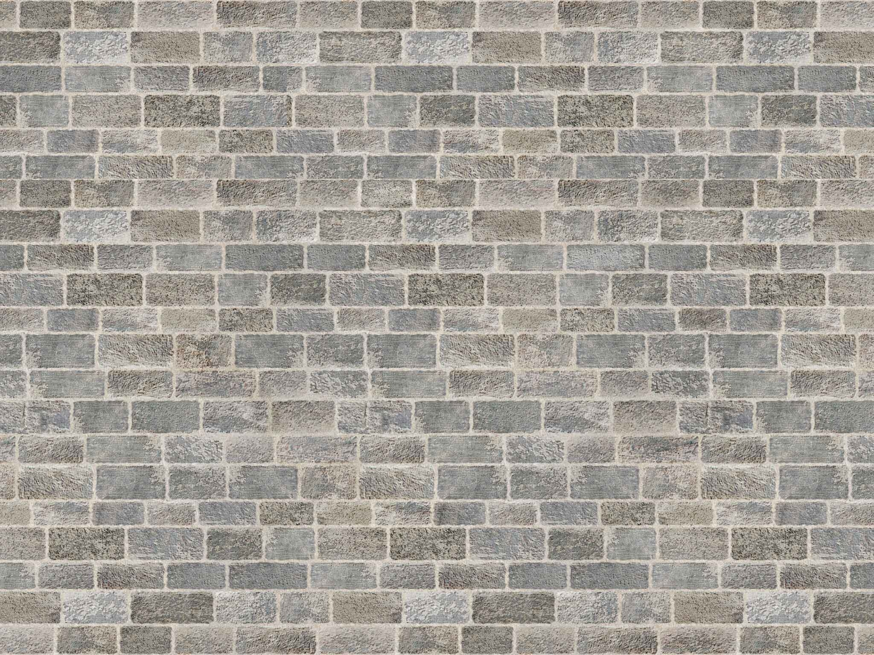
Enjoy the moment because death is Unexpected
In today’s world there is fight, war and conflicts among the people. People fight with each other on some materialistic thing such as money, love, land, property and many other things.
In present scenario the conflicts between Russia and Ukraine is on the same some piece of land. Why there is so many lives lost because of some piece of land or materialistic thing. If it continues like this then world war 3 will definetly happens.
So it is every individual’s rights to maintain peace and harmony in society or where they live. From this we can continue to live in a happy world.
THAT’S IT FROM MY SIDE…………….

Slide 17
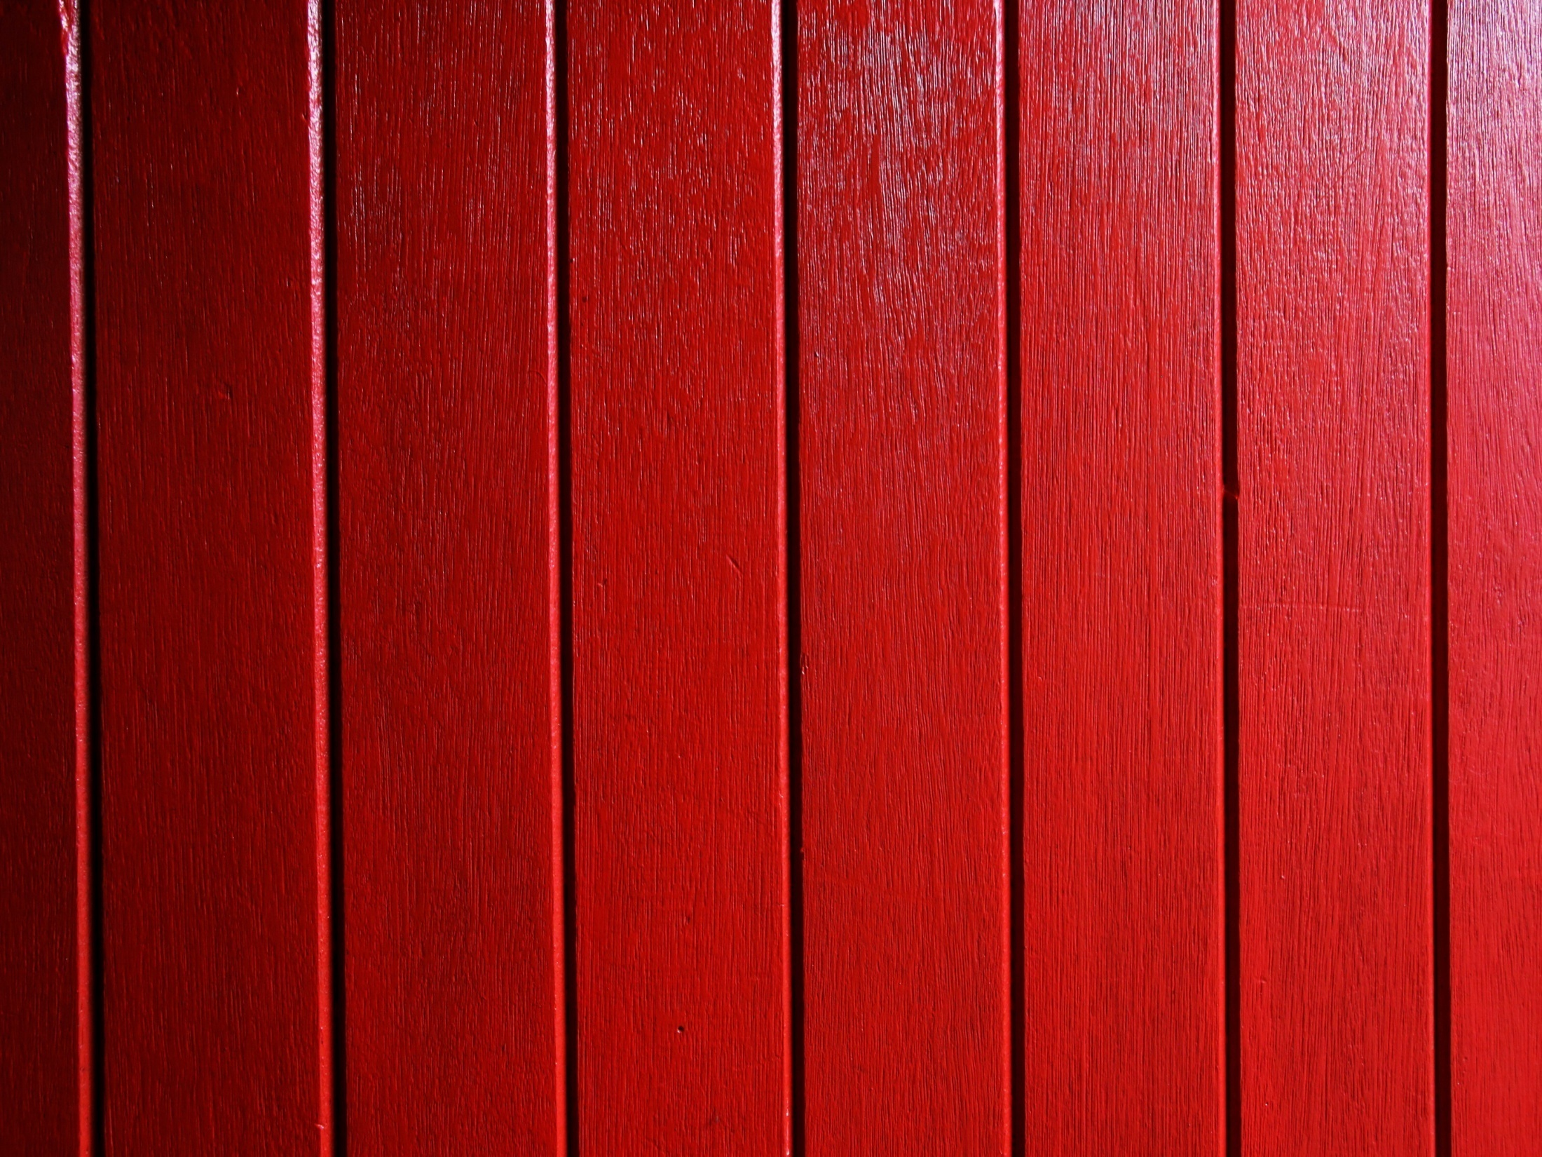
THANK YOU

