Slide 1
VINOBA BHAVE UNIVERSITY, HAZARIBAGH PRESENTATION TOPIC:- Exploring aim of life
PRESENTATION TOPIC:- Exploring aim of life
B.N.S D.A.V TEACHERS’
TRAINING COLLEGE GIRIDIH
Presented by:-
NAWAL KUMAR

Slide 2
Topic
AIMS OF LIFE

Slide 3
*AN AIM IS A GOAL OR PURPOSE IN LIFE. A PERSON WHEN YOUNG DREAMS TO BECOME AN ASTRONAUT ,OR DANCER, OR AN ACTOR . AIM HELPS YOU TRY, OR ASPIRE TO ACHIEVE IT.

Slide 4
AIM HIGH

Slide 5
Every individual must set well-defined objectives to achieve in life . It helps them to understand the career path and motivates them to move forward.

Slide 7
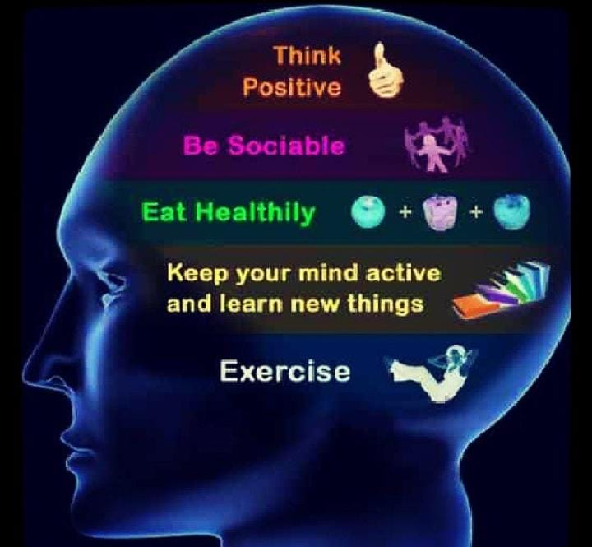

Slide 9
ARTHA:- HAVING THE MEAN OF LIFE IS THE AIM MOST ASSOCIATED WITH HAVING EMPLOYMENT. WHEN A PERSON FEELS SUPPORTED FINANCIALLY, THE OTHER ASPECTS OF THEIR LIFE HAVE A MORE SOLID FOUNDATION AND ARE ABLE TO DEVELOP.

Slide 11
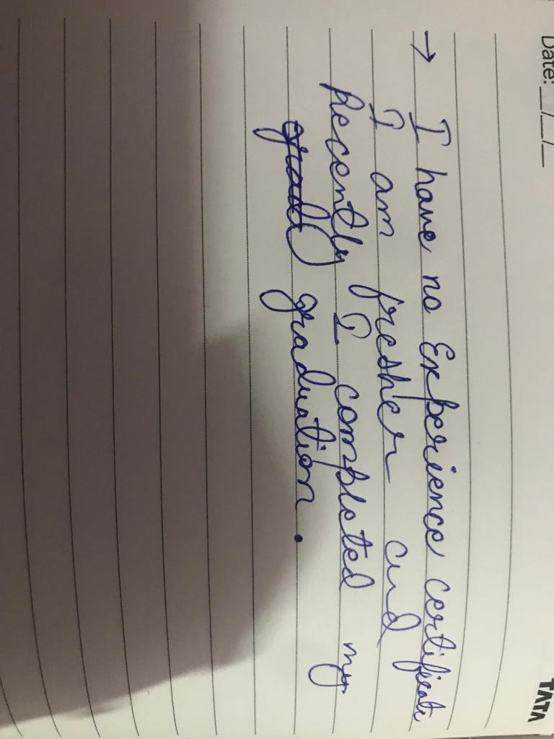
.
KAMA IS PLEASURE. IT CAN BE YOUR CREATIVE PURSUITS,THE ENJOYMENT OF ART AND MUSIC, OR HAVING MEANINGFUL CONNECTIONS WITH FRIENDS AND FAMILY.

Slide 13
DHARMA IS PURPOSE. IT IS THE ALIGNMENT WITH YOUR LIFE’S INTENTION , ENGAGING IN MEANINGFUL WORK, BEING CONNECTED TO A HIGHER CALLING.

Slide 15
MOKSHA IS LIBERATION. IT IS MOVING TO A HIGHER PLANE OF EXISTENCE, HAVING A MORE INCLUSIVE AND EXPANSIVE WORLDVIEW, AND CONNECTING DEEPLY WITH THE DIVINE NATURE OF REALITY.

Slide 17
BENEFITS OF SETTING AIM OF LIFE
ARE MORE MOTIVATED.
HAVE A CLEAR PATH
SUFFER LESS FROM STRESS ANXIETY
CONCENTRATED BETTER
SHOW MORE SELF-CONFIDENCE

