Slide 1
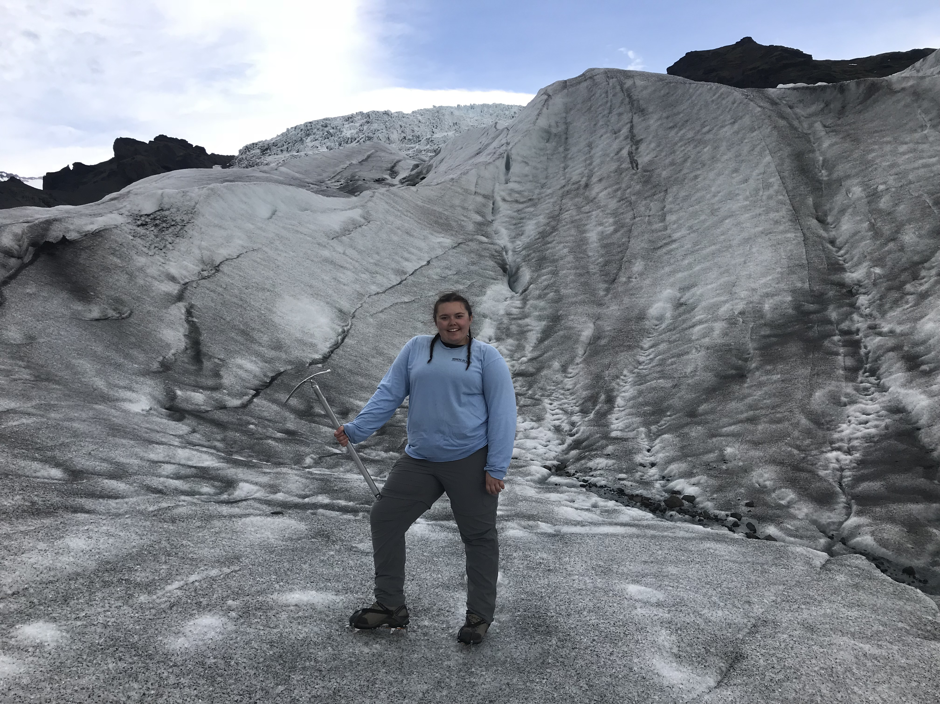
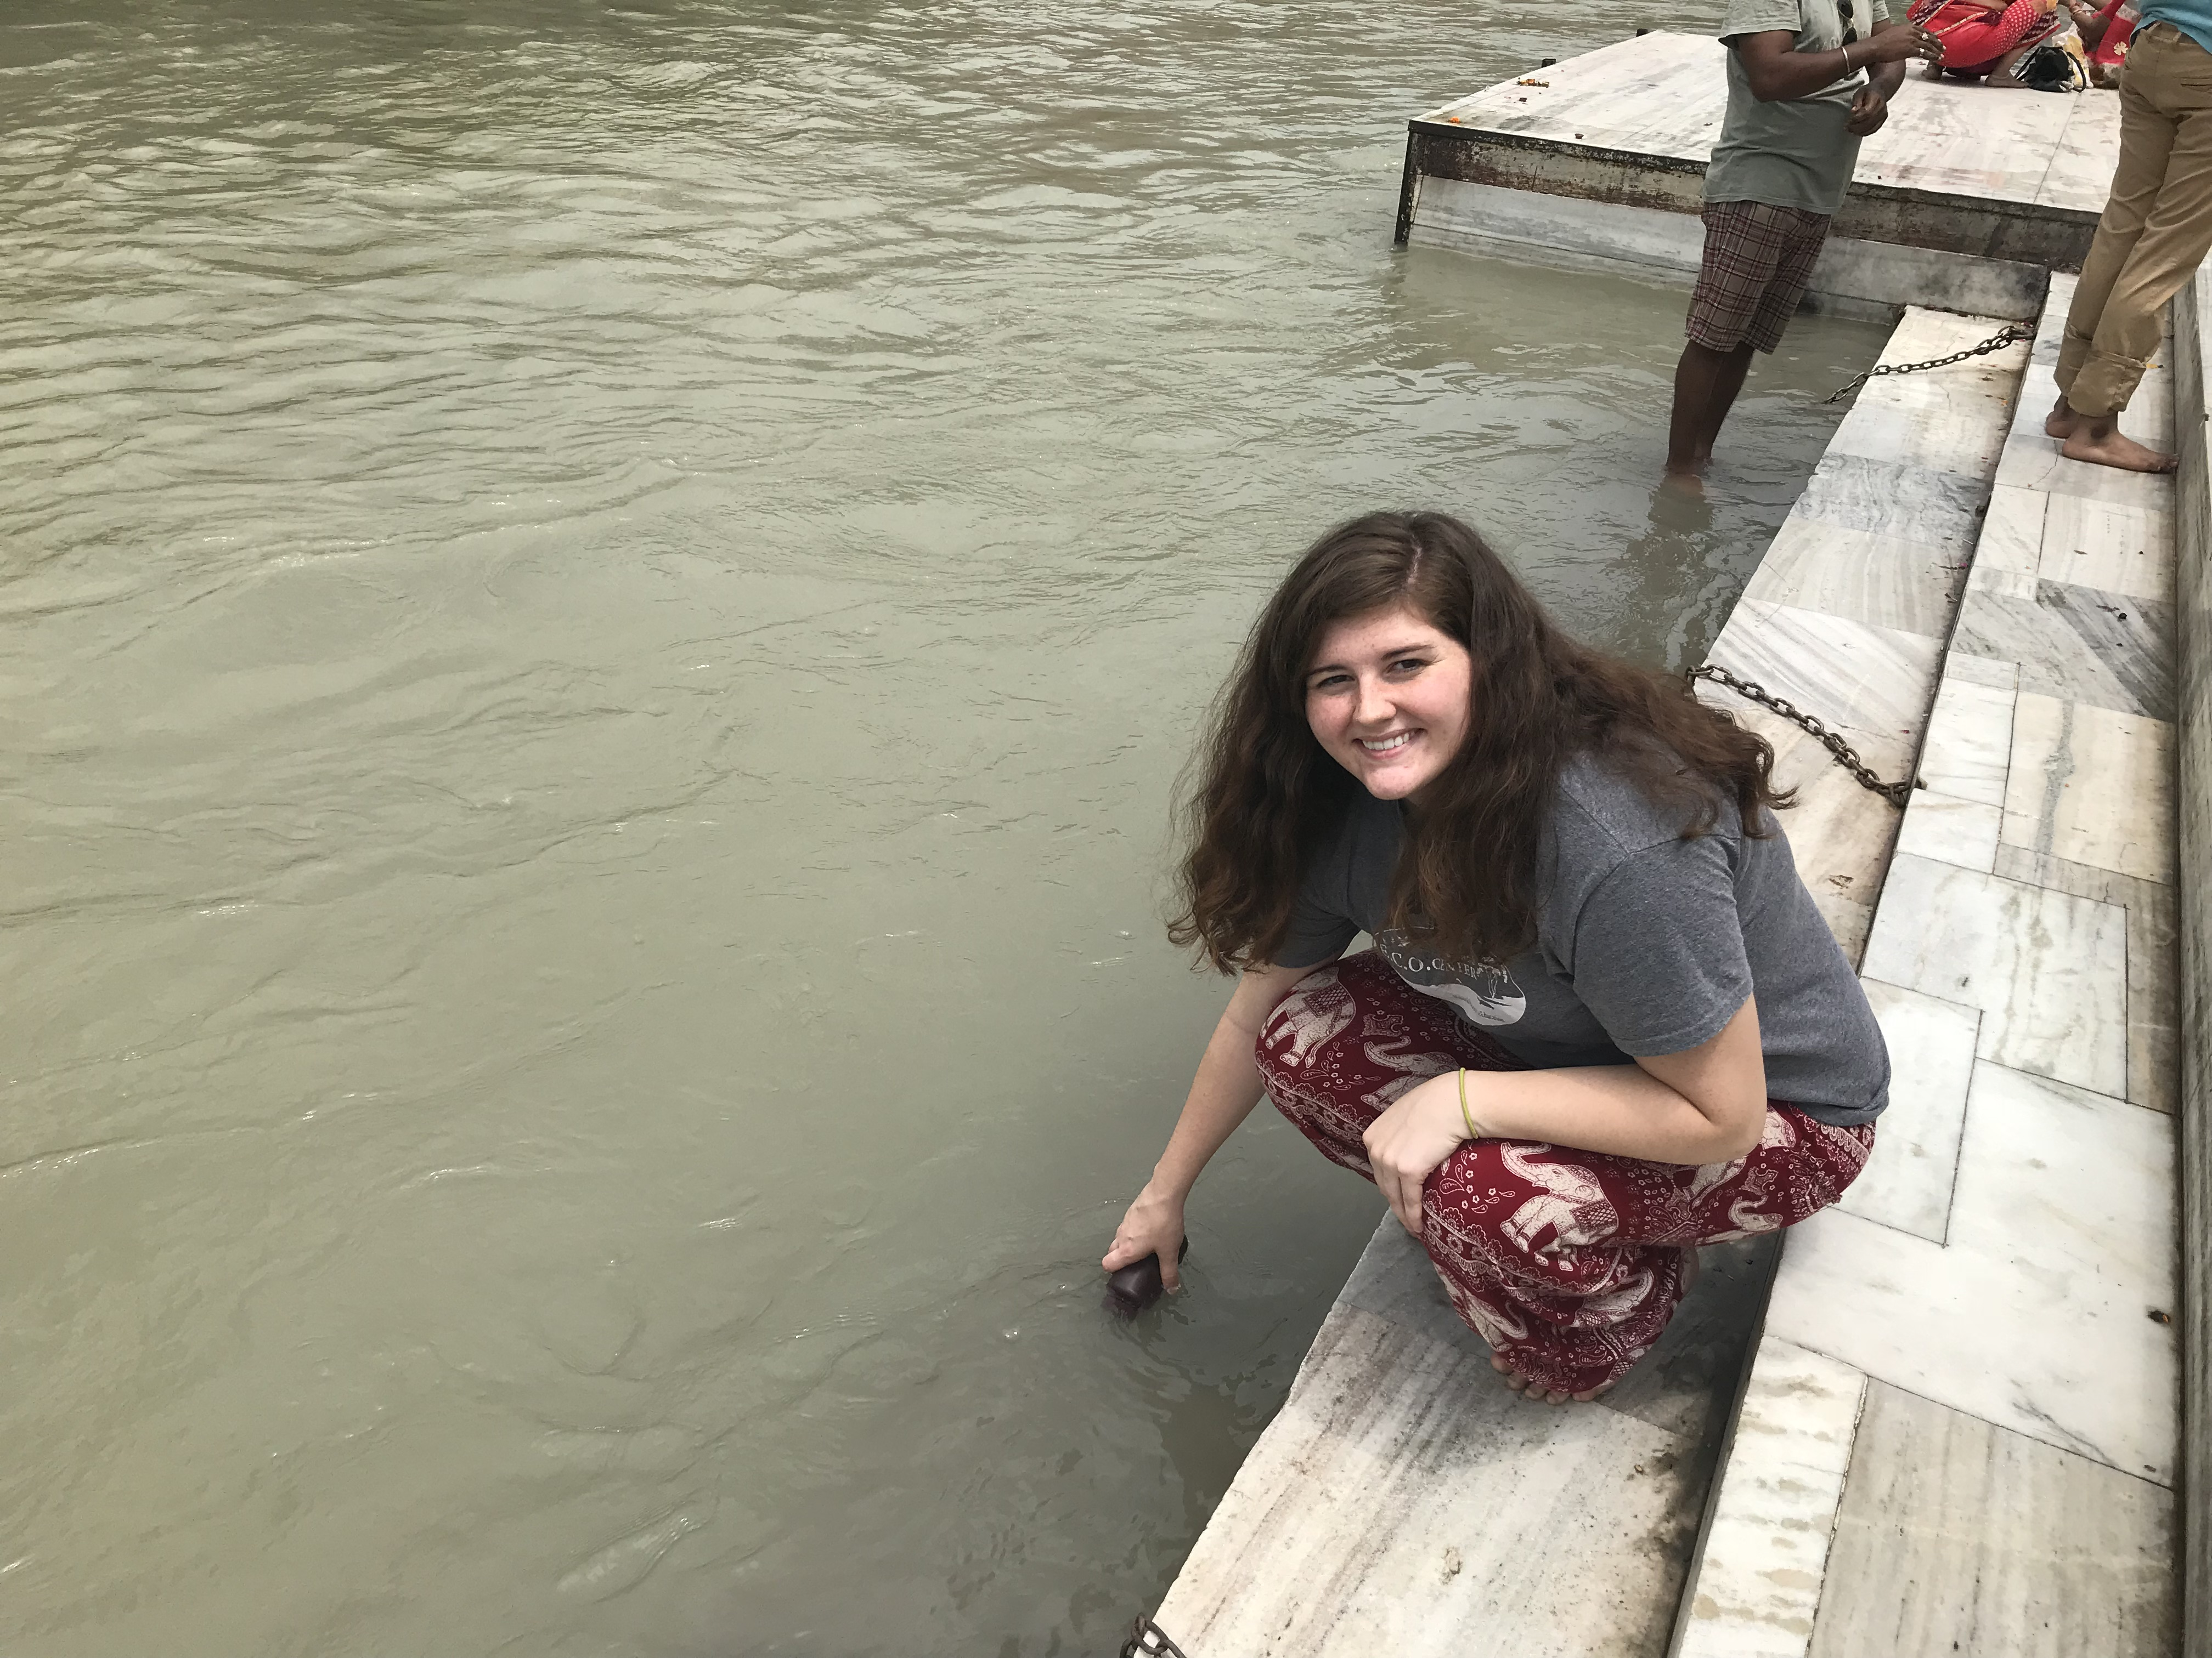
Comparative water quality analysis of Iceland and India
Carley Carder
Emily Larrimore

Slide 2
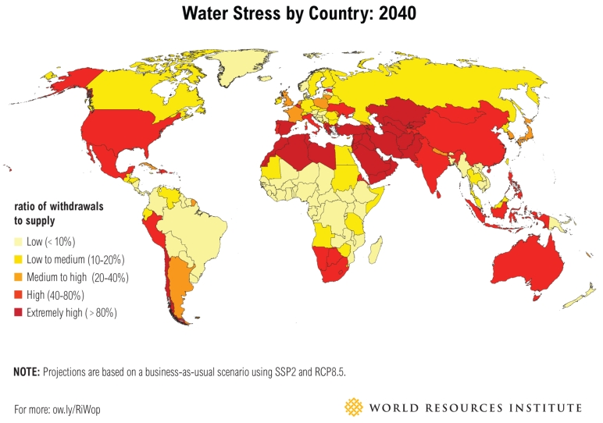
Water as a Resource
Over 2 billion people live in countries experiencing high water stress (UN 2018)
More than 2 billion people's drinking water source is contaminated with feces (WHO 2018)

Slide 3
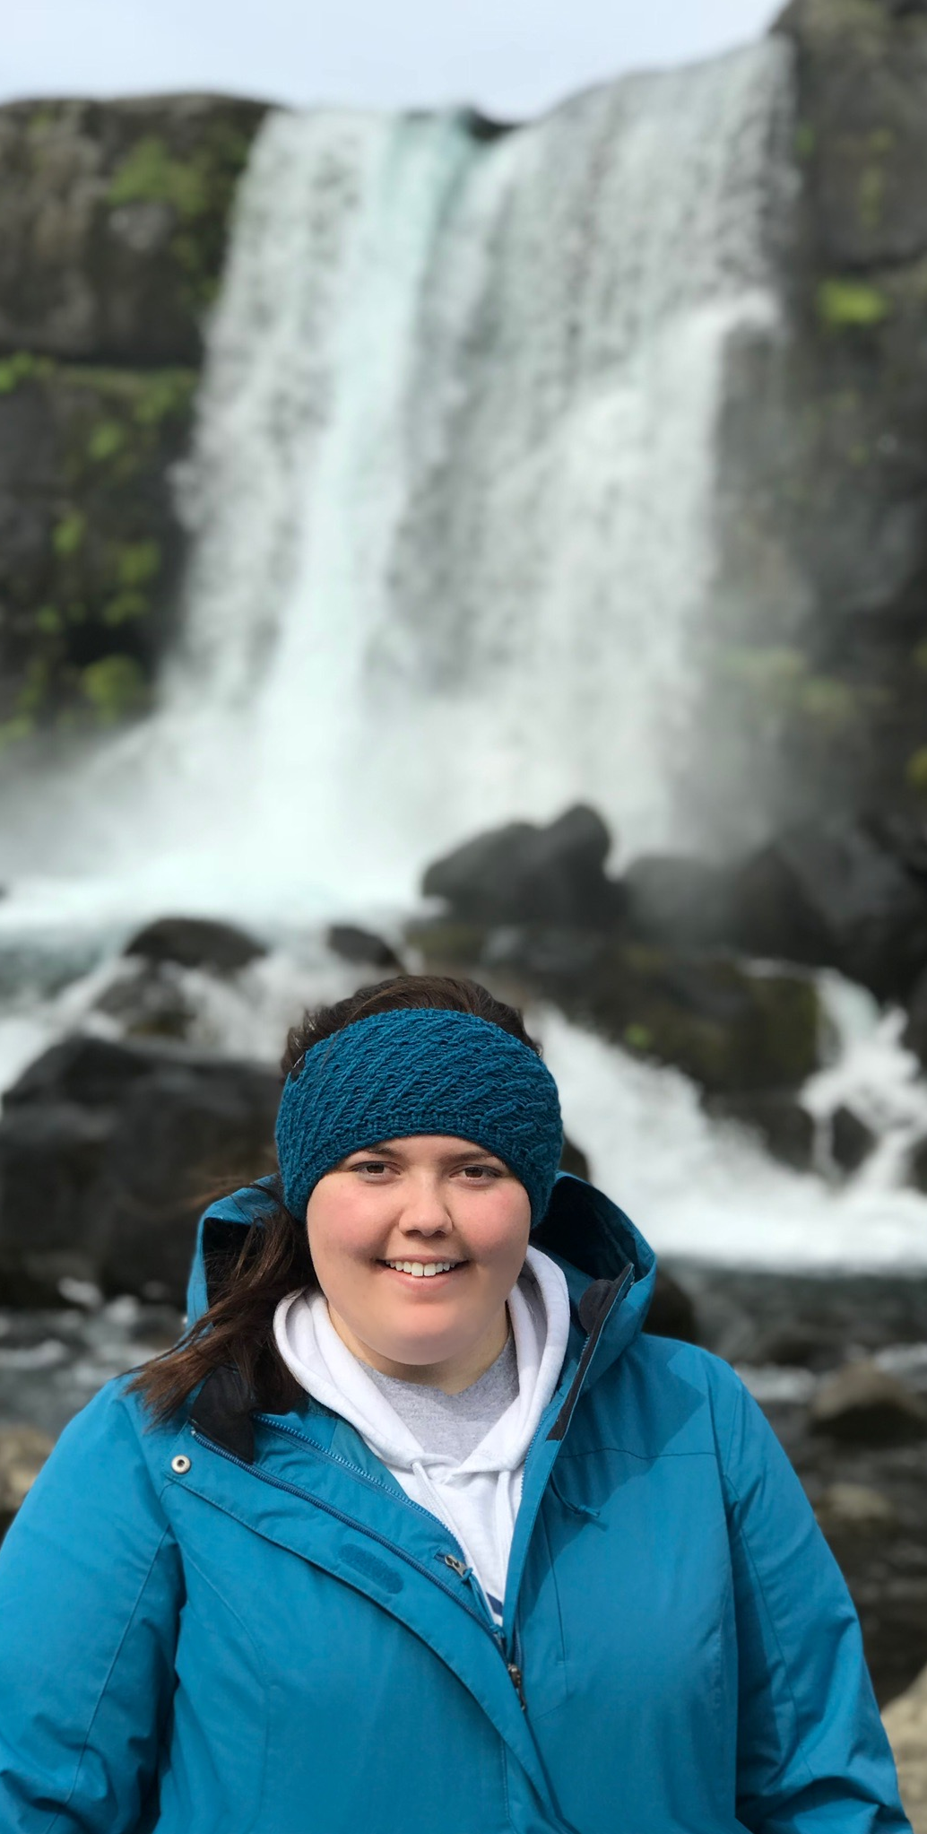
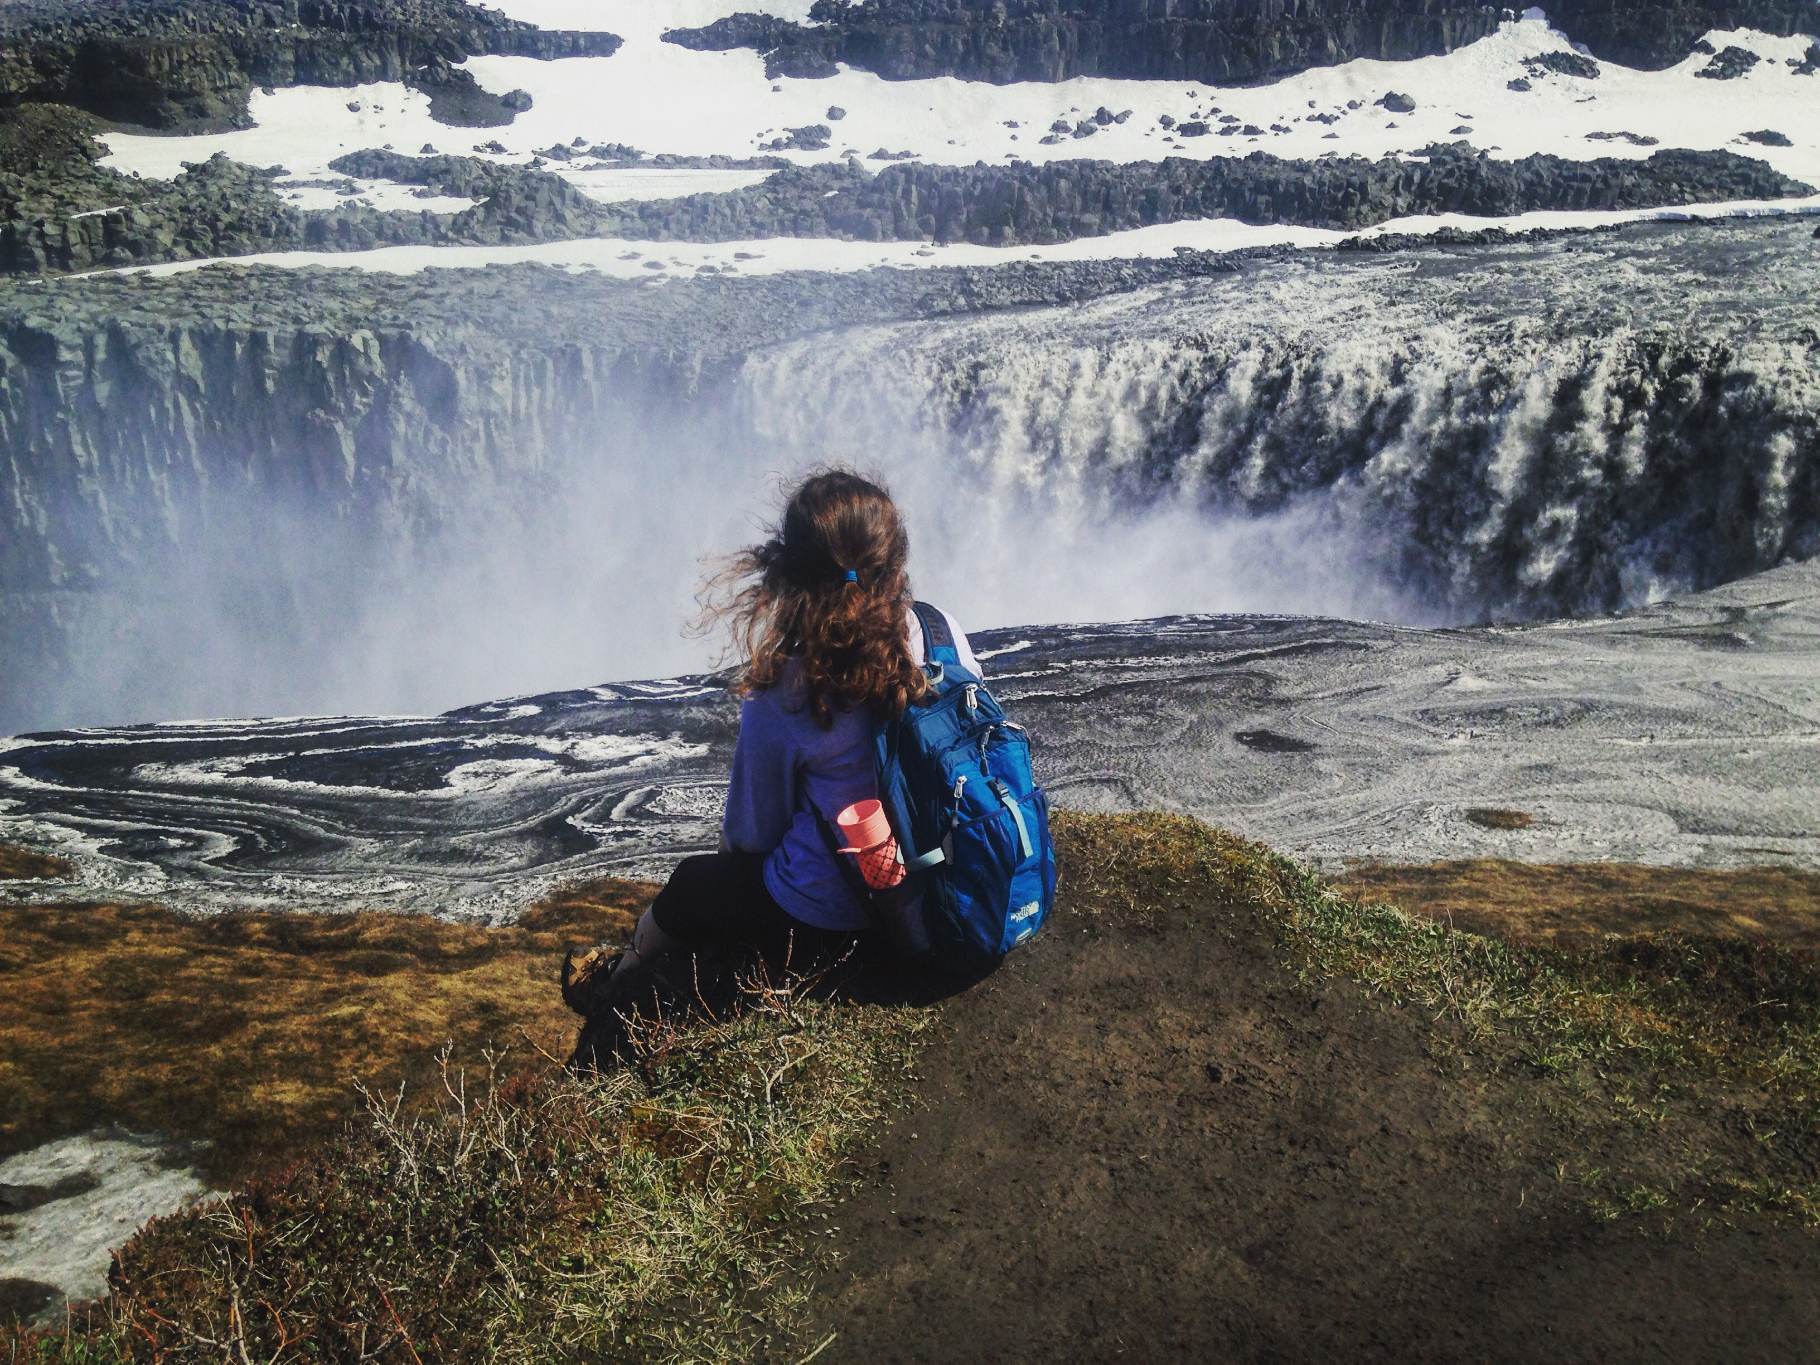
Water Quality's Effects on Society
Every minute a new born dies from infection caused by unsafe drinking water (WHO 2018)
Every $1 spent on investing in water and sanitation, there is a $4 return on investment (UN 2014)
Water is religiously important in some context for Hindus, Christians, Muslims, and Buddhists

Slide 4
Water Quality Parameters
Chemical Parameters
Physical Parameters
Nitrates
Total phosphates
pH
Temperature
Dissolved Oxygen
Biochemical oxygen demand
Turbidity
Total Dissolved Solids
Biological Parameters
Fecal coliform

Slide 5
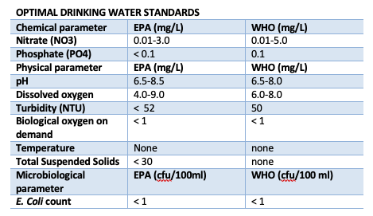
Drinking Water Standards

Slide 6
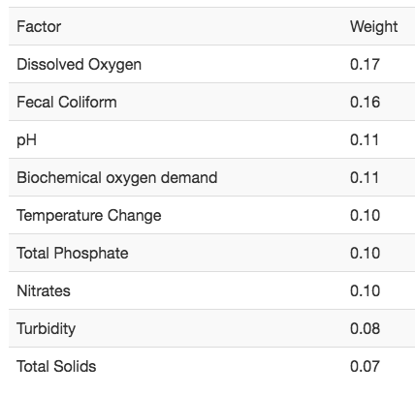
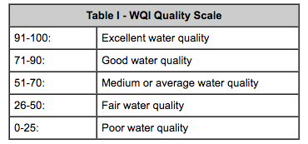
Creating a Water Quality Index
National Sanitary Foundation

Slide 7
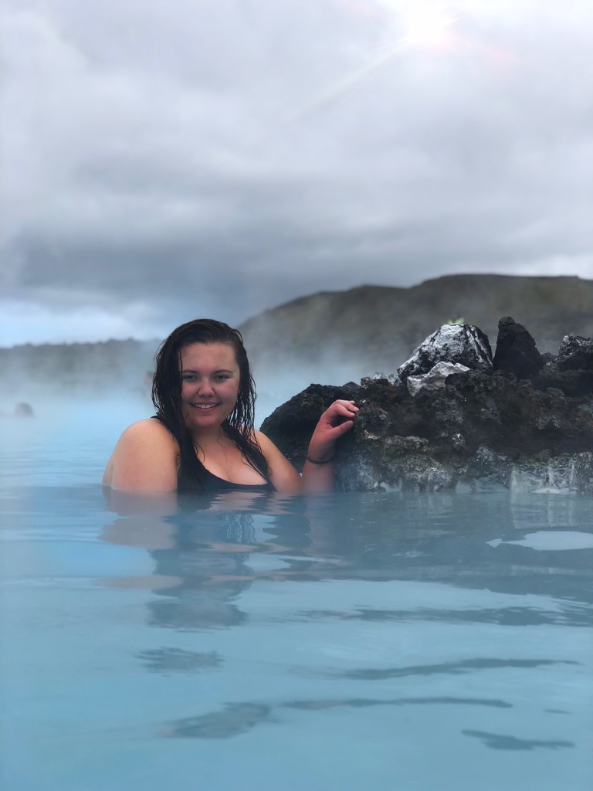
Iceland
The population of Iceland in 2018 was 323,000 (UN)
    2.5 million tourists visited Iceland in 2018 (Icelandic Tourism Board)
532,300 m³ water availability per capita (UN) (2018)
Iceland generates 85% of its energy from renewable hydroelectric and geothermal sources. (NEA-IS) (2018)
    After use this water is put into geothermal lagoons, like the world-famous Blue Lagoon
In Iceland, the cultural norm is to care deeply about the environment and the resources in it. (University of Colorado, Boulder) (2016)

Slide 8
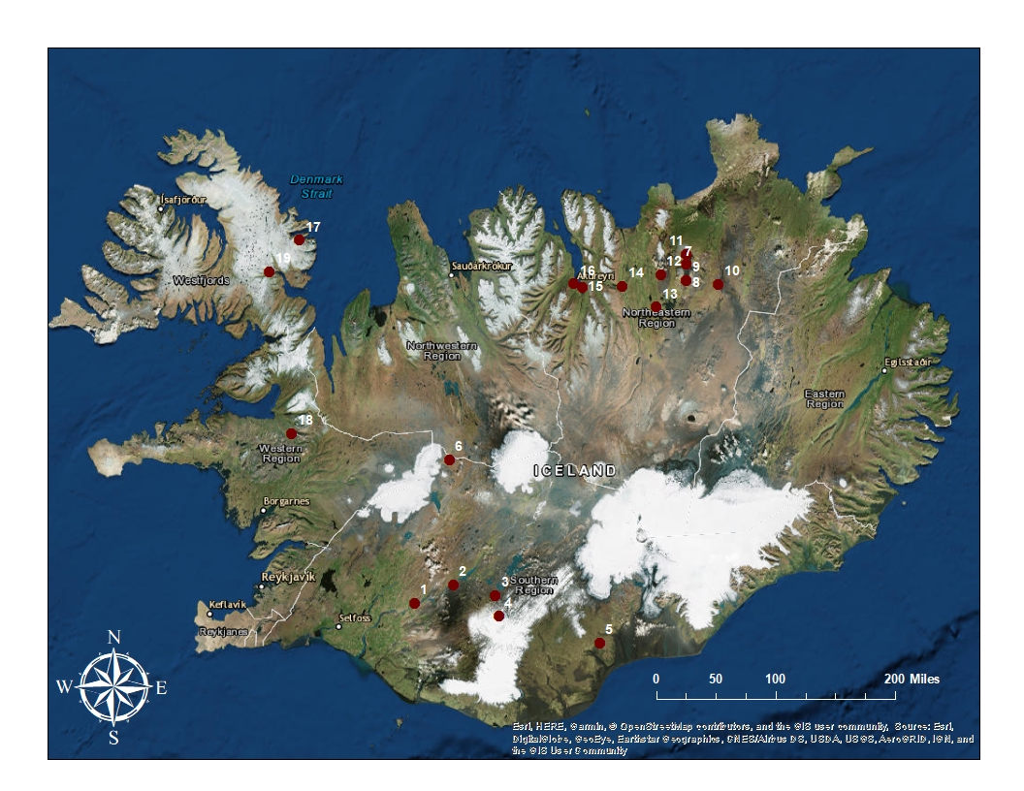

Slide 9
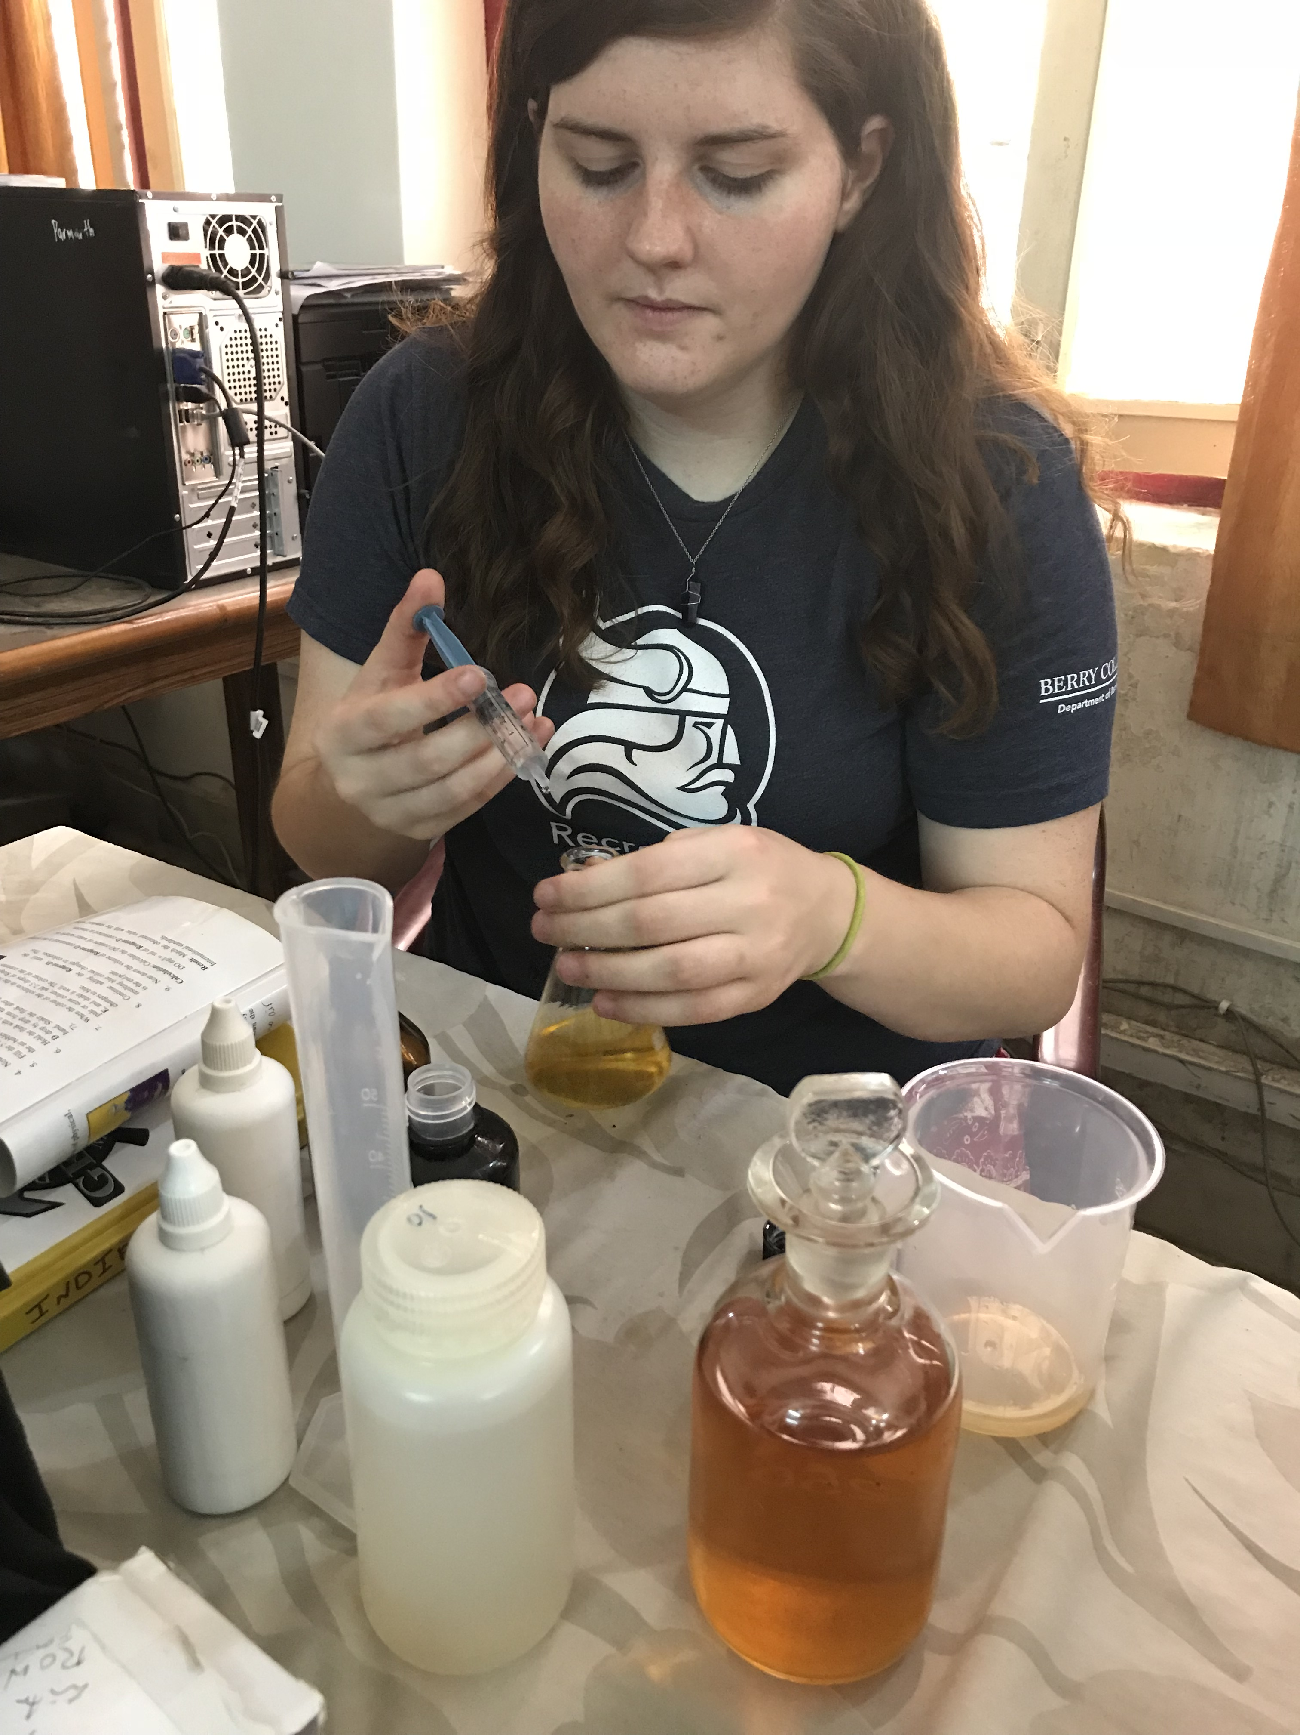
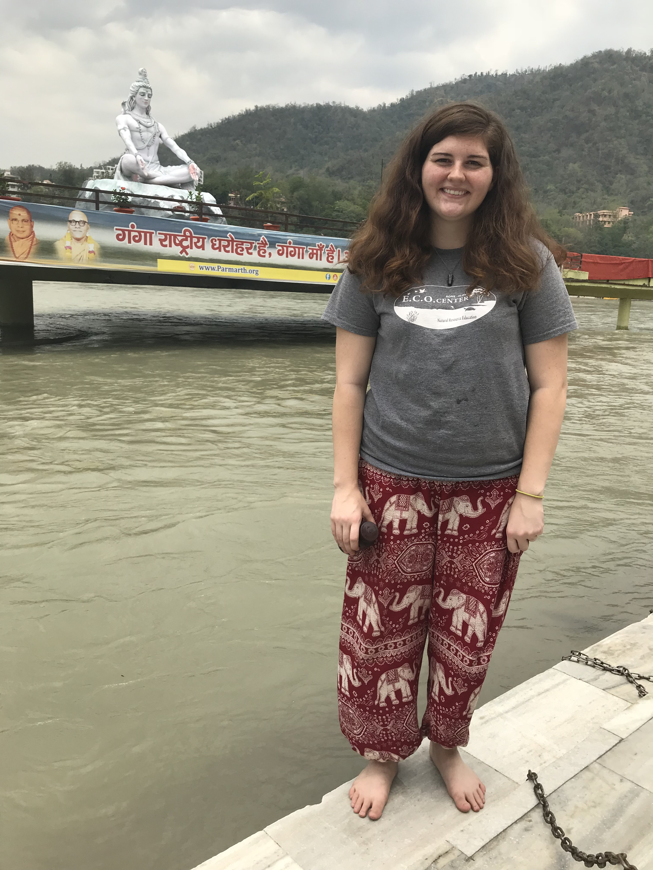
India
Population: 1.3 billion (UN 2018)
  16% of world population
1,474 m³ water availability per capita (MSPI)
  this is less than 1% of the water availability in Iceland
60% of Indians practice open defecation (GIWA 2015)
The Ganges is vastly important in Hinduism
  Pilgrims to the Ganges bath & drink the water
  India has 5.2 million feral cows

Slide 10
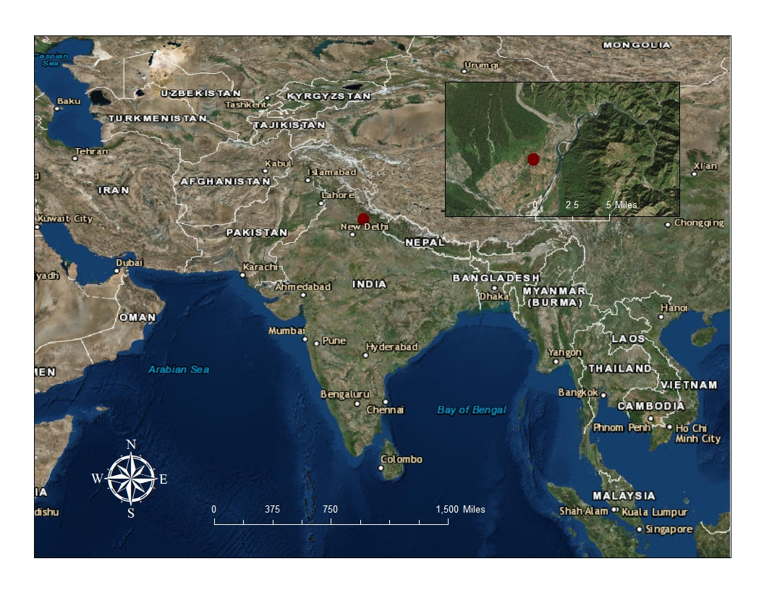

Slide 11
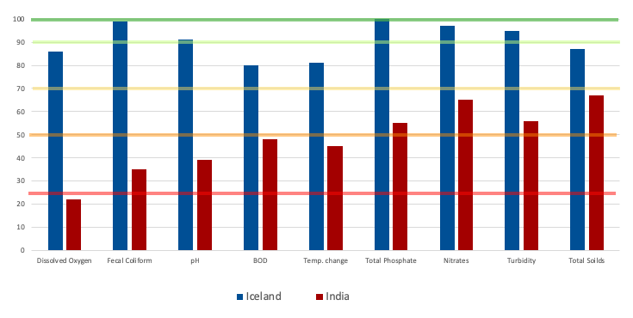
Excellent
Good
Fair
Bad
Very Bad
91%
45%

Slide 12
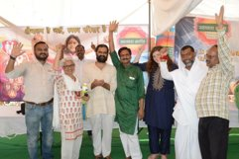
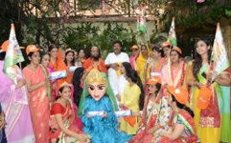
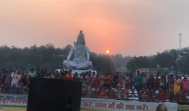
Case Study: Ganga River Discovery Center at Parmarth Niketan Ashram
Global Interfaith WASH Alliance headquarters
Engages global spiritual leaders to create a world where everyone has access to safe drinking water, sanitation, and proper hygiene
Ganga River Discovery Center
Uttarakhand recognizes personhood of the Ganges as of 2017

Slide 13
References
“Drinking-Water.” World Health Organization, World Health Organization, www.who.int/news-room/fact-sheets/detail/drinking-water.“Electricity.” National Energy Authority of Iceland, 2018, nea.is/hydro-power/electric-power/.
E. Etim, E & Odoh, Raphael & U. Itodo, A & Umoh, Sampson & Lawal, Usman. (2013). Water Quality Index for the Assessment of Water Quality from Different Sources in the Niger Delta Region of Nigeria. Frontiers in science.
“Facts and Statistics | WaterAid Global.” WaterAid, www.wateraid.org/facts-and-statistics.
“GIWA Mission.” Global Interfaith WASH Alliance, washalliance.org/about-giwa/.
Gregory, Kathrine V. Iceland's Environmental Saga: Motivations for Sustainable Action and Belief. University of Colorado, Boulder, 2016.
Guidelines for Drinking Water Quality. World Health Organization, 2017.
“Informational Graphic.” Getting the Picture | 3.0, 2016, www.gettingthepicture.info/3/.
“Key Facts from JMP 2015 Report.” World Health Organization, World Health Organization, 2016, www.who.int/water_sanitation_health/monitoring/jmp-2015-key-facts/en/.
Maddocks, Andrew. “Ranking the World's Most Water-Stressed Countries in 2040.” Ranking the World's Most Water-Stressed Countries in 2040 | World Resources Institute, 2015, www.wri.org/blog/2015/08/ranking-world-s-most-water-stressed-countries-2040.
Ólafsson, Gunnar Alexander. “Drinking Water and Sanitation Iceland.” United Nations Economic Commission for Europe, Ministry of Welfare-Iceland, Nov. 2012.
Olmstead, Sheila M. “The Economics of Water Quality.” Review of Environmental Economics and Policy, Environmental Economics, School of Forestry and Environmental Studies, Yale University, 2010.
Perlman, Howard,. “How Much Water Is There on, in, and above the Earth?” How Much Water Is There on Earth, from the USGS Water Science School, USGS, 2 Dec. 2016, water.usgs.gov/edu/earthhowmuch.html.
“Scarcity | UN-Water.” United Nation, www.unwater.org/water-facts/scarcity/.
UNdata | Country Profile | Iceland. United Nations, 2018, data.un.org/CountryProfile.aspx/_Images/CountryProfile.aspx?crName=Iceland.
“Water Quality Data.” Government of India, Ministry of Statistics and Programme Implementation, 2016.

Slide 14
Acknowledgments
Thank you to
    International Programs Office
    Swami Chidanand
    Swamini Adityananda
    Global Interfaith WASH Alliance
    And a HUGE thank you to
Dr. Tamie Jovanelly

Slide 15
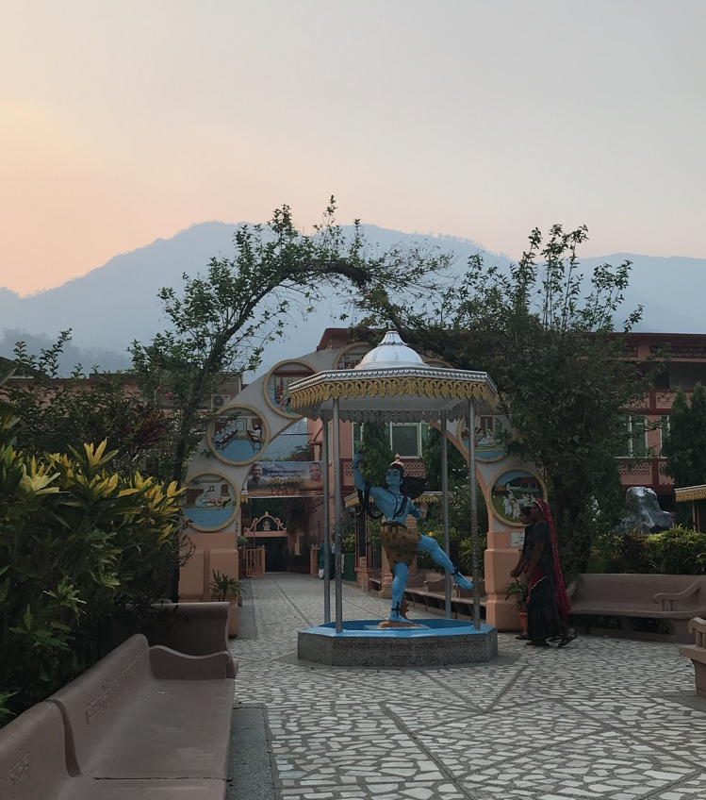
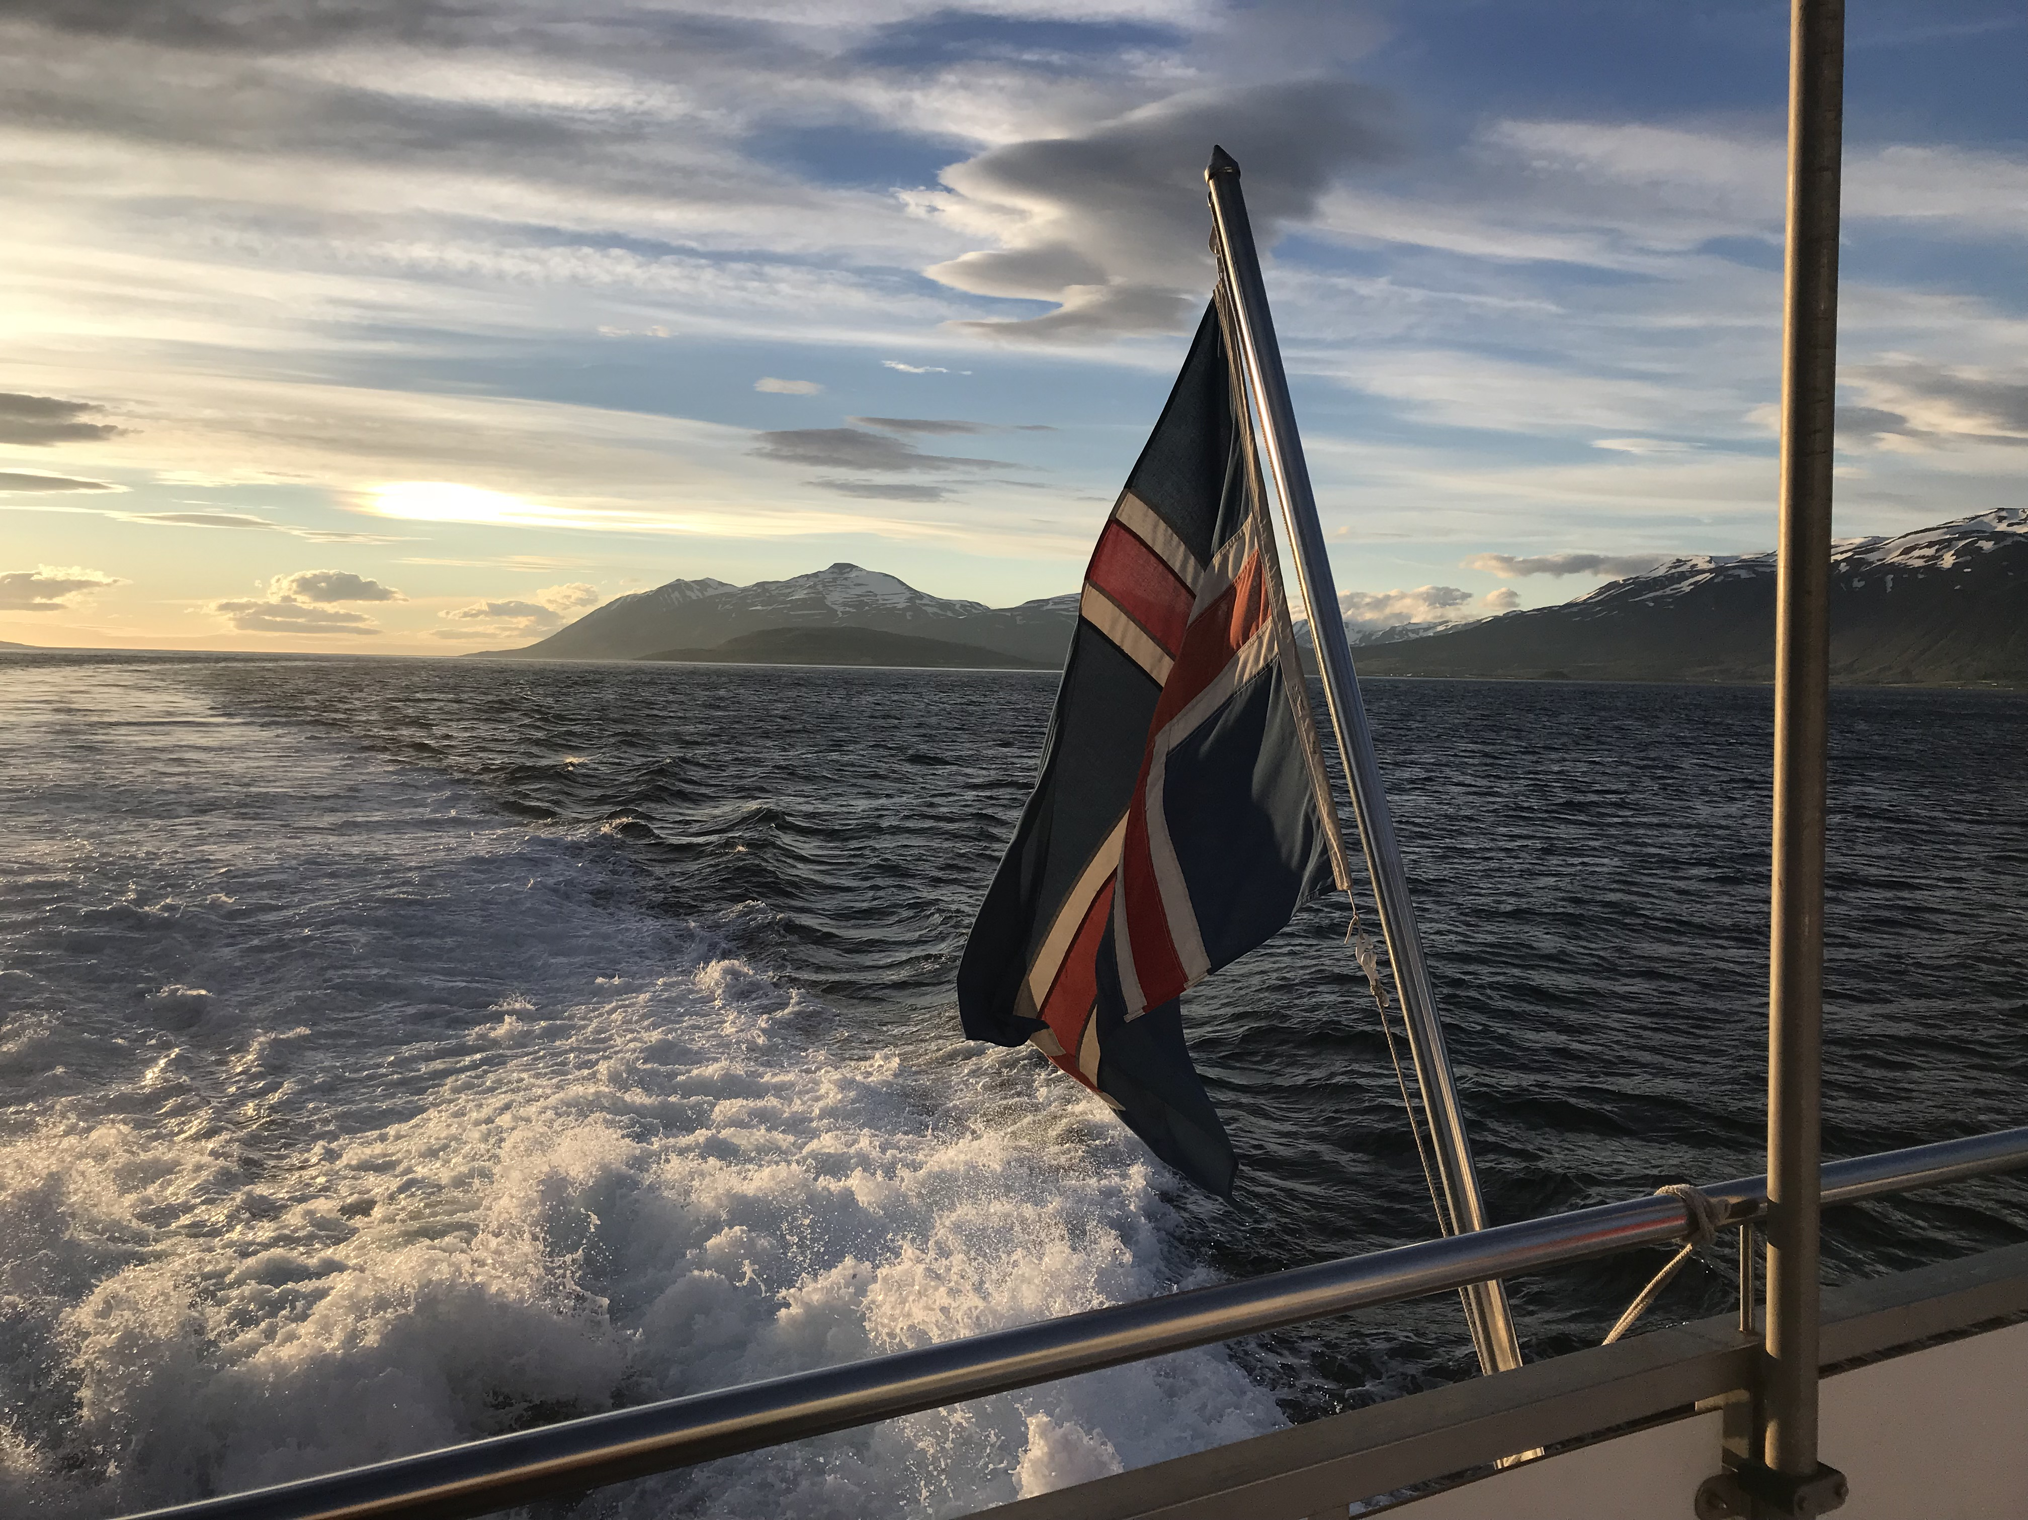
Questions?

