Slide 1

Delta Sigma Theta Sorority, Inc.
HERITAGE MOMENT
OCTOBER 8, 2024

Slide 2
THE DIVINE NINE
During the late 1950s, few African Americans entered college and fewer still remained to graduate. Those who did needed the support of other students like them. Many colleges had brotherhood and sisterhood organizations called fraternities and sororities. Because the organizations were named with letters of the Greek alphabet, they were collectively called the "Greek system." Before the end of legalized segregation, most of the groups in the White Greek system did not allow Black members. Therefore, Black students formed their own Greek organizations, ( BGLO’s) with nine Black fraternities and sororities. These African American fraternal organizations continue to offer support to their members even after graduation. The alumni chapters of Black fraternities and sororities are often more active than those on college campuses, as members join together to support each other and contribute to their communities.

Slide 3
BGLO’S
Black Greek-Letter organizations (BGLOs) emerged during a period that is characterized as a low point in American race relations. These associations were established on the principles of personal excellence, racial uplift, community service, civic action and kinship. Their emergence coincided with significant national developments, including the rise of Jim Crow laws, widespread racial violence and prejudice.
Today, there are nine BGLOs that comprise the National Pan-Hellenic Council, known as the Divine Nine. These organizations have made an impact on their communities through civic engagement and outreach programs that include literacy, professional development and voter registration to name a few…

Slide 4

NPHC
The National Pan Hellenic Council was founded on May 10, 1930, at Howard University in Washington DC. The chartering organizations were:
Alpha Kappa Alpha Sorority, Inc.
Delta Sigma Theta Sorority, Inc.
Zeta Phi Beta Sorority, Inc
Kappa Alpha Psi Fraternity, Inc. and
Omega Psi Phi Fraternity, Inc.
In 1931, Alpha Phi Alpha Inc. and Phi Beta Sigma Fraternity, Inc. joined the council, followed by Sigma Gamma Rho Sorority, Inc. in 1937. Iota Phi Theta joined the council as it’s 9th member in 1997.

Slide 5
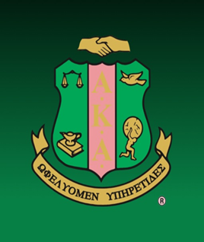

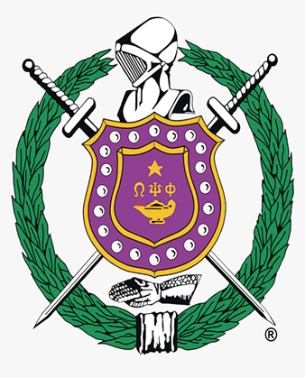
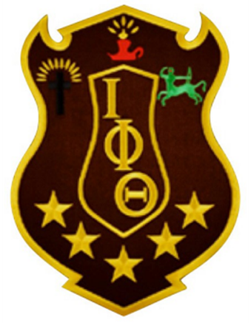

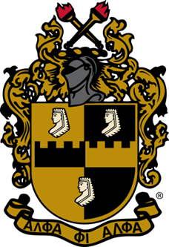



MEET OUR GREEKS!
ALPHA KAPPA ALPHA
OMEGA PSI PHI
KAPPA ALPHA PSI
IOTA PHI THETA
ALPHA PHI ALPHA
DELTA SIGMA THETA
SIGMA GAMMA RHO
ZETA PHI BETA
PHI BETA SIGMA

Slide 6

Alpha Phi Alpha
Alpha Phi Alpha, the first intercollegiate Greek-letter fraternity established for African American Men, was founded on December 4, 1906, at Cornell University in Ithaca, New York by seven college men who recognized the need for a strong bond of brotherhood among African descendants in this country. The fraternity initially served as a study and support group for minority students who faced racial prejudice, both educationally and socially, at Cornell. The Jewel founders and early leaders of the fraternity succeeded in laying a firm foundation for Alpha Phi Alpha’s principles of scholarship, fellowship, good character, and the uplifting of humanity.
Chapters were established at other colleges and universities, many of them historically Black institutions, soon after the founding at Cornell. The first alumni chapter was established in 1911. While continuing to stress academic excellence among its members, Alpha also recognized the need to help correct the educational, economic, political, and social injustices faced by African Americans. Alpha Phi Alpha stands as the sole Black Greek-letter organization founded at an Ivy League institution—Cornell University. Amidst a campus marked by segregation and social isolation for Black students, a troublingly low retention rate prompted the remaining individuals to form a support and study group.

Slide 7

Alpha Kappa Alpha
Established on January 15, 1908, at Howard University, Alpha Kappa Alpha emerged as the first Greek-letter organization founded by Black college women. Ethel Hedgeman Lyle, a Howard student, aspired to create a supportive network for women sharing similar goals—to uplift one another and leverage their talents for the greater good. Unlike prior challenges with campus administrators, the group’s acceptance as a recognized campus organization encountered no delays, leading to the group's official formation in 1908.
The founders assumed leadership roles within the YWCA and engaged in activities within the campus chapter of the NAACP. Additionally, the group aided Southern migrants in adapting to Northern life during the Great Migration. It advocated for women's suffrage, and the sorority also dedicated efforts to dressing dolls for underprivileged children at the Freedman’s Hospital. Notably, it established funds catering to students in need and those aspiring to pursue studies abroad.

Slide 8
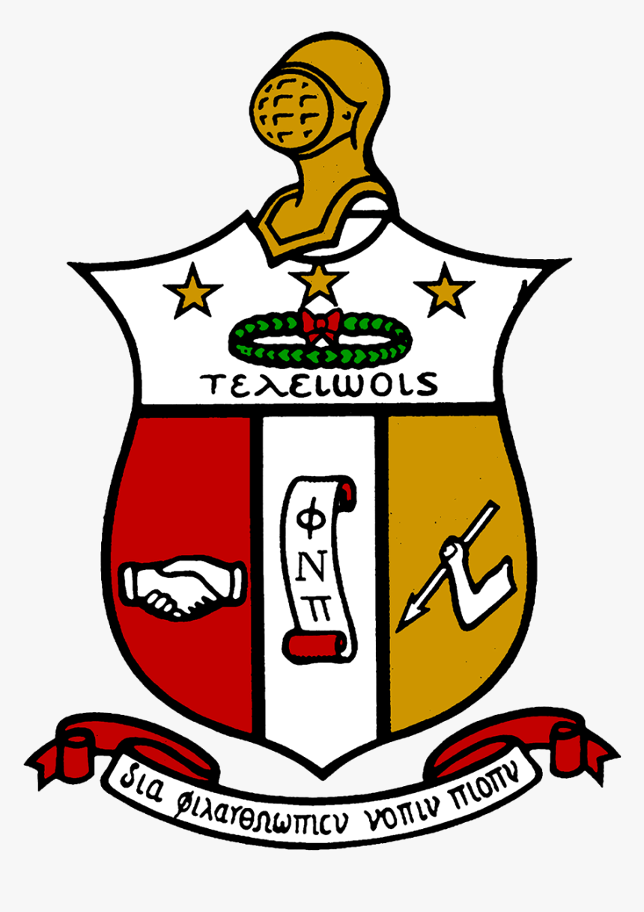
Kappa Alpha Psi
Most Black Greek-letter fraternities trace their origins to Howard University. However, Kappa Alpha Psi is one of a few BGLOs that emerged among Black students at predominantly White universities. Elder Watson Diggs and Byron Kenneth Armstrong, who had forged a friendship at Howard, found themselves at Indiana University, where they confronted the stark realities of Black life. Discrimination, inadequate social services and meager representation left Black students socially isolated within a campus environment. They were denied access to recreational and entertainment facilities.
Diggs rallied nine fellow Black men and established Alpha Omega as an interim fraternity, a precursor to a permanent organization. On January 5, 1911, this group birthed a new fraternity on campus, called Kappa Alpha Nu, which attained national recognition on May 15, 1911. Similar to other fraternities, this collective crafted a constitution, rituals, initiation ceremony and coat of arms. Their activities extended to hosting social events and annual ‘house parties’ that drew Black students from across the state. By 1914, they officially adopted the name Kappa Alpha Psi which expanded to multiple campuses

Slide 9

Omega Psi Phi
With the formation of the 1st Black fraternity at Cornell University, 3 students wanted to create something that Howard University could have of its own. At Howard, 3 students along with the assistance of a biology professor established a new fraternity called Omega Psi Phi on November 17, 1911. Initially, HU administrators opposed the formation of this group, reflecting the attitudes of many colleges nationwide, which were concerned that secret societies could erode trust among students and lead to immoral behavior. Initially denied recognition by the university, Omega Psi Phi members initiated a public relations campaign by placing index cards around the campus on trees, fences, bulletin boards and other visible locations.
The University president publicly denied the existence of Omega Psi Phi on campus, prompting members to personally lobby the faculty. After negotiations with the faculty, Omega Psi Phi transitioned from a local fraternity to a nationally recognized organization and was officially incorporated in 1924. Its chapters expanded across the country after WW1. In 1918, there were 3 chapters, and by 1923, there were 47 active chapters.

Slide 10

Delta Sigma Theta
Delta Sigma Theta emerged from a division within Alpha Kappa Alpha Sorority, (AKA), as members expressed dissatisfaction with the organization's limited focus on campus affairs. Some members wanted to pivot towards addressing broader issues like public service and women's advancement. and adopt a more politically-oriented stance.
In 1912, at Howard University, these members voted to transition from AKA to Delta Sigma Theta. The move sparked discord between graduate members, who favored maintaining the status quo, and new Alpha chapter members advocating for change. When a deadline imposed by a graduate member to cease reorganization efforts was ignored, 22 women parted ways from AKA and established Delta Sigma Theta on January 13, 1913. This desire to reform extended to establishing a national organization and altering the society's activities, accompanied by the name change that reflected their purpose. ….and as the saying goes … the rest is HERSTORY!

Slide 11

Phi Beta Sigma
Phi Beta Sigma Fraternity was founded at Howard University in Washington, D.C., January 9, 1914, by three young African-American male students. The Founders wanted to organize a Greek letter fraternity that would truly exemplify the ideals of brotherhood, scholarship, and service.
The Founders deeply wished to create an organization that viewed itself as “a part of” the general community rather than “apart from” the general community. They believed that each potential member should be judged by his own merits, rather than his family background or affluence…without regard to race, nationality, skin tone or texture of hair. They desired for their fraternity to exist as part of an even greater brotherhood which would be devoted to the “inclusive we” rather than the “exclusive we”.
From its inception, the Founders also conceived Phi Beta Sigma as a mechanism to deliver services to the general community. Rather than gaining skills to be utilized exclusively for themselves and their immediate families, they held a deep conviction that they should return their newly acquired skills to the communities from which they had come. This deep conviction was mirrored in the Fraternity’s motto, “Culture For Service and Service For Humanity”.

Slide 12

ZETA PHI BETA
Zeta Phi Beta Sorority, Inc. was founded January 16, 1920, at Howard University, Washington, D.C. The Klan was very active during this period and the Harlem Renaissance was acknowledged as the first important movement of Black artists and writers in the U.S. This same year the Volstead Act became effective heralding the start of Prohibition and Tennessee delivered the crucial 36th ratification for the final adoption of the 19th amendment giving women the right to vote. The worst and longest economic recession to hit the U.S. would define the end of the decade-The Great Depression.
It was within this environment that five coeds envisioned a sorority which would directly affect positive change, chart a course of action for the 1920s and beyond, raise consciousness of their people, encourage the highest standards of scholastic achievement, and foster a greater sense of unity among its members. These women believed that sorority elitism and socializing overshadowed the real mission for progressive organizations and failed to address fully the societal mores, ills, prejudices, and poverty affecting humanity in general and the Black community in particular.
Since its inception, Zeta has continued its steady climb into the national spotlight with programs designed to demonstrate concern for the human condition both nationally and internationally.

Slide 13

SIGMA GAMMA RHO
Sigma Gamma Rho Sorority, Inc. was organized on November 12, 1922, in Indianapolis, Indiana, by seven young educators. The group was incorporated on December 30, 1929, when a charter was granted to the Alpha chapter at Butler University. Since its inception, the dynamic women of Sigma Gamma Rho have built and sustained a well-known and well-respected reputation for leading positive change to help uplift the community through sisterhood, leadership, and service.
Sigma Gamma Rho’s commitment to service is expressed in its slogan, “Greater Service, Greater Progress.” The sorority has a proud history of providing positive and proactive community outreach nationally and internationally. The programs, partnerships, and sponsorships represent Sigma Gamma Rho’s commitment to promoting the greater good in education, service, and leadership development. In 2004, the National Headquarters moved from Chicago, Illinois to its current home in Cary, North Carolina.

Slide 14

IOTA PHI THETA
On September 19, 1963, at Morgan State College (now Morgan State University), 12 students founded what is now the nation's fifth largest, predominately African-American social service fraternity: The Iota Phi Theta Fraternity, Incorporated.
This group of men was unique for several reasons. First of all, many were long-time friends. Even more uniquely, many of these men were what are now referred to as "Non-Traditional Students" and were 3 to 5 years older than the average college student. Three were service veterans and were married with small children. Of this group of 12, several were also working full-time jobs, and all were full-time students.
Based upon their ages, heightened responsibilities, and increased level of maturity, this group had a slightly different perspective than the norm for college students. It was this perspective from which they established the Fraternity's purpose, "The development and perpetuation of Scholarship, Leadership, Citizenship, Fidelity, and Brotherhood among Men." Additionally, they conceived the Fraternity's motto, "Building a Tradition, Not Resting Upon One!"

Slide 15

MEDIA DISTORTIONS
As you can see, each fraternity and sorority has their own deep, rich history which can attest to and add to the history of BGLO's overall. Black Greek-letter organizations as a whole have taken one giant step in accomplishing unity throughout the Black community.
BGLO’s have played an important role in history, and are continuing to flourish in the twenty-first century, despite some of the negative attention of late. The work does not end in college. Each organization alone has reached hundreds of thousands of members in several hundred chapters at colleges and universities both in the United States and abroad. D9 organizations established all over the world serve a purpose of networking and service in our communities both domestic and foreign.
And, my sorors, despite what you may see or hear on social media, in my 54 years of membership I have NEVER worshipped the Goddess Minerva!

Slide 16

Perez, K. January 2007. The Importance of Black Greek-Lettered Organizations. https://www.theodysseyonline.com
Taylor, T. September 2023. How historically Black colleges and universities serve disadvantaged groups today
Taylor, K. August 2024. The Value of an Education at an HBCU: Benefits, Cost, and Impact. www.investopedia.com

