Slide 1
Heritage Moments
December 13, 2022
Murrieta Temecula Area Alumnae Chapter
Patricia P Watson Ed.D Chair
Marsha Edmond Co-Chair
Notes:
Be specific and direct in the title. Use the subtitle to give the specific context of the speech.
-The goal should be to capture the audience’s attention which can be done with a quote, a startling statistic, or fact. It is not necessary to include this attention getter on the slide.

Slide 2
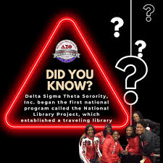

Slide 3
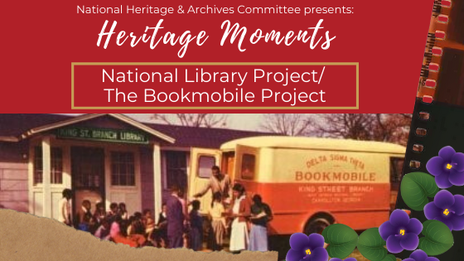
The National Library Project was established as Delta Sigma Theta’s first national project under the leadership of 7th National President Vivian Osborne Marsh during the Jim Crow era when libraries were not widely available to rural African Americans.

Slide 4
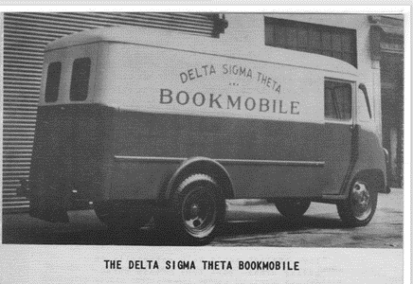
From its very beginning, Delta sought to widen the educational and cultural horizons of children and adults through the improvement of library services. Each year, funds were used for the purchase of books, audio-visual aids, and library equipment. Many chapter members gave their time in tutoring programs, the organization of clinics, and other services in their local libraries. Its pioneering is best demonstrated by the Delta Bookmobile sent to rural Georgia in 1937.

Slide 5
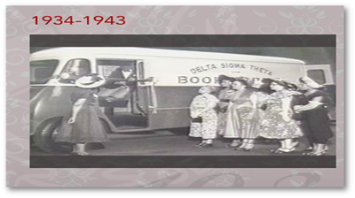
Delta Sigma Theta Sorority, Incorporated has been addressing literacy since the 1930s and continues to lead the charge today
The bookmobile started in the South, where there were no books or libraries available to people of color, as a need was clearly not being met. Since Delta’s focus is on public service, the lack of something critical for improvement and education, like books, seemed to be the natural place to focus our efforts. The best way to get the books out was through a traveling source or a particular school. That effort evolved into a 20-year run of providing materials to people, young and old in Southern areas. These were places where there was no access to libraries, or in communities where libraries did exist, but they weren’t allowed to use them.

Slide 6
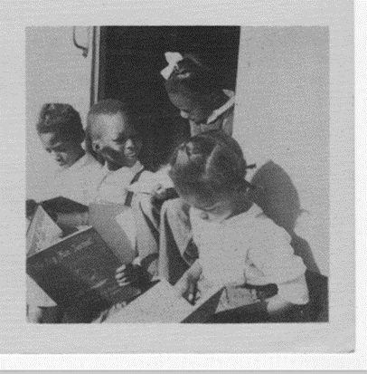
A librarian named Maude Watkins, from the New York Alumnae Chapter, was the acting director of the bookmobile program, appointed by then National President, Dr. Dorothy I. Height. Soror Watkins, a very active and committed member of the sorority and to education had a reputation for working hard for the education of young people.

Slide 7
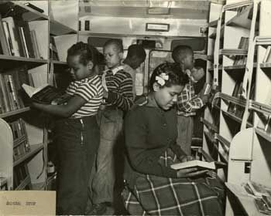
The success of the Delta Bookmobile stimulated the State of Georgia to undertake its own traveling library service as a public responsibility. Upon the adoption of the State service, Delta presented its Book mobile to the State and later received an American Library Association award for this contribution to southern education

Slide 8
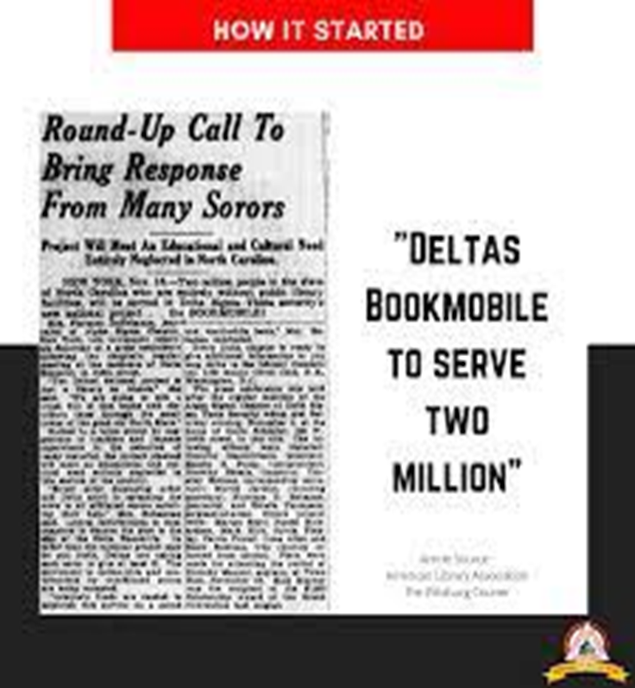
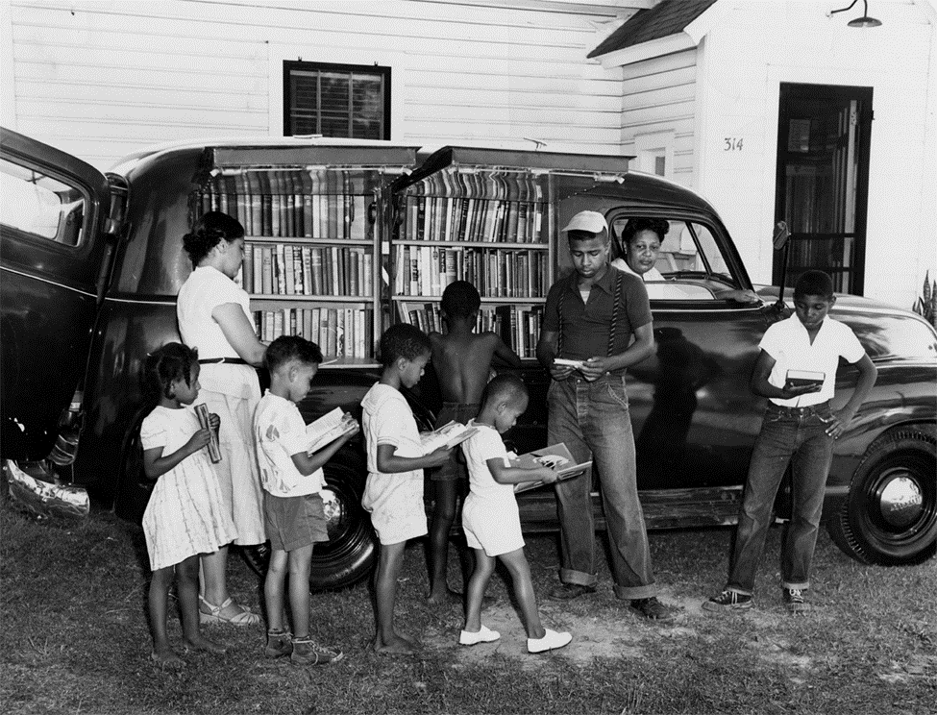

Slide 9
Timeline of the DST Bookmobile Program
In 1937, DST launched its Library Committee to provide books for people in rural southern communities. Members of New York City’s Alpha Sigma Chapter (now New York Alumnae Chapter -NYAC) announced the project at a press conference encouraging financial support from members of the Sorority and the general public. ("Deltas Bookmobile To Serve Two Million" (PDF))
Mid 1940s, momentum and money increased as each chapter contributed $2.50 toward the purchase of 10 books. Chapter names appeared in books donated. The administrative “traveling library” needs were organized and met by local and regional librarians. One of our Founders, Jimmie Bugg, attended the dedication in NC of the Franklin County Traveling Library. http://digital.ncdcr.gov/cdm/ref/collection/p249901coll36/id/1251
June 1950, the Ford bookmobile was purchased left New York equipped with books to serve people in Georgia’s rural areas. Maude Watkins, a New York librarian and member of NYAC, served as Acting Director. The mobile library in Carrollton County gained a tremendous amount of interest and was used by the community. ("Deltas Launch Bookmobile with TV, Luncheon, Tea," New York Amsterdam News (1943-1961); Jun 17, 1950 (PDF)
1951, ALA presented its Letter Award to Delta Sigma Theta Sorority, Inc., for its Bookmobile program in the South. Maude Watkins, NYAC past president, received the award on behalf of the sorority. ("Deltas Win American Library Award," The Chicago Defender (National edition) (1921-1967); Jul 21, 1951 (PDF))
1954 the sorority’s last bookmobile project was implemented in South Carolina, after which, the Sorority disbanded the National Library Committee. Today, the sorority’s literacy activities are under Educational Development, one of its Five-Point Programmatic Thrust areas.
Notes:
The counterargument should be the most common argument against the topic. The goal for this slide is to address the counterargument in such a way as to actually strengthen the original topic. Be sure to address each piece of evidence against the topic. As you address each piece of evidence elaborate on the text found on the slide. Remember to transition to the final slide, the action step.

Slide 10
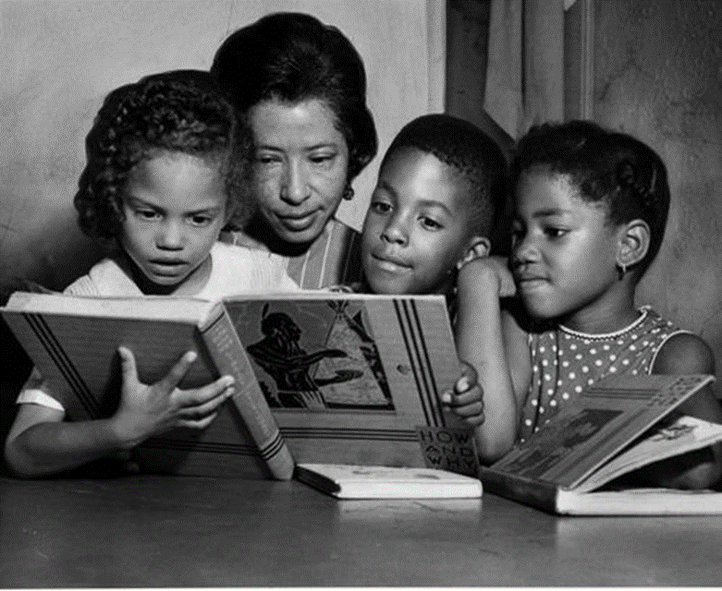
Update
In January 2023, the MTAAC Delta DEARS will continue Delta’s tradition of educating youth through literacy. In collaboration with the Educational Development Committee the MTAAC DEARS are partnering with the Julia Lee Performing Arts Academy to provide Bookmobile Services “Each One Teach One” to the TK and PK student populations for the duration of the school year. DEARS will be responsible for reading books under the supervision of the classroom teacher, to support student literacy.

Slide 11
Resources
Delta Sigma Theta Pamphlet (1937) Delta Sigma Theta National Library Project https://radar.auctr.edu/islandora/object/auc.
Driving Past Jim Crow; The Bookmobile of Delta Sigma Theta. 2013. https://bookmobiles.wordpress.com
Intersections | A Sorority, Literacy, Jim Crow, and Bookmobiles: A Legacy of Service https://www.ala.org/advocacy/intersections-sorority-literacy-jim-crow-and-bookmobiles-legacy-service
Giddings, P. (1988). In Search of Sisterhood. Delta Sigma Theta and the Challenge of the Black Sorority Movement. Copyright Delta Sigma Theta, Inc. Harper Collins Publishers.

