Slide 1
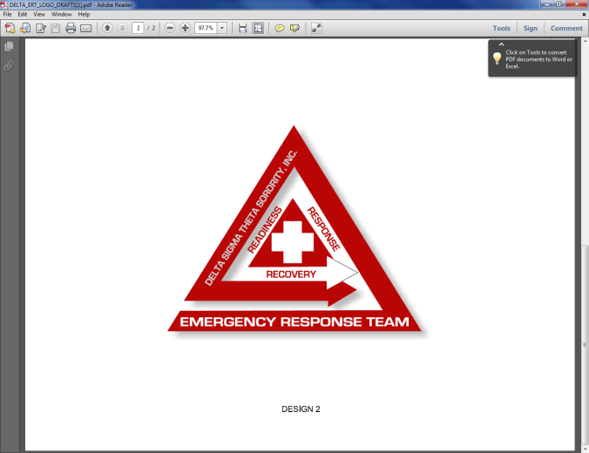
Delta Emergency Response Team (ERT)
The ERT mission is to
Increase awareness about emergency preparedness activities;
Provide steps for early response and efficient recovery;
Provide resource support and guidance for sorority members and communities impacted by natural or man-made disasters; and
Provide effective and immediate communication strategies to facilitate and aid in preparedness and response.
For more :information link to:
https://members.dstonline.org/Non-Menu-Subpages/ERT

Slide 2
DISASTER SUPPLY LIST
Are You Ready?
Recommended Disaster Supply Kit
Emergency Identification:
Duplicate identification for all family members.
Duplicate prescription for medication and glasses.
Contact numbers of family members and meeting point location maps.
Duplicate residency verification List of valuables for insurance claims.
List of valuables for
For more :information link to:
https://members.dstonline.org/Non-Menu-Subpages/ERT

Slide 3
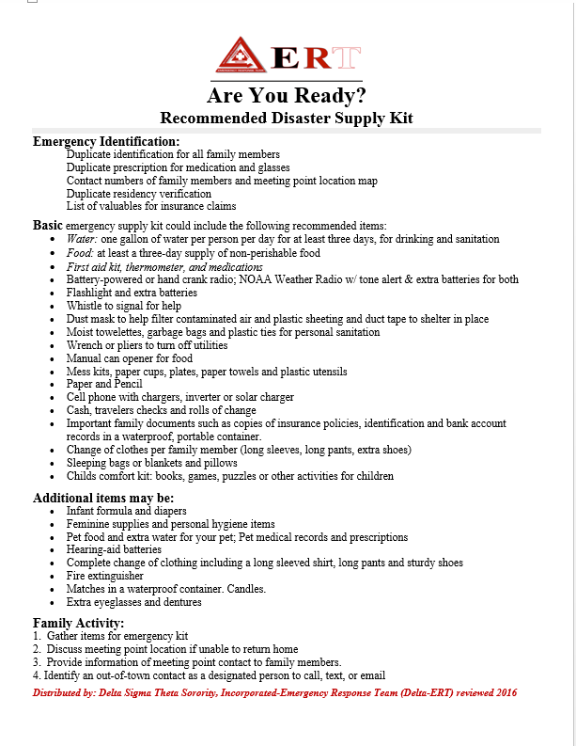
EMERGENCY
DISASTER
SUPPLY
LIST
For more information link to:
https://members.dstonline.org/Non-Menu-Subpages/ERT

