Slide 1
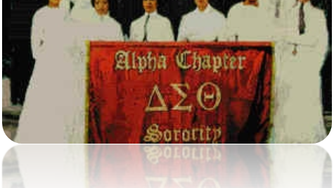
Murrieta-Temecula Area Alumnae Chapter
Heritage Moments Presentation
Patricia P Watson Ed.D, Chair
Manerva Hart D.D.S. Co Chair
February 9, 2021

Slide 2
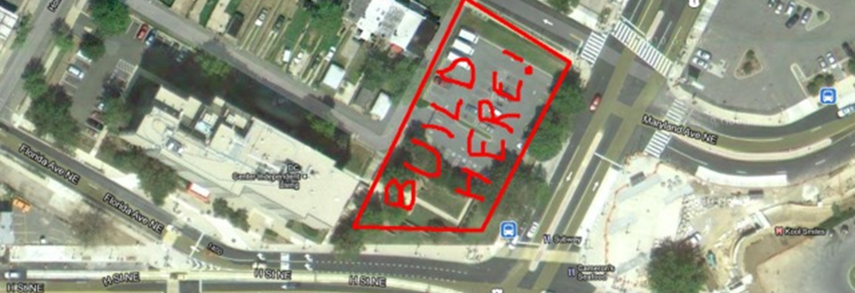
February’s Heritage Moment Celebrates
Fortitude at Delta Towers

Slide 3
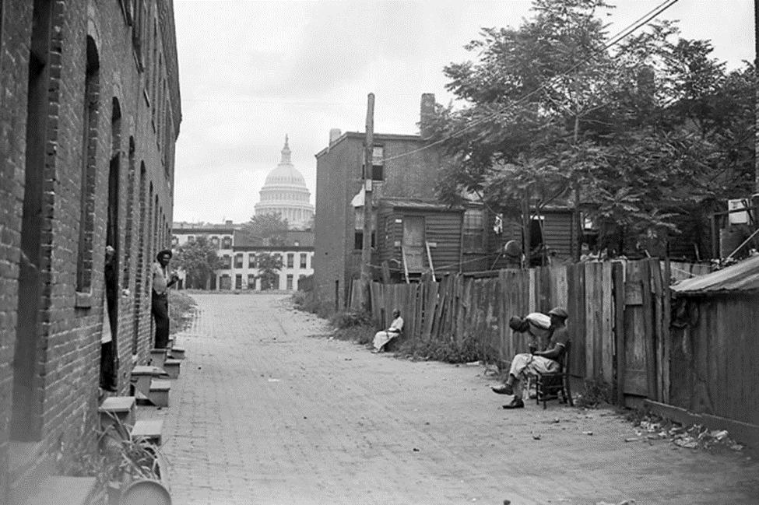
Breaking Ground..
In 1979, a resident of the H Street NE area for more than 20 years, stood in the mud last Saturday and proudly pointed to the housing and commercial projects being built in his neighborhood. Eleven years earlier, fires from the riots had consumed small stores and rowhouses in the area.
"Another year, and you won't know this place, he said”. All these beat-up old houses, all these shacks and rat holes are going away.. What an improvement.“ He was one of about 200 persons at 15th and H Streets NE who were on hand for the groundbreaking ceremonies for Delta Towers, a 10-story apartment building for the elderly and handicapped.

Slide 4
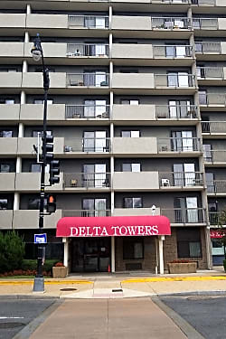
Delta Towers
The Washington D.C. Alumnae Chapter and Delta's Housing Corporation planned and constructed Delta Towers as a multimillion-dollar, ten-story building.
Delta Towers was one of the first early high-rise apartment buildings on the eastern end of H Street NE, at Florida Avenue and Bladensburg.
The Sorors of Delta Sigma Theta having bought the land from the District in the late 1970’s got funding from the Federal Department of Housing and Urban Development for a 138-unit senior housing complex.

Slide 5
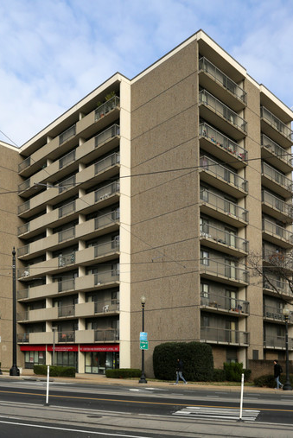
Open for Occupancy
Delta Towers included 149 independent-living residential apartments and opened for occupancy in 1980 as the first retirement center founded by any African-American sorority or fraternity in the United States.
Due to the success of Delta Towers, the chapter and housing corporation made plans to provide a second apartment building, Delta Towers II, near the first.

Slide 6
Delta Towers II
Delta Towers II was planned to provide 150 additional safe and affordable apartments for low to moderate income senior citizens. It would provide a senior citizen wellness center, ground level commercial office and retail services, and a community room. Delta Towers and Delta Towers II was initially intended to offer 300 affordable apartments for senior housing (affordable to households earning 60% or less of the area's median income). But plans changed…

Slide 7

A Plan Deferred…
In 2009, Delta tried to build on the second half of the property, proposing a 100-unit, eight-story, mixed-income project that would have cost about $37 million dollars, to be financed through low- income housing tax credits. However, it didn't pan out—-and not because of financing, said Katrina Jones, then, President of the Board of Delta Housing Corporation.

Slide 8
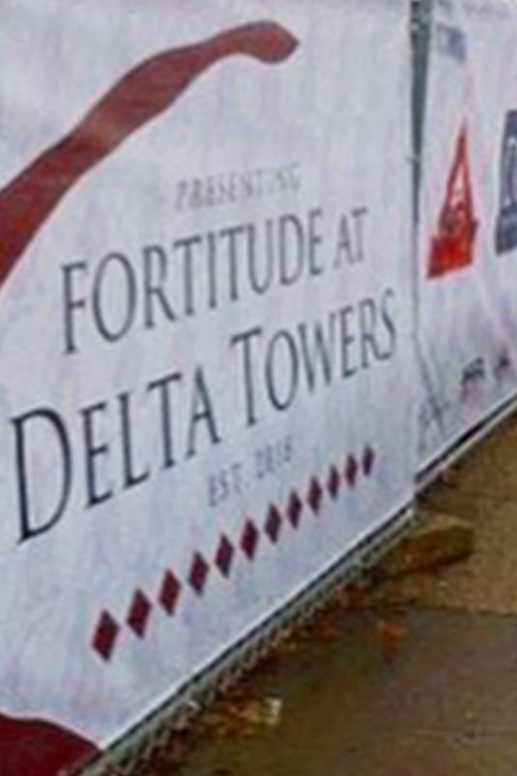
Persistence
It took 9 years, but on October 1, 2018, Gilbane Development Company and Dantes Partners, partnered with Delta Housing Corporation (DHCDC) to develop a new building. The plan was to go better, not bigger…and replace the current living space. Moving into a brand-new building would allow for the least amount of disruption to the seniors of the existing building as they would only need to move from their current unit to a unit in the new development.

Slide 9
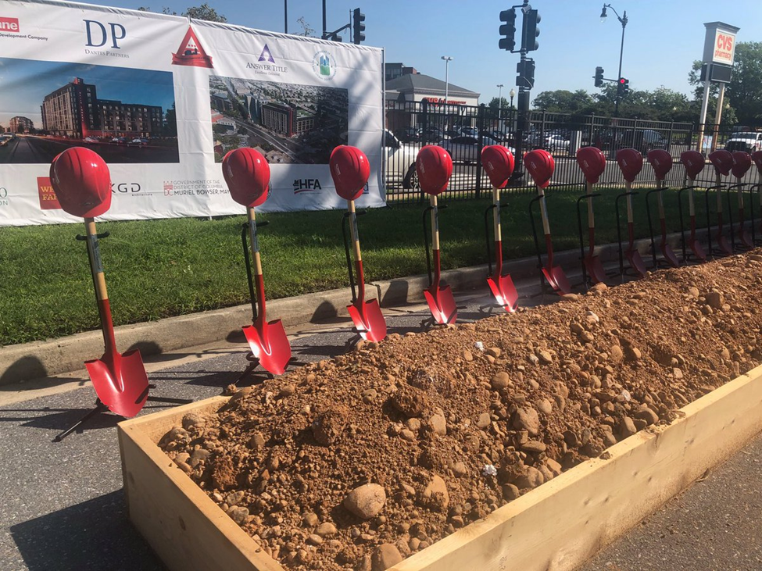
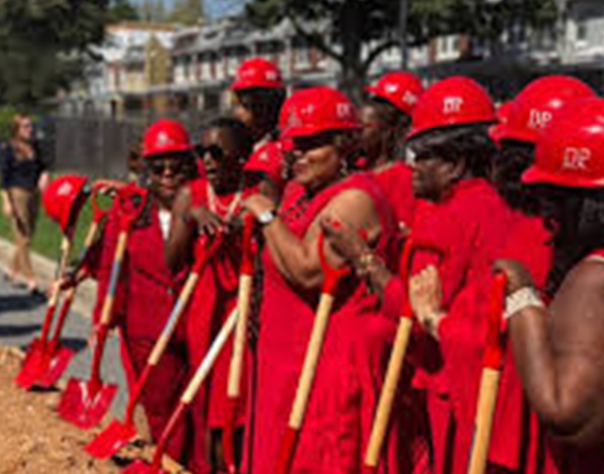
Committed
At the groundbreaking, Mayor Muriel Bowser announced that the city was committed and would invest $167.6 million for affordable housing in the fiscal year 2018 from the Housing Production Trust Fund (HPTF).
HPTF provides funding for projects that create or preserve affordable housing for Washingtonians.
The Delta Towers project received $23.3 million in HPTF funds with plans to include 30 additional units increasing capacity from 149 units to 179 units for seniors, including 18 permanent supportive housing (PSH) units.

Slide 10
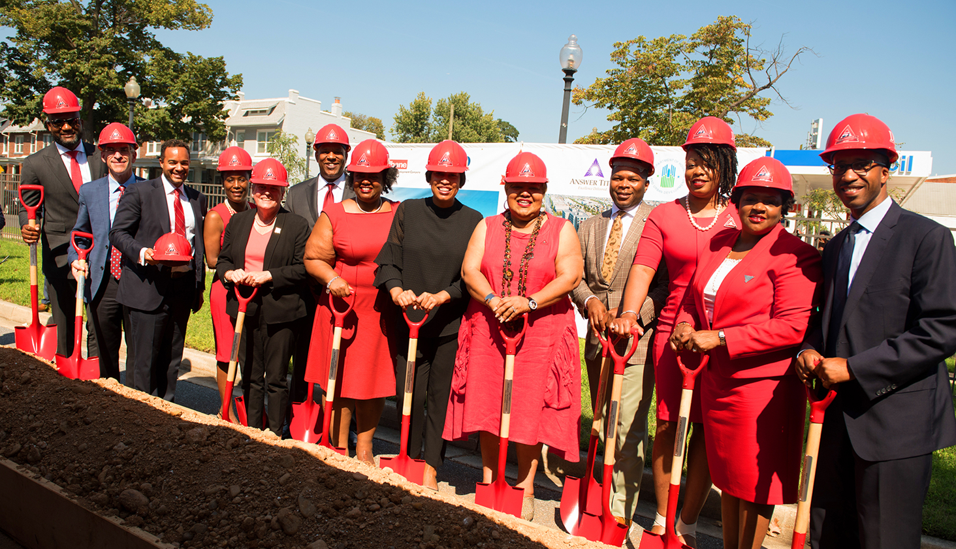
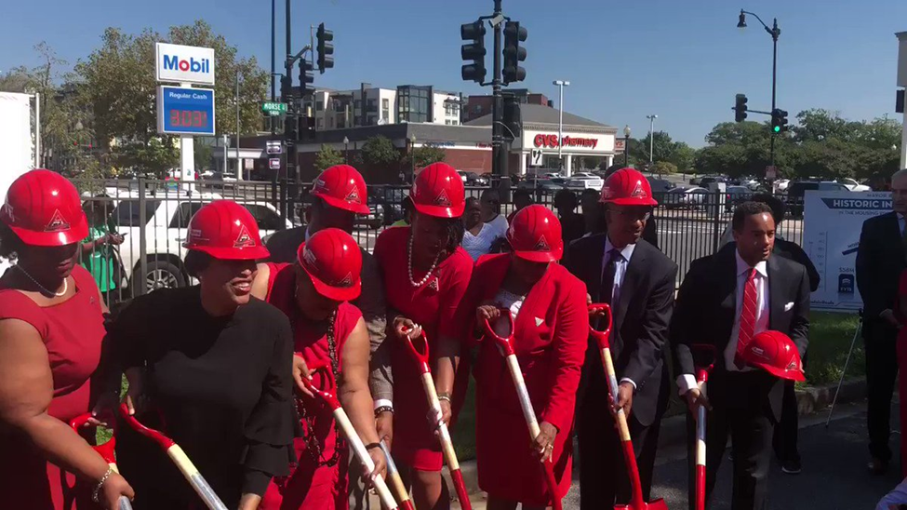
Breaking Ground
Building plans also include over 10,000 square feet of amenity space that will incorporate a conference room, cafe lounge, laundry, fitness room, games lounge, clubroom, rooftop terrace, and exterior courtyard.

Slide 11
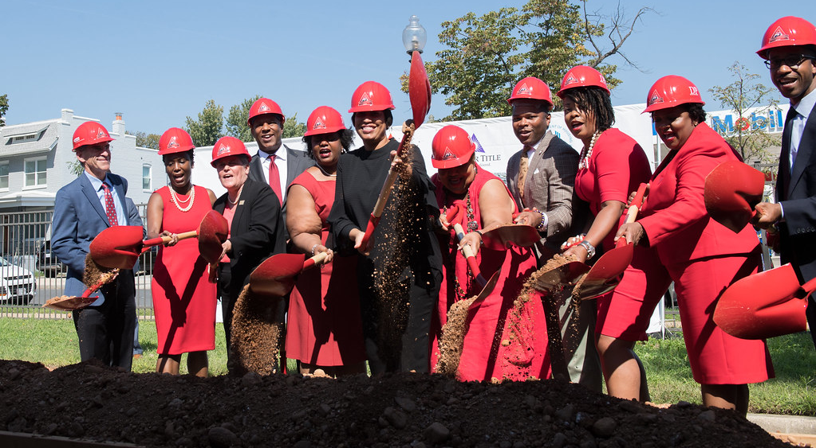

Slide 12
UPDATE…
November 19, 2020

Slide 13
Mayor Bowser Opens Fortitude at Delta Towers, Affordable Housing Community for Senior Residents in Ward 5
Mayor Muriel Bowser celebrated the opening of Fortitude at Delta Towers, a 179-unit, 100% affordable housing development for senior citizens who are 55 and older located at 808 Bladensburg Road, NE in Ward 5. The new project replaced existing units at Delta Towers, while adding 30 more affordable units, including 18 permanent supportive housing units for seniors.
The building has more than 10,000 square feet of amenity space that includes a conference room, cafe lounge, laundry, fitness room, games lounge, clubroom, rooftop terrace, and exterior courtyard.

Slide 14
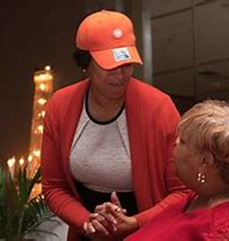
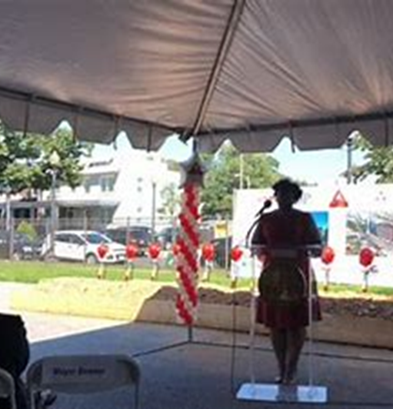
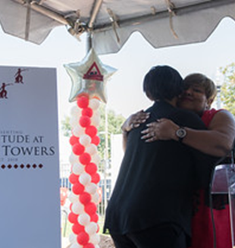
Mayor Bowser joined by the women of DST

Slide 15
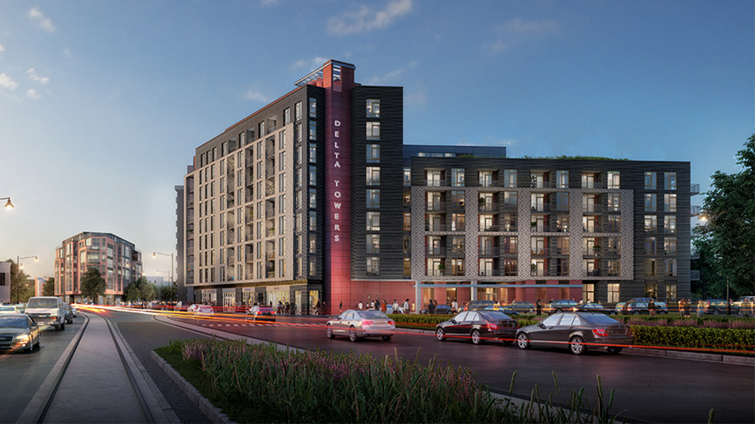

Slide 16
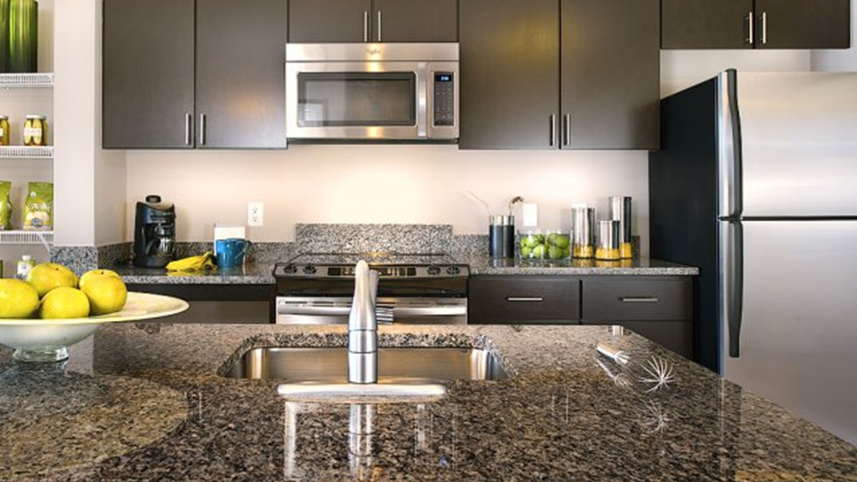
TYPICAL MODEL UNIT

Slide 17
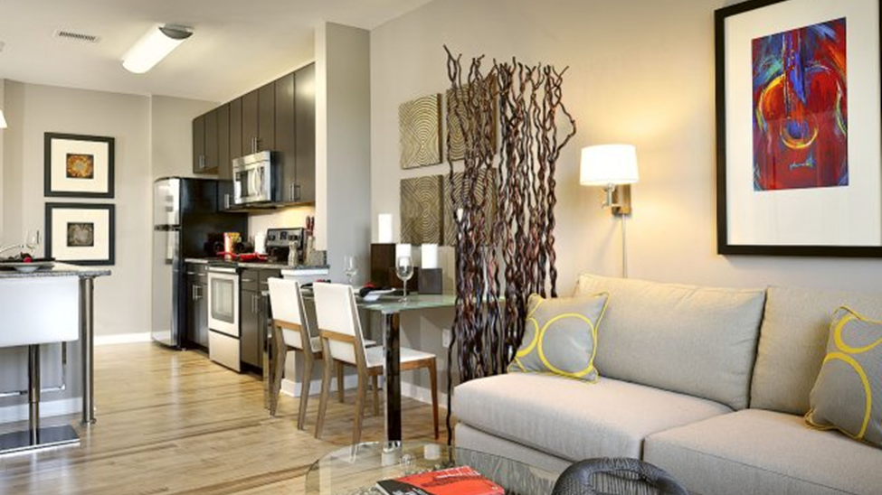

Slide 18
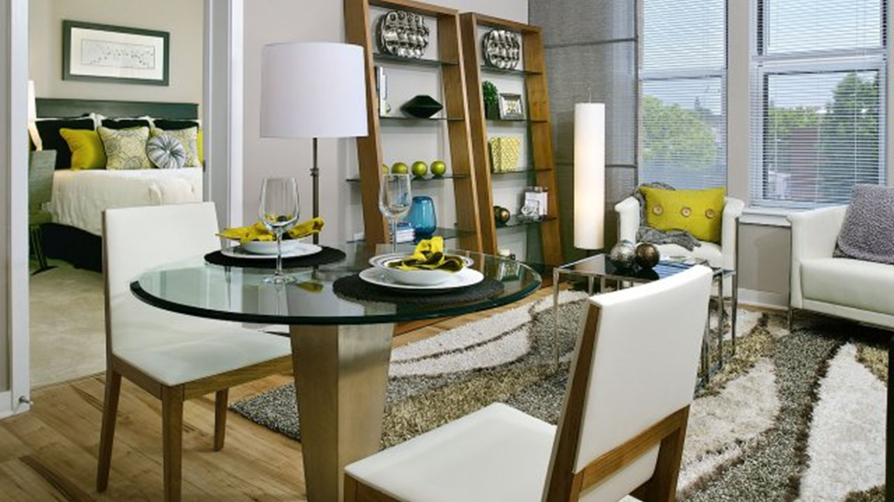

Slide 19
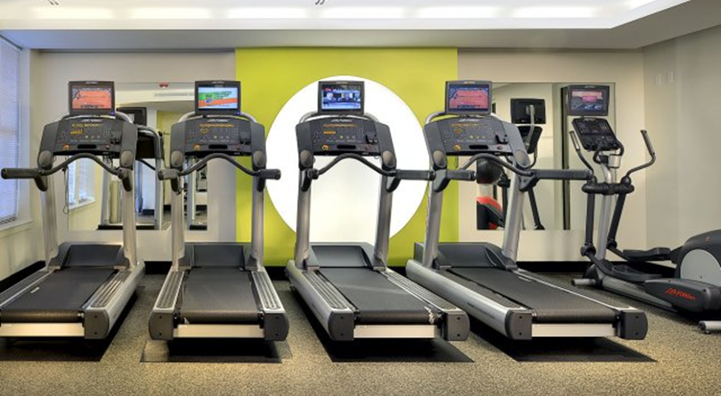

Slide 20
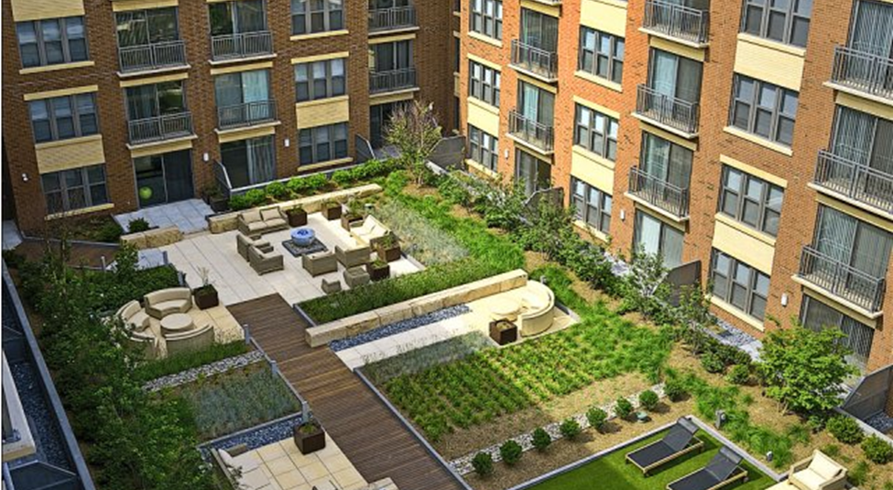

Slide 21
References
Deltas Sponsor Housing Project. (1979). Camp, P. https://www.washingtonpost.com/archive/local/1979/11/22/deltas-sponsor-housing-project/6f2e4589-01cd-4581-8b3a-3d879eab7b8e/
Delta Sisters Try Again For Second Senior Building on H Street NE.(2012). DePillis, L. https://www.washingtoncitypaper.com/news/housing-complex/blog/13122826/delta-sisters-try-again-for-second-senior-building-on-h-street-ne
Delta Sigma Theta offers affordable apartments for senior housing in the northeast area of Washington, D.C. https://wikivisually.com/wiki/Delta_Sigma_Theta
Fortitude at Delta Towers Breaks Ground to Provide Affordable Housing for Seniors. Mayor Bowser Announces Record $167.6 Million Investment in Affordable Housing in DC https://www.dantespartners.com/delta-towers-breaks-ground/
Record $167.6 Million Investment in Affordable Housing. https://www.youtube.com/watch?v=mfDSkt0dqAs
Groundbreaking. https://dhcd.dc.gov/event/groundbreaking-delta-towers
Mayor Bowser Opens Fortitude at Delta Towers, Affordable Housing Community for Senior Residents in Ward 5 (2020). Mayor Bowser Opens Fortitude at Delta Towers, Affordable Housing Community for Senior Residents in Ward 5 | mayormb (dc.gov)

Slide 22
Thank you for listening.
That Completes My Report.

