Slide 1
Heritage Moment
Delta Sigma Theta Sorority, Inc.
Murrieta-Temecula Area Alumnae Chapter
Patricia P Watson, Ed.D.- Chair
Manerva Hart DDS, Co-Chair
December 8, 2020

Slide 2
Once upon a time our Delta language was different…
Pledge – A young woman seeking membership (Initiate)
Dean of Pledges (DP) – Person who oversees the membership intake process. (LMC)
Hell Week (aka Probation)- The final week of pledging culminating in initiation
Anchor: The last person in a new member pledge line (Caboose)
Neophyte (NEO): A new member of an organization who has completed the new member process.
Prophyte: someone who has initiated new members.

Slide 3
Outdated terminologies…
Ship – Individuals who are members of the same intake class. (Line Sisters, Sands)
Head knocker- The Line President, Number 1, Captain
Pledge Mother- a special mentor who saw you through the initiation
DePledge- to terminate an initiation into the sorority
Hazing- any action taken or situation created, during an initiation meant to produce mental or physical discomfort, embarrassment, harassment, or ridicule. Hazing is both PROHIBITED and UNLAWFUL

Slide 4
Outdated terminologies…
Social Probation- A time when Pledges were not allowed to talk to anyone other than the Big Sisters or line sisters
Delta Ducks- stuffed ducks that Pledges were required to carry during the entire pledge period.
Duck Walk- a short squatty walk intended to mimic a duck
Teekee- a large wooden necklace made with Greek letters similar to a lavaliere.

Slide 5
This next one might surprise you….
Sisterly thanks to Soror Morrell at NSDCAC for sharing this info with me to include in this presentation…

Slide 6
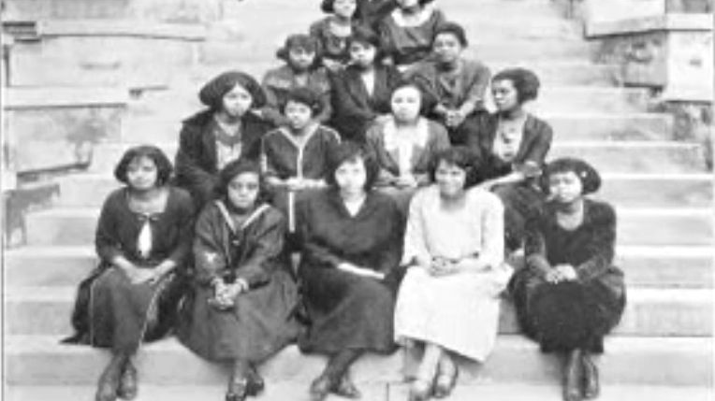
Once upon a time, Delta initiates were called “Barbarian,” “Barbie,”or “Barb.

Slide 7
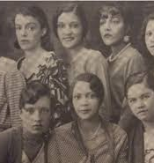
BARBARIANS
While the uniform dress that developed as a part of the pledge process for Black Greeks was generally in good taste, the use of derogatory names was a significant part of probation and pledging. As early as 1925 at Wilberforce University, Sigma Gamma Rho and Delta Sigma Theta Sororities called their initiates “Barbarians”. The Delta Sigma Theta description was more informative as on the page listing the chapter’s social calendar, they discussed the nine “Barbarians”, indicating a pledge line of 9 women.

Slide 8
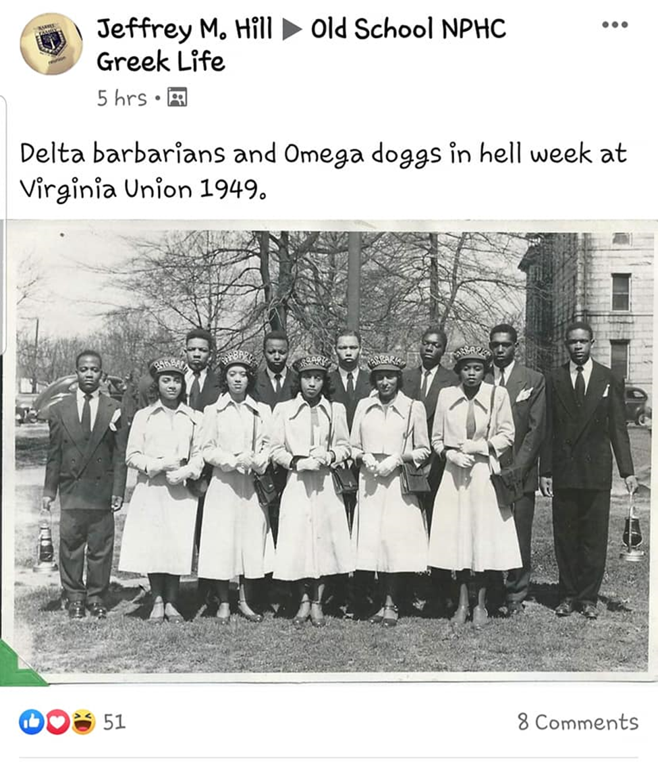

Slide 9
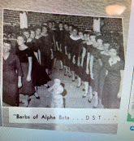
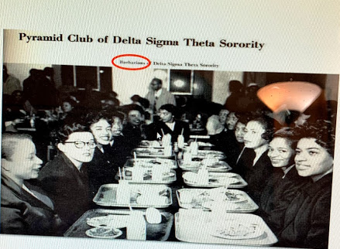
Barbarians

Slide 10
Everyone did it!
At Tennessee State, in 1955, the term “dog” was applied to pledges of Phi Beta Sigma, Alpha Phi Alpha and Omega Psi Phi. In the late 1950’s, Alpha Kappa Alpha pledges were called ‘worms’ and for a while “plugs”. By 1961 at Howard, Alpha Phi Alpha pledges were called “Apes”.

Slide 11
Why is this important?
These terms, titles and actions are past practices. Whether they seemed good or bad at the time, it teaches us about CHANGE. Change makes us more flexible, more understanding and prepares us for the future. Change encourages progress and give us the experience and drive to push forward.
Measuring change offers us a more complete picture of how we are developing, and that will help us make better choices and create stronger chapters.
Even small changes can make us look at others and oneself differently and change the way we see others.

Slide 12
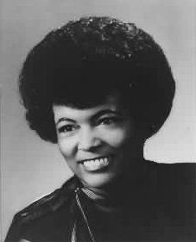
These words will NEVER be outdated
When I look at you, I see myself
If my eyes are unable to see you as my sister
It is because my OWN vision is blurred.
And if that be so,
It is I who need YOU
Either because I do not understand who you are
My Sister,
Or because I need you
To help me understand who I am
Lillian Benbow 15th National President

Slide 13
THANK YOU FOR LISTENING

Slide 14
REFERENCES
Brown,T., Parks,G., Phillips, C. (2010). African American Fraternities and Sororities: The Legacy and the Vision
Black Greek 101: The Culture, Customs, and Challenges of Black Fraternities and Sororities
Greek Vocabulary. Univ of Louisiana. Fraternity & Sorority Life. https://greeklife.louisiana.edu/node/95
Deltasigmatheta.org

