Slide 1

Delta Sigma Theta Sorority, Inc
MTAAC
Heritage and Archives Presentation
Patricia P Watson, Ed.D. Chair​
Manerva Hart D.D.S.
Marsha Edmonds Co-Chair Heritage & Archives​
Nov 30, 2021

Slide 2
Heritage Moment….
The month of November pays tribute to
Soror Dorothy Irene Height
10th National President
Delta Sigma Theta Sorority, Inc.

Slide 3
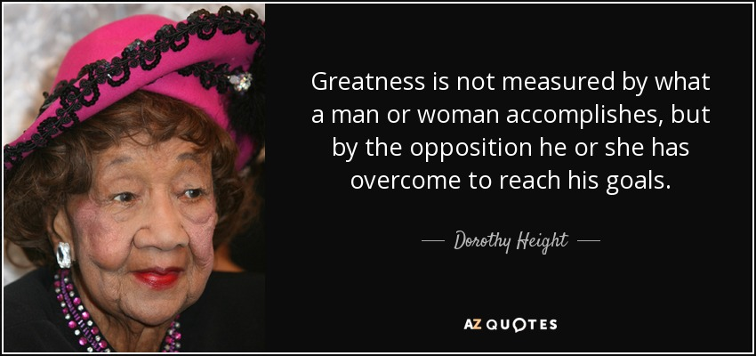

Slide 4
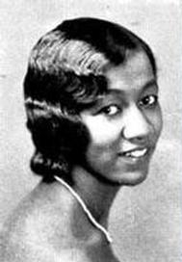
Early Years….
We’ve got to work to save our children and do it with full respect for the fact that if we do not, no one else is going to do it.
Dr Dorothy I Height
Born on March 24, 1912, in Richmond, Virginia, the daughter of a building contractor and a nurse, Dorothy Height moved with her family to Rankin, Pennsylvania and attended racially integrated schools.
In high school, Dorothy showed great talent as an orator. She also became socially and politically active, participating in anti-lynching campaigns. Her skills as a speaker took her all the way to a national oratory competition. Winning the event, she was awarded a college scholarship.
Dorothy had applied to and been accepted to Barnard College in New York, but as the start of school neared, the college changed its mind about her admittance, telling her that they had already met their quota for Black students --(2)! Undeterred, she applied to New York University, where she would earn two degrees: a bachelor's degree in 1930 and a master's degree in Educational Psychology.

Slide 5
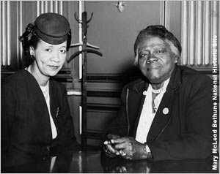
National Council of Negro Women
After working for a time as a social worker, Dorothy Height joined the staff of the Harlem YWCA in 1937 and had a life-changing encounter shortly thereafter. She met educator and founder of the National Council of Negro Women, Mary McLeod Bethune during a facility visit by First Lady, Eleanor Roosevelt. Soror Height later volunteered with the NCNW and became close to Soror Bethune who ultimately became her mentor.

Slide 6
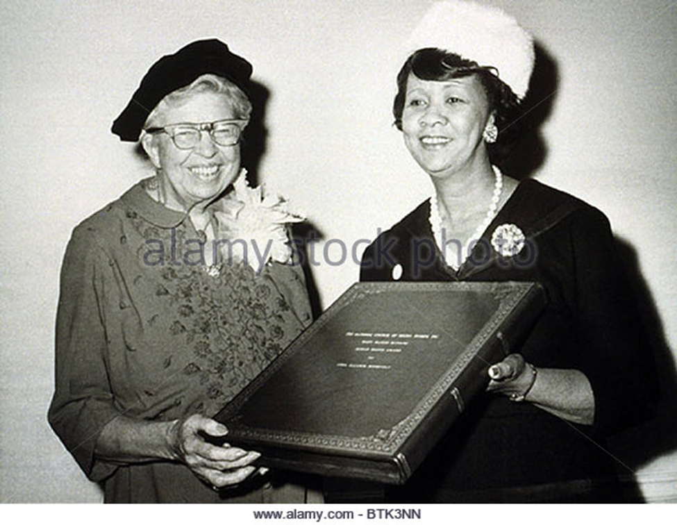
Eleanor Roosevelt (1884-1962), an early advocate of African American civil rights,
receives an award from Dr Dorothy I Height

Slide 7

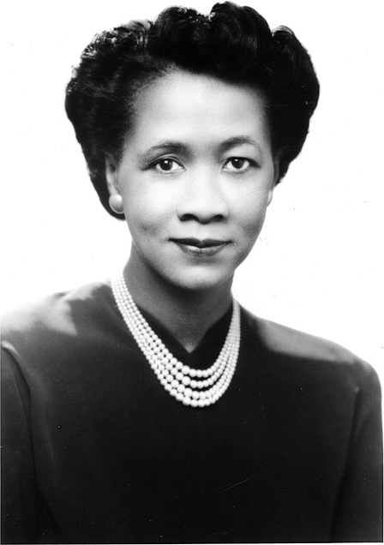
Blazing a Trail…
During her tenure with NCNW, Soror Height secured non-profit tax-exempt status enabling her to win grants from the Agency for International Development, Department of Health, Education & Welfare and the Ford Foundation to expand staff and develop programs for youth and women. In 1986, she launched the Annual Black Family Reunion Celebration to emphasize positive images of the strength and resilience of the African-American family. NCNW continues to advocate for African Americans, pushes for early childhood literacy programs and has partnered with NASA to develop community learning centers in minority and low income areas.

Slide 8
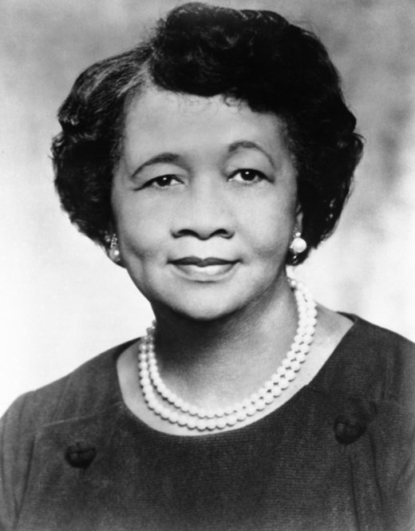
Delta Sigma Theta, Inc. …
Dorothy Height was initiated into Delta Sigma Theta Sorority in 1939 through Rho Chapter at Columbia University. During her tenure as 10th National President, she oversaw the purchase of the Sorority’s first National Headquarters building and helped to expand the organization’s social activism in the United States and abroad.
She was involved in hiring the organization’s first executive director, The Honorable Patricia Roberts Harris. Soror Height also developed leadership training programs as well as interracial and ecumenical educational programs for members of Delta Sigma Theta and other organizations and institutions throughout the United States.

Slide 9
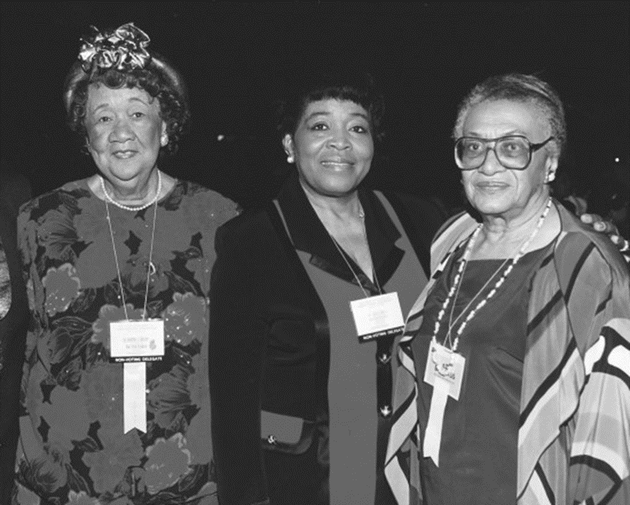
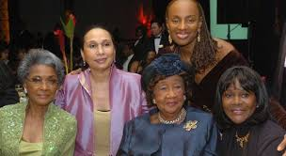
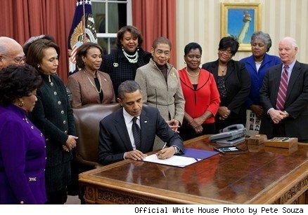
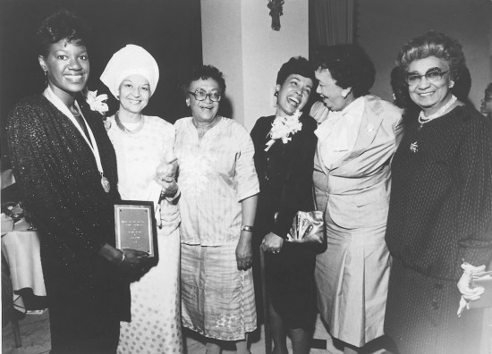
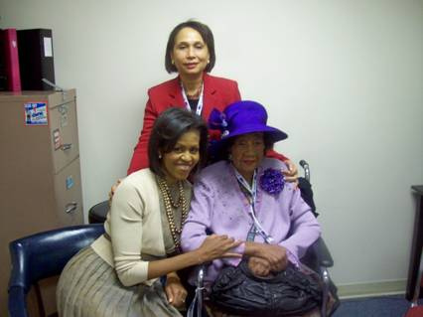
Greatness is not measured by what a man or woman
accomplishes, but by the opposition he or she has overcome
to reach his goals
Dorothy I. Height
Delta Sigma Theta national convention in St. Louis, 1994. Left to right: Sorors Dorothy I Height, Betty Shabazz, and Frankie Freeman
Nancy Wilson (left), Alexis Herman
and Cicely Tyson and Susan Taylor
President Barack Obama signed H.R. 6118, the “Dorothy Height Bill” in the Oval Office, Dec. 15, 2010, in front of members of Congress, former Cabinet member Alexis Herman, and members of Delta Sigma Theta Sorority, Inc. The bill designates the facility of the United States Postal Service located in Washington, D.C., as the “Dorothy I. Height Post Office.”
Delta Sigma Theta event in Chicago, late 1970s.
Left to right: Lady Carter, Frankie Freeman, Hortense Canady, Dorothy Height, Etta Moten Barnett.
FLOTUS, Secretary Alexis Herman
And Dr Dorothy Height

Slide 10

Fortitude
Courage in
pain or adversity
Synonyms
Determination, courage, bravery, endurance, resilience, mettle,
moral fiber, strength of character strongmindedness, backbone, , spirit Steadfastness
true grit, guts

Slide 11

Civil Rights Advocate…
During the 1960s Civil Rights Movement, Soror Height organized "Wednesdays in Mississippi, "which brought together Black and White women from the North and South to create a dialogue of understanding. Soror Height was also a founding member of The Council for United Civil Rights Leadership. In his autobiography, civil rights leader James Farmer described Dr. Height as one of the "Big Six" of the Civil Rights Movement, but noted that her role was frequently ignored by the press due to sexism.
No one will do for you what you need to do for yourself. We cannot afford to be separate. We have to see that all of us are in the same boat…Dr Dorothy I Height

Slide 12
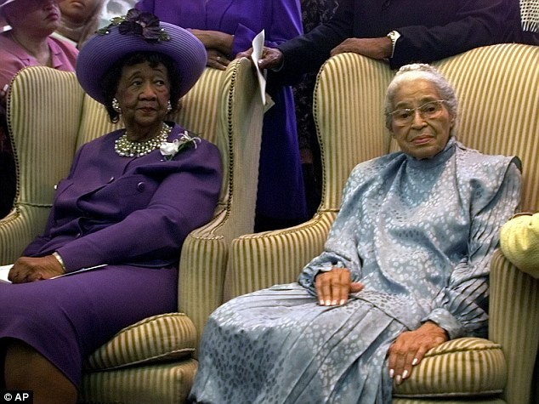
Mothers of the Civil Rights Movement
Dr. Height was a key figure throughout the Civil Rights Movement. She was the female team leader among the six leaders of the civil rights movement which included Dr. Martin Luther King, Jr. At the 1963 March on Washington, Dr. Height was on the platform when Dr. King delivered his famous "I Have a Dream" speech after convincing the leadership to allow the young preacher to speak last and for more than five minutes. During the civil rights era, Dr. Height led NCNW to deal with unmet needs of women and their families by combating hunger and establishing decent housing and home ownership programs through the federal government for low-income families. In 1971, she helped found the National Women's Political Caucus with Gloria Steinem, Betty Friedan and Shirley Chisholm.

Slide 13
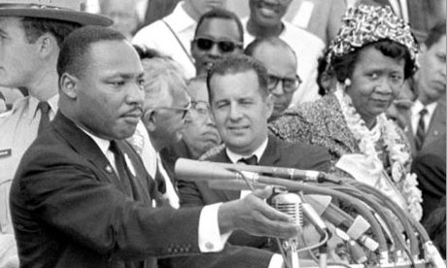
March on Washington
Dr Height stood close to Dr Martin Luther King Jr. when he delivered his "I Have a Dream" speech. However, despite her skills as a speaker and a leader, she was not invited to speak on that day. Soror Height later wrote that the March on Washington event had been an eye-opening experience for her. Her male counterparts "were happy to include women in the human family, but there was no question as to who headed the household," she said, according to the Los Angeles Times.

Slide 14
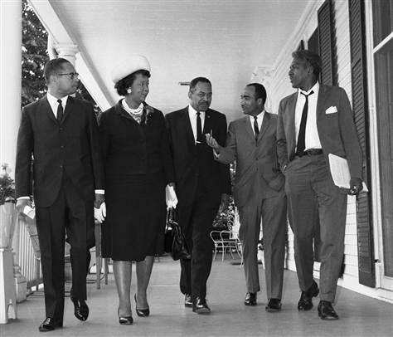
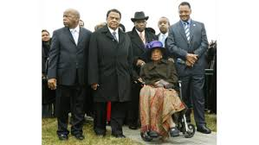
“More is accomplished together than one can do alone..”
(Peggy Lewis, at the Dorothy I Height stamp unveiling ceremony, 2017)
Dr. Height accompanied by Congressman John Lewis, Ambassador Andrew Young and Rev. Jesse Jackson
Left to right, Morris Dosewell, American Labor Council; Dorothy I. Height, President, National Council of Negro Women; Alexander Allen, Urban League; Basil Paterson, NAACP and Bayard Rustin, Director of the Philips Randolph Institute walk together after a meeting with Mayor Wagner in New York on June 4, 1965.

Slide 15
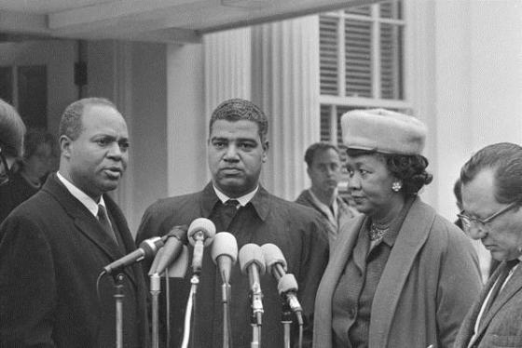
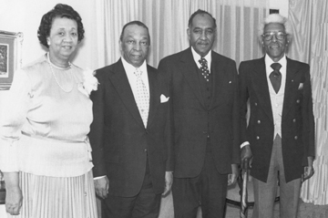
Left to right: President of the National Council of Negro Women Dorothy I. Height, former D.C. Mayor Walter Washington, former Maryland State Senator Clarence Mitchell and Bayard Rustin. (1978)
James Farmer, National Director of the Congress of Racial Equality; Whitney M. Young, Jr., Executive Director of the National Urban League; Dr. Dorothy I Height; President of the National Council of Negro Women

Slide 16
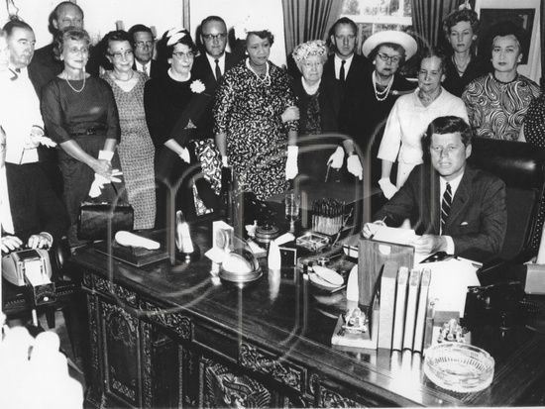
Dr. Height witnesses President John F. Kennedy sign the Equal Pay Act on June 10, 1963 in a ceremony at the White House. The bill was aimed at assuring women of paychecks equal to those of men doing the same work.

Slide 17
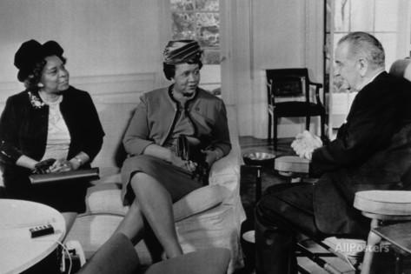
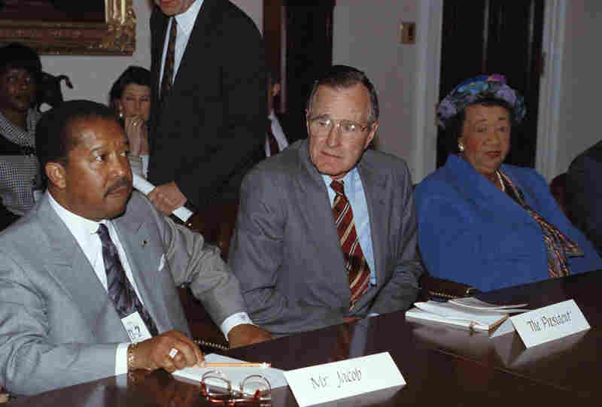
American leaders regularly took her counsel including First Lady Eleanor Roosevelt. Dr. Height encouraged President Dwight D. Eisenhower to desegregate schools and President Lyndon B. Johnson to appoint African-American women to positions in government. In the mid-1960s, she wrote a column called "A Woman's Word" for the weekly African-American newspaper the New York Amsterdam News, and her first column appeared in the issue of March 20, 1965, on page 8.
President George H. Bush meets with Dr. Dorothy I. Height and John Jacob of the Urban League
Dr. Dorothy I Height and Rosa Gragg,
President of the National Association of Colored Women's Clubs, meet with POTUS Lyndon B Johnson December 1963

Slide 18
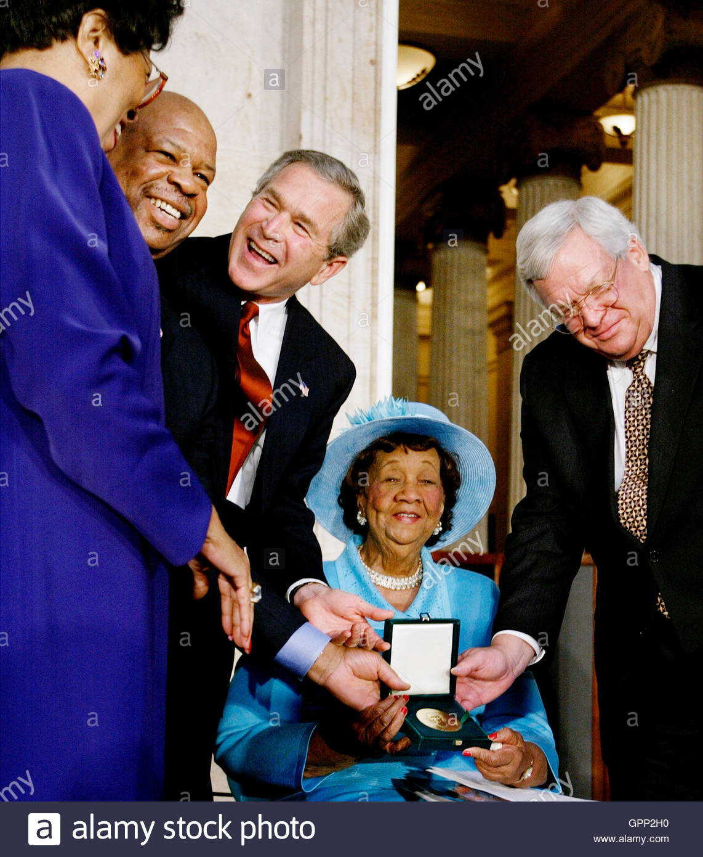
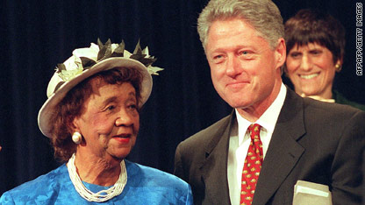
“Dorothy Height is one of the world's most tireless and accomplished advocates of civil rights, the rights of women, and the health and stability of family and community life. From the days when she helped Eleanor Roosevelt to organize the World Youth Conference in 1938, she has remained engaged in the public arena for 60 years and more. As a leader of the National Council of Negro Women and the Young Women's Christian Association, she's been a powerful voice for equal opportunity here and in developing nations around the world. In recent years, her Black Family Reunion celebrations have reminded our society that self-help and self-reliance within loving extended families are the dominant cultural traditions of the African-American community”.
Remarks upon presenting the Medal of Freedom, 1994
William J. Clinton 42nd President of the United States
President Bush gestures next to Dorothy Height during the presentation ceremony of the Congressional Gold Medal honoring Dr Height in the Capital Rotunda inside the U.S. Capitol on March 24, 2004. Also pictured U.S. Representative Diane Watson (L), Representative Elijah Cummings (2nd L), & Speaker of the House Dennis Hastert (R).

Slide 19
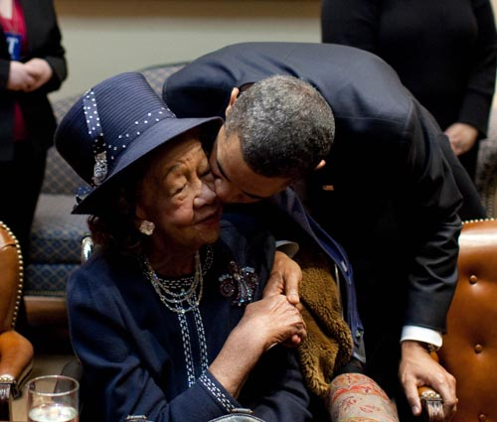
Dr. Dorothy Height, during a January intergenerational reflection on the civil rights movement at the White House. She recounts her memories of meeting one 15 year-old Martin Luther King, Jr.
President Obama and “the godmother of the Civil Rights Movement,”

Slide 20
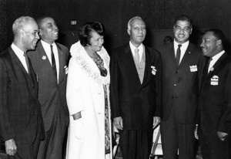
“Divine-ish”…
Roy Wilkins-Omega Psi Phi Fraternity
Floyd McKissick- Alpha Phi Alpha Fraternity
Dorothy I. Height-Delta Sigma Theta Sorority
Philip Randolph-Phi Beta Sigma Fraternity
Whitney Young-Alpha Phi Alpha Fraternity
Dr. Martin Luther King-Alpha Phi Alpha Fraternity

Slide 21
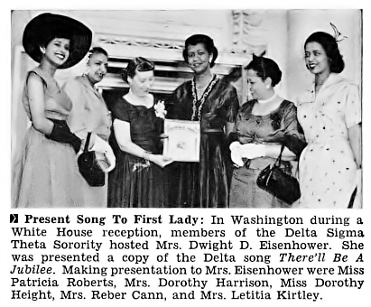
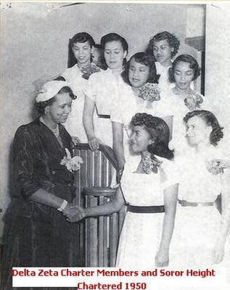
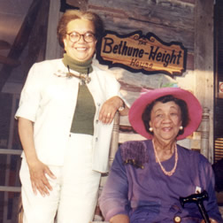
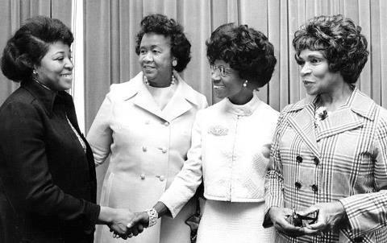
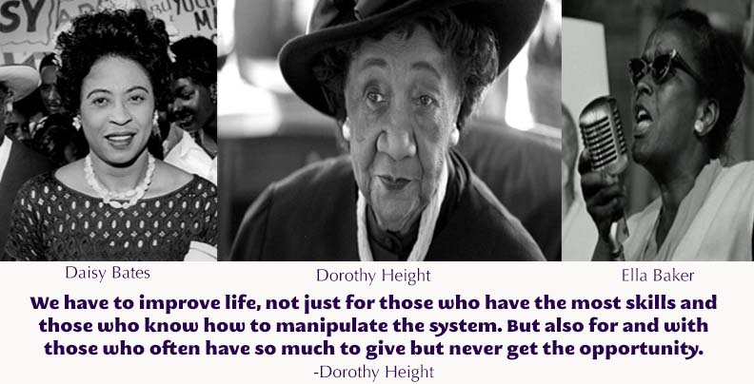
Marian Wright Edelman
Children’s Defense Fund
Left to right: Dr. Betty Shabazz, Dorothy Height, Shirley Chisholm, and Marian Anderson (Photo by Hal Mathewson/NY Daily News Archive via Getty Images)
Daisy Bates, Dr. Height & Ella Baker

Slide 22
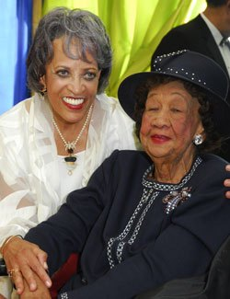
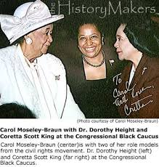
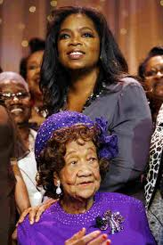
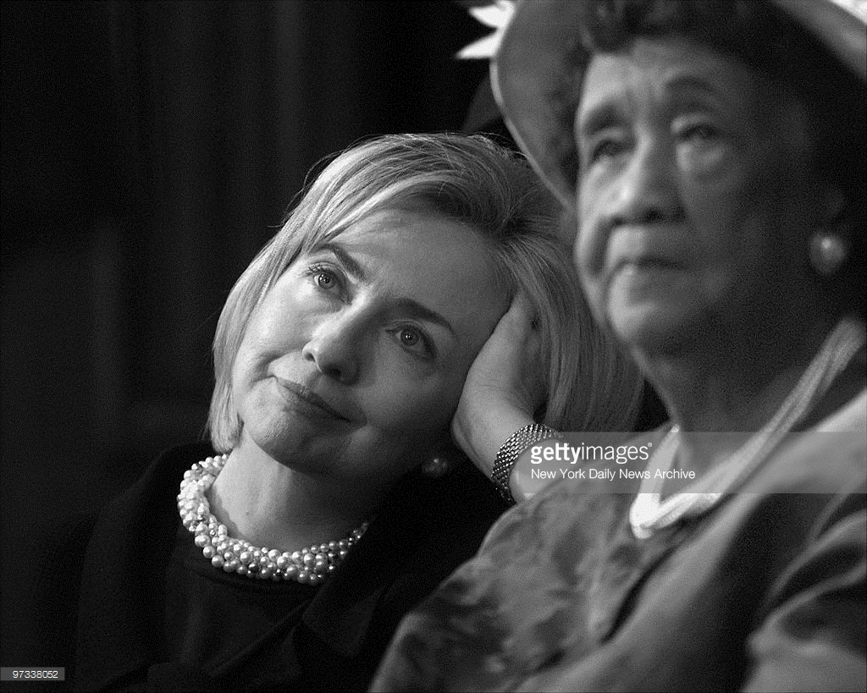
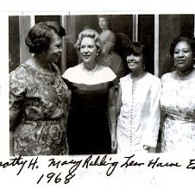
Dr. Johnnetta Cole & Dr. Height
Dr. Height, Senator Carol Mosley Braun
& and Coretta Scott King
Dr. Height & Oprah Winfrey
Dr. Height & Secretary Hillary R Clinton
Dorothy Height with Lena Horne and Edith Savage

Slide 23
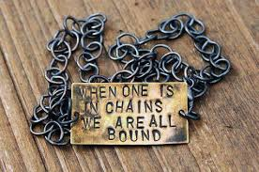
“Women’s Rights & Civil Rights are indivisible….”
Soror Height was known for her unyielding commitment to women and family life, her strong hand and voice for civil and human rights. She was a teller of history, fortune and ancestry. She pushed for action on many fronts, including education, jobs, health care and self-reliance. She was the woman warrior who stood among the men of the civil rights movement. She wore MANY hats….literally!

Slide 24
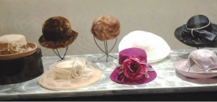
Soror Height was Woman of Many Hats
The hat represents authority, power and dignity and because it covers the head; thought. Different hats signify different social situations. Soror Height’s manner of dress combined business, politics and theater. She often had to debate significant issues and dressed in a manner that seemed to convey the seriousness of the matter. Her suits represented the conservative cuts of Capitol Hill and Wall Street with the ornamentation and color that captivated her audience before she even began speaking. ….And she wore her hats -- church lady hats -- that spoke of her zeal and devotion…

Slide 25
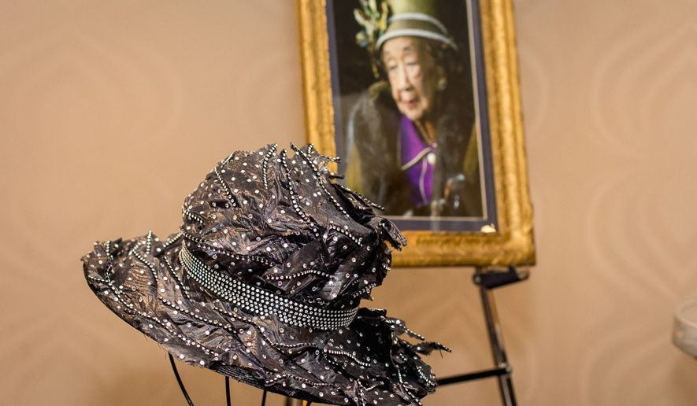
Smithsonian Exhibit Honors Dr Dorothy I Height

Slide 26
A Life… Well Done….
Never married…..Had no children… yet, mother to an entire nation….
Served on a number of committees, including as a consultant on African affairs to the Secretary of State, the President's Committee on the Employment of the Handicapped, and the President's Committee on the Status of Women. In 1974, she was named to the National Commission for the Protection of Human Subjects of Biomedical and Behavioral Research, which published the Belmont Report, a response to the infamous "Tuskegee Syphilis Study" and an international ethical touchstone for researchers.
President Ronald Reagan presented her the Citizens Medal Award for distinguished service to the country in 1989.
Other honors include the Presidential Medal of Freedom (1994),the Congressional Gold Medal (2004), the NAACP's Spingarn Medal and 36 honorary degrees
On December 15, 2010, President Barack Obama signed the “Dorothy Height Bill” that designates the United States Postal Service, located at 2 Massachusetts Avenue, NE, Washington, DC, as the Dorothy I. Height Post Office.

Slide 27
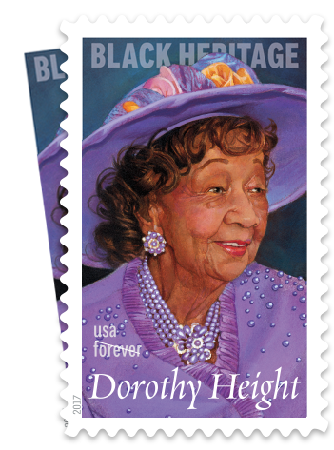
Black Heritage Series
On February 1, 2017, Dr. Dorothy I Height became the 40th addition and the 15th woman recognized with the United States commemorative heritage postage stamp.
The Black Heritage Series features other African American pioneers and activists including Harriet Tubman, W.E.B. Du Bois, Thurgood Marshall, and Martin Luther King, Jr.
"The Postal Service is proud to honor civil rights icon Dorothy Height, an American treasure, whose illustrious career spanned almost a century," said Ronald Stroman, Deputy Postmaster General and Chief Government Relations Officer, who dedicated the stamp.

Slide 28
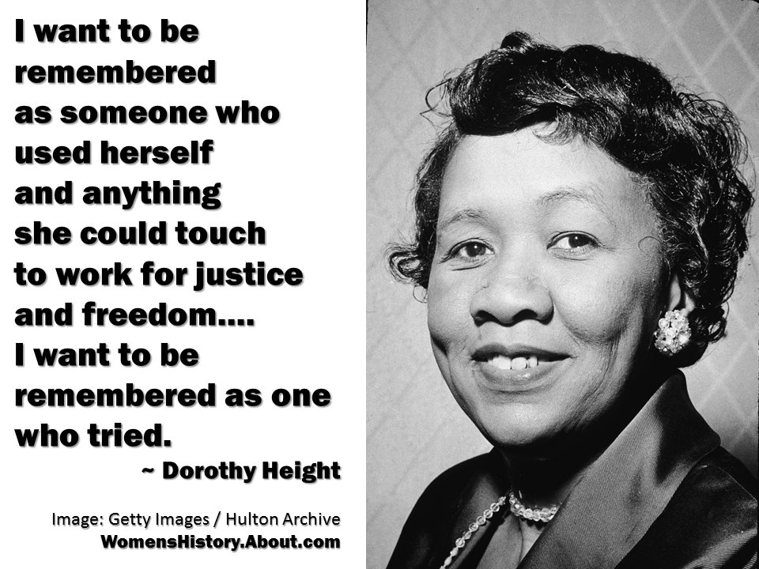

Slide 29
She will always
be our Delta Girl!
The Delta girl is one who has been given the opportunity of education and broad development: she is one who has enjoyed the privileges of culture and selected environment.
It is pleasing to a heartfelt depth to see her not as self-centered, not desirous of selfish power, not wanting the plaudits of people, not wanting glory- but with a purpose which directs her activities and all that she may control toward lifting somebody else.
Mary McLeod Bethune
Soror Dr Dorothy Irene Height
We will always remember her contribution to our treasured history!

Slide 30

References
Britannica. Dorothy I Height. https://www.britannica.com/biography/Dorothy-Height
Giddings, P. (1988). In Search of Sisterhood
Height, D. http://www.biography.com/people/dorothy-height-
Height, D. (2003). Open Wide the Freedom Gates
Legacy: Dorothy I Height http://www.legacy.com/obituaries/washingtonpost/obituary.
National Black Family Reunion. https://en.wikipedia.org/wiki/National_Black_Family_Reunion
National Council of Negro Women, Inc. http://ncnw-pgcounty.org/president-emerita/
Richardson, C, M; Liker, R.E. (2014). Historical Dictionary of the Civil Rights Movement
Ross, L.C Jr. (2000). The Divine Nine. The History of African American Fraternities and Sororities
Simmons, D. (2015). The Washington Times

