Slide 1
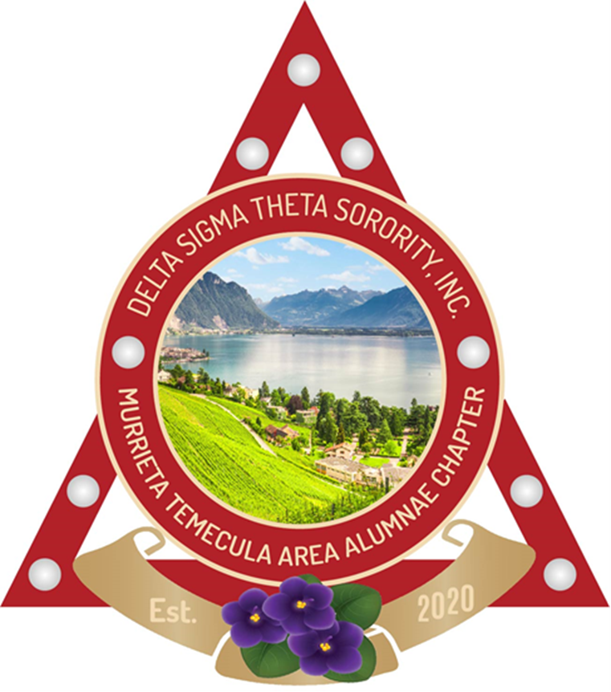
Delta Sigma Theta Sorority, Inc.
Heritage Moments
Patricia P Watson Ed.D. Chair
Manerva Hart D.D.S., Co-Chair
Marsha Edmonds
October 26, 2021

Slide 2

The month of October celebrates
Honorary Sorors:
Alice Moore Dunbar Nelson
and
Florence Cole Talbert-McCleave
Who wrote the words and composed the music to the
Delta Hymn

Slide 3
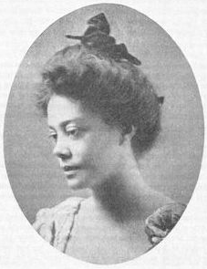
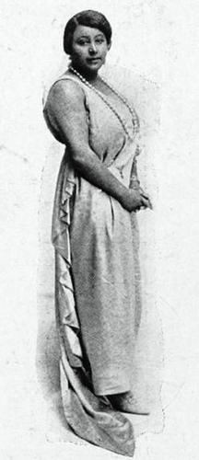
Alice Moore
Dunbar Nelson
Florence Cole
Talbert-Mc Cleave

Slide 4
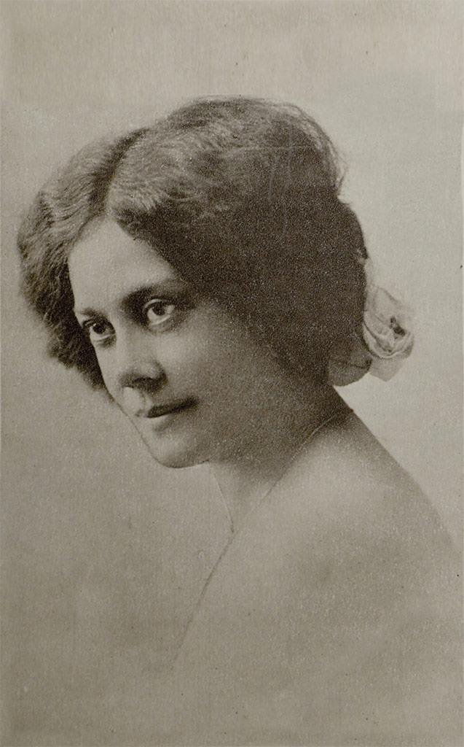
Alice Dunbar Nelson
Alice Moore was born on July 19, 1875, in New Orleans, Louisiana. She attended public school in New Orleans and enrolled in a teacher's training program at Straight University (later merged into Dillard University) in 1890. Upon receiving her degree in 1892, she began teaching in New Orleans.
In 1897, Alice moved to Brooklyn, New York, and began corresponding with the poet Paul Laurence Dunbar. On March 8, 1898, they married and moved to Washington, D.C. The marriage lasted until 1906 when Dunbar died although they had been legally separated since 1902.
Following her separation from Dunbar, Alice moved to Wilmington, Delaware and took a position as a teacher and administrator until 1920.

Slide 5
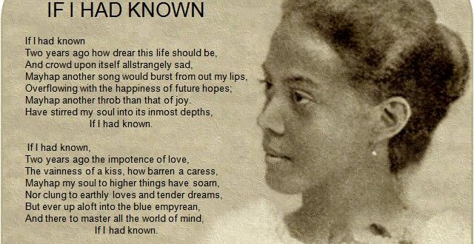
Soror Alice Dunbar Nelson

Slide 6
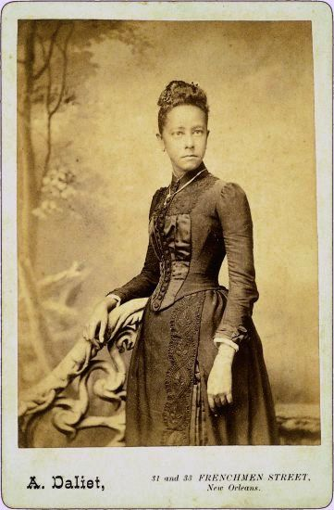
Alice Dunbar Nelson Activist
Soror Nelson was active in Delaware and regional politics, as well as in the emerging civil rights and women's suffrage movements. In 1915, she was a field organizer for the Middle Atlantic States in the campaign for women's suffrage. During WW1, she served as a field representative of the Woman's Committee of the Council of National Defense. Later, she served on the State Republican Committee of Delaware and helped direct political activities among Black women. From 1928-1931, she was executive secretary of the American Friends Inter-Racial Peace Committee.
From 1920-1922, Alice Dunbar-Nelson, with then husband Robert Nelson, was co-editor and publisher of the Wilmington Advocate, a progressive Black newspaper. From this period on, Soror Dunbar-Nelson maintained an active career as a journalist. She was a highly successful syndicated columnist and wrote numerous reviews and essays for newspapers, magazines, and academic journals.
Alice Dunbar Nelson was an Honorary Member of Delta
Sigma Theta in 1918 and wrote the WORDS to our
National Hymn.

Slide 7
Florence Cole
Florence Cole was born on June 17, 1890, in Detroit, Michigan to
Sadie and Thomas Cole. Her mother, a mezzo soprano with the
Fisk Jubilee Singers and civil rights activist, and her father, a
basso and well-known dramatic reader, ensured their daughter
had a musical upbringing, and Florence began her musical
training at the age of six as a pianist. At age eight, the family
moved to Los Angeles, California, and by twelve, Florence was
an accompanist at her mother's concerts.
Florence was the first black student to attend the Los Angeles High
School, and there she studied music history and modern languages.
Although acclaimed in school for her skills at the piano, Florence
decided to become a singer after watching a production of Aïda at
the age of fifteen. She immediately joined her school's Glee Club
(the first black soloist to do so), and began vocal training under
globally renowned singer Gloria Mayne Windsor. By age sixteen,
Florence was performing vocal concert alongside many prominent
singers. When graduation time rolled around; Florence Cole became
the first black student to participate in a high school commencement
program in L. A. when she was selected as the soloist for the
commencement.

Slide 8
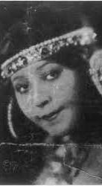
Florence Cole Talbert
Florence Cole Talbert McCleave was known
As the First Lady of the Grand Opera by the
National Negro Opera Guild. She was a
Pioneer for singers of color, a world
-renowned opera icon, and the inspiration
for the McCleave Project at Opera Memphis.
Recently inducted into the Memphis Music
Hall of Fame in 2019, Soror McCleave’s
legacy continues to receive Accolades and
recognition for her incomparable
singing talents and community initiatives to
open doors for musicians and singers of
color.

Slide 9
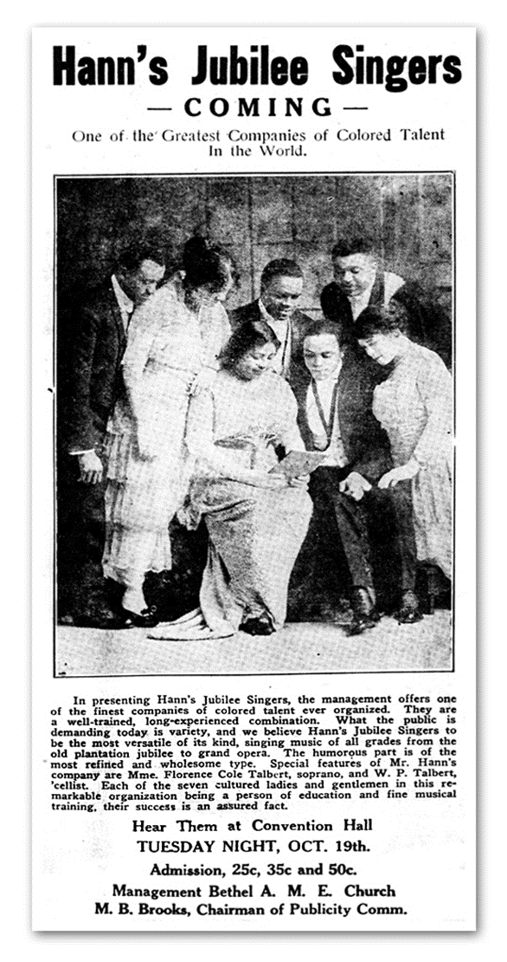
Florence began her college education at the University of
Southern California College of Music, but left during her
Senior year to tour with Hahn's Jubilee Singers across the
United States and Canada. She married her first husband,
Wendall P. Talbert, a pianist, and later separated from him
at the end of 1915, keeping his last name for professional
purposes. In 1916, Florence left the Jubilee Singers and
moved to Chicago, IL where she attended the Chicago
Musical College and became the first black student to
appear in the school's programs.
After only one year, she completed her music education
(which typically takes four years), and at graduation was
awarded the highest honor, the Diamond Medal, "for
outstanding achievement in vocal studies and for
the highest average in her graduating class."

Slide 10

Florence Cole Talbert became an
Honorary Member of Delta Sigma Theta in 1915 and composed the MUSIC to our National Hymn.

Slide 11
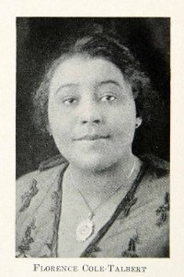
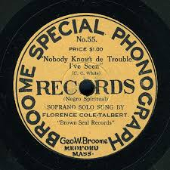
Talbert’s soloist career took off, and Florence toured across the United States from 1918 to 1925 appearing in concerts nationwide. During this time, she began her recording career, first with George Broome's Broome Special Phonograph, then with Black Swan Records, "the earliest major label to be owned and operated by African Americans," and finally with Paramount Records. Her vocals included spirituals, modern compositions, and classic operatic arias.

Slide 12
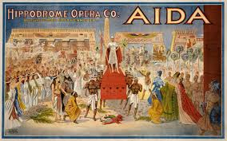
Soror Florence Cole Talbert-McCleave
From 1925 to 1927, Florence left the States to study music in Italy and France and continued her touring career across Europe. Although already renowned for her exquisite voice, Florence Cole Talbert's arguably biggest breakthrough came in March 1927 when she appeared in the titular role of Giuseppe Verdi's Aïda - the first African American woman to do so alongside an all-white professional company.
She received critical acclaim in Paris, London, and Rome, an invitation to join the
Facista Group of Lyric Artists, and a five-year contract to sing as Aida in the opera.
She turned down the contract, saying she needed to return to the U.S. with her
mother, but not before doing a few more concerts in Rome, Southern Italy, and Paris.

Slide 13

One of her most popular performances was the lead in the opera, Lakme’.
Lakmé is a tragic opera set in the Orient. It tells a story about tragic love between the daughter of a Hindu priest and a British military officer during the British Raj in India in the 19th century, this type of relationship was forbidden in colonial India, and her father wasn’t happy with it. The story ends with the officer falling out of love and going back to swear duty to his job, and with Lakme killing herself with poison. The Bell song is its most famous aria.
he opera's most famous aria is the "Bell Song" ("L'Air des clochettes") in act 2.

Slide 14

Black Swan-Lakme: Bell Song
Florence Cole Talbert

Slide 15
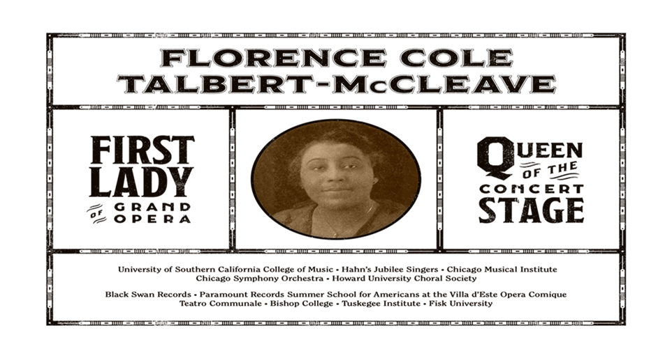
1927 saw the continuation of Florence's successful concert tours, but due to the pervading racism in the U.S. she found far fewer opportunities in opera compared to her time in Europe.
She did not let this stop her, though, and she began taking on students to mentor. When she was on tour in Tennessee, she met her second husband, Benjamin F. McCleave, and in 1930 the two were married. It was after her marriage that Soror McCleave decided to stop touring and focus on teaching. She became the first black director of music at Bishop College in Marshall, Texas. Then she headed the voice department at the Tuskegee Institute and the Fisk University. She and her husband ultimately settled down in Memphis, Tennessee and Florence opened her own studio to give private lessons to students.

Slide 16
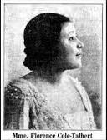
Florence Cole Talbert
She would later join the Memphis Alumnae Chapter
in 1935 and serve as one of the founding inspirations
for the Arts and Letter Award given yearly by this
Chapter to an individual who exemplifies excellence
in fine and creative arts.
Florence Talbert organized the Memphis Music
Association, wrote articles for the Tri-State
Defender and was one of the first African
American women to record commercially. She
was an active member in the National
Association of Negro Musicians (NANM) and
the Memphis Music Association.

Slide 17
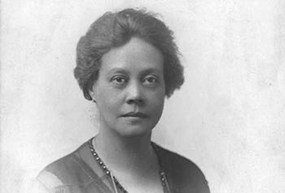
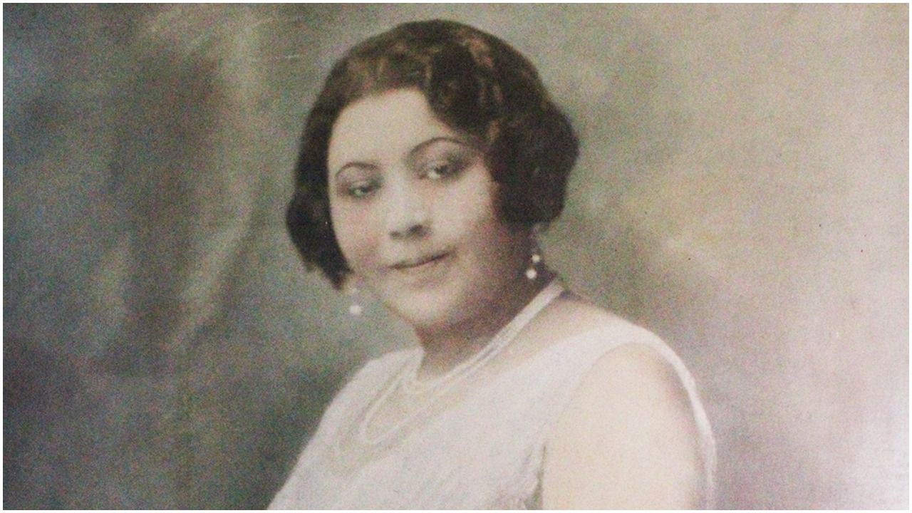
Sorors Dunbar-Nelson and Talbert-Mc Cleave gave Delta the everlasting gift of music and verse.
We will always remember their contribution to our treasured history.

Slide 18
References
University of Delaware Library http://www.lib.udel.edu/ud/spec/findaids/dunbarne.html
Giddings, P. (1988) In Search of Sisterhood. Delta Sigma Theta and the Black Sorority Movement
Ross, L. C. Jr.(2000). The Divine Nine. The History of African American Fraternities and Sororities
Deltasigmatheta.org
https://en.wikipedia.org/wiki/FlorenceColeTalbert
https://en.wikipedia.org/wiki/AliceDunbar Nelson
Marable,M., Frazier, N; McMillian, J.C. (2013) Freedom on My Mind: The Columbia Documentary History of the African American Experience Columbia University Press
First Lady od Grand Opera: Madame McCleave. Opera Memphis. (2019)

