Slide 1
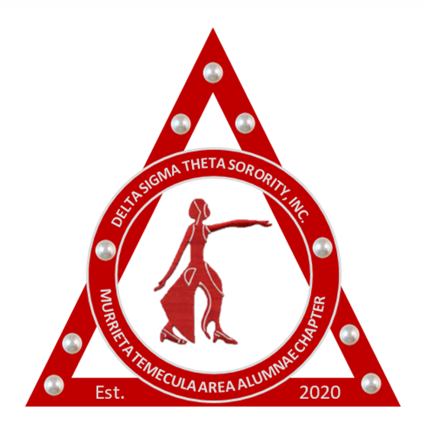
Delta Sigma Theta Sorority Incorporated
Murrieta-Temecula Area Alumnae Chapter
Heritage Moments
Patricia P Watson Ed.D. Chair
Manerva Hart, DDS. Co-Chair
September 8, 2020

Slide 2

Mission Statement
The National Heritage and Archives Committee, recognizing that Delta Sigma Theta Sorority is the heir of a rich legacy grounded in high scholarship and achievement, seeks to preserve this heritage for generations to follow.
In order to preserve our illustrious history and the high ideals of our Founders, it is essential that we continue to bring a system of uniformity, continuity and structure across the country to chapters in the establishment and development of their local chapter archives.

Slide 3
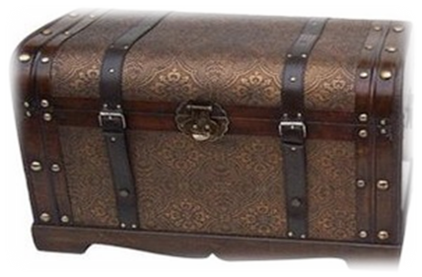
Why Archive Our History?
To:
Provide evidence of chapter history, contributions, and accomplishments.
Document the policies, programs, and activities.
Provide historical perspectives for future generations of Deltas.
Add to the body of knowledge documenting our shared local, regional and national history and experiences.

Slide 4
Role of the
Heritage Archives Committee
      Document chapter history
      Document chapter programs and activities
      Gather, organize, store and preserve records, documents, photos, etc.
      Display and celebrate our chapter history during special events

Slide 5
Heritage Moments
In 2015, all chapters were encouraged to preserve Delta’s glorious history on a monthly basis through a segment titled ‘Heritage Moments”.
Each month the Heritage and Archives Committee will present a PowerPoint presentation that commemorates important moments BY Deltas FOR Deltas and AS Deltas that have impacted the sorority, our nation and the world.
In celebration of the chartering of our chapter, Murrieta-Temecula Area Alumnae Chapter, September’s Heritage Moment celebrates the Founding of our illustrious Sorority, Delta Sigma Theta.

Slide 6


Slide 7

There was change in the air in 1912. African Americans were demanding laws that protected their civil rights, while women were demanding the vote.
Societal changes were beginning to make their way to the Howard University campus, and the 22 undergraduate members of Alpha Kappa Alpha were not immune. They saw themselves as an integral part of the developments swirling around them. They were participating in the fullness of extracurricular life, showing their leadership capabilities in those organizations as well as their respective classes. Madree Penn (White) held positions as class journalist, vice president and treasurer during her tenure at Howard; Bertha Pitts (Campbell) and Winona Cargile (Alexander) were also elected vice president, as was Vashti Turley (Murphy); and Osceola Macarthy (Adams)was elected class secretary one year. True to form, many rose to the top of AKA leadership after they joined.

Slide 8
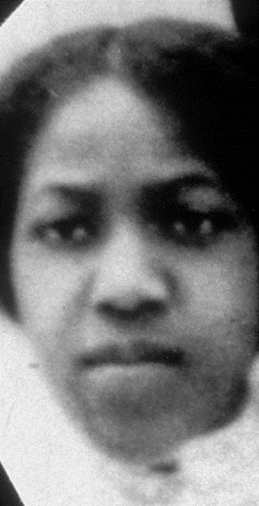
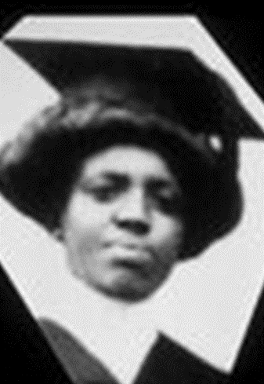

And so it was back in 1912 that Soror Madree Penn (White) went with the idea to Soror Myra Davis (Hemmings), then president of the Alpha Kappa Alpha Sorority at Howard University
asking that the group might consider becoming a chartered sorority and develop plans for incorporating itself under the laws of the land.
Afterwards a meeting of the Alpha Kappa Alpha Sorority was called.

Slide 9
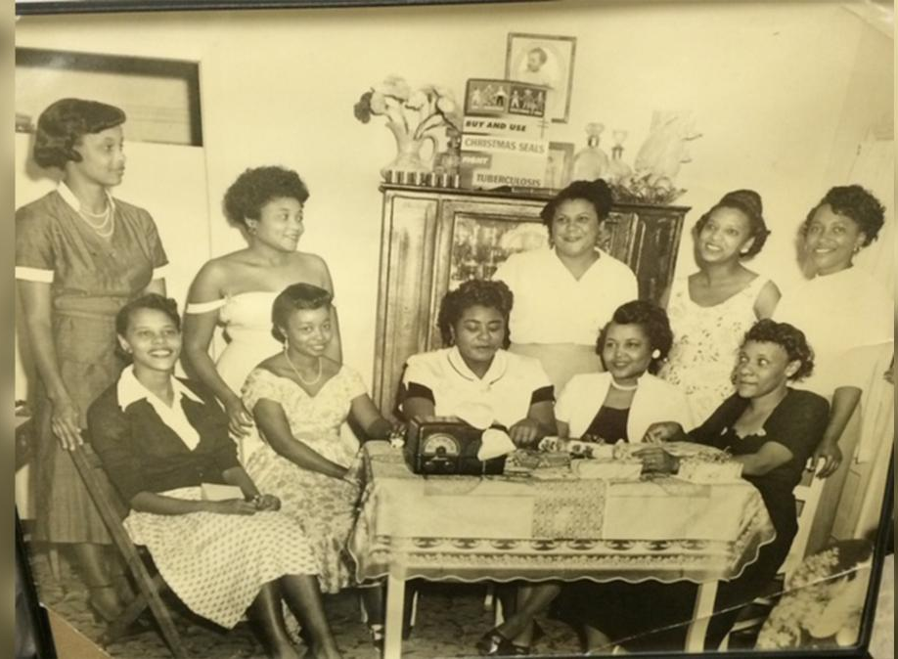
At the meeting, the new initiates, dismayed at the progress of the group, wanted to reorganize the sorority, establish a national organization, enlarge the scope of the sorority’s activities, and change its name to reflect a truer purpose.

Slide 10

The collegiate students wanted to move towards activism and greater public service rather than continue to focus on social activities. According to Delta Sigma Theta’s historian Paula Giddings, the 22 young women were concerned that since Alpha Kappa Alpha was not incorporated, there was NO ‘legal entity”. Since there was no charter, there was no authority to form other chapters thus limiting the ability to enlarge the scope of activity.

Slide 11

After discussing this important change in its status, the members agreed that the sorority should proceed to become a chartered organization on the Howard University campus, then file Articles of Incorporation in the office of the Recorder or Deeds, in the District of Columbia. It was further pointed out that the time was at hand when they should change the name of the organization to one distinctively Greek.

Slide 12

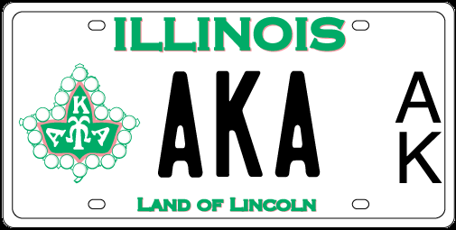
vs
They felt Alpha Kappa Alpha was solely a female derivative of Alpha Phi Alpha with no individual meaning and were not “Greek distinctive” letters. They also wanted to change the symbols, sorority colors and be more politically oriented. In 1912 at Howard University, the 22 undergraduates voted to change the organization’s name to Delta Sigma Theta. This new name was to reflect the group’s desire to change the direction of the group and change the philosophical underpinnings.

Slide 13

Delta = Change
The name Delta Sigma Theta, suggested by a committee headed by Soror Penn, (Delta means Change) seemed especially appropriate for a Greek letter society, and along with a design for a pin, this name was accepted by the undergraduate membership.
It was thus that the name of the first sorority at Howard University was changed from Alpha Kappa Alpha to Delta Sigma Theta. Soror Davis, a senior and President of the Alpha Kappa Alpha Sorority, remained president of both Alpha Kappa Alpha and Delta Sigma Theta Sororities.

Slide 14
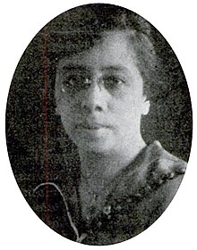
However, one graduate, Nellie M. Quander, present at the re-organization meeting, objected to the change of the name from Alpha Kappa Alpha to Delta Sigma Theta. She hastily contacted other graduate members scattered over the country. Those whom she could reach in Washington, DC and neighboring cities reorganized Alpha Kappa Alpha and declared their determination to hold onto their tradition and to their original name. Quander, along with Minnie Smith, Norma Boyd, Julia Evangeline Brooks, Nellie Pratt Russell and Ethel Jones Mowbray moved to incorporate Alpha Kappa Alpha on January 29, 1913.

Slide 15
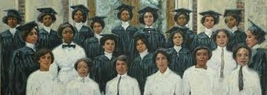
There were twenty-two charter members of Delta Sigma Theta Sorority. Soror Myra Davis (Hemmings) was the first president, serving from the first meeting on January 13, 1913, until late spring when she graduated from Howard University. Soror Madree Penn (White), who conceived the idea of the re-organization, became second president of the Sorority—the Alpha Chapter. The rest is history….

Slide 16
Murrieta Temecula Area Alumnae Chapter Members
We, as members of Delta Sigma Theta Sorority, Incorporated and members of MTAAC stand on the shoulders of our illustrious twenty-two Founders who met in the reception room of Minor Hall at Howard University on January 13, 1913. Their goals were directed toward providing programs and services which promote human welfare. They wanted to use their collective strength to promote academic excellence and to provide assistance to persons in need. We support those goals and pledge be a positive change agent in the communities in which we live and work.

Slide 17
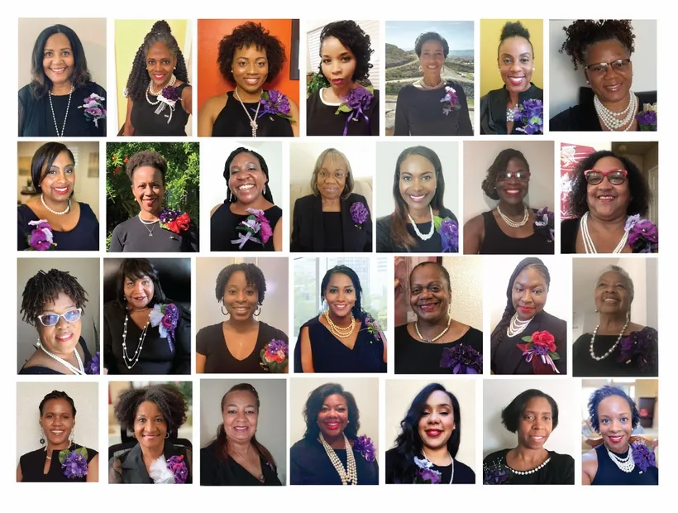

Slide 18
CONGRATULATIONS
SORORS!

Slide 19
Resources
A History of the Founding of Delta Sigma Theta Sorority. http://nueta.tripod.com/HISTORY.HTM.
Alpha Kappa Alpha Sorority. Wikipedia. https://en.Wikipedia.org/wiki/Alpha_Kappa_Alpha
Delta Sigma Theta 53rd National Convention Heritage & Archives Workshop. www.deltasigmatheta.org
Giddings, Paula. (1988). In Search of Sisterhood. Delta Sigma Theta and the Challenge of the Black Sorority Movement.
Nellie Quander. Wikipedia. https://en.Wikipedia.org/wiki/Nellie_Quander
Ross, L.C. (2000). The Divine Nine. The History of African American Fraternities and Sororities

