Slide 1


Murrieta-Temecula Area Alumnae Chapter
Heritage Moment
March 14, 2023
Patricia P Watson Ed.D Chair
Marsha Edmond Co-Chair

Slide 2
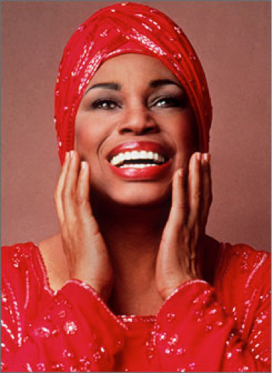
Opera legend Leontyne Price was the first African American soprano to achieve international acclaim having followed in the footsteps of Marian Anderson, the first African American to sing at the Met. Price sang at the Met for several seasons, with one of her most important roles being that of Cleopatra. This is her story…

Slide 3
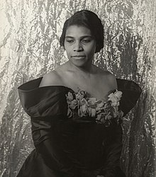
Mary Violet Leontyne Price was born in Laurel, Mississippi on February 10, 1927. She showed a natural affinity for music at an early age and began piano lessons at the age of three and a half. At age eight, she had begun visiting the home of Alexander and Elizabeth Chisholm who encouraged Leontyne's piano-playing and singing, often inviting her to sing at house parties.
Aged 9, she was taken on a school trip to hear Marian Anderson sing a recital in Jackson. The experience was her first significant exposure to classical music, and she later recalled that "The whole aura of the occasion had a tremendous effect on me, particularly the singer's dignity and, of course, her voice".
Marian Anderson

Slide 4
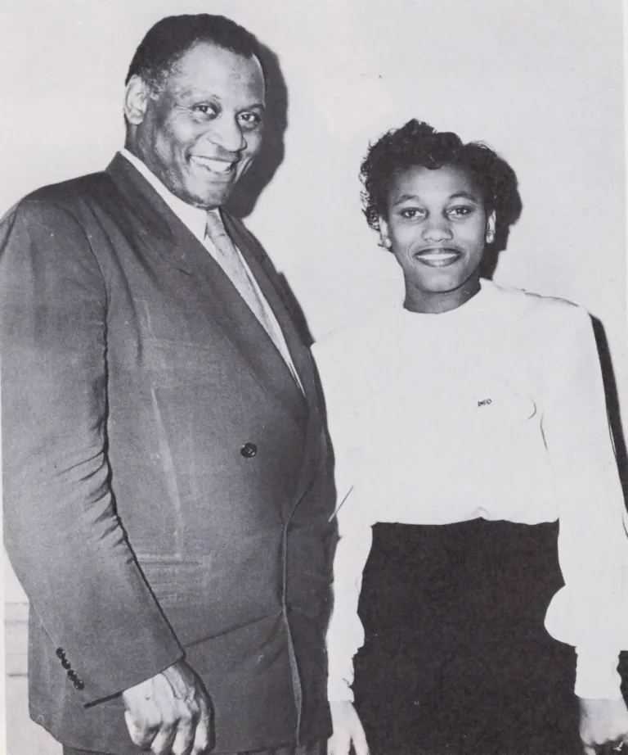
In her teen years, Price was a cheerleader and salutatorian.
She earned extra money by singing for funerals and civic functions.
Mississippi was highly segregated at the time, and subject to Jim Crow laws. As a Black woman, her only musical career path was as a teacher. So, she began her study in music education at Central State (now Wilberforce) University in Ohio. However, on the advice of the university president and after frequent singing in a glee club she changed her major to voice in her third year. She also participated in master classes, including one with the renowned bass Paul Robeson at Antioch College. Robeson was impressed by Price's voice, and—knowing she was aiming to enroll at Juilliard—worked with the Central State administrators to host a benefit concert to help raise money for her tuition. The Chisholms also remained supportive of Price and gifted the bulk of the money needed for Juilliard.
Paul Robeson & Leontyne Price

Slide 5
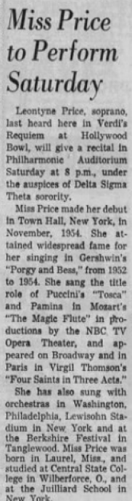
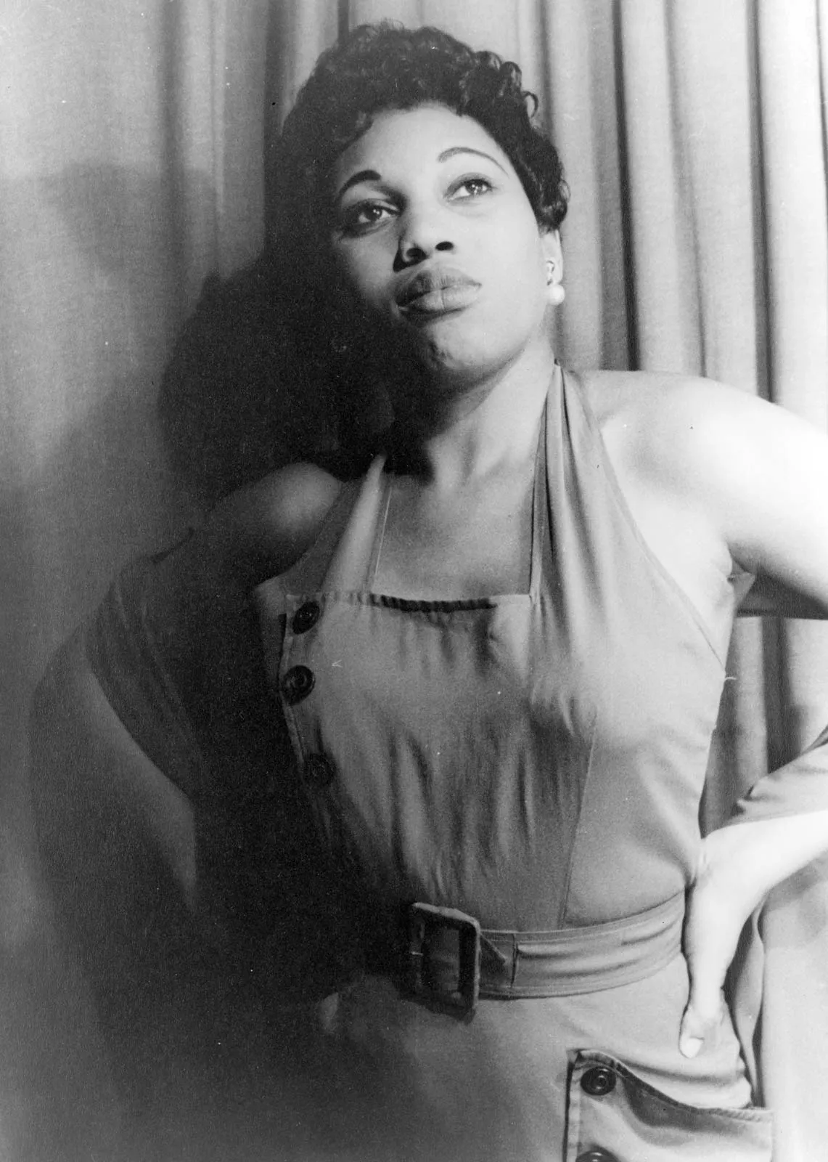
While at Wilberforce, Price joined Delta Sigma Theta, who later helped arrange and support several of her first recitals in major cities
Los Angeles Times, March 17, 1957

Slide 6
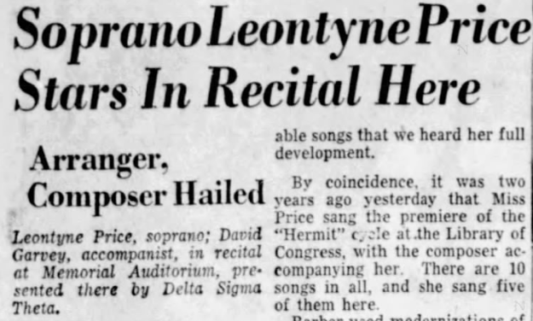
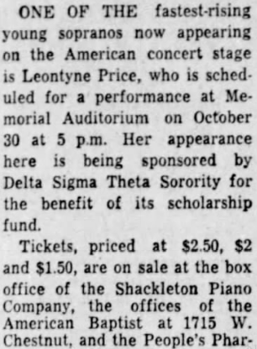
In 1955, she starred in a recital in Louisville, Kentucky sponsored by Delta Sigma Theta. She did the same in Los Angeles, California, in 1957.
Louisville Journal Courier, October 31, 1955
Louisville Journal Courier, October 9, 1955

Slide 7
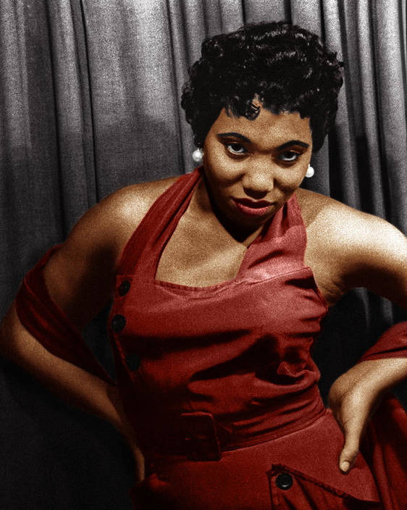
After entering the Julliard, Price made her debut in Four Saints in Three Acts in 1952. This performance led to the famed Ira Gershwin casting Price as Bess in his revival of the African American opera Porgy and Bess.

Slide 8
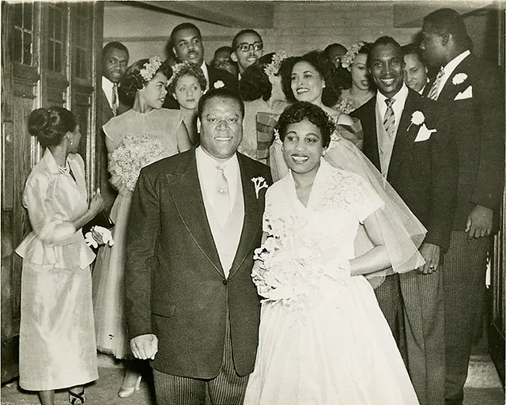
On the eve of the European tour, Price married William Warfield, her Porgy, and a noted bass-baritone concert singer.
When Porgy and Bess returned to the States in 1953, Warfield was unable to adjust a busy recital and concert schedule and was dropped from the cast, while Price sang Bess for another year, on Broadway and a second US tour.
Warfield said the episode put a strain on their young marriage. The couple was legally separated in 1967 and divorced in 1973. They had no children.

Slide 9
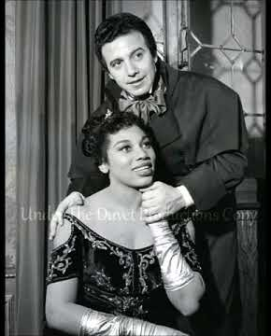
The door to opera opened through the young medium of television and the NBC Opera Theatre. In January 1955, Price sang the title role in Puccini's Tosca, the first appearance by an African American in a leading role in televised opera. Price went on to star in three other NBC Opera broadcasts. Tosca was not controversial, so Price's appearance had not been widely advertised by NBC, which had a policy of "integration without identification," and the Jackson, Mississippi, NBC affiliate carried the broadcast signal to her hometown of Laurel. However, Jet Magazine noted that her appearance with a White tenor marked a first TV broadcast with a mixed-racial couple, and her later NBC Opera broadcasts were boycotted by several NBC affiliates, most of them in the South, because of her race.

Slide 10
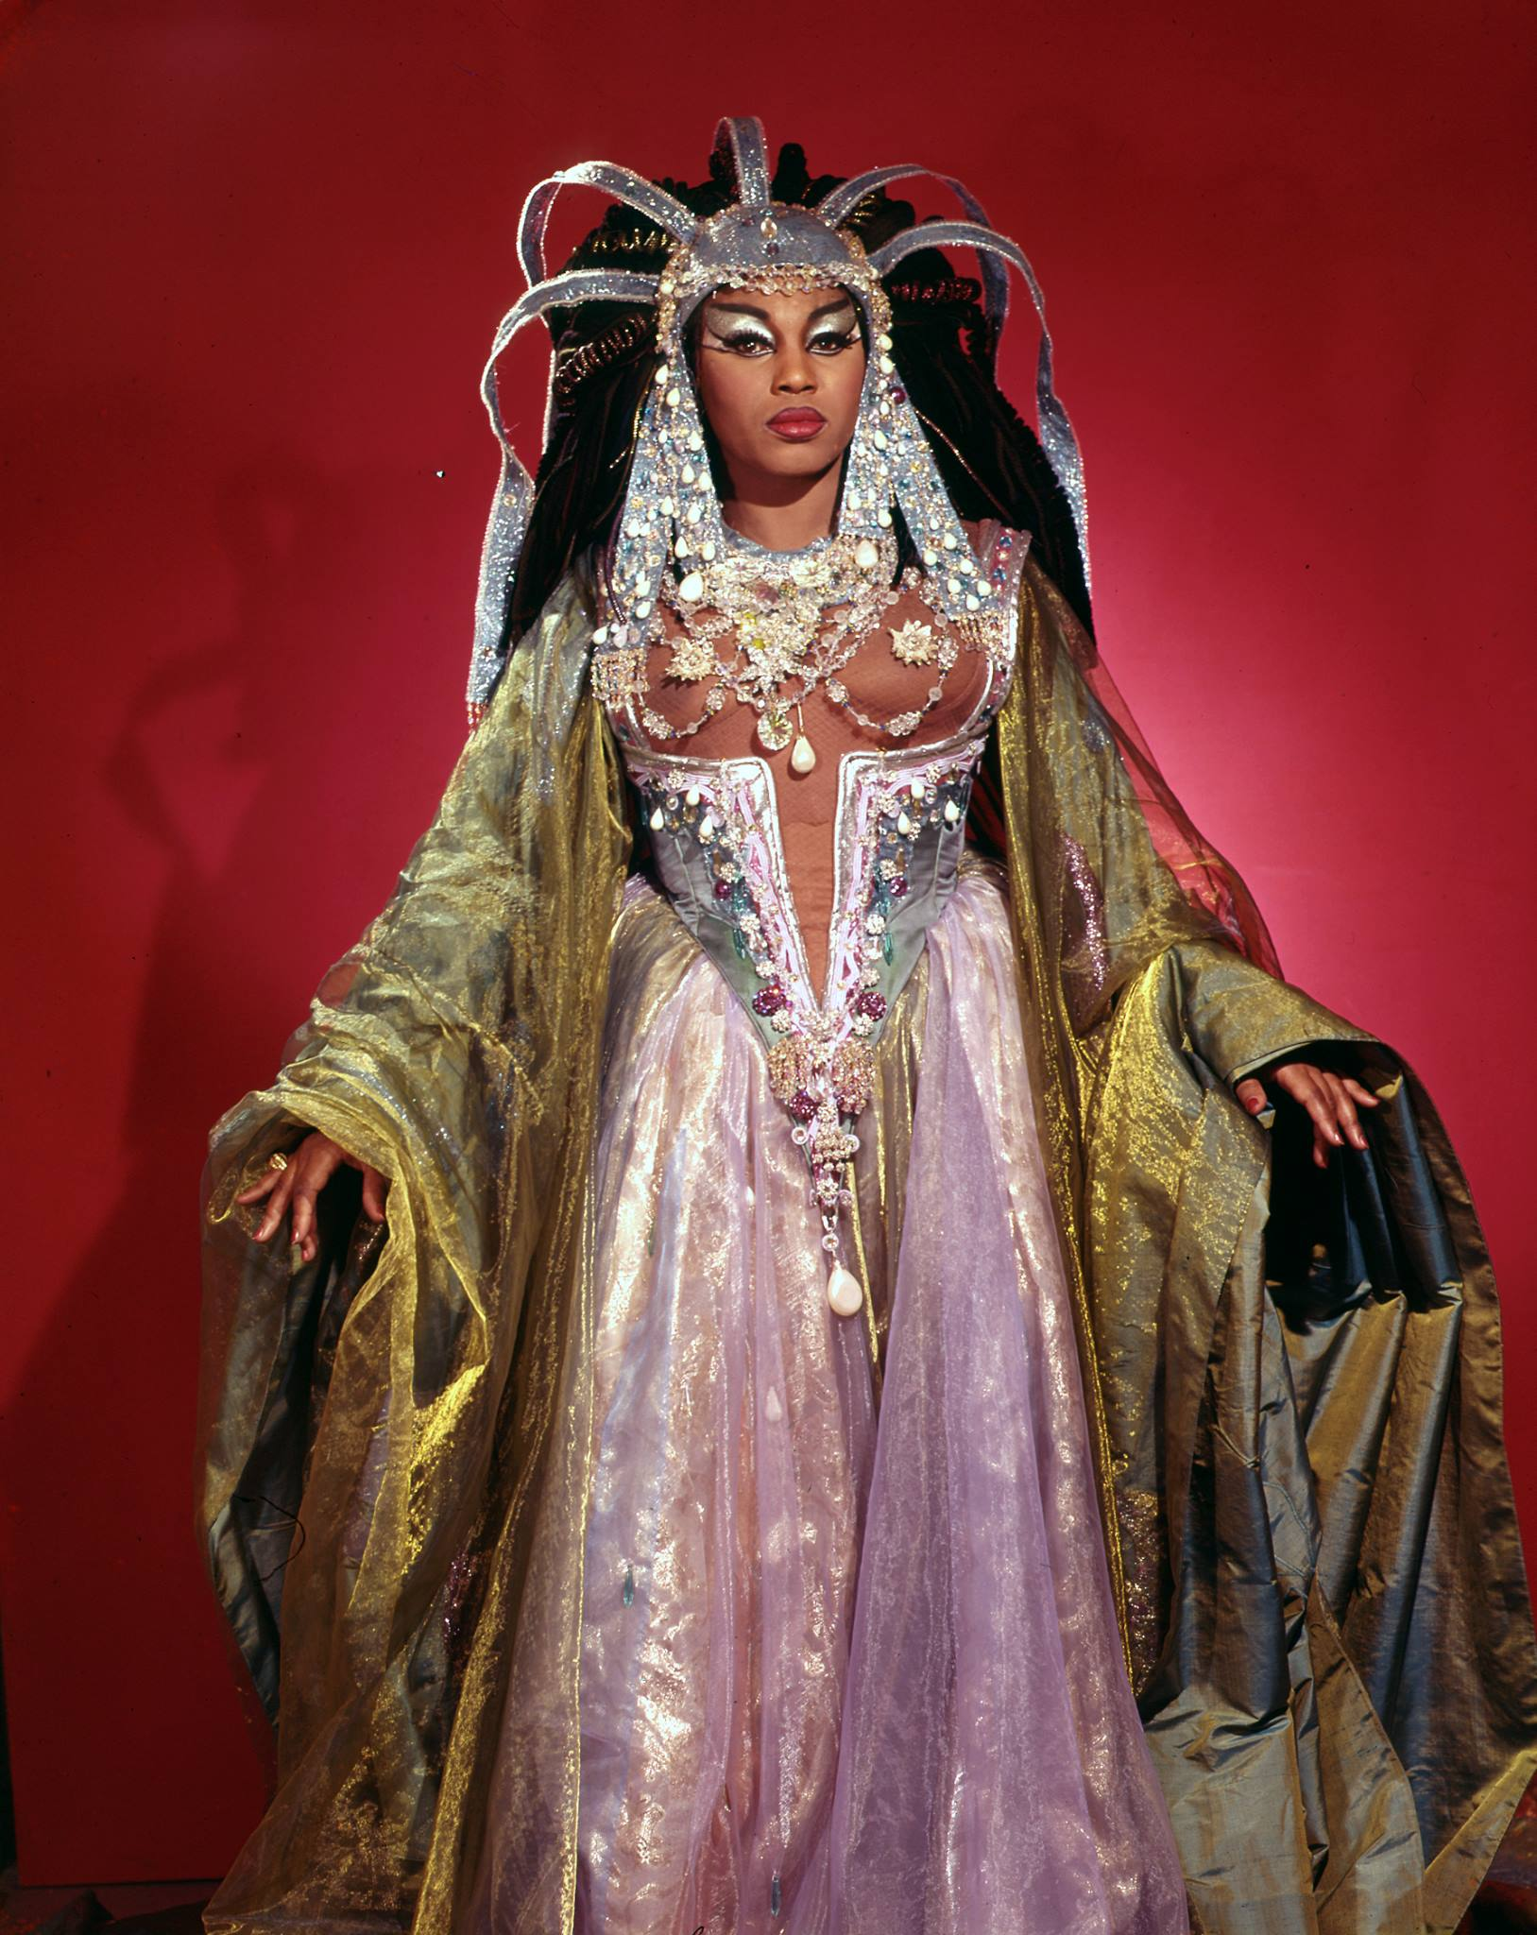
After a successful Town Hall recital debut in November 1954, Price began touring the U.S. and Canada in recitals on the Columbia Artists roster. In 1956, she toured India and then, the next year, Australia, giving concerts and recitals for the U.S. State Department. In May 1957, she performed Verdi's Aida, in a concert performance with the Philadelphia Orchestra at the May Festival in Ann Arbor, Michigan, her first public performance of what became her signature role.

Slide 11
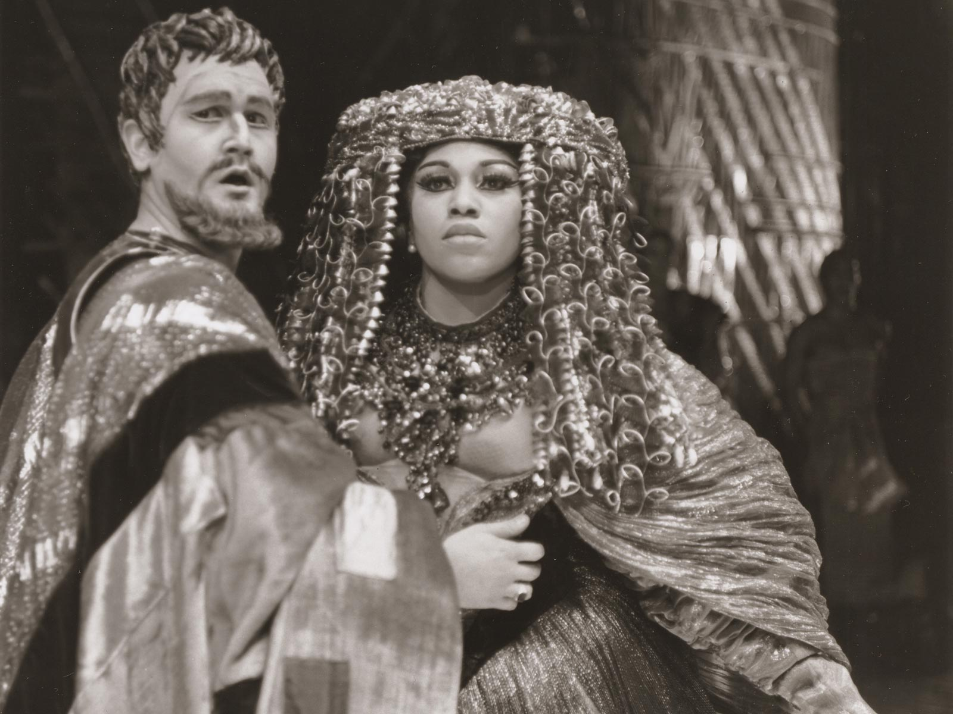
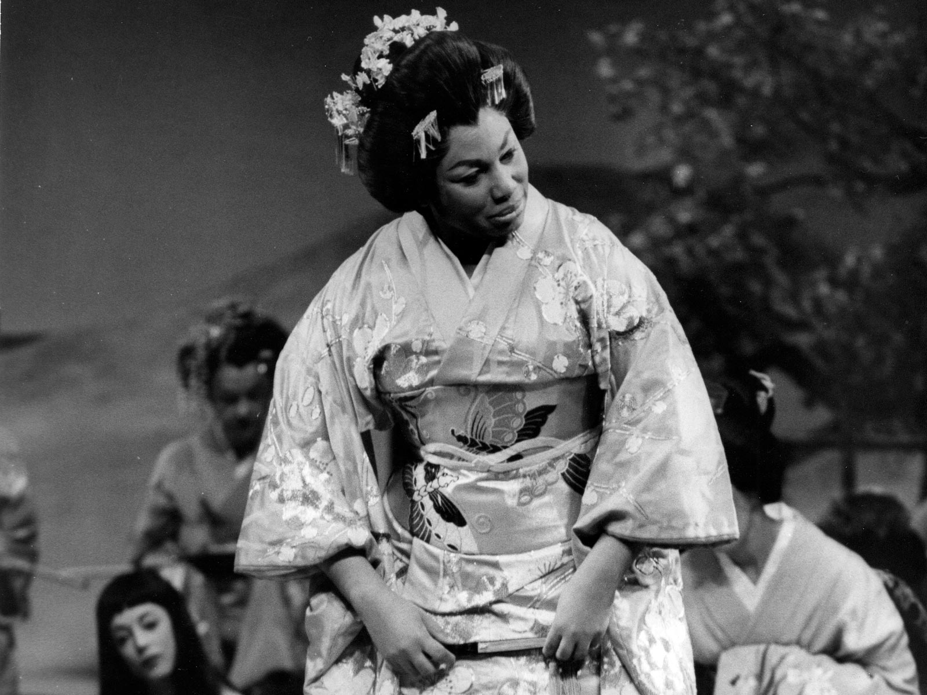
Price made her operatic debut at the San Francisco Opera in 1957 and became the Prima Donna at the New York City’s Metropolitan Opera House in 1961, starring in several prominent productions; the most notable being Antony and Cleopatra and Madame Butterfly.

Slide 12
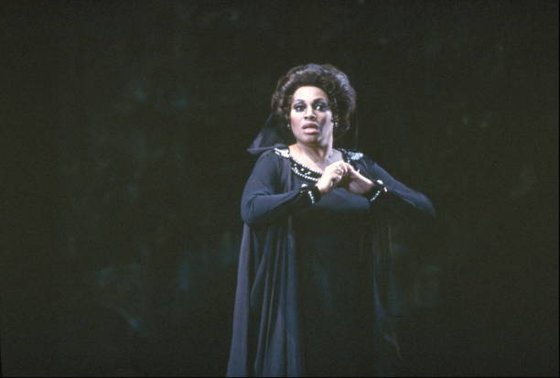
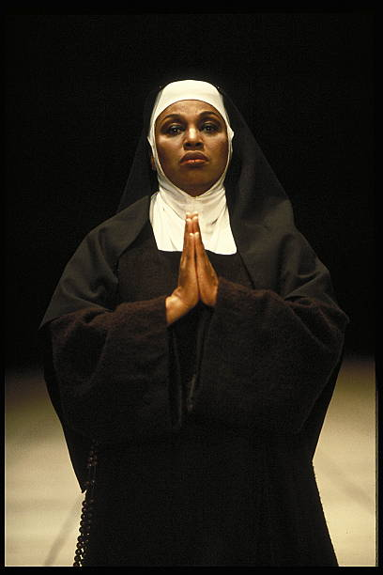
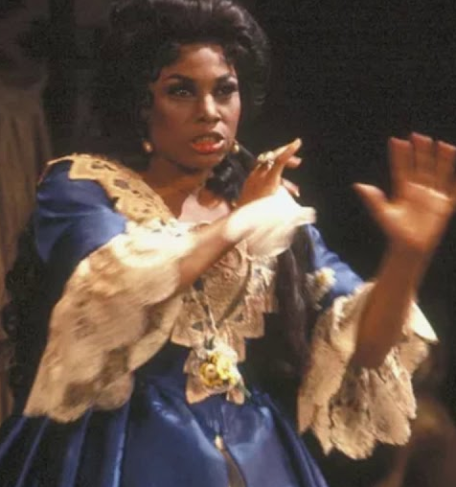
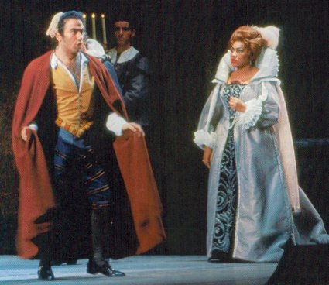
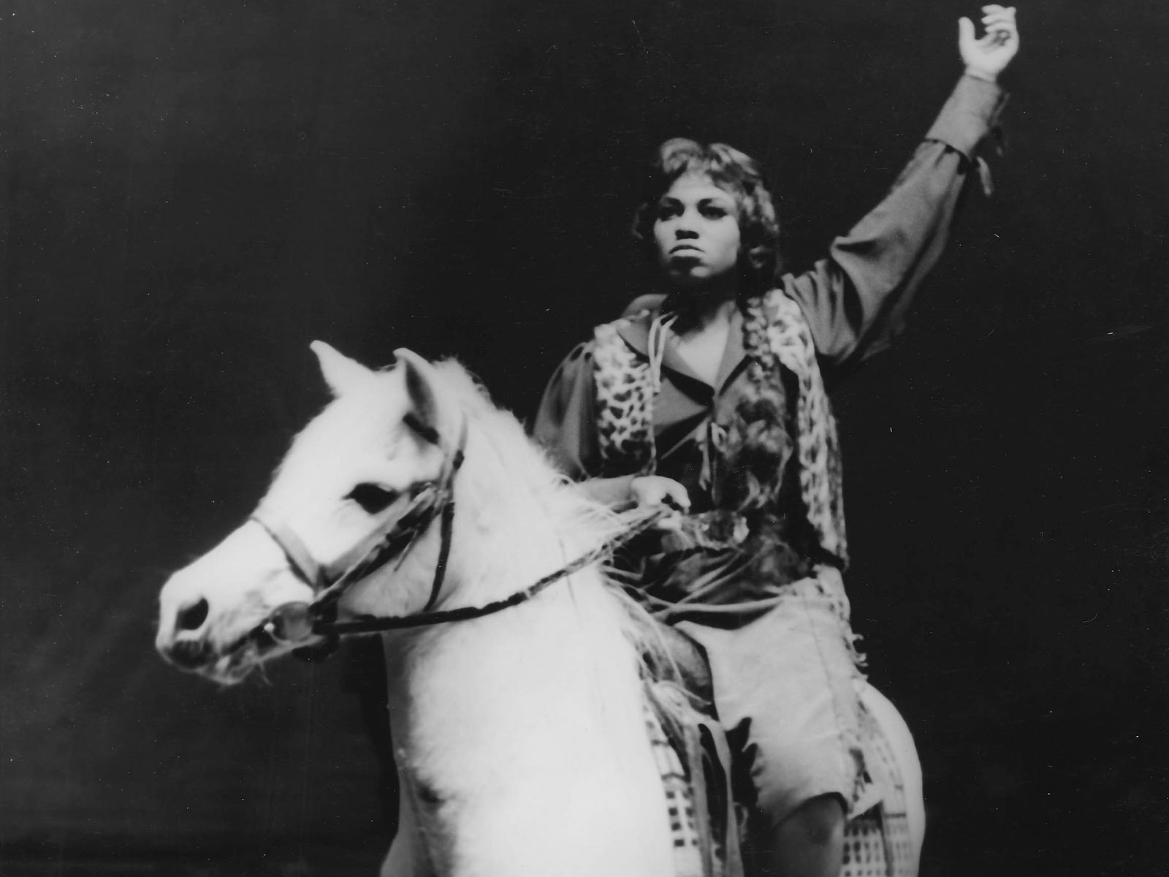
In the late 1960s, Price cut back her operatic performances and devoted more of her career to recitals and concerts. She said she was tired, stressed by the racial tensions in the country and her role as a token of racial progress. Her recitals and concerts were highly successful, and, for the next two decades, she was a mainstay in the major orchestral and concert series in the big American cities and universities.
She knew to keep a presence in opera and returned to the Met and the San Francisco Opera, her favorite house, for short runs.
IL TROVATORE
Don Giovanni
La Fanciulla del West
Dialogues of the Carmelites
Ariadne Auf Naxos

Slide 13
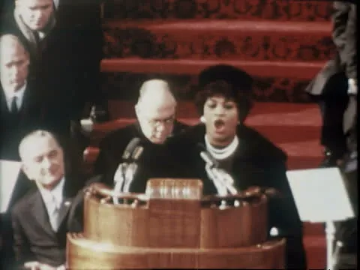
In the U.S., she had become an iconic figure and was regularly asked to sing on important national occasions. In January 1973, she sang "Precious Lord, Take My Hand" and "Onward, Christian Soldiers" at the state funeral of President Lyndon B. Johnson. (She had sung at his inauguration in 1965 pictured.) President Jimmy Carter invited her to sing at the White House for the visit of Pope John Paul II and at the state dinner after the signing of the Camp David Peace Accords. In 1978, Carter invited her to sing a nationally televised recital from the East Room of the White House. In 1982, she sang "Battle Hymn of the Republic" before a Joint Meeting of Congress on the 100th anniversary of the birth of President Franklin Roosevelt. In fall 1986, Price sang the national anthem backed by the Los Angeles Philharmonic on Orange County Performing Arts Center's opening. Price also sang for Presidents Reagan, George H. W. Bush, and Clinton.
Performing America, the Beautiful with US Marine Corps Band at LBJ Inauguration; January 20, 1965, in Washington, DC
(Footage by Getty Images)

Slide 14
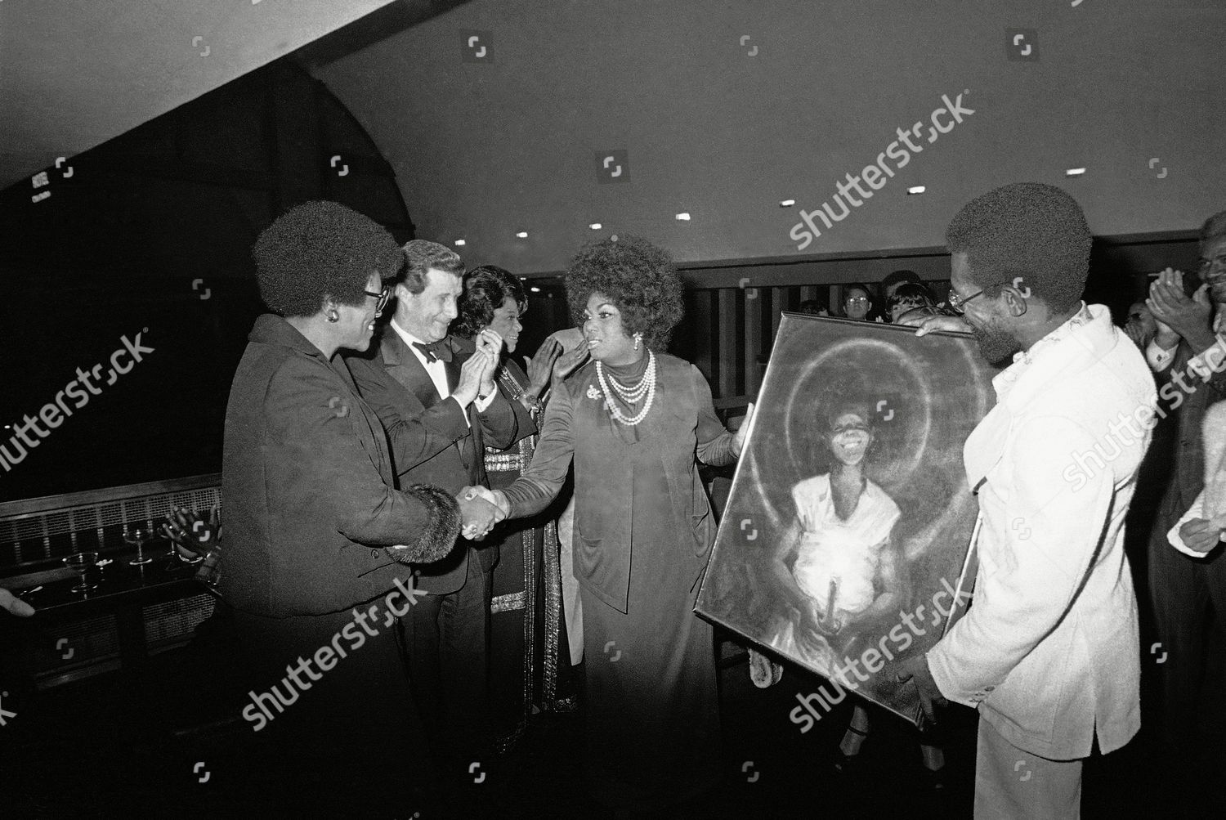
WORKING IN DELTA
In the mid-seventies, Delta Sigma Theta established the Arts & Letters Commission, co-chaired by Leontyne Price and Lena Horne. Their mission was to support Black women in the arts.
Pictured. Leontyne Price, being honored by Delta Sigma Theta, accepts a painting presented to her at the Metropolitan Opera House, She is shaking hands with Delta's President, Lillian P. Benbow, next to who is standing Schuyler G. Chapin, General Manager of the Metropolitan Opera.

Slide 15
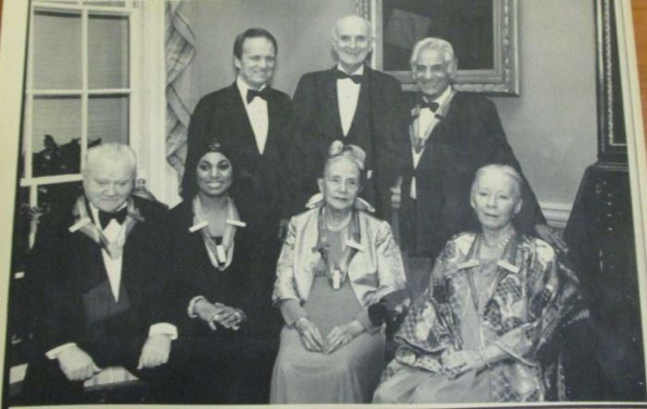
Among her many honors and awards are the Presidential Medal of Freedom (1964), the Spingarn Medal (1965), the Kennedy Center Honors (1980), the National Medal of Arts (1985), the Golden Plate Award of the American Academy of Achievement (1986), numerous honorary degrees, and 13 Grammy Awards for operatic and song recitals and full operas, and a Lifetime Achievement Award, more than any other classical singer. In October 2008, she was among the first recipients of the Opera Honors by the National Endowment for the Arts. In 2019, Leontyne Price was awarded an honorary doctorate degree from Boston Conservatory at Berklee.
Leontyne Price and other
1980 Kennedy Center honorees

Slide 16
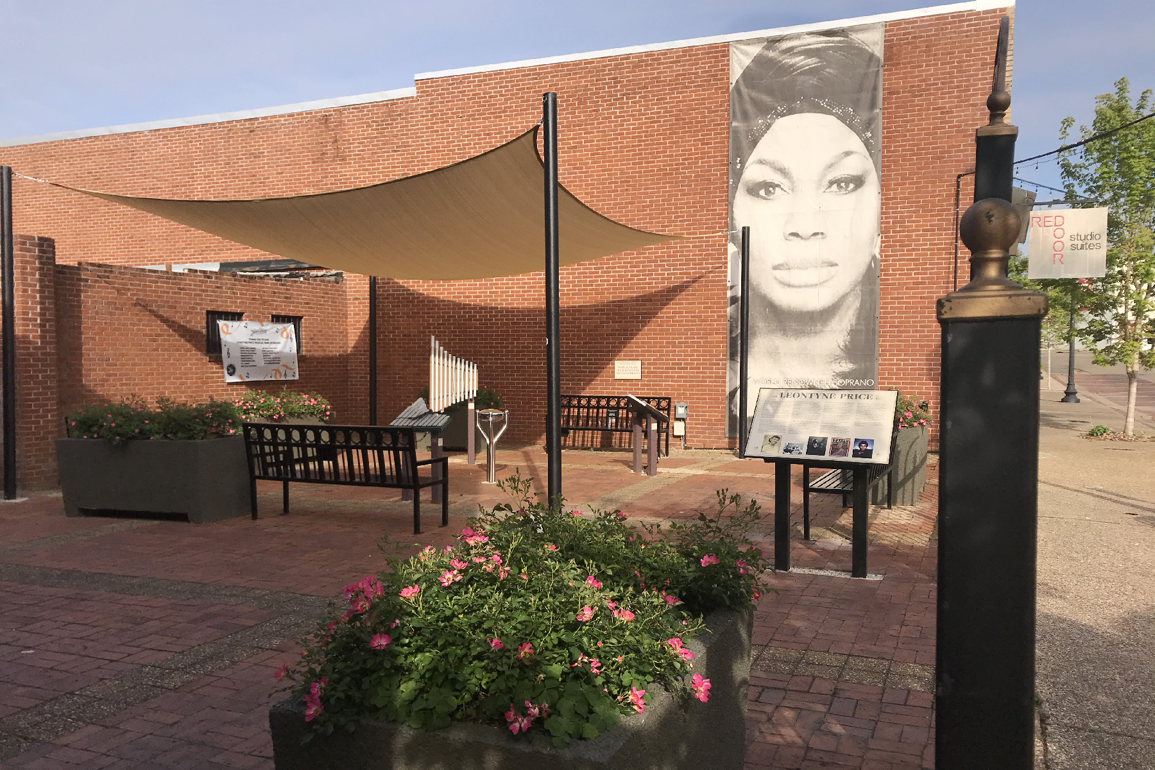
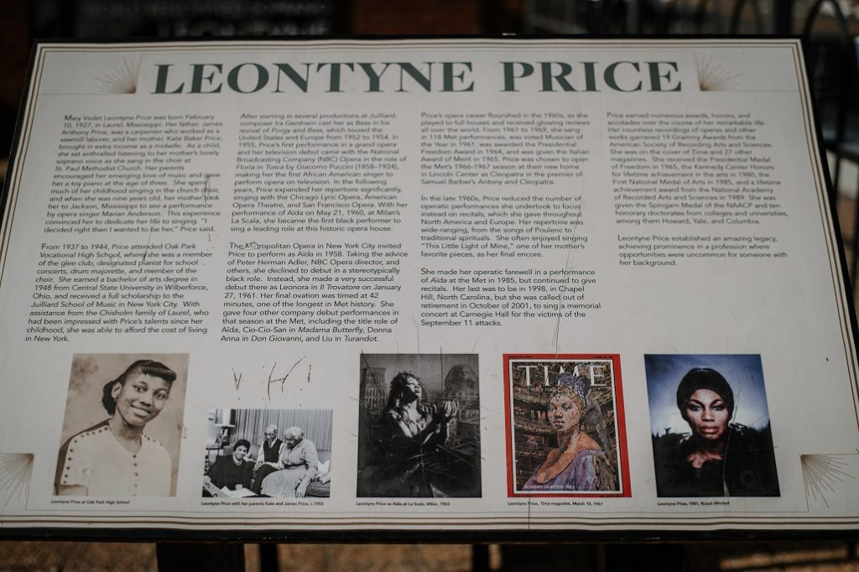
Leontyne Price Musical Park
Dedicated in August 2020, The “Treble Makers,” a Leadership Jones County team, raised over $15,000 to fund a project for the community for arts education. The park was built to enable people of all ages—but especially formative youth—to experience the enrichment that music can provide through both sheer enjoyment and gaining an understanding of musical concepts. The many students who come to the park to play and learn will be inspired by Laurel’s most famous daughter.

Slide 17
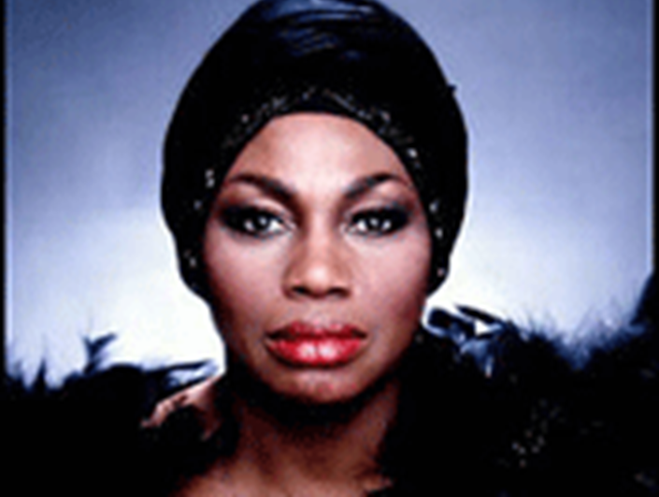
It is impossible to speak of Price’s Met career without noting that she was the first African American superstar singer—one who was indispensable and around whom the company planned its season repertoire. As one of the company’s leading prima donnas, Price accompanied the Met on tour, including to several Southern cities where theaters were segregated. Her presence there was an important factor in changing the discriminatory policies. In fact, the rise of her Met career coincided with the Civil Rights Movement in the United States, and she was proud to be a part of it. Along with her exceptional artistic achievements, it remains part of her remarkable legacy.

Slide 18
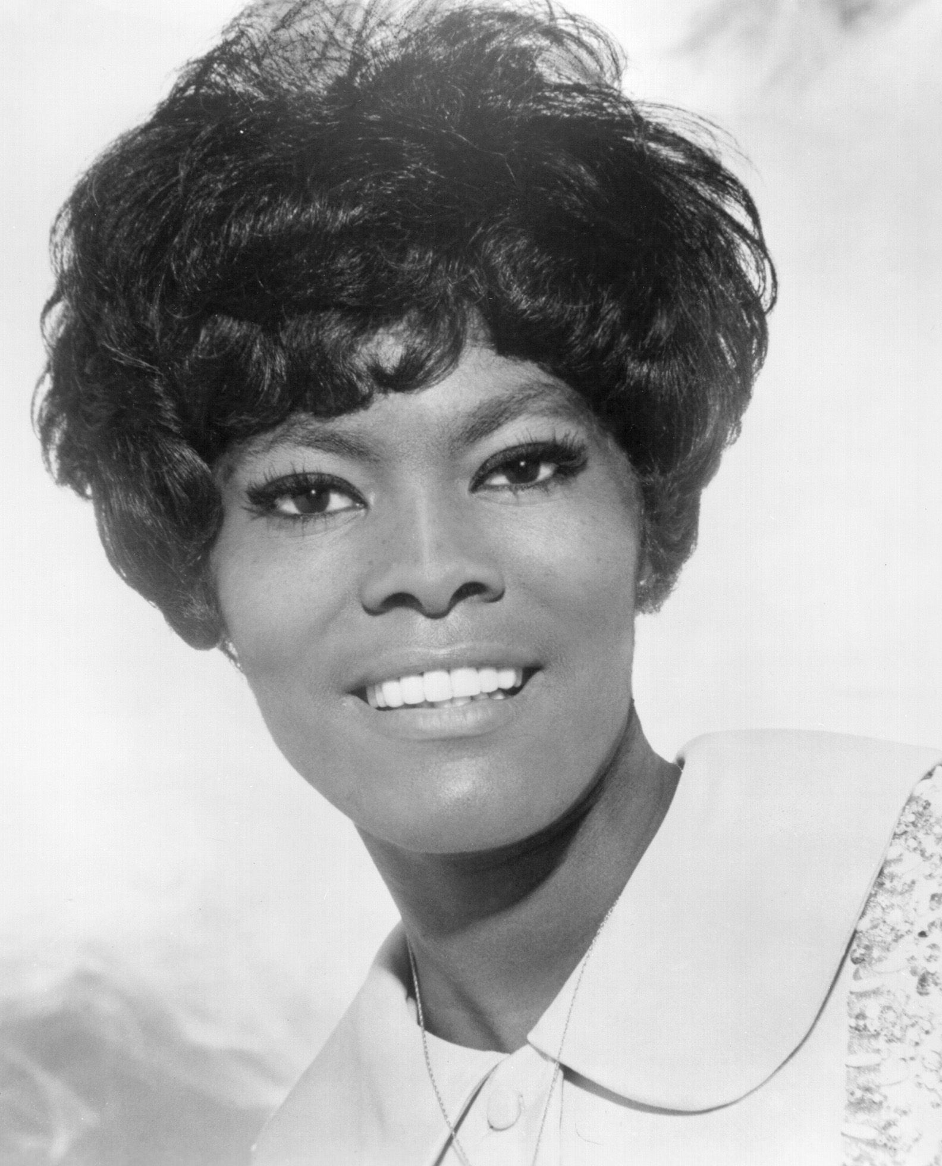
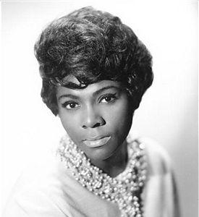
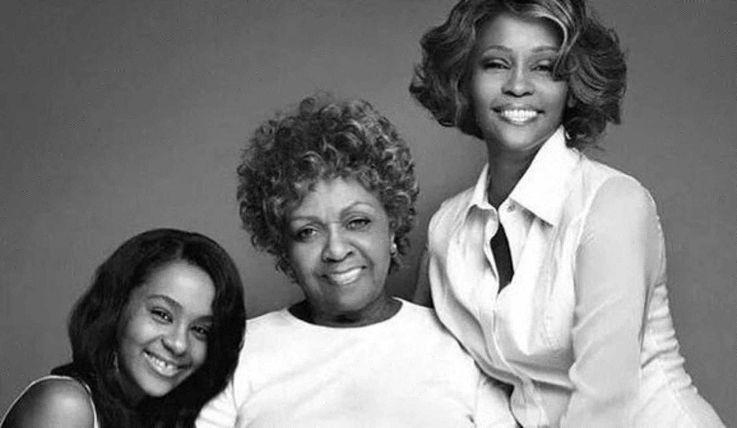
It’s in the DNA
Cissy Houston (cousin)
Whitney Houston (cousin)
Bobbi Kristina Brown (cousin)
Dionne Warwick (cousin)
Dee Dee Warwick (cousin)

Slide 19
References
Arts & Letters Commission. http://dsthoustonalumnae.org/arts-letters/
Becque, F. 2019. Leontyne Price, Delta Sigma Theta, #NotableSororityWomen, https://www.franbecque.com/leontyne-price-delta-sigma-theta-notablesororitywomen-whm2019/
Delta Sigma Theta Sorority. https://www.facebook.com/dstinc1913/
Laurel Main Street Recognized At Mississippi Main Street Annual Awards
http://laurelmainstreet.com/laurel-main-street-recognized/
Leontyne Being Honored by Delta. https://www.shutterstock.com/editorial/image-editorial/leontyne-price-opera-singer-new-york-usa
Price, Leontyne. Wikipedia. DST Heritage Moments. https://en.wikipedia.org/wiki/Leontyne_Price.
The Timeless Voice of Leontyne Price. https://www.weeklymusiccommentary.com/2021/02/the-timeless-voice-of-leontyne-price.html

