Slide 1

Delta Sigma Theta Sorority, Inc.
Heritage & Archives
Heritage Moment
Patricia P Watson Ed.D. Chair
Manerva L Hart D.D.S. Co-Chair
May 11,2021

Slide 2
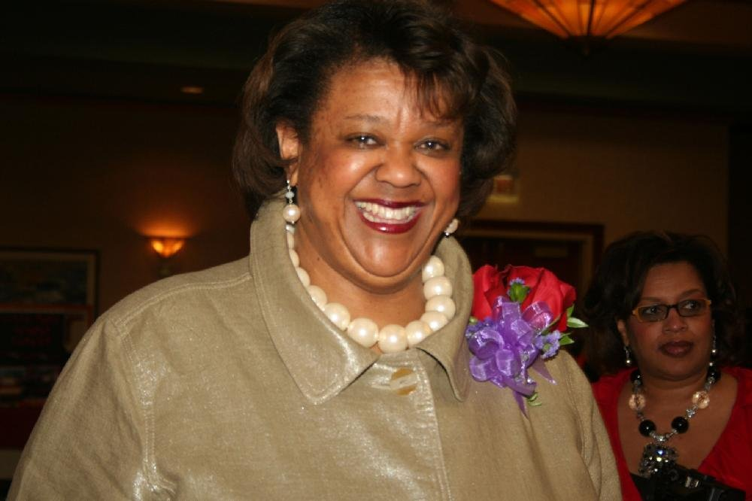
April’s Heritage Moment Celebrates
The Cynthia M.A. Butler-McIntyre Campus in Cherette, Haiti

Slide 3
DISASTER!
A magnitude 7.0 earthquake struck Haiti on the afternoon of January 12, 2010.
With approximately 3 million people affected, this earthquake was the most devastating natural disaster ever experienced in Haiti. Roughly 250,000 lives were lost, 300,000 people were injured, as the country faced the greatest humanitarian need in its history.

Slide 4
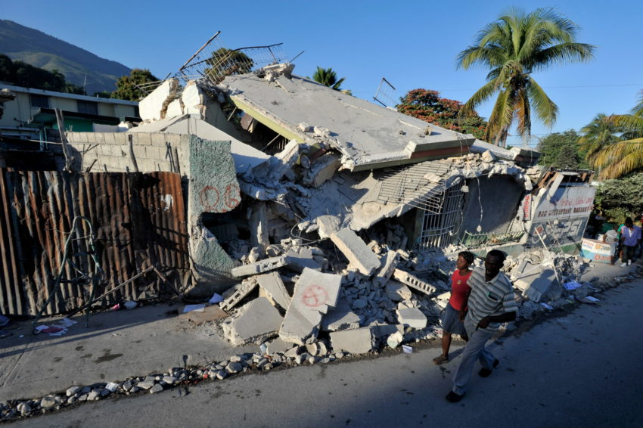

Slide 5
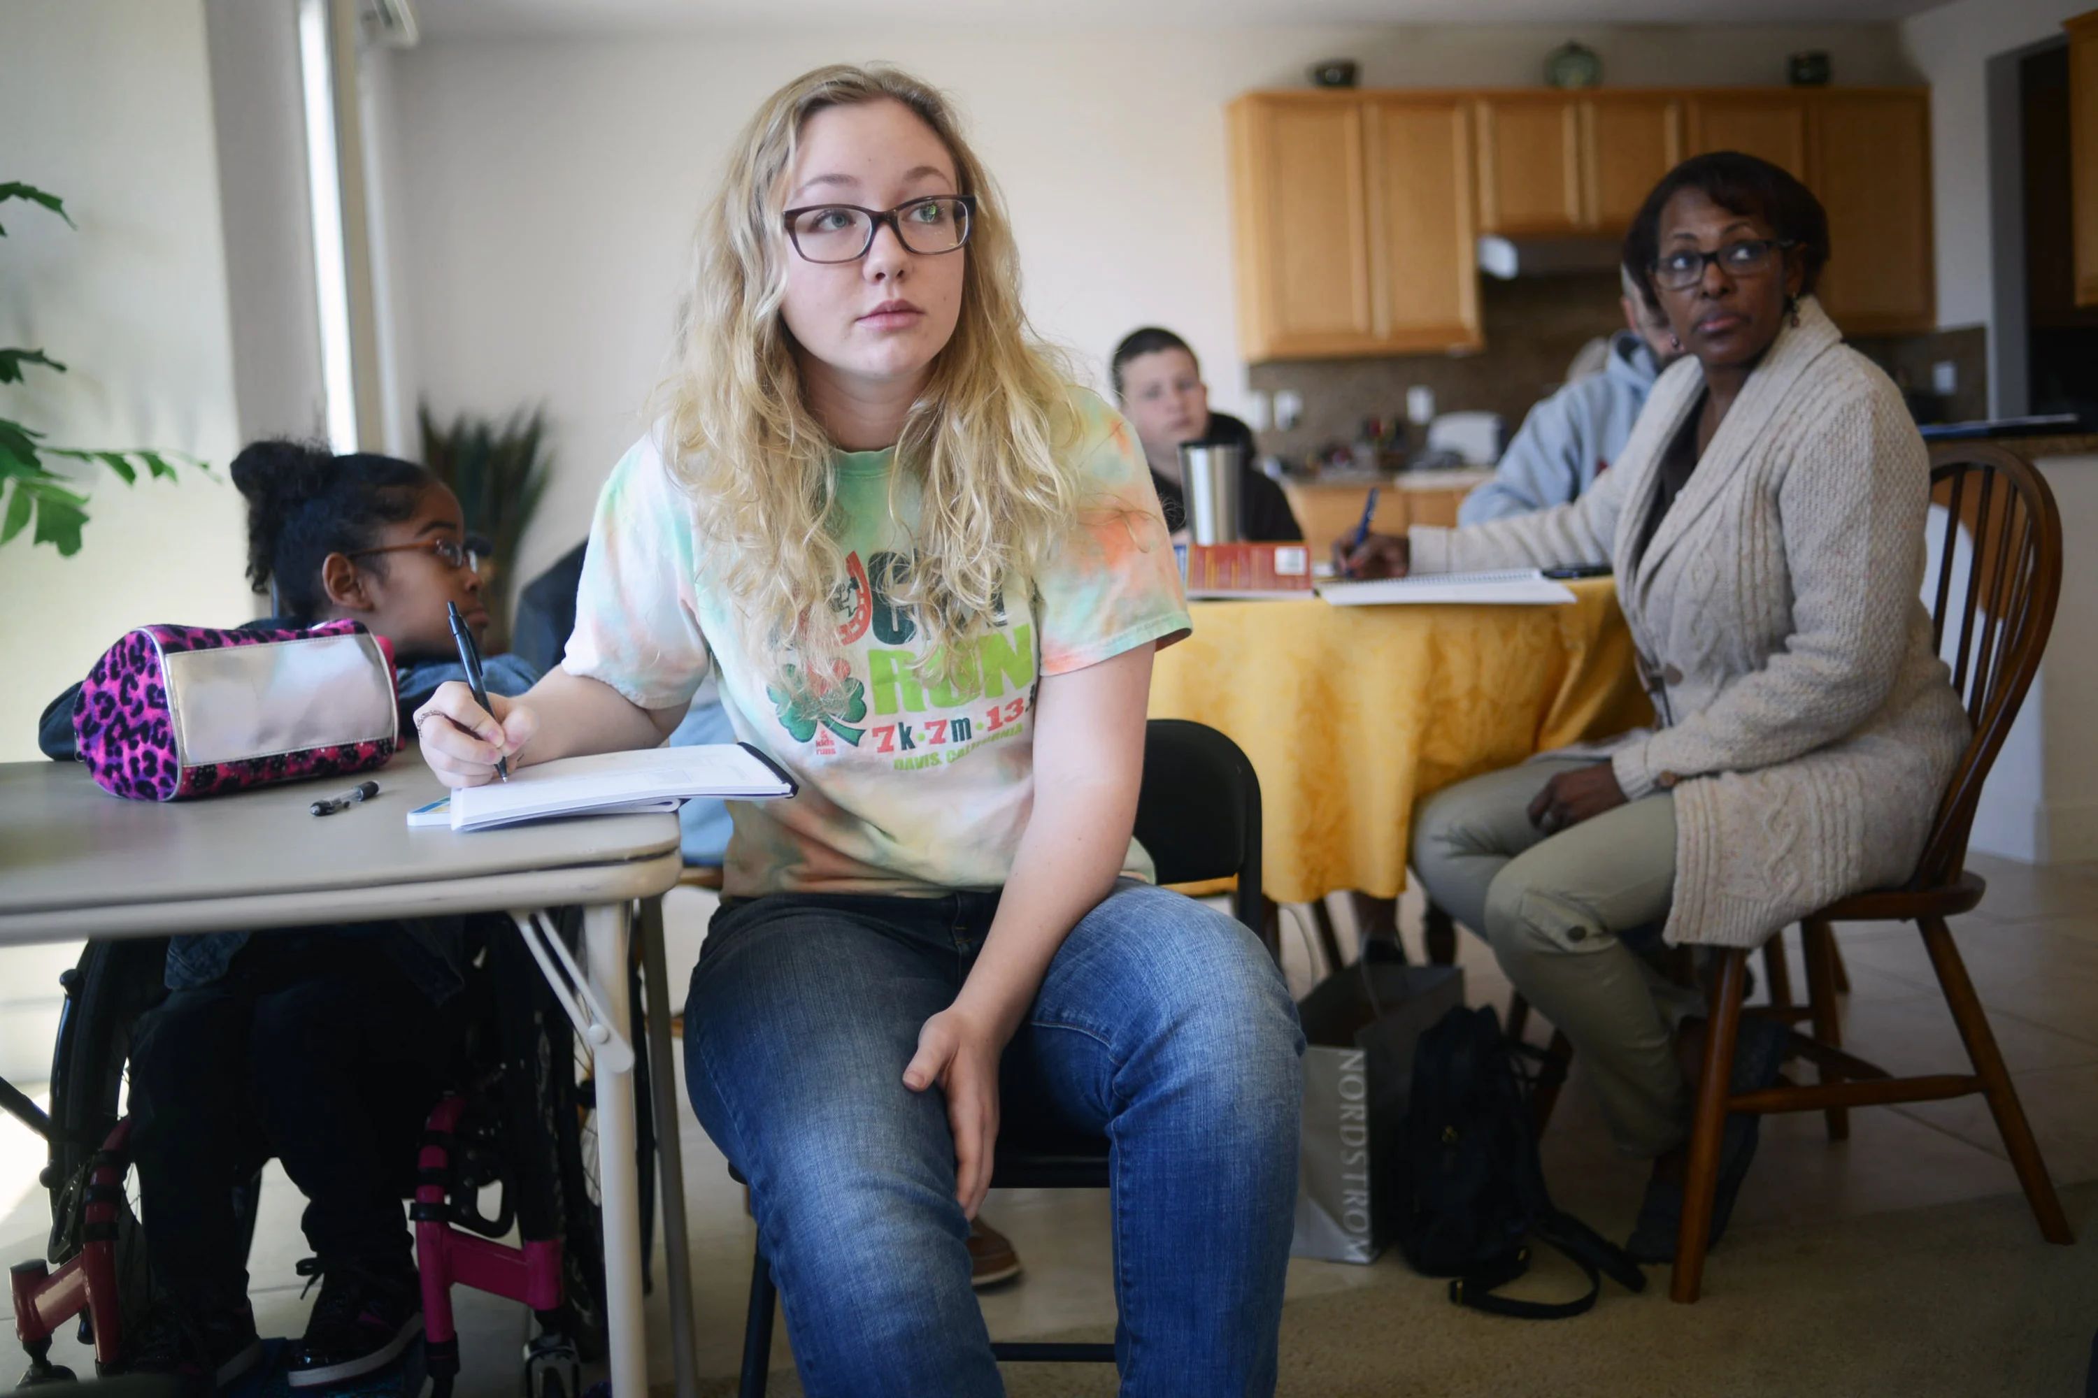
A Call to Action
Spearheaded by Solano College students in the college’s MESA program – (Mathematics, Engineering, Science Achievement), contacts were made with WEI, which supported fundraising activities and travel logistics for the MESA students.
WEI, (Water & Educational International), is a global humanitarian organization founded and incorporated in 2007. It’ s purpose is addressing the need for safe water in developing countries and providing educational opportunities.
After lengthy preparation, a group of students made their first visit to Cherette in the summer of 2011 on a cultural, fact-finding trip.

Slide 6

The students visited the village and the school. They also asked for community input to help them determine what needed to be done and where they could help best. They decided to focus on the school.
The students came back to the U.S., researched, wrote a proposal and sent it out to various places that might be able to help financially.
Delta Sigma Theta Sorority, Inc. stepped up and funded much of the needed money to build the school. Initial estimates were about $20,000, but the projected ended up costing about $25,000.

Slide 7
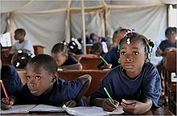
The Plan
The plan was to rebuild and improve an existing school with that included larger classrooms, new technologies and unlimited access to clean water to promote academic excellence in the remote village of Cherette, 96 miles southwest of Port-au-Prince.

Slide 8


Partnership
Delta Sigma Theta Sorority, Inc. WEI, and DREF who had previously earmarked funds to provide clean water for Haitians, partnered to upgrade the existing dilapidated school with cramped classrooms offering no protection from the sun and rain.
But ended up constructing a new building with larger classrooms, an administration building with a library & resource center, modern bathroom, and kitchen to educate approximately 300 students from Pre-K to 6th grade

Slide 9
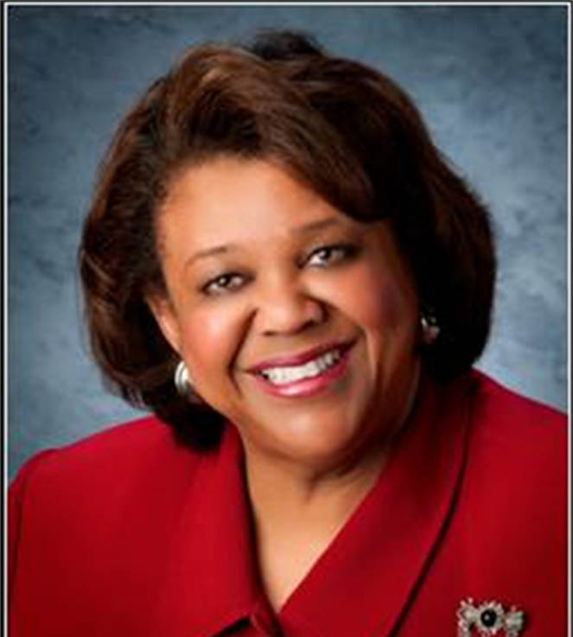
WEI controls all managerial and financial entities of the school, as well as its legal and daily responsibilities.
However, the school’s administration chose to name the school Delta Sigma Theta Sorority, Inc. Elementary School at The Cynthia M. A. Butler-McIntyre Campus in recognition of the funds that were donated by members of the sorority in support of the Clean Water Haiti Fund in 2010, and the grant from the Delta Research & Educational Foundation that provides clean water onsite at the school.

Slide 10
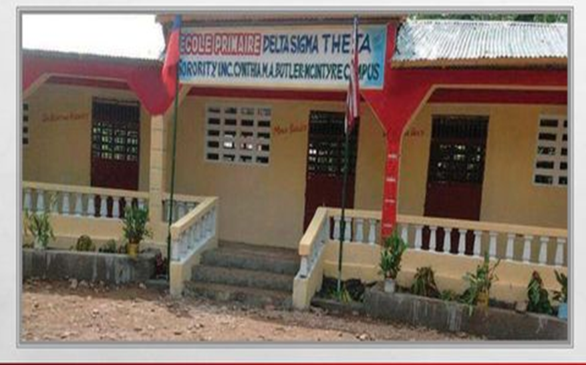
The classroom building is made of typical cinder blocks with a concrete foundation and wood tresses. It includes a solar suitcase and is outfitted with a 50-watt solar panel strong enough to power lights and charge computers.
Delta Sigma Theta also donated new desks.

Slide 11
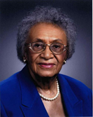
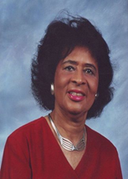
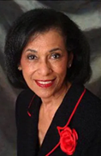
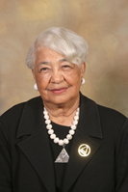
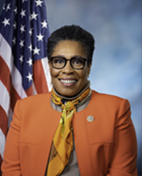
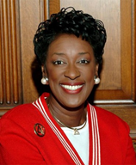
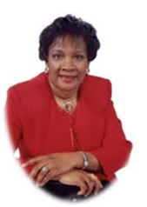
Designated areas of the school were named in honor of the (then)seven living Past National Presidents: Frankie Muse Freeman, Esq., Dr. Thelma T. Daley, Dr. Mona Humphries Bailey, Dr. Bertha M. Roddey, Congresswoman, now HUD Secretary Marcia L. Fudge Esq., Rev. Dr. Gwendolyn E. Boyd and Dr. Louise A. Rice

Slide 12
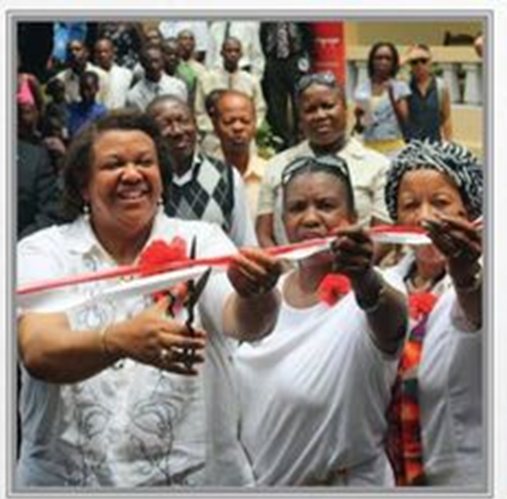
Dedication Ceremony
June 15, 2013

Slide 13
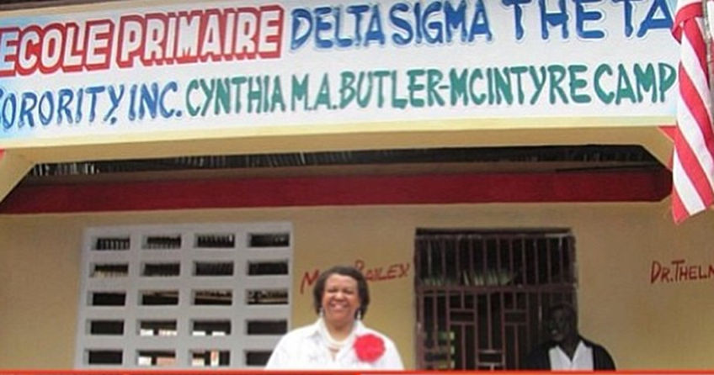

Slide 14
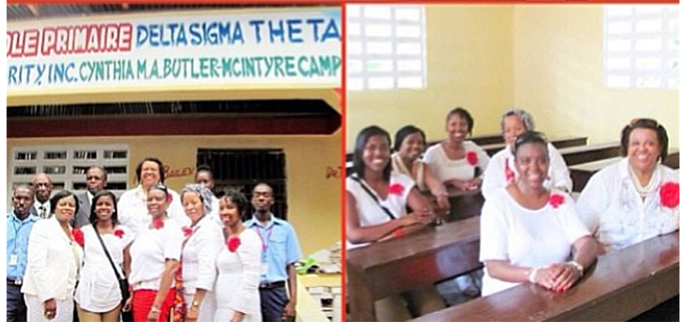

Slide 15
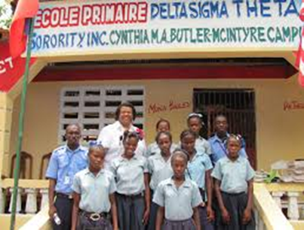

Slide 16
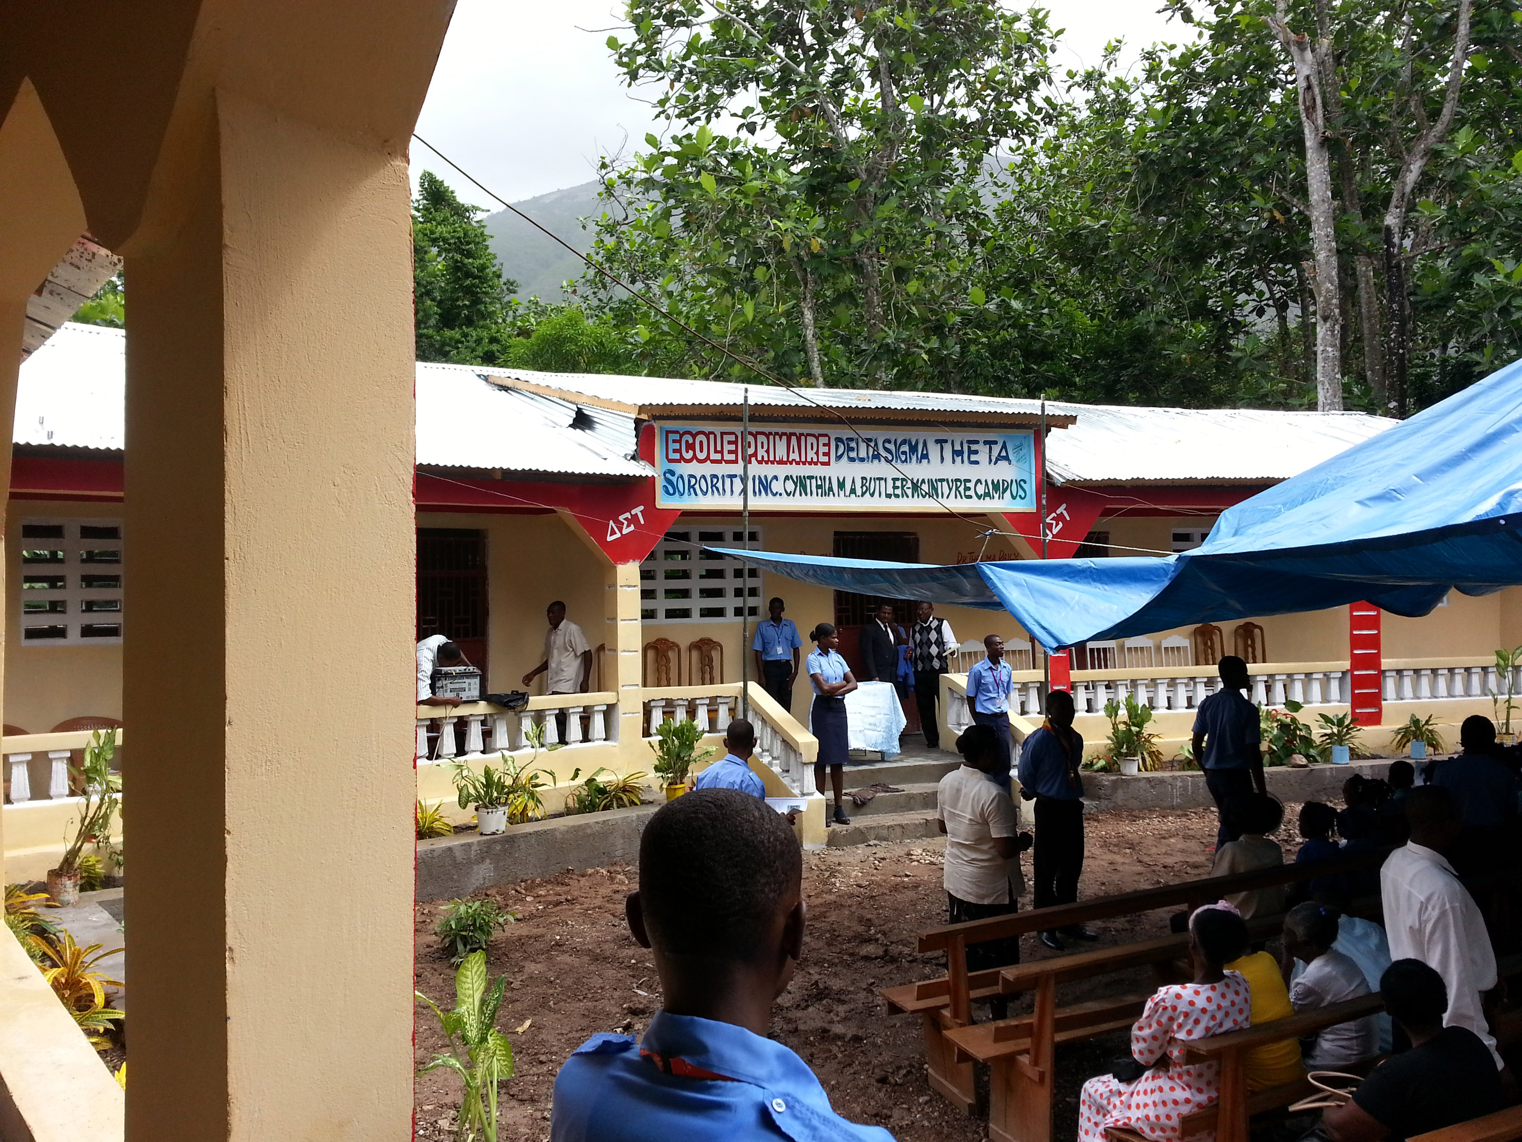

Slide 17
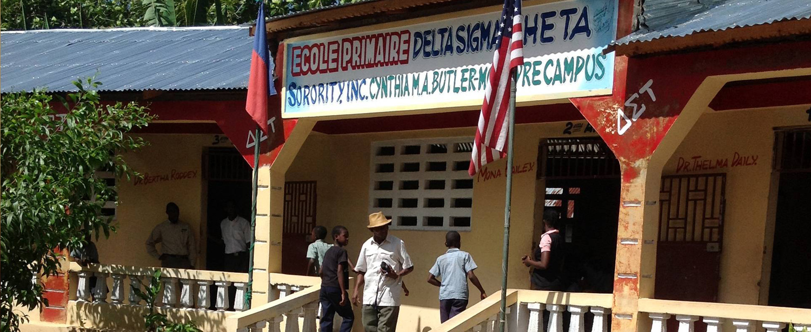

Slide 18
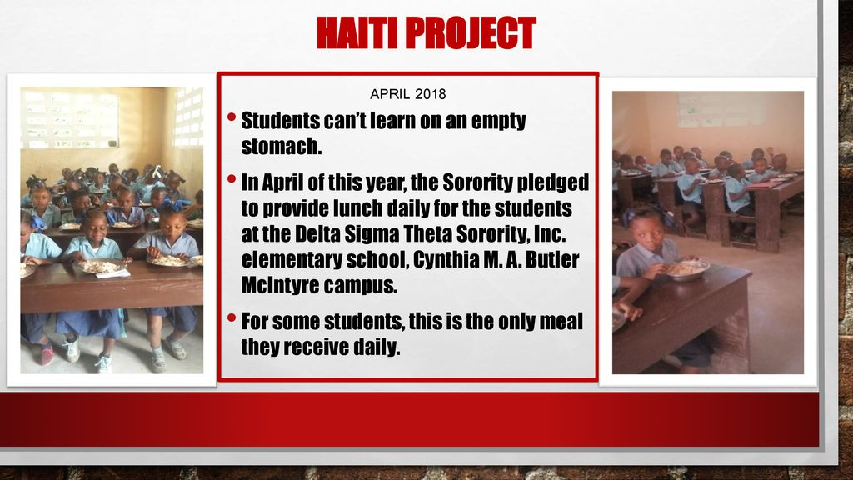
Updates- 2018

Slide 19
References
Delta Sigma Theta Opens Elementary School in Haiti. Delta Sigma Theta
Sorority, Inc. Jun 04, 2013. deltasigmatheta.org
Delta Sigma Theta Sorority, Inc. Elementary School. Chere’tte, Haiti. dst.org.
Sorority opens elementary school in Haiti. 2013. L’ Union Suite. https://www.lunionsuite.com. delta sigma theta.
Wei Humanitarian. Cherette School Project. https://weihumanitarian.org/donations/cherette-school-project
Atlanta Black Star. 2013. Delta Sigma Theta Opens Elementary School in Haiti
Brown, C. Delta Sigma theta Opens School in Haiti. New York/ Amsterdam News. http://amsterdamnews.com/news/2013/jun/17/delta-sigma-theta-sorority-opens-school-in-haiti/
Perrin, J. 2013. Boss Moves: Delta Sigma Theta set to open school in Haiti.
Worldvision. www.blackenhttps://www.worldvision.org/disaster-relief-news-stories/2010-haiti-earthquake-factsterprise.com
Winlow. S. Solano College Students Give Haitian Students Educational Boost. https://www.dailyrepublic.com/all-dr-news/solano-news/local-features/solano-collage-students-give-haitian-children-educational-boost/

