Slide 1

HERITAGE &
ARCHIVES
NOVEMBER
HERITAGE
MOMENT
DELTA SIGMA THETA SORORITY, INC.
PATRICIA P WATSON Ed.D. Chair
MANERVA HART D.D.S. Co-Chair
November 10, 2020

Slide 2
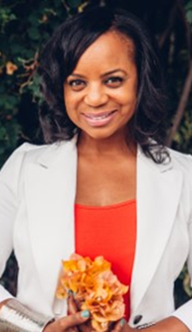
SHA’ GIVENS
Today’s Heritage Moment takes us all the way to Kenya, Africa. I’d like to introduce you to Soror Sha’ Givens the Founder of an organization called I Can Fly (ICF)
In 2001, Soror Sha’ Givens, a native of Los Angeles, and member of the Inglewood Alumnae Chapter was encouraged to accompany church members to Africa. There, she met girls and women in rural villages who never learned to read and write simply because they were girls and witnessed young children working for $1.00 a day because they were unable to afford school. Days later, exhausted from sleep deprivation, she crafted a plan to launch the first Adult Women’s Literacy Program in a small Kenyan village located in Machakos. The program quickly grew from twelve women to three hundred ages 18-85 years old.

Slide 3
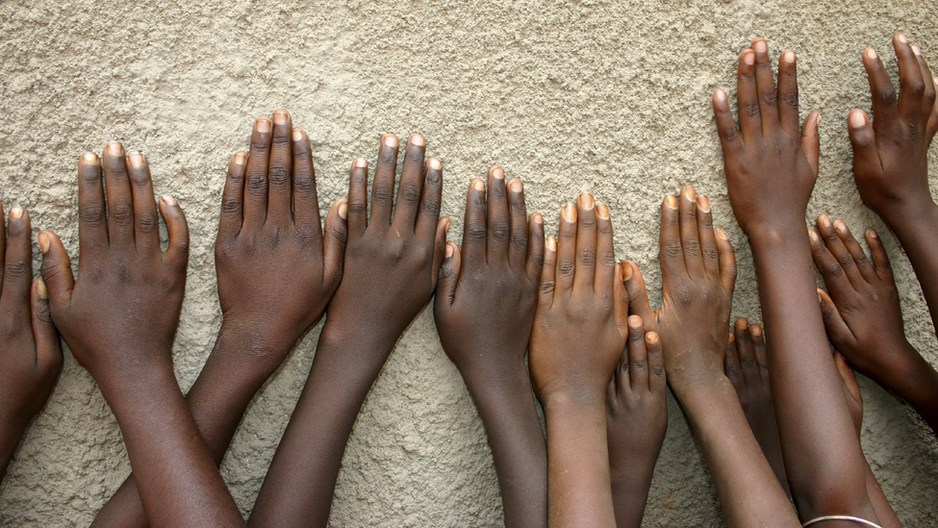
Isaiah 40:31
“But those who wait on the Lord shall renew their strength; they shall mount up with wings like eagles. They shall run and not be weary. They shall walk and not faint.”

Slide 4
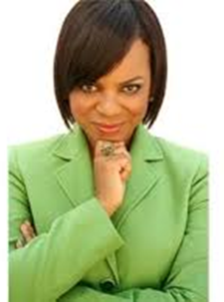

Rev. Sha’ Givens recounts, the meaning behind ICF…Derived from Isaiah 40:31, “But those who wait on the Lord shall renew their strength; They shall mount up with wings like eagles, They shall run and not be weary, They shall walk and not faint. “When I read the part, “They shall mount up on wings like eagles,” I did research on the eagle, and found the eagle is the only bird or species known to be able to fly through the eye of the storm without dropping, being shaken, without dying, or getting hurt, because of the way that they spread their wings. We can do that. We have that ability, when we wait upon God. And that’s when I was like “I Can Fly.”

Slide 5

I CAN FLY is a 501© 3 non-profit organization. It is funded by the generous support of individuals, churches and organizations who believe that we can change the lives of vulnerable children and youth.

Slide 6
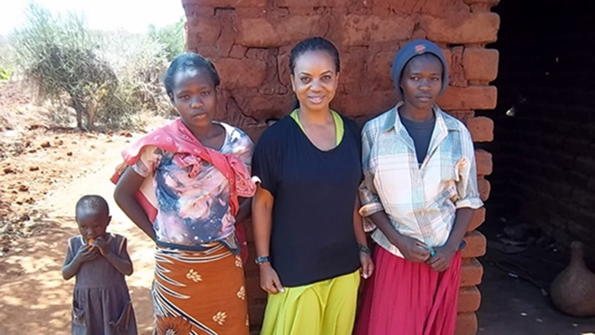

Slide 7
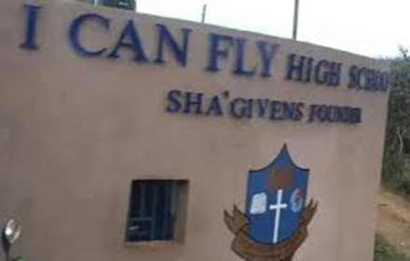
Three years after launching the Literacy Program for women, Soror Givens decided to open a high school to provide free and subsidized education for youth. In Kenya, education is not free. As a result, the High School became a pillar of hope to children in the community who could not afford school fees.

Slide 8
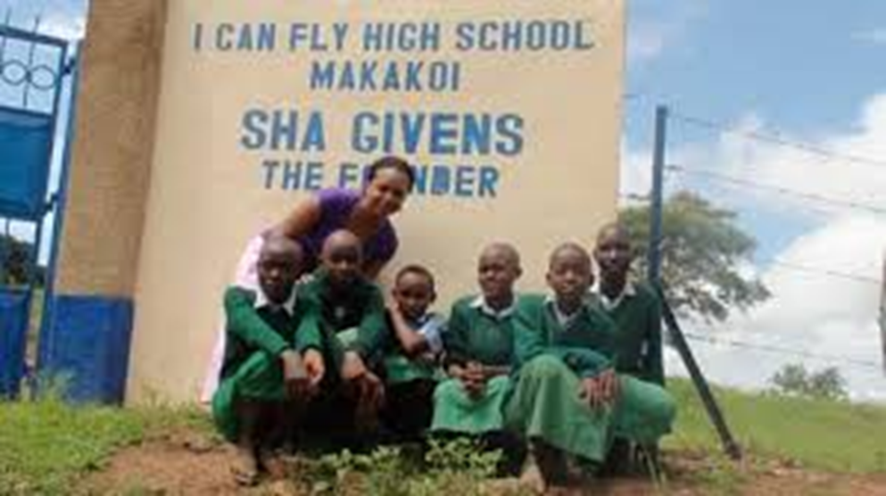

Slide 9
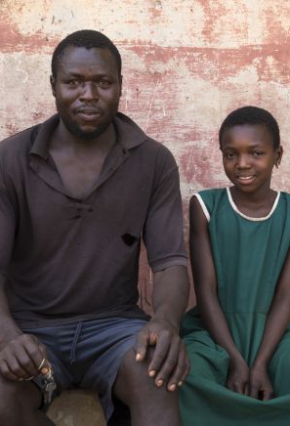
One year after opening the I Can Fly High School Givens read a story in the Kenyan newspaper about a 10-year-old girl engaged to a 55-year-old man for the price of $40 cash and a cow. She cried in disbelief as she didn’t know that early marriages were a cultural tradition in their tribe. As she continued reading the article, she read about ‘rescuers’; people who rescued young girls from child marriage situations. She learned that the man complained to the girl’s family that since his wife had been ‘kidnapped’ he demanded his dowry be returned. The family, unable to return the cash or cow offered the man a new bride, their 6-year-old, and he accepted.
depiction only

Slide 10
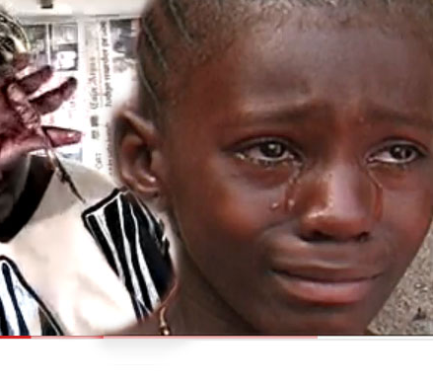
Givens also learned it is customary for young girls to undergo female genital mutilation (FGM) before the parents marry them off. She felt a deep sadness for girls who are forced to grow up before their time and desperately wanted to help them, but she wasn’t sure how. Rescuing girls from female genital mutilation and early marriages seemed a daunting task and became even more difficult because the girls were told that they were not considered women or even valuable unless these body parts were removed.

Slide 11

The Butterfly Project
Soror Givens created the Butterfly Project in 2012 that provided rescue services, free education and shelter to children caught up in cultural systems that invade their human rights. Today there are three Butterfly Houses in two locations that has helped over numerous girls escape poverty and the cultural traditions that harm them.

Slide 12
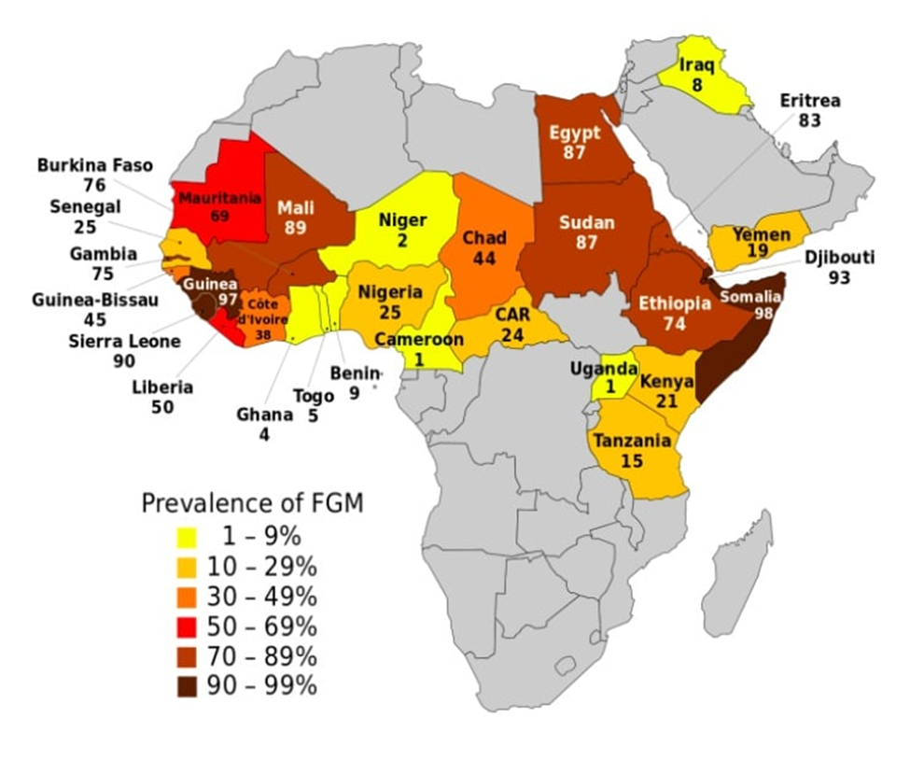
Africa’s Prevalence of FGM

Slide 13
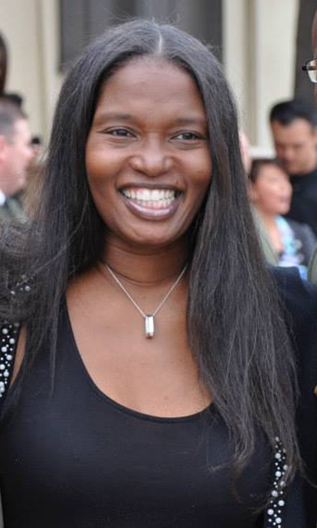
Kimetha Hill
During an interview with ---Voice and Viewpoint’s Kimetha Hill in 2014, Givens explained the Butterfly Project.
“I was driving up the street in LA and I started seeing these butterflies in my mirror behind my car. By the time I pulled up in my mom’s driveway there were all these butterflies in my mom’s garden. Then I heard the Lord say, “You will build a house called the Butterfly House. And you will gather little girls from all over East Africa. Victims. You will feed them; you will nurture them. You will take care of them while they’re in their cocoon. After they leave, I Can Fly High School they will fly away like butterflies as they have gone through a transformation. And I will lead you to get them.”

Slide 14

One of Soror Given’s mentors donated $1,000. She hired an architect and began laying the foundation. She remembers, “It was a slow process and I fundraised everywhere I could. A lot of people told me to go away, but I didn’t stop.” As Rev. Sha’ began sharing the story of the girls, the money began to pour in. Back in Kenya, rescuers began to save more and more girls.

Slide 15
How a rescue is done….
I CAN FLY International practices a grass roots approach in partnership with other organizations, individuals and entities to rescue vulnerable girls at the most crucial stages in their development. Most rescues occur when a girl as young as 7 years old is threatened to be married off, undergo female mutilation, found working in an unhealthy environment, sex trade, or living in extreme poverty. Once they receive a call alerting them to such events, they strategically organize a plan to retrieve the girl from the toxic environment. Many rescues are voluntary because of a “STEP ONE” approach which involves a first warning given to parents or guardians to release the girl/victim. This caution aspect of their approach is led by local law enforcement, social workers and community leaders. In such cases and others the Child Welfare Society of Kenya assists with the documentation of the case, initial counseling and a placement plan. Once the girl/victim is removed from the environment the child is taken to I Can Fly High School or I Can Fly Rescue Center for refuge.

Slide 16
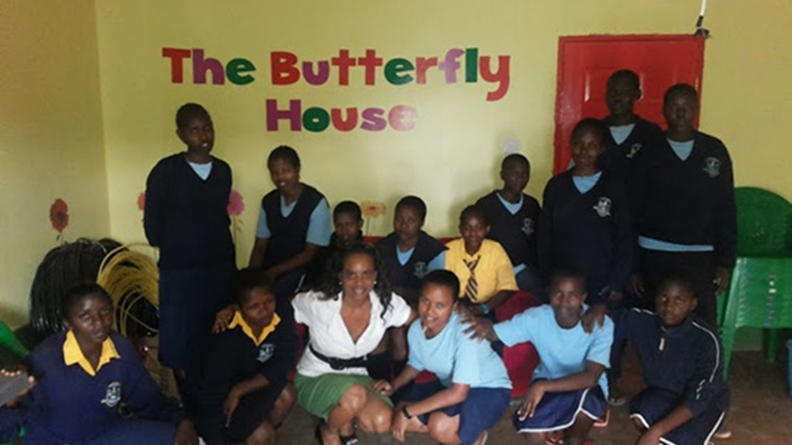

Slide 17
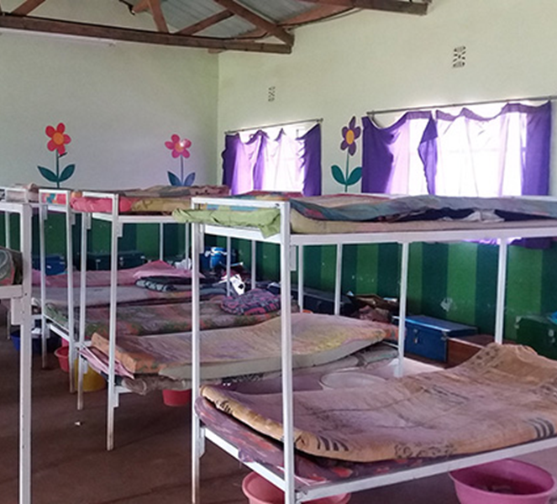
The Butterfly Project offers free education to girls from five distinct counties in Kenya. Most of the girls come from small, rural villages where water, food, and other basic needs are scarce due to unemployment and drought. The Butterfly girls live on the I Can Fly school campus in the Butterfly House. The Butterfly Houses are equipped with beds, modern amenities and living room space. Three meals per day, 24-hour security, transportation and enrichment activities are also provided.

Slide 18
EXPANSION
The Eagles Project
The Little Butterflies
The Scholars

Slide 19
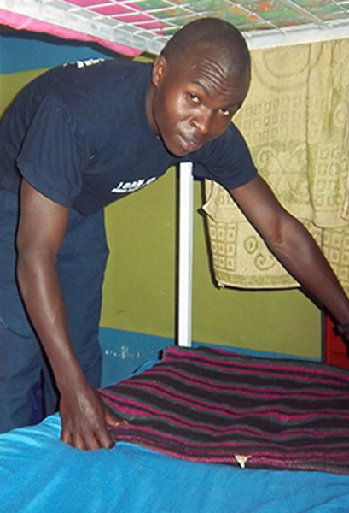
The Eagles Project
After the Butterfly Project for girls launched, they were challenged by frequent requests for assistance for young boys. They were moved by the stories of boys who were orphans and child laborers at the age of fourteen but remained determined to work hard in school and achieve their dreams. Many walked for several miles to the campus asking for an opportunity to learn.
The Eagle’s Initiative for boys, ages 13-18 years old provides educational opportunities to high achieving boys who perform above 80% of Kenya’s national academic average in primary school. Their families are normally unable to afford school fees, which places them at risk of drug-use, homelessness and unemployment, ultimately perpetuating poverty cycles within the family structure. All boys admitted into the program receive a quality education, housing, meals and enrichment activities.

Slide 20
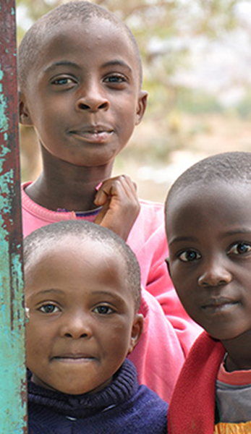
The Little Butterflies
It is not uncommon for girls ages 6 to13 years old in certain regions throughout East Africa to experience early marriages, trafficking, rape and unplanned pregnancies. In some remote villages where resources like schools, hospitals, police stations and employment are scarce, young girls face greater hardships. Girls are married off to elderly men for dowry exchanges in the form of cash and cows. Others are given out for sex in exchange for products such as blankets, bread and beer. This issue exists because of cultural norms practiced by particular tribes and lack of accountability enforcing the law against early marriages and FGM from regional officers.
Through their partnerships with local non-profit entities, churches and concerned individuals they are able to identify young children who are in need. Once a child is taken into their program, her education, shelter, meals, counseling and enrichment activities are fully sponsored. An approved school facility that offers a safe living environment helps the child continue her life on a path toward healing, recovery and transformation.

Slide 21
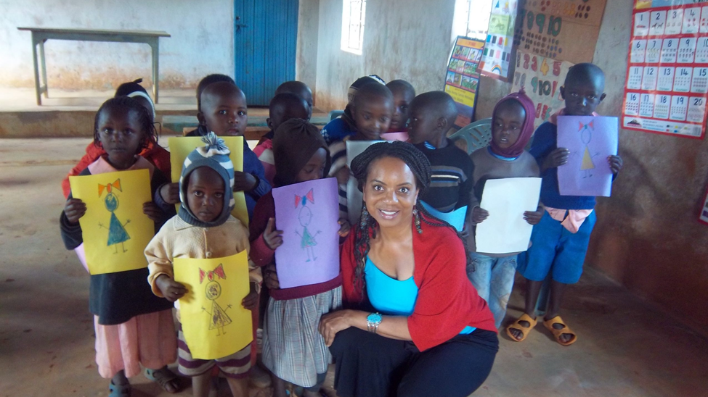

Slide 22
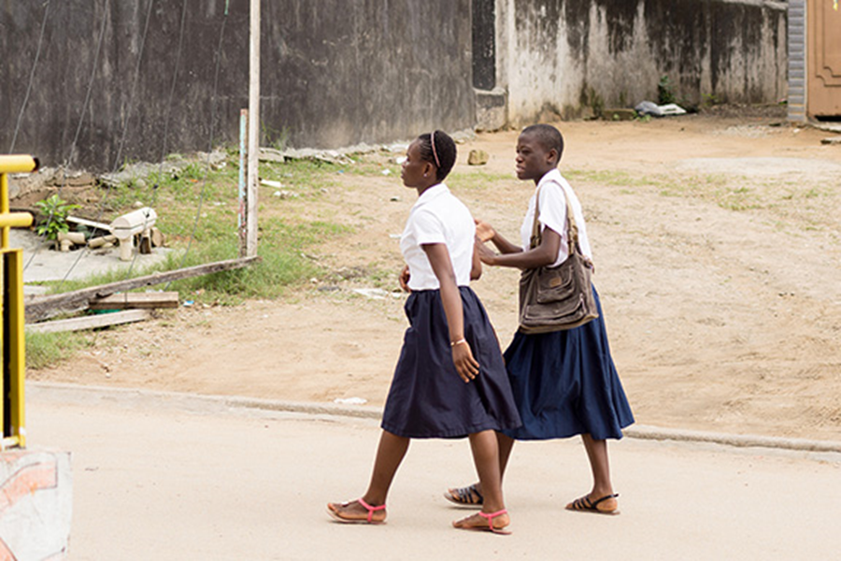
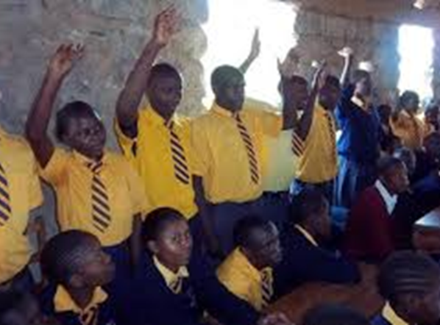
The Scholars
ICF also helps High School seniors who qualify for universities, colleges and trade schools transition into their next phase of life. Most graduating seniors enter schools of higher education with little to no assistance because of poverty in their families and communities. To help relieve some of the financial hardships they face, ICF provides small scholarships to students after admission into their school of choice. The scholarships are used for an array of needs such as college tuition, housing, food and books.

Slide 23
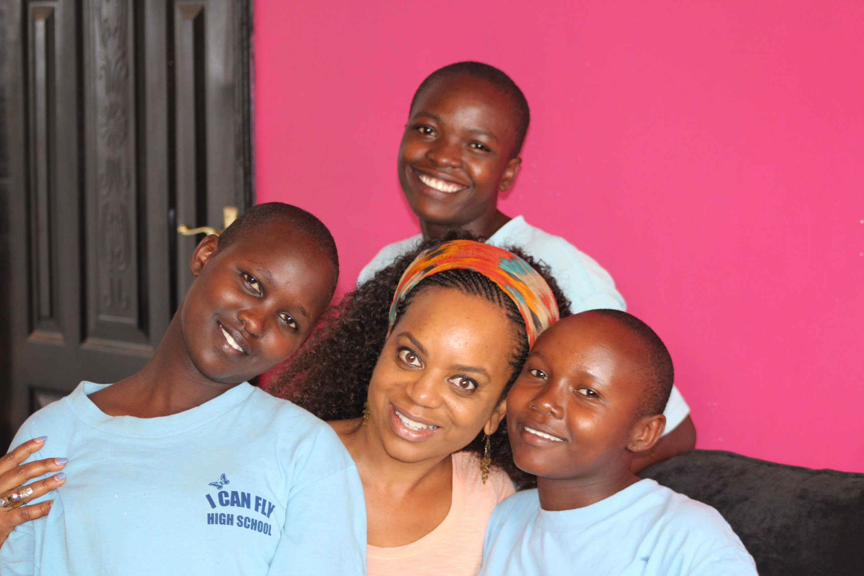
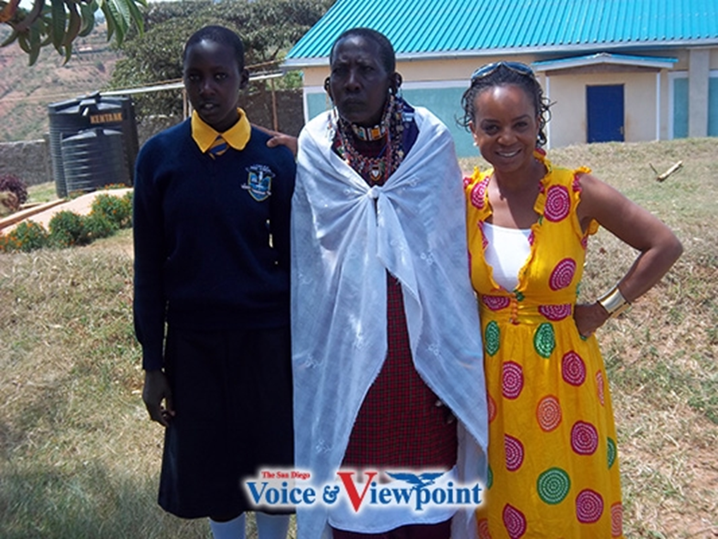
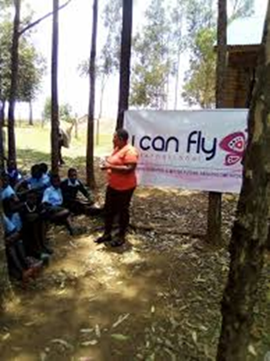
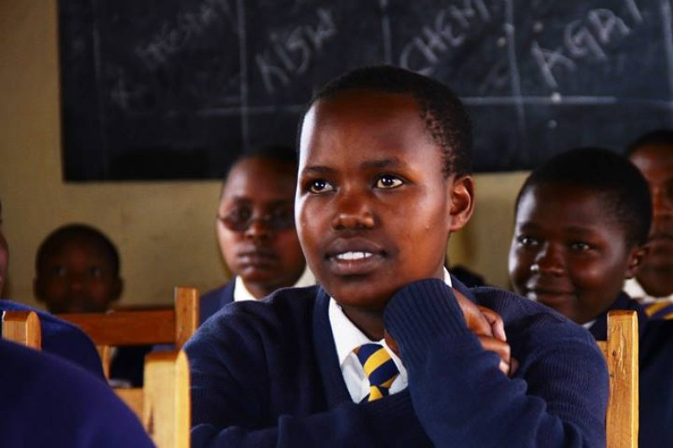
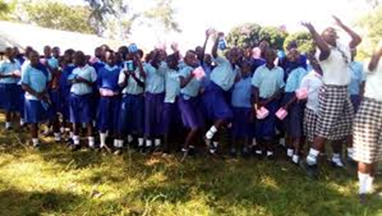
The Work

Slide 24

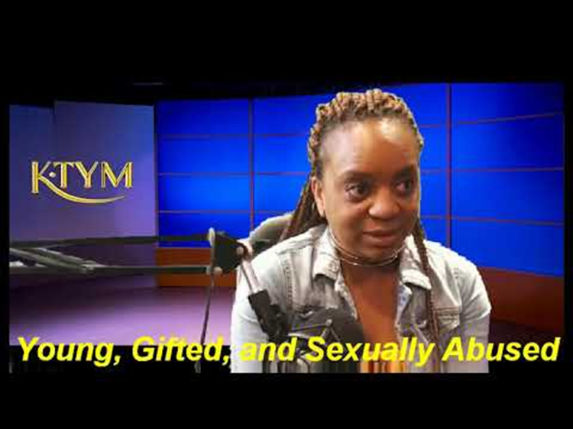
SPEAKING APPEARANCES

Slide 25
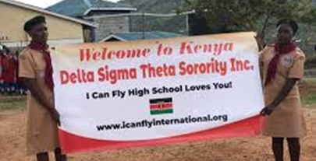

Slide 26
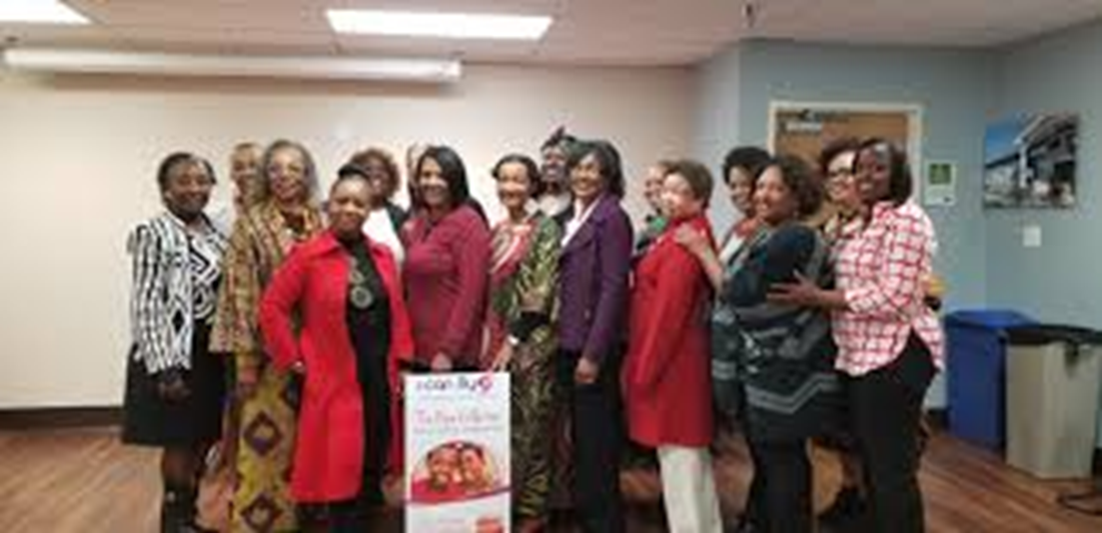

at NSDCAC

Slide 27
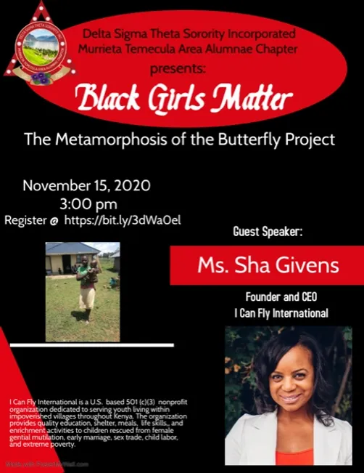

To learn more about
Soror Sha Givens,
MTAAC is hosting
Black Girls Matter
The Metamorphosis of the
Butterfly Project
on November 15th.
Please register today!

Slide 28
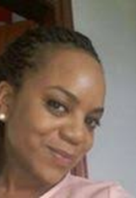
Soror Sha’ Givens,
Thank you for allowing God to use you to empower women, vulnerable children and youth around the world through education and justice initiatives. You are a real-life, real time, right now inspiration.

Slide 29
REFERENCES
Sha’ Givens. Voyage LA. www.http://voyagela.com/interview/meet-sha-givens-can-fly-international-los-angeles-view-park
Hill, Kimetha. 2014. Living God’s Purpose: Rev. Sha’ Givens Establishes I Can Fly International in Kenya. Voice and Viewpoint. www.https://sdvoice.info/living-gods-purpose-rev-sha-givens-establishes-i-can-fly-international-in-kenya/
I Can Fly.icanflyinternational.org.
The Weight She Carries. https://theweightshecarries.com/founder-of-butterfly-girls-project-shares-her-story-of-being-drugged-and-raped/
YouTube KTYM Media Gospel Internet. 2018. Young, Gifted and Sexually Abused.
Delta Sigma Theta Sorority, Inc. 2019. Southern Region. Alabama State Cluster. https://dstsouthernregion.com/Documents/Call%20To%20Cluster%202019-2020%20Final.pdf
China House launches project to combat FGM in Kenya. https://chinadevelopmentbrief.cn/reports/china-house-launches-project-to-combat-fgm-in-kenya/

