Slide 1
TITLE
Date
Designing a Study for Statistical Analysis
Mr. Renato

Slide 2
Designing a Study for Statistical Analysis
Today’s Objectives:
You will learn:
How to Design a Study for Statistical Analysis
How to Evaluate a Study
Long-term Objectives:
Prepare you for future lessons related to:
Using statistics to make fair decisions
analyzing decisions and strategies using statistical concepts

Slide 3
Designing a Study for Statistical Analysis
Activities for Today to Help you Accomplish Objectives of Designing and Evaluating Studies:
Give an overview of what a study is
Work together to Remember aspects of studies
Analyze studies
Work together and in groups to practice Evaluating, Designing, and Planning studies
Before we begin… let’s look at 3 Essential Questions…

Slide 4
Essential Questions
What is a statistical analysis?
What is a study?
Why are studies done?

Slide 5
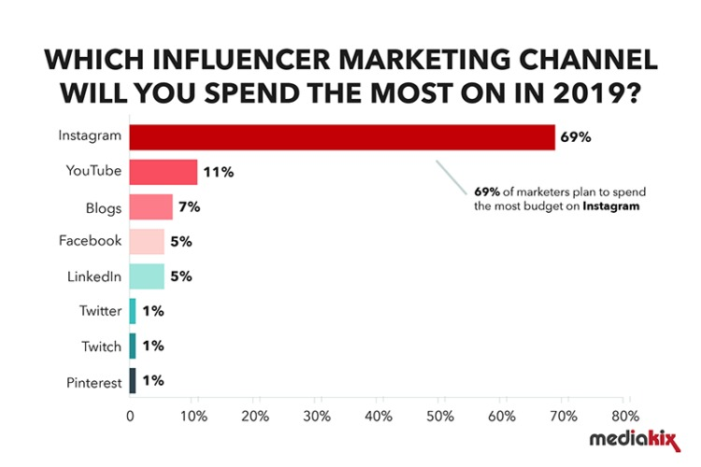
What is Statistical Analysis?
Representation of Data
What is the purpose and why do we care about statistical analysis?
Understand relationships between things
Explain behavior or phenomena
Predict what people or companies will do (which can help guide other people’s decisions)
How do you use statistics in your daily life?
…. How are statistics created? They come from studies.

Slide 6
What is a Study?
A study is a process that begins by asking a question that can be answered with data.
Define why you need the study/analysis – to understand a phenomenon
Formulate what study design, operations, and layout are needed
Collect data
Clean-up the data
Look at presentation possibilities
Solve the problem by reviewing the data
Conclude – Give your conclusions
Today – we will focus on beginning aspects of Steps 1 – 2 and part of 3. (Because the next lessons focus on data representation, aspects of data, and interpretation of data)
…. How do you start a study? Start with “What Kind of Study do I want?”

Slide 7
Decide the Kind of Study
To create a study, you have to choose
What kind of study you will use and
How to sample the population.
…. You have two kinds of studies to start thinking about…

Slide 8
Experimental & Observational Studies
Experimental
Controlled
Attempt to understand a Cause-and-Effect Relationship
Assign groups
Decide how each group is treated
Someone is running it.
Observational
Not controlled
Attempts to understand relationships
No groups assigned
Did not decide how each group was treated
You did not create the situation – someone else did.

Slide 9
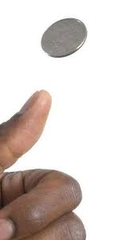
Coin Tossing - Experiment
Coin tossing as a study to determine how many times something lands on heads or tails
Activity:
Go into groups of 2 and toss a coin 10 times.
Pick 1 person to toss the coin and the other to record the results.
Record:
How many times does a coin land on heads? Tails?
Report back your findings to the class

Slide 10
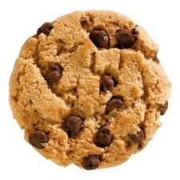
The Chocolate Chip Cookie – Observing How Many Chips are in a bag of Chip’s Ahoy?
Activity (together as a class):
Determine how many chocolate chips are in a bag of Chips Ahoy
What do you need to know?
Report back your findings:
How many chips in a cookie?
How many cookies in a bag?
What was the difference between the two studies?

Slide 11
Experimental & Observational Studies
Experimental
Controlled, i.e. 10 coin tosses
Attempt to understand a Cause-and-Effect Relationship
Assign groups
Decide how each group is treated
Someone is running it.
Observational
Not controlled
Attempts to understand relationships (chips to cookies to number of chips in a bag)
No groups assigned
Did not decide how each cookie or group of cookies were treated.
You did not create this – someone else did.
Next: Decide who or what you will study: your population.

Slide 12
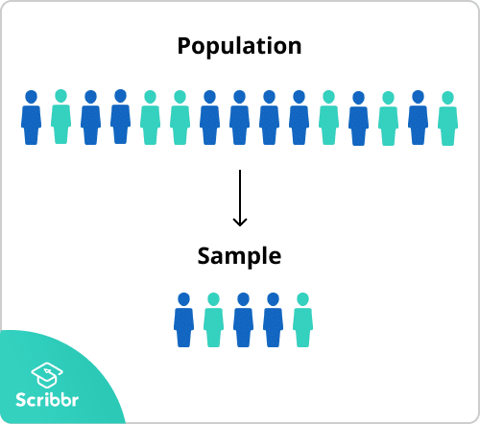
Designing a Study
Start with a population
What is a population?
In Math, what is the symbol for population?
= N (big N)
Create a sample
What is a sample?
In Math, what is the symbol for sample?
= n (little n)
Why use a sample?
Apply what you know in the next slide:

Slide 13
Populations and Samples
In the Cookie example
What was Your:
Population?
Sample?
Next: Decide your method of sampling.

Slide 14
Sampling Methods
Good sampling involves “probability”-the chance that something will occur or be present.
One method is probability sampling
Another method is non-probability sampling.
…. What is the difference?

Slide 15
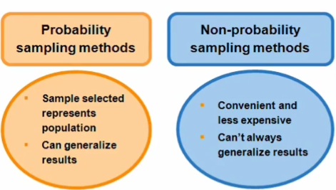
Sampling Methods

Slide 16
Sampling Methods – Simple Random Sampling

Slide 17
Sampling Methods – Systematic Random Sampling

Slide 18
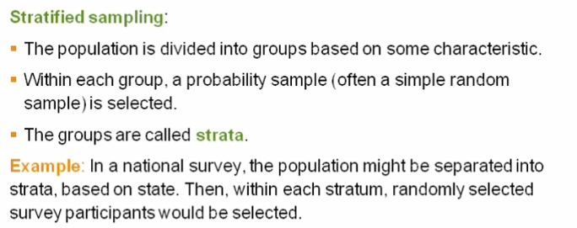
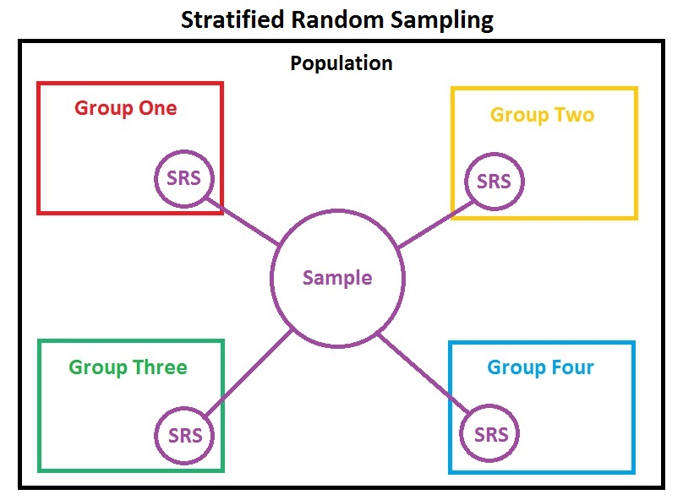
Sampling Methods – Stratified Sampling

Slide 19
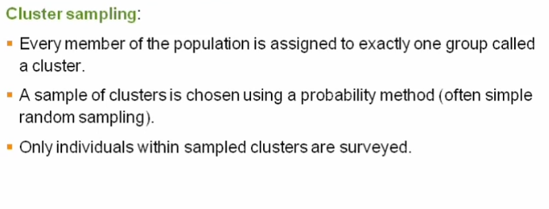
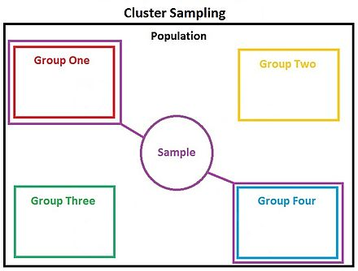
Sampling Methods – Clusters

Slide 20
Remembering and Analyzing …
What’s the difference between a stratified sample and a simple random sample?
What are the various parts of an experiment?
What are the key differences between stratified sampling and cluster sampling?

Slide 21
Non-Probability Sampling

Slide 22
Non-Probability Sampling – Why Not Use?

Slide 23
Evaluating Studies
What is better? Voluntary or simple random sampling? Why?

Slide 24
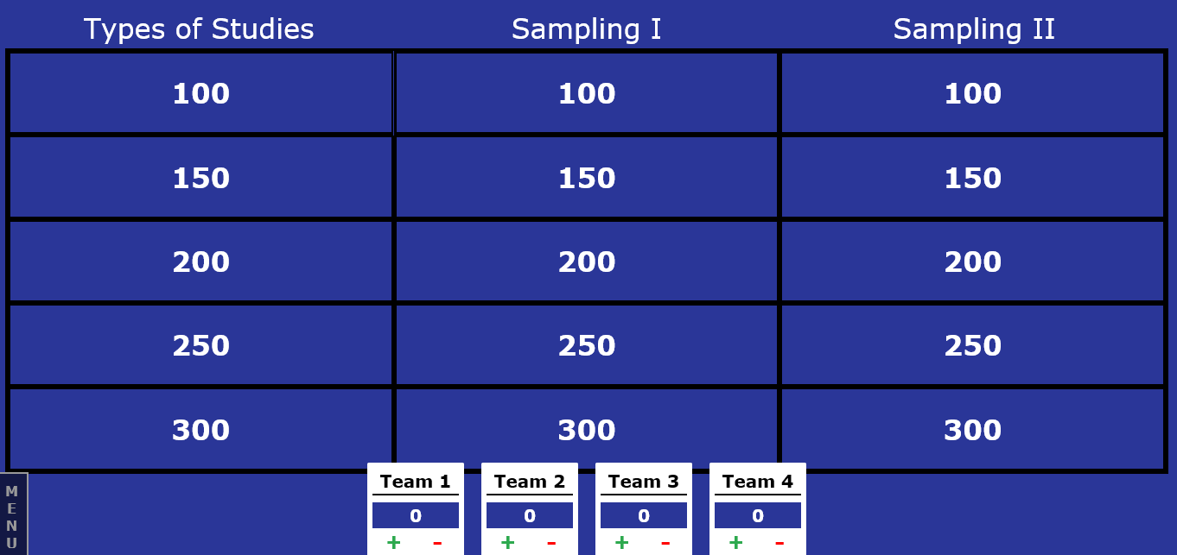
Let’s Play Jeopardy!
https://jeopardylabs.com/play/designing-a-study

Slide 25
Design a Study:
Activity: Design a Study. In small groups, you will create a study and discuss with the class.
Performance Task 1:
Design a study in which you determine the number of times you pick 5 of the same round items out of a bag of 20 items.
What other items can you put in there and how many of each? (Creating the population)
Performance Task 2:
Design a study in which you choose a sample of customers from a store to determine what is their favorite color.

Slide 26
Designing a Study for Statistical Analysis – What you did today:
Today – You learned:
How to Design a Study for Statistical Analysis
How to Evaluate a Study
Activities we did together as a class:
Gave an overview of what a study is
Worked to Remember and Analyze studies
Worked together and in groups to Evaluate, Design, and Plan studies

Slide 27
Questions? Next: Take quiz Next week: Representing Data

