Slide 1
TITLE
Date
Expected Value
Mr. Renato

Slide 2
Expected Values
Today’s Objectives:
You will learn how to:
Calculate Expected Values
Calculate Probabilities of Independent Events

Slide 3
Expected Value
What is Expected Value

Slide 4
Expected Value
https://www.youtube.com/watch?v=b6VK2VPMXNI

Slide 5
Expected Value
https://www.youtube.com/watch?v=b6VK2VPMXNI

Slide 6
Expected Value
https://www.youtube.com/watch?v=b6VK2VPMXNI

Slide 7
Expected Value

Slide 8
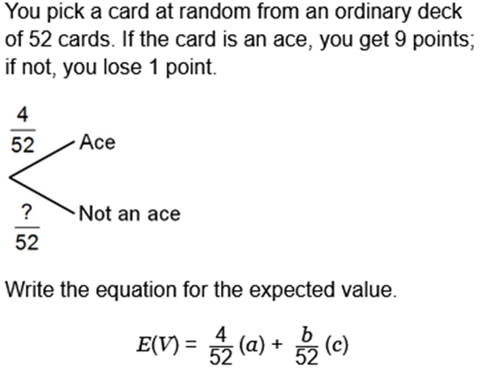
Expected Value

Slide 9
x
0.8
0.2
0.8
x
0.2
1.6

Slide 10
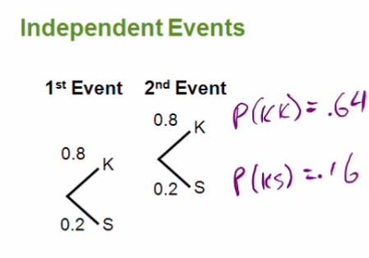

Slide 11
Review
Today’s Objectives:
You learned how to:
Calculate Expected Values
Review what are Independent Events

Slide 12
Questions? Next: Finish Assignment and Complete Quiz

