Slide 1
TITLE
Date
Representing Data
Mr. Renato

Slide 2
Representing Data
Today’s Objectives:
You will learn how to:
Describe a data set
Determine if data represented is misleading

Slide 3
Representing Data
Activities for Today to Help you Accomplish Objectives of Designing and Evaluating Studies:
Give an overview of: charts
Work together to Remember aspects of: charts, box plots, stem and leaf charts
Analyze graphs
Before we begin… let’s look at ways we can describe data.

Slide 4
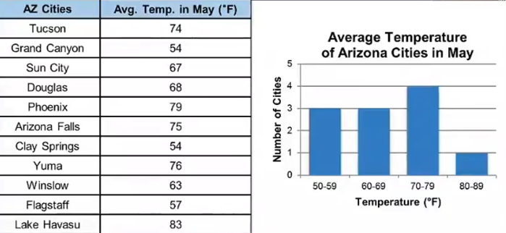
How Can you Describe a Set of Data
Title
Check the table information (look for specific details)
Check the intervals for width
Review the scale
Where does y-axis start? Where does x-axis start?
Let’s look at Categorical Data.

Slide 5
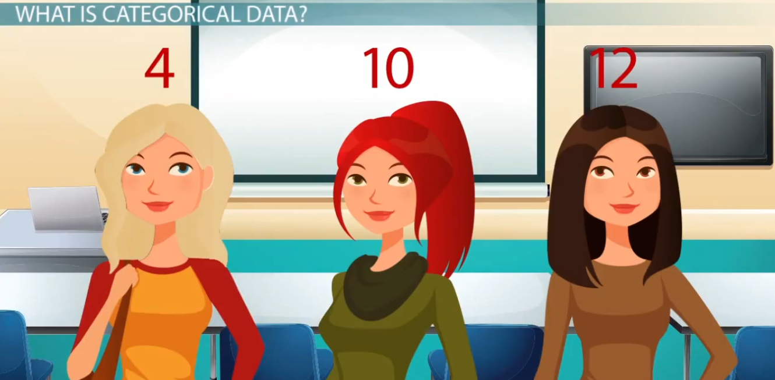
Categorical Data
Let’s look at Categorical Data compared to Numerical Data.

Slide 6
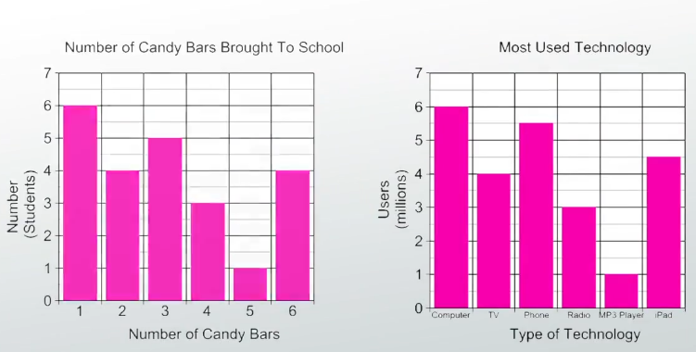
Numerical Data
What is numerical data?
How does it differ from categorical data?
Now, let’s look at different numbers to summarize a set of data.

Slide 7
How Can you Describe a Set of Data – Mean, Median, Mode
Data can be described by using the following:
Mean: the Average
Median: the point in the middle
Mode: the most frequently occurring
Range: What is the difference between the high and low numbers.

Slide 8
How Can you Describe a Set of Data – Mean, Median, Mode
Data can be described by using the following:
Mean: the Average
Median: the point in the middle
Mode: the most frequently occurring
Range: What is the difference between the high and low numbers.

Slide 9
How Can you Describe a Set of Data – Mean, Median, Mode
Data can be described by using the following:
Mean: the Average
Median: the point in the middle
Mode: the most frequently occurring
Range: What is the difference between the high and low numbers.

Slide 10
How Can you Describe a Set of Data – Mean, Median, Mode
Data can be described by using the following:
Mean: the Average
Median: the point in the middle
Mode: the most frequently occurring
Range: What is the difference between the high and low numbers.

Slide 11
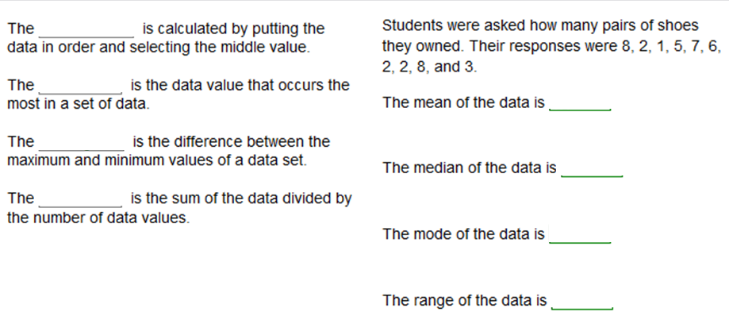
How Can you Describe a Set of Data – Fill this out with your partner
Recall:
Mean: the Average
Median: the point in the middle
Mode: the most frequently occurring
Range: What is the difference between the high and low numbers.

Slide 12
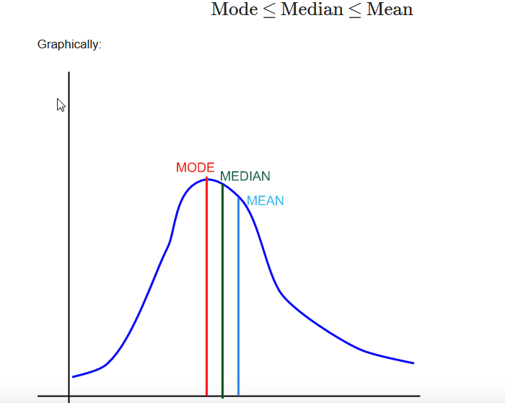
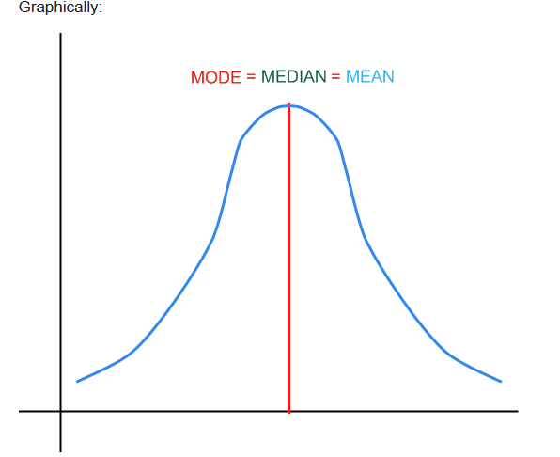
How Can you Describe a Set of Data – Mean, Median, Mode
Data can be described by using the following:
What if the 3 are not equal?
Graph becomes Skewed

Slide 13
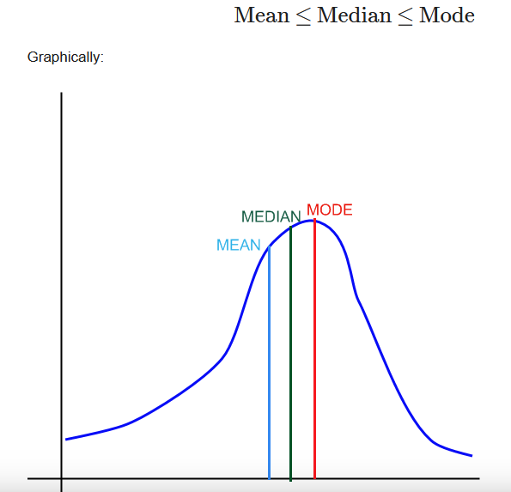
What is Skewed? Skewedness?
Which graphs are Skewed?
When data are not equally represented, there is a tendency for the graph to look like it’s leaning one direction or another, and not even.

Slide 14
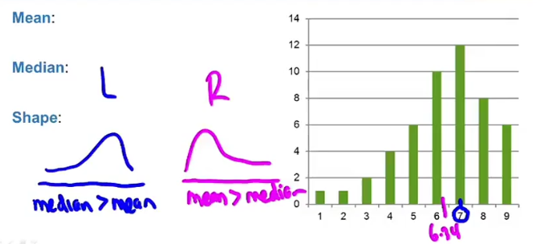
What is Skewed? Skewedness?
Skewed right: Data to the Left
Skewed left: Data to the Right

Slide 15
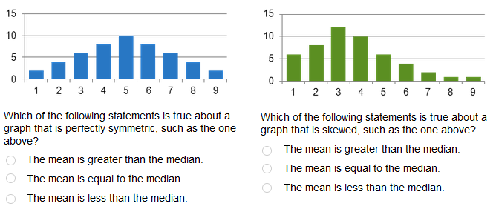
What is Skewed? Skewedness?
Let’s look at how to view data using Box and Whiskers

Slide 16
Patterns of Graphs – What is a stem and leaf?
Video:
https://www.khanacademy.org/math/ap-statistics/quantitative-data-ap/histograms-stem-leaf/v/u08-l1-t2-we3-stem-and-leaf-plots
https://www.khanacademy.org/math/ap-statistics/quantitative-data-ap/histograms-stem-leaf/v/u08-l1-t2-we3-stem-and-leaf-plots

Slide 17
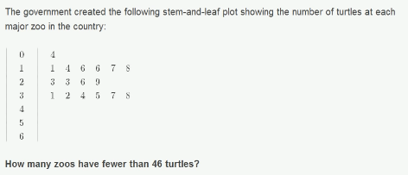
Patterns of Graphs – Apply

Slide 18
Patterns of Graphs – What is Box and Whiskers?
Video:
https://www.khanacademy.org/math/cc-sixth-grade-math/cc-6th-data-statistics/cc-6th-box-whisker-plots/v/constructing-a-box-and-whisker-plot
https://www.khanacademy.org/math/cc-sixth-grade-math/cc-6th-data-statistics/cc-6th-box-whisker-plots/v/another-example-constructing-box-plot
After watching the videos: Describe: Quartiles

Slide 19
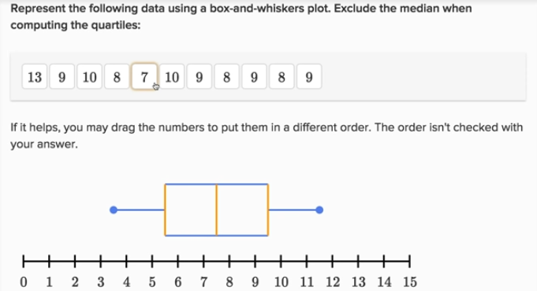
Patterns of Graphs – Apply

Slide 20
Review

Slide 21
Review – Mean, Median, Mode
The mean, median and mode are the most typically used measures of center. The mean and median are used for quantitative data, and the mode is used for categorical data.
For quantitative data, one would typically use the mean. With one caveat: the mean is very sensitive to outliers. This means that one outlier (either legitimate value or a typing error) could make a drastic difference on the value of the mean.
In such cases, when there are outliers or the distribution is fairly skewed, it is preferable to use the median as the most accurate measure of center, because the mean gets distorted by skewness or outliers.
One example of this is when samples are collected to assess income of the respondents.
If we take a sample of 100 people, and we find that 99 of them make $10,000 per year, and 1 person makes $100 million per year, the average income of that sample would be (10,000*99 + 1*100,000,000)/100 = $1,009,900.00.
So, on average, everyone makes $1,009,900.00, so you would get the idea that this sample must come from a very affluent area, but that is not the case: it is just one outlier highly distorting the mean. Indeed, in this case, the median is $10,000, which is a much more representative value of center for this sample.

Slide 22
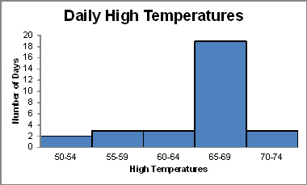
Recall and Apply: How Can you Describe a Set of Data – Mean, Median, Mode
What is the best way to describe this graph? In terms of mean, median, mode, or range?
Why?

Slide 23
Patterns of Graphs – Apply

Slide 24
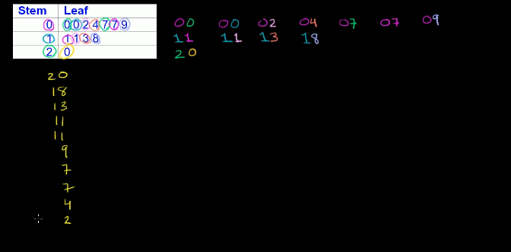
Patterns of Graphs – Apply
Answer:

Slide 25
Questions? Next: Take quiz Next week: Standard Deviation

