Slide 1

TITLE
Margin of Error
Mr. Renato
Date

Slide 2

Today’s Objectives:
You will learn how to:
How to use Margin of Error

Slide 3
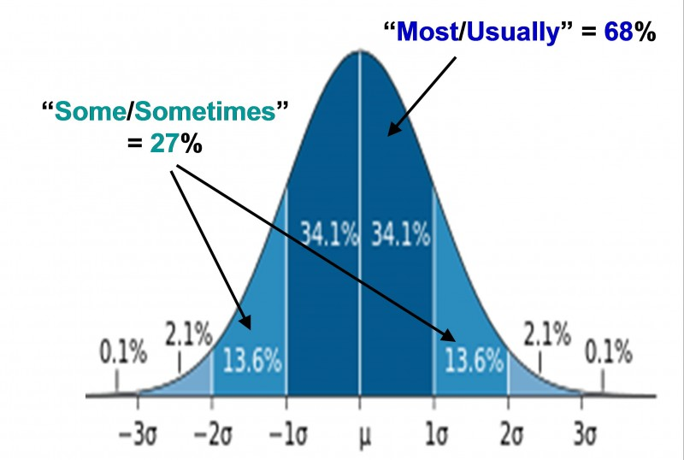
Normal Curve - Recall

Slide 4
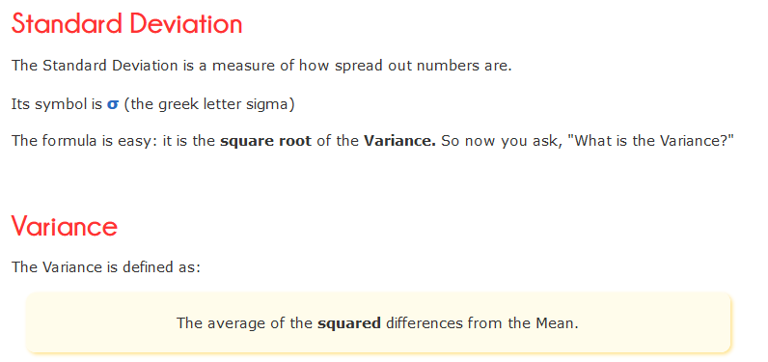
Standard Deviation - Recall

Slide 5
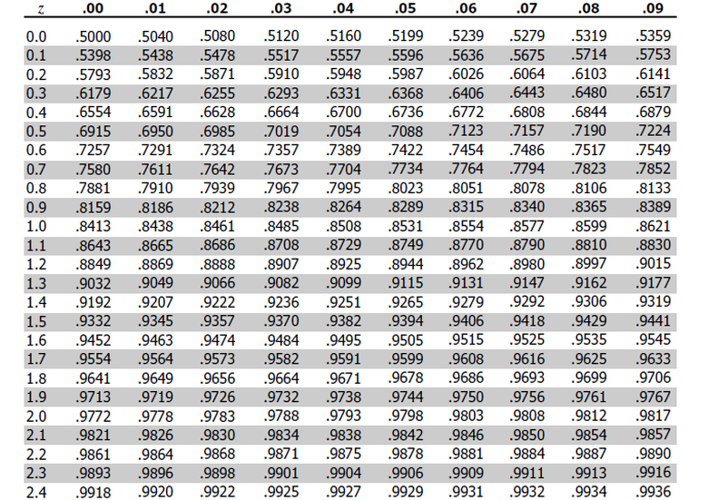
Z-Table - Recall
http://www.z-table.com/

Slide 6

Margin of Error – Who, What, Where…
Who needs to calculate Margin of Error
What Margin of Error is
Where to use Margin of Error
When Margin of Error is used
Why Margin of Error is important

Slide 7

Margin of Error – Who, What, Where…
When a research question asks you to find a statistical sample mean (or average), you need to report a margin of error, or MOE, for the sample mean.
You can also calculate the margin of error of a sample proportion, which is the amount of “successes” in a sample compared to the whole.
The general formula for the margin of error for the sample mean:

Slide 8
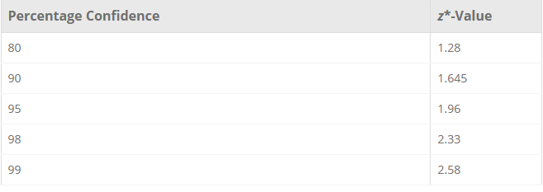
Margin of Error
Sigma is the population standard deviation, n is the sample size, and z* is the appropriate z*-value for your desired level of confidence (which you can find in a z-table).

Slide 9
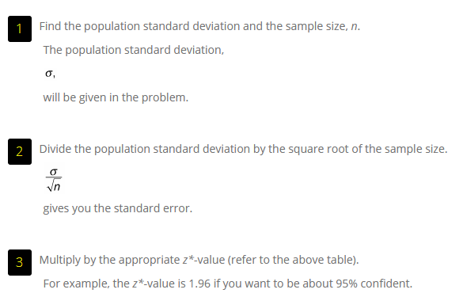
Margin of Error

Slide 10
Margin of Error
Suppose you’re the manager of an ice cream shop, and you’re training new employees to be able to fill the large-size cones with the proper amount of ice cream (10 ounces each).
You want to estimate the average weight of the cones they make over a one-day period, including a margin of error.
Instead of weighing every single cone made, you ask each of your new employees to randomly spot check the weights of a random sample of the large cones they make and record those weights on a notepad.
For n = 50 cones sampled, the sample mean was found to be 10.3 ounces. Suppose the population standard deviation is 0.6 ounces.
What’s the margin of error? (Assume you want a 95% level of confidence)

Slide 11
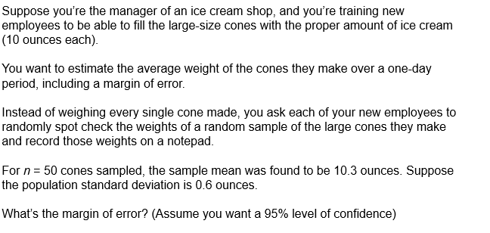

Margin of Error

Slide 12
Margin of Error – So What?
So to report these results, you say that based on the sample of 50 cones, you estimate that the average weight of all large cones made by the new employees over a one-day period is 10.3 ounces, with a margin of error of plus or minus 0.17 ounces.
In other words, the range of likely values for the average weight of all large cones made for the day is estimated (with 95% confidence) to be between 10.30 – 0.17 = 10.13 ounces and 10.30 + 0.17 = 10.47 ounces.
The new employees appear to be giving out too much ice cream (although the customers probably aren’t too offended).

Slide 13
Today’s Objectives:
You learned how to use Margin of Error
Who needs to calculate Margin of Error
What Margin of Error is
Where to use Margin of Error
When Margin of Error is used
Why Margin of Error is important

Slide 14
Questions?

Slide 15
Thank you and Have a GREAT WEEKEND!!!

