Slide 1
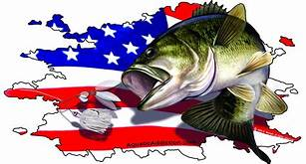
Ellsworth Results
June 13, 2020
TEAM # OF FISH BIG BASS WEIGHT POINTS
K. BUTLER/K. BUTLER 5 3.48 13.12 65.12
M. MICHELSON/C. GOODWIN 5 4.16 12.36* 64.36
R. ARNHART/G. ZARING 5 3.92 11.37 61.37
M. REEVES/G. GREEN 5 3.90 10.49* 59.49
C. MARSHALL/C. FRANKLIN 5 2.78 9.98 57.98
J. MARTINES/T. GIPSON 5 2.66 9.38 56.38
L. LANKFORD/R. JARVIS 4 2.55 8.68 53.68
D. SCOTT 4 DNW 7.85 51.85
B. BREEZE/J. WYATT 5 DNW 7.68 51.68
K. DAVENPORT/T. DAVENPORT 5 DNW 5.65 48.65
D. MILLER/M. PIERCE 3 2.83 5.61 46.61
C. CONDER/Z. FANSLER 4 1.85 5.59 45.59
B. TOMPKINS/S. TOMPKINS 3 2.25 5.52 44.52
W. MURPHY/R. MURPHY 1 4.06 4.06 42.06
S. LEAF/G. ALLEN 2 DNW 3.05 40.05
* = 1 pound penalty dead fish

