Slide 1
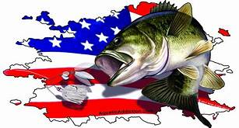
Fort Cobb, Oklahoma
June 4, 2022
TEAM # OF FISH BIG BASS WEIGHT POINTS
L. LANKFORD/M. LANKFORD 5 4.95 20.57 73.57
G. GREEN/M. REEVES 5 4.51 19.48 70.48
J. MARTINEZ 5 3.96 17.47 67.47
A. HOLLIMAN/K. BILLINGS 5 3.38 15.84 64.84
J. FRYE/C. PEET 4 4.72 13.46 60.46
R. CASTLEBERRY/J.CASTLEBERRY 4 4.32 12.24 57.24
K. BUTLER/K. BUTLER 5 3.55 11.63 57.63
R. ARNHART/G. ARNHART 3 4.34 9.84 53.84
S. BOYD/J. COATS 2 4.21 7.07 50.07
S. LEAF/C. YOUNG 2 4.31 6.37 48.37
M. MICHELSON/C. GOODWIN 2 DNW 3.91 44.91
V. POWERS/T. POWERS 1 2.88 2.88 42.88
J. HEAD/J. COMPTON 0 0.00 0.00 1.00
T. WILLIAMSON/K.C. JOINERS 0 0.00 0.00 1.00
K. DAVENPORT/T. DAVENPORT 0 0.00 0.00 1.00
R. JARVIS/A. JARVIS 0 0.00 0.00 1.00

