Slide 1
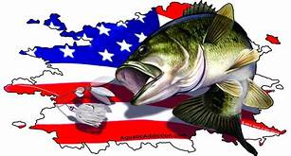
Lake Lawtonka Results June 9, 2018
TEAM # OF FISH BIG BASS WEIGHT POINTS
S. LEAF/G. ALLEN 5 1.94 8.38 60.38
M. MICHELSON/C. GOODWIN 1 6.50 6.50 57.50
A. HOLLIMAN/K. BILLINGS 4 1.68 6.03 55.03
G. BRANNAN/T. JIMESON 2 2.60 4.06 52.06
J. WYATT/T. GIPSON 2 1.87 3.21 50.21
C. CONDER/Z. FANSLER 2 1.86 3.07 49.07
M. PIERCE/D. MILLER 1 2.05 2.05 47.05
W. MURPHY/R. MURPHY 1 1.64 1.64 45.64
J. DOWNS/B. TOMPKINS 1 1.53 1.53 44.53
M. LANKFORD/J. LANKFORD 1 1.34 1.34 43.34
K. BUTLER/K. BUTLER 2 DNW 1.29* 42.29
K. DIGBY/J.J. MONROE 1 1.25 1.25 41.25
K. DAVENPORT/T. DAVENPORT 0 0.00 0.00 1.00
B.BREEZE/R. OLIPHANT 0 0.00 0.00 1.00
J. MARTINEZ/H. MARTINEZ 0 0.00 0.00 1.00
S. OUSLEY/F. VANPELT 0 0.00 0.00 1.00
* 1 POUND PENALTY – DEAD FISH

