Slide 1
Earning Beyond Royalties!
Bob McGough - talesbybob.com

Slide 2
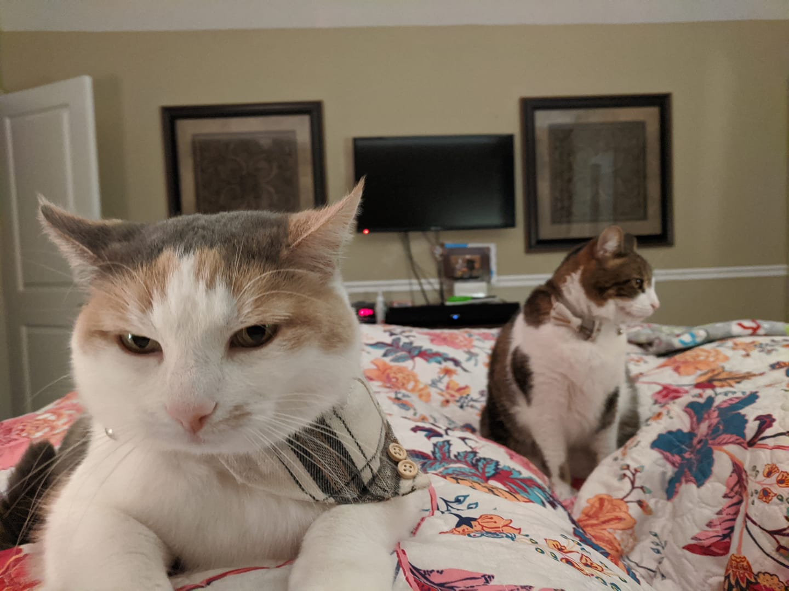
Who Am I?
Started in 2012 with NaNoWriMo.
Originally traditionally published.
After some mentoring, began to seriously self publish in 2021.
Author, podcaster, indie game designer, freelancer.
Collects useless academic degrees.
Loves puns.
Office Cats Parker and Olive.
Portly.

Slide 3
Why You Should Listen To Me:
Huge nerd, with a love of tracking stats.
Have been building my brand over the better part of a decade.
Has been to Paradise.
Learn from my mistakes, so you don’t have to make them!
I’m a more realistic example.
Huge emphasis on transparency.
Not Currently Paved, No Parking Lot

Slide 4
You Are An Author!
Sell Books!

Slide 5
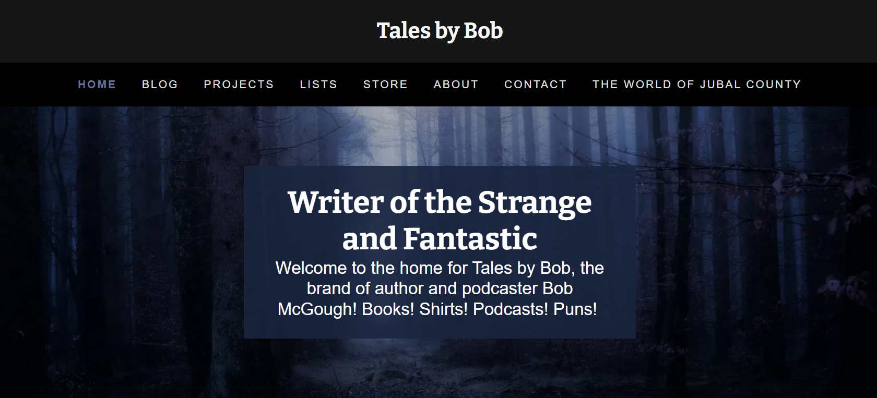
Establish Your Turf!
The goal needs to be to always get people onto your turf.
Your turf is your email list, and your website.
Social media is constantly changing, don’t get burned!
Websites cost, email lists don’t.
Always have a signup sheet, the time to start building your email list was 5 years ago.

Slide 6
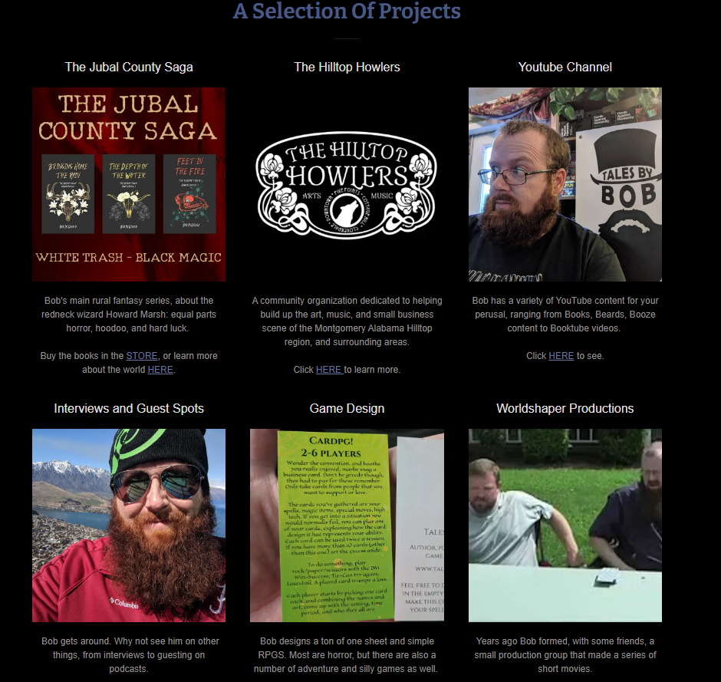
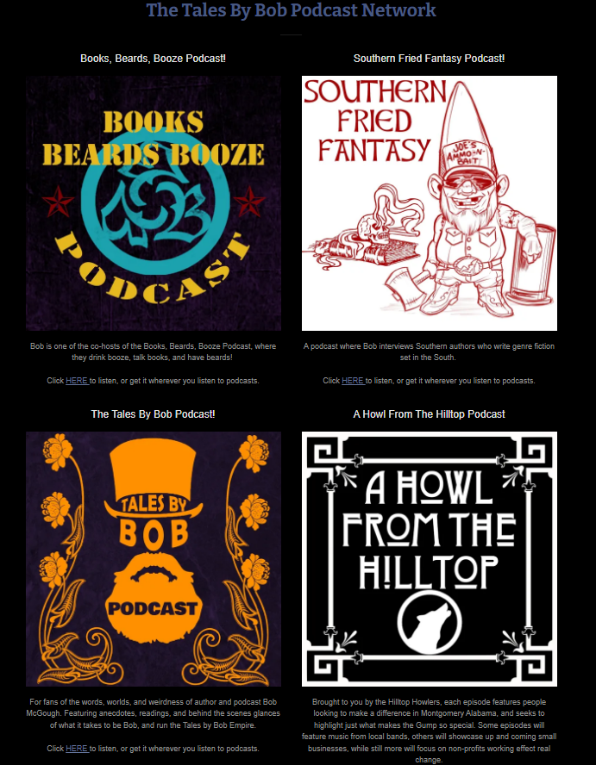
Build Over Time
This is not a race.
Take your time, do it right, don’t do it quick.
Start in your comfort zone, then expand outwards.
Think before you leap, to save redos.

Slide 7
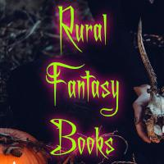
Knowing When To Fish Or Cut Bait
It’s often difficult to know when to stop investing time in an avenue.
Weigh how integral this is to your brand long term.
Weigh how much time it takes from task number one: writing.
Be patient, success will not happen overnight.
An example where Bob cut bait.
“Fish? Yes please!

Slide 8
Most Of What Works For Me…
…Probably Won’t Work For You!
At least not without tweaking to some degree.
This is my disclaimer, for the specifics I am going to hit you with.
At least not without tweaking to some degree.
This is meant more to show some universals, but also get you thinking.
Use your expertise! Huge on Lovecraftian Horror? Make Lovecraftian Horror shirts for example.

Slide 9
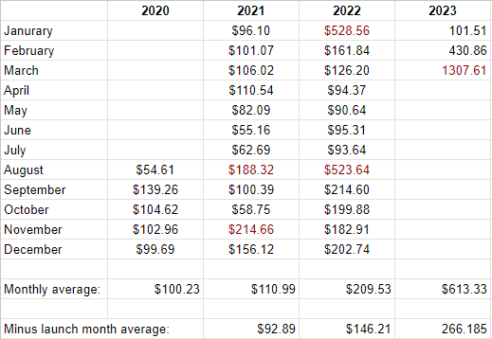
How Bob Makes Money
Many streams can grow to become a larger river.
I have 11 revenue streams, often multiple from one type of product for ease of scaling.
The goal is for book sales to be number one, always.

Slide 10
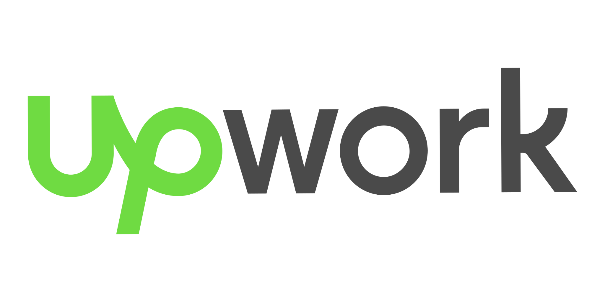
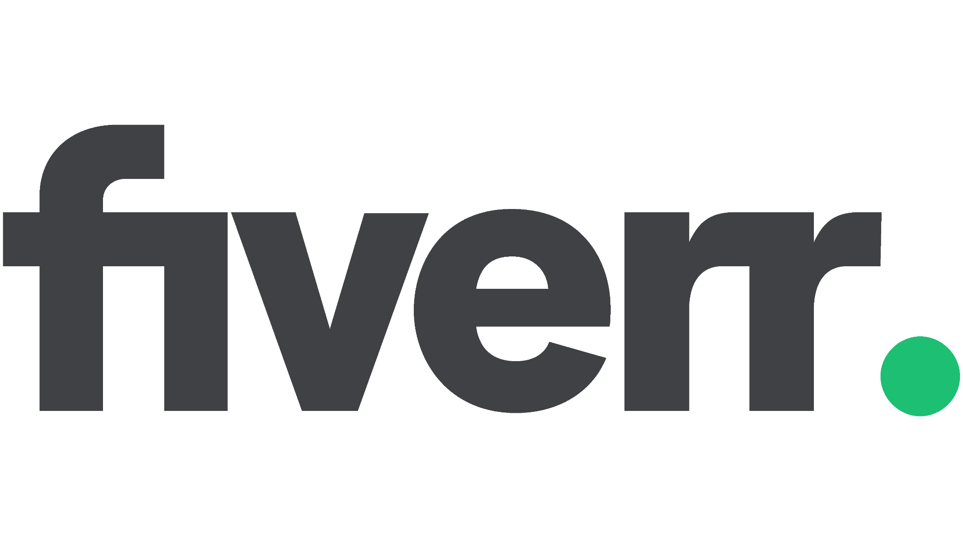
How Bob Makes Money - Freelancing
1
Was important early on, as I built out other streams.
Taught me skills, and meeting deadlines.
I used Fiverr.
Takes time to build up, which in turn takes time away from writing your own works.
Way to build the war chest.
You have interests outside writing - everything needs words!

Slide 11
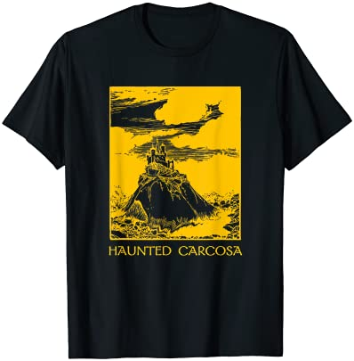
How Bob Makes Money - POD Shirts
2-4
Stick to what you know.
Use existing assets as much as possible to save on costs.
Learn graphic design, as some designs will never sell.
Products like Affinity > Adobe due to no recurring costs. Buy once, cry once.
I use: Amazon Merch, Redbubble, TeePublic. There are more. Many, many more.
Germans love me. So I guess I’m the wurst!

Slide 12
How Bob Makes Money - Shirts Continued Part 1
Option One: Make, Sell, Ship Them Yourself.
In this method you either buy a screen press and learn the process of making shirts yourself, or you contract out with a local screen printer. You order them in bulk, in a variety of colors and sizes, then list them on your website (or a site like etsy). When orders come in, you handle shipping them out.
Pros: You will have an inventory on hand to take to conventions. This is the most lucrative path, as you can get the shirts made very cheaply, and most if not all the profits go to you.
Cons: Very time consuming. Requires a number of upfront costs. You have to keep an inventory on hand. Very likely all marketing will be on you. Hard to diversify products, like offering mugs, popsockets, etc.

Slide 13
How Bob Makes Money - Shirts Continued Part 2
Option Two: Dropship Through A Platform Like Shopify
Here, you build a site using a platform like Shopify, or integrate it into your own site. You then connect to a dropshipping company like Printful. They handle the shipping, Shopify handles the sales and ordering, and you have control over the front end.
Pros: You have more control than dropshipping through another company. You have more control over the pricing. You pay less per item sold. All products on a site will be yours, you have less competition. Easy to diversify products. You can sometimes sell through other sites.
Cons: You have to draw people to your site. If you aren’t niche enough you can get lost in the mix. You often have to pay monthly fees to companies like Shopify. Which if you are selling thousands a month isn’t noticeable. But if you are only selling a few items, that can quickly eat up all your profits.

Slide 14
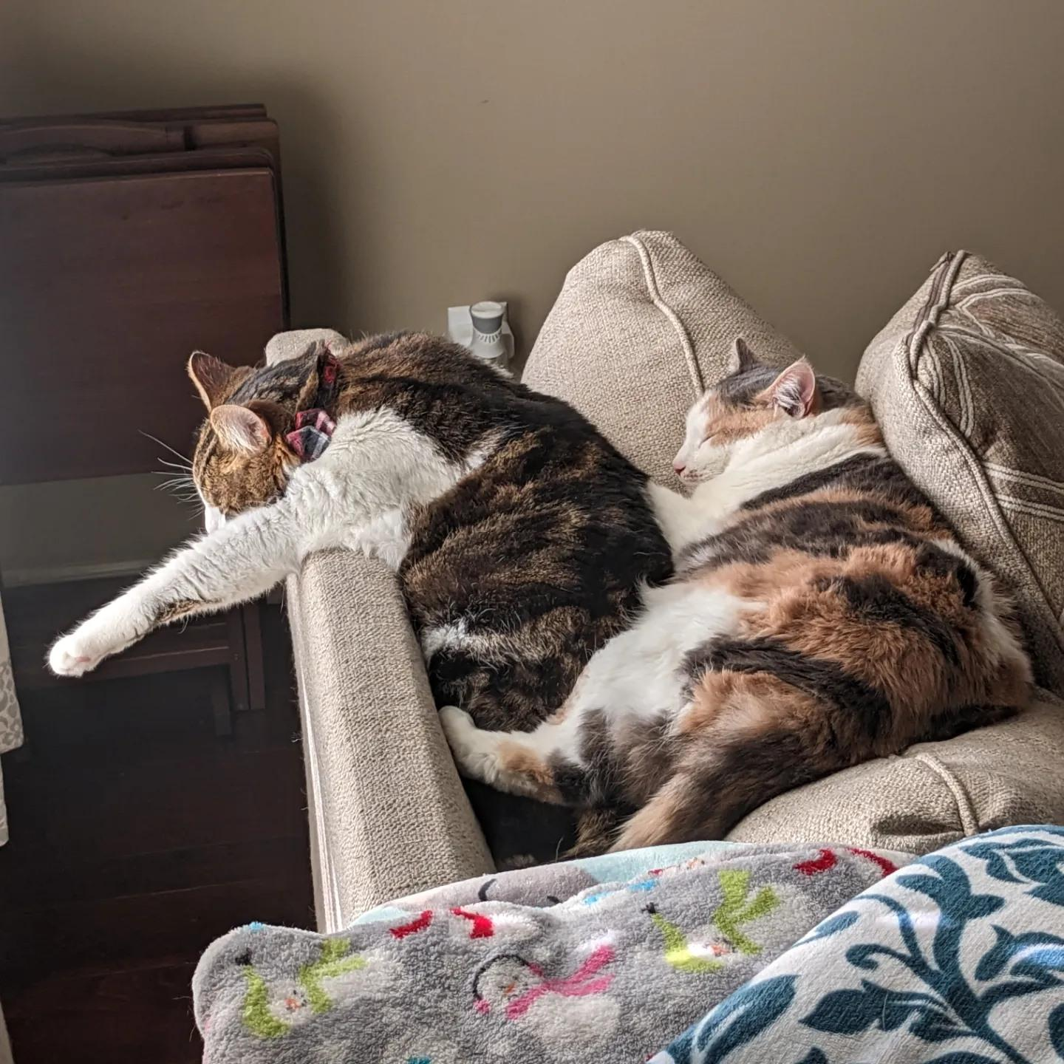
How Bob Makes Money - Shirts Continued Part 3
Option Three: Dropship Through A Company Like TeePublic
There are a large number of print on demand companies online that will handle every aspect of selling a shirt from printing, to selling, to shipping. You simply upload your design and they handle the rest, then cut you a check each month or quarter.
Pros: The easiest of the three choices, and potentially the least time consuming. There are zero upfront costs, beyond getting the design made. You are on sites where people come to shop for just these items. Fairly easy to embed links on your own site. Often easy to diversify products.
Cons: You will make less per shirt. These sites are often crowded, so it can be hard to get noticed.
“This is boring, move it along.”

Slide 15
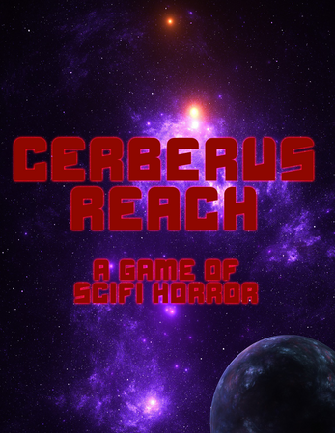
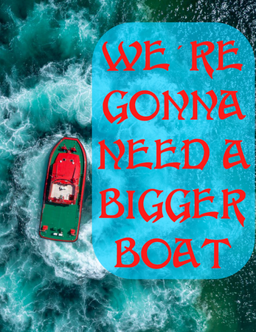
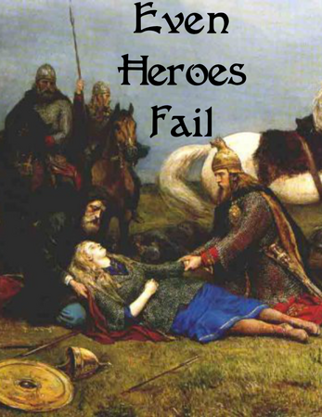
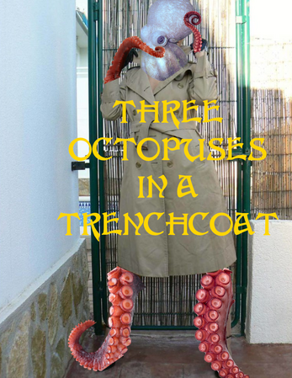
How Bob Makes Money - One Sheet RPGs
5-6
Again, huge nerd.
Deeply embedded in the RPG space.
One sheet rpgs are quick and easy to create for me, as game design is something I have experience with.
Virtually no cost to produce beyond time, as I make my own covers.
The space has somewhat low expectations in design aesthetic.
Bundles sell well.

Slide 16
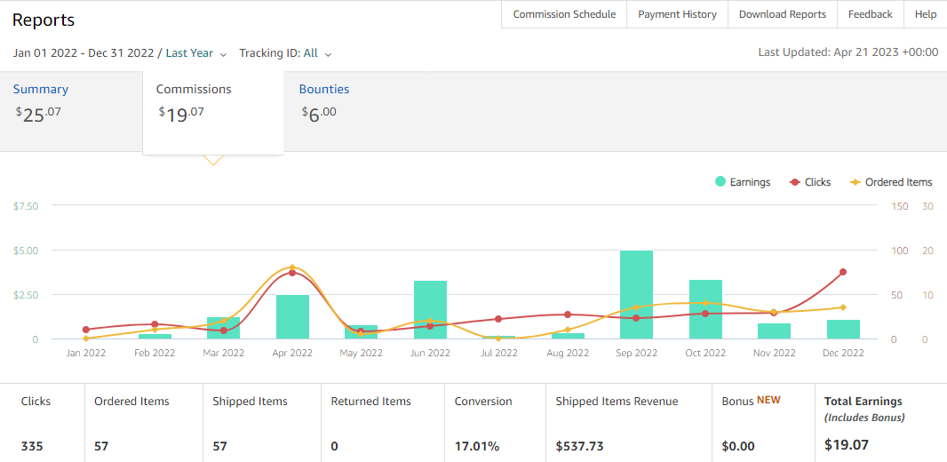
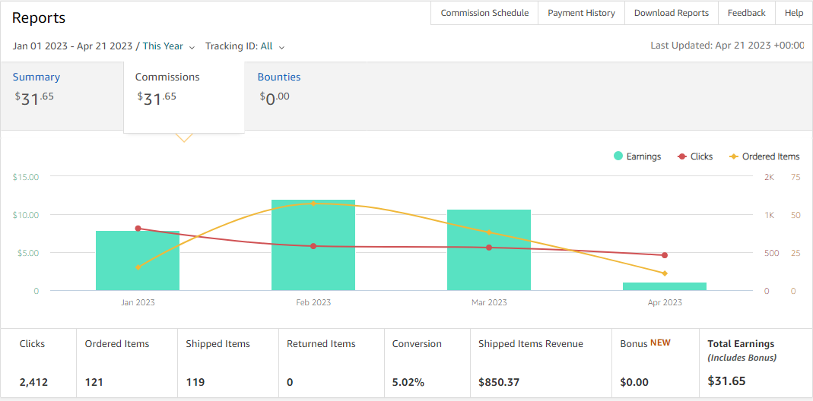
How Bob Makes Money - Affiliate Links
7
Started this as part of the Books, Beards, Booze Podcast.
Recently started focusing effort on my List Project, which has begun to pay off in noticeable ways.
I use Amazon Associates. Be careful, and read/obey the fine print.
2022
2023

Slide 17
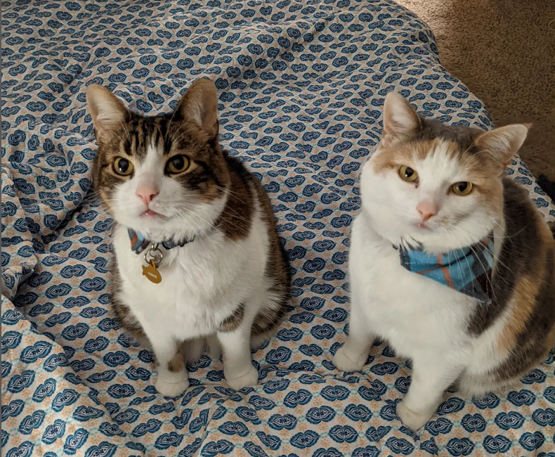
How Bob Makes Money - Fees
8
Beyond the monetary benefit, they stoke the ego.
Virtually no cost to self, beyond time preparing/ travel costs.
It takes time, and building connections to get to the point that you can do this.
Remember, You’re A Big Fish To Someone, If Their Bar Is Low Enough!
Did someone say fish?

Slide 18
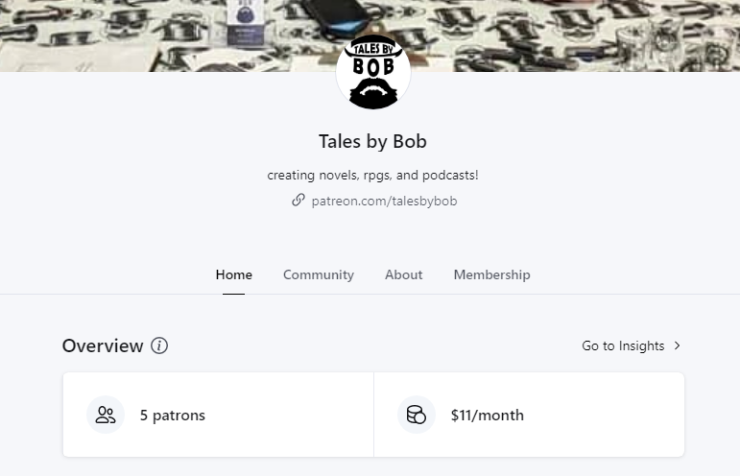
How Bob Makes Money - Patreon
9
Synergy with podcasting.
Frequently uses assets you already have lying around.
Book cover reveals, sneak peaks of chapters, world building, etc cost you no extra and can generate this essentially passive income.

Slide 19
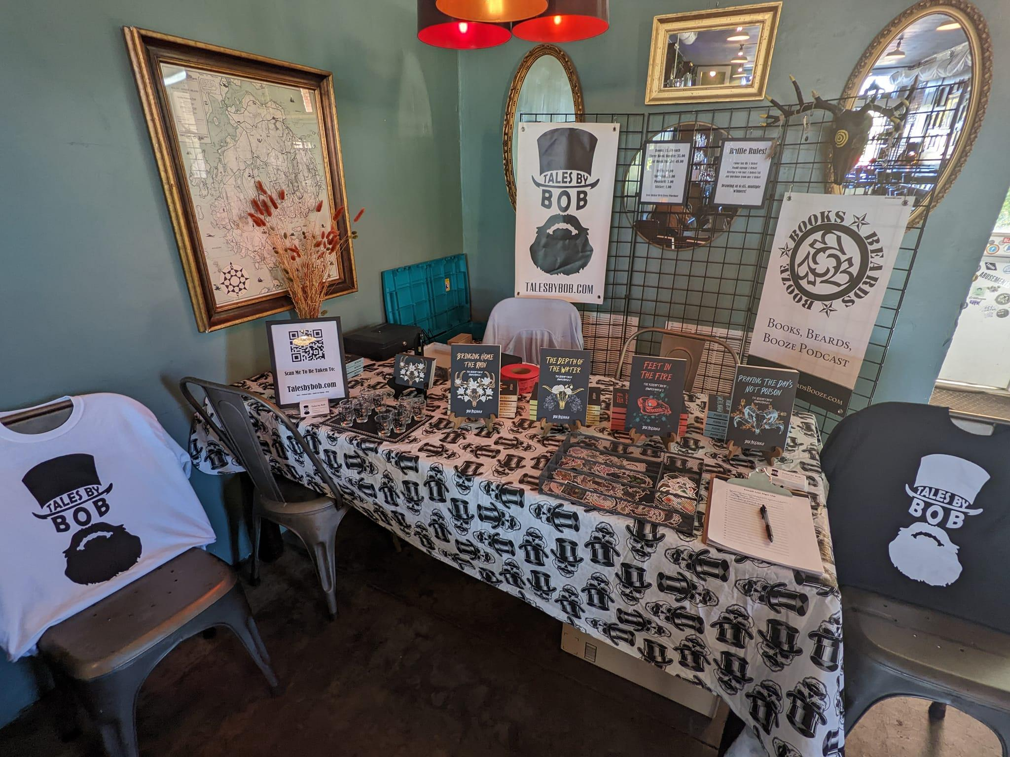
How Bob Makes Money - Book Sales, In Person/Online
10-11
Get to unusual places in the physical.
Bring value to the online spaces you are in.
Being the odd man out can really work in your favor.
Book Launch Event In An Area Coffee Shop/Bar

Slide 20
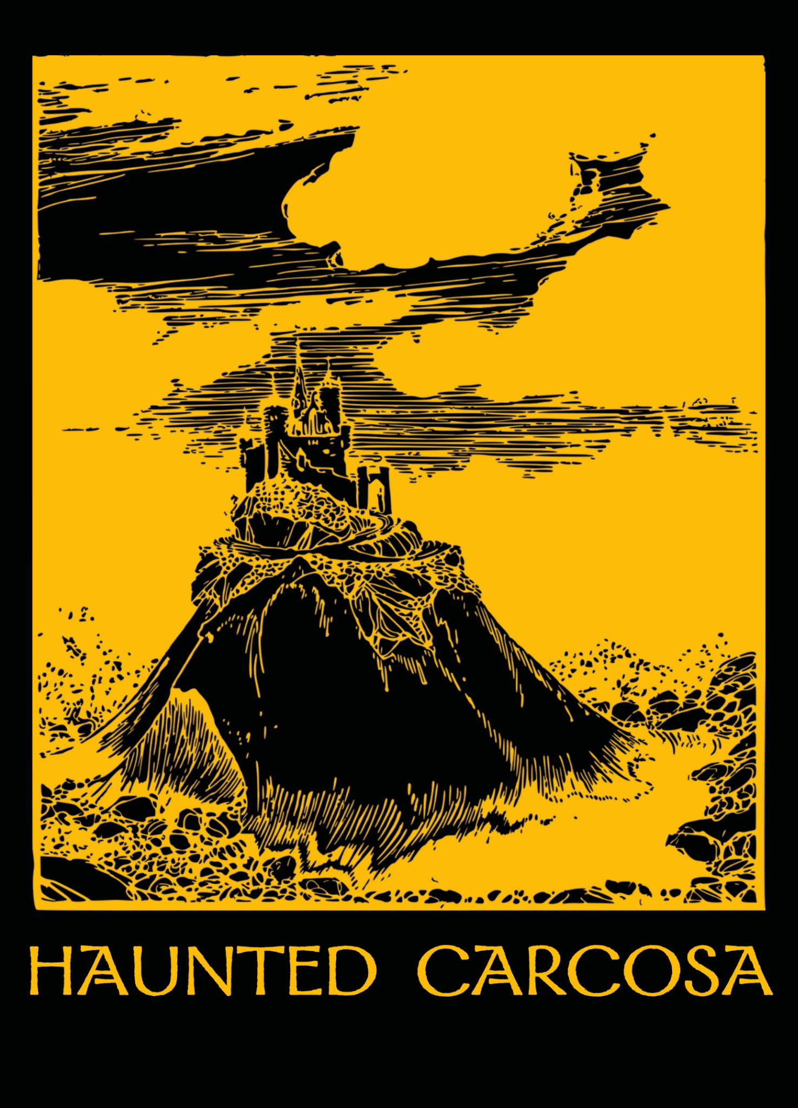
How Bob Makes Money - Postcards, Stickers, etc
Often can already use assets you have lying around.
Having a small something for sale reaches a totally different demo.
Easy and cheap to mail.
Cheap enough you can bundle or give away.
Wait for sales to get these made.
Remember me?

Slide 21
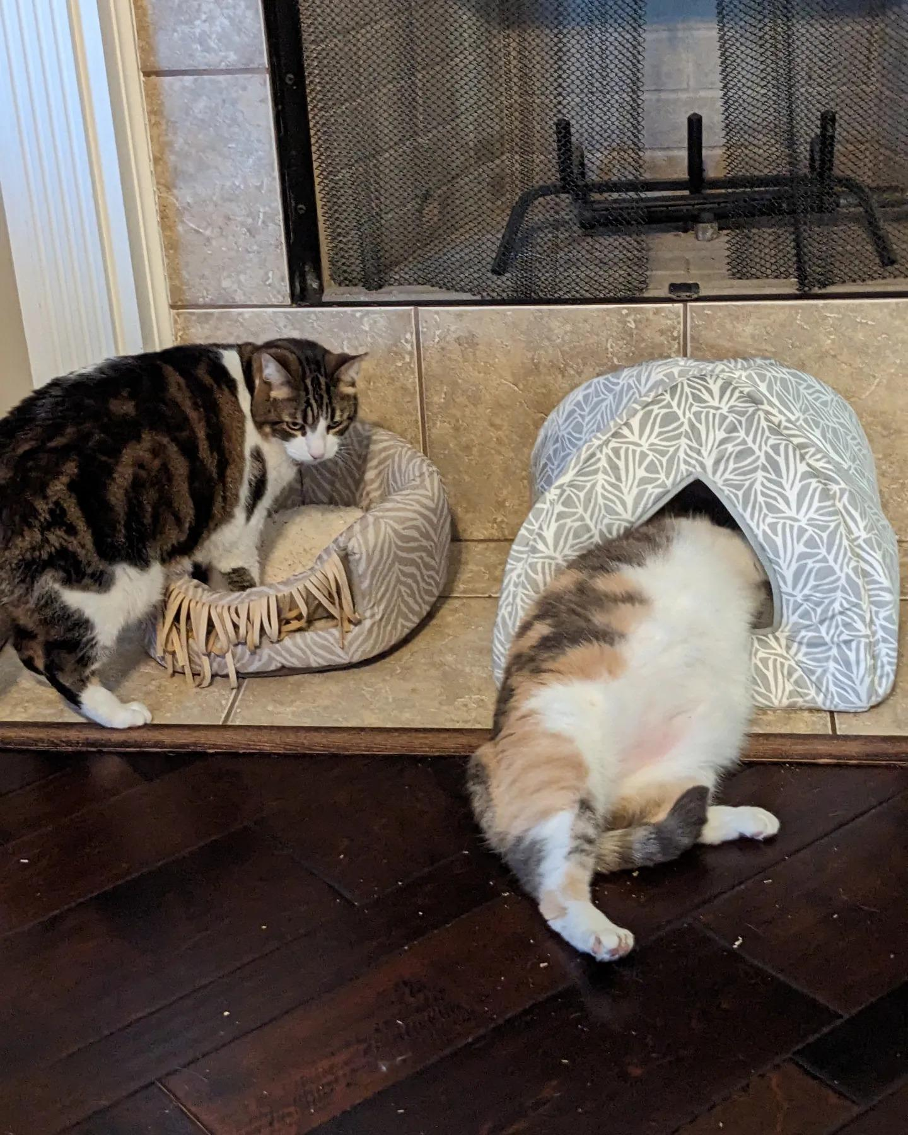
Chat GPT - AI
“Chat GPT is not going to take your job. Someone better at using Chat GPT than you will take your job.” - Scott Galloway
Be careful, the space is very heated.
Long term will likely bring down costs.
Don’t worry, there is nothing you can do.
“Cat GPT?”

Slide 22
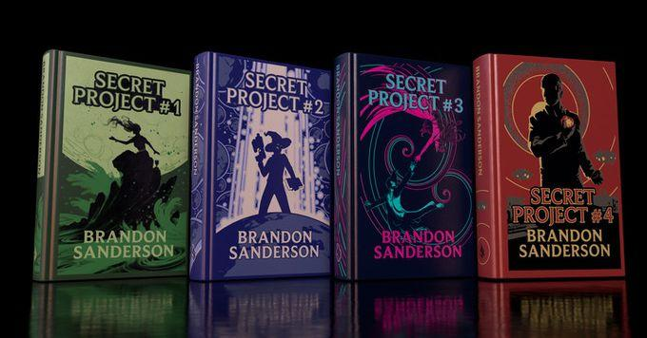
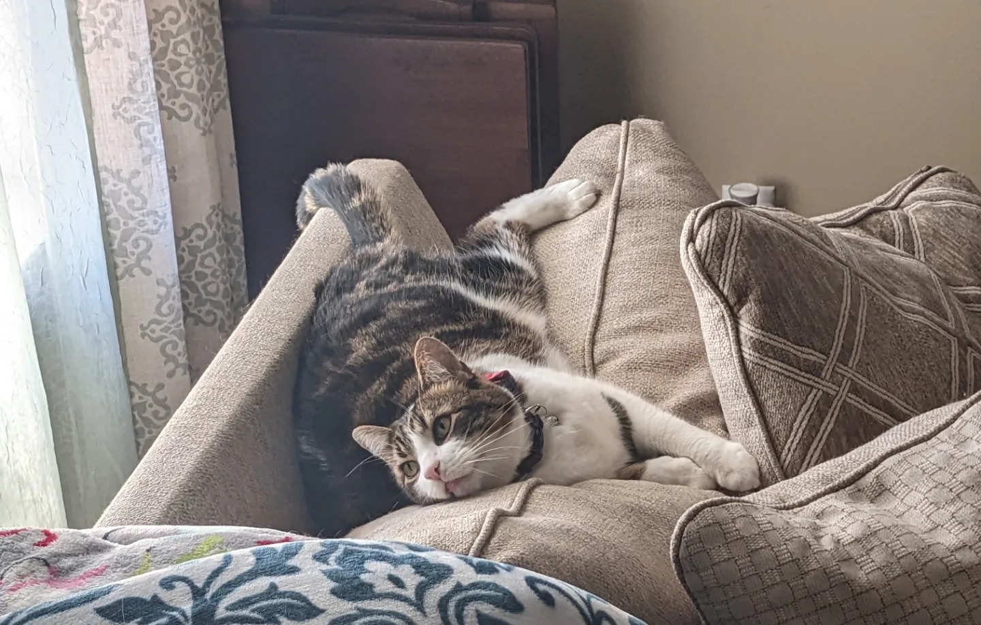
The Sanderson Kickstarter
Biggest Kickstarter of all time. 41.7 million+
Sanderson has been treating writing like a company vs solo effort for a long time.
Big fans want multiple product types, and more high end products.
They are a fraction, but preparing for them can work out nicely.
“Man, that would buy a lot of catnip.”

Slide 23
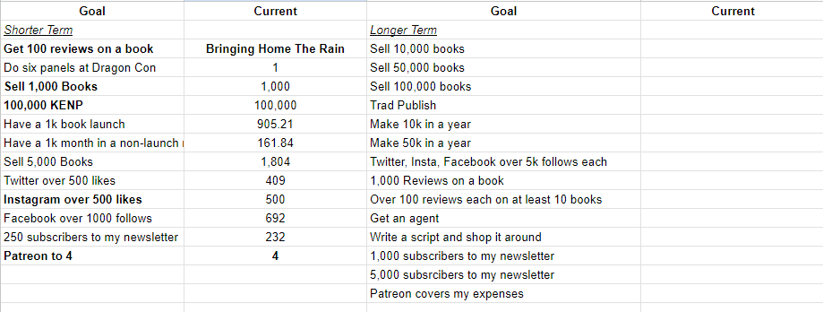
Define Success For Yourself - Set Goals

Slide 24
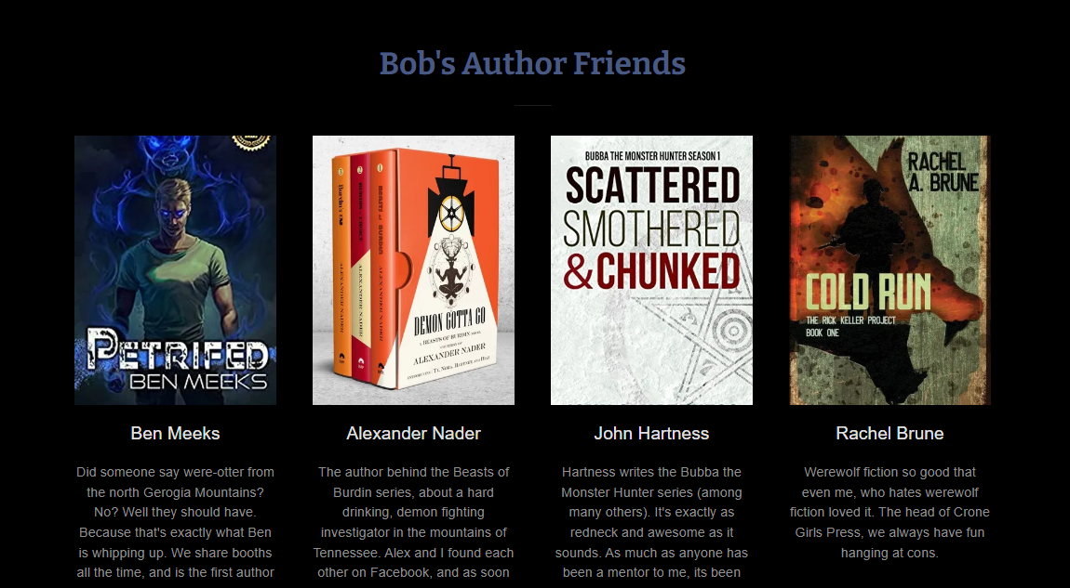
Support Each Other, Always
No matter how quickly you write, you cannot write enough books to supply all demand.
A rising tide lifts all boats.

Slide 25
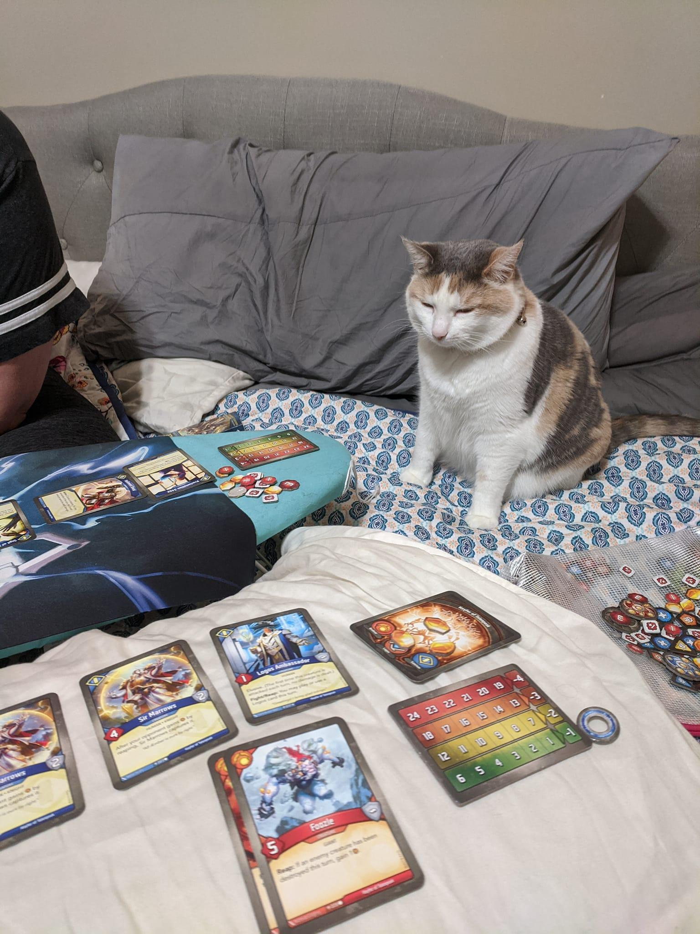
Questions? Hatemail?
talesybob@gmail.com
“I’m just confused.”

