Slide 1
Organic Marketing For Authors: How to Sell Yourself and Your Book

Slide 2
AGENDA
Topic one: Why You Should Listen to Me
Topic two: Real Life Examples: Online
Topic three: Real Life Examples: In Person
Topic four: Quick Recap
Topic five: Questions
From bookmarks and bumper stickers to social media and podcasting, author Bob McGough will show you how to grow your brand and your platform in traditional and nontraditional ways.

Slide 3
Why Should I Listen To Bob?

Slide 4
Because he is using plant imagery as a bad visual pun for organic marketing.

Slide 5
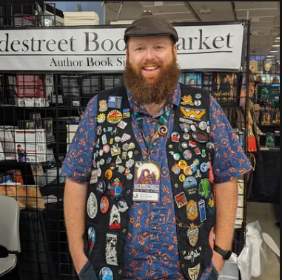
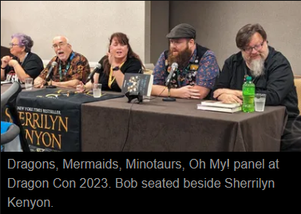
I’m going to be incredibly transparent with you, giving actual real-life examples drawn from my career.
I have been/will be traditional published as well as somewhat successfully self publishing.
I have done all this without paying for ads.
Feel free to ask questions.
Jokes Aside (For The Moment)

Slide 6
Real Life Examples: Online

Slide 7
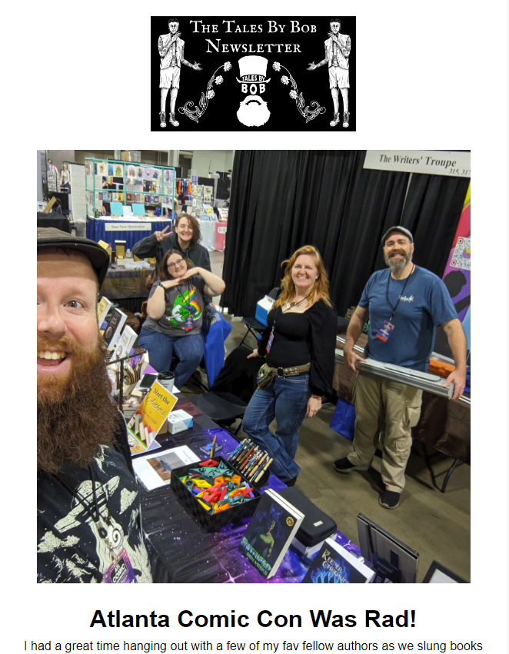
Your Newsletter is your best marketing device.
Costs nothing/very little.
You have total control.
Make sure you have a written email list signup on your table at events.
I promise, you are interesting enough for an email list
Don’t be spammy.
Only email folks who actively have signed up for your email list.
I have 650ish subscribers, and average a 40% open rate.

Slide 8
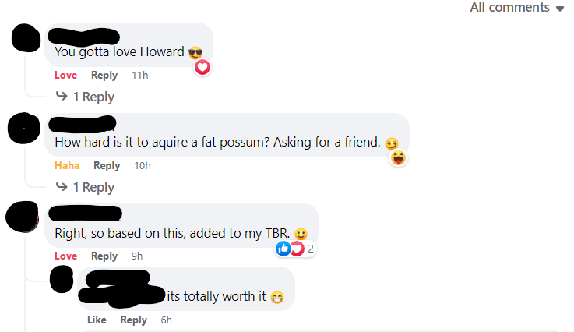
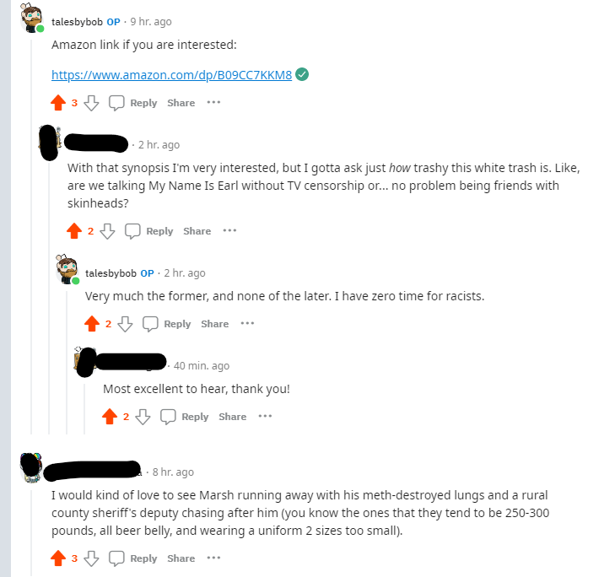
Interactive Activity That Highlights The Feel Of My Books
This is a very visually based post, which catches the eye. It also features a possum (which people love), is a little bit silly, and really captures the feel of my books, which will catch some interest.

Slide 9
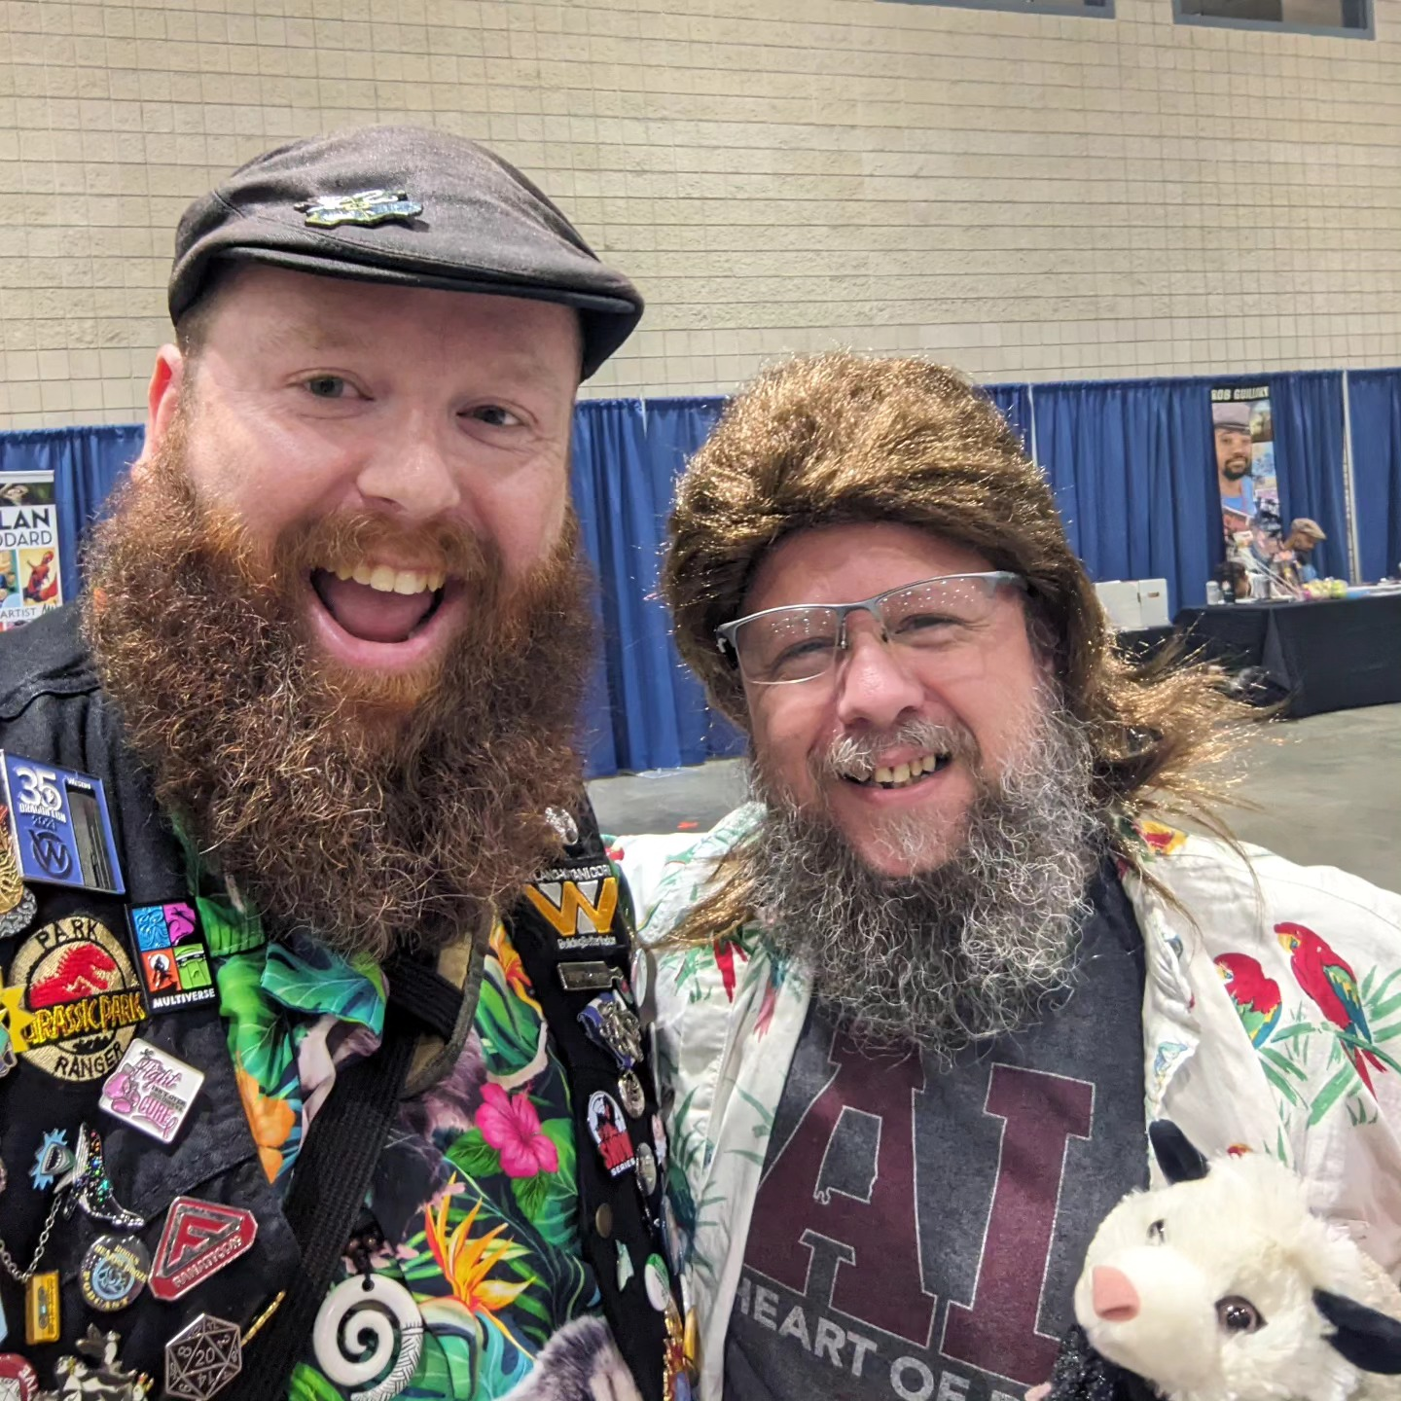
No One is going to cosplay as a redneck wizard…
…Until they do!

Slide 10
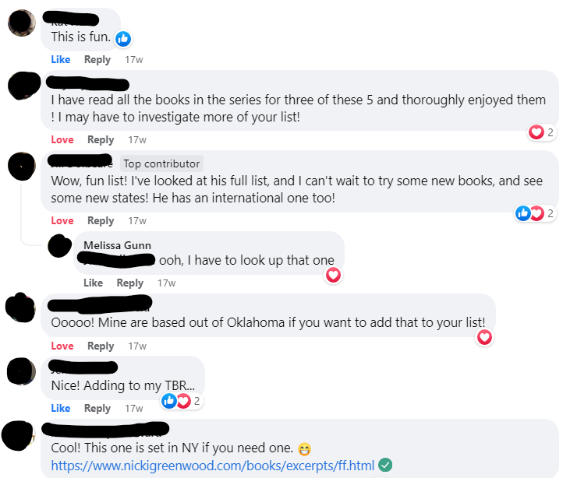
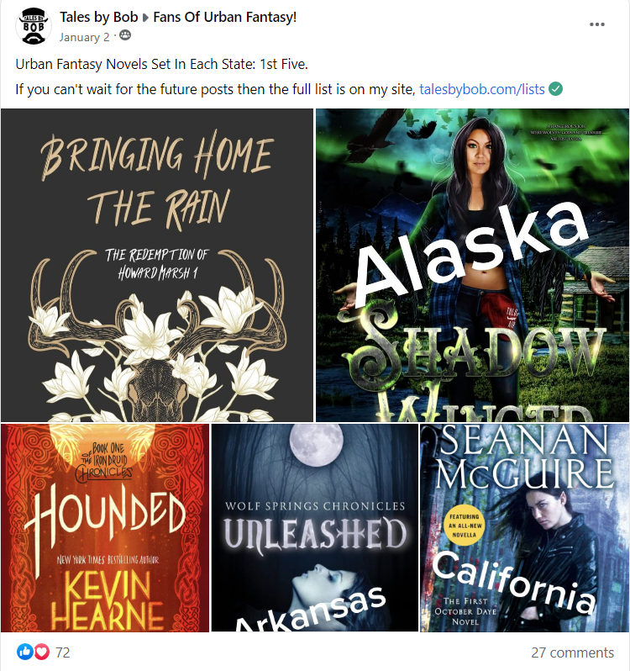
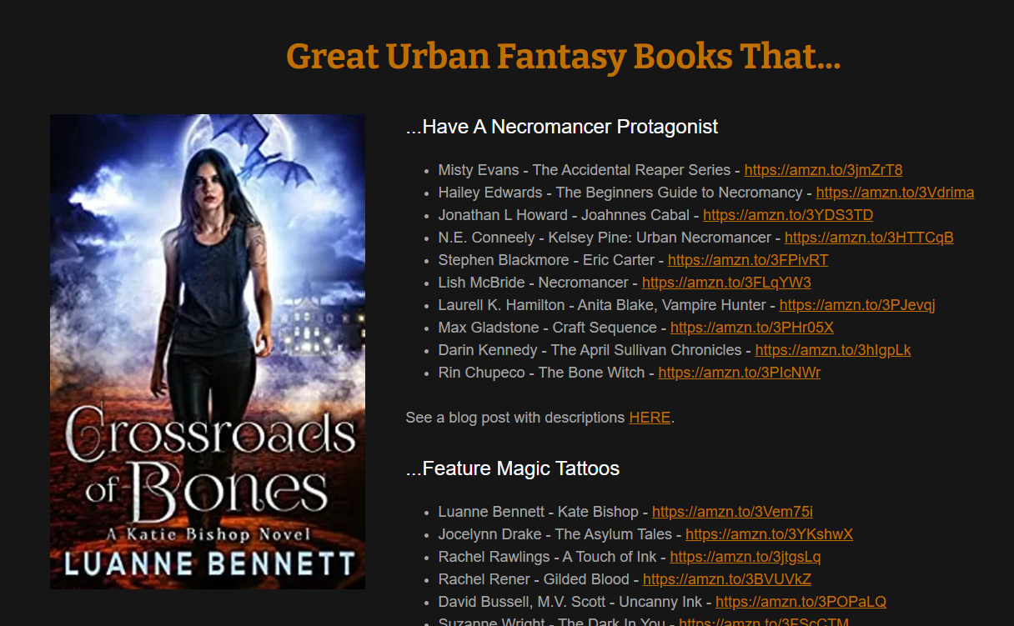
Bringing Value To The Community, That Drives Traffic
In this specific post I mixed myself, with a pair of very popular trad authors, and a self published author who I am friends with, who is known in this Facebook group. It takes you back to my site, where I have more lists. (Pictured below)

Slide 11
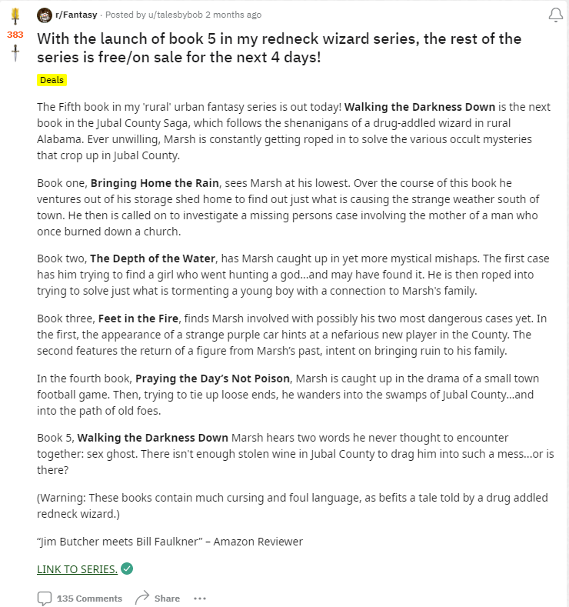
My Fifth Book Launch Post On r/Fantasy (Reddit)
This required that I be an active member of the r/Fantasy community. As in someone actively taking part in conversations, and not just spamming my books.
It generated scores of comments
Over 380 upvotes
Types of Comments
Requests for audiobook
Comments from past readers
Comments asking about the setting

Slide 12
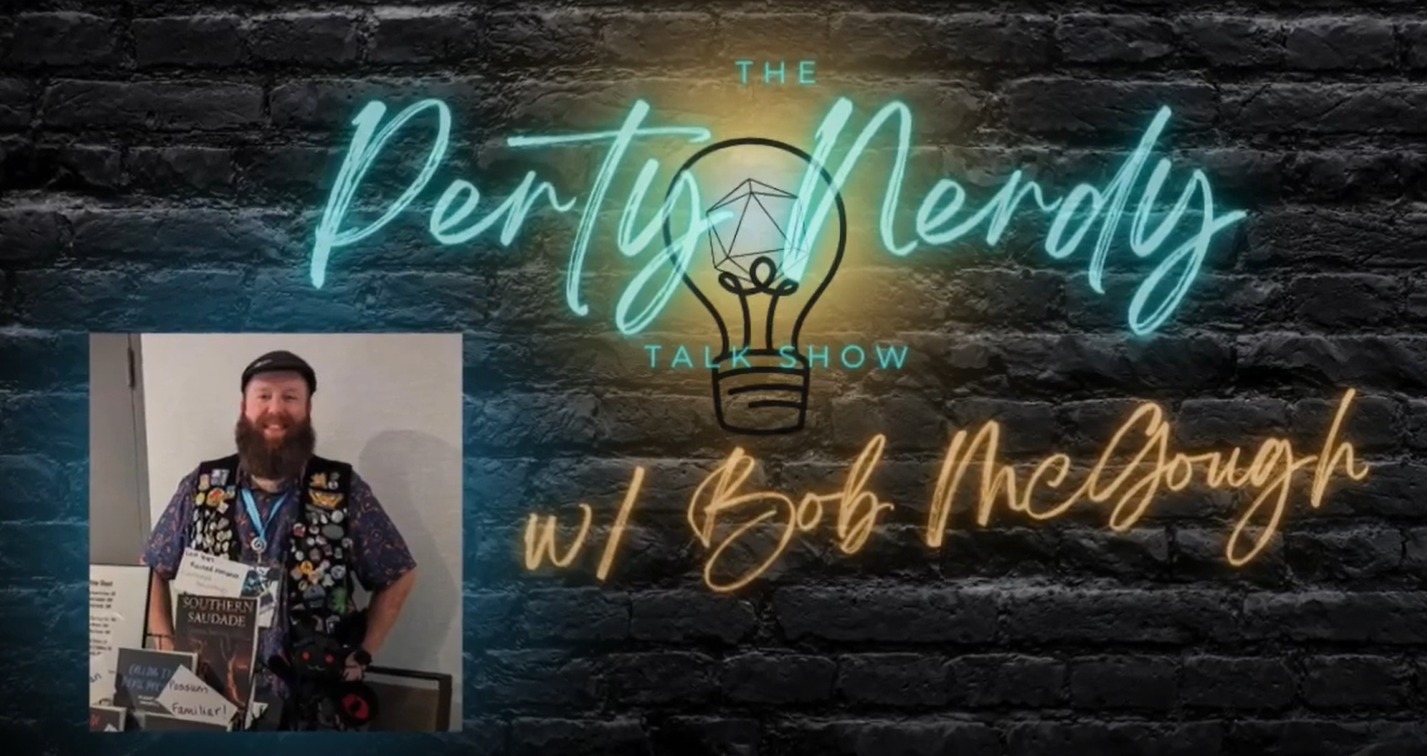
Interviews and Guest Appearances
There are always podcasts and YouTube shows looking for guests. Just reach out and ask…the worst they will say is no.
There are also groups, like R/podcastguestexchange that are places where folks go to find guests, or offer themselves up as guests.
Many of these won’t give you a ton of exposure. But even those are great practice, build confidence, and you never know what will come from them.

Slide 13
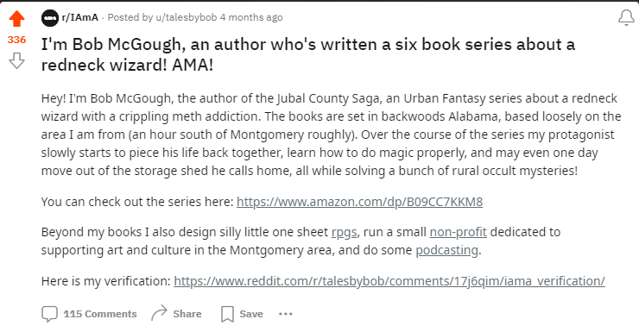
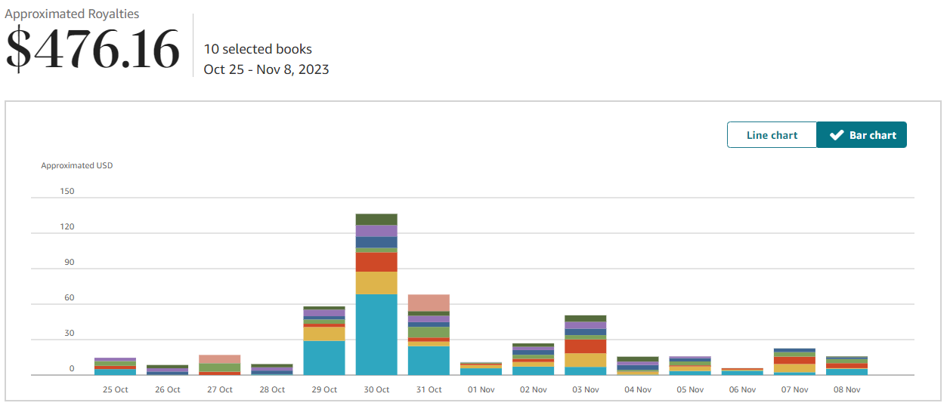
Reddit IAMA Post
The IAMA (I am a) subreddit is a place where you can go to post something interesting about you, and folks ask questions.
It generated 115 comments
336 upvotes (likes)
382.25 dollars in sales over the following week.
Led to a screenwriter reaching out.

Slide 14
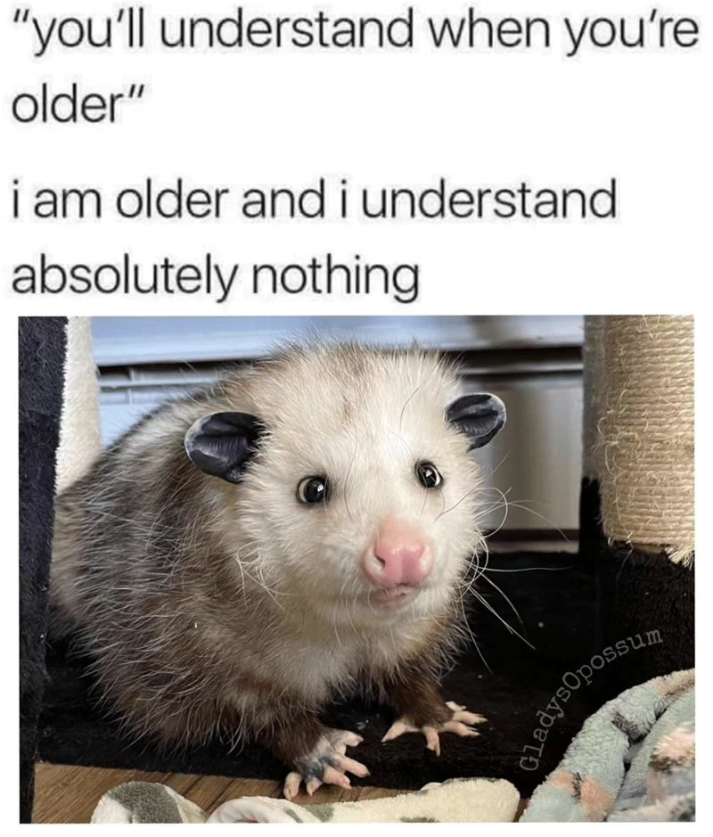
MEmes
People, generally don’t like meth. Or rednecks. They especially don’t like the combination of the Two.
People do like Possums.
My books have a possum.
Thus: I share possum memes.
They make me happy.
They make others happy.
They soften a ‘harsh’ topic.
Folks love to share memes.

Slide 15
Real Life Examples: In Person

Slide 16
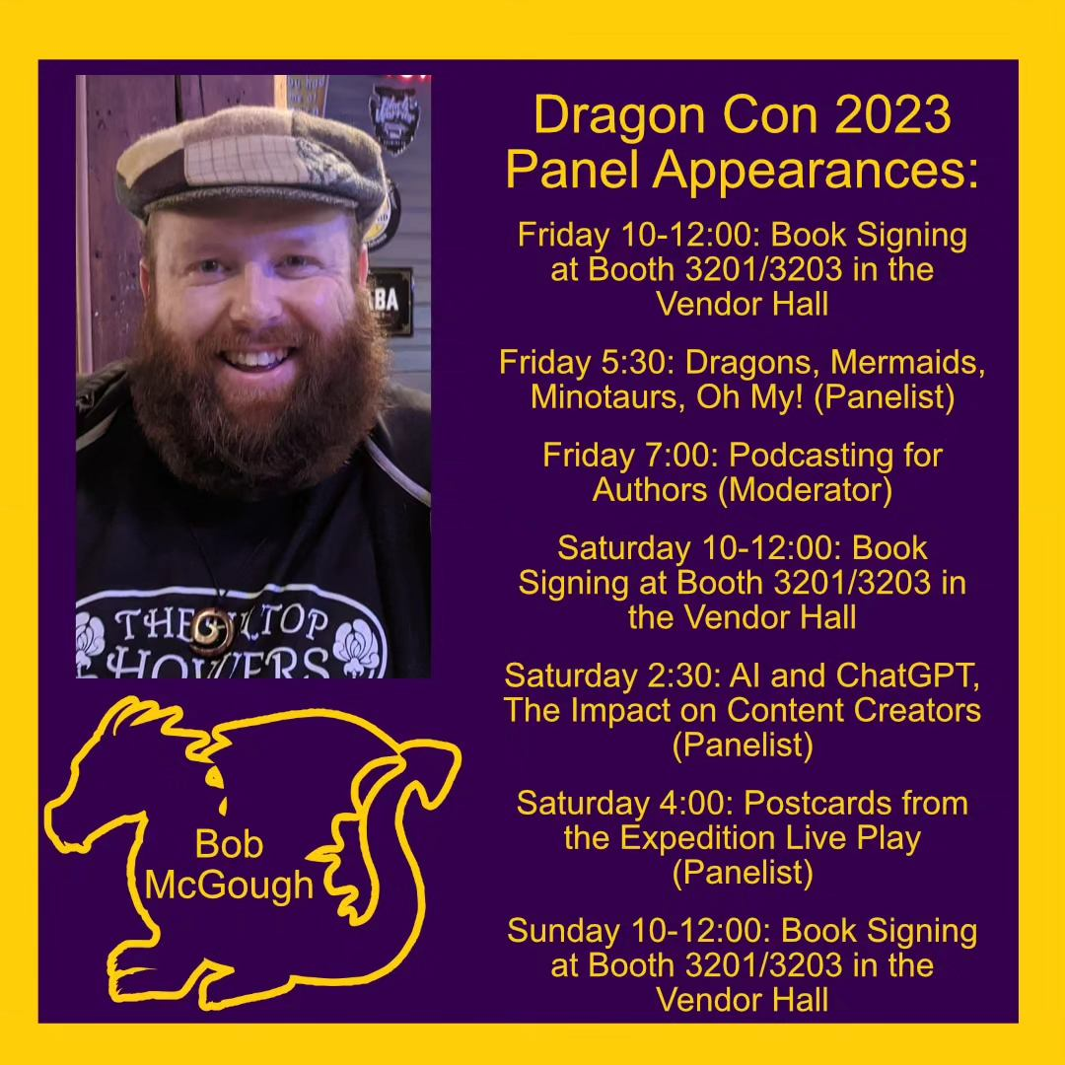
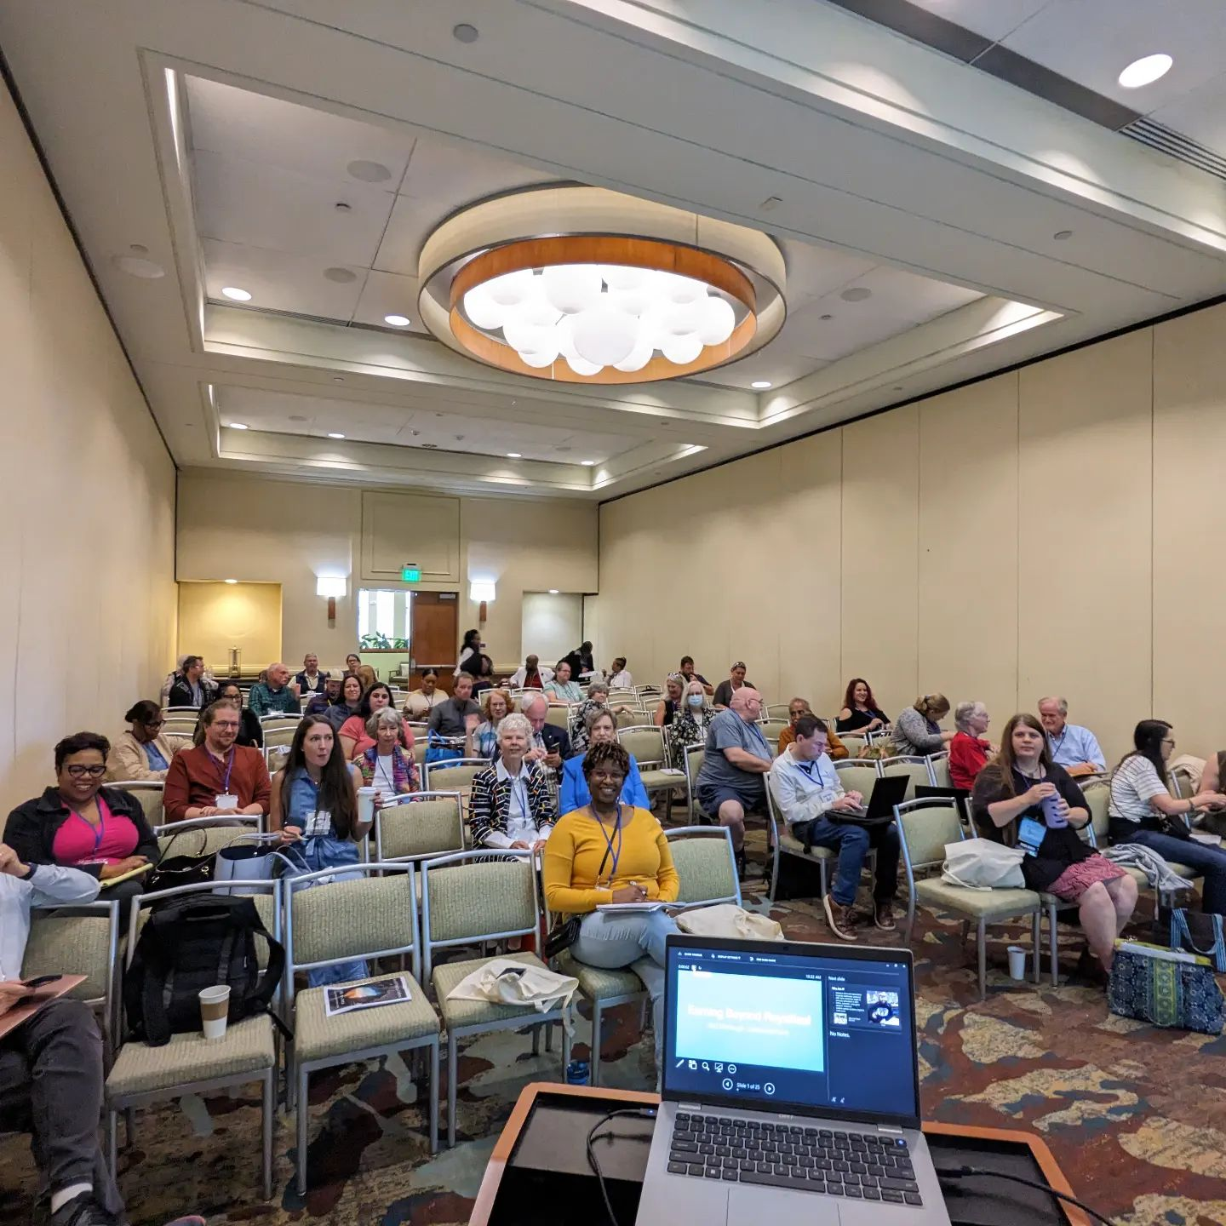
Convention Panelist – Workshop Presenter
I do a ton of panels at nerdy conventions across the southeast.
They humanize you.
They give you credibility as an expert.
Folks will ‘follow you home.’
Workshops are similar, except:
They offer even more credibility.
You get paid.

Slide 17
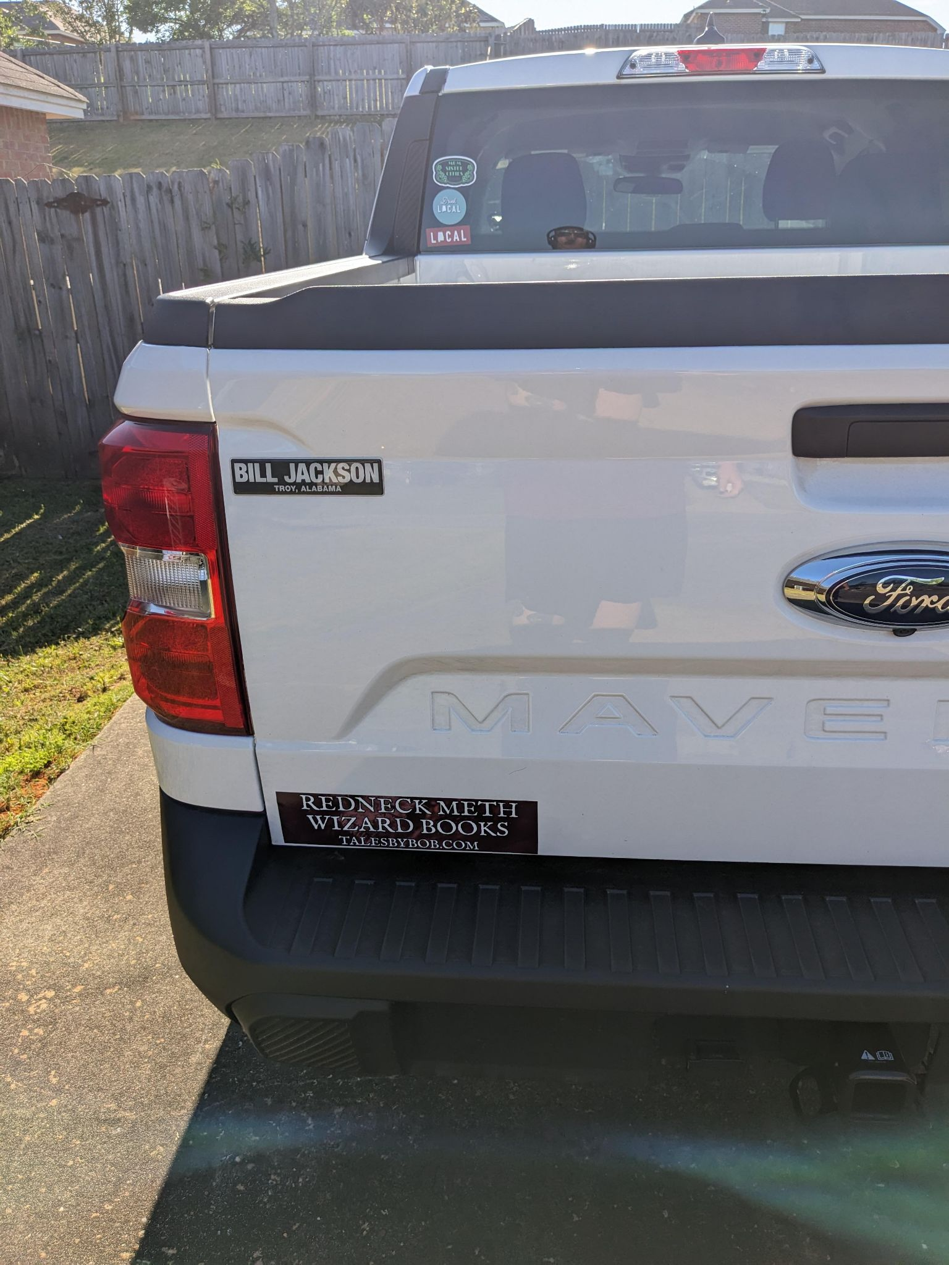
Passive Advertising
I don’t know if this Has gotten me Many sales or reads. But I do know that there is zero chance of me reaching folks on the ride to and from work without this.
I also will place stickers in other spaces that allow it. They may never get noticed, but unless I am going to stand in that place forever, I figure there is at least a tiny chance to get noticed that I wouldn’t have otherwise.

Slide 18
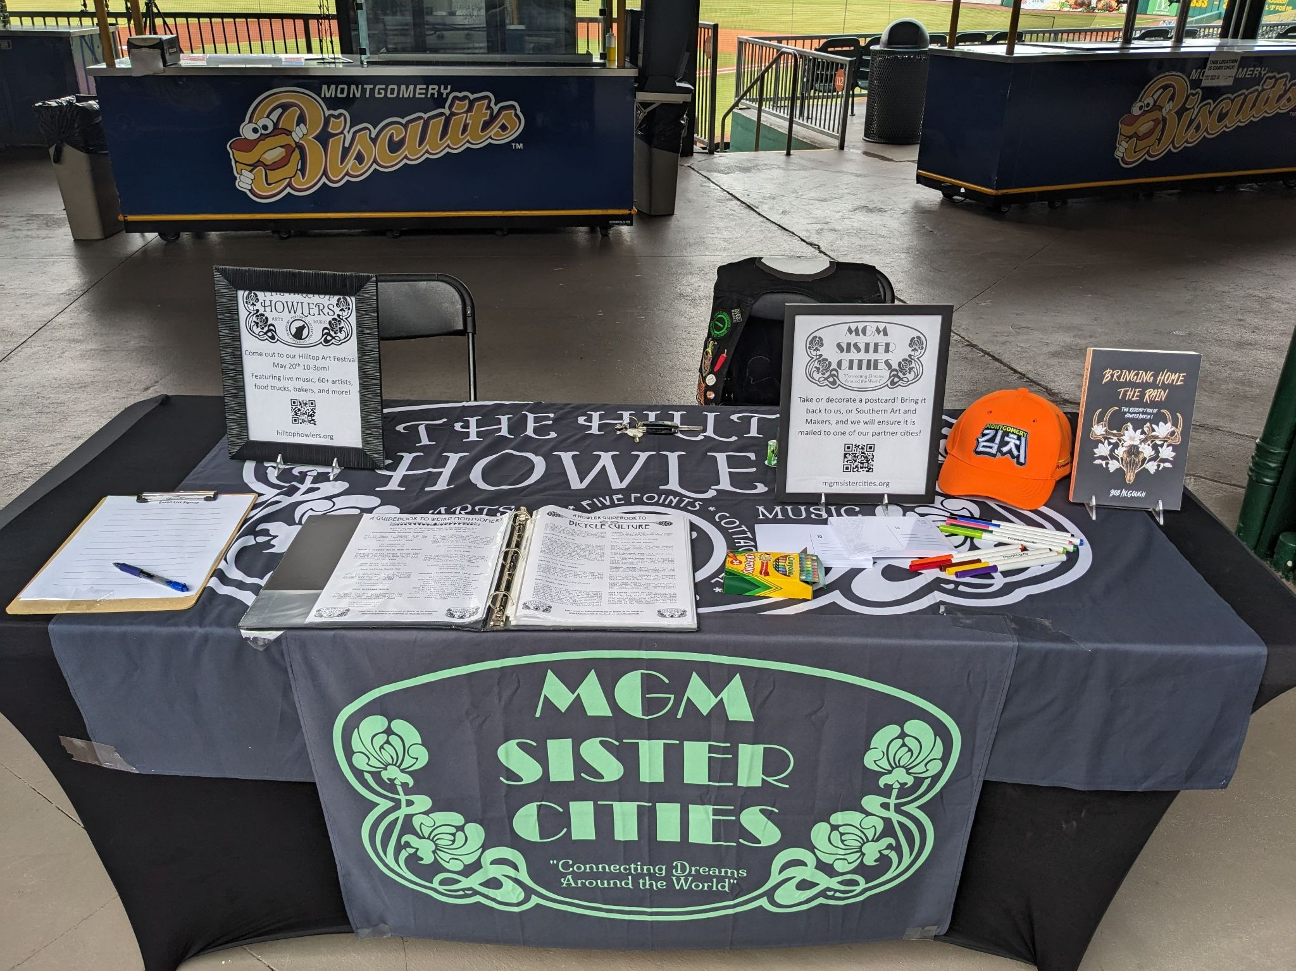
Subtle Promotion At Other Events
I do a lot of events that aren’t book focused, usually through my non-profit. These are spaces where folks see I am bringing value to the community.
That doesn't mean that I can’t have a book off to one side. It’s not the focus, and I don’t bring it up usually, as that’s not the reason I am in these spaces. But if someone asks, I will tell them about my books.

Slide 19
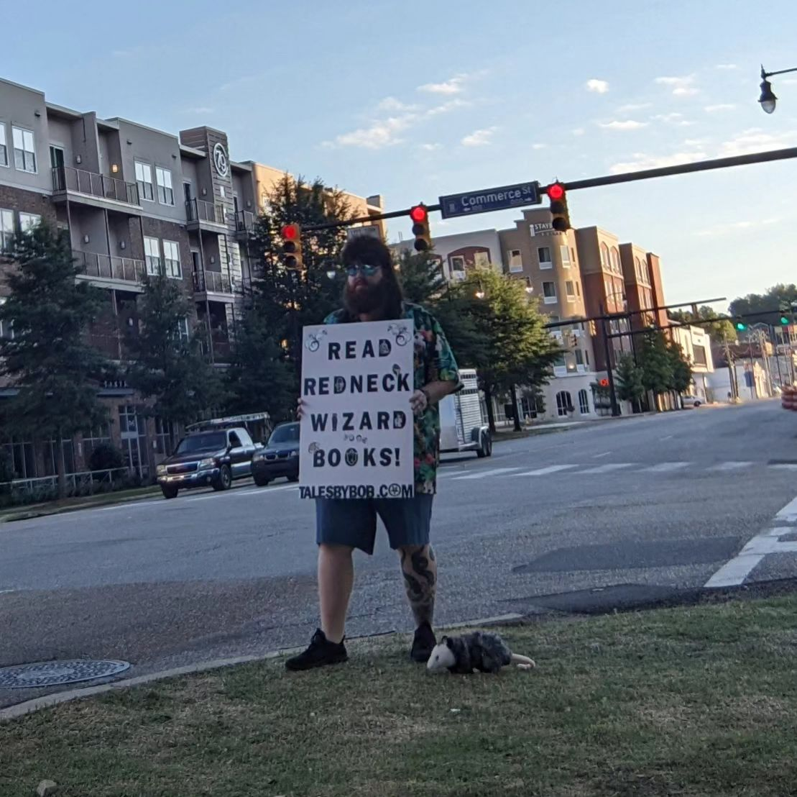
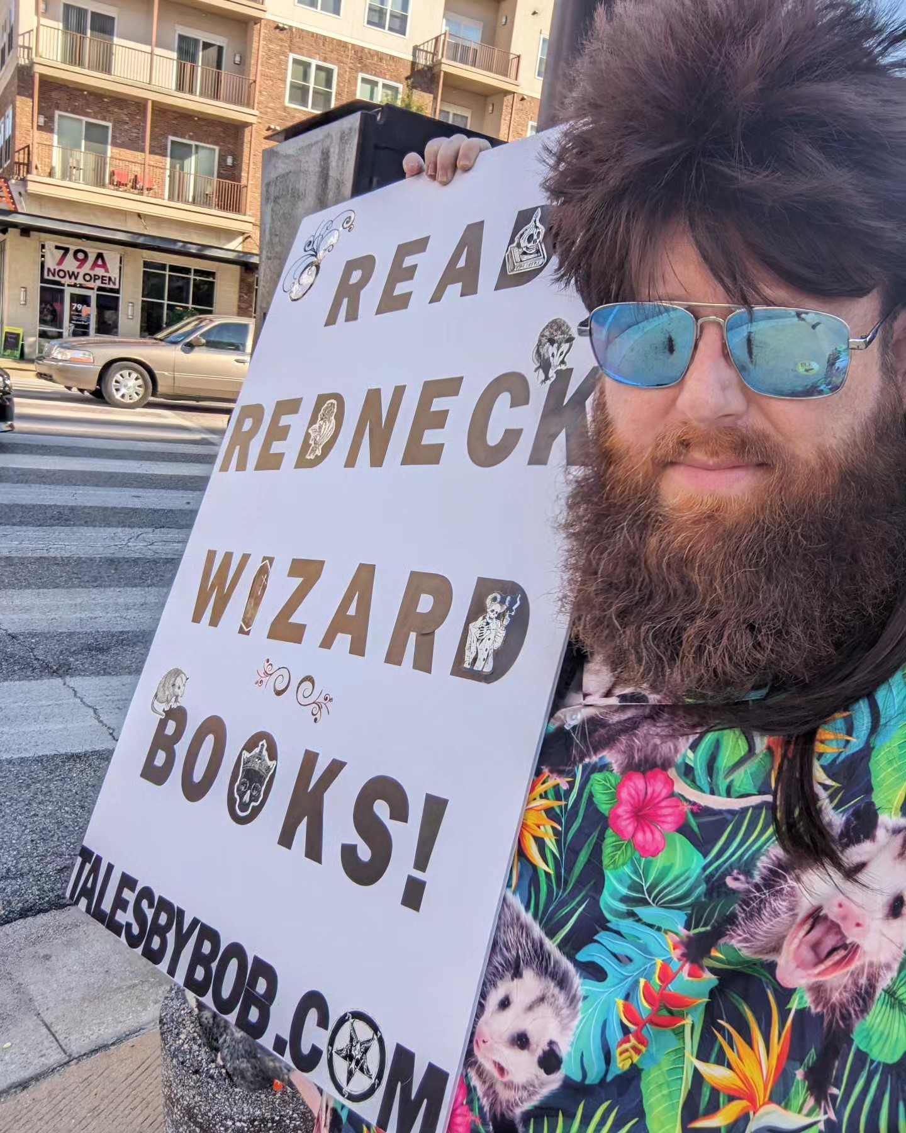
Get weird with it!
I dressed up as Howard marsh and stood on the street corner in downtown Montgomery, complete with sign and stuffed possum.
I got a gun brandished at me.
I had several People honk.
A few took pictures.
Folks talked about it on Reddit.
A month later a guy ran up to me at an event and told me how he bought all my books because he saw me.

Slide 20
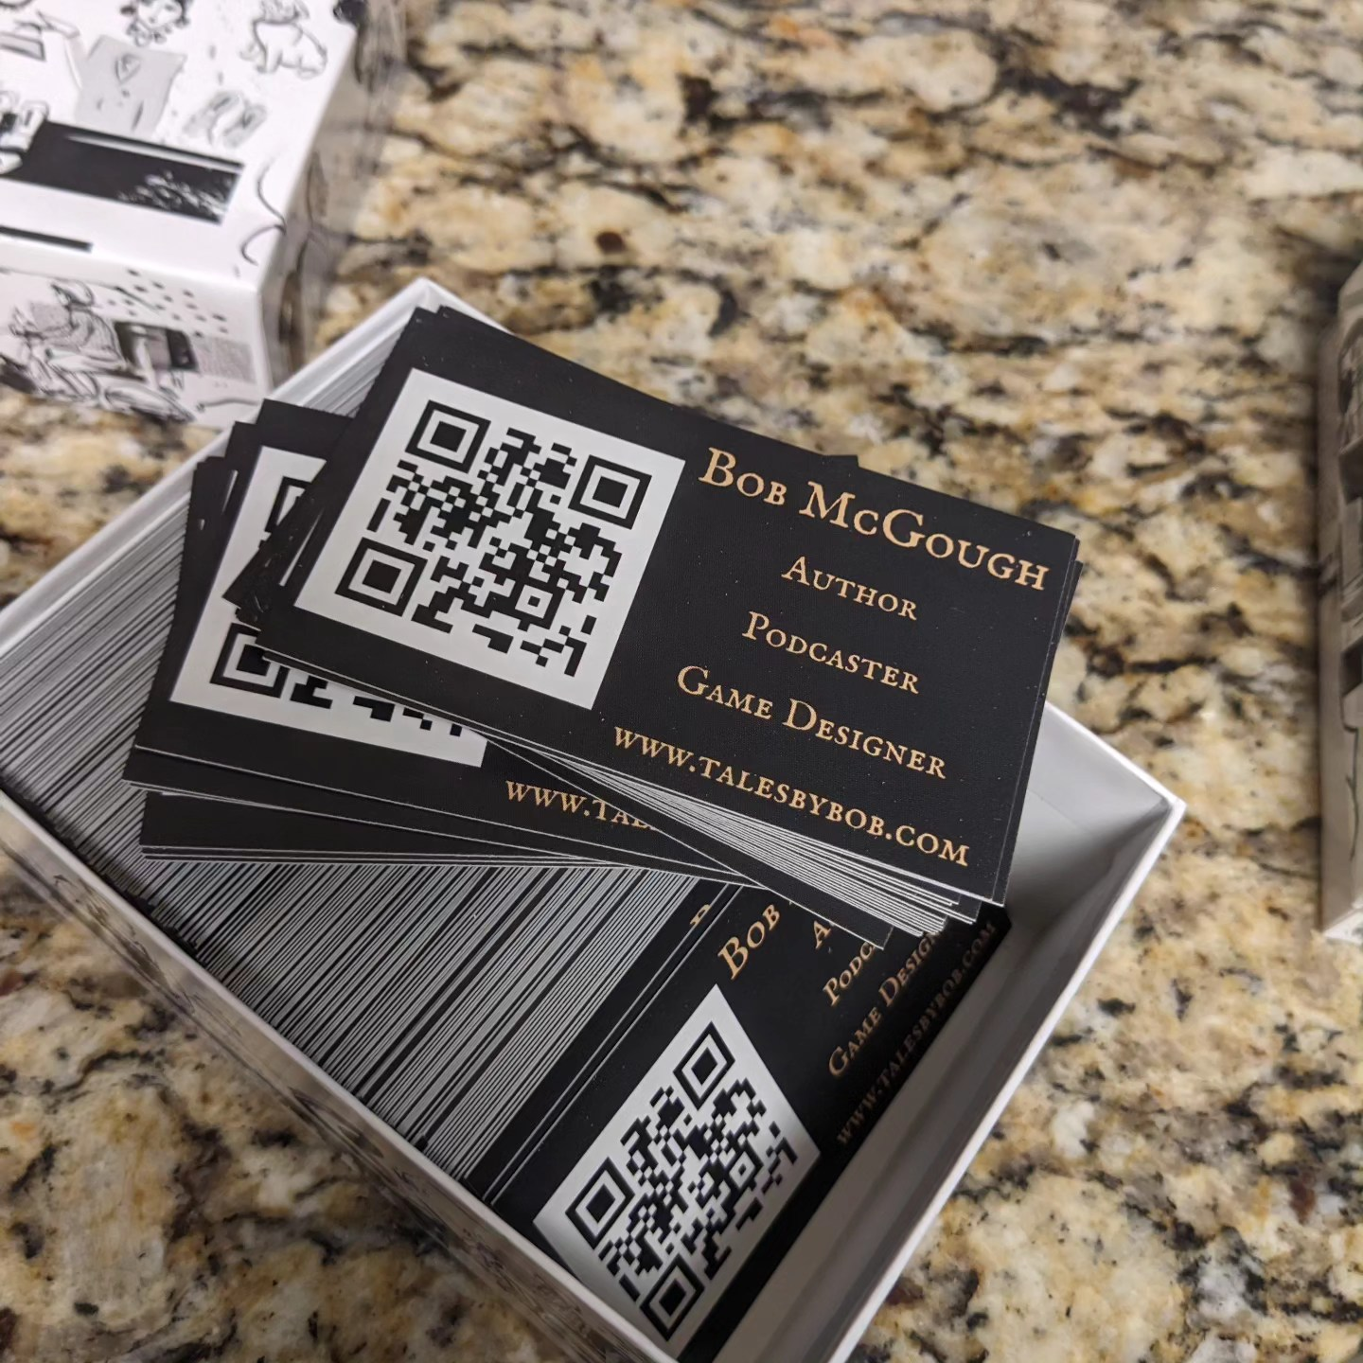
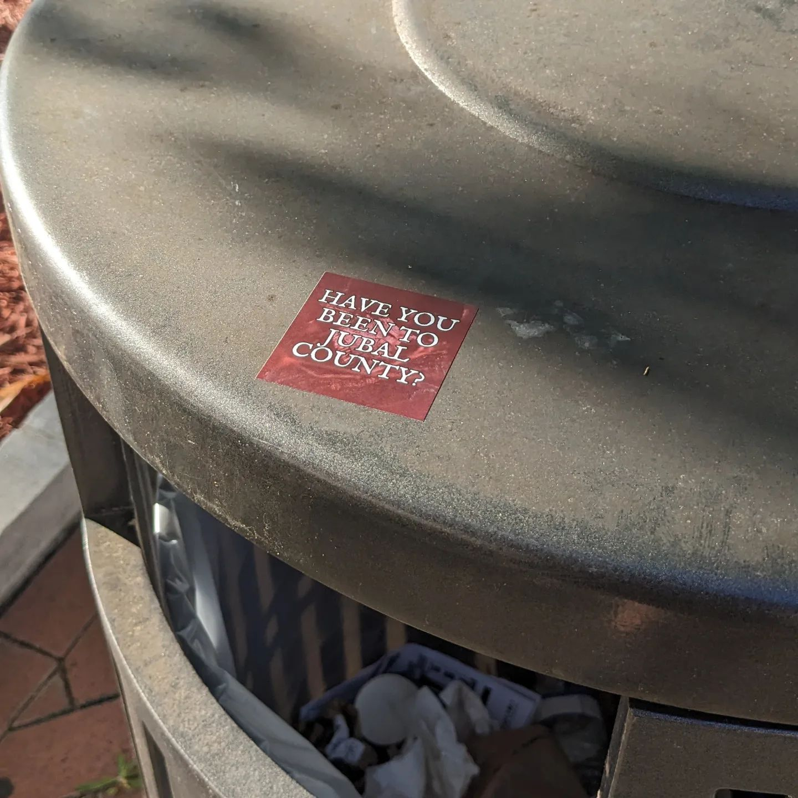
Stickers and Business cards (Small free things)
People like free stuff. Picking the right free stuff is hard.
Business cards are a can’t miss.
Put a QR code to your linktree on it.
Do not put your email or phone number. You can always write it on the back if needed.
A lot of authors do bookmarks and stickers. In my opinion stickers are a better choice.
Folks LOVE stickers.
They will often put them in public places, like their water bottle.

Slide 21
Quick Recap

Slide 22
Top take aways and tips!
Bring value to the community.
Be genuine.
You need to be creative, not just in your writing, but also in your marketing.
Blind luck will be a factor. You never know what will be the thing that kicks off or brings a great opportunity.

Slide 23
Questions?

Slide 24
Thank you
​A copy of this presentation can be found on my website. You can also use the contact form there to ask me any questions about…well pretty much anything really.
www.talesbybob.com​

