Slide 1
Southern Fantasy and Horror
Bob McGough

Slide 2
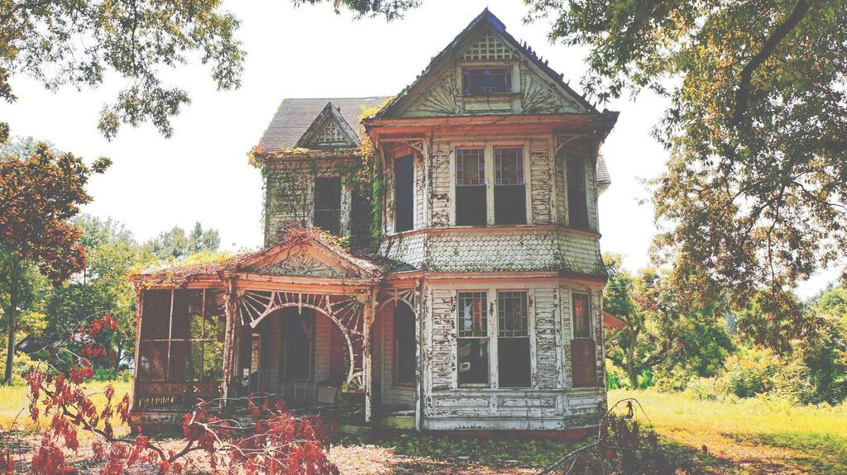
Southern Gothic
Stories about deeply flawed, eccentric characters who may be involved in the occult, usually set in decaying settings. Commonly has events stemming from the effects of poverty, alienation, crime, or violence.
The castle and manors of Europe replaced with post-war rotting plantation homes.
Examples:
The Sound and the Fury - William Faulkner
A Good Man is Hard to Find - Flannery O'Connor

Slide 3
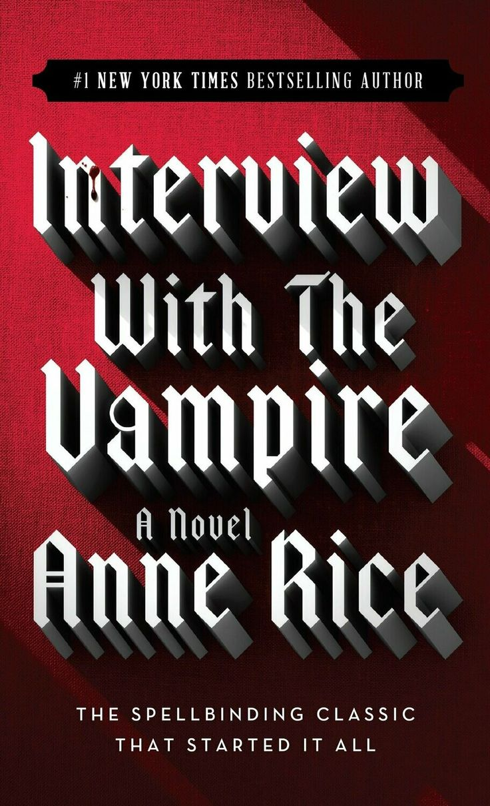
Southern Horror
Builds on Southern Gothic roots in many cases. Frequently mines the darker aspects of southern history for its horror, such as the legacy of racism and poverty.
Examples:
Deliverance - James Dickey
Interview with a Vampire - Anne Rice
Those Across the River - Christopher Buehlman
The Elementals - Michael McDowell

Slide 4
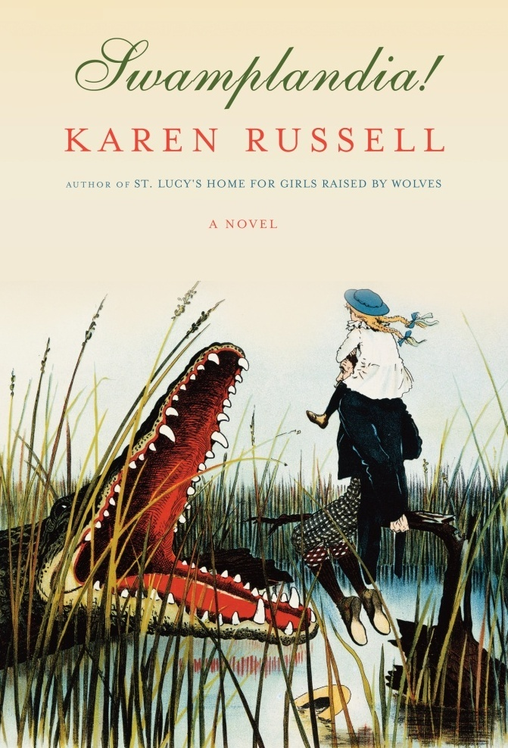
Southern Fantasy
Much more rare.
Examples:
Big Fish - Daniel Wallace
Swamplandia! - Karen Russell
Beloved - Toni Morrison (won the Pulitzer Prize)
Galveston - Sean Stewart

Slide 5
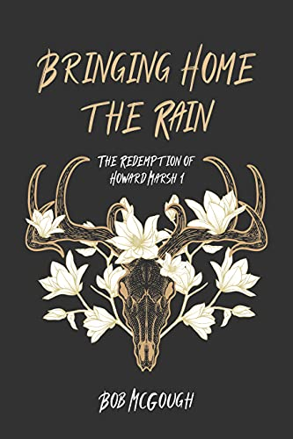
Rural and Southern Urban Fantasy
Atlanta and New Orleans are common settings for Urban Fantasy, but much of the Urban Fantasy coming out currently are set in more rural locales.
Examples:
Bubba the Monster Hunter Series - John G. Hartness
The Keeper Chronicles - Ben Meeks
Tales of Weird Florida - Martin Shannon
The Jubal County Saga - Bob McGough
Hunter Houston - Bobby Nash

Slide 6
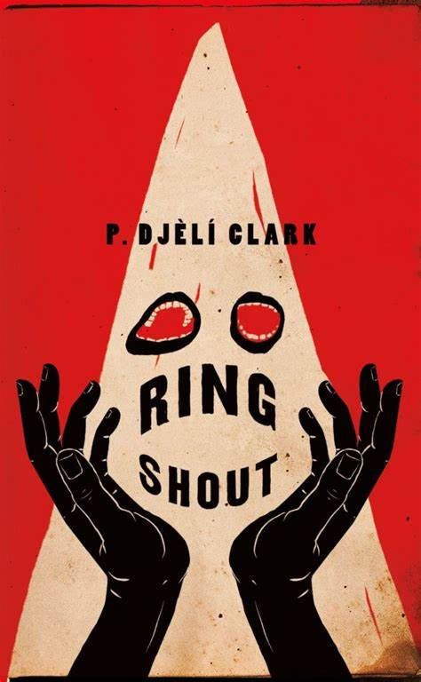
Reclaiming Lovecraft
H.P. Lovecraft was hugely influential, but also extremely racist. There has been a push to ‘reclaim’ his legacy, and some of that is heavily featured in Southern Literature.
Examples:
Lovecraft Country - Matt Ruff
Ring Shout - P. Djèlí Clark

Slide 7
Depictions in Film
Various Examples:
Southern Gothic - Midnight in the Garden of Good and Evil, Winter’s Bone
Southern Horror - The Texas Chainsaw Massacre, The Skeleton Key
Southern Fantasy - Big Fish, Beasts of the Southern Wild
Reclaiming Lovecraft - Lovecraft Country
Special mention: True Detective

Slide 8
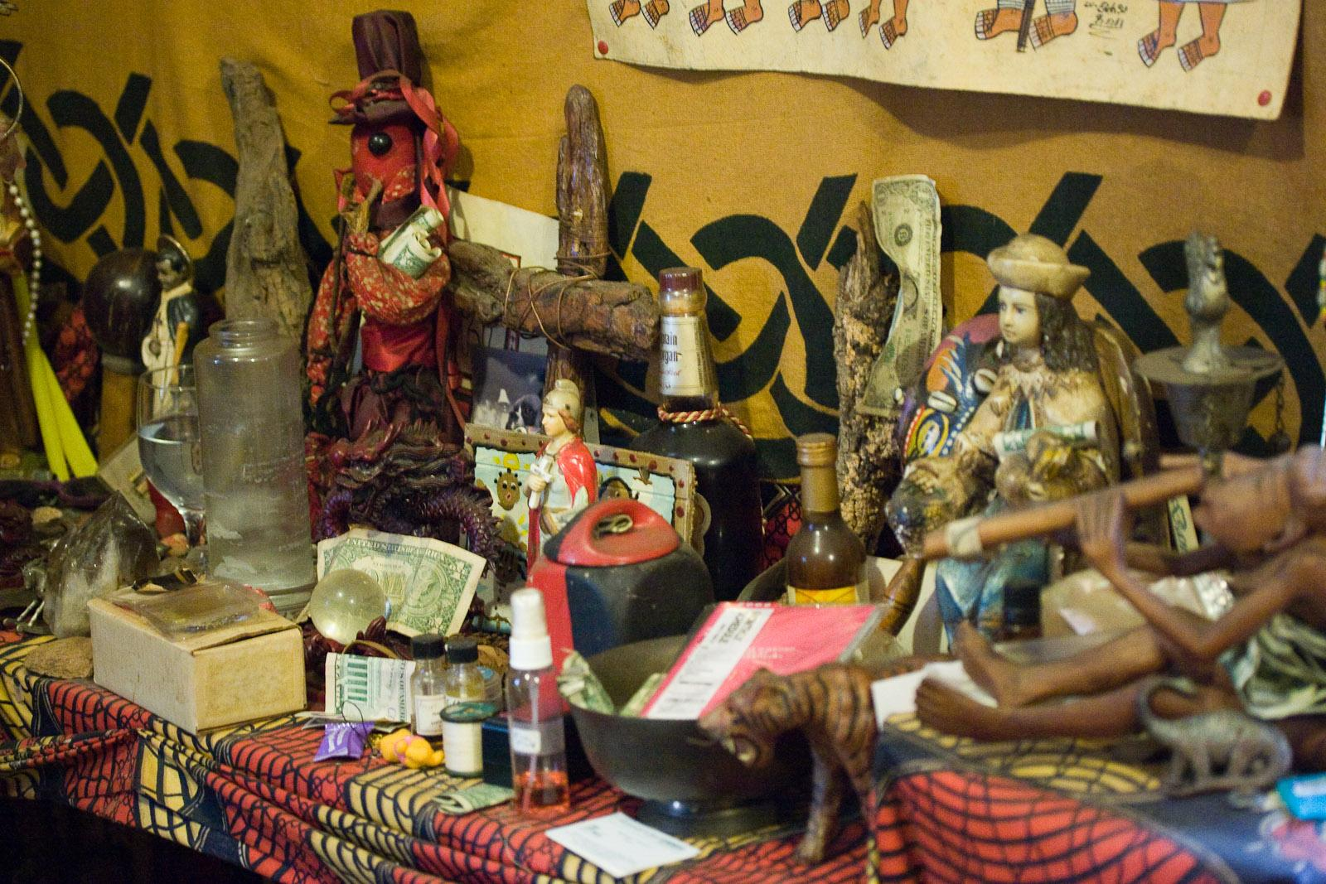
Voodoo
Louisiana Voodoo is a blend of African traditional religions, Haitian Vodou, and Roman Catholicism. Still a vibrant cultural practice into the modern day.
Can be either a religion or a practice, or both.
No formal theology, creed, organization, sacred texts
Heavy emphasis on ancestor worship
Does not actually use Voodoo Dolls
Gris-Gris are charms used to either help or harm

Slide 9
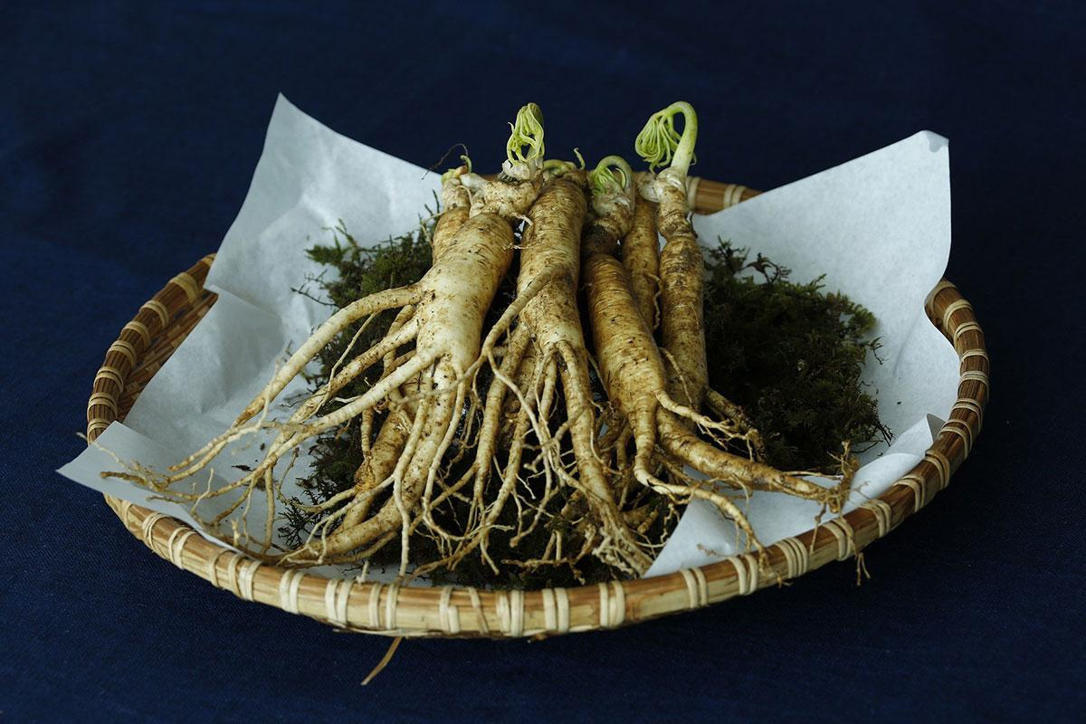
Hoodoo
African Diaspora tradition developed during slavery, though the word ‘Hoodoo’ was only first documented in 1870. Still actively practiced.
Has come to use the bible as source of magical power
Early heavy reliance on rootwork and botany.
Post Civil War, Hoodoo became a target of marketing by white drug store owners, leading to a corruption of the traditions. This is known as marketeered Hoodoo.
The origin of many traditions that have grown outside the religion, including Bottle Trees and Haint Blue.
Spell Jars, Black Cat Bones, Goofer Dust, and Crossroads are important elements.

Slide 10
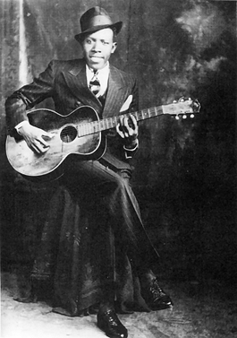
Crossroads Devil
A tradition that has multiple sources, in the South the concept of going to the crossroads to sell your soul to the devil in exchange for earthly power or skill originated in Hoodoo.
Robert Johnson was the first well known person who it is claimed performed such a ritual.
Blues Legend Robert Johnson

Slide 11
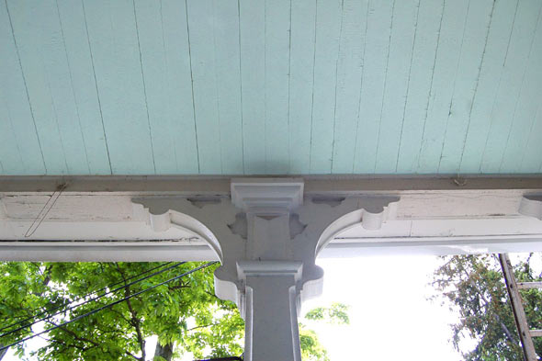
Haint Blue
Begun amongst the Gullah community of South Carolina. The blue is thought to trick spirits such as ‘haints’ or ‘boo hags’ into believing the surface is either the sky, which they will then pass up through, or water, which spirits are said to be unable to cross.

Slide 12
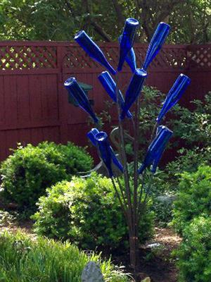
Bottle Tree
Similar in idea and origin to Haint Blue. It came to Hoodoo from the trans- atlantic slave trade. The concept is that spirits will be drawn into the bottle, and then destroyed by sunlight.

Slide 13
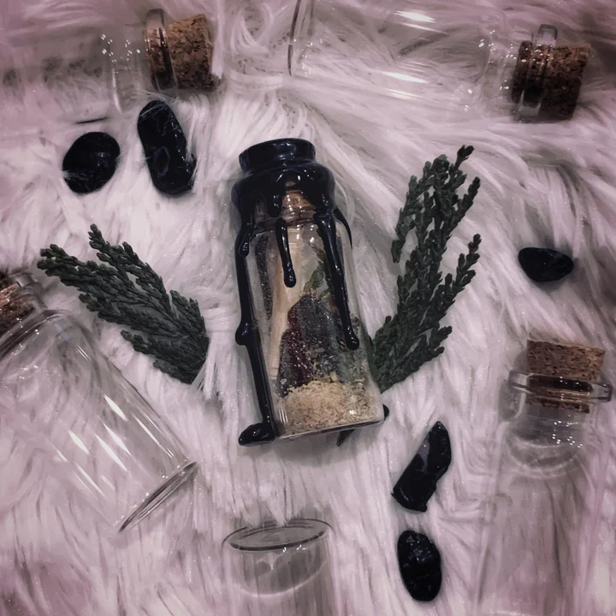
What-Not Jars
Inspired by Spell Jars of Hoodoo tradition.
Traditional spell jars typically use honey or vinegar as a base, mixed with graveyard dirt or goofer dust. Then a variety of symbolic elements are mixed in, and placed with a bit of paper with the targets name written upon it.

Slide 14
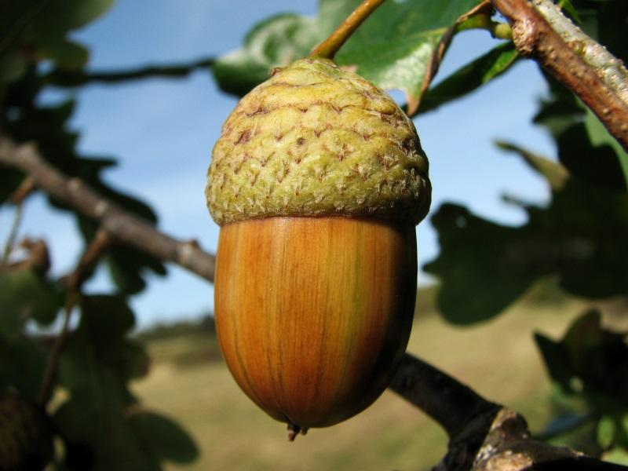
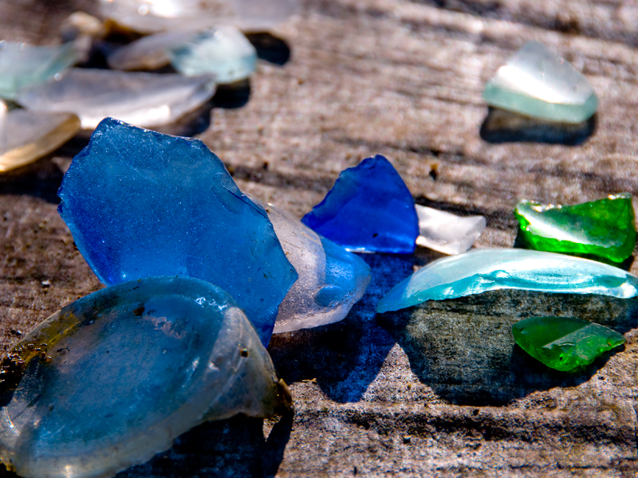
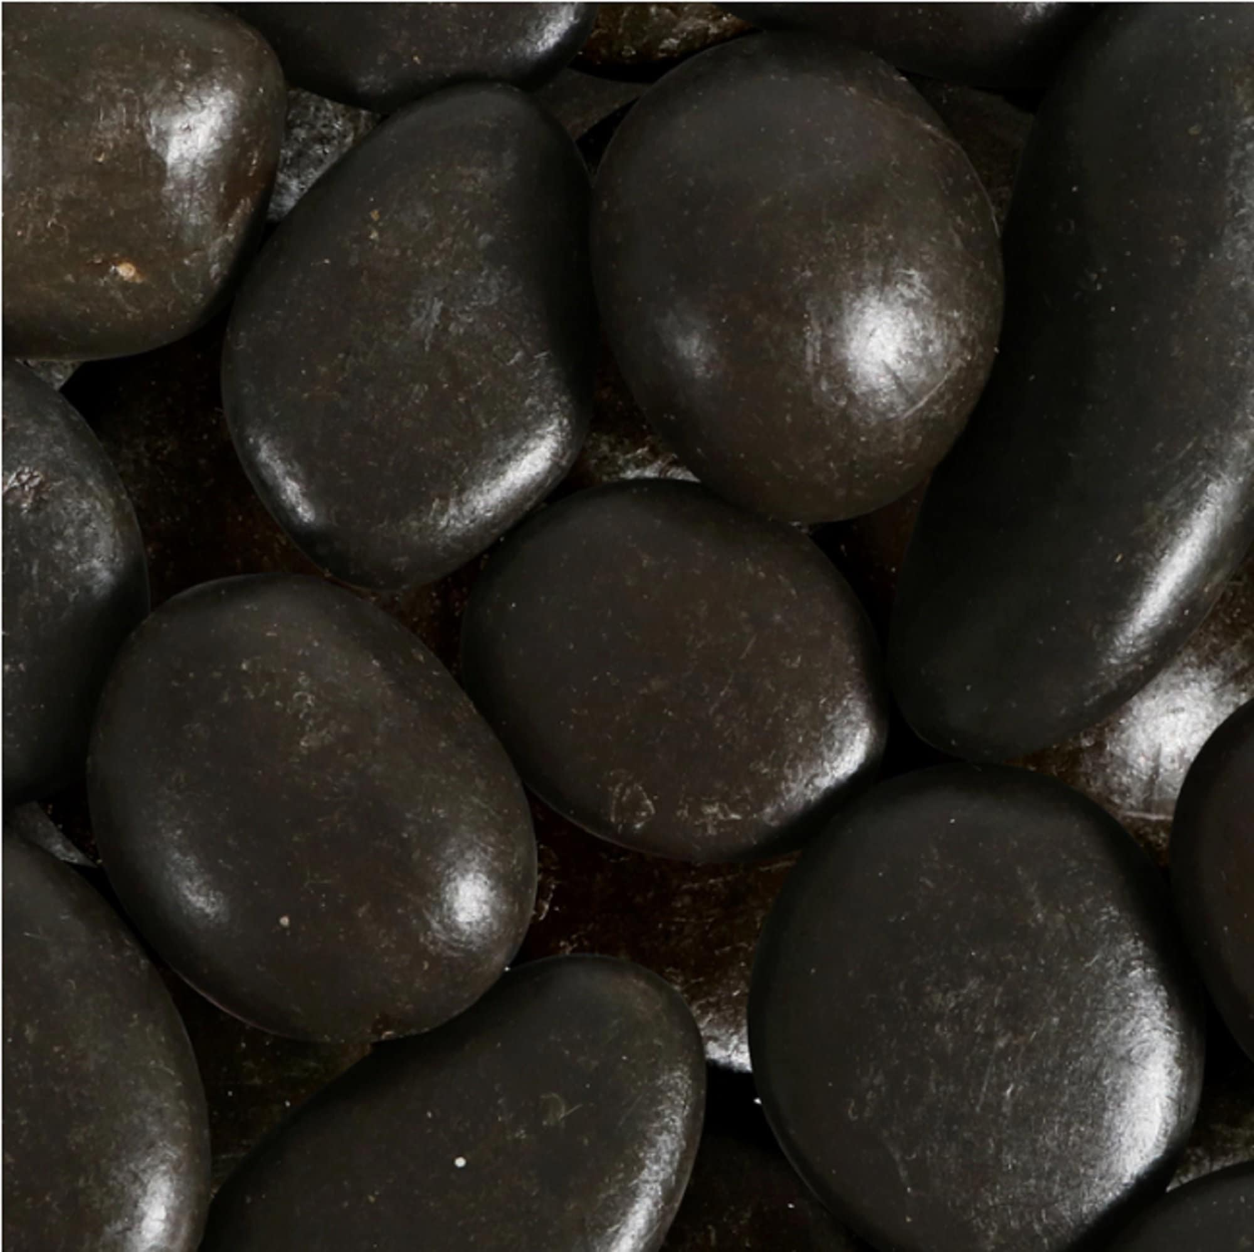
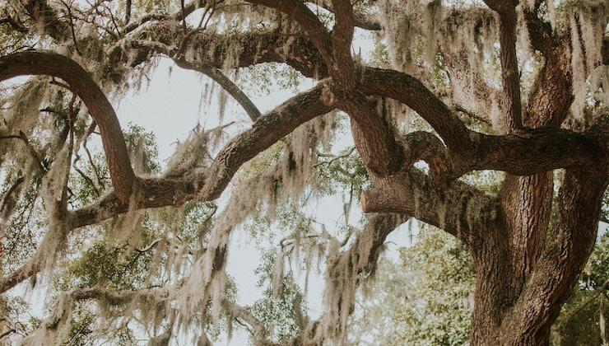
What-Not Jars - Symbolism
Oak -
Strength, Stability
Spanish Moss -
Justice, Revenge
Sea Glass -
Transformation
Black River Rocks -
Knowledge, Protection

