Slide 1
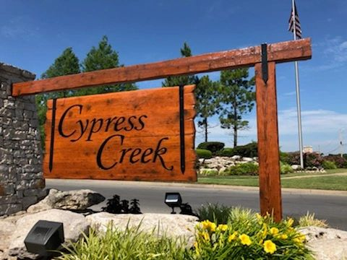
Cypress Creek Annual Board Meeting 4/22/21

Slide 2
Presidents Report
2020 Accomplishments
  Initiated fence replacement project
  Serviced 3 fountains
  Pool
    Replaster the pool
    Remodeled the bathrooms
    Removed stumps in front
    Resealed the parking lot
    Leveled the sidewalk going to pond
  2021 –
    Completion of fence project
    Identified a new fountain service company
    Drainage project at pool

Slide 3

CYPRESS CREEK FINANCIAL SUMMARY
April 22nd ANNUAL HOA MEETING

Slide 4
CASH POSITION
AS OF APRIL 1, 2021
Cash - Operating Account (April 1) $63,943
  + Outstanding Dues to Receive $ 1,250
  - Outstanding Expenses $55,497
  - Move to Cash Reserve $ 5,000
  = End of Assessment Period cash $ 4,696
Cash - Reserve Account (April 1) $ 5,000
- Receive from Operating Account $ 5,000
= End of Assessment Period cash $ 10,000
Total End of Assessment Period Cash $ 14,696

Slide 5
UNPAID DUES
 | April 1 2021 | JULY 1 2020 | SEPT 6 2019
AGED | $2,689 | $ 1,338 | $14,014
CURRENT | $2,642 | $ 2,774 | $59, 025
TOTAL | $5,331 | $ 4,112 | $73,039

Slide 7
YOUR DUES AT WORK

Slide 9
Committee Reports
Landscape - Brian Konieczny
Social – Priscilla Eddy
Architectural – John Moore
Compliance – Daryl Ousley-Wray
Welcome – Greer Nichols

Slide 10
New Business
Election of officers
Erosion plan – Greer Nichols
Tree plan – Greer Nichols

Slide 11

Master Tree Plan
Greer Nichols

Slide 14
Unfinished Business
Security Feasibility Study – Russ Anderson

Slide 15
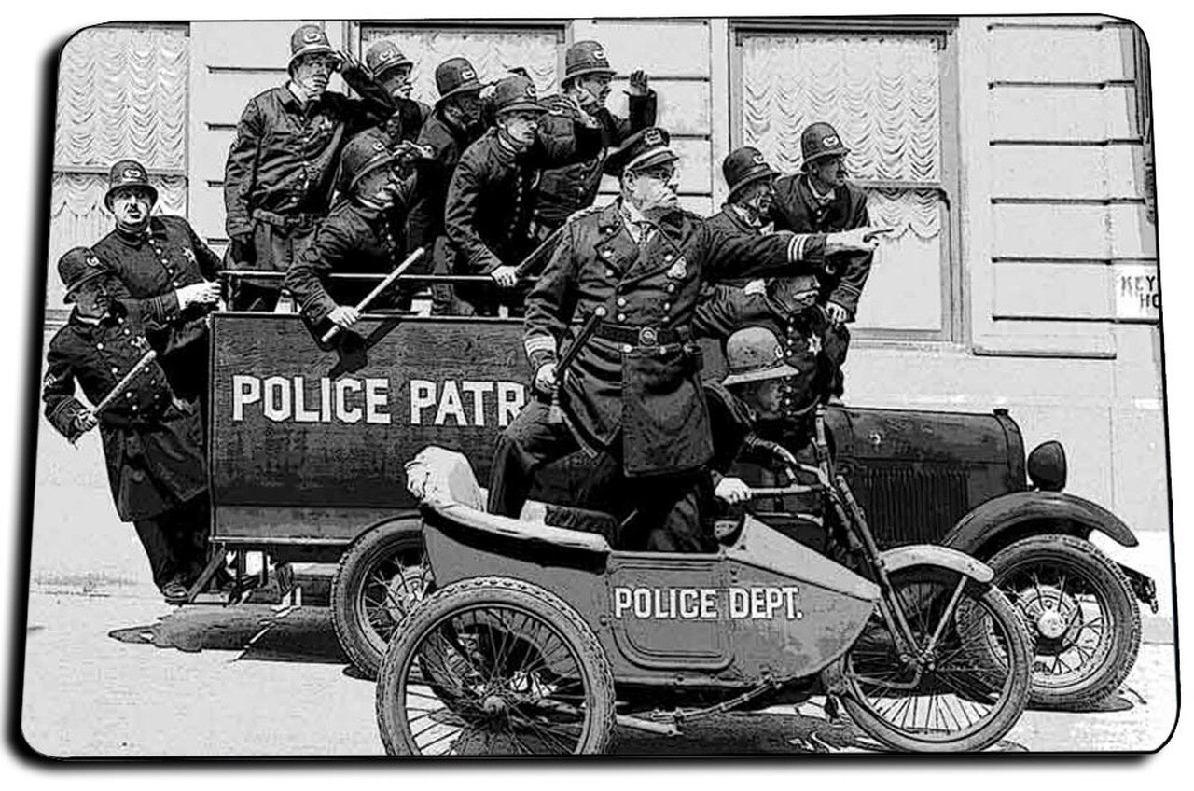

Neighborhood security
Cypress Creek Neighborhood Association Annual Meeting
22 April 2021

Slide 16
Concerns
Residential burglary
Theft from vehicles
Theft of vehicles
Vandalism

Slide 17
Possible solutions
Controlled access, i.e., gating neighborhood entrances
Hired security patrols
Neighborhood watch programs
Neighborhood entrance cameras

Slide 18
Controlled Access (gates)
Residential gate access systems range from $5,000 to $10,000
  Includes gate, the electrical system that operates the gate and the electronic access control panels
  Does not include cost of electricity and cell service to notify residents of guests at the gate, nor the installation costs
  For three entrances, $15,000 - $30,000 for equipment only, plus the installation, entrance reconstruction, electricity costs
Negative issues:
  Maintenance and repair of streets moves from City of Tulsa to the HOA
  Would need to rebuild main entrance to accommodate and to prevent traffic from backing up on 41st Street
  Electricity currently only available at the main entrance
  Maintenance and repair cause inconvenience and higher costs
  Creates no record of incoming/outgoing traffic for police investigative purposes

Slide 19
Hired Security Patrols
Tulsa Security Task Force
Two patrols through neighborhood each evening
$447 per month; additional patrols would increase this amount
Advantages:
  Visible presence
  Professional security
Disadvantages
  Limited coverage
  Some deterrent effect, but little assistance to police investigation and prosecution of crimes committed

Slide 20
Neighborhood entrance cameras
Investigated several options
Purchasing vs. Leasing
Data storage and access
Crime prevention effectiveness
Assistance to police investigation and prosecution

Slide 21
Cameras purchasing option
Advanced Alarms
Equipment recommended (per entrance – 3 entrances, with a 4th coming soon)
  Two cameras, surveillance hard drive, network video recorder, wifi bridging devices
  Electricity would have to be provided; currently available at main entrance, but not at the other two entrances
  Nearby residence would be required to house the wifi bridging device
Cost
  For equipment and installation – $10,706
  For electrician to run electricity – $6,500 +
  PSO costs for setting meters and establishing service – no estimate provided by PSO
  Cost for electricity and for wifi service

Slide 22
Cameras purchasing option
Advantages
  HOA would own all equipment once installed
  Access to data monitored by HOA or designee
Disadvantages
  Getting approval from the City for easement incursion for electricity
  Getting approval from nearby residents for wifi device installation
  Recurring issue if an agreeing resident moves – process for continued agreement
  Cost of electrician to run power to the cameras
  Cameras not specifically designed to capture license plate information
  Limited assistance police investigation with limited license plate reading ability

Slide 23
Cameras leasing option
  Flock Safety
  Recommended equipment
    Stand-alone solar powered HD license plate-reading camera system
    Recommend 2 per entrance (one incoming, one outgoing)
    Cellular cloud-based data storage (no equipment required)
  Flock Safety Short Recording - Cypress Creek - Tulsa, OK – Zoom
  Cost
    $2,500 per camera per year
    One camera per entrance - $7,500 per year
    Two cameras per entrance - $15,000 per year

Slide 24
Cameras leasing option
  Disadvantages
    Do not own equipment
    Annual rental fee, so recurring annual cost
    Monthly cost - $1,250 (2 cameras per entrance)
  Advantages
    Do not own equipment – not responsible for repairs or upkeep
    HD license plate reading cameras
    Increased utility to police for investigative and prosecution purposes
    Once agreement with TPD in place, automatic interface with TPD
    No installation cost nor need to run electricity (solar powered stand alone)

Slide 25
Cameras leasing option
  Advantages (continued)
    HOA owns all the data
    HOA can designate who can access the data
    Captures usable and specific information on vehicles
    Scalable and searchable
    Cost analysis (2 cameras per entrance)
      $15,000 per year
      $1,250 per month
      $4.38 per resident per month
      $52 per resident per year

Slide 26
Announcement of new board members

Slide 27
Questions and Answers

