Slide 1
Ableism 102:
Next Steps in Dismantling Ableism
Miranda Grunwell
269-345-1516 x120
grunwellm@dnswm.org

Slide 2
Definition of Disability
A physical/mental impairment that substantially limits one or more major life activities
The ADA also protects people who:
  Have a record of such impairment
  Are regarded as having such an impairment

Slide 3
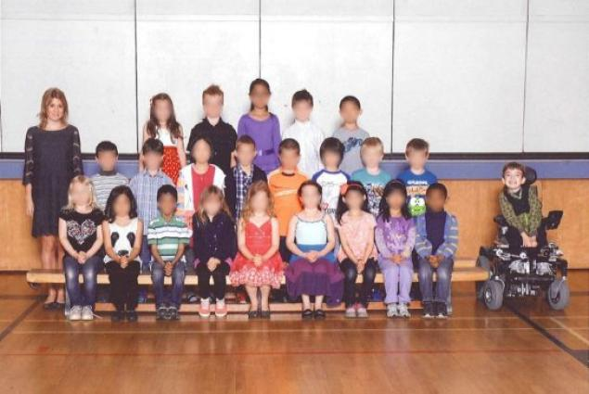
Ableism
The systematic oppression (mistreatment, marginalization, exploitation) of people with disabilities

Slide 4
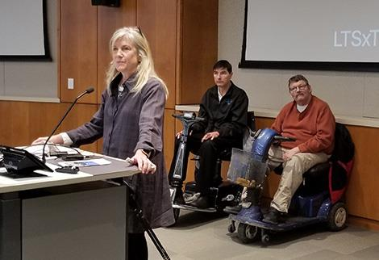
Let’s talk!
What are some examples of why it can be difficult to have a disability?

Slide 5
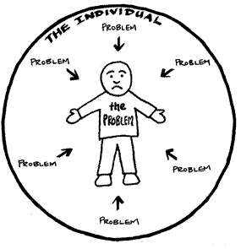
Model of Disability: Medical
Medical Model of Disability:
Disability is caused by a person’s impairment or difference.
    Looks at what is wrong with the person
    Impairments should be fixed.

Slide 6
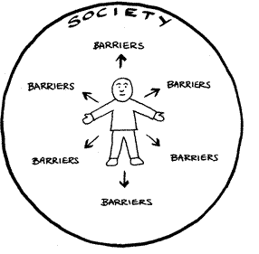
Model of Disability: Social
Social Model of Disability:
Disability is caused by the way society is organized.
  Looks at ways to remove barriers
  Choice and control over their own lives

Slide 7
Model of Disability: Holistic
Holistic Model of Disability:
Disability is a physical or mental impairment that by itself and/or in interaction with the environment interferes with a person’s full and equal participation in any aspect of life or society.
Looks at treatments/therapies and social/environmental changes that support Disabled people’s needs, wants, and goals
Impairments are inherently disabling and/or disabling due to social and environmental factors.
Source: Introducing the Holistic Model of Disability

Slide 8
Applying Models of Disability
Diabetes
Medical Model: medication, diet, and finding a cure
Social Model: job accommodations, free healthcare, person picks their treatment plan
Holistic Model: person-centered, parts of both models are used

Slide 9
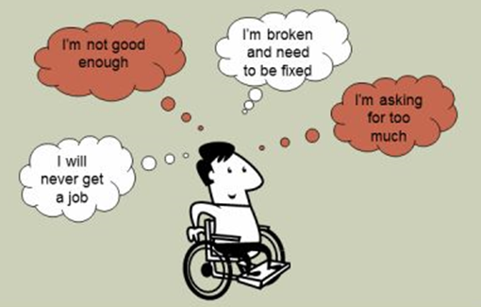
Four Levels of Ableism
Personal
Interpersonal
Organizational
Institutional

Slide 10
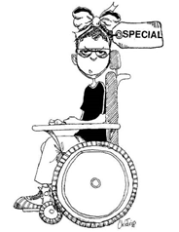
Personal
Your thoughts, values, feelings, and beliefs about disability
  “I’m so glad my baby wasn't born with a disability.”
  “People with disabilities are so inspirational and nice!”
Action Step: Challenge your own implicit bias and ask, “Why am I thinking or feeling this way?”

Slide 11
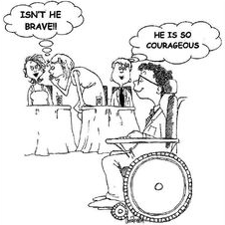
Interpersonal
Actions, behaviors, and language regarding disability
  “She can’t be on this committee – she would have too much trouble understanding what’s going on.”
  “It’s so cute that he has a girlfriend!”
Action Step: Use neutral language, show respect, and ask!

Slide 12
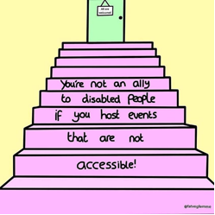
Organizational
The way an organization does things
The organization could make the changes.
  “Our public event flyers don't include information on how to request accommodations.”
  “You must be able to lift 50 pounds for this job.”
Action Step: Review organizational policies, procedures, programs, and services regularly.

Slide 13
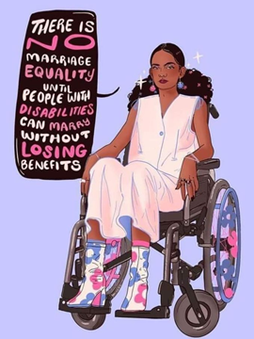
Institutional
Consists of systemic rules, policies, and procedures
Change could be made to policies, but it’s outside of your control or your organization.
  Marriage inequality
  Guardianship/conservatorship
Action Step: Advocate with legislators for improved laws and policies.

Slide 14
Power & Privilege
Power is having the ability to make decisions that impact others.
Power for people without disabilities:
  Selecting where people with disabilities can live
  Determining if a person with a disability can work
  Deciding if a student will be segregated at school

Slide 15
Power & Privilege
Privilege is what I am able to do.
Privilege for people without disabilities:
  Presumed competence
  Access to public/private life and spaces
  Right to try and fail

Slide 16
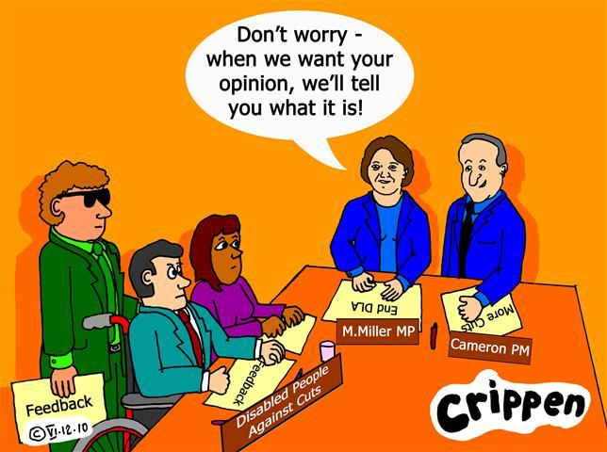
You and I Activity
Need two volunteers who are willing to read in front of the whole group
  One person reads statements starting with “You”
  One person reads statements starting with “I”

Slide 17
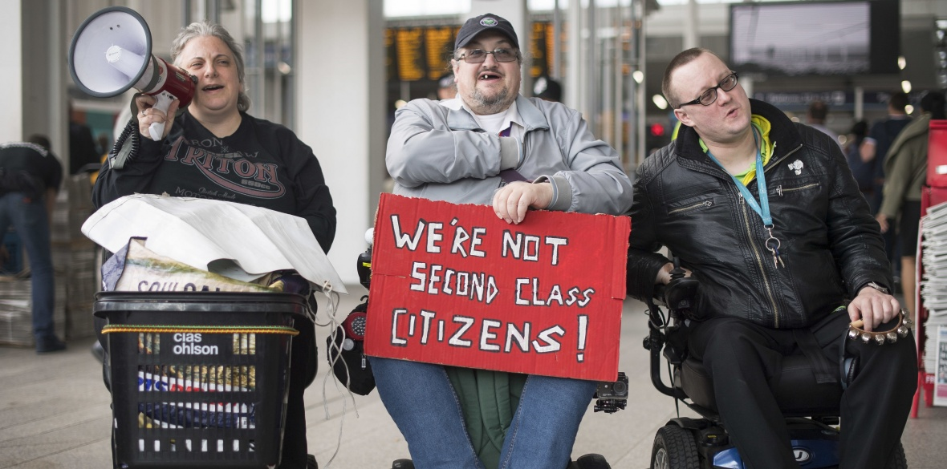
Oppression
Oppression is using our power and privilege against others.
Power + Privilege = Oppression
Oppression is the opposite of inclusion.

Slide 18
Full Inclusion
Inclusion is a journey.
Generally, people don’t like having to change the way they do something to accommodate someone else.
Full inclusion will challenge us to do things differently.
Reflect upon systemic ableism in our processes.
What if it means changing how an event is always done?

Slide 19
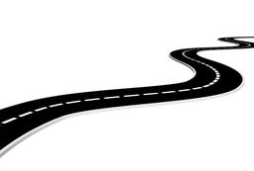
Scale of Inclusion
5. Inclusion
3. Project with Funding
1. Denial – Exclusion
4. Understanding –
Integration
2. Charity

Slide 20
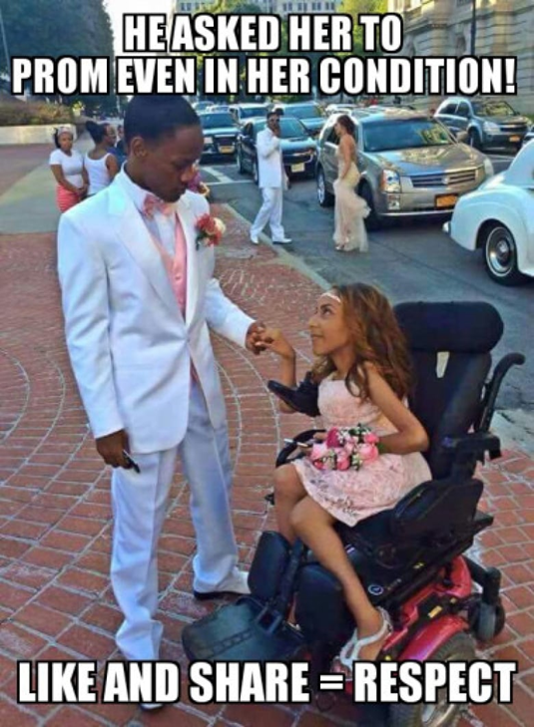
Stopping Ableism
Don’t share or repost.
Ask the person why they are thinking that way.
Model alternative language.
Call people in/out and provide education on why their words or actions are ableist.
Learn from people with all types of Disabilities

Slide 21

Questions? Comments?
Miranda Grunwell
grunwellm@dnswm.org
www.dnswm.org

