Slide 1
Disability & Allyship
Miranda Grunwell
grunwellm@dnswm.org
269-345-1516 x120

Slide 2
Definition of Disability
A physical/mental impairment that substantially limits one or more major life activities
The ADA also protects people who:
  Have a record of such impairment
  Are regarded as having such an impairment

Slide 3
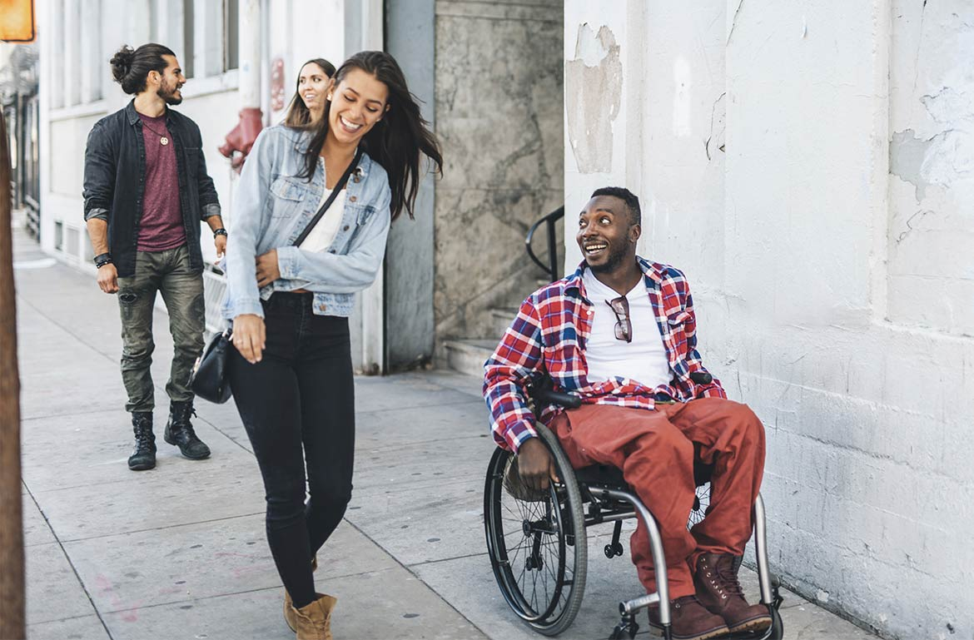
What is an Ally?
A member of a dominant group who takes action against oppression out of the belief that eliminating oppression benefits everyone

Slide 4
What is a Disability Ally?
A person without a Disability who takes action against oppression out of the belief that eliminating oppression benefits everyone
Presumes competence
Believes people with Disabilities when we express our experiences and desires
Uses neutral language to describe Disability

Slide 5

What is not true Allyship?
Not actively helping the Disability Community
Thinking of Allyship as a destination and not a journey
Labeling yourself an Ally
Viewing people with Disabilities as objects of pity or inspiration
Neutrality or just a feeling of solidarity

Slide 6
Why do we need Allies?
Ableism: The systematic oppression, mistreatment, and marginalization of people with disabilities
  Discrimination in favor of non-disabled people

Slide 7
Tips for Being a Disability Ally
Educate Yourself
Be a Role Model
Language Matters
Invite others to the table
Nothing about us without us!
Recognize and Compensate
Apologize when needed
Take Action

Slide 8

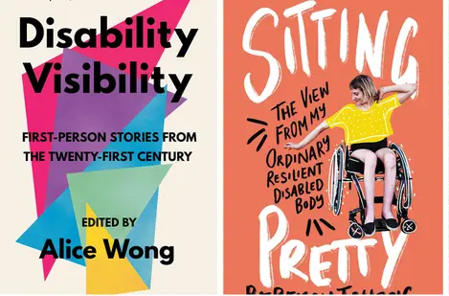


Educate Yourself
Learn from people with Disabilities.
Ask about things you don’t understand.
Learn about the current topics and trends.
Examine ways society excludes Disabled people.

Slide 9
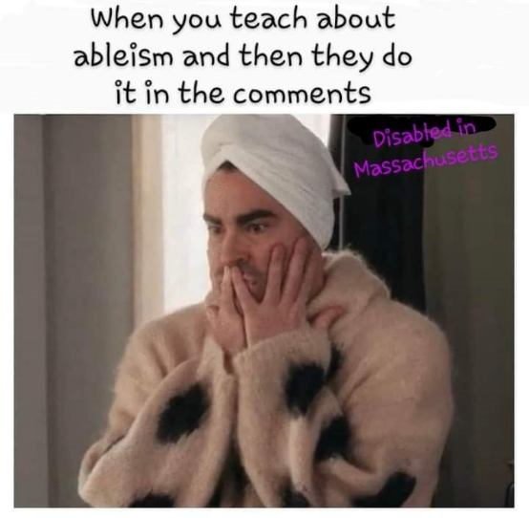
Be a Role Model
Focus on your impact, not your intent.
Lean into your discomfort.
Challenge assumptions and myths.
Consider accessibility in everything you do!
Hire and promote people with Disabilities.
Check your own privilege.
Don’t lead with assumptions!

Slide 10

Language Matters
Disability is not a dirty word!
Words have an impact on others around you.
Avoid using slurs and outdated language.
Each person gets to choose the words that describe them.
Members of the in-group can reclaim language an ally cannot:
  Crip, gimp
Consider sensitivities related to humor.

Slide 11

Invite others to the table
Ask yourself whose perspectives are missing from the conversation.
Lift up perspectives of those who should be included.
Build capacity.
You may need to be quiet!
Actively recruit people with Disabilities.

Slide 12
Nothing about us without us!
Respect our individual experiences.
People with Disabilities are in charge of our own lives.
Policymakers shouldn’t only consult nondisabled “experts” on Disability issues.
Don’t speak for us or about us.
People with Disabilities should be leading the change.

Slide 13

Recognize and Compensate
Recognize the work of Disabled people.
Give Disabled people credit for their work.
Disabled people should not always have to explain themselves.
Consulting is a job.
Pay us for the work we do!

Slide 14
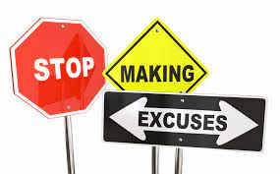
Apologize when needed
You will not always get it right all the time!
Reflect on how you can do better next time.
Take accountability.
Sit with your feelings and don’t be defensive.
Apologize.
Change your behavior.
Be open to feedback.

Slide 15
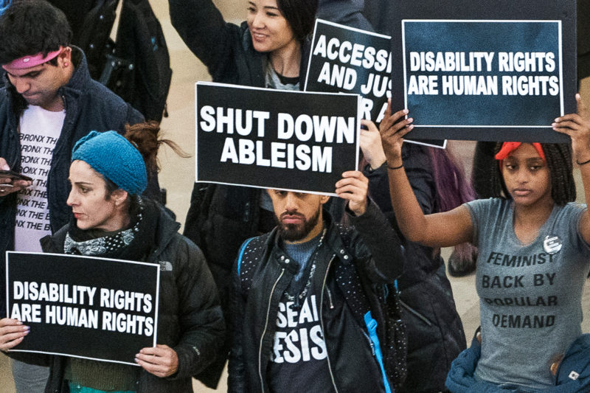
Take Action
Keep learning.
Donate time, talent, labor, and financial resources.
Unlearn your biases and assumptions.
Create collaborative events.
Vote in people with Disabilities!
Lobby/Advocate with policymakers.
Show up!

Slide 16
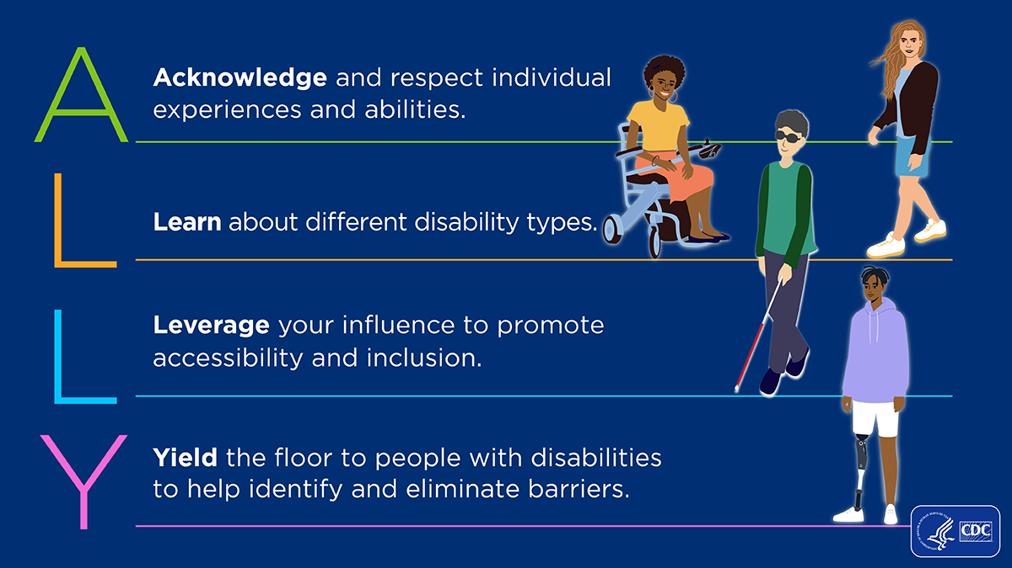
How to Be a Better Disability Ally
How to Be a Better Disability Ally with Daphne Frias (video)

Slide 17
Questions? Comments?
Miranda Grunwell grunwellm@dnswm.org
www.dnswm.org

