Slide 1
Pathfinder: Michigan’s Career Exploration Tool
May 5, 2023
Michigan Department of Labor & Economic Opportunity Employment & Training

Slide 2
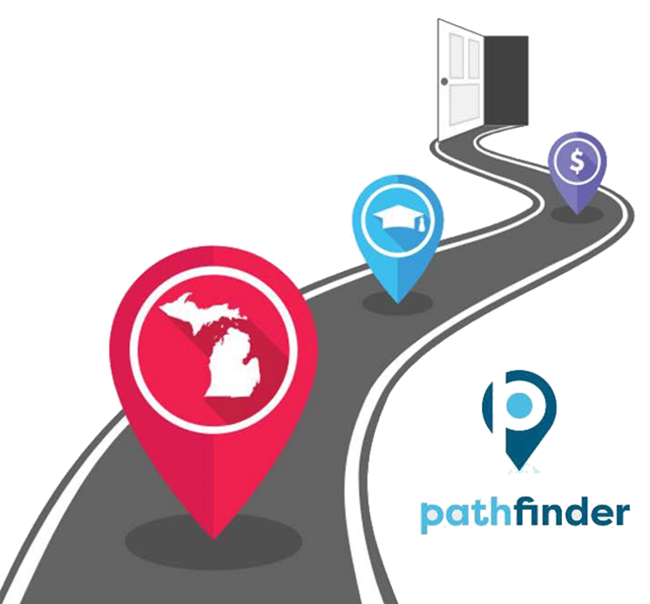
Pathfinder
Michigan's Online Career Exploration Tool
2022 Monthly Average:
3,009 unique visitors
707 completed roadmaps
Provides information to make informed choices
Combines official data sources
Connects education and training programs with employment
Pathfinder.MiTalent.org
Notes:
2018 to current version

Slide 3
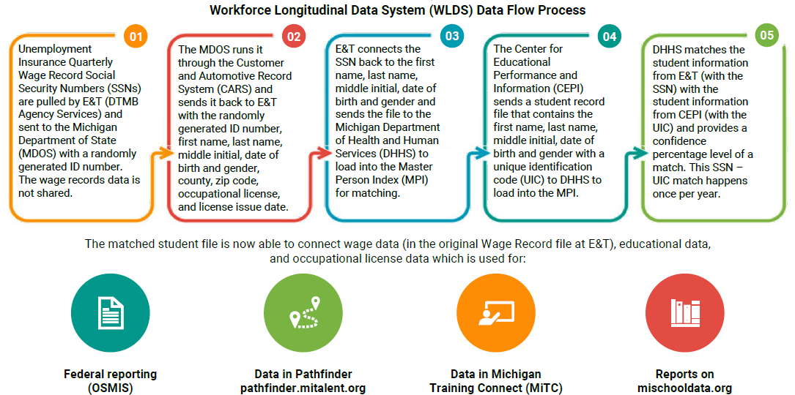
Workforce Longitudinal Data System (WLDS)

Slide 4
Pathfinder’s Data
SCHOOL/PROGRAM
OCCUPATION
High School Career & Technical Education Providers
Michigan Department of Education – Office of Career & Technical Education
Private & Public Community Colleges & Universities
Center for Educational Performance & Information
U.S. Department of Education College Scorecard
Proprietary Schools / Other Training Providers
Michigan Training Connect
Michigan Wage Data – Occupational Employment Statistics
Michigan Bureau of Labor Market Information & Strategic Initiatives
U.S. Bureau of Labor Statistics
Annual Openings & 10-Year Growth Projections
Michigan Bureau of Labor Market Information & Strategic Initiatives
U.S. Bureau of Labor Statistics
Education & Training Requirements (National Level)
U.S. Bureau of Labor Statistics
Pathfinder.MiTalent.org

Slide 5
USDOL Workforce Data Quality Initiative (WDQI)
LEO-E&T identified credentials as an important addition to our Workforce Longitudinal Data System (WLDS) in a 2019 WDQI grant.
LEO-E&T connected our system data and assisted state partners in publishing to the national Credential Registry.
Pathfinder.MiTalent.org

Slide 6
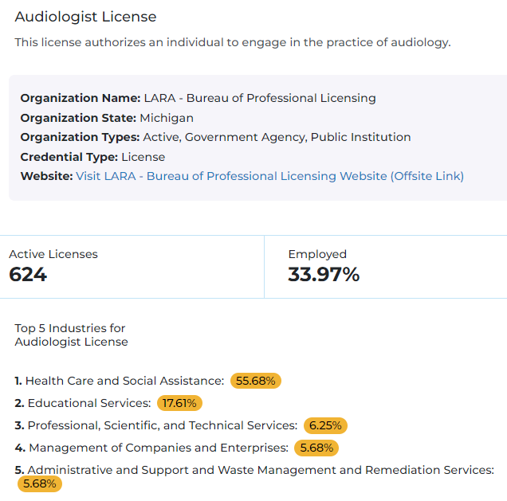
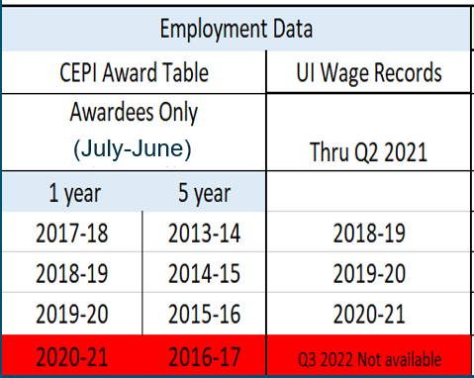
Credential
Profiles

Slide 7
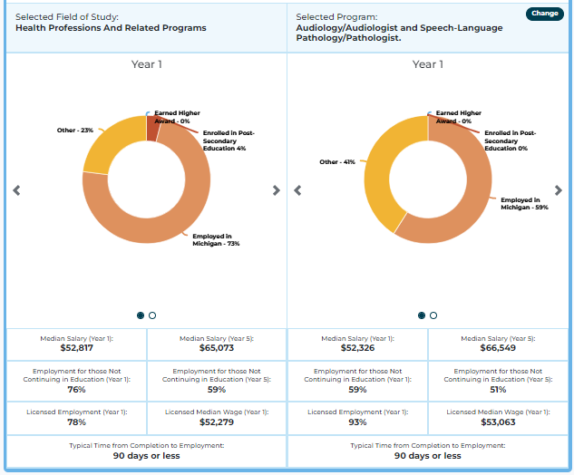
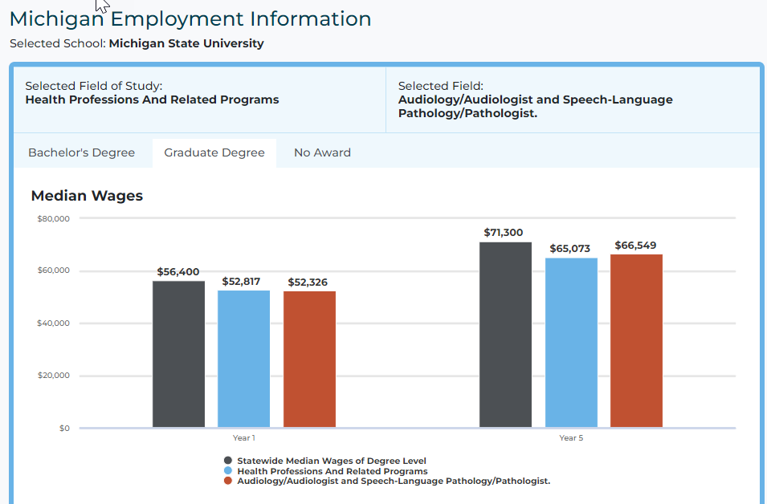
Program
Outcomes
Pathfinder.MiTalent.org

Slide 8
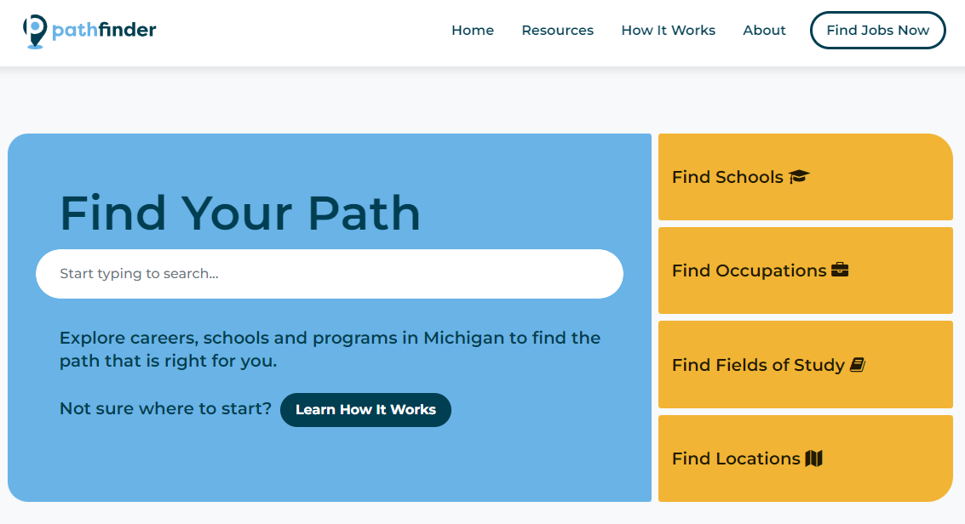
Pathfinder
Pathfinder.MiTalent.org

Slide 9
Next Steps
Exploring funding options
Future enhancements / expansion opportunities
Additional certification & license information
State-issued credential attainment verification
Increasing Usage
Internal and External Partners
Promotion
Toolkit
Pathfinder.MiTalent.org
Notes:
Registered Apprenticeship
Inclusion of other Departmental programs/designations
User Experience

Slide 10
Discussion
Career Exploration Requirements
Current Tools
Initial Feedback
Opportunities to partner
Presentations
Newsletters / conferences
Desktop Icons
Pathfinder.MiTalent.org

Slide 11
Discussion
Michigan Reconnect Applicants
Career Paths
Schools
Other uses
Program options within a field
Occupation research
Pathfinder.MiTalent.org

Slide 12
Contact Information
Questions?
Email
LEO-Pathfinder@michigan.gov
Website
Pathfinder.MiTalent.org
Notes:
Elyse & Jeni

