Slide 1
Help! I don’t speak swahili, kinyarwanda, spanish, or arabic!
HOW TO SUPPORT ENGLISH LEARNERS IN YOUR CTE PROGRAM
ALANE ROZELLE, KENT CAREER TECH CENTER, GRAND RAPIDS
MOSPA 2023
Notes:
INTRODUCE MYSELF—EXPERIENCES IN CENTRAL AMERICA, YEARS WITH MIGRANT WELFARE, YRS W/ KCTC, EDUCATION, MY LANGUAGES.

Slide 2
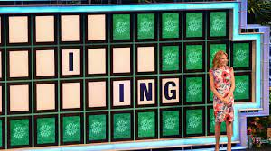
GAME TIME!
LET’S PLAY:
DO YOU HEAR LIKE AN ENGLISH-LEARNER?
UNSCRAMBLE THESE GARBLED PHRASES.
Notes:
INTRODUCE NEXT SLIDE: WHAT DOES ANOTHER LANGUAGE SOUND LIKE TO YOU? (ALLOW ANSWERS) SO WHAT MIGHT ENGLISH SOUND TO AN ENGLISH-LEARNER? LET’S START OUT WITH A LITTLE TEST:

Slide 3
What an el might hear:
DISS
GUYS
THEY’LL
HIM
IT
OWL
FRAYED
HOSE
HOSS
Notes:
(2 MIN PER PHRASE)
THE SKY’S THE LIMIT
ALFREDO SAUCE

Slide 4
UP
RACKED
HICK
GULCH
OAK
THUMB
OTHER
OVEN
FIN
CHIN
Notes:
(2 MIN PER PHRASE)
A PRACTICAL JOKE
THE MOTHER OF INVENTION

Slide 5
WHO ARE THEY & WHERE ARE THEY FROM?
MICHIGAN OVERALL—numbers
Why have they come? How did they end up in the Mittens?
Immigrants are good for the community
Notes:
OKAY, SO LET’S GET INTO THE STATISTICS THAT PROVIDE THE WHY FOR NEEDING THIS WORKSHOP.

Slide 6
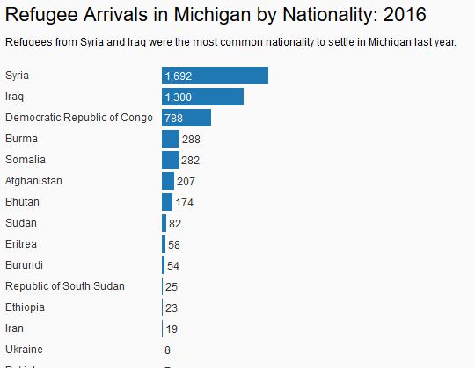
RECENT IMMIGRATION INTO MICHIGAN
Notes:
THERE ARE INFLUXES OF REFUGEES AND IMMIGRANTS EVERY YEAR. THE COUNTRY OR AREA OF ORIGIN CHANGES OFTEN BASED ON THE WORLD “HOT SPOTS.” MICHIGAN IS ONE OF THE MAIN STATES FOR RESETTLEMENT, ESP. IN THE DETROIT/DEARBORN AREA AND THE GRAND RAPIDS AREA, DUE TO POPULATIONS ALREADY HERE AND DUE TO TWO OF THE LARGEST RESETTLEMENT AGENCIES—SAMARITAS AND BETHANY—BEING LOCATED IN MICHIGAN. UNACCOMPANIED CHILDREN AND FAMILIES WITH CHILDREN WILL EVENTUALLY END UP IN THE SCHOOL SYSTEMS, SO WE NEED TO BE PREPARED TO RECEIVE THEM.

Slide 7
https://mlpp.org/2022immigrantsnapshot/Michigan.pdf

Slide 8
OUR GROWTH AT KCTC
Ave. 19 distinct languages;
50% WIDA scores <4.0 target
Notes:
2-3 MINUTES

Slide 9
Immigration benefits michigan
https://www.samaritas.org/Portals/0/UM%20Re-Issued%20Final%20Copy%20-%20Draft%205.pdf
1. Immigrants want to assimilate into the American culture.
2. Immigrants fill shortages of jobs and pay taxes.
3. Immigrants are not all criminals or terrorists.
---Majority are “documented.” Terminology: undocumented vs illegal
---Not all from Mexico/Latin America.

Slide 10
RIGHTS TO EDUCATION
OCR (Office of Civil Rights) Title VI Policy is Violated If:
students are excluded from effective participation in school because of their inability to speak and understand the language of instruction;
national-origin minority students are misassigned to classes for those with intellectual disabilities because of their lack of English skills;
programs for students whose English is less than proficient are not designed to teach them English as soon as possible, or if these programs operate as a dead-end track; or
parents whose English is limited do not receive school notices and other information in a language they can understand.

Slide 11
Per title vi, schools are required to:
identify students who need assistance;
develop a program which, in the view of experts in the field, has a reasonable chance for success;
ensure that necessary staff, curricular materials, and facilities are in place and used properly;
develop appropriate evaluation standards, including program exit criteria, for measuring the progress of students; and
assess the success of the program and modify it where needed.

Slide 12
WHY CTE SHOULD BE GOOD FIT FOR ELLs
See and Do
Developing vocab in desired career path
Learning a marketable skill along with language-learning
Giving graduation a purpose
Developing relationships with adults in the career path and connections in industry
Learning the “American” system of work
Notes:
3-4 MINUTES

Slide 13
First: get to know one another
Names / Identity
Home Country, Culture, Languages Spoken
Prior Education & English Ability
Support Base
Names have meaning
Names say who we are
Names connect us to our roots
Notes:
Pair and Share: (3 min.)
Do you know what your name means?
Do you know your nation or culture of origin?
If you’re from a family that has “recently” immigrated, what has been your/their experience?

Slide 14
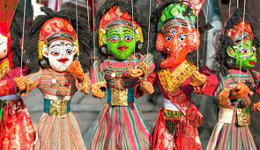
1. Wida 2. Can do DESCRIPTORS 3. LANGUAGE ACQUISITION PLANS
WIDA AND LAPs
Nepalese ethnic dancers
Notes:
THE NEXT TWO SLIDES WILL COVER THE WIDA TEST AND THE CAN-DO DESCRIPTORS FOR DECIPHERING THE WIDA RESULTS. WE WILL LOOK AT AN EXAMPLE OF AN L.A.P. A LITTLE LATER IN THIS PRESENTATION.

Slide 15
WIDA
https://www.michigan.gov/mde/0,4615,7-140-22709_40192---,00.html
Can do DESCRIPTORS
https://wida.wisc.edu/sites/default/files/resource/CanDo-KeyUses-Gr-9-12.pdf
Notes:
5-6 min

Slide 16
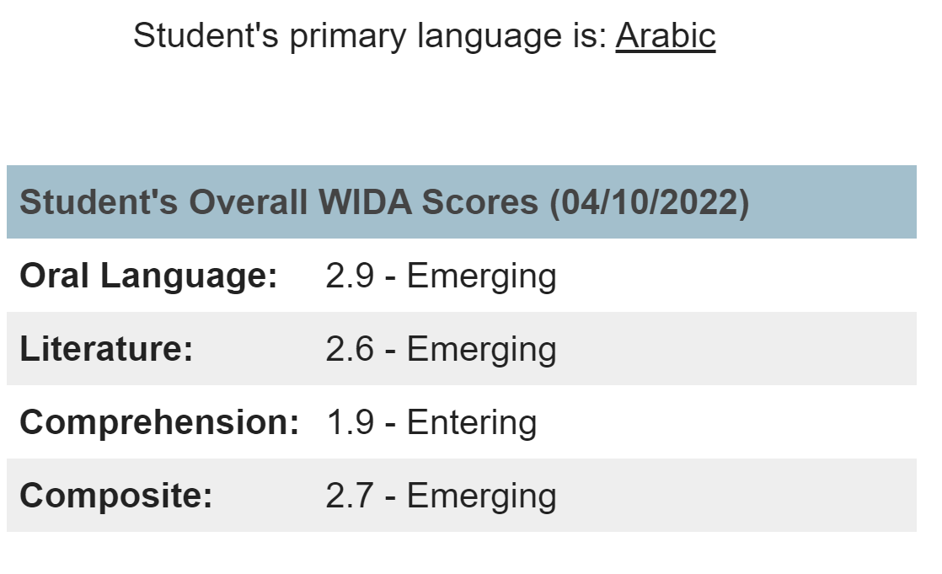

Slide 17
CLASSROOM TIPS FOR INSTRUCTION/SUPPORT
1. BUILD RELATIONSHIPS.
2. INCORPORATE THE EL’S CULTURE IN THE CTE CLASSROOM.
3. PAIRING: same language vs a native English-speaker.
4. LECTURING/INSTRUCTION: speech, idioms, vocab.
*PAIR & SHARE– next slide!
Notes:
AT THIS POINT, WE’VE TALKED ABOUT THE WHO AND THE WHY AND HOW TO DETERMINE ENGLISH LEVEL. LET’S NOW DIVE INTO WAYS TO SUPPORT THE ENGLISH-LEARNERS IN YOUR CLASSROOMS. FIRST & FOREMOST, BUILD RELATIONSHIP WITH THEM! OF COURSE, THAT APPLIES TO ANY STUDENT, ENGLISH-LEARNER OR ENGLISH-NATIVE. HOWEVER, THERE MAY BE ADDED DOUBT, TIMIDITY & DISTRUST WHEN THERE ARE CULTURAL & LANGUAGE DIFFERENCES. IT MAY TAKE AN ENGLISH-LEARNER MORE TIME TO OPEN UP TO YOU.

Slide 18
PAIR & SHARE:
DISCUSS HOW YOU WOULD EXPLAIN THESE TERMS OR IDIOMS:
RED FLAG (!)
HIT IT OUT OF THE BALLPARK (We’re playing baseball now?)
TAKE A BACK SEAT TO …
WATER UNDER THE BRIDGE
DON’T LET THE CAT OUT OF THE BAG (What cat? Why in bag?)
IT’S A PIECE OF CAKE (Where’s the cake?)
Notes:
LET’S TAKE A PAUSE RIGHT THERE AND DISCUSS IDIOMS USED IN THE CLASSROOM. THINK ABOUT WHAT A NON-NATIVE ENGLISH LEARNER IS GOING TO THINK ABOUT THESE PHRASES. TAKE TURNS –ONE OF YOU BEING THE ENGLISH LEARNER AND ONE OF YOU BEING THE INSTRUCTOR OR SUPPORT STAFF.

Slide 19
5. VISUALS: VOCAB, DEMOS, HANDS-ON
6. ASSESSMENTS/EVALUATIONS—
--EXTENDED TIME,
--SHORTENED ASSIGNMENTS,
--ALTERNATE MEANS OF DEMONSTRATING MASTERY* (examples)
7. BE THE SCRIBE: for resumes, essays, cover letters
--sentence starters
8. ONLINE REVIEW GAMES: QUIZLET, BLOOKET, JEOPARDY, etc.
--
Notes:
PICTIONARY: 3 MINUTES

Slide 21
PICTIONARY TIME!
Notes:
YOU DO NOT HAVE TO BE AN ARTIST! HERE IS A RECENT EXAMPLE OF SKETCHES AND DOODLES I ACTUALLY USED WHEN HELPING A STUDENT WITH A TEST OVER—CAN YOU GUESS?– THE URINARY SYSTEM. FIND A NEW PARTNER—QUICKLY—AND DRAW WHAT’S ON YOUR CARD. SEE IF THE ENGLISH-LEARNER CAN GAIN BETTER UNDERSTANDING. WHAT WAS YOUR EXPERIENCE?

Slide 22
HAND-OUTS:
C.L.A.A.S.S.
*CLARITY
*LINKS
*ACCESSIBILITY
*ASSESSMENTS
*SUPPORTS
*SOCIAL
OAKLAND SCHOOLS
*LESSON PLAN/FORMATIVES
*SOCIAL & ACADEMIC TALK
*TRANSLATION
*ACCOMMODATED TEXT
*VOCAB
*VISUALS
*FEEDBACK

Slide 23
Language acquisition plan (lap)
Also called: Individual Language Plan (ILP), Language Development Plan (LDP), etc.
Example:
https://www.bismarckschools.org/cms/lib/ND02203833/Centricity/Domain/209/ILP%20BPS%202017-18.pdf
https://kisd-my.sharepoint.com/:b:/g/personal/alanerozelle_kentisd_org/Ef6DmHPDKZdaqp9Wf-rX3TEBFJxGfKQEsZtOYbu8sSDCyg?e=FFxqDR
Notes:
4 MINUTES

Slide 24
PAIR & SHARE
USING SOME OF THE INFO SHEETS YOU’VE JUST BEEN PRESENTED, DISCUSS WITH A PARTNER THE HELP SUGGESTIONS THAT YOU THINK MIGHT BEST SUPPORT A LOW-SCORING ENGLISH-LEARNER IN YOUR (OR ANY) CTE CLASSROOM.
(AUTO REPAIR, CONSTRUCTION, IT, WELDING, GRAPHICS, CULINARY, COSMETOLOGY, NURSE TECH, ETC.)
Notes:
RISE & MOVE—FIND A DIFFERENT PARTNER.—4 MINUTES

Slide 25
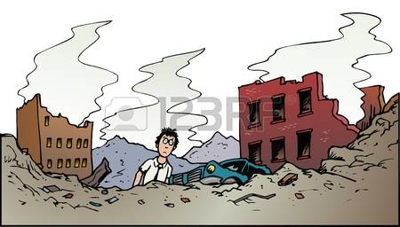
OBSTACLES/ ISSUES
ATTENDANCE
FAMILY RESPONSIBILITIES
HISTORY / TRAUMA
UNDOCUMENTED
OTHER: LOSS, FINANCES, LACK OF KNOWLEDGE OF U.S. SYSTEM
Notes:
WE’VE BUILT RELATIONSHIPS, WE’VE PROVIDED IN-SCHOOL SUPPORTS, BUT THE STUDENT IS STILL STRUGGLING AND IS ABSENT A LOT! WHAT ARE ADDITIONAL BARRIERS, BESIDES LANGUAGE, THAT IMMIGRANT & REFUGEE STUDENTS MAY PRESENT? (5-6 MIN.)

Slide 26
COMMUNICATION W/ COMMUNITY
PROPIO ONE Interpretation Services for phone calls.
Hire staff that are multilingual or learn a language yourself.
It’s important that parents be informed of school activities and rules in a language that they can understand.

Slide 27
WORK-BASED LEARNING
*NorthStar: must be low income and additional barrier such as ELL, homeless, unaccompanied minor, refugee, pregnant.
*Step between no job and a real job. Learning to be employable.
*Not always in desired career path.
*Limited term: 6-7 weeks in summer, some during school year.
*More likely to graduate.
Other WBL / OJT options at KCTC:
*Language has not been a large barrier
*Transportation can be an issue
*Work Eligibility is issue until law is changed

Slide 28
SEAL OF BILITERACY
https://www.michigan.gov/documents/mde/Michigan_Seal_of_Biliteracy_1.10.2017_610783_7.pdf
TO RECOGNIZE NATIVE SPEAKERS OF LANGUAGES OTHER THAN ENGLISH
AND
TO RECOGNIZE NATIVE ENGLISH SPEAKERS WHO MASTER ANOTHER LANGUAGE

Slide 29
GAME TIME: guess the English equivalent
Spanish: He’s in his turkey age.
Spanish: She made herself purple.
Creole: Wen fish ko from ribba bottom tell yu alligatah hongri, belieb an.
Swahili: How can you be burned by a hot pepper you haven’t eaten?
He’s in his teenage angst period.
She ate like a horse.
Listen to the voice of experience.
Mind your own business!
Notes:
ONE LAST ACTIVITY: WE TESTED OUR ABILITY TO EXPLAIN SOME OF OUR ENGLISH IDIOMS; HERE ARE SOME IDIOMS FROM OTHER LANGUAGES. WHAT DO YOU THINK THEY MIGHT MEAN?

Slide 30
Burmese: Like playing a harp to a buffalo.
Nepali: The summary of the heaven in front of the king of gods.
Kinyarwanda: Every cackling hen was an egg first.
An uncultured person will not appreciate the finer things in life. (Like throwing your pearls before swine.)
Trying to show off your bit of knowledge in front of the expert.
Every successful person started somewhere.

Slide 31
ADVOCATE!
Be a friend as well as a helper.
Help find what’s best for your ELLs.
You may be the only one speaking up for them.
Campaign to change laws: for example, MI ID or DL; resolve DACA; pathway to Citizenship, etc.
https://aclumich.org/en/press-releases/aclu-thanks-michigan-legislators-introducing-bills-allow-undocumented-immigrants
*RECOMMENDED BOOK:
“Teaching English Language Learners in Career and Technical Education Programs,” Victor M. Hernández-Gantes and William Blank, 2009.

