Slide 1
Roadmap to Success: Michigan Education and Career Pathfinder
Natalie Kochendorfer
Departmental Specialist
Talent Information Systems
Talent Investment Agency

Slide 2
What is Pathfinder?
Free online career exploration and planning tool
Provides information to help users make more informed choices on education and career opportunities in Michigan
LMI
Wage data
Performance outcomes
Return on Investment
Roadmap to career success
Complimentary to other skill assessment and interest profilers

Slide 3
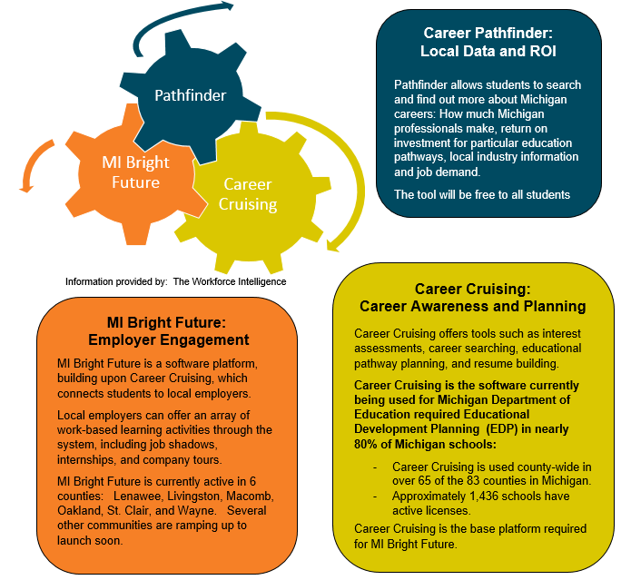
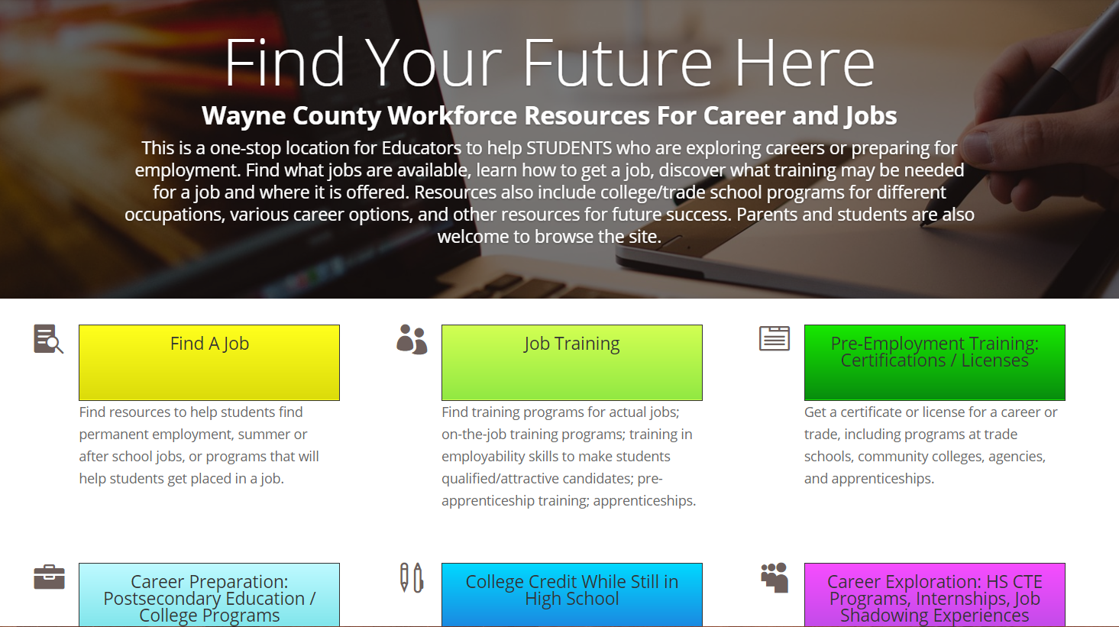

Slide 4
Why was Pathfinder created?
Help increase the number of students and adults with high-quality degrees and credentials
Support TIA’s commitment to customer focused services by engaging people early about opportunities
Support GTIB’s desire to increase career options awareness for students, parents, teachers and counselors
Support MDE’s commitment to becoming a Top 10 education state within the next 10 years
Provide information to assist students with Educational Development Plans
Support Michigan Career Pathways Alliance

Slide 5
Who should use Pathfinder?
Students
Parents
Counselors/Teachers
Job Seekers

Slide 6
Pathfinder Features
Search by:
Occupation
Field of Study
School
Location
Hot Careers
Comparison capabilities
Filtering capabilities
Print/Save/Email Roadmap
Additional Resources
Michigan data

Slide 7
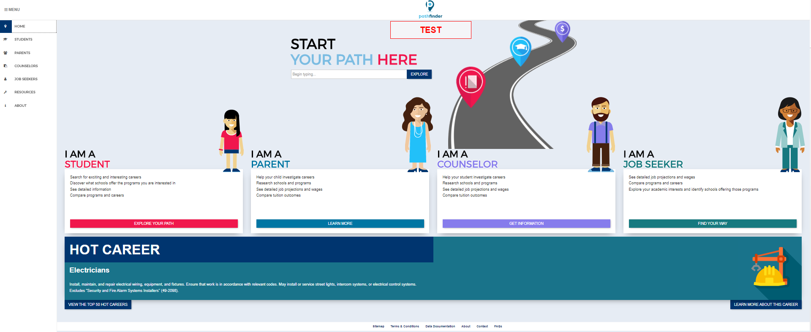
Demo

Slide 8
Questions?
Natalie Kochendorfer
KochendorferN1@michigan.gov
517-373-8505
Jeni Spaulding
SpauldingJ@michigan.gov
517-241-8727
http://pathfinder.mitalent.org

