Slide 1
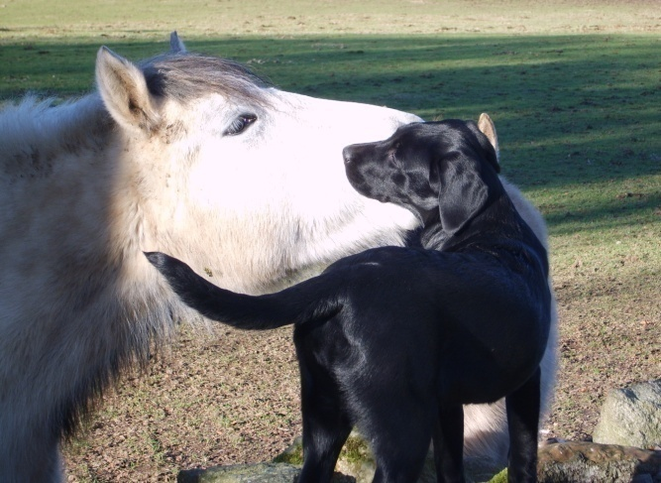
Crathes Horse & Dog Charity Show
The Milton Events Field, Crathes, AB31 5QH
by kind permission of Leys Estate and the Burnett Family
in aid of
The Equine Grass Sickness Fund
SUNDAY 1st June 2025
EVENT Sponsorship

Slide 2
Deeside Horse & Dog Charity Show
The Crathes Horse & Dog Charity Show are proud to support
The Equine Grass Sickness Fund
The Moredun Foundation Equine Grass Sickness Fund is the only registered charity in the UK raising funds specifically for research into grass sickness.
EGSF is dedicated to supporting and advancing research into grass sickness and further improving the treatment of grass sickness.
Grass Sickness remains a major cause of mortality in horses and ponies in Britain with more than 95% of cases proving fatal.
A number of chronic cases do survive with specialised intensive nursing and many have gone on to live a full working life.
All proceeds from our 2025 show will go to EGSF and we are asking for your kind support to make the day as successful as possible whether by providing Sponsorship or give a donation. In 2024 we raised over £5,000 and hoping to exceed this in 2025

Slide 3
Any Donation made can be made under Gift Aid by completing and returning the attached form along with your donation.
SPONSORSHIP OPTIONS
Business Sponsors can support with a tailored package to include:
All-day display of your banners/advertising around the ring.
Your advert printed in the catalogue free of charge.
Promotion over the PA system throughout the day.
Take an advert in the catalogue:
Option (1) Full page 180 x 125mm £50.00.
Option (2) Half page 90 x 125mm £30.00.
Sponsor a class or Championship for only £10:
Your name in the catalogue.
Available Classes – See Entry Schedule
Sponsor the Overall Championship for only £40;
Your name in the catalogue.
Your name on the Sash.
E. Any other Donation to Show kindly welcomed, whether;
Class Prizes
Cash
EVENT Sponsorship

Slide 4
APPLICATION FORM
Contact Name ................................................................................
Company Name ................................................................................
Contact Address ................................................................................
................................................................................
Postcode ................................................................................
Telephone ................................................................................
Email ................................................................................
Sponsorship Information (please indicate your choice by ticking a box):
Option A – Show Sponsor £ ....... (Suggested Minimum £80)
Option B –
(1) Full Page Advert £ 50
(2) Half Page Advert £ 30
If choosing options A or B, please enclose advertising copy, or forward to us by 1st May at the latest.
Option C & D –
(1) Sponsor a Class £ 10 Preferred Class No:
(2) Sponsor the Overall Championship Sashes £ 40
(If chosen Class/Championship already taken we will endeavour to select next similar Class instead)
Please send completed form to;
Karen Stewart, Stablesbrae, Durris, Banchory, AB31 6DS
or e-mail to stablesbrae@btinternet.com
Any queries contact 01330 811802 or 07802 892824
I enclose a total payment of: £……………………
Cheques Payable to NESHPES or by Bank Transfer to
Sort Code 83-15-14 Account No. 00209460
EVENT Sponsorship

