Slide 1
37th Annual
Aberdeen Highland Pony Show
THE MILTON EVENTS FIELD, CRATHES, AB31 5QH
SUNDAY 1st June 2025
EVENT Sponsorship

Slide 2
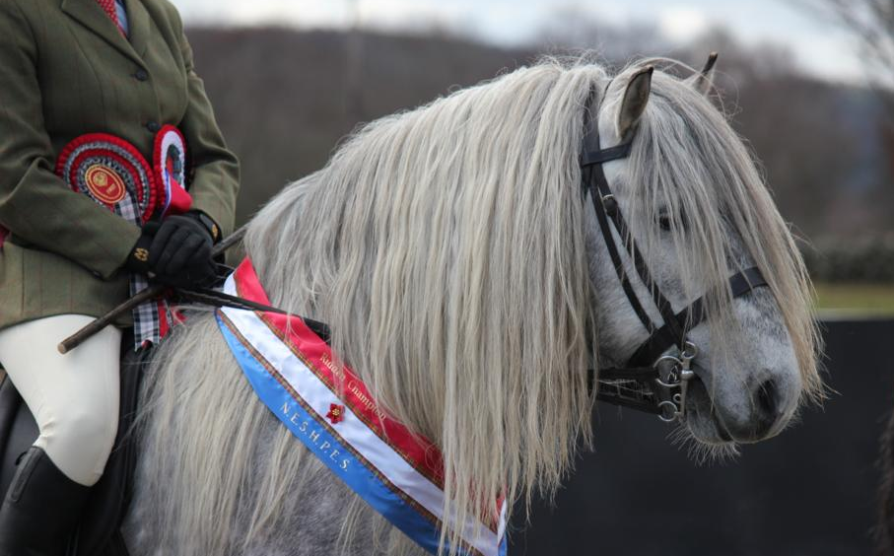
ABERDEEN HIGHLAND PONY SHOW
This year will mark the 37th anniversary of the North East of Scotland’s premier highland pony event. Our annual show attracts over 200 class entries from all over Scotland, and with visitors coming from around the world, it is where you can see one of the largest displays of Highland Ponies in the UK.
2025 will again see NESHPES host the Crathes Equine & Dog Grass Sickness Show on the same day and with over 100 classes it will be a busy day.
The highlands will going through their paces in, In Hand and Ridden classes, making our show the perfect opportunity to see the versatile Highland Pony taking part in all disciplines and is the perfect day out for all horse lovers.
With plans in place for an exciting day, your company name has the potential to be seen and heard by hundreds of visitors throughout the day.
Organised by North East Scotland Highland Pony Enthusiasts Society (NESHPES), a local club founded in 1983 to promote the use of Scotland’s Native Breed, the Highland Pony, the show provides an ideal opportunity to promote your business and also help support one of Scotland’s most popular Native Breeds.
Karen Stewart
Show Secretary
07802 892824
EVENT Sponsorship

Slide 3
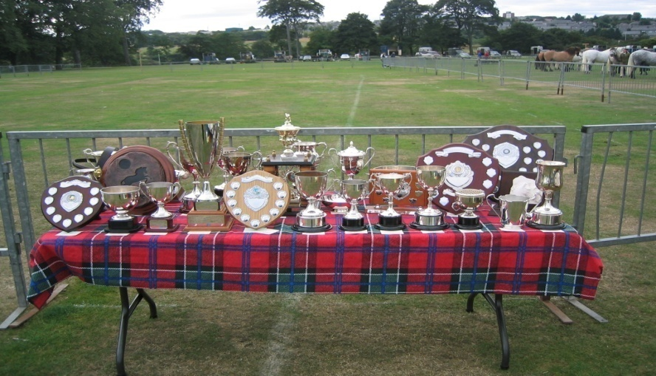
SPONSORSHIP PACKAGES
Be a show sponsor for a minimum donation of only £80:
All-day display of your banners/advertising around the ring.
Your advert printed in the catalogue free of charge.
Promotion over the PA system throughout the day.
Opportunity for Trade Stand space (available with prior agreement and subject to Licence conditions).
Take an advert in the catalogue:
Option (1) Full page 180 x 125mm £50.00.
Option (2) Half page 90 x 125mm £30.00.
Sponsor a class for only £20 or championship sash for £25:
Your name in the catalogue.
Your name on the Sash.
D. Any other Donation to Show kindly welcomed, whether;
Class Prizes
Cash
All Sponsorship comes with Exclusive entry to our first class Sponsors Hospitality Tent
EVENT Sponsorship

Slide 4
Option C - Available Classes:
In Hand
Stallion 3 yo and over
Junior Gelding 4, 5 & 6 yo
Senior Gelding 7 yo and over
Yeld Mare 4 yo and over (competing in Section II)
Veteran pony, 15 yo and over on day of show
Yeld Mare 4 yo and over (not competing in Section II)
Mare with foal at foot
Foal
3 yo filly or gelding
2 yo filly, colt or gelding
1 yo filly, colt or gelding
Part Bred
Sashes & Rosettes - In Hand Champion & Reserve
Rosettes – In Hand Champion & Reserve
Ridden
15. Ridden – Novice pony
16. Ridden – Veteran pony, 15yo and over on day of show
Ridden – under 14hh
Ridden – 14hh and over
Part Bred or Non HPS Show Eligible Highland Pony
Sashes - Ridden Champion & Reserve
Rosettes – Ridden Champion & Reserve
Specials
Young Handler
Progeny
Sashes – Overall Champion & Reserve
Rosettes – Overall Champion & Reserve

Slide 5
APPLICATION FORM
Contact Name ................................................................................
Company Name ................................................................................
Contact Address ................................................................................
................................................................................
Postcode ................................................................................
Telephone ................................................................................
Email ................................................................................
Sponsorship Information (please indicate your choice by ticking a box):
Option A – Show Sponsor £ ....... (Minimum £80)
Option B –
(1) Full Page Advert £ 50
(2) Half Page Advert £ 30
If choosing options A or B, please enclose advertising copy, or forward to us by 24 May 2025 at the latest.
Option C –
Sponsor a Class £ 20
(2) Sponsor a Championship Sash £ 25
Preferred Class No or Sash:
(If chosen Class/Sash already taken we will endeavour to select next similar Class/Sash instead)
Please send completed form to;
Karen Stewart, Stablesbrae, Durris, Banchory, AB31 6DS
or e-mail to stablesbrae@btinternet.com
Any queries contact 01330 811802 or 07802 892824
I enclose a total payment of: £…………………….
Cheques Payable to NESHPES or by Bank Transfer to
Sort Code 83-15-14 Account No. 00209460
EVENT Sponsorship

