Slide 1
Neutron Absorber Performance
Matt Eyre
April 2023
Notes:
Good afternoon! I am Matt Eyre and I look forward to spending a few minutes with you talking about one of my favorite topics – neutron absorbers!

Slide 2
Neutron Absorber Performance in Spent Fuel Pools
A personal Historical Perspective
Or
How did we get here?!
Notes:
As I look back on US commercial nuclear power’s trajectory, I see distinct milestones on the path to the use of spent fuel pool storage rack neutron absorbers. And, in perfect hindsight, see where problems arose. I will be blasting through 76 years of commercial nuclear power history. Please bear with me and hold on.

Slide 3
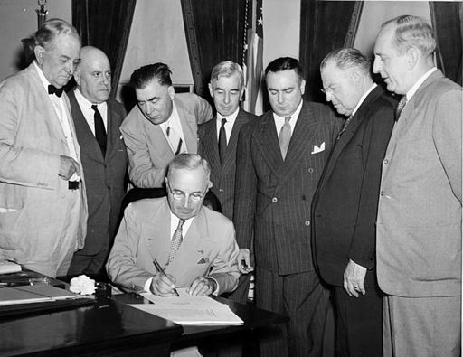
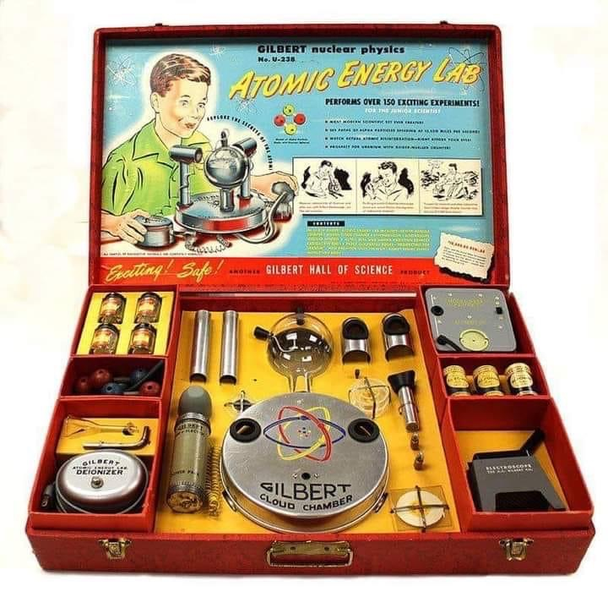
The Sun Shines on the Golden Age
1947
US Atomic Energy Commission formed to develop civilian nuclear applications
1950s
BORAL used as a neutron absorber
Mania for all things ”Atomic”
1960s
Design, building of commercial sized nuclear power plants
Most spent fuel racks use geometry, not absorber panels
Fuel not expected to stay long in pools
Notes:
Back before many of us here were born, lies the beginning of the Golden Age of Commercial Nuclear Power. In 1947, after the end of World War Two, the US government wanted to capitalize on this new technology. Thus, the Atomic Energy Commission was formed to advocate and regulate civilian atomic power. The phrase “too cheap to meter” was used in a 1954 speech by the then-Chairman of the Atomic Energy Commission, Lewis L. Strauss at the 20th anniversary of the National Association of Science Writers, held on September 16, 1954. In the ensuing mania for atomic energy, BORAL quietly was marketed as a commercial neutron absorber material. But, most of the emerging nuclear power stations did not use BORAL. They didn’t need to. The spent fuel was expected to remain in the pools only a few years before being sent off for reprocessing.

Slide 4
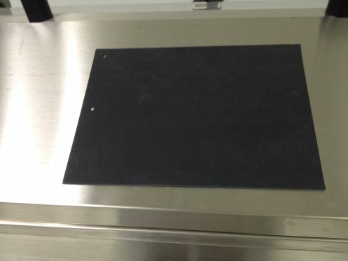
Clouds Gather
1975
US Nuclear Regulatory Commission began operation as a successor to the AEC
1977
President Carter indefinitely defers reprocessing of commercial spent nuclear fuel
Plutonium diversion concern
As-built pools/racks not going to cut it
1977-1980
Bisco qualifies BORAFLEX as a spent fuel pool rack neutron absorber
Low-cost alternative to BORAL
Reprocessing
Notes:
Fast forward a decade and change was in the wind. In 1975, the US Nuclear Regulatory Commission was created as a successor to the Atomic Energy Commission. The general consensus was that the commercial nuclear power program needed an entity who’s purpose was strictly regulation. Within a couple years, America’s Nuclear Engineer, President Carter suspended the US reprocessing industry due to plutonium diversion concerns. NOW, the spent fuel racks at nuclear power plants would be expected to keep the fuel a lot longer. Seeing that there would be a market for a lot of neutron absorbers, Bisco developed and qualified a silicone-based boron carbide neutron absorber material BORAFLEX, as a low-cost alternative to BORAL.

Slide 5
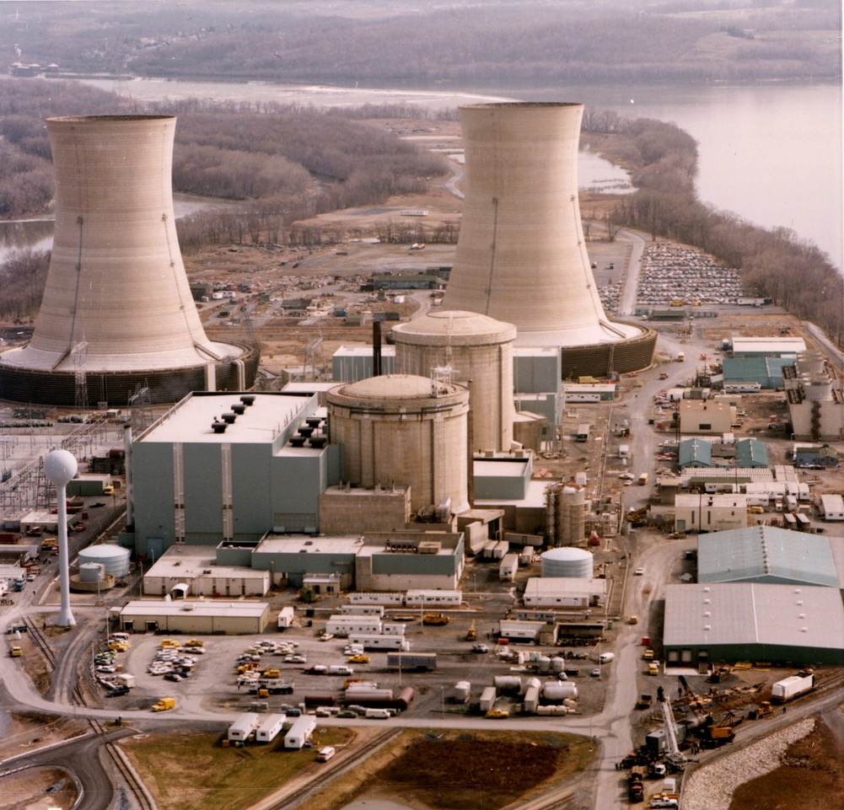
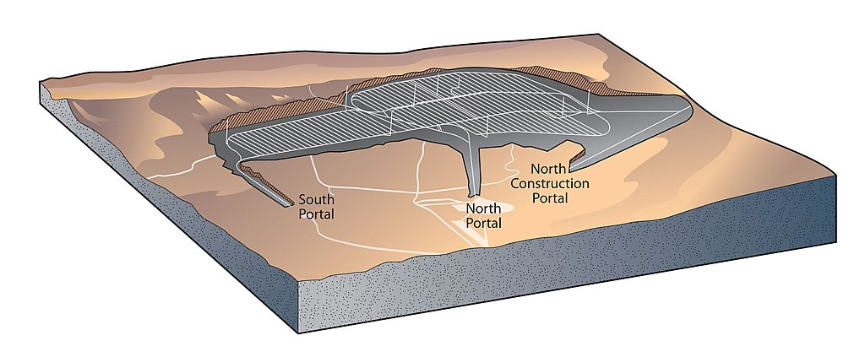
The End of One Era and a New Beginning
1979
March 28 – Three Mile Island Unit 2 Accident
1983
Nuclear Waste Policy Act of 1982 establishes deep geological disposal of spent nuclear fuel
1986
First NRC-licensed interim dry cask storage facility at Surry Nuclear Power Plant
1998 seems a long way off…
Notes:
As some of you may recall, the meltdown of Three Mile Island Unit 2, a brand-new reactor in its first operating cycle scared the crap out of the US psyche. Yup, this happened on President Carter’s watch. TMI put commercial nuclear power plant design and construction planning on pause. With spent fuel pools filling up and no spent fuel reprocessing; the commercial nuclear power industry demanded action. Congress responded with the Nuclear Waste Policy Act of 1982 establishing a repository for the country’s spent nuclear fuel. All the nuclear power plants had to do is wait until January 1998 and the Department of Energy was going to start picking up spent fuel from power plant sites. Virginia Power planned the first on-site dry storage facility at Surry Nuclear Power Plant. Just a few dry casks and then the DOE trucks would arrive.

Slide 6
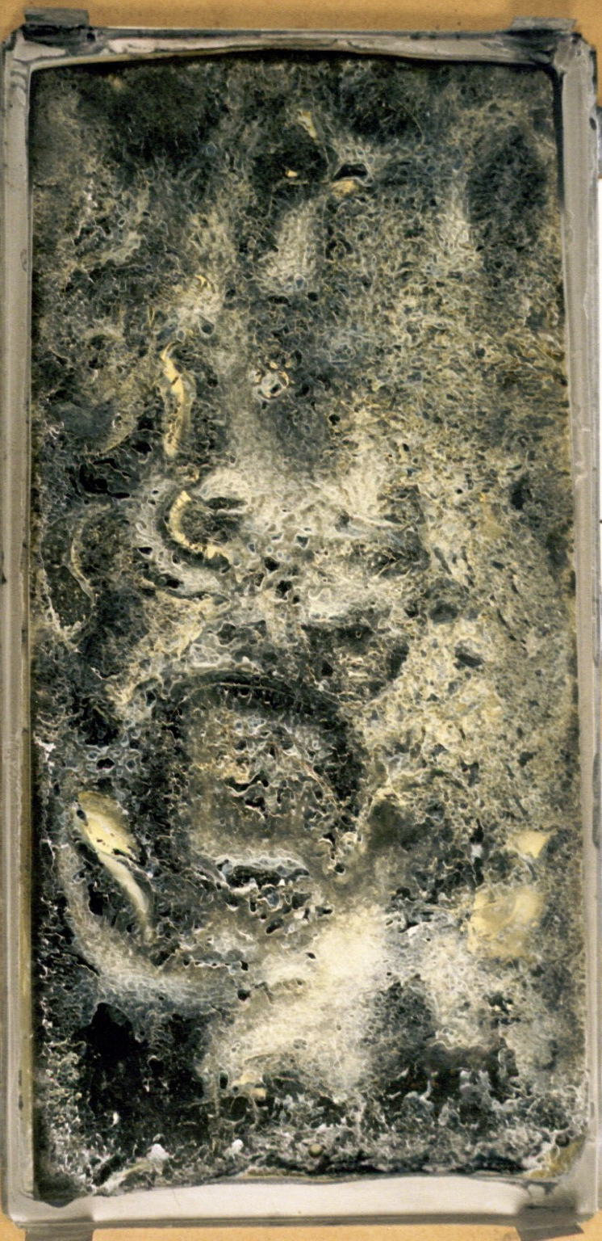
Bad News for Cheap Neutron Absorbing
1987
USNRC issues Information Notice 87-43 “Gaps in Neutron-Absorbing Material in High-Density Spent Fuel Storage Racks”
1988
EPRI issues BORAFLEX performance report
1996
USNRC issues Generic Letter 96-04 “BORAFLEX Degradation in Spent Fuel Pool Storage”
BADGER first used in BWR spent fuel pool with BORAFLEX
Somewhere between mid-80s and mid-90s
NRC Staff letter to Holtec International regarding BORAL Surveillance
Notes:
With commercial nuclear power plants needing to hold onto their spent fuel for another decade or so, many looked to improve their in-pool storage capacity. Replacing un-poisoned, low-density racks with higher density racks incorporating neutron absorber panels became industry-wide projects. Many of those re-racking projects looked for ways to reduce the overall cost. Bisco’s BORAFLEX was about half the cost of BORAL. Quite a few plants went for the low-cost rack.
Unfortunately, polymers never do well in high radiation fields. With plants seeing silica building in pool water chemistry samples, plants that had BORAFLEX surveillance coupons found the source and that BORAFLEX was shrinking, gapping and dissolving. In 1987 the NRC issued Information Notice 87-43 documenting what every BORAFLEX user was experiencing. EPRI responded quickly with a document providing a roadmap for living for a while with BORAFLEX. By 1996, the NRC issued Generic Letter 96-04 which required utility users of BORAFLEX to state the condition of their BORAFLEX neutron absorbers, the basis for that determination and what the pool operators were going to do going forward.
EPRI again responded quickly with a means to characterize the in-rack performance of BORAFLEX absorber panels and by routine testing, trend the degradation. BADGER (an acronym) was first used at a Boiling Water Reactor. Between the mid-80s and mid-90s an NRC staff member sent a letter to Holtec, by then the premiere spent fuel storage rack designer/builder, agreeing that there is plenty of operating experience with BORAL and that further surveillance of BORAL as a spent fuel pool neutron absorber was unnecessary. Utilities in the midst of re-racking, installing racks or even having BORAL coupons in their pools abandoned their BORAL surveillance programs.

Slide 7
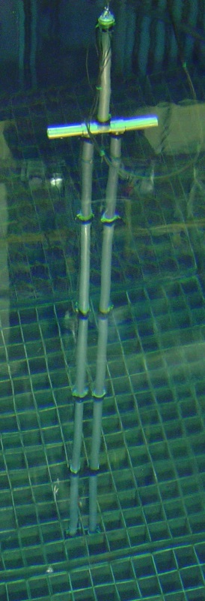
Nuclear Power Industry Manages the Damage
1997
BADGER first used in PWR spent fuel pool with BORAFLEX
EPRI issues BADGER introductory report
1998
DOE to begin acceptance of spent nuclear fuel from commercial nuclear power plants per the Nuclear Waste Policy Act
Didn’t happen
Utilities file suit
2001
Reynolds Metals develops and qualifies METAMIC
More metal-based neutron absorbers appear as alternatives
Notes:
In 1997 BADGER was used at a PWR. With deployment at both a PWR and BWR, EPRI issued the BADGER introductory report in 1998. The industry had a tool to plan the next mitigation activity. In the mean time, it became obvious that January 1998 was a bust for DOE taking fuel from reactor pools. Many utilities filed suit.
Seeing that there would be a BIG market for neutron absorbers, Reynolds Metals, the aluminum foil people, developed and qualified METAMIC a new type of aluminum-based neutron absorber suitable for wet and dry storage applications. Many more aluminum-based absorbers were developed. If you are associated with a commercial nuclear power plant, you know of at least one.

Slide 8
BORAFLEX – Dead Panel Absorbing
2012
USNRC issues BORAFLEX, RACKLIFE and BADGER Description and Uncertainties report
USNRC issues IN 2012-13 BORAFLEX Degradation Surveillance Programs and Corrective Actions in the Spent Fuel Pool
2013
BADGER receives first significant upgrade since introduction in 1996
26 years since initial BORAFLEX “heads up” IN 87- 43
Notes:
BADGER and RACKLIFE are EPRI products designed to help utilities manage BORAFLEX degradation. As margins to the minimum areal density continued to shrink, the NRC looked closer at the utility tools and how there were being used. IN 2012-13 and the BORAFLEX, RACKLIFE and BADGER description and uncertainties report were issued. By now, most, if not all, PWRs were abandoning BORAFLEX in-place and taking soluble boron credit in their criticality analyses. BWRs and PWRs also began to re-rack again to put the BORAFLEX issue behind them. A number of PWR plants re-racked due to the nature of their plant’s fuel pool cooling and cleanup systems and problems with silica-caused water clarity. For BWRs, it was BADGER, lose capacity by checkerboarding or re-rack. In 2013, BADGER was upgraded to respond to industry needs. Strangely enough, 2013 was over 25 years since the industry got it’s first warning about problems with BORAFLEX.

Slide 9
Concern for All Pool Neutron Absorbers
2016
NRC issues GL 2016-01 “Monitoring of Neutron-Absorbing Materials in Spent Fuel Pools”
NEI issues 16-03 ”Guidance for Monitoring of Fixed Neutron Absorbers in Spent Fuel Pools”
EPRI issue Zion Station BORAL Absorber Panel Inspection/Test Report
BORAL in pool performing as expected
BORAL coupons reflect panel performance
Notes:
By 2016, the NRC was hearing not only about BORAFLEX, but also Carborundum, Tetrabor and some hysteria around BORAL. Generic Letter 2016-01 was issued and the tone was somewhat similar to 96-04. What do you have in your racks, what is its condition and how are you going to determine it is doing its job going forward? NEI responded quickly with help from EPRI and issued NEI 16-03. EPRI had done just about all it could do for BORAFLEX and was working hard to address the emergent concerns about BORAL. The decommissioning of Zion Station was used to do a coupon and in-service panel comparison. Users of Carborundum and Tetrabor were few in number and pretty much left to struggle on their own using whatever was at-hand (BADGER, coupons and re-analysis).
Now, up to this point, I’ve reported on the facts with my own personal experience and perspective. I’m about to launch into my own opinion of where we are now and what we can do. Viewer discretion is advised.

Slide 10
Neutron Absorbers – Good, Bad & Ugly*
Good
MAXUS, Metamic, BORALCAN, Talbor, Bortec, etc.
Fully dense aluminum-boron-carbide mixed metal composite
Likely to meet criticality performance requirements for life of plant
My opinion – add BORAL
Aluminum clad aluminum-boron-carbide cermet
Also likely to meet criticality performance requirements for life of plant
Bad
BORAFLEX
Polymer-based boron-carbide-silica
Cannot meet criticality performance requirements for life of plant
*Opinion of Matt Eyre
Notes:
Let’s do a round up of neutron absorbers and see where they are with respect to being able to ensure spent fuel pool subcriticality with sufficient margin all the way to decommissioning.
What’s good or likely to go the distance includes: MAXUS, Metamic, Talbor, Bortec, BORALCAN and Advanced Metal Matrix Composite. Note that BORALCAN and AMMC should not be confused with AAR BORAL. What about AAR BORAL you ask? I think, based on everything I have read, that it too can take a spent fuel pool to end of plant life.
Clearly BAD, I think there is plenty of data to show that BORAFLEX will, absolutely, positively NOT last to end of plant life as an effective neutron absorber.

Slide 11
Neutron Absorbers – Good, Bad & Ugly*
Ugly
Carborundum, Tetrabor
Borated Resin
May or may not meet criticality performance requirements for life of plant
*Opinion of Matt Eyre
Notes:
I feel sorry for the users of Carborundum and Tetrabor. Their situation is Ugly since there are not many wet storage applications of these materials. Performance reports are mixed but there is an overall assumption that while it may take longer, these materials are destined to go the way of BORAFLEX.

Slide 12
What Now?!*
NEI 16-03 rev 1. and EPRI i-LAMP (2018)
Coupons rule!
Hope you have enough
Surrogate/sibling coupon (EPRI i-LAMP)
Lot of data wrangling
Need clear, explicit candidate screening criteria and operational boundaries
In-situ measurements provide imprecise picture
Inherent measurement uncertainties of in-situ equipment
Unavailability of individual panel areal density records
As-built construction of spent fuel pool racks
May be better to cut out a rack panel and make coupons
Once and done
Better argument for representation of specific spent fuel rack neutron absorbers
Utility/plant in control of its own fate
*Opinion of Matt Eyre
Notes:
While the NRC has endorsed NEI 16-03 revision 0, there are questions regarding revision 1. Those plants that racked or re-racked with BORAL and assumed the NRC letter to Holtec was a golden ticket to not needing a surveillance program, I feel your pain. However, if you have neutron absorber surveillance coupons, you have an easier path forward assuming you have sufficient coupons.
If you are thinking to rely on in-situ measurements like BADGER, your path is harder. There are inherent test equipment and test geometry uncertainties highlighted by the NRC consultant report. If you don’t have detailed as-fabricated areal density data for your panels, you may be stuck assuming the absorber panels start at the minimum used in the original criticality analysis of record. And the as-built condition of the racks may further obscure the areal density reading by adding more uncertainty due to the BADGER-rack structure orientation.
My read of the current EPRI i-LAMP shows a data mining expedition for fabrication, installation and operating history. Also, in the current form, there is to be work to be done to provide clear and unambiguous screening or selection criteria for sibling pools and absorbers. And ongoing, these siblings would have to track each other’s screening/selection parameters to ensure that one or the other plant does not fall out of the screening or selection criteria.
Frankly, in my opinion, if you don’t have coupons, then make them. Convince the NRC that cutting out an in-service panel and using that as coupons going forward is a viable way to become a coupon surveillance user. While the activity is costly in the short term, it is a one-time project. Using an in-service panel as a coupon source and example of in-service panel performance is defendable. AND, you, the utility operator of that plant are in control of your own fate.

Slide 13
Thank you for your attention. Questions?
Notes:
If by this point, you are confused, despairing, angry or hopeful or resolved then my job is done. Now, confer with your peers, management, industry experts (NEI and EPRI are a good start) and plot the best (most reasonable, cost effective, technically defendable, and operator friendly) course forward. Use the history of how this all came to pass to understand what may impact your plans and design adaptability into your program.

