Slide 1
Advantages of Next Generation Clad Neutron Absorber for Spent Nuclear Fuel Storage and Transportation Needs through Examination of MAXUS®
PATRAM 2022
11-15 June 2023, Juan-les-Pins, France
Matthew Eyre
Notes:
Good afternoon. My name is Matthew Eyre and would like to start this presentation with a question. Are you confident in the life of system performance of your installed neutron absorber?
As I've noted with myself, with people, aging past 60 years usually results in lower performance expectations. With spent fuel systems, the performance requirements remain the same throughout the life of the system.

Slide 2
Presentation Overview
Issues with Early Clad Aluminum-based Neutron Absorbers
MAXUS® Development
MAXUS® Testing and Operational Experience
MAXUS® Performance Conclusions
Notes:
In this talk, I will provide a brief description of MAXUS, refer you to tests that are a matter of NRC record and then I will provide information of the results of the long term accelerated corrosion testing that has recently been completed.

Slide 3
Early Clad Aluminum-Based Neutron Absorbers
BORAL® Original Fabrication
1950s
AAR (Aircraft container designer/fabricator)
Alloy 1100 aluminum used as core and cladding
First Commercial Application
1964 Yankee Rowe
Spent Fuel Pool
Extensive Use through 2000s
Spent Fuel Pools
Dry Cask Storage/Transport
Notes:
MAXUS is designed as a neutron absorber to ensure sub-criticality of nuclear fuel placed in fuel pools or dry casks. It is intended to become a permanent and integral part of the fuel pool rack or dry cask basket and perform its function for the life of the system. In the next few slides, I will show you details of the structure of MAXUS.

Slide 4
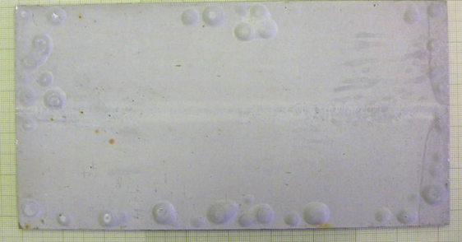
Operating Experience with Early Clad Aluminum-Based Neutron Absorbers
Self-Shielding and Neutron Streaming
Large Boron-Carbide Particle Size
75-250 microns
US NRC restriction to 75% areal density credit
Water Retention Due to Porosity
1-7% porosity
Varied from production lot to production lot
Clad Delamination/Blistering
Porosity and water retention
Material fabricated in the 1970s through 1980s
Example of BORAL® Blisters
EPRI Handbook on Neutron Absorber Materials for
Spent Nuclear Fuel Applications, 2005 Edition

Slide 5
Development of MAXUS®
Nikkeikin Aluminium Core Technology Co., Ltd. (ACT)
Research and Development 2003 to 2008
MAXUS® Composition
Core: A1070 and boron carbide (natural B₄C)
Clad: AA5052
Clad
AA5052
Core
A1070 + B4C
Images Courtesy of Nikkeikin ACT
Notes:
MAXUS is a clad aluminum-boron carbide metal matrix composite. The core is composed of A1070 aluminum and boron carbide. The cladding is a 5052 alloy. The photos illustrate a cutaway of the MAXUS sheet showing the relationship of the clad and core. The detailed core photo illustrates the homogenous distribution of boron cabide particles in the A1070 matrix.

Slide 6
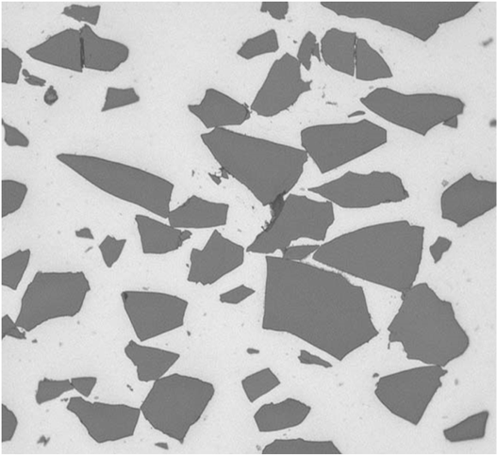
MAXUS® Addresses Regulatory Concerns
Particle Size
Range Much Smaller
Mean Size < 85 microns
Negligible Effect on Self-Shielding or Channeling
Near Theoretical Density
No Observable Porosity
Clad
Core
Clad-Core Interface
20 microns
Particle Size 30 mass % B₄C
Image Courtesy of Nikkeikin ACT

Slide 7
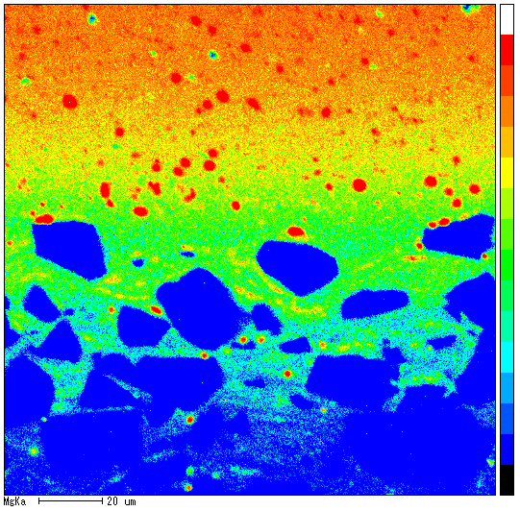
MAXUS® Addresses Regulatory Concerns (2)
Intimate Bonding of Core and Clad
Diffusion of AA5052 Magnesium into the A1070 Core Matrix
Combined with Near Theoretical Density, Preclude Possibility of Core-Clad Separation or Blister Formation
Clad
Core
Mapping of Mg
Images Courtesy of Nikkeikin ACT

Slide 8
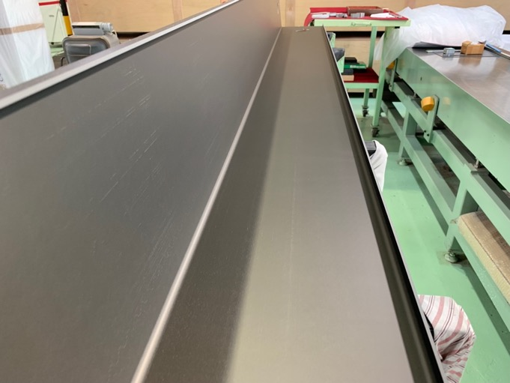
MAXUS® Advantages
Fabrication Supports Cutting and Bending to Shape
Clad Reduces Material Transfer from Roller
Boron-Carbide at Absorber Surface Increases Material Transfer from Roller
Embedded particles serve as a nucleus for pitting corrosion
AA 5052 Clad Has Well Documented Corrosion Performance
Assures Long-Term Performance in the Operational Environment
Clad Provides Protective Surface
Handling
Final Service Fabrication/Installation
Assures Areal Density Not Affected
ACT Niigata Fabrication Facility
Image Courtesy of Nikkeikin ACT
Notes:
MAXUS has been qualified by Curtiss-Wright Nuclear's NETCO division for use in commercial nuclear power applications under its 10CFR Part 50 Appendix B quality assurance program. A number of submittals have been made to the US Nuclear Regulatory Commission in support of a US reactor license amendment which describes the qualification tests is available as a public record. You can find it with an Internet search using the NRC's ML number shown on the screen.
MAXUS completed a long-term accelerated corrosion test program to further demonstrate the life-of-system capability of the neutron absorber function. There were 48 MAXUS flat test coupons used in the long-term corrosion test. Half of the coupons have 21% boron carbide and the other half have 40% boron carbide. These boron carbide concentrations represent the lower and upper bound of design usage for Light Water Reactor fuel storage and transport systems.
Further, 12 bend coupons were tested to evaluate the effect of cold work on the corrosion performance of MAXUS. The bend coupon test lasted 12 months and consisted of equal numbers of 10 and 30 weight percent boron carbide.

Slide 9
MAXUS® Testing and Operational Experience
Production Requirements
Must Meet Material, Dimensional and Boron-10 Areal Density Specifications
Production Material Boron-10 Areal Density Tests
Meets or Exceeds Customer Specification
10CFR Appendix B, NQA-1 Compliant Records and Test Coupon Archive
Customer May Consider Use of Documented Additional Available Areal Density
Notes:
The flat coupon test population was further divided into General and Encapsulated coupons. The General coupons are bare; in other words, fully exposed to the test bath environment. The Encapsulated coupons are enclosed in a ventilated stainless steel capsule that simulates a rack or dry cask basket wrapper plate.
All of the coupons were pre-characterized prior to placement in the test baths. The following parameters were measured:
Visual examination and high resolution photography
Dry weight
Length, width, thickness
Areal density in terms of grams Boron-10 per square centimeter

Slide 10
MAXUS® Testing and Operational Experience
Corrosion is Operational Longevity Concern
Readily Apparent for Wet Storage Applications
Dry Cask Loading in Pools and Residual Moisture
MAXUS® Subjected to Extensive and Long-Term Aqueous Corrosion Testing
Representative PWR and BWR Water Chemistries
Bare, Galvanic, Encapsulated and Bend Coupons
Details Reported in Prior PATRAM Paper
“5-Year Accelerated Corrosion Testing of MAXUS® for Spent Fuel Pool and Dry Cask Performance”, PATRAM 2019 Paper No. 1300, August 2019
Notes:
During the last year of flat coupon testing, twelve bend coupons were introduced to the BWR and PWR test baths. The coupons incorporated a 90 degree bend and were placed in the test baths fully exposed to the test bath environment similar to that of general flat test coupons. As with the flat coupons, the bend coupons were pre-characterized for post-test comparison.

Slide 11
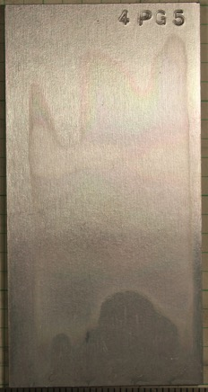
MAXUS® Accelerated Corrosion Test
Example of Corrosion Test Results
Maximum Boron Carbide Loading
No significant dimensional changes
No significant change to coupon weight
No significant change to areal density
No blistering or delamination
40% B₄C BWR General Coupons
40% B₄C PWR General Coupons
Left Pre-Test, Right Post-Test
Images Courtesy of Nikkeikin ACT

Slide 12
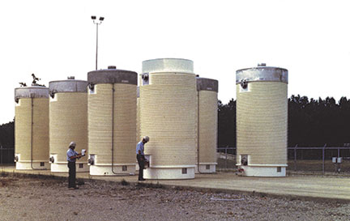
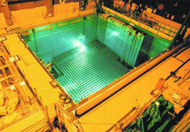
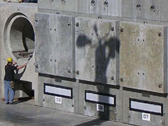
MAXUS® Industry Experience
Market Introduction in 2008
As of January 2023, ACT Has Delivered
Absorber Panels for > 550 BWR and PWR Dry Casks
> 4700 Spent Fuel Pool Absorber Inserts and Flat Absorber Panels
Images US NRC Radioactive Waste webpage

Slide 13
Conclusions
MAXUS® is an optimum neutron absorber for dry cask or wet pool.
MAXUS® addresses all early clad absorber concerns.
Extended corrosion tests demonstrate suitability for dry and wet storage applications/environments.
The design, manufacturing and composition of MAXUS® allow transition from wet to dry environments necessary for dry cask operations.

Slide 14
Thank you for Your Attention!
Questions?
Notes:
I'd like to acknowledge ACT and Curtiss-Wright for their vital role in the sponsorship, performance and documentation of this research.
Thank you very much for your time and attention.

