Slide 1
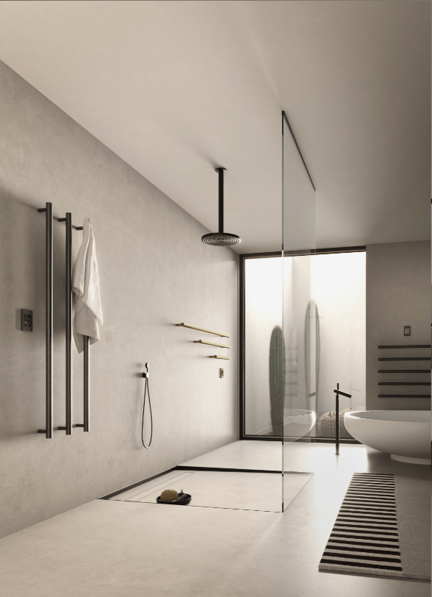

HEATED TOWEL RACKS
Product Knowledge Training
TOWEL WARMERS | SPACE HEATERS | DRYING RACKS

Slide 2
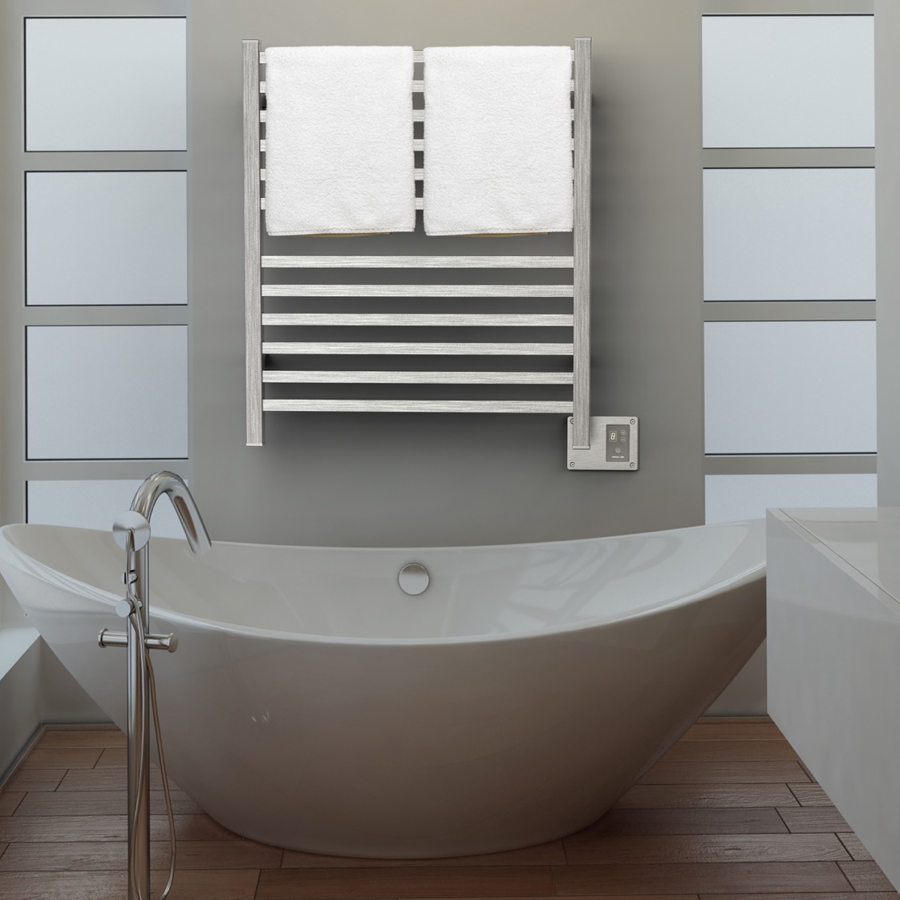

Learning Objectives
Benefits, functions and applications
Technology
How to Sell
Collections and Accessories
Q2833B
Notes:
In this PK presentation, we will be exploring the various benefits, functions and applications of towel warmers in and around the home.
We will look at the different heating technologies that we use to power our products.
Then we’ll go over a few tips and tricks about hot to sell these products to your customers
Lastly, we’ll review the different collections to help familiarize yourself with them and how to order them.

Slide 3
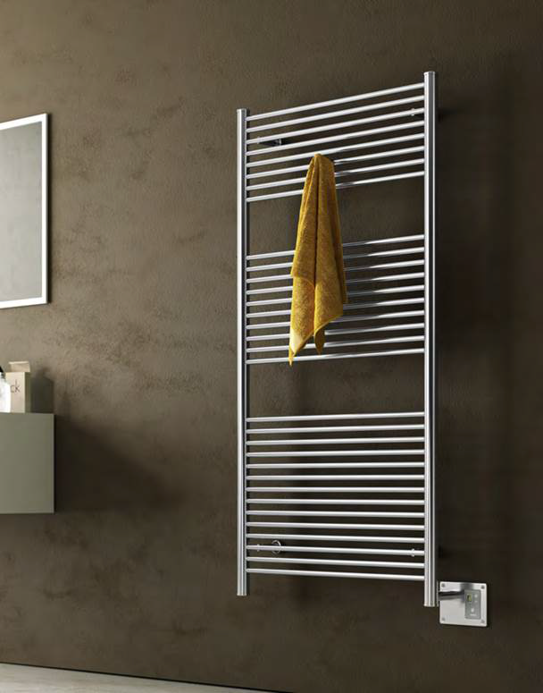
Benefits
There are 3 major benefits of Heated Towel Racks
Luxury & Comfort
Health & Wellness
Cost Savings
A2856B
Notes:
When it comes to towel warmers, there are 3 main benefits these products provide to their users; although most people only think about the first benefit listed.
Luxury & Comfort
Health & Wellness
Cost Savings

Slide 4
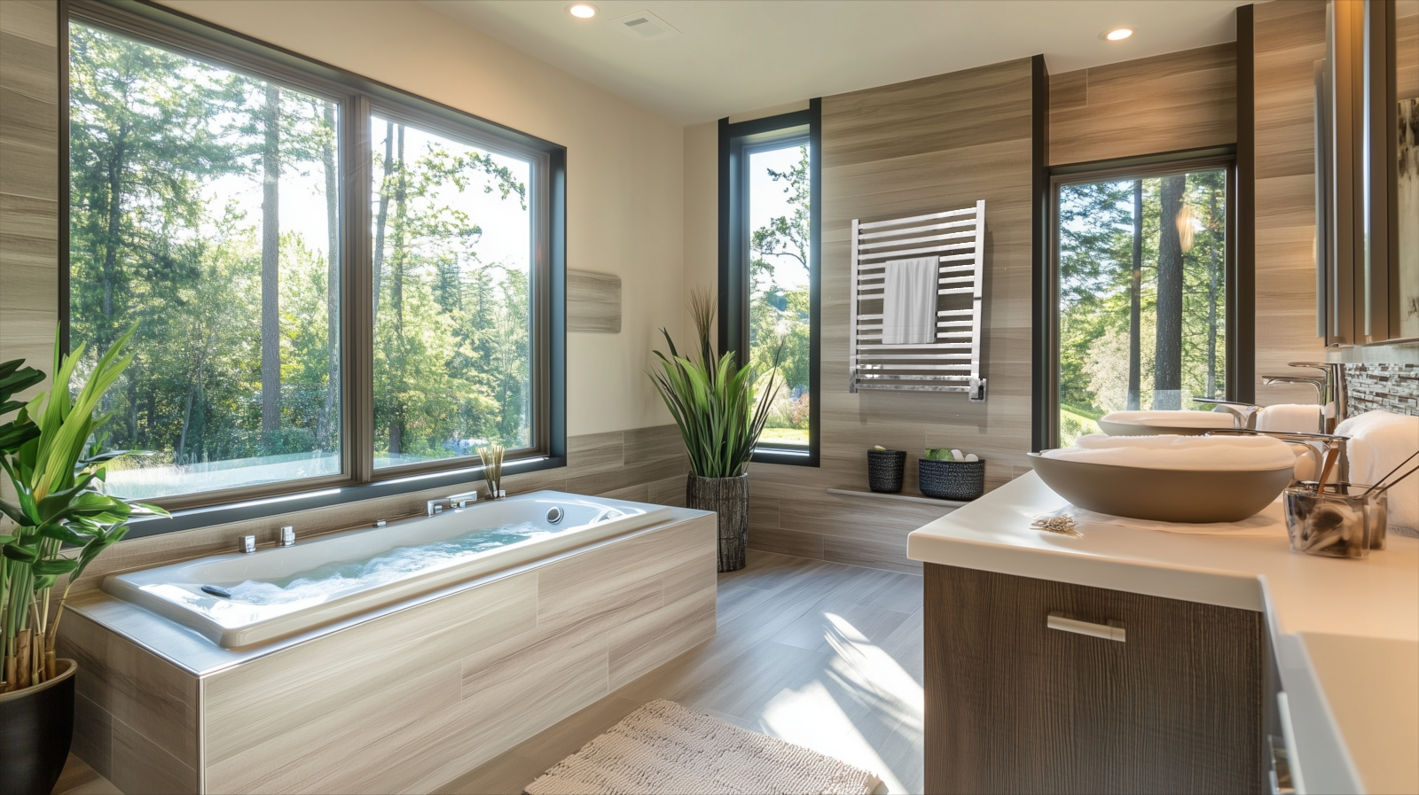
Luxury & comfort
Heated towels & robes
Wrap up in warmth after bathing
Adds radiant heat to bathrooms
No more damp, smelly towels
Notes:
The first benefit for towel warmers is the luxury and comfort these products provide.
A warm towel or bathrobe to wrap yourself in when jumping out of the shower or bath. This can help ease the transition from a hot shower to the cooler ambient air temperature in the bathroom
Radiant heat in the bathroom – we have some collections that can also provide radiant heat into the bathroom which can improve the comfort and wellbeing of the guest by raising the temperature a few degrees, especially on cold winter nights.
Never use a cold, damp, smelly towel again.
This benefit is all about playing into the senses of temperature and touch and is even more relevant when working with aging clients as they are more sensitive to temperatures.

Slide 5
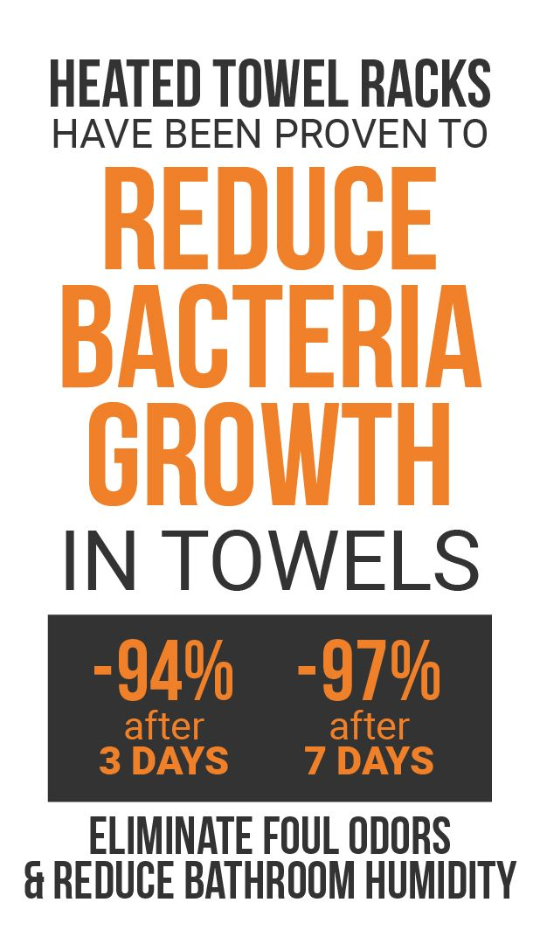
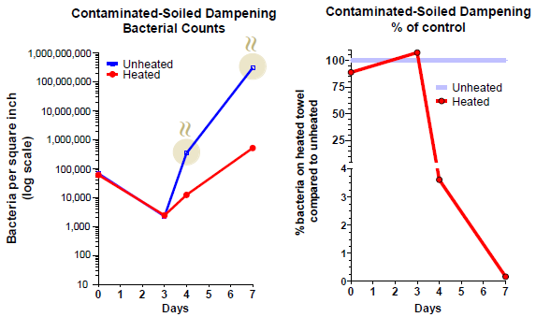
Health & Wellness
Notes:
The second benefit is focused on health and wellness. This is become a very important and influential element to interior design.
In 2022, we conducted a controlled study with a scientific lab. They had two of our freestanding towel warmers with 2 towels placed on each unit. One unit was turned on, one unit left off.
They would wet the towels daily to simulate daily use. They would then cut out small coupon samples from the towels and measure bacteria counts. What they found was quite astonishing:
After 3 days, there was a 94% reduction in bacteria growth for the towels on the heated towel rack
After 7 days, there was a 99% reduction in bacteria growth for the towels on the heated towel rack
There were no odors given off by the towels on the heated towel rack; where as the towels on the non-heated rack did give off unwanted odors.
What this tells us is that by placing towels on a towel warmer, it will dry your towel out quick enough to help reduce and minimize the growth of bacteria that thrives in damp environments.
In addition, using your towel warmer for extended periods of time or leaving it on 24/7 can help to reduce humidity and moisture in the bathroom which promotes a healthier environment.

Slide 6



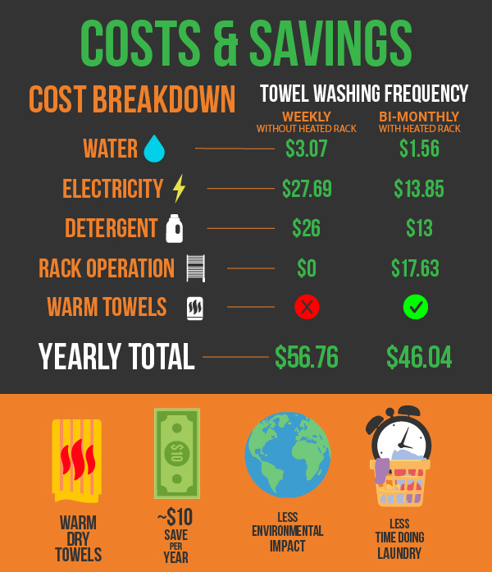
Cost Savings
Assumptions:
Laundry Loads per Week: 1
Average Household: 4 People
Towels per person per Week: 2
Average HTR Rating: 150W
Electricity Cost: $0.17 per kWh
We surveyed 3000 people across the country to gather data on basic towel usage habits to better understand how heated towel racks can improve daily lifestyles.
Notes:
We surveyed 3000 people across the country to better understand general towel usage habits. We wanted to see how towel warmers can fit in and provide not just a lifestyle improvement but also see if it could also save money.
On average, people use their towels for 1 week or less before washing them. By introducing a towel warmer into their bathroom, people can double the length of time they use their towel, reduce water and detergent consumption and extend the life of their towels by reducing wear and tear on them.

Slide 7
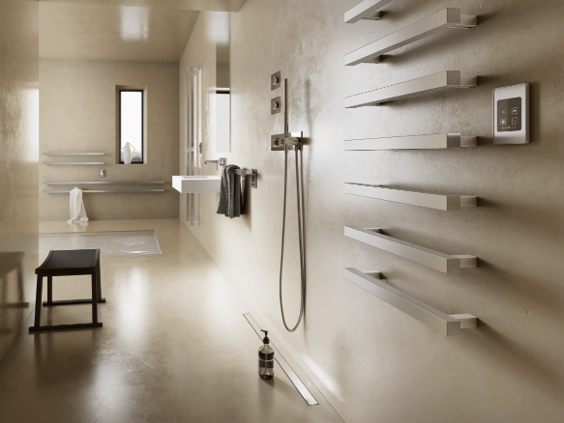
Where to use Heated Towel Racks
Notes:
Any questions on the benefits of towel warmers? What was the most appealing benefit for you?
Next, we’ll look at where towel warmers are used.

Slide 8
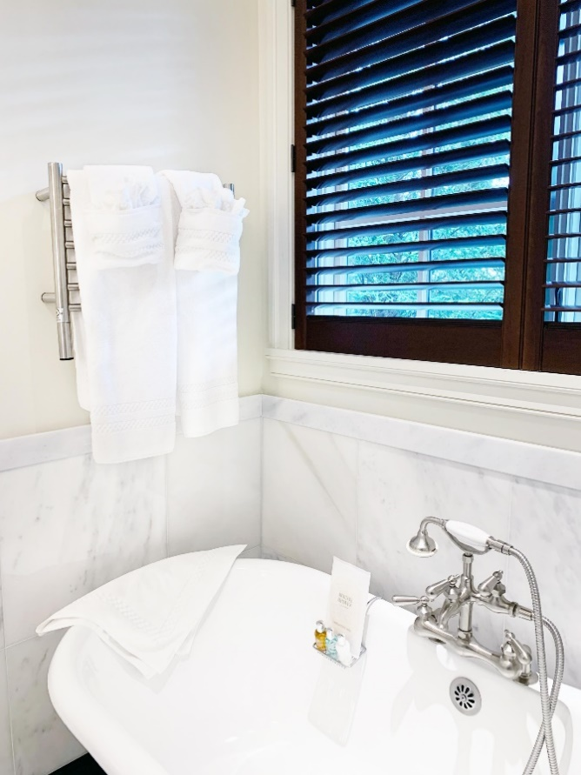
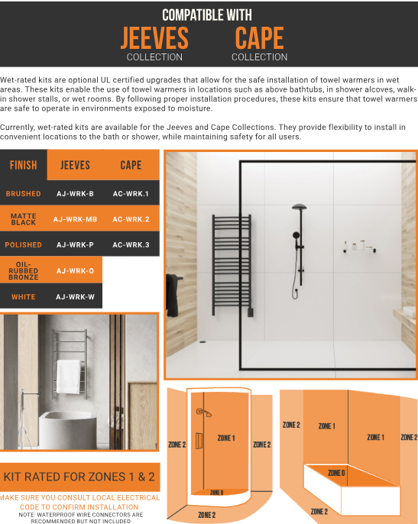
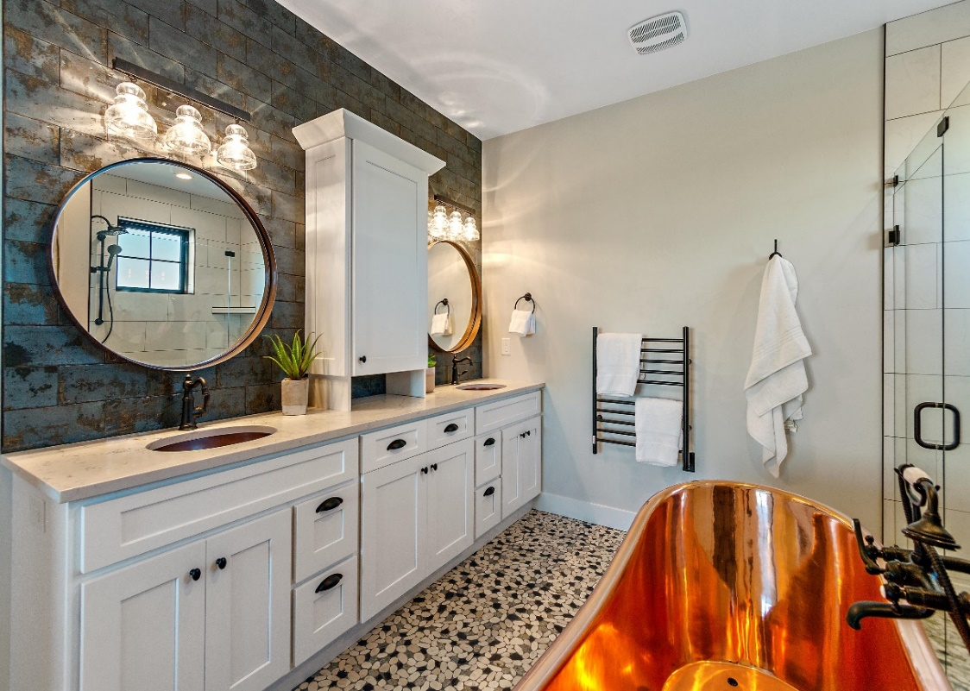
Bathrooms
Notes:
Using towels in bathrooms:
Adds comfort and luxury to the bathing experience
Keeps towels and bathrobes dry and warm for every use
Reduces humidity and moisture extending the life of grout and wood vanities
Replaces the need for towel bars and robe hooks.
If necessary, pair a wet rated kit to ensure all code requirements are met if installing above a tub, in a shower or in a larger wet area. These are available for our Jeeves and Cape collections only.
These kits allow for the installation in Zones 1 & 2 as labeled by the National Electrical Codes.

Slide 9
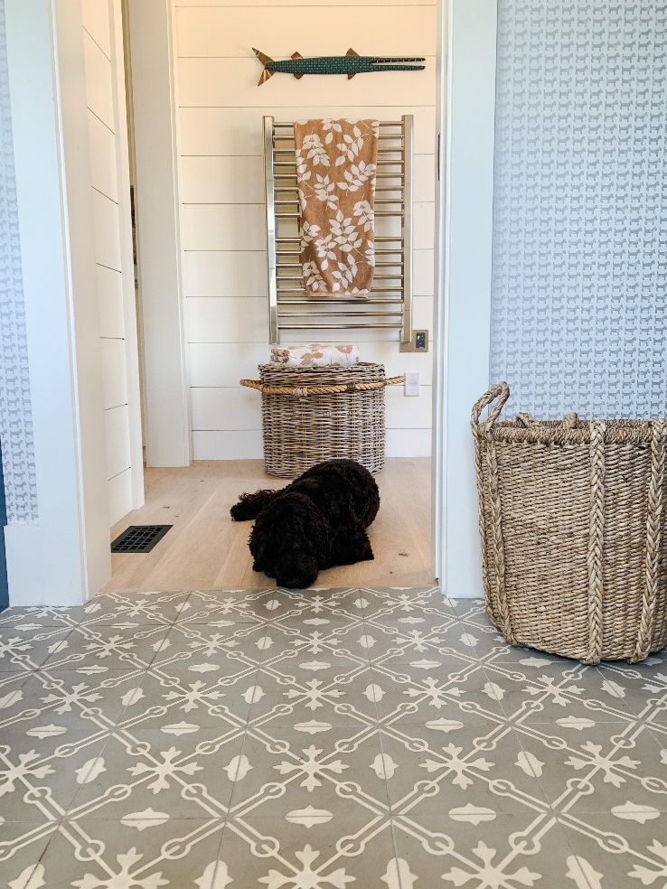
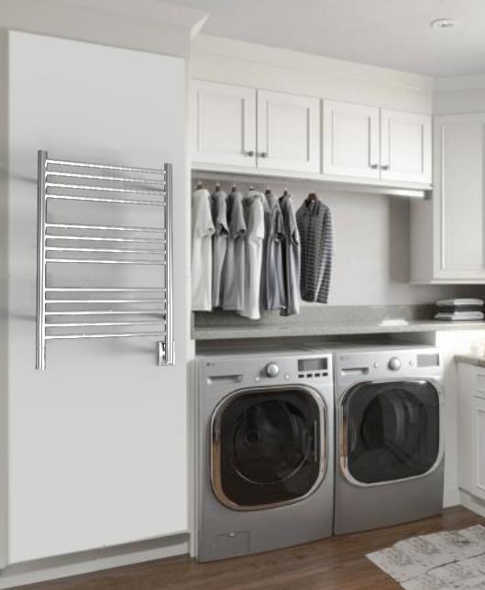
Applications: Laundry & Mud Rooms
Laundry Rooms:
Dry delicates, silks and other fabrics/garments that don’t go in a tumble dryer.
Reduce wrinkles while gently drying clothes.
Keeps laundry organized – no longer hanging on banisters, shower curtain rods or door handles.
Mud or Wet Rooms:
Hang and dry coats, scarves, mittens etc on cold & wet winter days.
Dry bathing suits, pool/beach towels, wet suits and life jackets during the summer.
Reduces humidity and provides warmth during colder months.
Notes:
Beyond bathrooms, laundry rooms and mud rooms are very popular and useful places for installing towel warmers.
Laundry Room:
Any item that you air dry as opposed to using a tumble dryer can be dried on a towel warmer. They don’t get hot enough to harm or damage most fabrics, but you can also place a towel, single-ply over the top of the unit, and then place any garments over the towel.
Reduces wrinkles while gently drying clothes
Keeps laundry organized – not hanging clothing over shower curtain rods, doorknobs, railings or furniture
Mud/Wet Room:
Hang & dry coats, scarves, mittens etc on cold & wet winter days.
Dry bathing suits, pool/beach towels, wet suits and life jackets during the summer
Reduces humidity and provides warmth during colder months

Slide 10
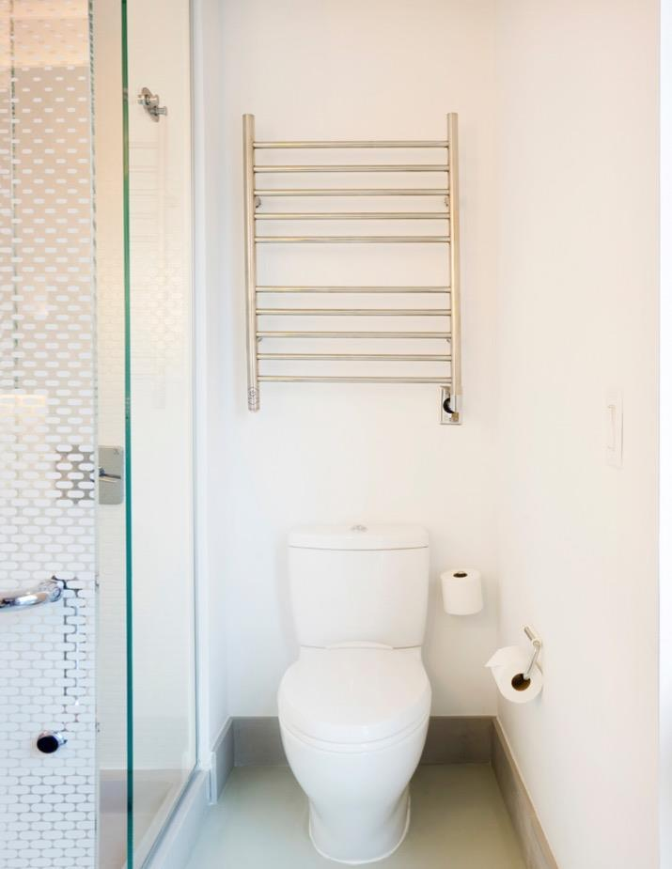
Other Applications
Some applications that are less common, but still offer plenty of benefits include:
Pool house
Basement
Garage/Workshop/Home Gym
Nursery
Boats/RVs
Commercial: Hotels, assisted living, spas/gyms, multi-family
Yotel Hotel – Radiant RWH-SP
Notes:
While less common, these locations can also benefit from having towel warmers to increase functionality for homeowners.
Knowing the versatility of these products, people will find more value in adding them throughout their home.

Slide 11
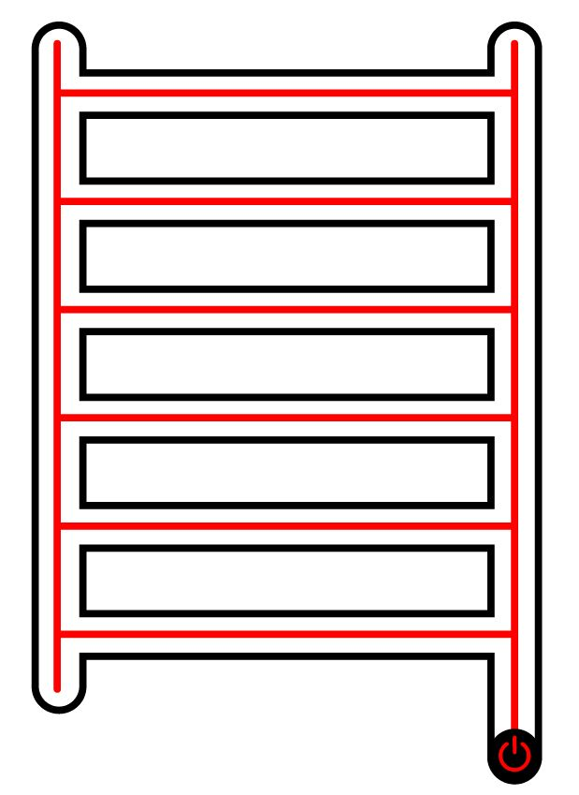
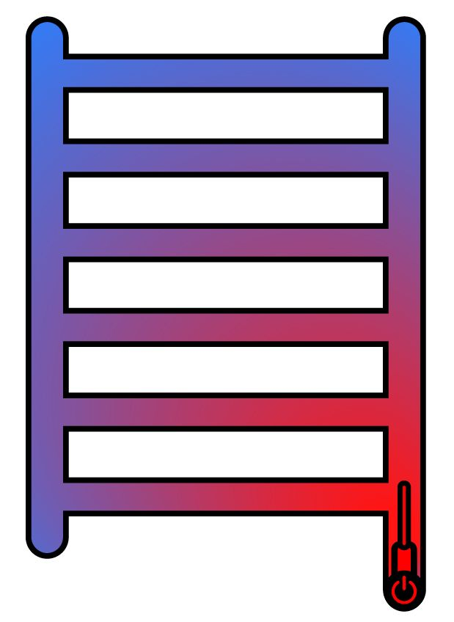
Heating Technology
Dry Element Technology
Liquid Filled Technology
Notes:
We use two different technologies while provide different pros and cons and give users the choice depending on what appeals to them more.
Dry Element:
Pro: Quick heat up time; 10-15min to reach max temp; with heat starting in 5min or less
Con: Heating cables cannot be repaired; unit must be replaced.
It is used in 9 of our 11 collections: Sirio, Quadro, Antus, Vega & Modello I which are made in Italy. Cape which is made in South Africa and Radiant, Solo and Swivel collections made in China.
Liquid filled technology:
Pro: Heating element can be replaced; don’t need to replace entire unit
Con: Longer heating time, ranges from 15-45min depending on size of unit – But you can use a timer or leave it on 24/7 and its thus irrelevant.
It is used in 2 of our 11 collections: Jeeves which is made in South Africa and Traditional which is made in China.

Slide 12
Competitive Advantages
Amba only sells heated towel racks– we are the experts!
  11 Different collections stocked in 10 different finishes
  All collections stocked in Atlanta, GA
  Ships fast – Easy S/H Freight Rate Chart
  24hrs to ship orders & no dropship fees
  Competitively priced starting at $310 List
  Custom Finishes including RAL & PVD – Match other MFGs
  All Horizontal & Vertical bars heat
  Mounting brackets on vertical bars; not horizontal bars
Notes:
A variety of bar styles from round, square, flat panels and single bars.
Over 180+ SKUs stocked in GA with <1week lead time.
Over 250+ special order sizes – as narrow as 13” wide and up to 80” tall to fit unique spaces
Custom finishes – RAL & PVD; color match other MFGs

Slide 13
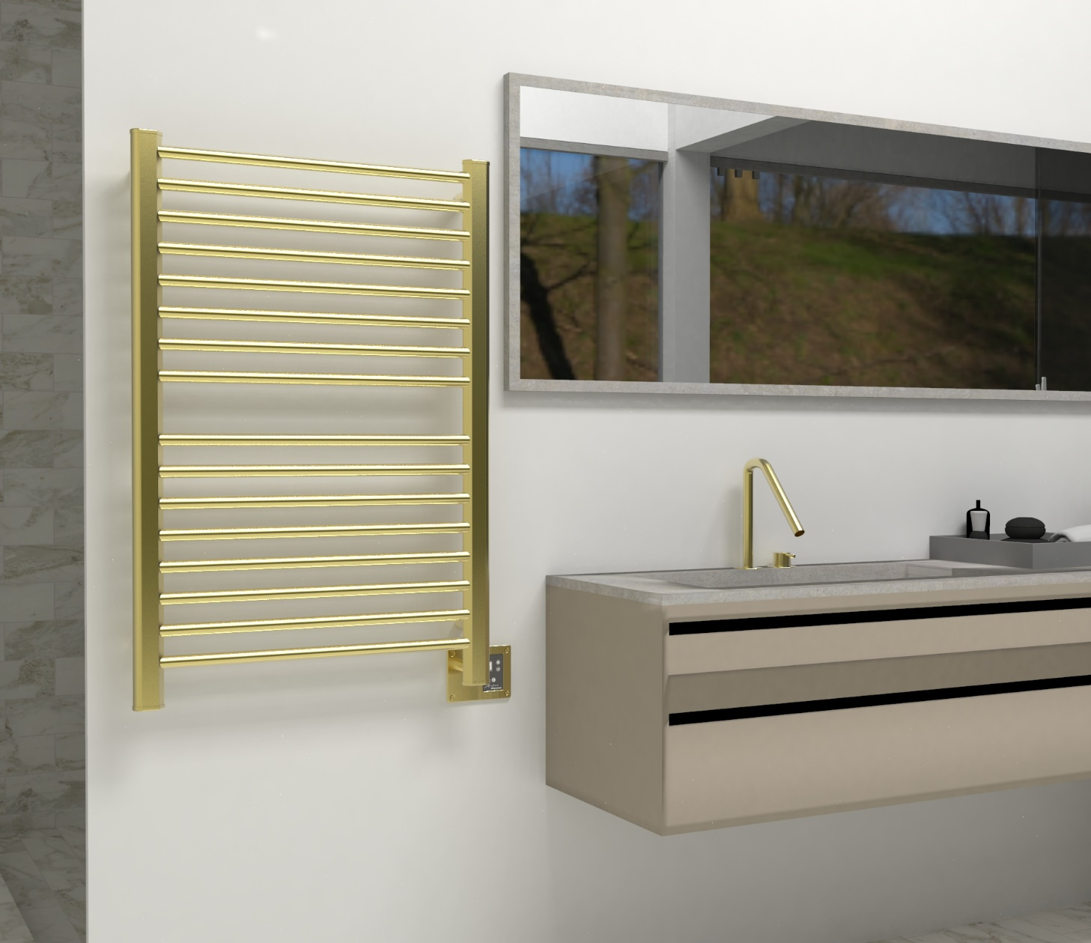

How to sell Heated towel racks
Hang bathrobes from top of vertical bars
Introduce towel warmers at the start of the project
Preserves their investment in bathroom
Any bathroom with steam or tubs with systems should have a towel warmer
Promotes Health & Wellness design
Reallocate budget from accessories to 1 towel warmer – you’re not adding more costs!
Upgrades the bathroom and provides a more luxurious, bathroom oasis.
Section 1
Section 2
There are two sections on this towel warmer to hold 2 towels; the vertical bars double as robe hooks to hold 2 bathrobes
Notes:
It is vital to bring up towel warmers early on in any bathroom project due to the electrical requirements. If you wait until you select your accessories, its often too late.
In most primary bathrooms, you will find 2 towel bars and 2 robe hooks. A towel warmer can replace the need for those items in a bathroom while upgrading the experience.
When you step out of the shower or bath, there is a big temperature difference in the ambient air. Using a towel warmer can ease the shock of those temperature differences when wrapping up in a warm towel or robe.
This is the perfect item to pair with steam showers or bathtubs with systems. These customers have the budget for more expensive products and a towel warmer will not break the bank.
In some cases, our affordable collections could even save money when compared to the cost of 2 towel bars and 2 robe hooks.

Slide 14
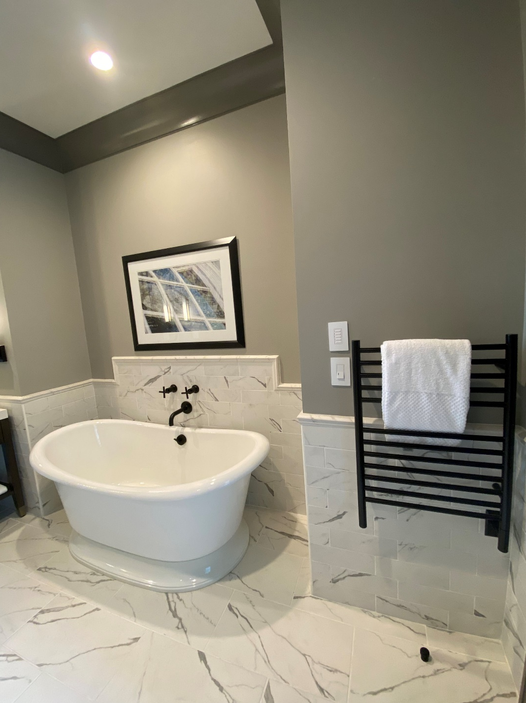


requirements
Electricity:
  Requires standard 120V connection.
  Installs same as light sconce
  Doesn’t require a dedicated circuit.
  Always suggest a programmable timer
Code:
  National Electrical Code (NEC) dictates a towel warmer must be 3’ from water source (unless using a Wet Rated Kit).
  Local codes supersede national code.
  All products are UL or ETL certified
Liberty Hotel by Hilton – Jeeves ESMB
Notes:
The basic requirements to install a towel warmer are very simple.
They run off the same 120V electricity that powers any lights, fans, electric mirrors in the bathroom.
Electricians can piggyback of any outlet or switch in the bathroom to power a towel warmer
They are all UL or ETL certified and meet national codes. Standard code requires a 3ft distance between the towel warmer and water source, but our wet rated kits can bypass that minimum while still being code compliant.

Slide 15
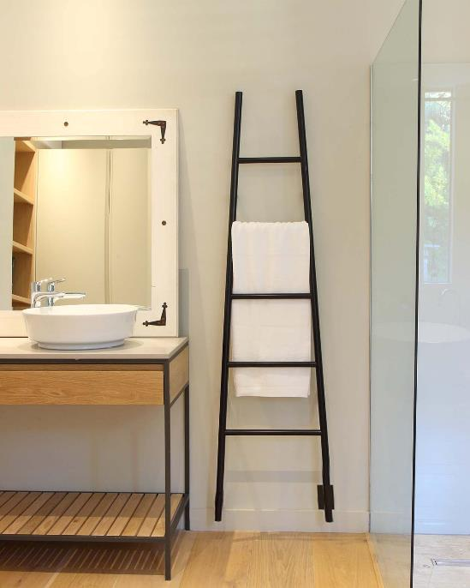
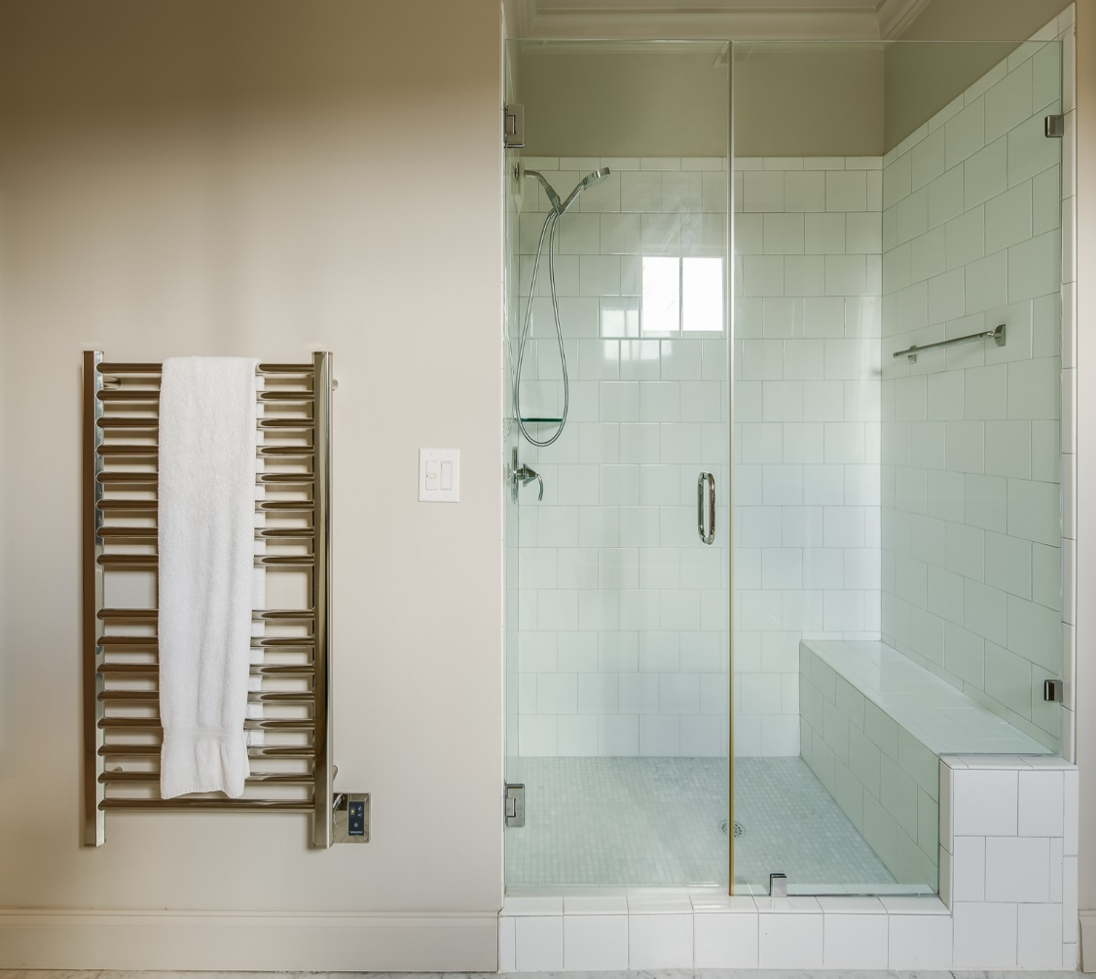
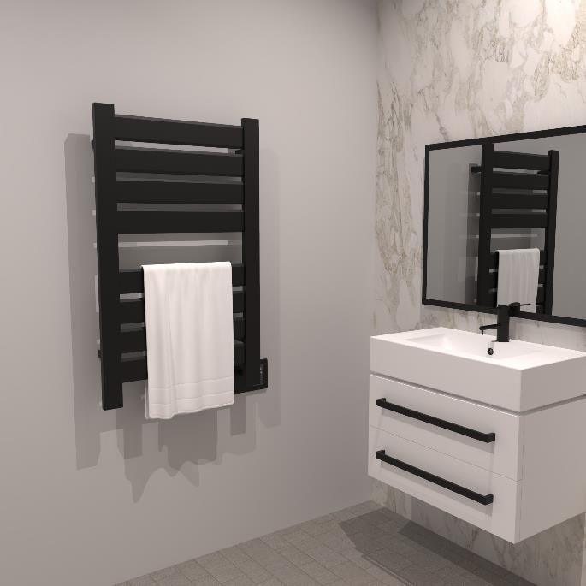
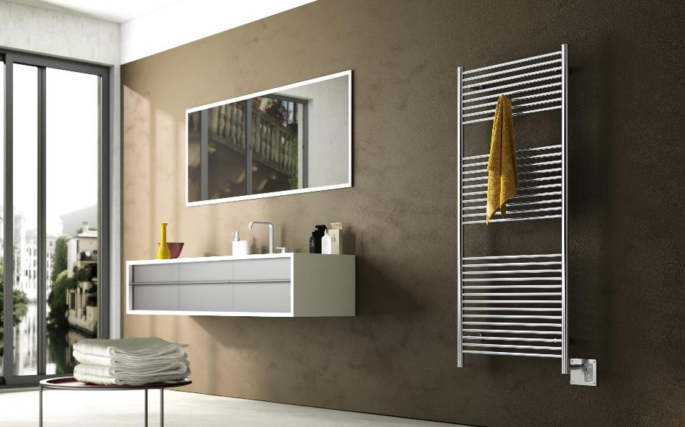
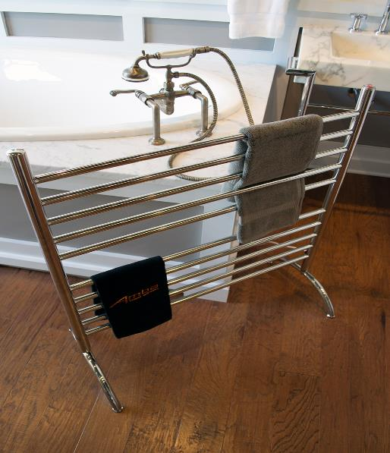
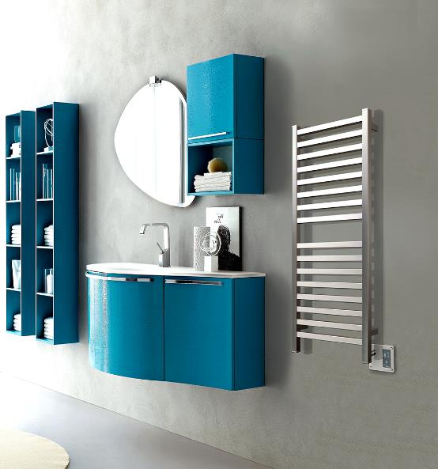
Collections & Accessories
Notes:
Now that we understand the benefits & functions of the category, the technology used to power them and how to sell them, lets explore the different collections that we offer.

Slide 16

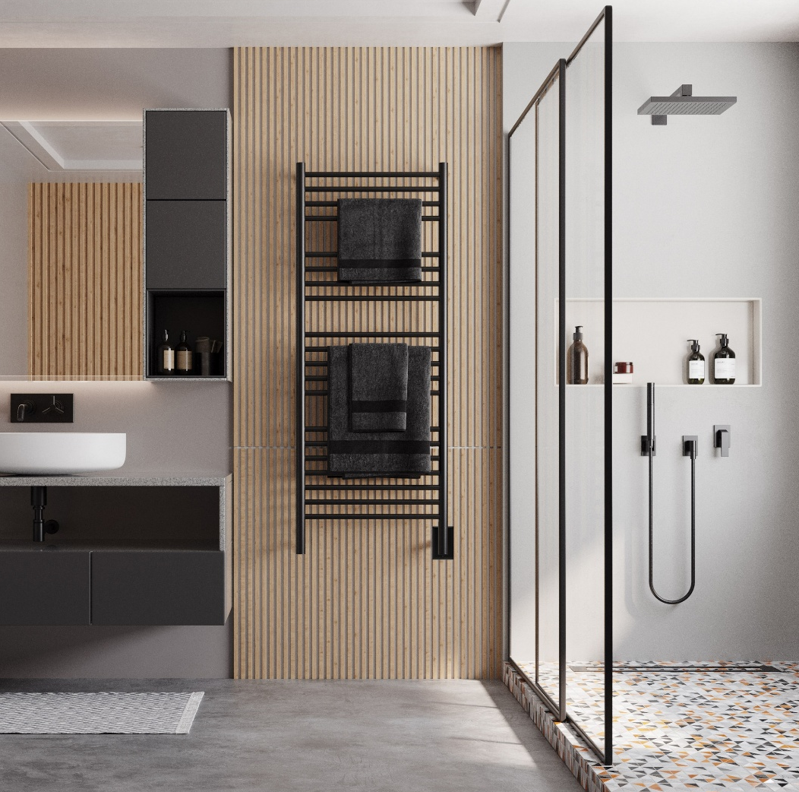

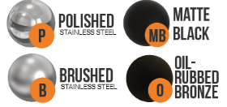

JEEVES COLLECTION
How to Order:
You will need to order two line items for a complete product:
Select towel rack size & finish
Select timer or on/off switch – no integrated switch
Options:
Wet Rated Kit
Double Gang Plate
Bathrobe Hanger
Notes:
Our most popular collection, Jeeves are made in South Africa and are stocked in 5 different finishes: Brushed, Polished, Matte Black, ORB and White. This hardwired only collection uses our liquid filled heating technology which takes about 15-45min to heat up depending on the size. We have 13 stocked sizes including a ladder and shelf model with additional special order sizes, including narrow sizes at 13” & 16” wide and 24” wide models. The electrical will come standard on the right side of the unit, but it is possible to move the electrical to the lower left side upon request. There is an upcharge for this and it adds 1-2 days to your lead time.
When ordering a Jeeves models, you will select the towel rack size and finish that fits your customers needs. You will NEED to add a timer or switch as there is no integrated On/Off switch on the unit itself. We offer a couple of different options depending on their preferences. Optional accessories include our Wet Rated kit in case the unit is going to be near a water source. This kit ensures the product will meet the local electrical codes in your jurisdiction. We offer double gang plates if they want to place the timer/switch adjacent to the towel warmer which makes for a cleaner installation. Lastly, we have bathrobe hangers which attach to the unit for additional hanging space. *Note – these are only offered in a brushed and polished finish.

Slide 17
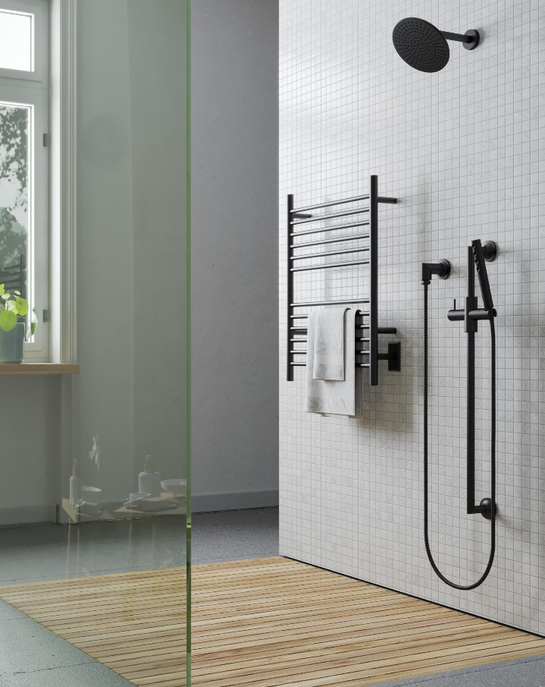


Cape COLLECTION
How to Order:
All you need to order for a complete product is the towel rack itself.
Options:
Wet Rated Kit
Double gang plate
Notes:
The Cape collection is one of our newest collection. Made by the same factory as renown Jeeves collection but offering a quicker heating option using our dry element technology, at a more affordable price point.
We stock 1 size – 24”W x 32”H – in 3 finishes: Brushed, Polished & Matte Black.
The product comes out of the box as a plug-in unit that also includes a hardwire kit, so the homeowner can decide whether they want to simply plug it in to an outlet or direct wire it for a cleaner look.
With an integrated On/Off switch located on the bottom of the right vertical bar, you can order just the rack and have everything needed for use.
We do offer an optional Wet Rated kit which can be added if it is needed to meet any local codes to be installed in ‘wet locations’ to ensure safety for all users.
You can also add separate programmable timers if you want to program it to turn on/off automatically, and a double gang plate can be paired with any timer to locate it adjacent to the towel rack.

Slide 18
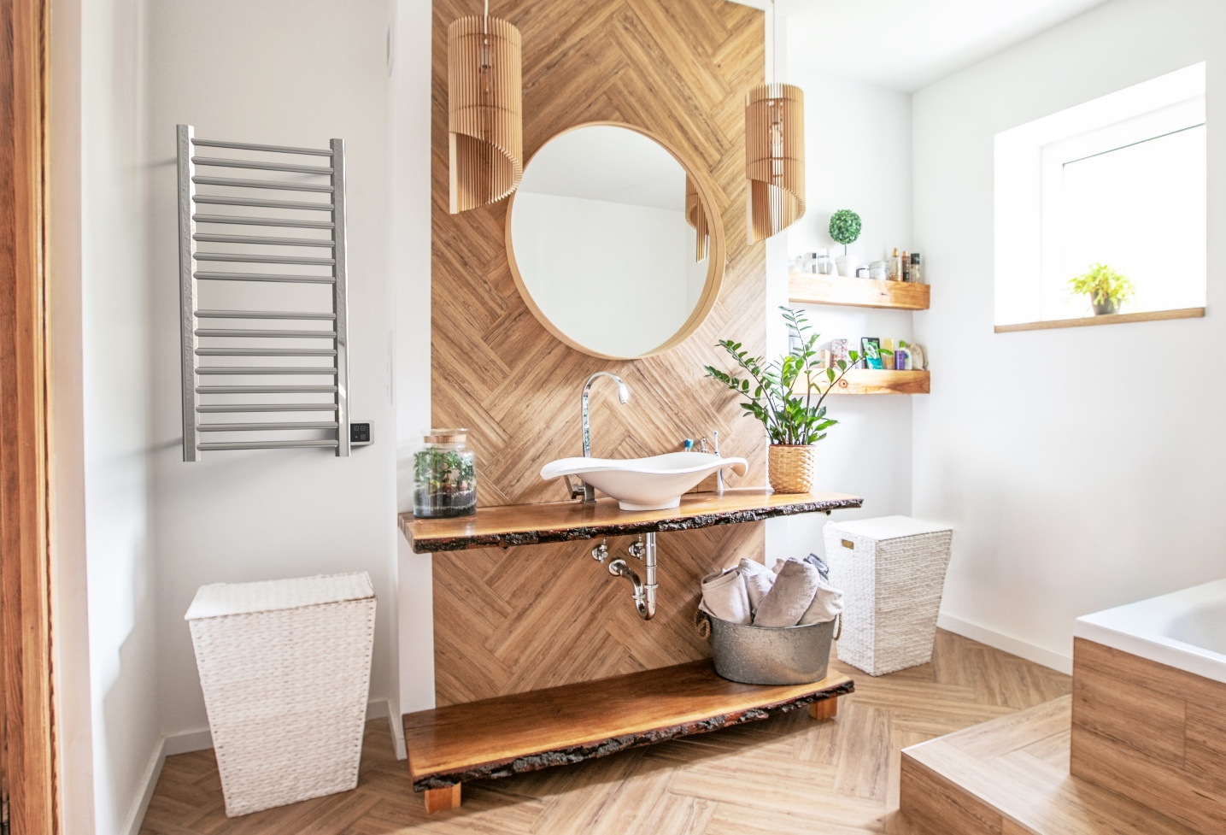
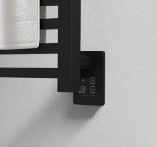
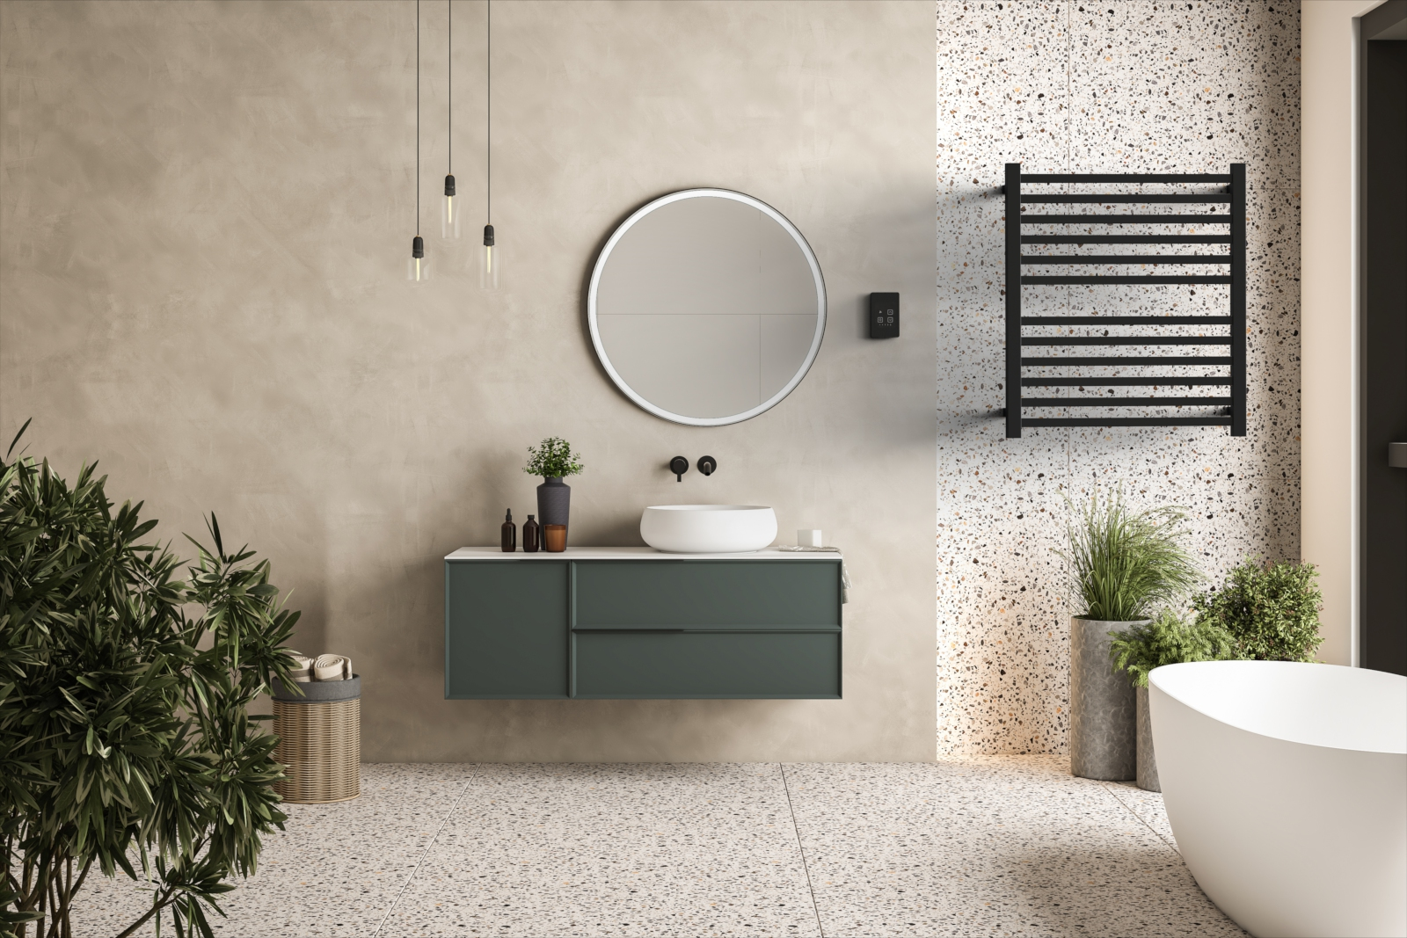
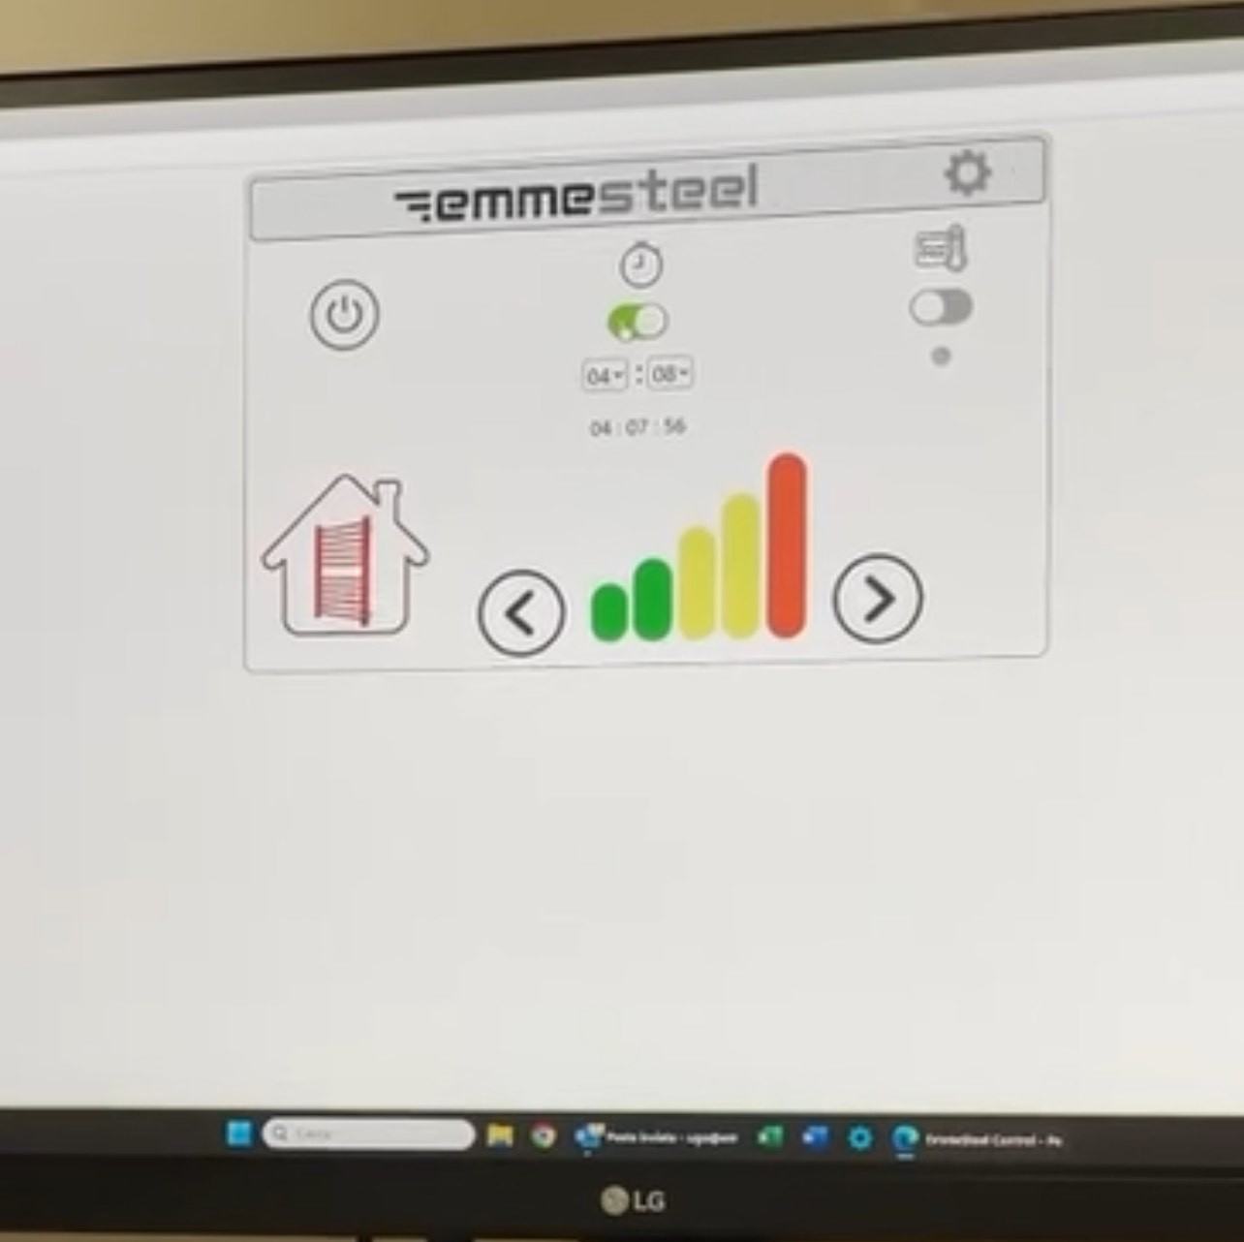
Touch Digital Heat Controller
On/Off Switch
5 Temperature levels
Wi-Fi Connectivity
Integrated Countdown Timer using web app
(Programmable Timer suggested)
Notes:
Our newly redesigned Touch Digital Heat controller has been slimmed down by almost 50% and is now the size of a standard single gang outlet. With a 1200W capacity, it is possible to pair multiple units to a single controller.
It is packed with many great features including:
On/Off function
5 power levels to regulate the desired temperature
Wi-Fi connectivity for control via a web-app on your phone
Countdown timer functionality that can be programmed on your phone. Set it for any length of time up to 23hrs 59mins
Controller can be installed vertically or horizontally without and impact to usability.
Our programmable timer or smart switch and still be paired with it for added functionality.

Slide 19
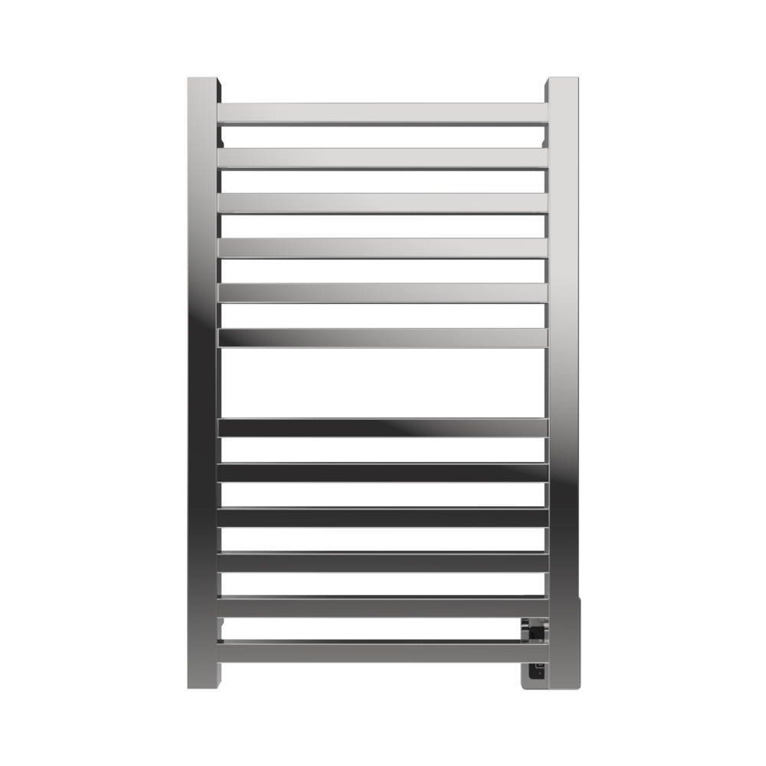
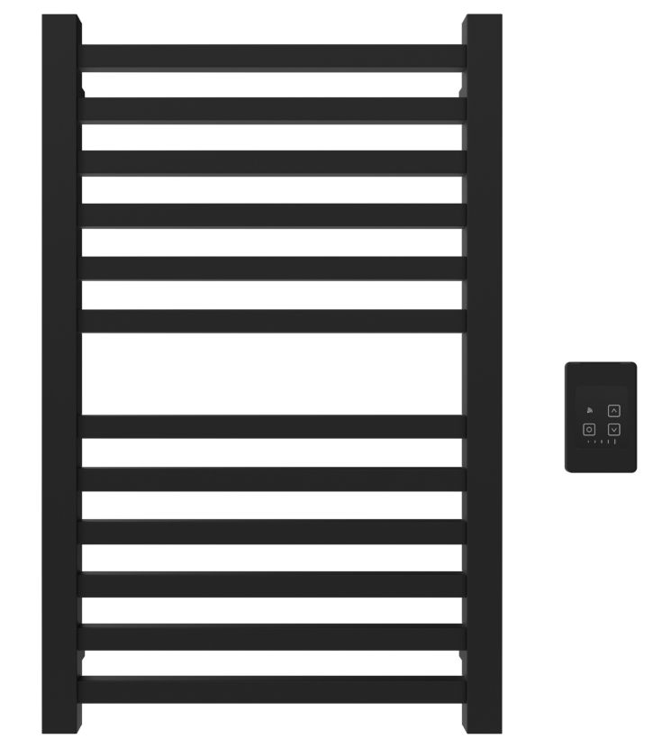


Touch DIGITAL HEAT CONTROLLER
Our Italian collections REQUIRE a Touch Digital Heat Controller (sold separately)
Choose between integrated & remotely located wired option
Remote TDHC requires concealed wall box (ATW-CWB)
Integrated Touch DHC
Remote Touch DHC
Notes:
There are 2 different versions of our new Touch Digital Heat Controller: Integrated and Remote. When choosing any of our Sirio, Quadro, Antus, Vega or Modello I collections, you must pair one of these controllers with it.
Integrated Touch DHC is connected directly to the towel warmer. Control a single rack with this controller. This is the simplest application and installation. When selecting this version, only E.g., items are required for a complete package.
Remote Touch DHC allows the controller to be located away from the rack. This can be beneficial for certain circumstances where space is limited, or a cleaner look is desirable as the controller can be hidden in a closet or placed on another wall. You can wire multiple units to a single controller for simultaneous control.
When selecting this controller, it is necessary to add 1 concealed wall box per unit. The concealed wall box is installed behind the wall and then drywall or tile is placed over it, keeping the clean look on the wall without cover plates.
E.g. you are ordering 2 towel racks. Add 2 concealed wall boxes and 1 remote Touch DHC.
The Touch DHC is ONLY compatible with the 5 Italian collections – Sirio, Quadro, Antus, Vega & Modello i. It cannot be paired with any other collections we offer.

Slide 20




SIRIO COLLECTION
How to order:
Select rack size and finish
Choose a controller:
  Standard Touch DHC (bottom image)
  Remote Touch DHC (top image)
    Needs Concealed Wall box
Options:
Timers
Notes:
Our Sirio collection, made in Italy, offers a high-end option that doubles as both a towel warmer and radiator. The contemporary design of our Sirio models feature round horizontal bars. The vertical bars have a flat face with a rounded exterior edge and chamfered interior edge.
This collection uses our dry element technology. It has a temperature range of 110F – 194F and will reach its top temperature in 15min or less.
For your convenience, we offer the option to order from additional special-order sizes as well as custom finishes include RAL and PVD finishes which can color matched to many other MFGs finishes. *Note – we cannot match living finishes.
When ordering our Sirio collection, you will need to pair one of our new Touch DHC’s with the rack. They can choose between the integrated and remote Touch DHCs based upon their preferences.
Optional: While not needed, you can add a separate timer to the unit in case the customer wants to program the unit to turn on/off automatically based upon a desired schedule. We also carry bathrobe hangers but only stocked in Brushed or Polished finishes.

Slide 21



QUADRO COLLECTION
How to order:
Select rack size and finish
Choose a controller:
  Standard Touch DHC
  Remote Touch DHC
    Needs Concealed Wall box
Options:
Timers
Notes:
Our Quadro collection, made in Italy, offers a high-end option that doubles as both a towel warmer and radiator. The Quadro models feature square horizontal and vertical bars for a clean, modern appearance.
This collection uses our dry element technology. It has a temperature range of 110F – 194F and will reach its top temperature in 15min or less.
For your convenience, we offer the option to order from additional special-order sizes as well as custom finishes include RAL and PVD finishes which can color matched to many other MFGs finishes. *Note – we cannot match living finishes
When ordering our Quadro collection, you will need to pair one of our new Touch DHC’s with the rack. They can choose between the integrated and remote Touch DHCs based upon their preferences.
Optional: While not needed, you can add a separate timer to the unit in case the customer wants to program the unit to turn on/off automatically based upon a desired schedule. We also carry bathrobe hangers but only stocked in Brushed or Polished finishes.

Slide 22
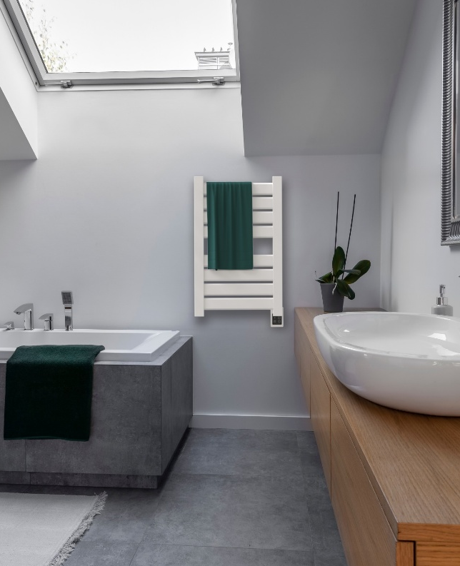


VEGA COLLECTION
How to order:
Select rack size and finish
Choose a controller:
  Standard Touch DHC
  Remote Touch DHC
    Needs Concealed Wall box
Options:
Timers
Notes:
Our Vega collection, made in Italy, offers a high-end option that doubles as both a towel warmer and radiator. The Vega models feature flat panels for exceptional towel coverage and a modern, clean appearance.
This collection uses our dry element technology. It has a temperature range of 110F – 194F and will reach its top temperature in 15min or less.
For your convenience, we offer the option to order from additional special-order sizes as well as custom finishes include RAL and PVD finishes which can color matched to many other MFGs finishes. *Note – we cannot match living finishes
When ordering our Vega collection, you will need to pair one of our new Touch DHC’s with the rack. They can choose between the integrated and remote Touch DHCs based upon their preferences.
Optional: While not needed, you can add a separate timer to the unit in case the customer wants to program the unit to turn on/off automatically based upon a desired schedule. We also carry bathrobe hangers but only stocked in Brushed or Polished finishes.

Slide 23
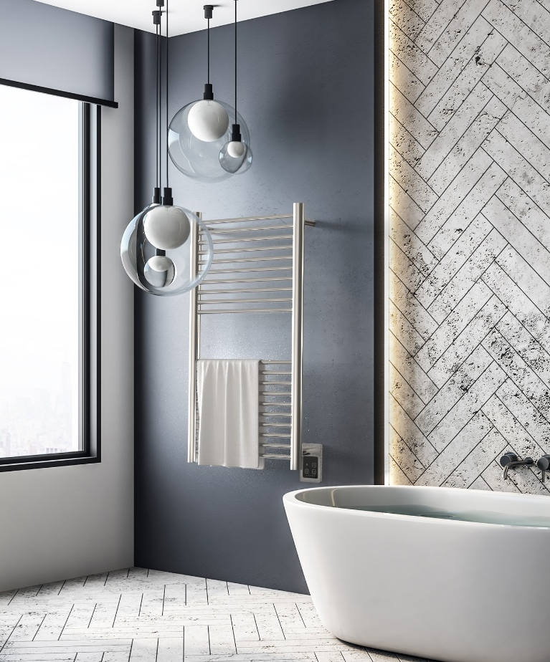


ANTUS COLLECTION
How to order:
Select rack size and finish
Choose a controller:
  Standard Touch DHC
  Remote Touch DHC
    Needs Concealed Wall box
Options:
Timers
Notes:
Our Antus collection, made in Italy, offers a high-end option that doubles as both a towel warmer and radiator. The transitional style of the Antus models feature round horizontal and vertical bars providing a versatile appearance to match with many styles.
This collection uses our dry element technology. It has a temperature range of 110F – 194F and will reach its top temperature in 15min or less.
For your convenience, we offer the option to order from additional special-order sizes as well as custom finishes include RAL and PVD finishes which can color matched to many other MFGs finishes. *Note – we cannot match living finishes
When ordering our Antus collection, you will need to pair one of our new Touch DHC’s with the rack. They can choose between the integrated and remote Touch DHCs based upon their preferences.
Optional: While not needed, you can add a separate timer to the unit in case the customer wants to program the unit to turn on/off automatically based upon a desired schedule. We also carry bathrobe hangers but only stocked in Brushed or Polished finishes.

Slide 24


Modello i Collection
How to order:
Select bar length, quantity, style and finish
Choose a controller:
  Standard Touch DHC
  Remote Touch DHC – recommended when selecting 2+ bars
    Needs 1 concealed wall box per bar
Options:
Timers
Notes:
The all-new Modello i collection is a unique single bar product. Choose between a round or square bar style to blend with your design theme. Stocked in 4 finishes: Brushed, Polished, Matte Black or Satin Brass.
The Modello i bars can be installed horizontally like a traditional towel bar, pairing multiple bars for complete towel coverage. In this configuration, we would recommend a minimum of 3-4 bars per towel. They can also be installed vertically where space is limited or to replace towel bars. Mix and match sizes (and finishes!) to create a one-of-a-kind look!
When ordering our Modello i collection, you will need to pair one of our new Touch DHC’s with the rack. They can choose between the integrated and remote Touch DHCs based upon their preferences. You can control multiple bars on a single controller as they are extremely low wattage (10W = 20” bar; 20W = 40” bar & 30W = 59” bar). If ordering multiple bars, you will need to go with the Remote Touch DHC option and include 1 concealed wall box per bar.
This collection uses our dry element technology. It has a temperature range of 110F – 194F and will reach its top temperature in 15min or less.
We offer an additional special-order size at 79” long, as well as custom finishes include RAL and PVD finishes which can be color matched to many other MFGs finishes. *Note – we cannot match living finishes
Optional: While not needed, you can add a separate timer to the unit in case the customer wants to program the unit to turn on/off automatically based upon a desired schedule.

Slide 25

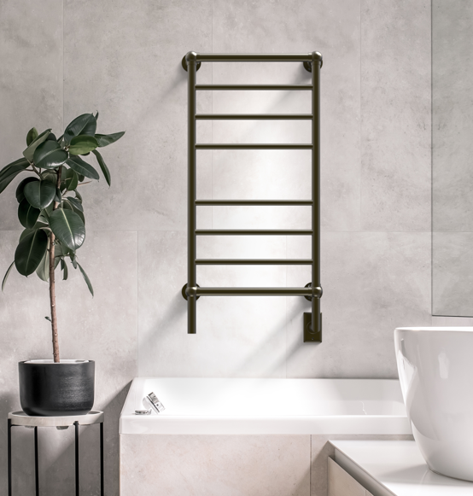


TRADITIONAL COLLECTION
How to Order:
You will need to order two line items for a complete product:
Select towel rack size & finish
Select timer or on/off switch – no integrated switch
Notes:
Our traditional collection emulates the classic styling that many desire. With round horizontal and vertical bars and beautiful finials that add a luxury touch.
Using our liquid filled heating technology, these products have a longer heat up time – 30min to 45min – but the heating elements can be replaced, if they fail.
The collection is stocked in 3 finishes – brushed nickel, polished nickel and brushed bronze.
When ordering this collection, you will need to add a timer or on/off switch so you can control the unit.

Slide 26
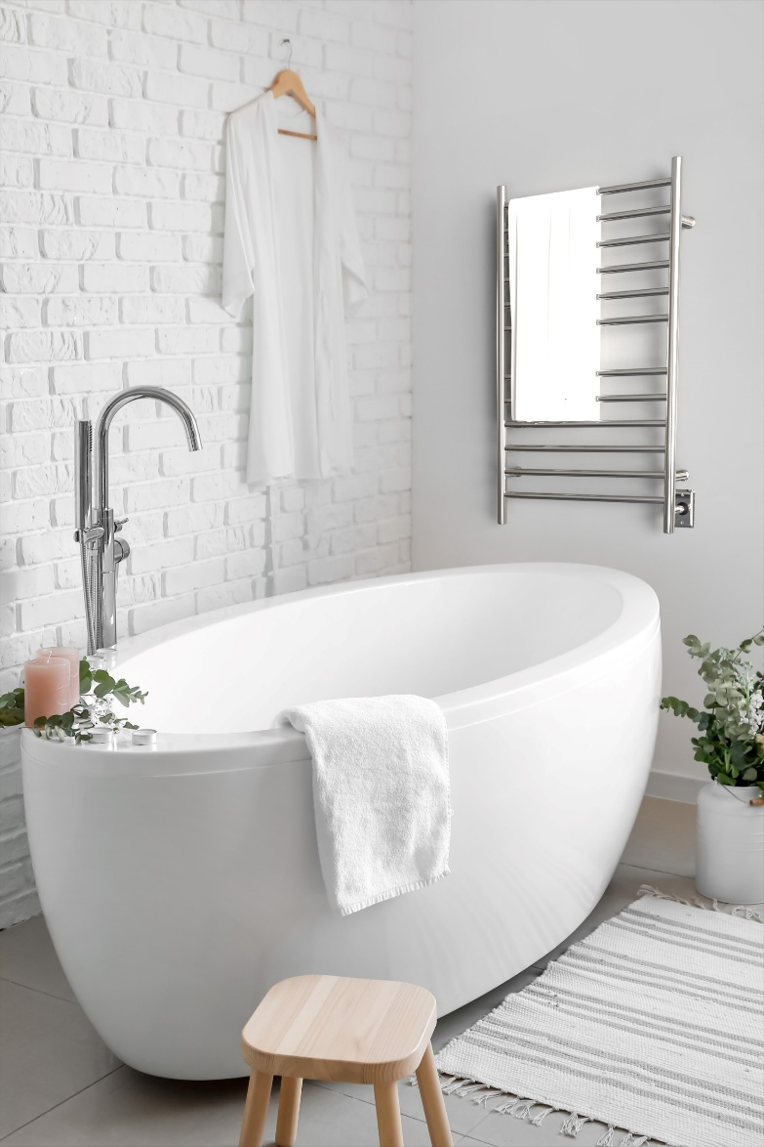

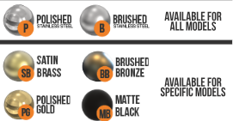
RADIANT COLLECTION
How to Order:
All you need to order for a complete product is the towel rack itself.
Options:
Timers
Double gang plate
Notes:
Our Radiant collection is an affordable option that still gives the user all the comforts and luxuries of a towel warmer, but at a friendlier price point.
All models are stocked in a brushed and polished finish. We have 4 other finishes that are offered on some of the models.
This collection comes as a plug-in & hardwired combination out of the box. So whether you want to plug-in it for a retrofit or direct wire it for a cleaner look, you have everything needed in the box. There is a built-in on/off switch located on the bottom of the right vertical bar.
We have 3 different sizes as well as a shelf unit that gives you a variety of sizes depending on the space and how many towels you want to hang. Choose between round or square bars depending on the design theme in the bathroom.
The shelf is a unique product that emulates the hotel shelf style bar, where the shelf also heats up.
Besides the towel rack itself, the only options to add on to the unit would be a timer or a double gang plate.

Slide 27
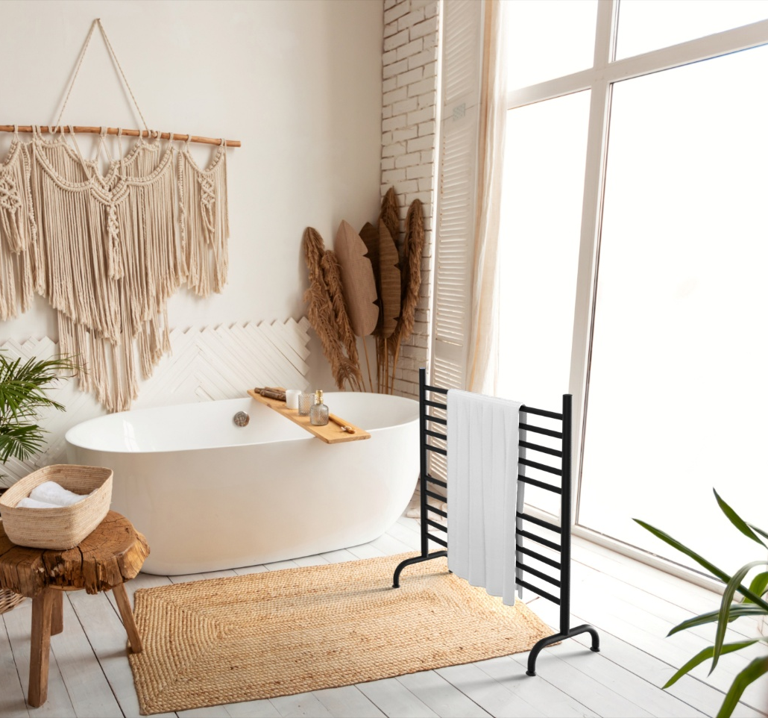


SOLO COLLECTION
How to Order:
You will need to order one line item for a complete product – that’s it!
Select towel rack size & finish
Options:
Plug-in programmable timer
Notes:
Our Solo collection is a freestanding towel rack that sits on the ground. This is the perfect solution when wall space is not available.
We carry 2 sizes – a 24” wide and 33” wide model and they are stocked in a brushed, polished and matte black finish.
The Solo collection is a lightweight, portable product weighing between 10 & 13lbs. It can be moved from a bathroom to a laundry room to dry clothing. Take it outside by a pool or hot tub to hold bathing suits, towel etc..
When done with it, the legs can fold flat and the unit can be stored in a closet, behind a door or under a bed.

Slide 28
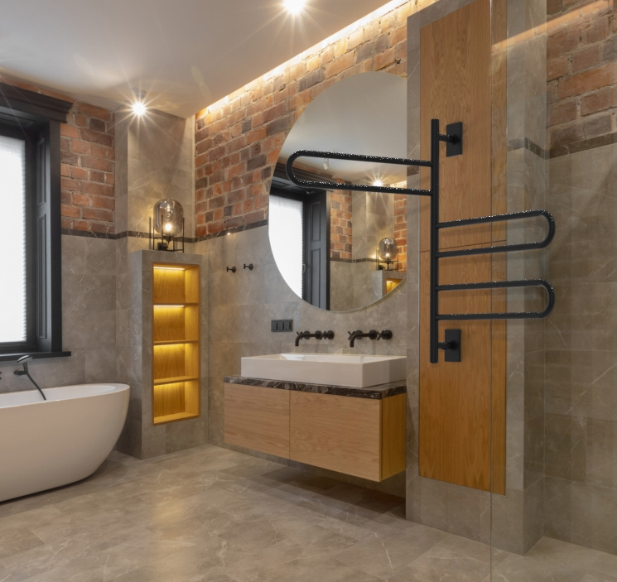


Swivel Collection
How to Order:
You will need to order one line item for a complete product – that’s it!
Select towel rack size & finish
Options:
Timers
Notes:
Our newly redesigned Swivel collection is offered in two styles: Swivel Bar and Swivel Loop. These new models have an upgraded dry element heating system that is more powerful and effective. The entire collection is a plug-in + hardwired combination. There is an integrated On/Off switch located on the bottom of the vertical bar.
This is a great collection for spaces with minimal wall space or where you want to be able pull the bars out to hang items and them push them up against the wall so they are out of the wall. Laundry rooms is a very population spot for these models.
The Swivel Bar collection has 5 individual bars that all swivel independently.
The Swivel Loop collection has 3 pairs of looped bars that swivel independently.
These models will be stocked in 3 finishes: Brushed, Polished & Matte Black

Slide 29
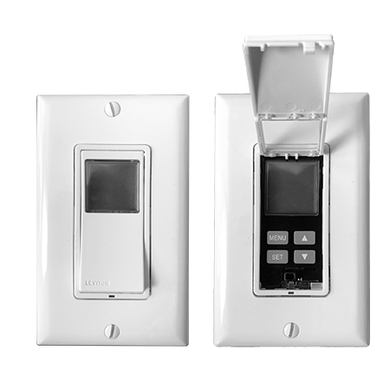
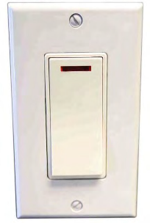
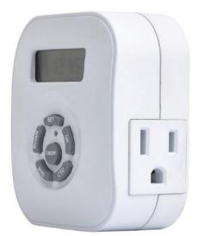
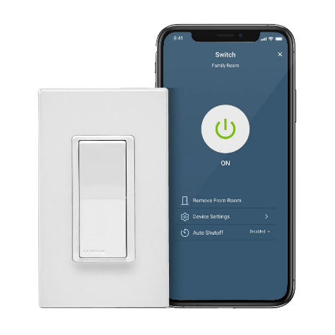
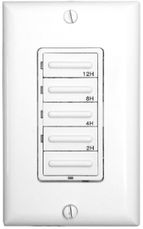
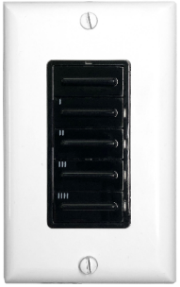
TIMERS & SWITCHES
Plug-In Programmable Timer
On/Off Switch
Hardwired Programmable Timer
Wi-Fi Smart Switch
Hardwired Countdown Timer
Note: BLACK COLOR CHANGE KITS SOLD SEPARATELY
Notes:
We offer a choice of controls that can be added to any of our heated towel racks. All controls are made by Leviton. These are the control options that we recommend to use with our products.
None of our products come with built-in programmable timer functionality, which is a very popular requirement from homeowners. We offer 2 hardwire timer options – programmable timer and wifi smart switch; as well as a plug-in programmable timer.
Programmable timers – program exactly when your towel warmer turns on and off based upon your desired schedule. We recommend at least 1hr prior to use and ~2hrs after to sufficiently dry all towels.
Wi-Fi smart switch – the controller has all the functionality of our programmable timer, countdown timer and on/off switch built into a single controller. It can be integrated with Alexa, Siri and Google Home and allows the user to control their towel warmer from anywhere!
Color change kit are available for Countdown Timer, Programmable timer and Wifi Smart Switch if needed. This is an additional line item.

Slide 30
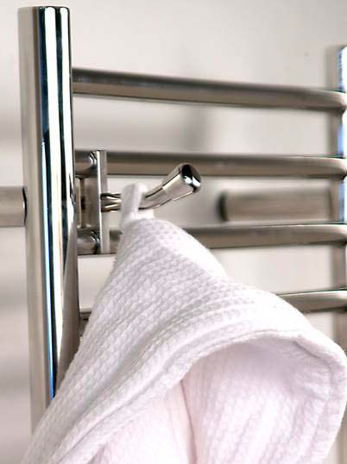
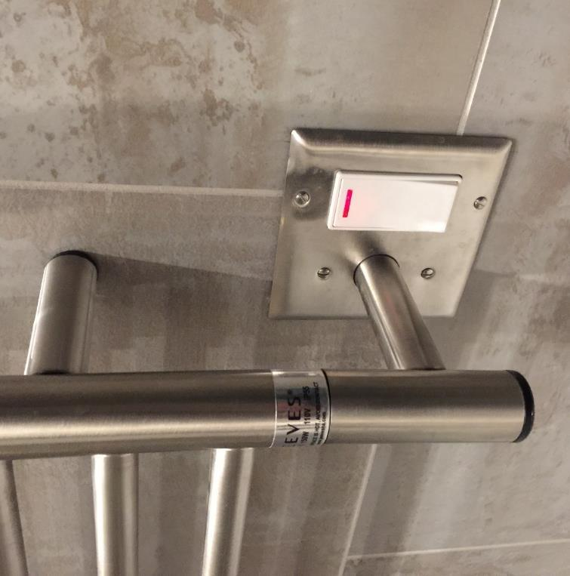
DOUBLE GANG PLATE & Bathrobe Hook
Double gang plates & robe hooks available – collection specific
Notes:
Our double gang plates, available for the Jeeves, Cape & Radiant collections allows the user to place the switch adjacent to the towel rack. This allows for a simple installation as the electrician just needs to make space for a larger, double gang box. Plates are offering in all matching finish.
Our bathrobe hooks simply secure onto 2 of the horizontal bars and give space for users to hang additional towels, robes or other garments. They are not available for all collections and stocked only in brushed or polished. While we offer the bathrobe hooks, we encourage users to hang towels or robes from the tops of the vertical bars which all heat.

Slide 31
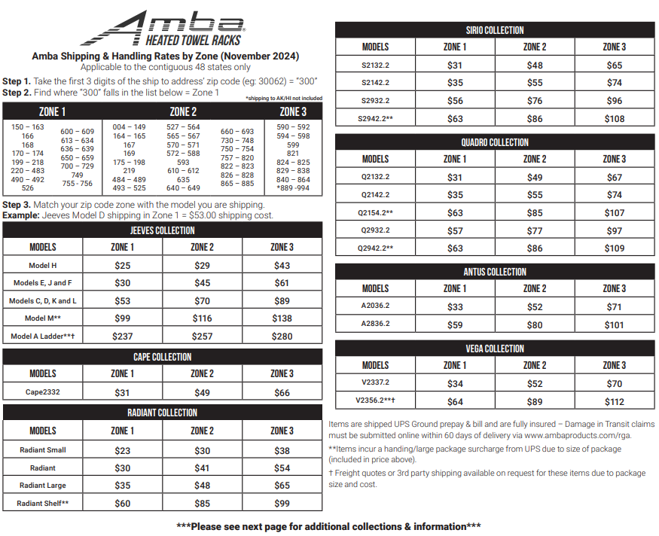
Shipping & Handling Rates
Notes:
We have simplified process for calculating freight rates when shipping within the contiguous 48 US states with a S/H rate chart. For shipping to AK or HI, please contact us for freight quotes.
Step 1: The US has been broken down into 3 zones. Take the first 3 digits of the zip code to find your zone.
Step 2: Find the collection and model that you are shipping
Step 3: Find the Zone you are shipping to from Step 1 and you will see the freight cost.
All towel racks are shipped individually, so when ordering multiple racks, you will have multiple freight costs.
Accessories and controllers are shipped separately from the rack and will have its own freight charge. We can usually bundle multiple accessories into a single box for a single freight cost.
For our Canadian customers, our Canadian price list has freight costs, customs & duties built into the list price so you don’t need to factory any additional costs except any HST/GST taxes.

Slide 32
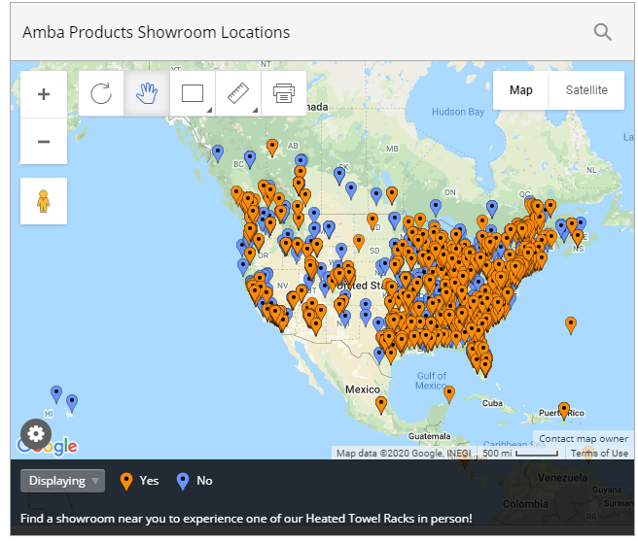

ONLINE RESOURCES
CATALOGS & PRICE LISTS:
ambaproducts.com/catalogs
SHOWROOM LOCATOR
EASY ORDER TRACKING:
ambaproducts.com/order-status/
STOCK CHECK:
ambaproducts.com/stockcheck/
RGA/Warranty Claims:
ambaproducts.com/RGA
ambaproducts.com/showrooms
Display Program
EMAIL CONTACTS:
orders@ambaproducts.com
returns@ambaproducts.com
customerservice@ambaproducts.com
Notes:
We have quite a lot of great resources available to all showrooms AND they don’t require remembering usernames and passwords.
You can check the status of a PO, currently inventory levels which are updated every weekday morning, submit RGA claims for returns or damaged items.
There are digital versions of our catalogs and price lists that can be easily downloaded.
We also have a live chat on our website if you prefer to communicate with Amba that way instead of email/phone.

Slide 33
What did you learn about towel warmers?

Slide 34

IN SUMMARY
Pamper and indulge yourself with an affordable luxury
Prevent growth of bacteria and promote health, wellness & hygiene
Replaces the need for towel bars & robe hooks
Use in a variety of locations, not just bathrooms
Help keep rooms mold and mildew free
Variety of designs, finishes, and sizes
US List Prices start at $310
Add comfort to any room

