Slide 1
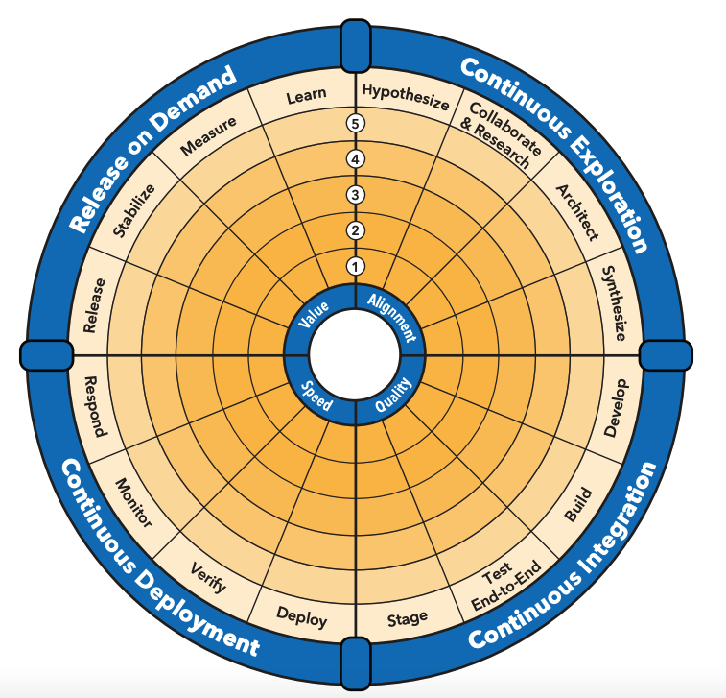
SAFe DevOps Health Radar
Mark your Level

