Slide 1
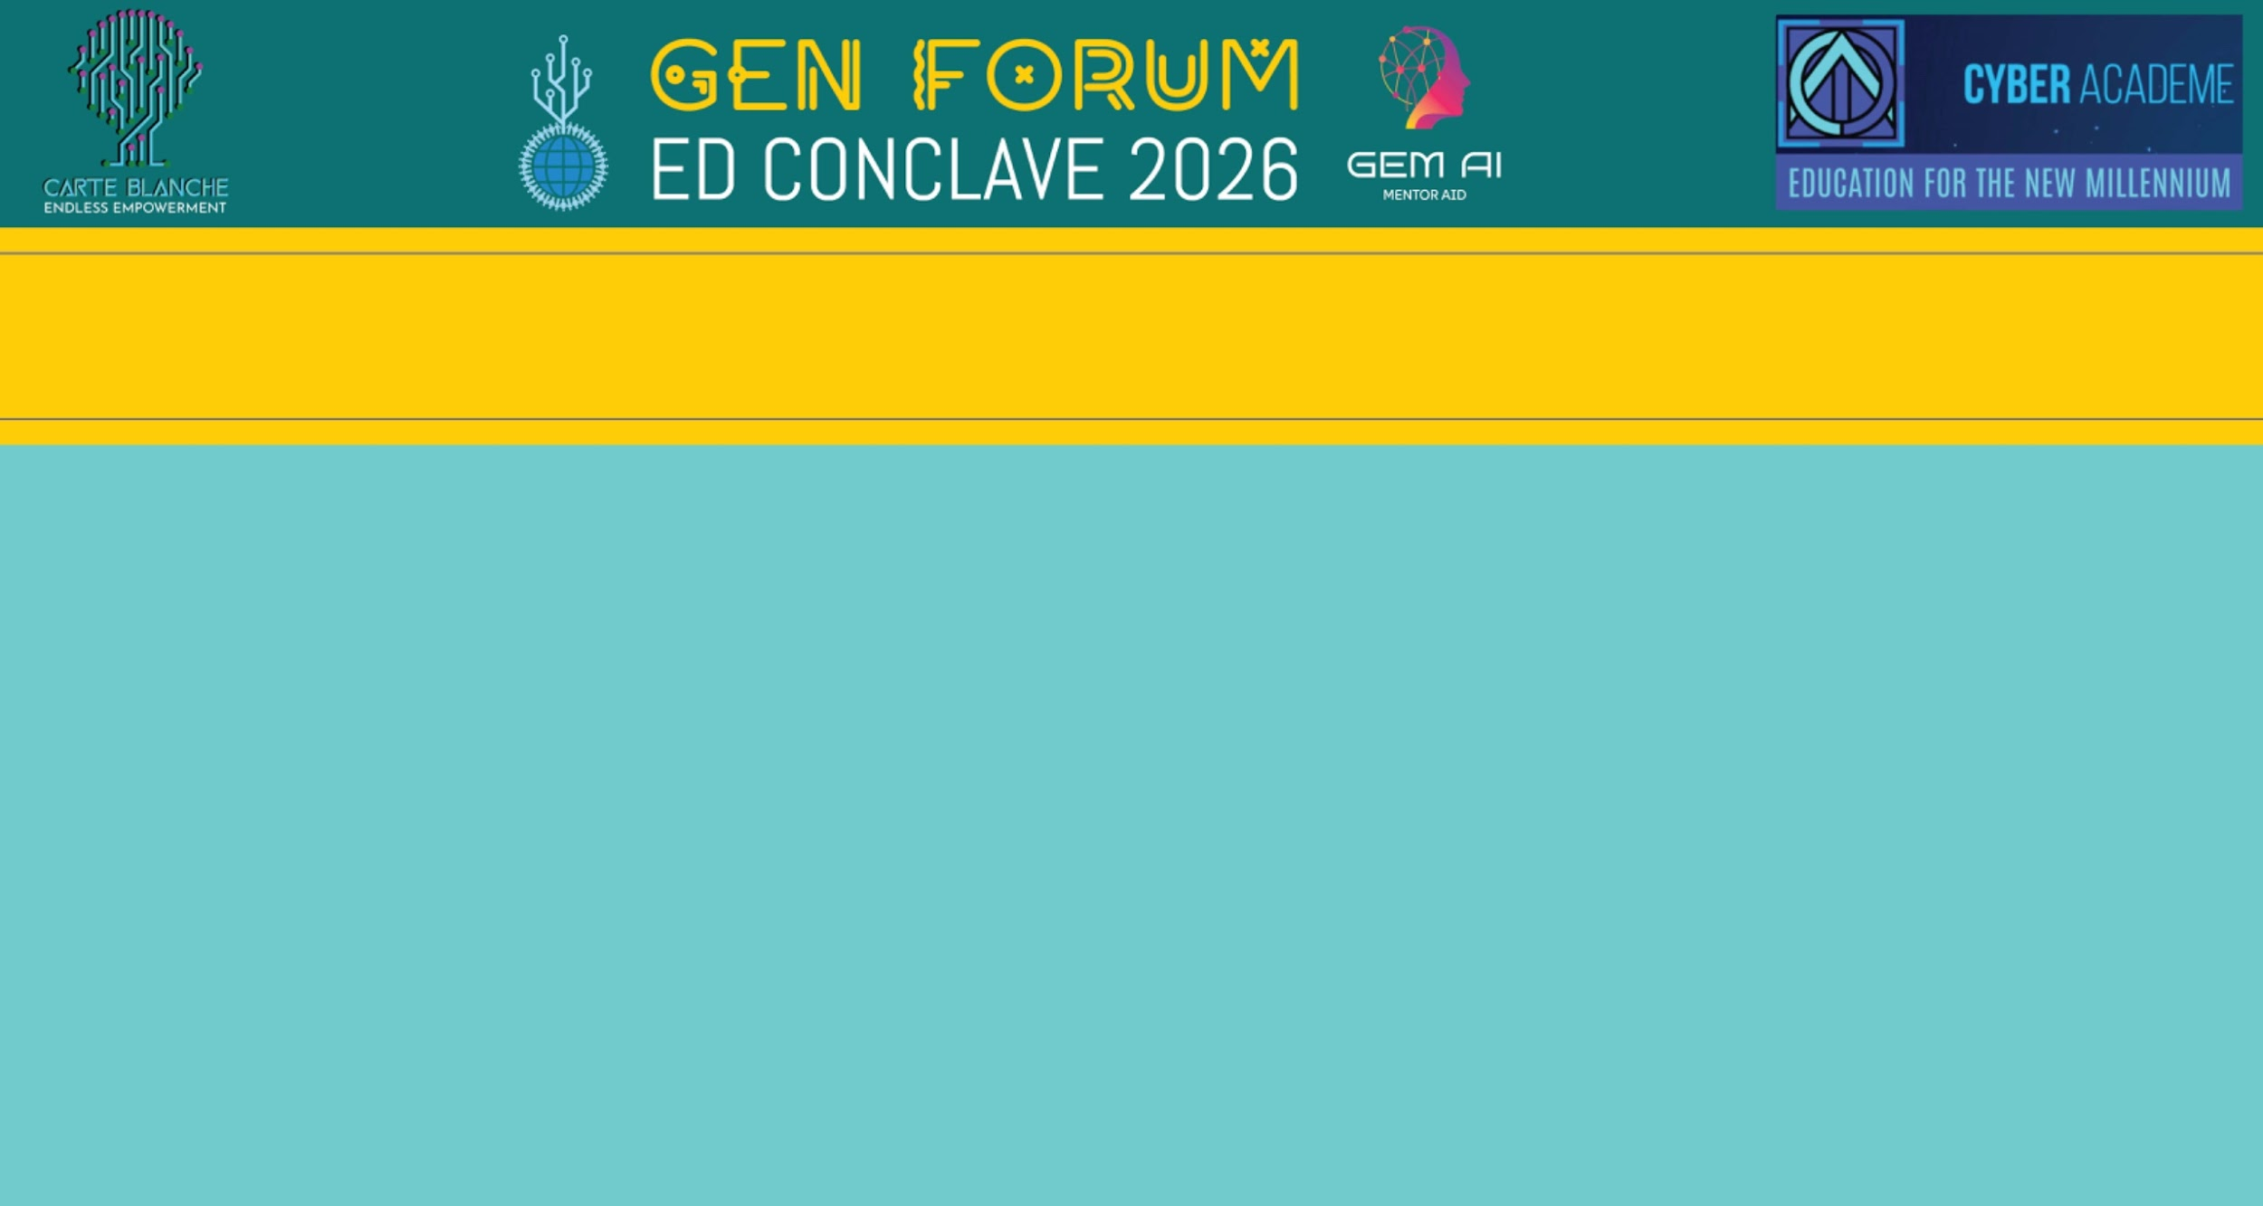

THE FUTURE OF AI IN ITES
By Aditya Rath and Nived Anoop

Slide 2
What is ITES?
What do ITES companies do?
ITES stands for Information Technology Enabled Services, and it is the largest employer in the private sector.
These companies work to manage large amounts of data, and run call centres, data entry jobs, human resources and many other backend operations.
Companies such as Wipro, Infosys, TCS are all classified as ITES companies.

Slide 3
The Current Problem
AI can automate many tasks. It is powerful, however the AI tools operate inside a fixed workflow designed by humans. The process itself, the sequence of steps of how everything is done rarely changes..
We have automated how the task is done, but in the process neglected possibilities of the need for flexibility.
A process made for normal conditions may be overloaded with a spike in volume, and every transaction follows the same rigid path, even when it doesn't need to.

Slide 4
Case Study
To demonstrate the issues of this problem, we can take the example of withdrawing money from banks:
Whenever we take a loan, banks need to find out if you are trustworthy. To calculate this, banks use the information of your net worth, what collateral you are able to put up and your credit scores.
Even after filling out your data, you need to negotiate with bank officials to finalize your loan amounts and more details.
Of course, safety is a major concern. But is so much protection needed at every single step, every single time?

Slide 5
The Future Solution? - IT Project Manager
1
2
3
4
Observation
Simulation
Optimisation
Action
Doesn’t just track how things are correlated but also how something is caused.
A digital twin is created. This can test a large number of potential changes.
Using a technique called reinforcement learning, it finds the best workflow through trial and error.
If the change works, it scales up. If it doesn’t work it is rolled back and the next test is done

Slide 6
How the industry transforms?
From Linear to Platform Economics.
From Process Contracts to Outcome Contracts.
.
Industry transformation
The End of the Process Manager Role
The Rise of Process-as-a-Service

Slide 7
Concerns that must be addressed
Ways in which trust will be developed for AI
Visibility
Human approval
Safety Guardrails

Slide 8
CONCLUSION
In conclusion, the future of AI in ITES is not just automation but creating systems which think, and adapt constantly.
Systems which are flexible not rigid, and respond intelligently according to each scenario.
Technology alone isn’t enough. While the tools are there, what matters is whether industries embrace change.

