Slide 1


Kaushal Bodh – Content and Curriculum Mapping
Dr. Vinay Swarup Mehrotra
Professor & Head, Curriculum Development & Evaluation Centre
PSS Central Institute of Vocational Education (PSSCIVE), Bhopal
(a constituent unit of National Council of Educational Research and Training,
Ministry of Education, Government of India)

Slide 2


Slide 3
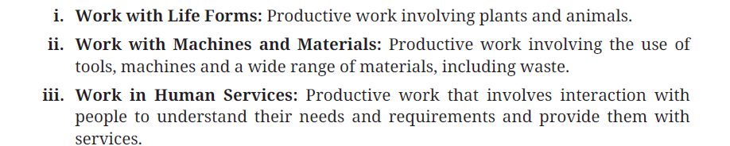
Three Forms of Work

Slide 4
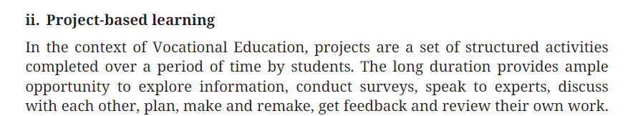
Project-Based Learning

Slide 5
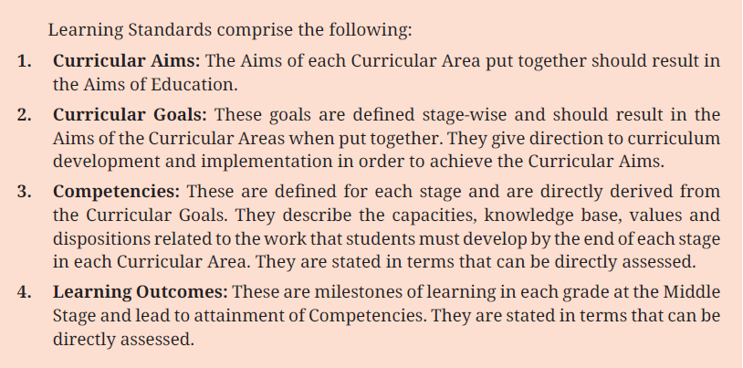
Learning Standards

Slide 6
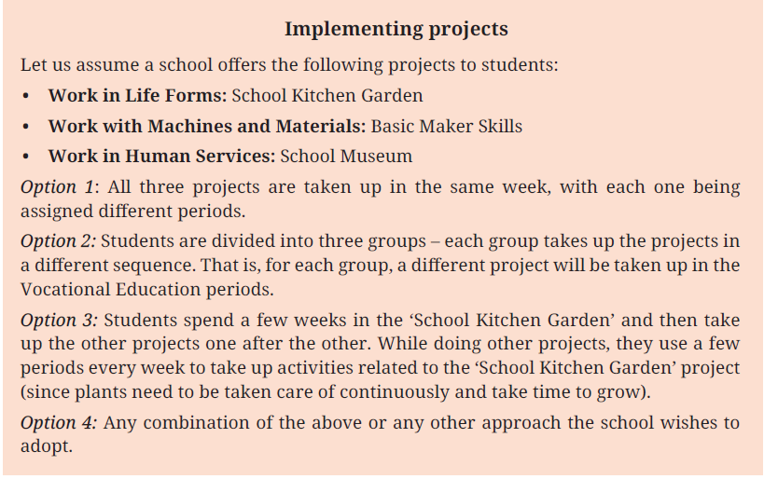
Implementing Projects

Slide 7
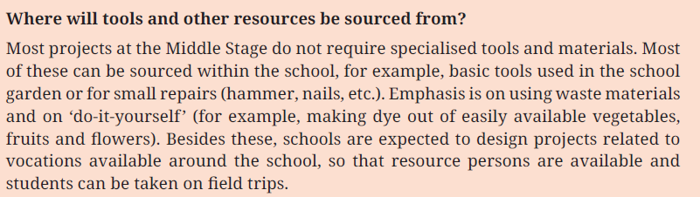
Tools and Materials

Slide 8
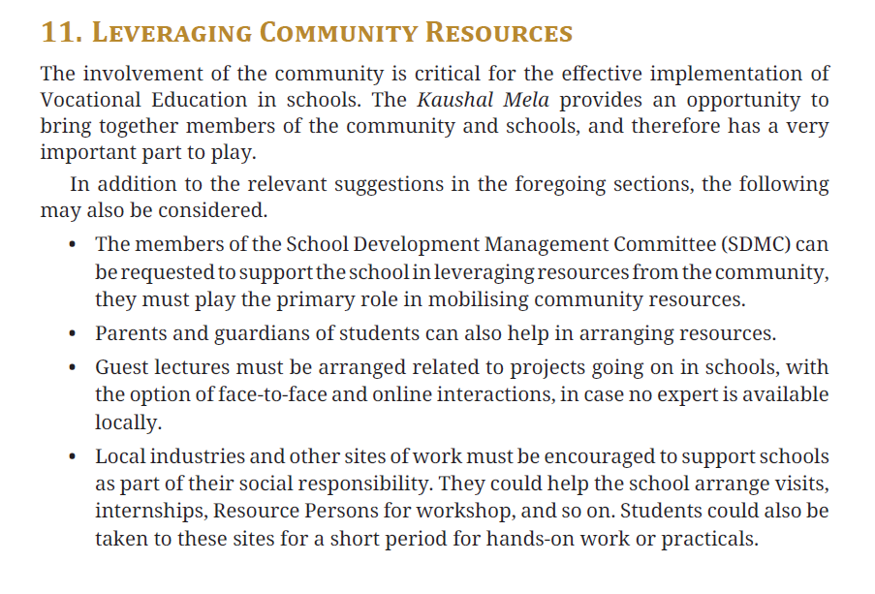
Leveraging Community Resources

Slide 9
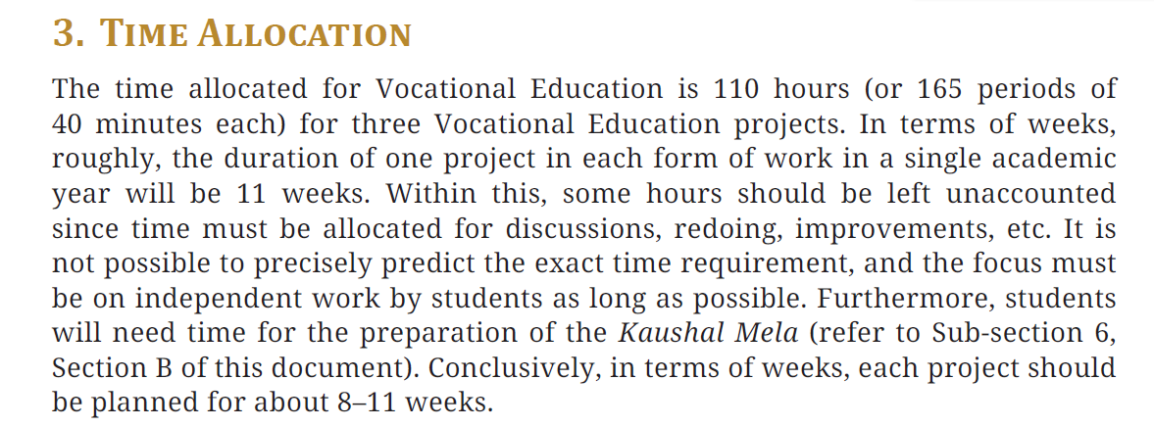
Time Allocation

Slide 10
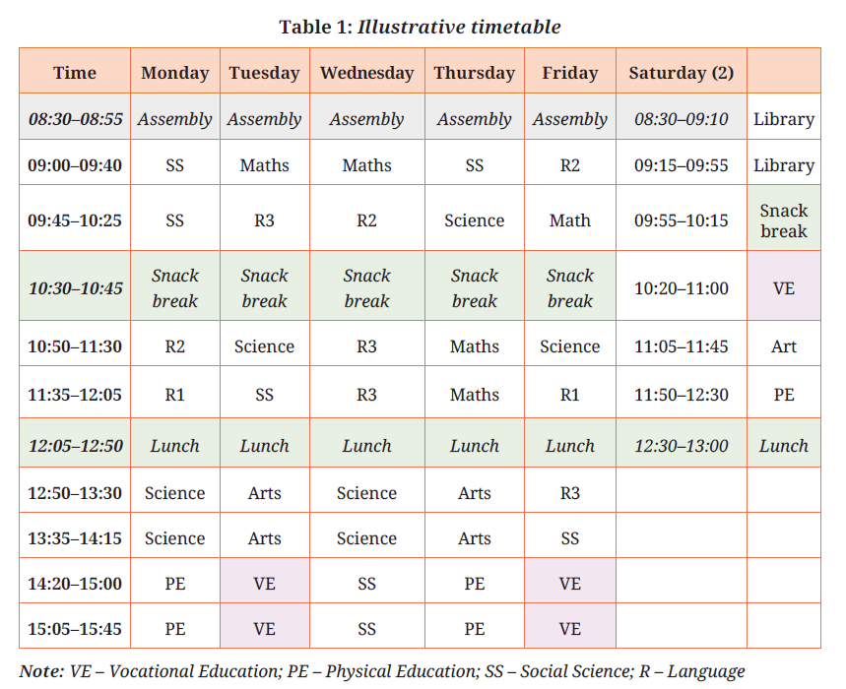
Time Allocation

Slide 11
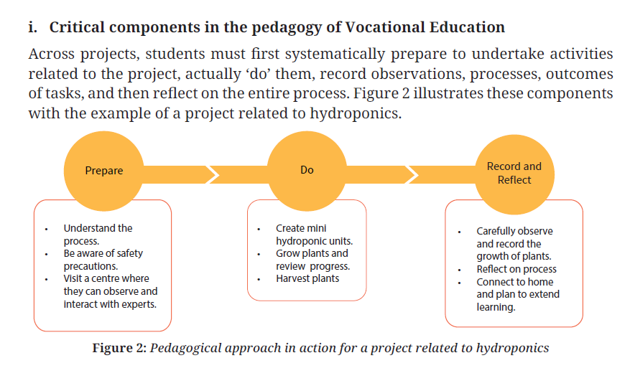
Pedagogy

Slide 12
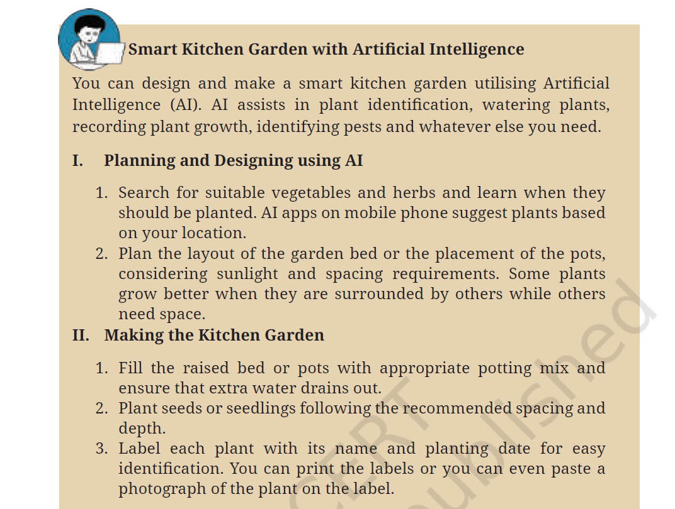
Integration of Artificial Intelligence

Slide 13
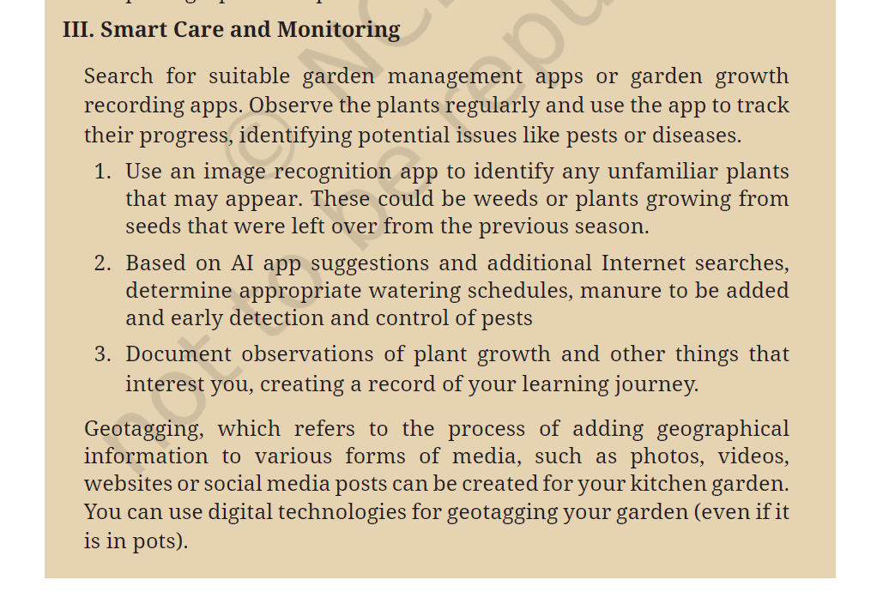
Integration of Artificial Intelligence

Slide 14
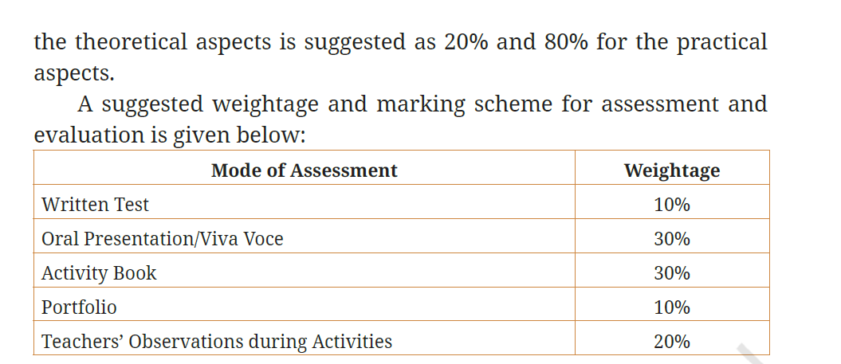
Assessment

Slide 15
Assessment
Formative Assessment (continuous)
Activity Book 30%
Portfolio 10%
Teachers’ Observations during Activities 20%
Total (Formative): 60%
Summative Assessment (final performance evaluation
)
Written Test 10%
Oral Presentation / Viva Voce 30%
Total (Summative): 40%

Slide 16
Rubric: Kitchen Gardening
Each student plans, plants, and maintains one crop and reports the process.
Performance Levels : 4 – Excellent, 3 –Good, 2 – Basic, 1 – Needs Improvement
Total = 100%
Criteria | 4 (Excellent) | 3 (Good) | 2 (Basic) | 1 (Needs Improvement) | Weightage
Understanding of Task | Clearly understands purpose and steps; works independently | Minor guidance needed | Partial understanding | Does not understand task | 10%
Planning (Crop & Materials) | Chooses suitable plant; plans materials and steps correctly | Mostly appropriate choices | Limited planning | No proper planning | 15%
Execution (Planting Work) | Correct method (soil, depth, spacing); neat work | Minor errors in method | Several mistakes | Incorrect planting | 20%
Care & Responsibility | Regular watering, care, and monitoring | Mostly regular care | Irregular care | Neglects plant | 20%
Observation & Recording | Regular records maintained | Some records maintained | Minimal recording | No record | 15%
Problem Solving | Identifies and addresses issues (pests, drying, etc.) | Notices issues but limited action | Rarely notices problems | No effort to solve problems | 10%
Presentation / Explanation | Explains process and learning clearly | Adequate explanation | Basic explanation | Unable to explain | 10%

Slide 17
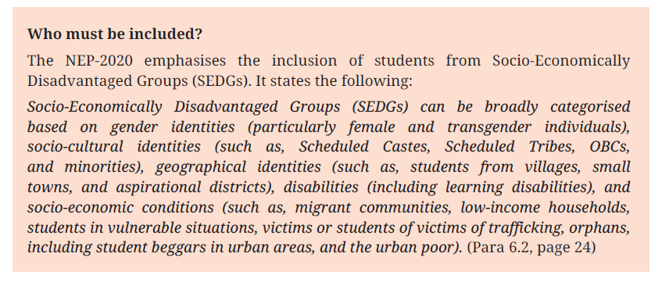
Inclusive Skill Education

Slide 18
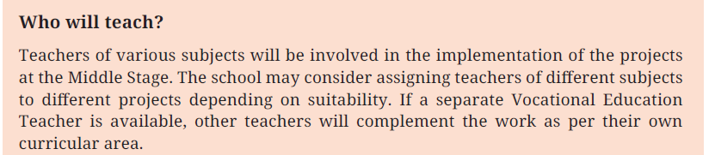
Who Will Teach ?

Slide 19


Slide 20
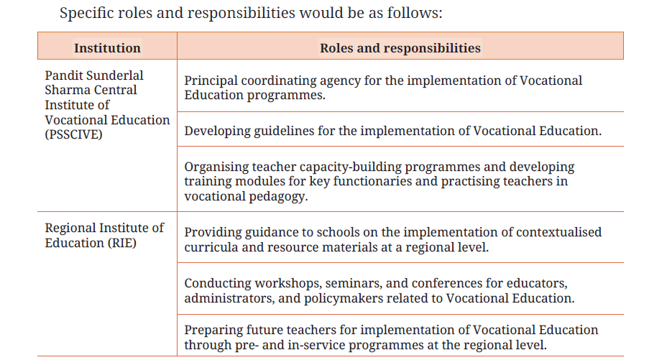
Roles and Responsibilities of National Level Institutions

Slide 21
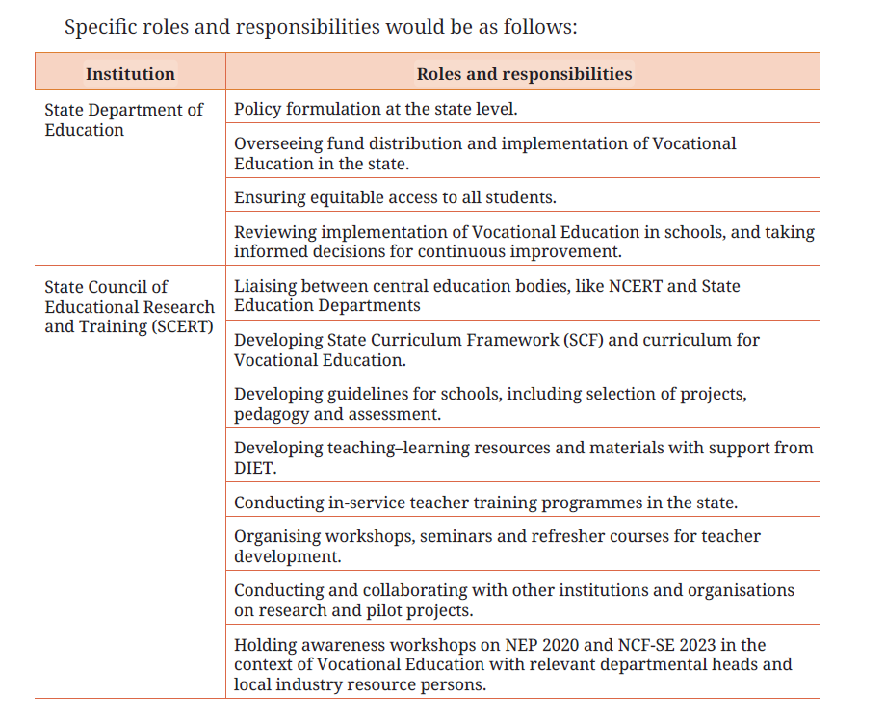
Roles and Responsibilities of State Level Institutions

Slide 22
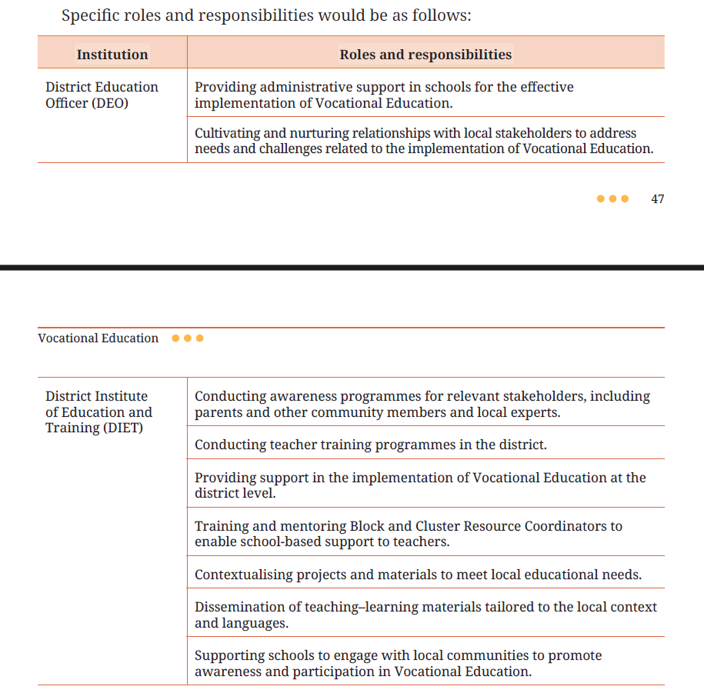
Roles and Responsibilities of District Level Institutions

Slide 23
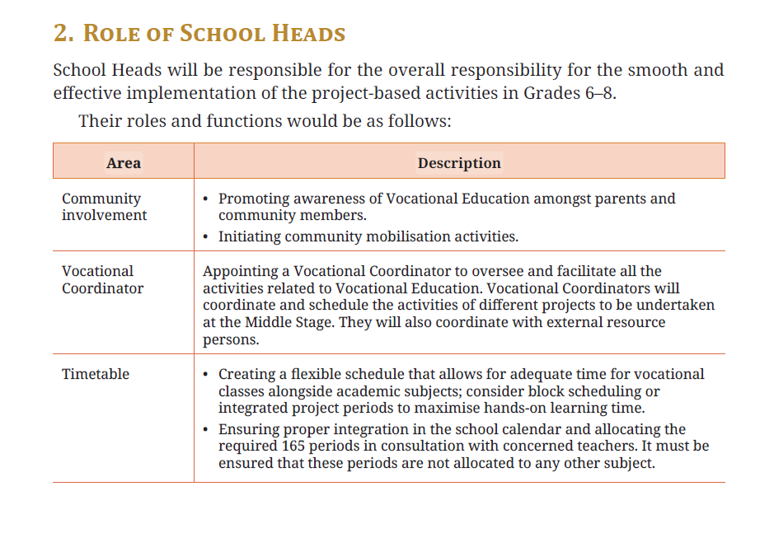
Roles and Responsibilities of School Head

Slide 24
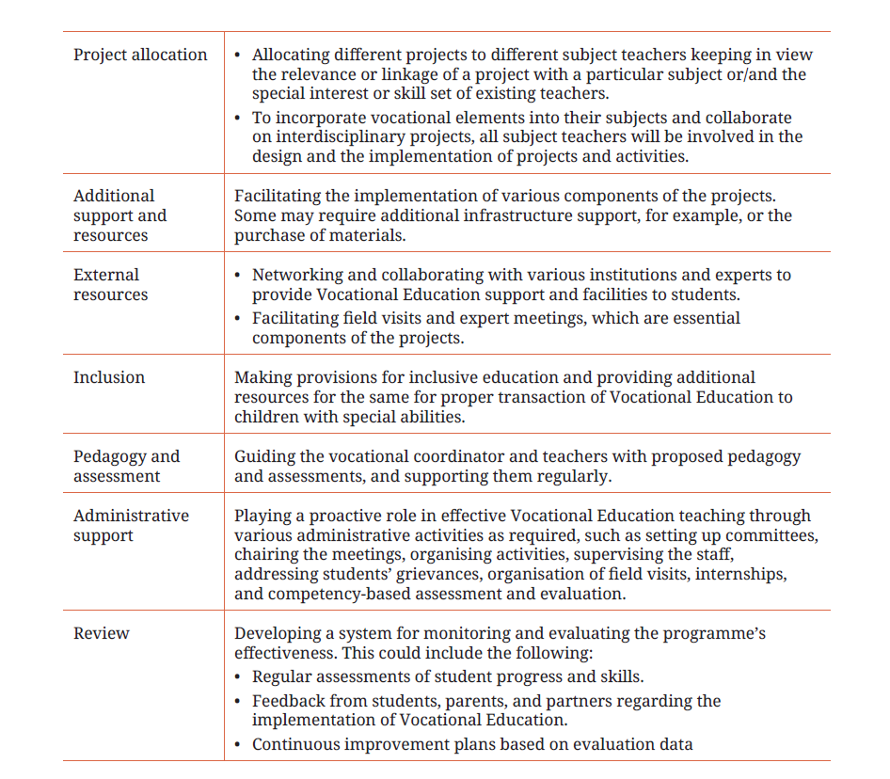
Roles and Responsibilities of School Head

Slide 25
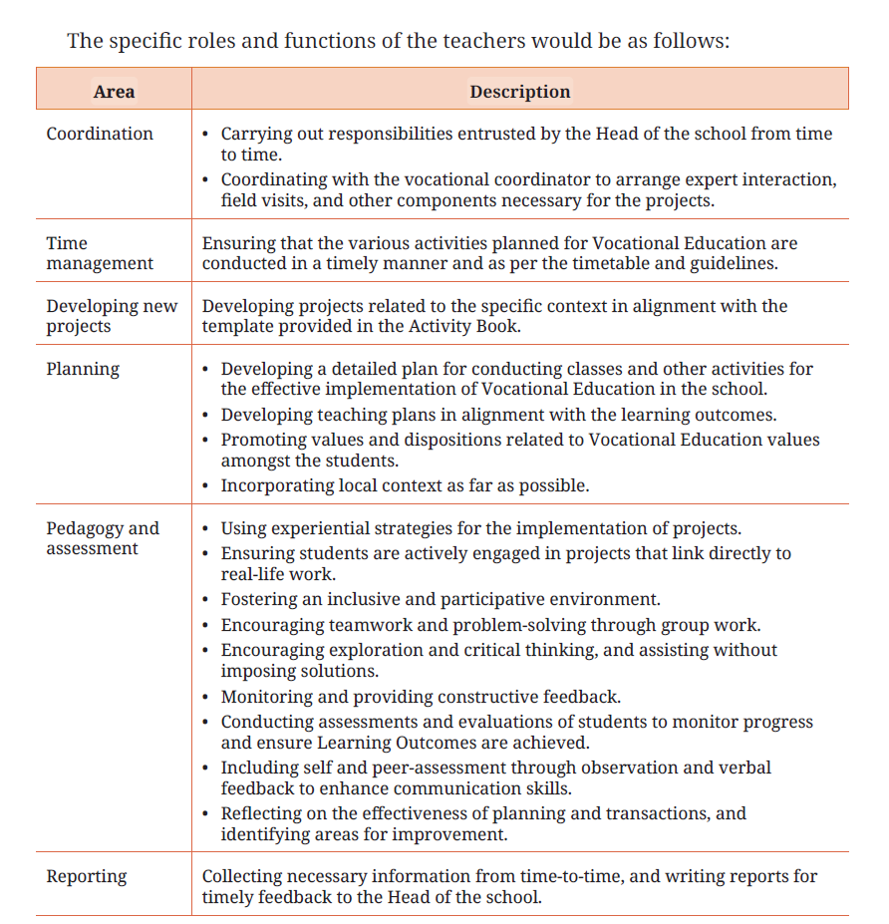
Roles and Responsibilities of Teachers

Slide 26
Thematic Alignment with Curriculum
The goal is to ensure that Skill Education is not treated as an "extra" subject, but rather a practical extension of what students learn in their core academic classes.
Cross-Curricular Links: Teaching how mathematical concepts (like geometry or ratios) apply to carpentry, fashion design, or coding.
Contextual Learning: Presenting science through the lens of industry. For example, teaching environmental science through the theme of "Sustainable Agriculture" or "Green Energy Jobs."
Soft Skills Integration: Embedding communication, teamwork, and ethics into every module, showing how these "themes" are universal across all career paths.

Slide 27
Level-Appropriate Content Selection
Content must be mapped to the cognitive and physical developmental stages of the students. It is usually divided into three broad tiers:
Foundational Level (Awareness): Basic "Hand-on" activities that improve dexterity without requiring complex machinery.
Intermediate Level (Exploration): Introduction to specific tools and digital literacy.
Advanced Level (Specialization): Teaching complex problem-solving and project management within a specific vocational stream.

Slide 28

Organisation of Kaushal Mela

Slide 29
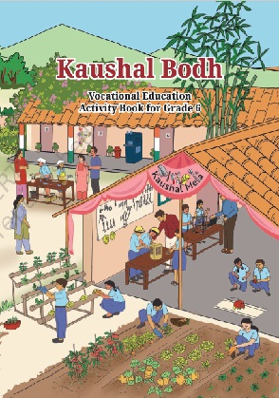
Activity book of Vocational Education “Kaushal Bodh”
(Grade 6)

Slide 30
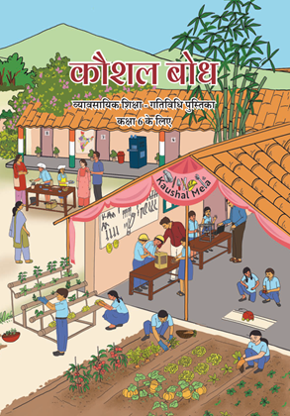
व्यावसायिक शिक्षा की गतिविधि पुस्तिका
"कौशल बोध"
(कक्षा 6)

Slide 31
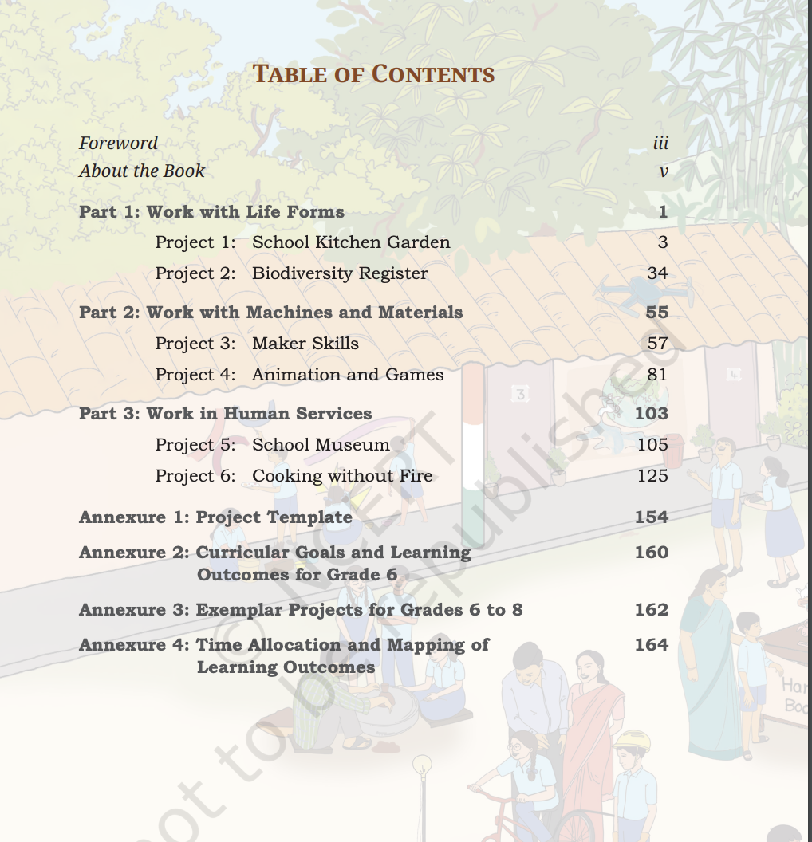
Content of Activity Book “Kaushal Bodh”
(Grade 6)

Slide 32
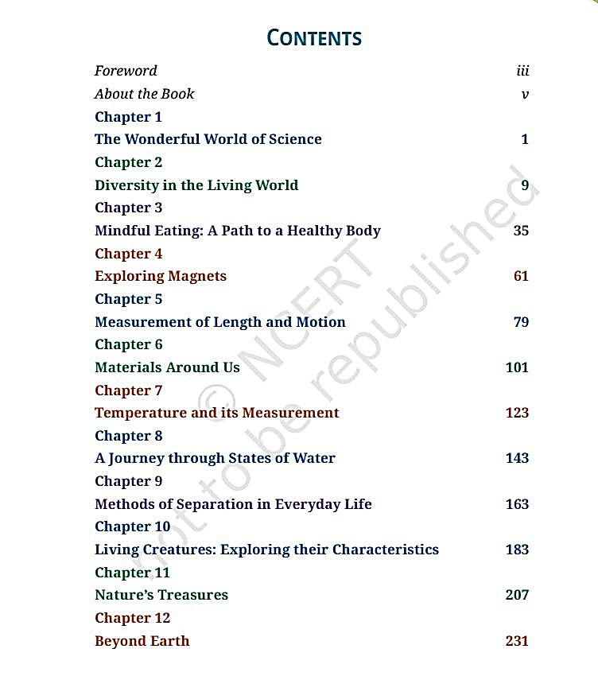
Textbook of Science (Grade 6)
Curiosity

Slide 33
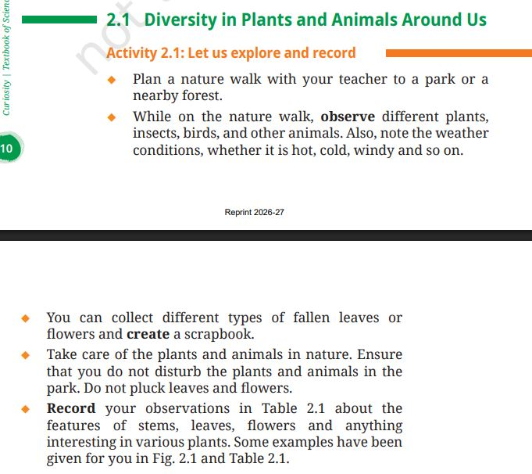
Textbook of Science (Grade 6)
Curiosity

Slide 34
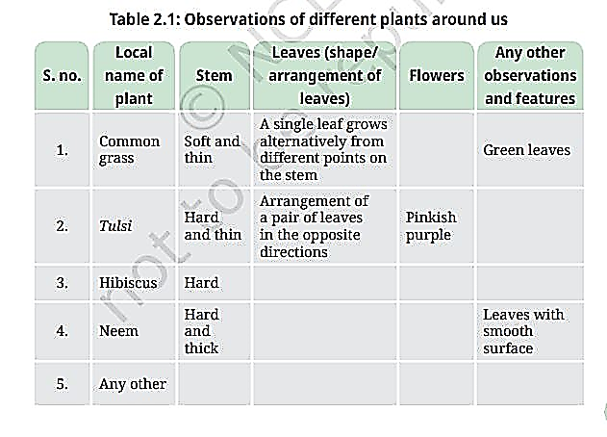
Textbook of Science (Grade 6)
Curiosity

Slide 35
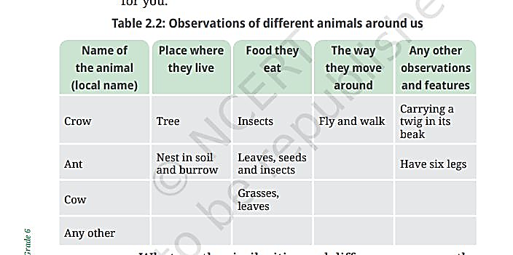
Textbook of Science (Grade 6)
Curiosity

Slide 36
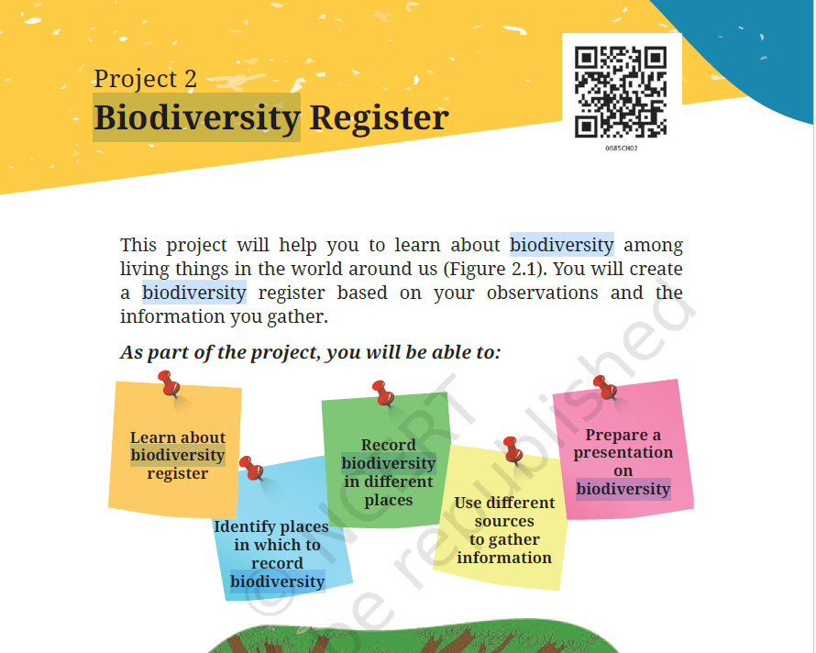
Activity Book “ Kaushal Bodh” (Grade 6)

Slide 37
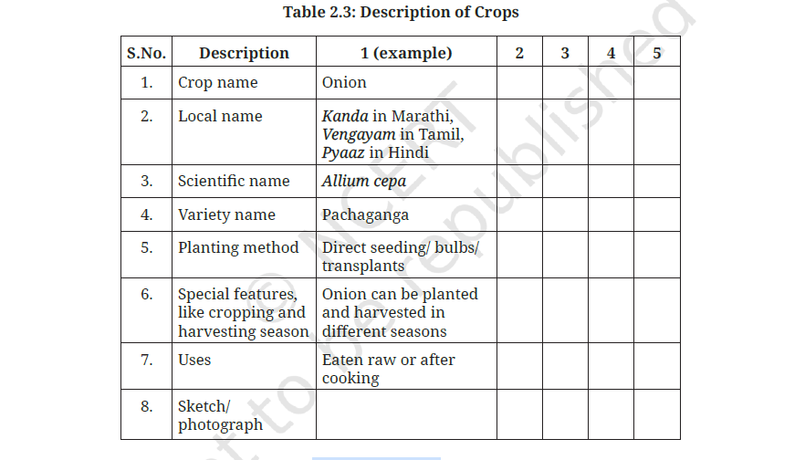
Activity Book “ Kaushal Bodh” (Grade 6)

Slide 38
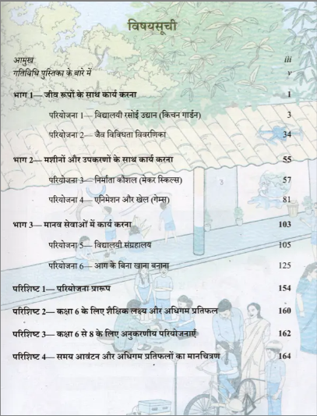
व्यावसायिक शिक्षा की गतिविधि पुस्तिका की विषय-सूची
“कौशल बोध” (कक्षा 6)

Slide 39

Activity Book of Vocational Education “Kaushal Bodh”
(Grade 7)

Slide 40
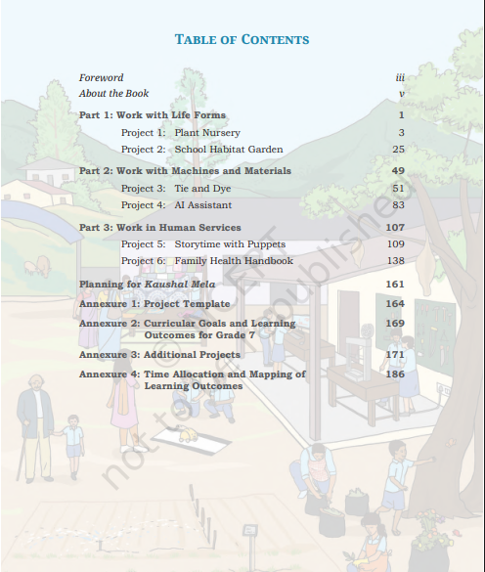
Content of Activity Book “Kaushal Bodh” Grade 7

Slide 41

व्यावसायिक शिक्षा की गतिविधि पुस्तिका
"कौशल बोध"
(कक्षा 7)

Slide 42
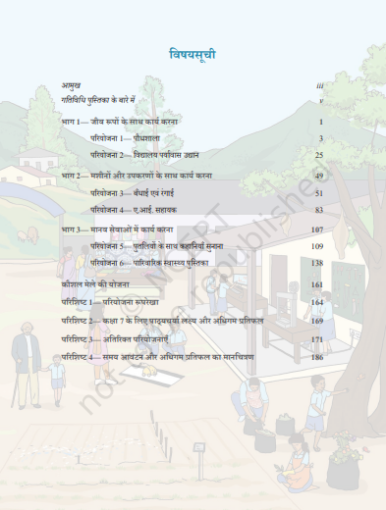
व्यावसायिक शिक्षा की गतिविधि पुस्तिका “कौशल बोध” की विषय-सूची (कक्षा 7)

Slide 43
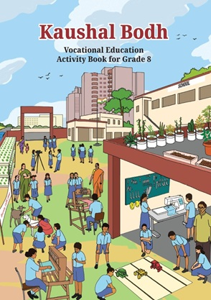
Activity book of Vocational Education “Kaushal Bodh”
(Grade 8)

Slide 44
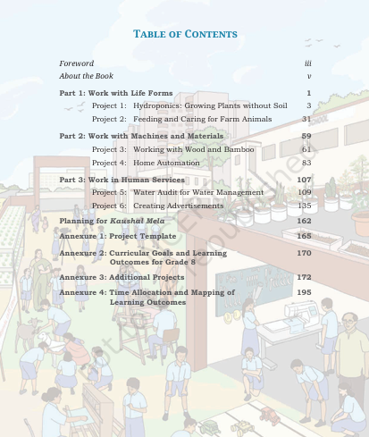
Content of Activity Book
“Kaushal Bodh” (Grade 8)

Slide 45
Websites
Ministry of Education, Government of India
https://www.education.gov.in/
Ministry of Skill Development and Entrepreneurship
https://msde.gov.in/
National Council of Educational Research and Training
https://ncert.nic.in/
PSS Central Institute of Vocational Education
https://psscive.ac.in/

Slide 46

Thank you

