Slide 1
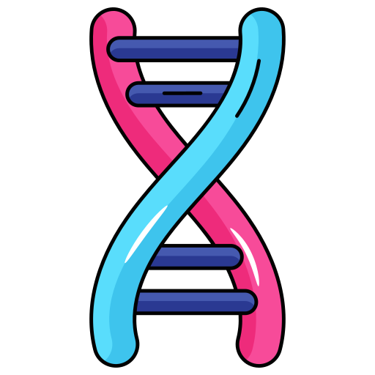

From Data to Diagnosis:
AI in Healthcare
Connected Healthcare, Powered by AI.
Presented by:
Kruthi and Nithila
TCIS Grade 12

Slide 2


INTRODUCTION
AI speeds up diagnosis and analyses medical data efficiently
It predicts health risks early for proactive care.
A centralised platform connects patient records for personalised preventive care.

Slide 3

STORING RECORDS TODAY
Electronic Health Record (EHR) systems allow sharing of patient information across healthcare branches.
Hard to access: Different hospitals have separate record systems.
Physical documents: Difficult to manage.
Repetition: Need to fill in details every visit.

Slide 4

THE AI SOLUTION
Patients create a secure digital health profile.
Hospitals upload patient data to the platform.
AI analyses the medical data to identify patterns and health risks and provides preventive suggestions.

Slide 5

EXAMPLE
A patient visits different hospitals over time.
All records are securely stored and accessible through one unified platform.
The AI identifies early signs of health risks and suggests preventive recommendations.

Slide 6
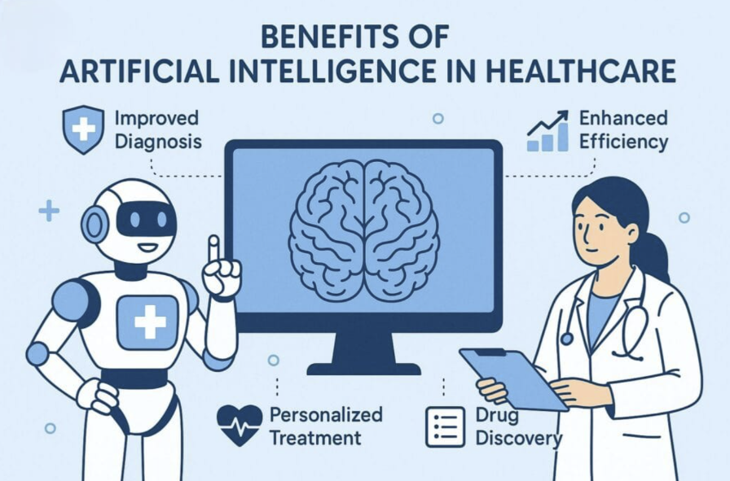
THE BENEFITS
Less time filling forms
Improved healthcare in rural areas.
No need for duplicate medical tests.

Slide 7
CONCERNS AND SOLUTIONS
CONCERNS:
SOLUTIONS:
Unauthorised access to records.
Login authentication.
AI giving inaccurate predictions.
Supervision and continuous training.
Cybersecurity threats and hacking.
Advanced security measures and regular monitoring.

Slide 8
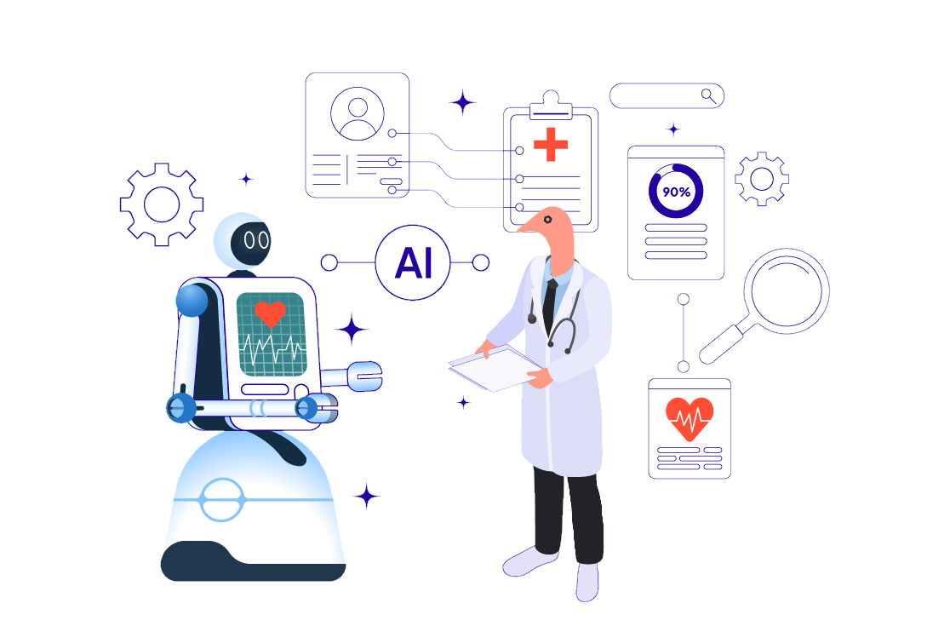
CONCLUSION
To conclude, AI can provide:
Smarter and faster healthcare
Better personal experience
AI-assisted medical decisions
Connected and accessible healthcare systems

Slide 9


Thank You!

