Slide 1
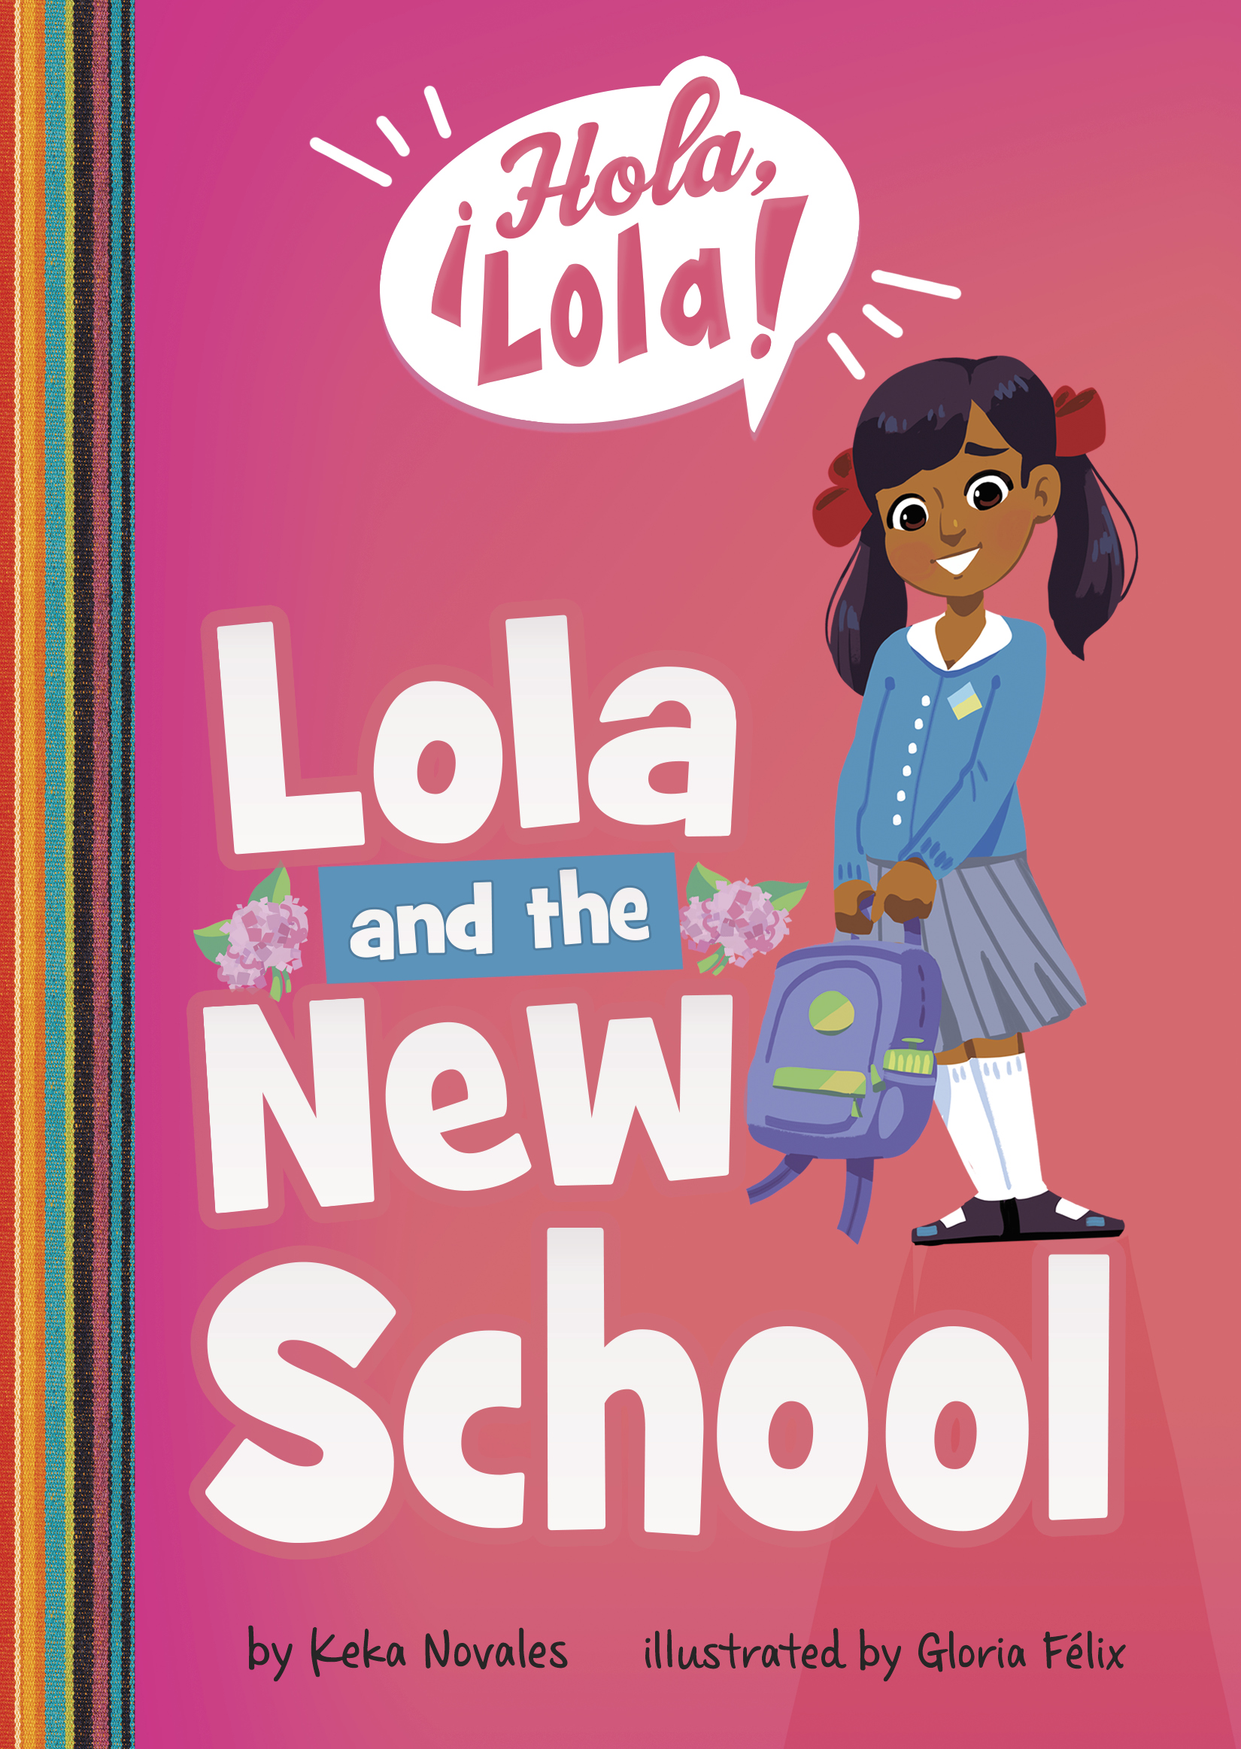
Spanish Glossary
Pronunciation Guide
Guía de Pronunciación en Español

Slide 2
Abuelita- Grandmother
(aab-way-LEE-tah)

Slide 3
Buenas Noches- Good night
(BWEH-nahs NOH-ches)

Slide 4
Canillitas de Leche- Guatemalan milk candy
(KAH-neh-YEE-thas dey LEH-chay)

Slide 5
Colochos de guayaba- Round, guava paste candy covered in sugar
(koh-LOH-choh dey GUAY-ah-vah)

Slide 6
hola- hi or hello
(OH-lah)

Slide 7
La llorona- a legendary figure believed to appear at night (near creeks or bodies or water) and cry for her children
(lah yoh-ROH-nah)

Slide 8
Mija- Spanish for “my daughter” but can also be used as a term of affection meaning “my child,” “dear,” or “honey”
(MEE-HA)

Slide 9
Santo Cielo- an exclamation meaning “my goodness”
(sahn-TOH syeh-loh)

Slide 10
El SombrerÓn- a legendary figure who is short, wears a big hat, and is believed to only appear at night
(ehl sohm-breh-ROHN)

Slide 11
Te amo- I love you
(the AH-moh)

Slide 12
For more resources
visit www.kekanovales.com

