Slide 1
EMDR Protocols
Christy Stewart, LAC

Slide 2


Blind Therapist
A
Purpose of protocol
Similarities and Differences
Summary

Slide 3
Purpose of Blind Therapist
“The blind to therapist (B2T) protocol (Blore & Holmshaw, 2009a, 2009b) was devised to circumvent client unwillingness to describe traumatic memory content during eye movement desensitization and reprocessing (EMDR).

Slide 4






It can be & has been used on the following clinical presentations:
Minimizing potential for vicarious traumatization
Reassertion of control among “executive decision makers”
​
Shame and embarrassment
​
Cultural issues: avoiding distress being witnessed by a fellow countryman
Need for the presence of a translator versus prevention of information “leakage”
Reducing potential stalling in processing: client with severe stammer
Notes:
https://www.emdria.org/resource/the-development-and-uses-of-the-blind-to-therapist-emdr-protocol/

Slide 5
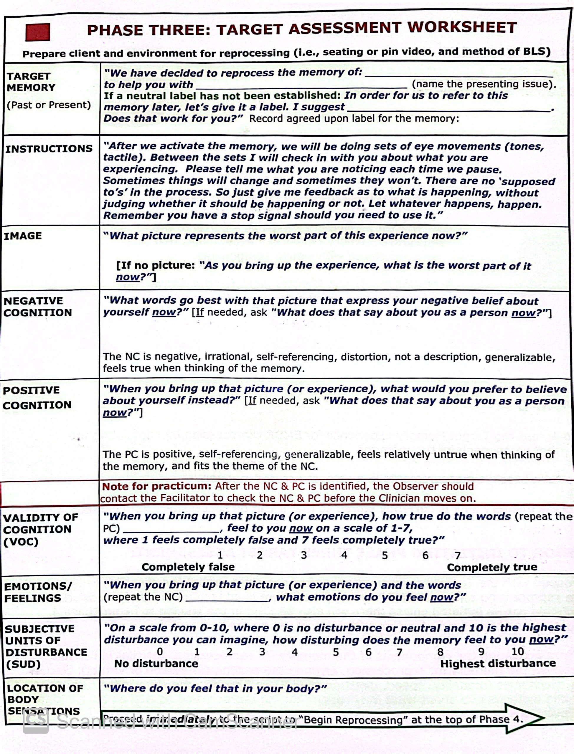
Differences in Phase 3
• Target images can be labelled “A,” “B,” “C,” and so forth rather than identified as per normal Phase 3 requirements.
“Think about the picture that represents the worst part of this experience…Let me know when you finished,”
Or “tell me when you have it.”
***If struggling to hold image in mind, “What are afraid would happen if we got in touch with the memory?”

Slide 6
Phase 4- Desensitization
Similar to EMD Script

Slide 7
Script
“Bring up the picture (or worst part), those negative words (repeat NC), and begin a set of eye movements (12-20 repetitions or shorter of fast BLS in order to limit associations)
After each set, “Let it go, take a breath…Is anything changing?” (don’t ask what the client is noticing now. Emphasize that you just want to know if anything is changing; new memories, emotions growing or decreasing in intensity, new insights, etc. Not looking for details or specifics.)
If changing, say “Good. Focus on that.”
If not changing, take SUDS, and then suggest client zoom into the scene or focus on any of the 5 senses one at a time, or try parts work with ‘the part of you that is preventing you from accessing this memory’ and then continue with BLS.
It is possible client can be disarmed by asking them, “If you could be anywhere else right now, where would you be?” Then quickly refer back to target by saying, “Now bring up your target ___(fill in blank)___, notice what you’re feeling and where you feel it as you start your bi-laterals.”

Slide 8
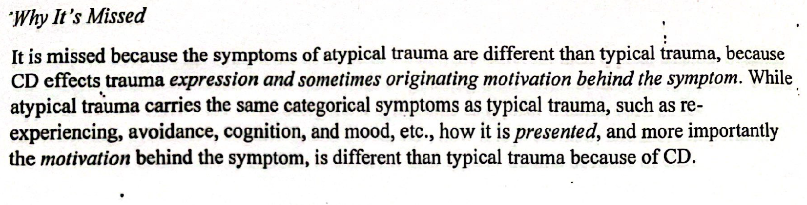
Atypical trauma: https://d.docs.live.net/cee24533646549dd/Desktop/PLR/atypical%20trauma.pdf

Slide 9
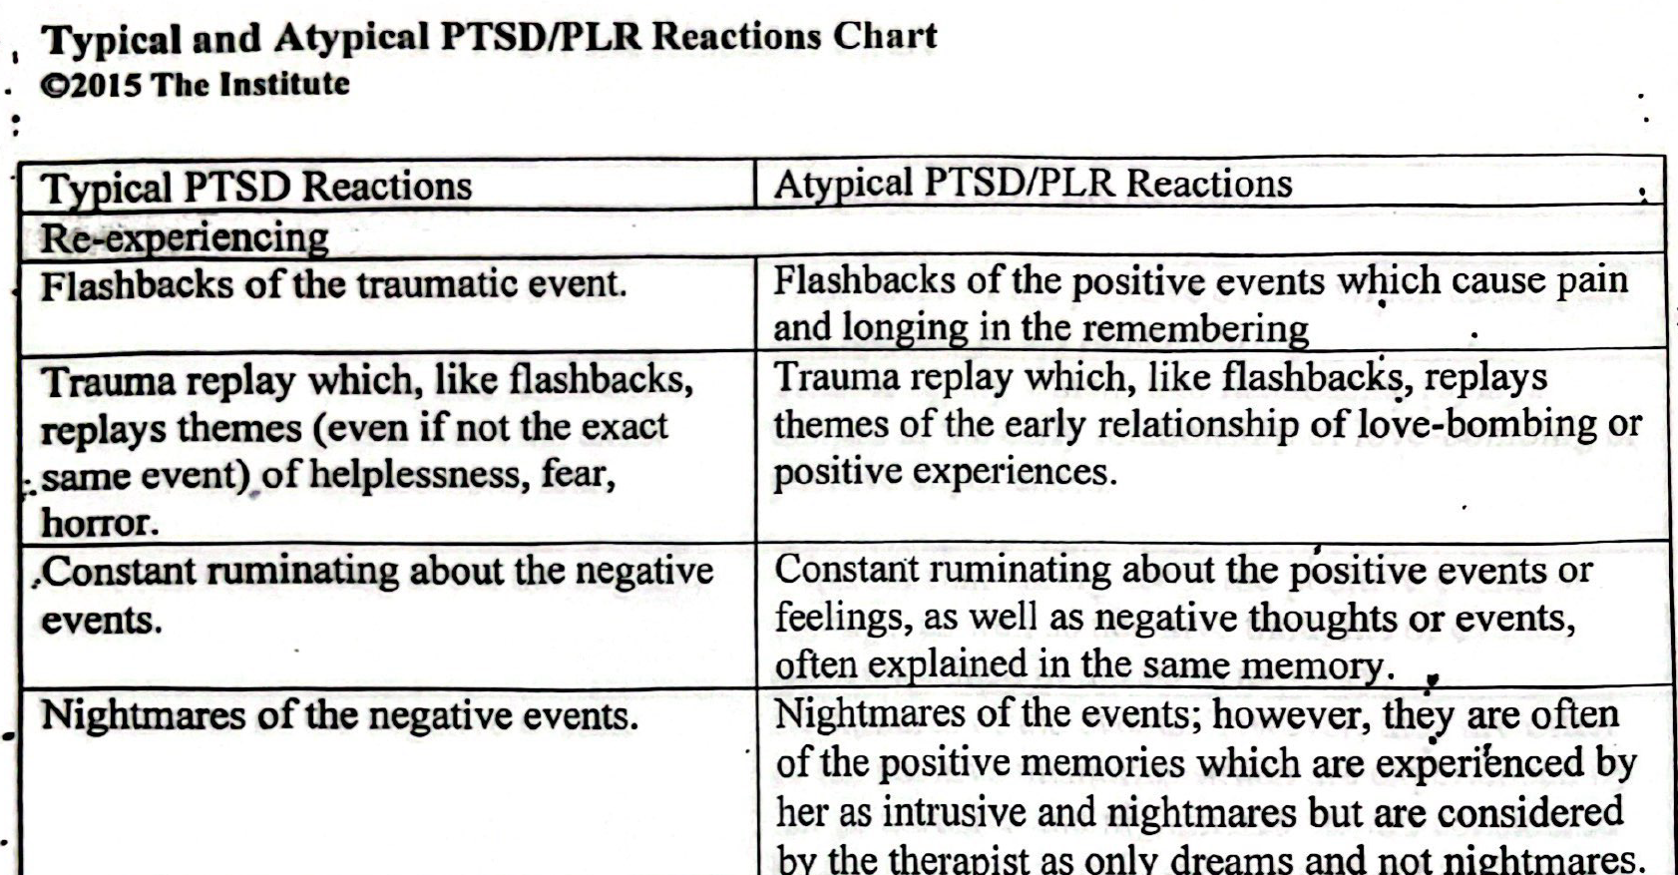

Slide 10
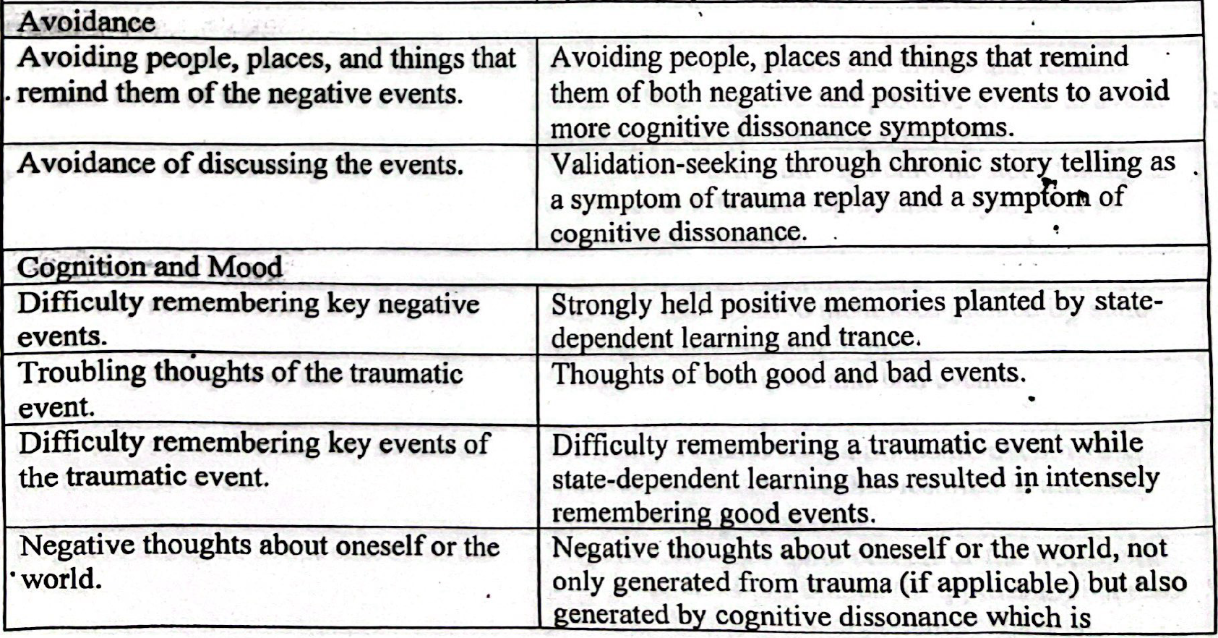
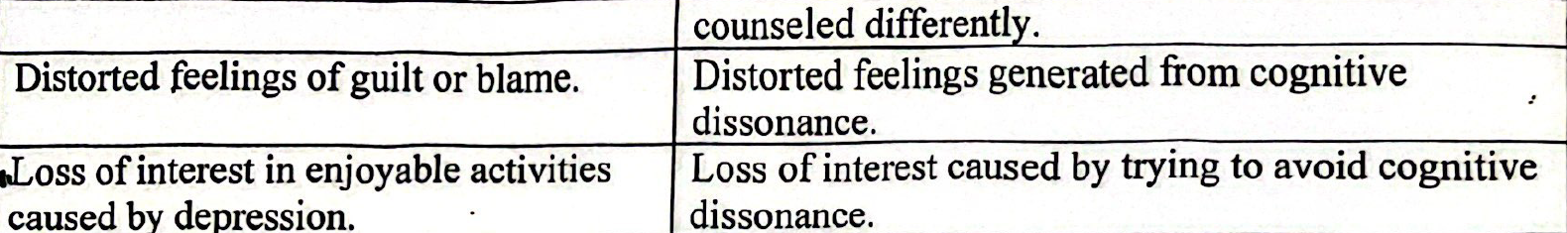

Slide 11
Plan for Phase 3
What would you like to believe about yourself when you think of this target? *then proceed with phases as normal.
“What part represents the best part of this experience now?”
Positive Cognition
What words go best with that picture that represents the positive belief you have about your partner, or the experience, or your relationship now (this idea brings pain/distress).”
VOC
“On a scale of 1-7, 1 being false and 7 being completely true, how true do those words feel when held together with the memory now?”
***Looking for VOC to go down to 1.
*for example, “I will never find love again.” NC or
Installation
Negative/realistic Cognition
Image
“I am not loved by Bob.”
Work to get SUDS to 0 before going to installation phase.

Slide 12
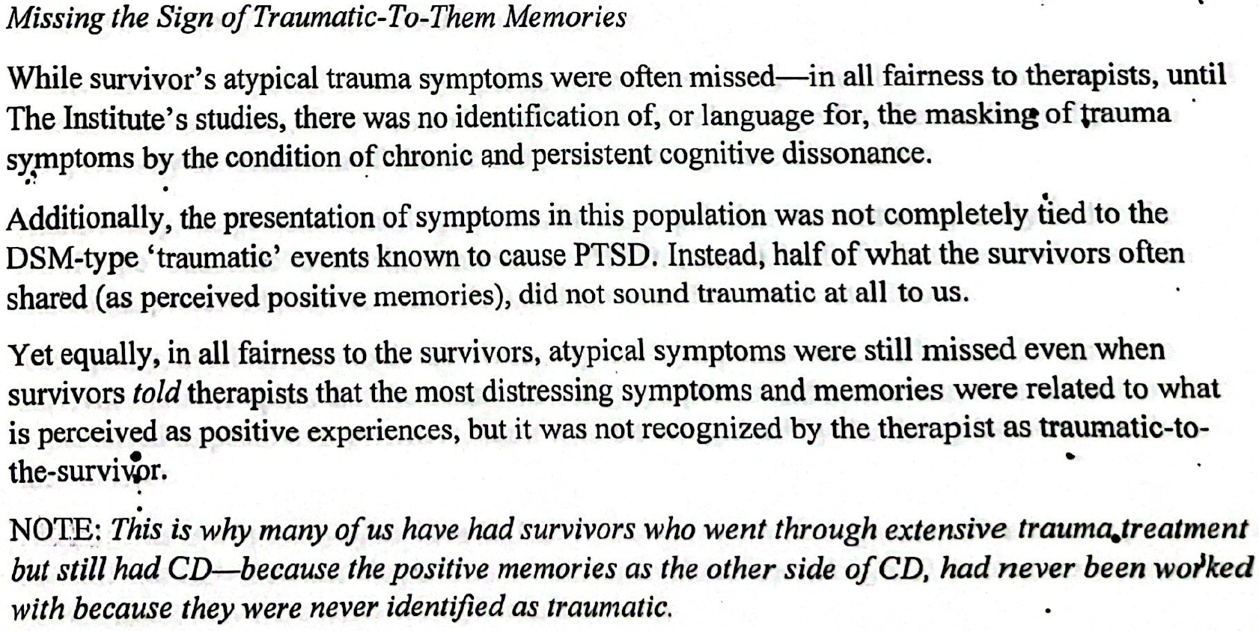
Summary

