Slide 1
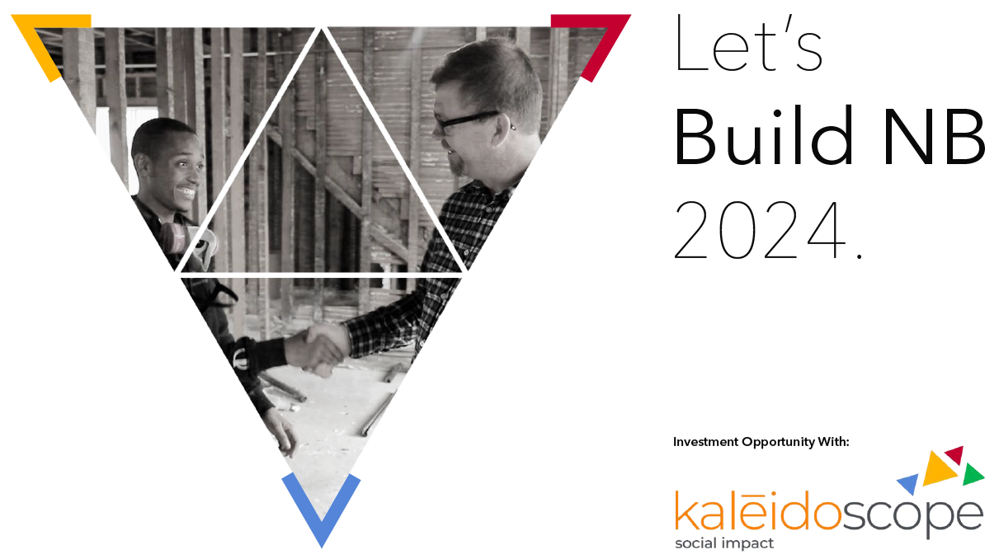

Slide 2
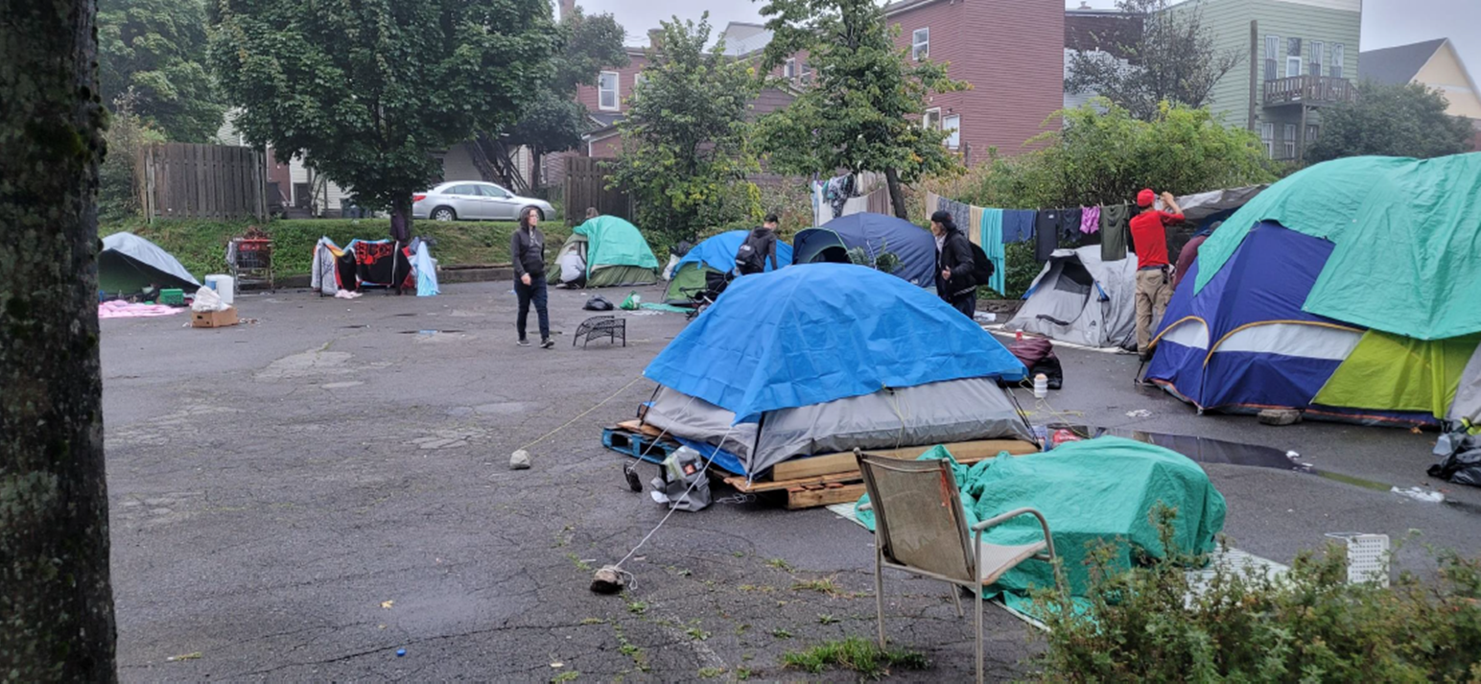
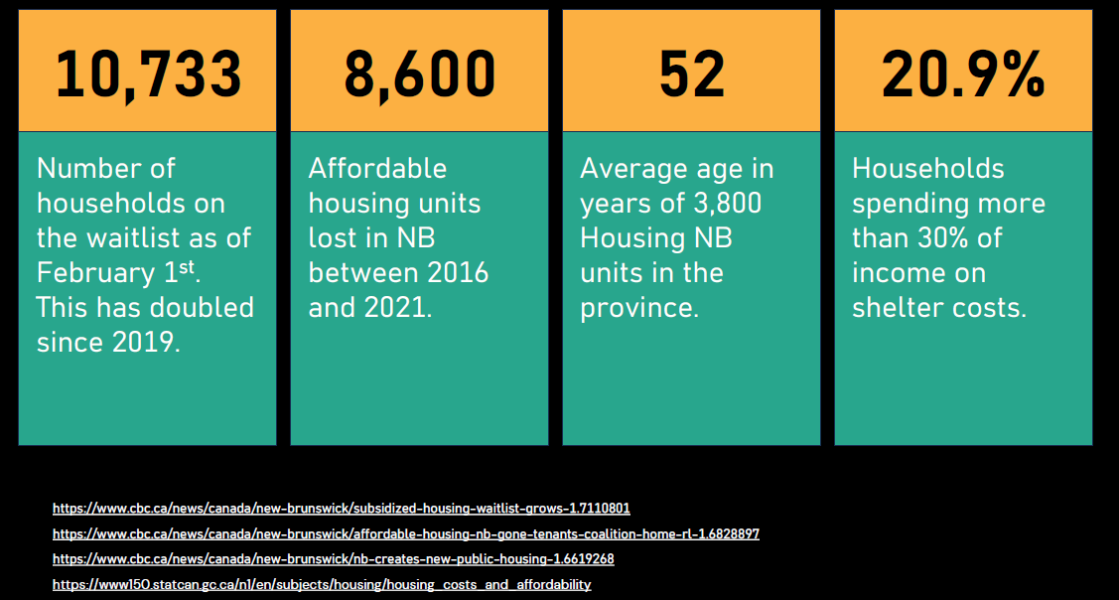


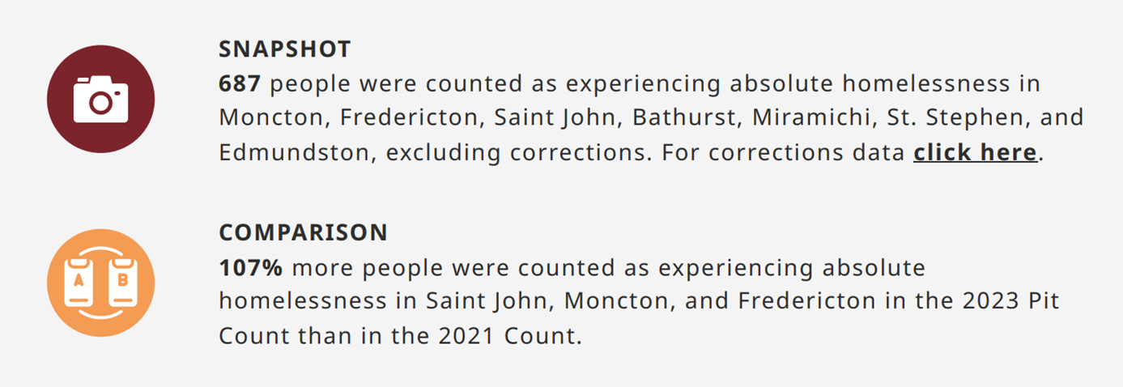
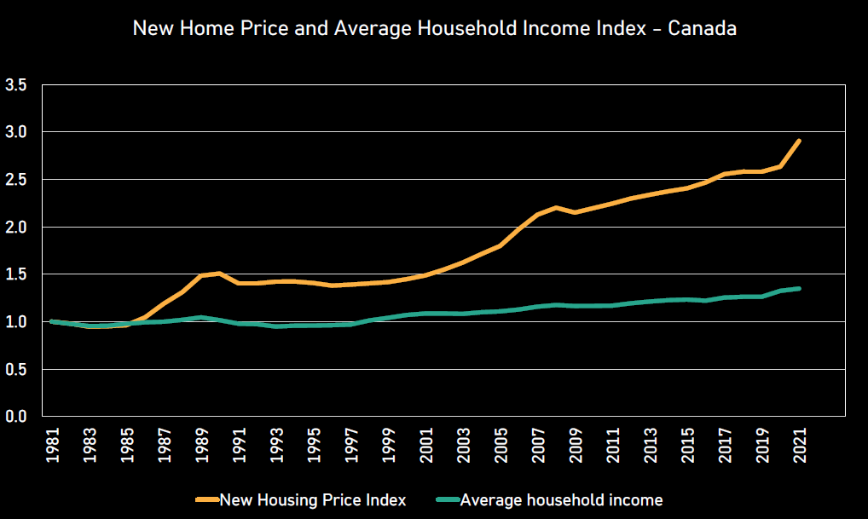
Tables, graphs and information from Human Development Council and NBPHA 2024

Slide 3
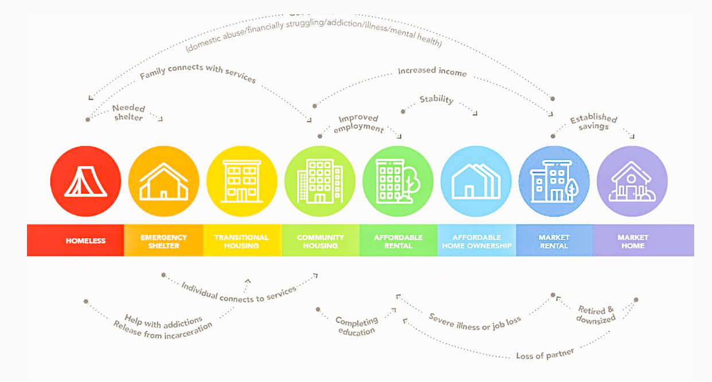
Graph from United Way Halifax

Slide 4

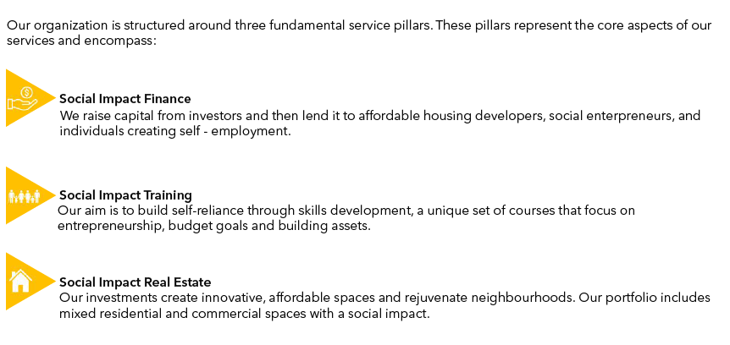
Kaléidoscope Social Impact – what we do

Slide 5
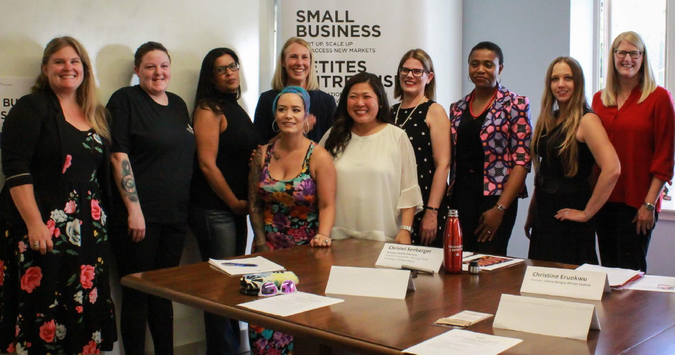
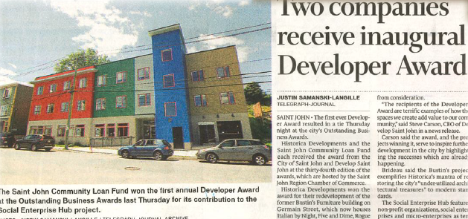
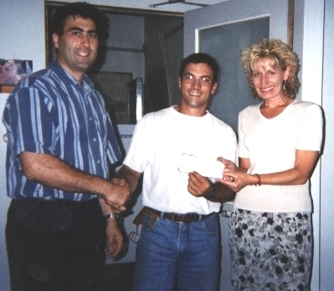

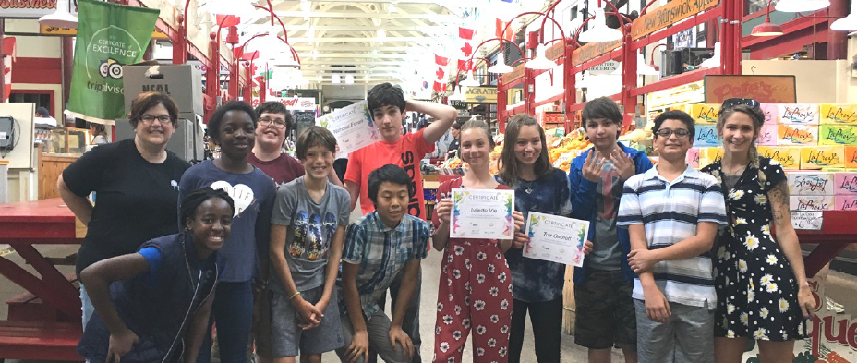
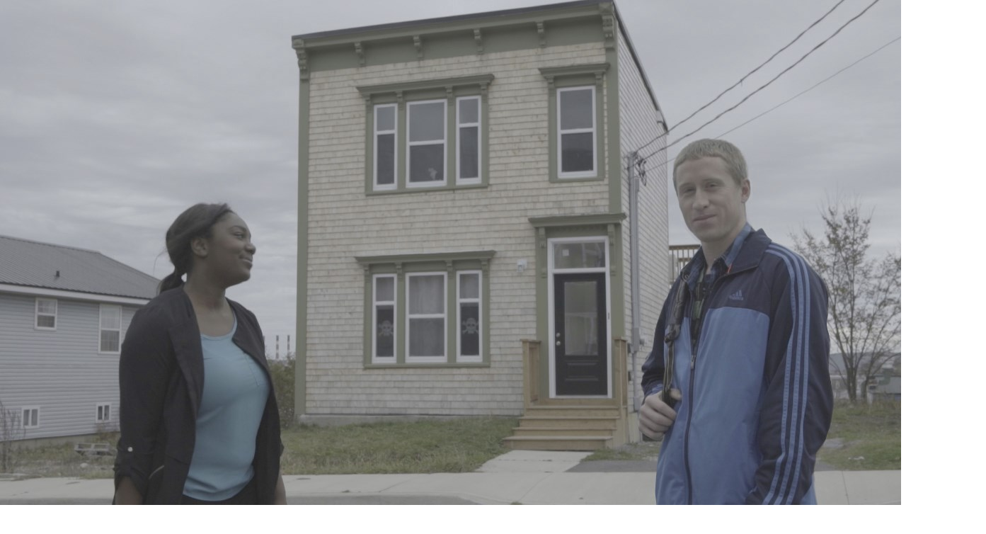
Timeline
Notes:
We have grown from a small community loan fund to a dynamic organization that manages multiple major activities. It is this kaleidoscope of people, ideas, and outcomes that gave us our new name: Kaléidoscope Social Impact.

Slide 6
Property acquisition
Pre-construction
Construction
Average loan is $200K
Nimble
Often first in
Bridge to take out by other lenders
Leverages other financing
Can sit 2nd or 3rd
KSI financing

Slide 7
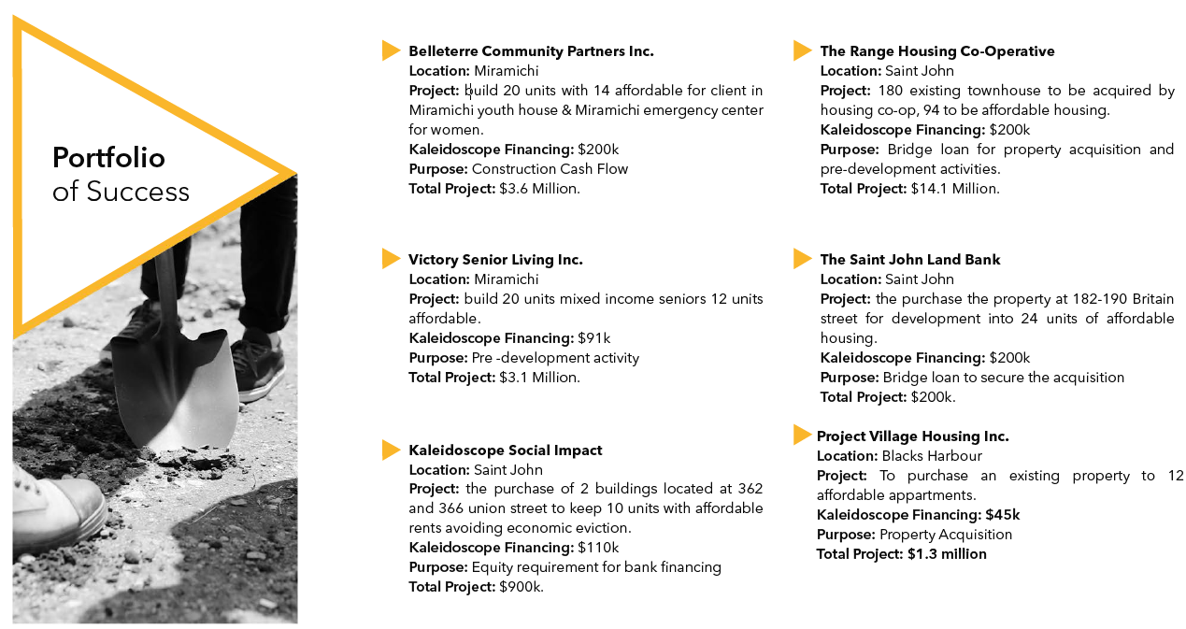
“We appreciate that in addition to providing right-in-time ﬁnancing, the Kaléidoscope team, as developers themselves, understand the challenges and complexities projects face.”
Matt Rouleau
Director of Development – Project Village Housing
Member of the Board – Belleterre Developments

Slide 8
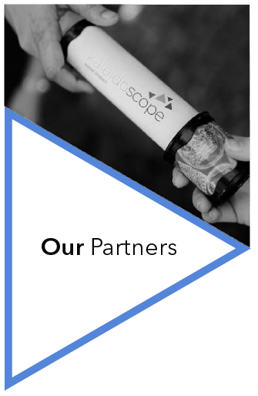
Development Partners
NB Housing Hub: The Housing Hub was created as part of the NB Housing Strategy. They will be supporting developers in rural areas with pre-development work, and therefore supporting our pipeline.
NB Non-Profit Housing Association: KSI is a member of the NBPHA which is an important connector to the whole non-profit housing ecosystem. They provide important data on assets held, market rents by region, and developer capacity.
IKAR Holdings Corp: As a new architectural firm and innovator, IKAR provides an important view to what can be done with design.
Belleterre Developments: Belleterre is a very well vertically integrated developer who we have worked with on three projects now. We see them as one of the key developers in NB.
Freshwinds Coop: Freshwinds is a new coop but with veterans at the helm. It is an important model and we want to make sure we are involved with non-profit and cooperative models.
Village Housing: Another innovator, Village Housing is part of a community development exercise in Blacks Harbour, which is integrating housing, shared EVs, alternative energy and food security.
Rehabitat: Working with Rehabitat allows us to focus on the rehabilitation of existing structures, breathing new life into communities and preserving historical integrity, especially in the Saint John region.
Financial Partners
Canada Mortgage and Housing Corporation (CMHC): As Canada's national housing agency, CMHC is a pivotal partner, providing essential support and resources that help drive affordable housing development in NB.
NB Housing Corporation: NB Housing supplies generally the other stack of financing required for projects, including the AHRP and the rental supplement program.
Omista Credit Union: Omista has come in on a couple of deals and as a community financial institution, we have mission alignment.
Bayview Credit Union: Another financial ally, Bayview Credit Union holds all of our banking assets, as well as being involved in other deals we finance.
New Market Funds: NM Funds is a national partner bringing in other housing-focused capital. They are knowledgeable and mission-aligned as well. We will do more projects with New Market.
Partnerships, spanning from governmental bodies to financial institutions, developers, and housing associations, empower us to execute our mission with greater efficacy and impact. They enhance our capability to create inclusive, sustainable housing solutions and drive social change through collective action and shared expertise to address the housing shortage. As a small province, we are on a first-name basis with the key people in all of these organizations. We also have access to MPs, MLAs Ministers, and the Premier. This adds value to what we can accomplish.

Slide 9
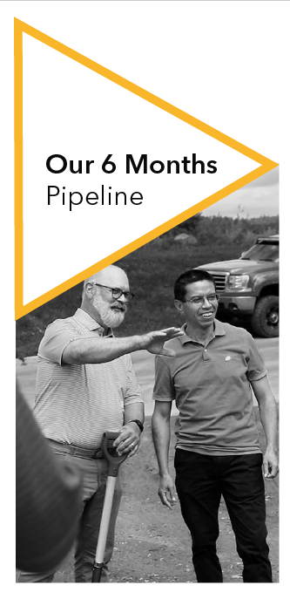
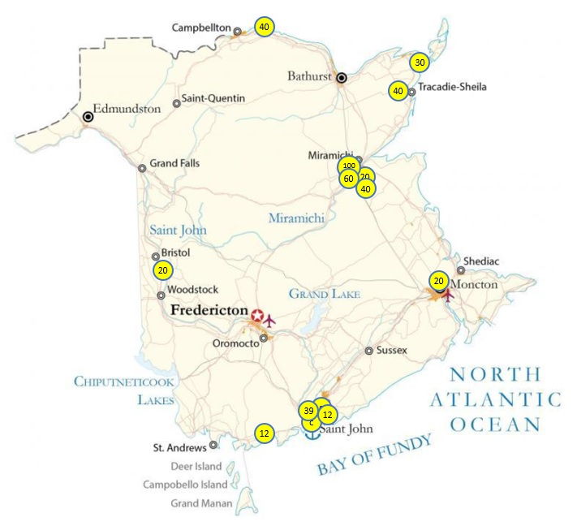
Projects Across NB
Our 9-Month Pipeline
At March 2024
Pipeline Characteristics
Loan requests - $4.4 million
Projects - 12 housing, 2 commercial non-profit
Units – 433 with 60% affordable
NPOs / Sq Footage – 9 NPOs with 20,000 sq ft
Project value - $106.9 million
Leverage - 24 x

Slide 10
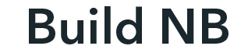
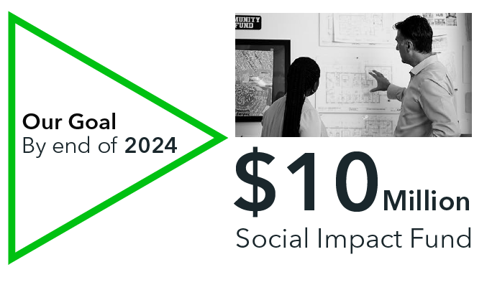
The rationale for focusing on housing
Loss of housing units due to rising costs:
The past five years have seen a significant decline in New Brunswick’s (NB) free market affordable housing inventory, as demand from immigration has enabled landlords to increase rents. In that period, NB lost 8,000 affordable units, those renting for under $1,000 per month.
Increase waiting lists for subsidized housing:
The sharp contrast between the demand for and the supply of subsidized housing is highlighted by the 11,000 individuals on waiting lists. This indicates not only the scarcity of affordable options but also points to systemic issues that need to be addressed through multiple means: legislation (rent control), increased capital subsidies and rent subsidies, increased investment in trades, and innovation in housing design.
Visibility of homelessness:
The emergence of tent encampments in urban areas, sheltering more than 700 people, is a clear and visible sign of a housing emergency. These temporary settlements are symptomatic of a broader societal issue that requires immediate and sustainable action.
Developer needs:
Developers are faced with major financing gaps. One, banks, credit unions, and government do not provide financing for property acquisition and only a portion of pre-development. Two, once a project is approved by the government, and often there are at least two levels of government, the developer will wait for a couple of months for financing to start, and generally it is based on reimbursement of expenses. Three, due to holdbacks, as the project progresses, cash flow becomes an issue. Kaléidoscope provides this property acquisition, pre-development, and construction bridge financing.
A minimum of 95% of our funds will be put towards financing affordable housing and the development of spaces that will support non-profit organizations. This strategic focus is designed to fulfill the desperate need for affordable housing and to enhance the capacity of non-profits to serve communities effectively.
* Our current percentage is 80% housing to 20% enterprise, which is changing monthly as loans continue to be made for housing projects.

Slide 11

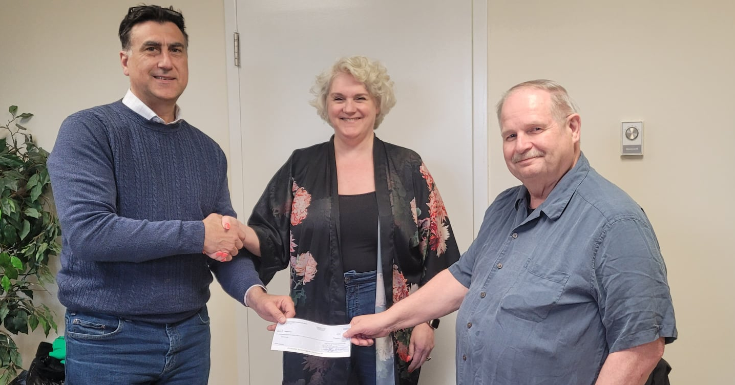
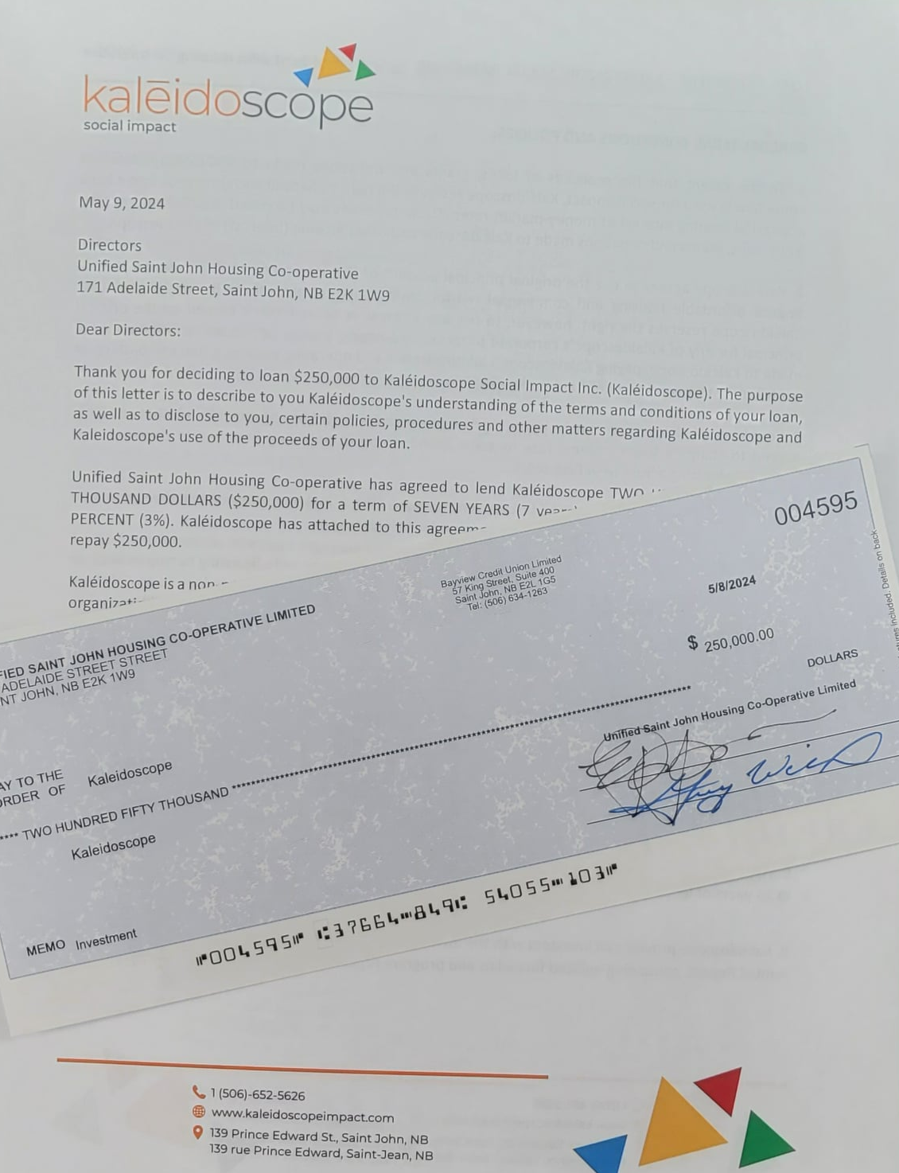
Members investing in members
Money invested is already tagged to support two projects in NB

Slide 12
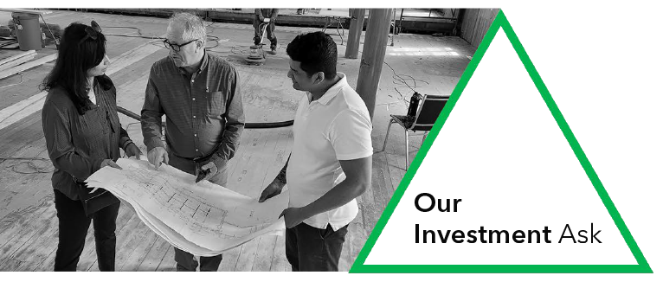
Our Investment Offering
Term: 7-year standard
Interest Rate and the Blend: we are looking to blend out at an average of 3.5%, so we can have higher and lower rates
Interest Payment Structure: Interest on the loan will be paid annually, rather than compounded and paid out at term.
Shared Risk: we ensure equitable treatment of investors. This means no single investor bears precedence over another. (in 25 years, no investor has lost money)
Loan agreement: the deal is formalized with a loan agreement and promissory note.

Slide 13
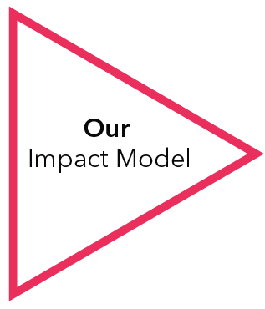
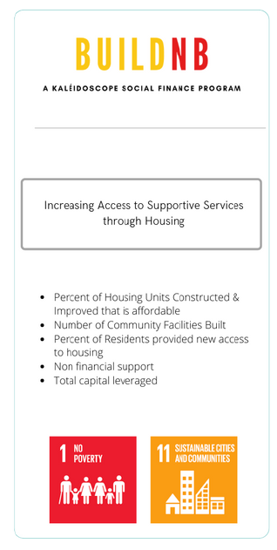
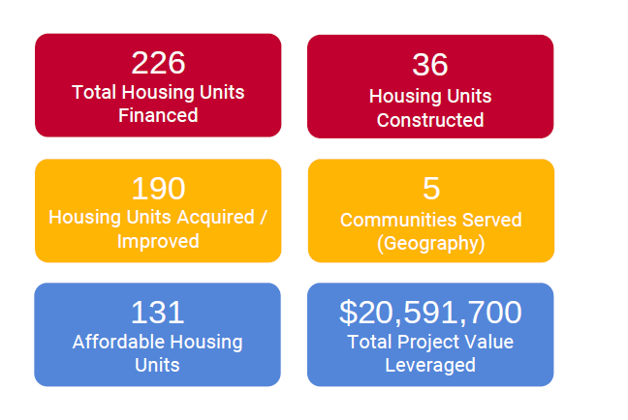
Outcome Goals
Key IRIS+
Indicators
What we report to our investors.
UN Sustainable Development Goals

Slide 14
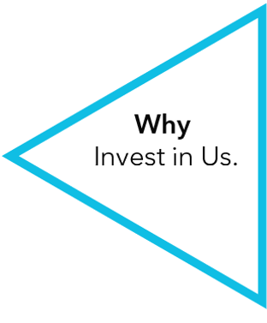

Why an investment in KSI makes sense.
100% of your investment is based in NB.
It is managed here, and goes to work here.
We have a 25 year track record of community investment.
We have 15 years experience as a developer.
We report twice a year to investors using a robust impact methodology.
Overall, the KSI Fund offers a compelling investment opportunity for those seeking both financial returns and social impact. Its holistic approach, experienced team, diverse financing strategies, and proven track record set it apart in the field of social finance and real estate development.
Notes:
Why an investment in KSI makes sense.
Extensive Lending Track Record: KSI has made close to 350 loans, all to help people and organizations, create income and build assets that foster self-reliance and community well-being. Its ability to work across the continuum of needs and opportunities is unmatched in the region. Its financing has been diverse, from individual micro-enterprises to social enterprises and housing projects developed and managed by organizations. It has used equity, revenue-based financing, balloon payments, and many more variations to assist the borrower in achieving success.
Real Estate Development Experience: Kaleidoscope began to develop real estate in 2009, accumulating 14 years of experience in property acquisition, renovation, new construction, and property management. Like its lending, it has never been boxed into any one type of project as long as the project helped create affordable housing and or catalyze community building. One of its projects provided at-risk youth to learn carpentry skills as they gutted and developed two affordable housing units. It built the Social Enterprise Hub, a 15,000 sq ft commercial building that houses enterprising non-profits, and social and microenterprises. It currently is building 51 units of affordable housing and renovating a 150-year-old church for a creative maker space.
Staff and Committee Expertise: The staff of KSI have extensive experience in housing development and have support from others in the field through their skilled volunteer committee and board members. They include individuals with MCIP designation, CPAs, MBAs, and masters in urban and rural development. Their experience is deep and extensive in housing and community economic development. (Please see data room for staff and volunteer CVs/bios)
Robust Reporting and Impact Framework: KSI's commitment to tracking outcomes using recognized indicators (IRIS, SDGs) and employing software for managing and reporting outcomes ensures transparency and accountability. Annual reporting, including audited financial statements and impact reports, adds credibility. (Please refer to framework)
Unique, Stable and Compelling Offering: KSI's combination of real estate development and lending experiences is distinctive, providing a comprehensive approach to social impact that few others in the Atlantic Region can replicate. Weathering various economic cycles and consistently delivering without any investor losses over two decades speaks volumes about their stability, adaptability, and ability to maximize impact.
Overall, the KSI Fund offers a compelling investment opportunity for those seeking both financial returns and social impact. Its holistic approach, experienced team, diverse financing strategies, and proven track record set it apart in the field of social finance and real estate development.

Slide 15
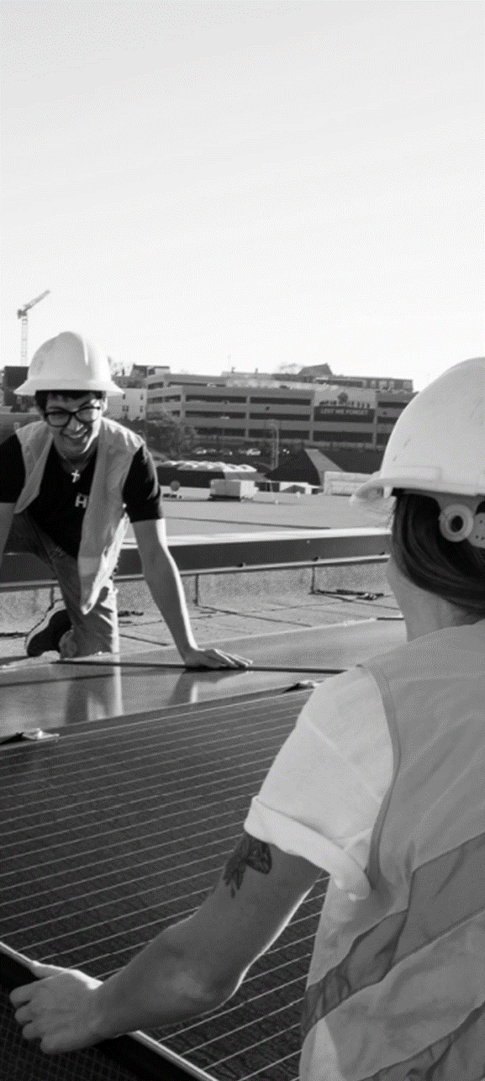

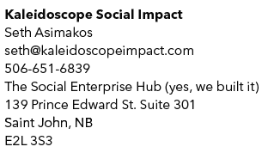
We can provide additional information.
Incorporation, By-Laws, Letters Patent
Annual Reports, Impact Report, Video
Board and Staff Bios and CVs
Financial Model, Financial Statements
Agreements – Investor and Loan
Investor Pipeline
Loan Policies and Manuals
Loans – Current and Pipeline
Supporting documents

Slide 16
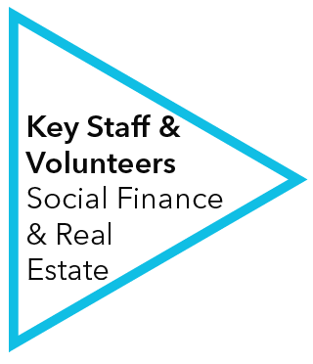
Seth Asimakos, BA, MSc
Co-Founder and CEO
Seth meets with the SF Team weekly to review the portfolio, discuss new applications, the capital available and the pipeline. He reviews final packages and signs off on agreements.
Guillermo Marroquin, B. Com, MSc, MBA
Financial & Project Analyst
Guillermo receives and conducts due diligence on all incoming applications for BUILD NB, as well as supports the SF Team with enterprise applications.
Peggy Thompson
Social Finance Associate and Office Manager Peggy receives all non-housing applications, carries out due diligence processes all loan payments, and data entry and supports the SF Team.
Ray Hachey
Property Maintenance Manager
Ray supports the SF Team with his knowledge and experience in property management. He is brought into discuss new developments, manages our smaller renovation projects, and ensures preventive maintenance on our properties.
Diane Snelgrove, BA
Enterprising Women Coordinator
Diane provides support to enterprise-related loan applicants as they prepare for financing, both in Enterprising Women class and one-on-one.
Melissa Leighton, CPA, CA
Co-Founder of B and L Financial Services
Melissa is our CFO, who meets with our Treasurer Greg Powell, CPA, and Seth weekly to review AP. She also works to reconcile the loan portfolio with Peggy monthly and produces our monthly financial statements.
George Karaphillis, MBA
Retired Dean of the Business School at UCB
George Chairs our Loan Committee, bringing 50 years of
experience in community economic development, investment funds, and community-owned property.
Jody Kliffer, MCIP, MA
Envision Real Estate Development Manager
Jody sits on our Loan Committee, bringing a decade of experience in planning and development from the City of SJ and the SJ Land Bank.
Doyin Somorin, MSc., MBA
Manager of Integration and Retention at Ignite Fredericton
Doyin sits on the Loan Committee bringing her experience
with newcomers and an EDI lens to the table.
Ebenezer Ajibade, MBA
President Phenomenal Difference Consulting
Ebenezer sits on the Loan Committee, bringing his experience in business analytics with both small and large enterprises.

Slide 17
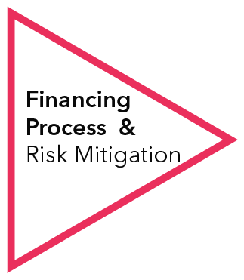
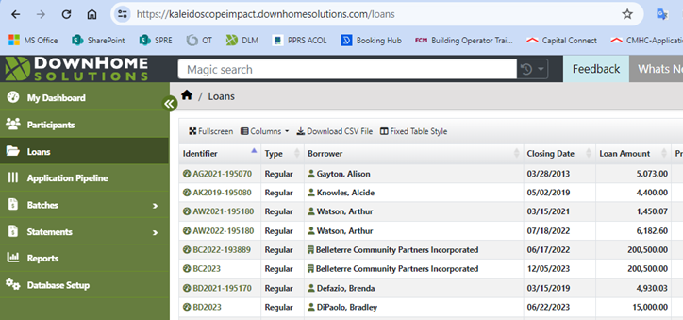
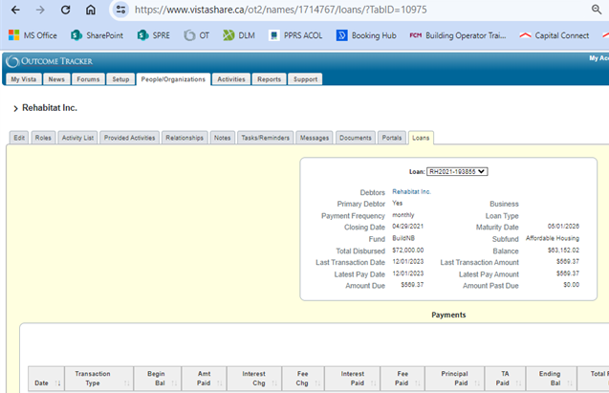
The Loan Process
Staff take inquiries and facilitate the application and due diligence process
Applicants are inputted into the client and loan management software (see below)
Due diligence is carried out to confirm the business case, financials, and financing partners
The CEO is consulted before the final package and recommendation is sent to the committee
The applicant meets with the committee, who then make a decision
The committee, when making a positive decision, also confirms the loan terms
Once the committee decision is delivered, staff build the agreement and have it executed
Loans may be disbursed in full or based on milestones
Any housing loans are secured on the land title; for enterprise loans, up to a 30% reserve is set aside
Individuals are followed up monthly or quarterly depending on the project timeline
Loan payments are made via automatic withdrawal using Payment Stream Software via Credit Union
Weekly Social Finance Team meetings to review the portfolio (payments, reserve, aftercare), applications, pipeline, and capital
(For more information on the loan process, you can review our loan policies and loan manuals)
Down Home Solutions
Loan management software
Outcome Tracker
Client Management Software

