Slide 1

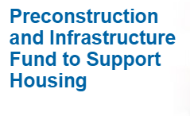
RDC funding to support housing
Alexis Hutchison-Tripp
Regional Development Corporation (RDC)
September 16, 2024

Slide 2
Overview
Preconstruction and Infrastructure Fund to Support Housing program overview
Other funding programs
Q & A

Slide 3
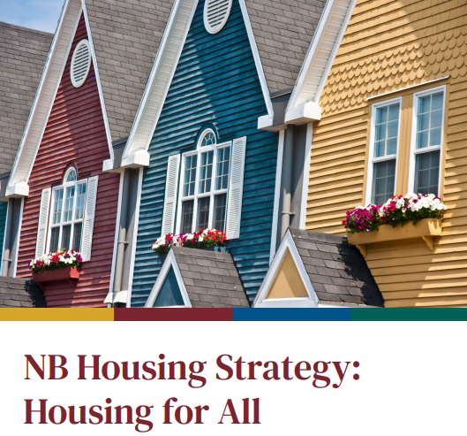
Background
Announced as part of the NB Housing Strategy: Housing for All
Goal: Create the conditions to increase the number of housing developments in the province and create more safe and affordable housing for New Brunswickers.
Approach consistent with RDC Development funds

Slide 4
RDC funding contribution
Up to 75 %
Recipient required to contribute a minimum of 10 %
Unused funding does not automatically carry-over to the next fiscal year

Slide 5
Preconstruction funding stream
For upfront project work necessary to demonstrate the viability of a proposed housing development and to secure financing for the construction and operation phases
Eligible expenses
  Feasibility studies, business cases, assessments, strategies, etc.
  Engineering and architectural work, from project conception to tender documents
  Obtaining permits
  Legal work directly related to the project
Eligible applicants
  Non-profit incorporated organizations, local governments, First Nations, & regional service commissions

Slide 6
Small community housing infrastructure funding stream
Available to small communities with a population of less than 25,000 to assist with the costs associated with building or enhancing core infrastructure to service new housing developments
Eligible expenses
  Capital construction of new core infrastructure (e.g., water, wastewater, roads, etc.) that directly support the construction of new housing developments
Eligible applicants
  Local governments (<25,000 residents), First Nations, not-for-profit organizations providing infrastructure necessary to enable housing development
Funding will be provided to the owner of the asset

Slide 7
Assessment criteria
Project benefits
Project viability
Project sustainability
Applicant viability
Applicant capacity
Alignment with NB Housing Strategy
How will this project help your community meet its housing needs?
Role of private developer (if any) must be clearly communicated.

Slide 8
Ineligible expenditures
Ineligible expenditures
Cost of land
Reduction of deficits or the retirement of debts;
Fundraising campaigns
Operating costs (including wages and salaries)
In-kind contributions
See program guideline for full list

Slide 9
Preconstruction and Infrastructure Fund to Support Housing - Summary
Funding stream | Eligible recipients | RDC financial contribution | Annual budget*
Preconstruction | •Not-for-profit incorporated organizations •Local governments •First Nations •Region Service Commissions | •Up to 75% •Minimum recipient contribution of 10 % | $2,500,000
Small community infrastructure to support housing | •Not-for-profit incorporated organizations Local governments (<25,000 residents) •First Nations | •Up to 75% •Minimum recipient contribution of 10 % | $20,000,000
*Your project may also be eligible under other RDC funding programs

Slide 10
RDC Regional
Contacts
Regional Service Commission | Regional Officer
1 – Northwest | Éric Dubé
2 – Restigouche | Francisca DeGrace
3 – Chaleur | Francisca DeGrace
4 – Péninsule | Francisca DeGrace
5 – Miramichi | Alexis Hutchison Tripp
6 – Kent | Gilles Cormier
7 – Southeast | Gilles Cormier
8 – Sussex | Francine Scott
9 – Fundy | Francine Scott
10 – Charlotte | Francine Scott
11 – Capital | Alexis Hutchison Tripp
12 – Western | Éric Dubé

Slide 11

Scott.Lloy@gnb.ca
(506) 476-1473
Submit applications to:
RDC-SDR@gnb.ca
or
contact your Regional Officer

