Slide 1
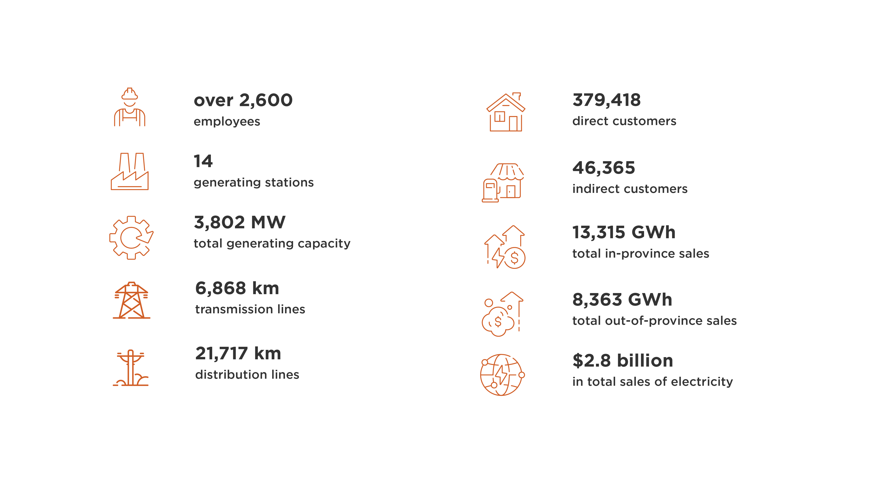

Slide 2


OUR VISION
We enhance lives by providing
clean, competitive and reliable energy solutions.
OUR MISSION
We are passionate and committed to offering the best customer experience, ensuring energy security and accelerating a sustainable clean energy transition.

Slide 3




OUR VALUES
Safety at Heart
We are committed to the safety of every employee and member of the public through
• planning safety into the work • reporting so we can all get better
• following the rules • having courage
• being a leader in safety • saying no to unsafe work
Care for our Team
We care for our team. We are open, honest and transparent with each other to build trust. We embrace diversity, creating an inclusive culture that supports employee well-being, encourages continuous learning and drives high performance.
Care for our Customers
We care for our customers. We put their experience at the centre of everything we do.
We are committed to delivering relevant and valuable solutions. We act with integrity and
do what we say we are going to do.
Care for our Future
We care for our future. We work with customers and communities to explore and deliver on their evolving energy needs while being environmentally responsible for future generations. We are curious and open to new ways of working.

Slide 4






ENERGIZING OUR FUTURE
TRANSITION
MODERNIZE
ELECTRIFY
COMPETE
THRIVE
ORGANIZE

Slide 5
Collaboration with NB Non-Profit Housing Groups
Relationship building with NBNPHA & NB Housing Corporation
Non-Profit Housing Organization webpage on saveenergynb.ca
Attending events

Slide 6
2023 Summary - Special Offers
509 units received free Commercial Building Retrofit Program audits
26 Business Rebate Program participants received incentives of 50%
28 buildings received free Total Home Energy Savings Program free audits

Slide 7
Overview of NB Power's Energy Efficiency Programs

Slide 8
Agenda
Why Energy Efficiency?
Energy Management 101
Why NB Power?
Residential Energy Efficiency Programs
Business Energy Efficiency Programs
2024 Special Offer
Questions

Slide 9
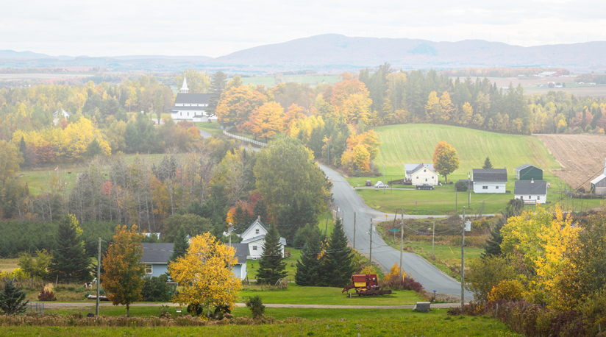
Why Energy Efficiency?

Slide 10
Benefits of Energy Efficiency
Financial savings
Improves comfort
Increases productivity
Stimulates the economy
Create jobs
Lessons our impact on the Environment
Reduces Green House Gas Emissions
Defers the need to build new generation
Keep rates low and stable (avoided costs).

Slide 11



ENERGY EFFICIENCY IS A WIN ● WIN ● WIN
for New Brunswick, the Environment and OUR economy
Since 2015, New Brunswickers have invested in energy efficiency and:
Saved
$773 million
in lifetime energy costs.
Reduced
Greenhouse gas emissions equivalent to taking 166,186 cars off the road for a year!
Invested
$519.5 million
in the local economy!
As of December 31, 2023.
Notes:
(Speaker – Industrial)
Energy Efficiency is WIN WIN WIN for New Brunswickers, the Environment, and our Economy

Slide 12
Energy Management 101

Slide 13
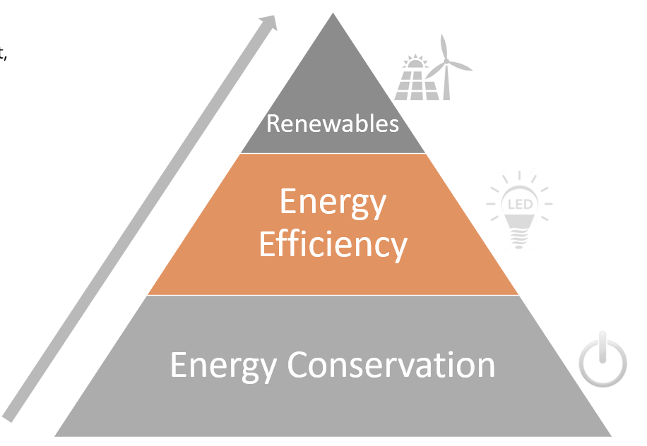
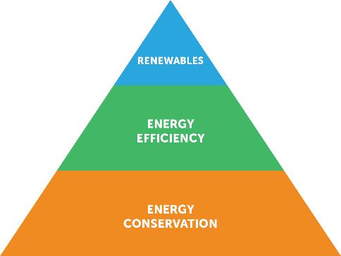
ENERGY EFFICIENCY PROGRAM GOALS
Work with Non-Profit Housing Organizations to help navigate energy efficiency programs
Reduce energy consumption
Save on maintenance costs
Help sites achieve sustainability goals
Create a healthier, safer, and more comfortable spaces
Notes:
(Speaker – Industrial)
Energy management is more important than ever before as we transition to a low carbon economy. That means energy efficiency is the most important tool to minimize environmental impact while maximizing productivity and profit.
Benefits of Energy Efficiency measures
Financial savings
Improves comfort
Increases productivity
Stimulates the economy
Create jobs
Lessons our impact on the Environment
Reduces Greenhouse Gas Emissions
Defers the need to build new generation

Slide 14
Why NB Power?

Slide 15
Energy Efficiency is a cornerstone of NB Power’s commitment to a vision of sustainable electricity.
And to being our customers’ partner of choice.
Energy efficiency promotes the efficient use of energy in our customer’s homes and businesses.

Slide 16

  NB Power; Delivery agent for energy efficiency programs in New Brunswick
    deliver programs for all fuels
    provide access to incentives for all sectors
    Increase awareness and access to incentives

Slide 17
Energy Efficiency Programs
Since 2015 NB Power has been delivering Energy Efficiency Programs to all New Brunswick communities.
And Since April 2018, these program have included incentives for all energy fuel types, not just electricity

Slide 18
Residential Energy Efficiency Programs

Slide 19
Total Home Energy Savings Program
The Total Home Energy Savings Program offers money back on efficiency upgrades on everything from insulation and air-sealing to high efficiency central heating systems to windows, doors, and more.
  Lower your energy bills
  Increase comfort
  Help the environment
Retrofit existing houses
All New Brunswickers, all fuels
Two audit process, purchase/install upgrades after the initial energy evaluation

Slide 20

Residential Buildings
Single family homes (includes duplexes and townhouses)
Smaller apartment buildings: No more than 3 stories high having a footprint of not more than 6458 ft² (600m²)
Includes a Home Energy Assessment (HOT 2000, CMHC compliant)
Incentives for building envelope, windows, doors, heating systems

Slide 21
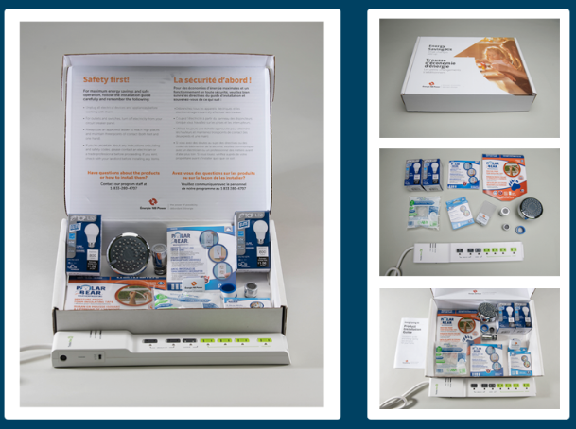
Community Outreach Program
The Community Outreach Program traditionally works with non-profit, community organizations to help their clients save money and become more comfortable with low-cost, energy efficient products.
The kits contain EE products, installation instructions, and other energy efficiency tips.

Slide 22
Business Energy Efficiency Programs

Slide 23
Every Business is Different!
That's why our programs are designed to work for you.
Whether upgrading refrigeration, lighting, heating systems, or optimizing energy use on the production line…we’re here to help you identify eligible projects.
Start reducing costs today with energy efficient upgrades.

Slide 24
Commercial Building Retrofit Program
Here are some examples of eligible entities:
Nursing Homes
Motels
Hotels
Campgrounds
Golf courses
Restaurants
Take-out restaurants
Large apartment buildings

Slide 25
Commercial Building Retrofit Program
Get up to $1.25 Million back for energy saving upgrades!
  Projects that save energy and result in a reduction in greenhouse gas emissions are eligible for an incentive.
Some project examples include:
    Renewable Energy {Wind, Solar}
    Insulation/Air Sealing, Windows and Doors
    HVAC {RTU’s, PTAC’s and various heat pumps}
    Building Management Control Systems
    Commercial Kitchen/Laundry Equipment
    Commercial Refrigeration Equipment {walk in coolers/freezers, reach in coolers/freezers}
    Interior and exterior lighting
    Pools
    Elevators
  Get up to $1.25 Million back for energy saving upgrades! Get up to $1.25 for energy saving upgrades!

Slide 26
Business Rebate Program
  A rebate program that caters to all Commercial and Industrial businesses.
  This new program provides simple, accessible product rebates that do not require an audit or feasibility study.
  This new incentive stream will complement the existing Commercial Buildings Retrofit Program in that it provides an option for simple, stand-alone efficiency measures.

Slide 27
Business Rebate Program
Participants can get 25% of eligible project costs up to $250,000.00.
Examples of some eligible product categories:
      Commercial Laundry Equipment
      Commercial Kitchen Equipment
      Commercial/Industrial Refrigeration Equipment
      HVAC
      LED Lighting and Controls
      Motors

Slide 28

NEW CONSTRUCTION,
COMMERCIAL AND INDUSTRIAL
Program launched summer 2023
Up to $250,000 per building
Paths include:
  NECB 2020 Energy Modelling
  Part 9 Residential Buildings
Notes:
(Speaker – New Construction)

Slide 29
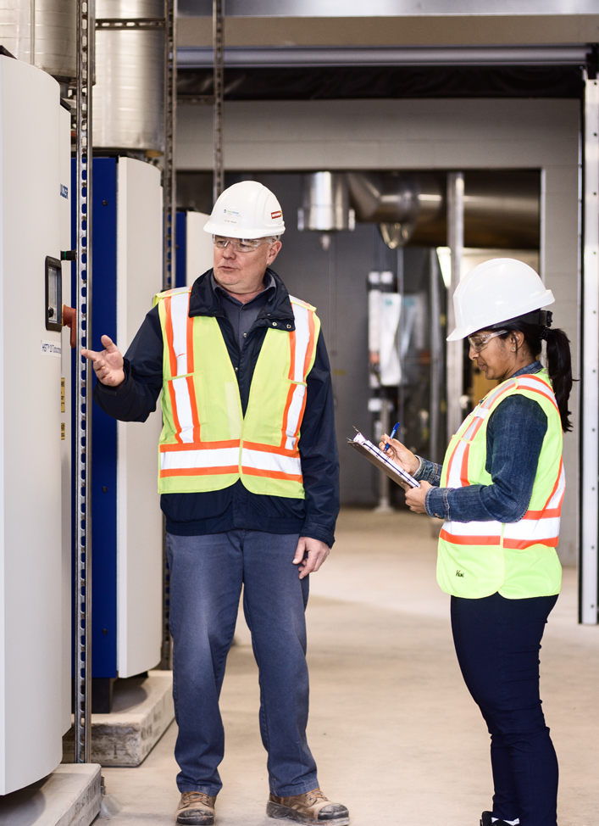
Eligible Building Types
Business and institutional buildings
Not-for-profit buildings
First Nations buildings
This can include:
A new structure
A new addition to an existing structure
Renovations that include replacement of all systems impacting energy consumption
--------
The following projects are not eligible to participate in the NCCI program:
Residential projects eligible for the New Home Energy Savings Program
Federal, Provincial and Municipal buildings

Slide 30

NEW CONSTRUCTION,
COMMERCIAL AND INDUSTRIAL
NCCI@nbpower.com
Notes:
(Speaker – New Construction)

Slide 31
Special offer 2024
Non-Profit Housing Organizations are invited to consider a special offer of larger incentives of up to 50% through the Business Rebate Program
Deadline February 7th, 2025

Slide 32
QUESTIONS?
NPH-LSBL@NBPOWER.COM

