Slide 1


Peter Corbyn, P.Eng.
New Brunswick
Non-Profit Housing Association
April 9, 2024

Slide 2









Slide 3
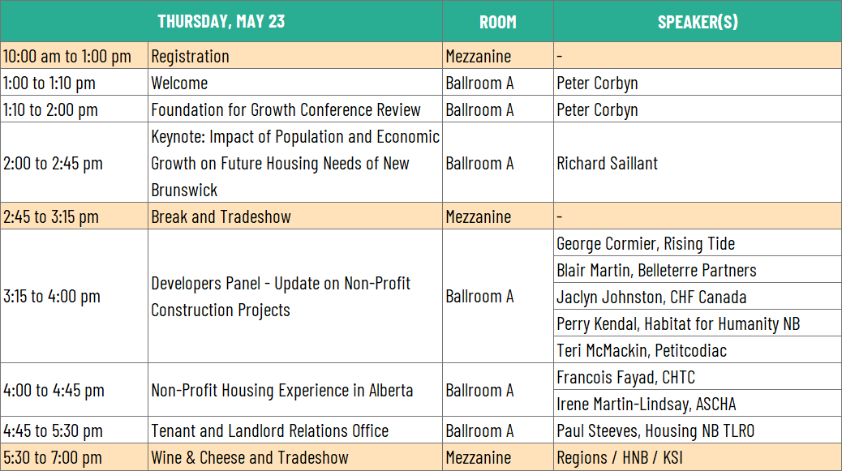

Slide 4
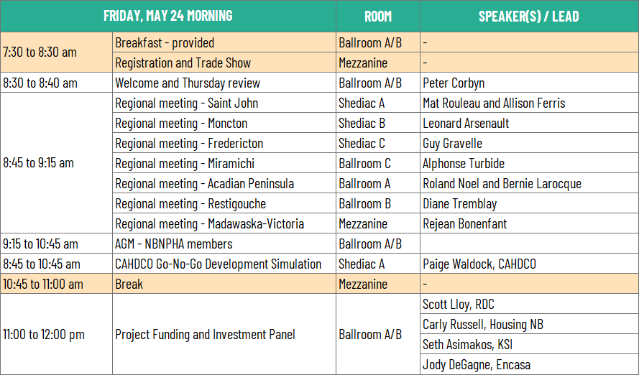

Slide 5

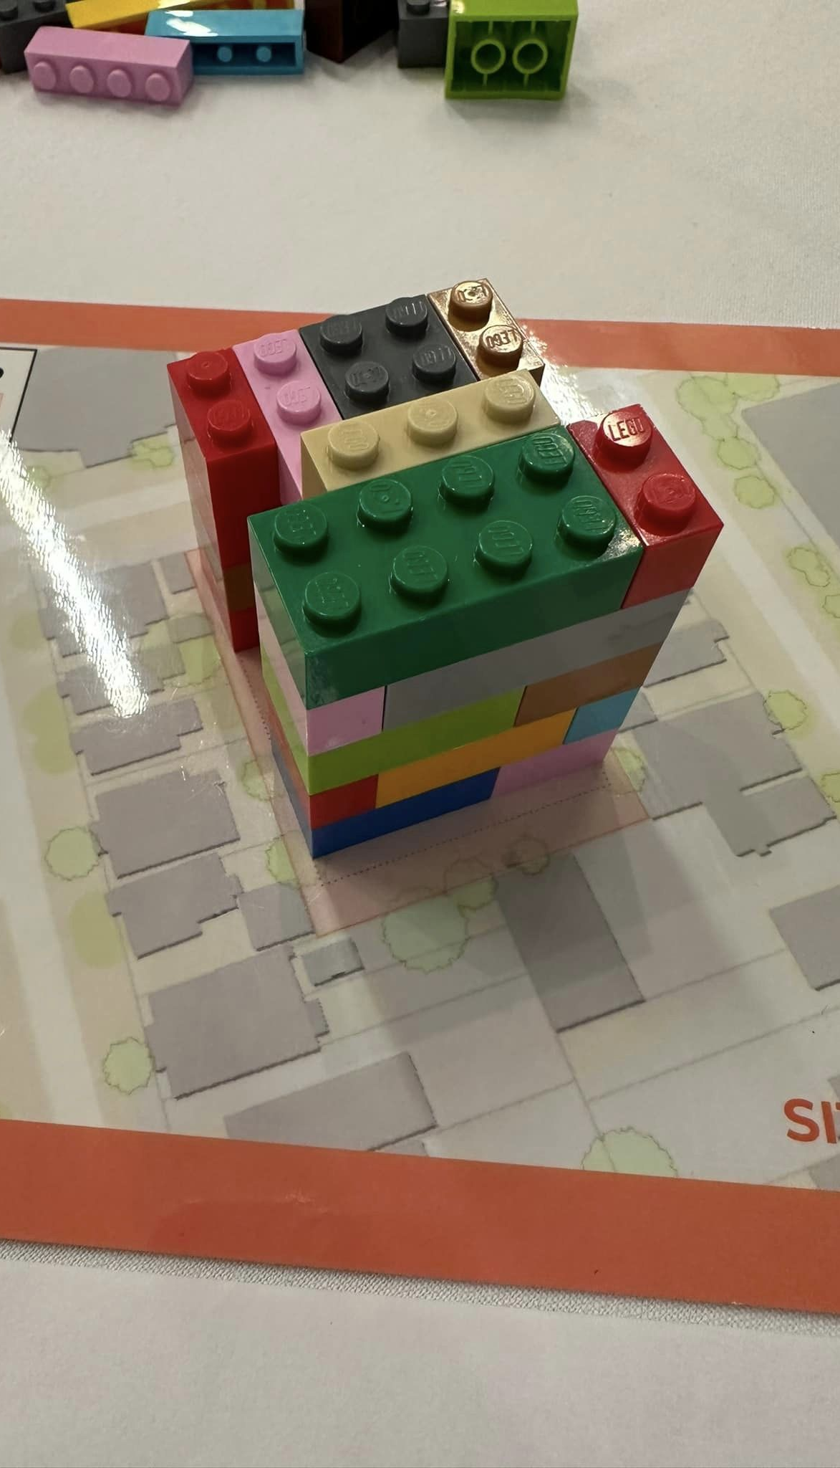
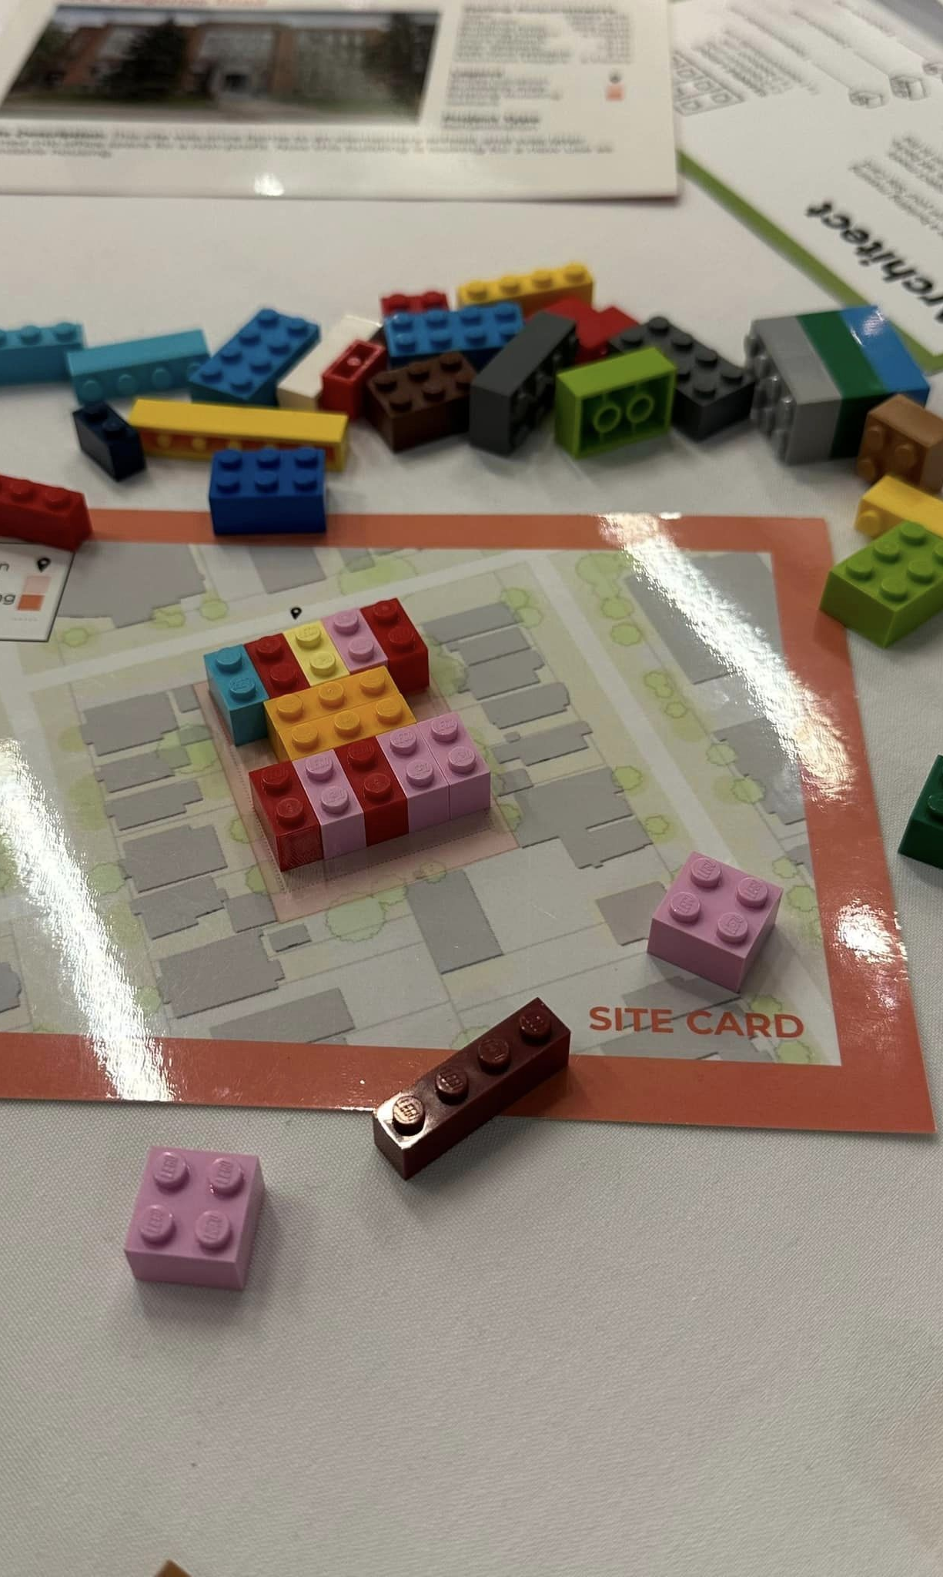

Slide 6
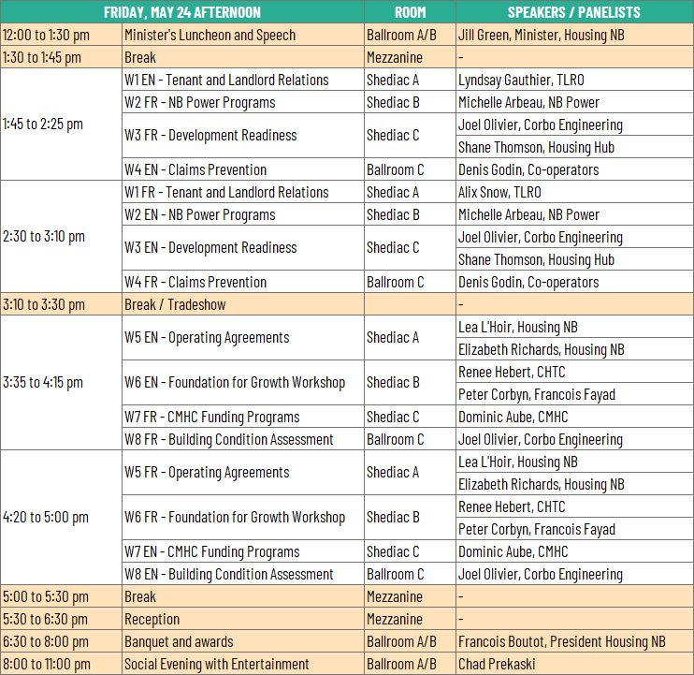

Slide 7
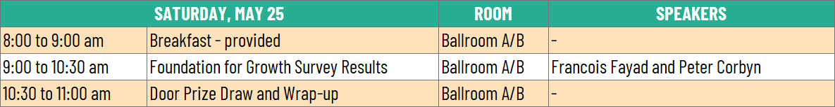
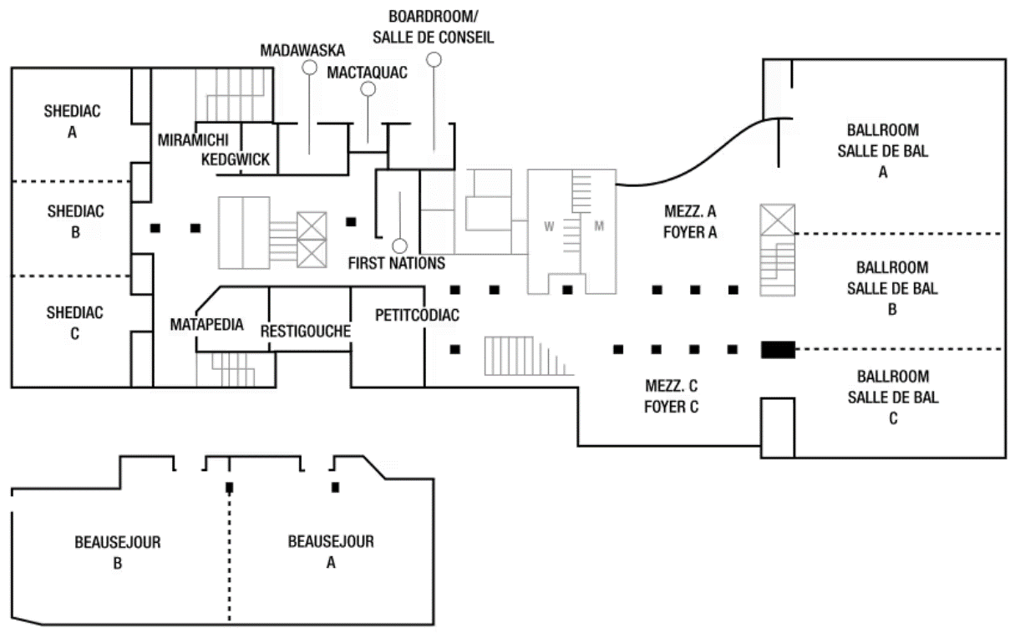
MADAWASKA-VICTORIA
SAINT JOHN
ACADIAN PENINSULA
MONCTON
RESTIGOUCHE
FREDERICTON
MIRAMICHI

