Slide 1
Risk Management 101
NBNPHA 2023
Chris Davey
Co-operators Insurance
Risk Specialist

Slide 2

Table of Contents:
What is Risk Management?
What's in it for me?
Fire, smoking, emergency exits, fire plan, Smoke detectors
Water prevention and early detection
Liability – outside, inside
Weather related losses, how to be better prepared
Appliances – maintenance requirements
  Washer
  Dryer
  Dishwasher
  Fridge
  Air conditioner

Slide 3
What is Risk Management?
The process of identifying, assessing, and controlling both financial and physical risk.
So, what does that mean??
  Finding dangerous areas on your property that can either hurt someone, cost money to fix, or be lost forever.

Slide 4
What’s in it for me?
It is making your organization a safer place to live, for both the homes and communities
There will be fewer accidents and injuries will happen.
You can potentially to avoid catastrophic losses.
You can reduce amounts of insurance claims, that in turn can help save on their insurance premium.
It can enable growth within the coop
It will help budget planning on required maintenance and upkeep.
It will help the board with prioritizing their property and financial risk needs

Slide 5
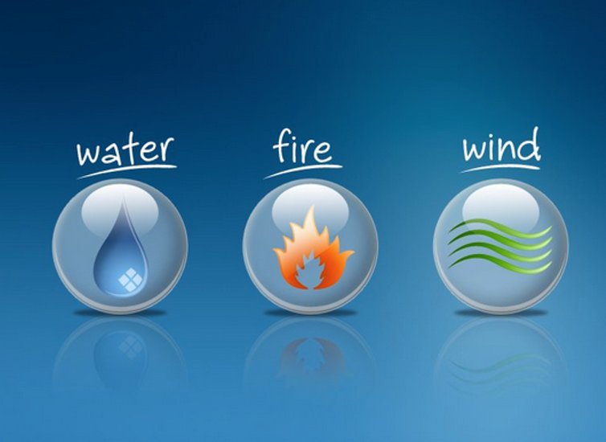
What is the cause of your losses?

Slide 6
Fire Safety
Fire is FAST! There is little time!
In less than 30 seconds a small flame can get completely out of control and turn into a major fire. It only takes minutes for thick black smoke to fill a house. In minutes, a house can be engulfed in flames. Most fires occur in the home when people are asleep. If you wake up to a fire, you won't have time to grab valuables because fire spreads too quickly and the smoke is too thick. There is minimal time to escape, you need to be ready.

Slide 7
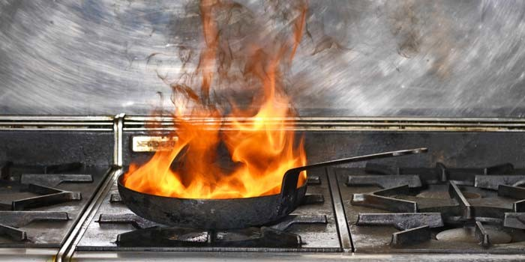
Fire – where can it start?
Smoking related materials
Kitchen Cooking
Electrical faults, including the use of extension cords
Temporary heaters
Arson

Slide 8

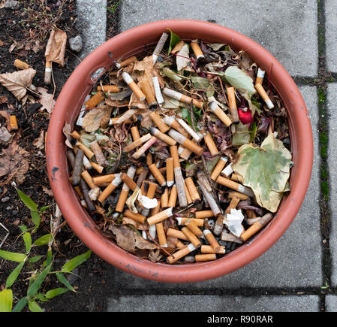

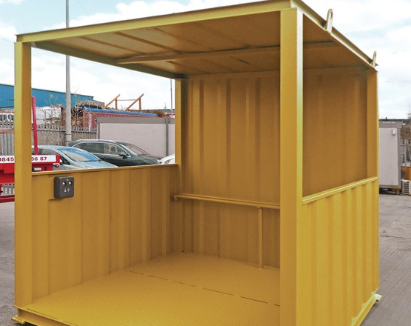
Smoking Related Materials
Smoking related materials
Kitchen Cooking
Electrical faults, including the use of extension cords
Temporary heaters
Arson

Slide 9
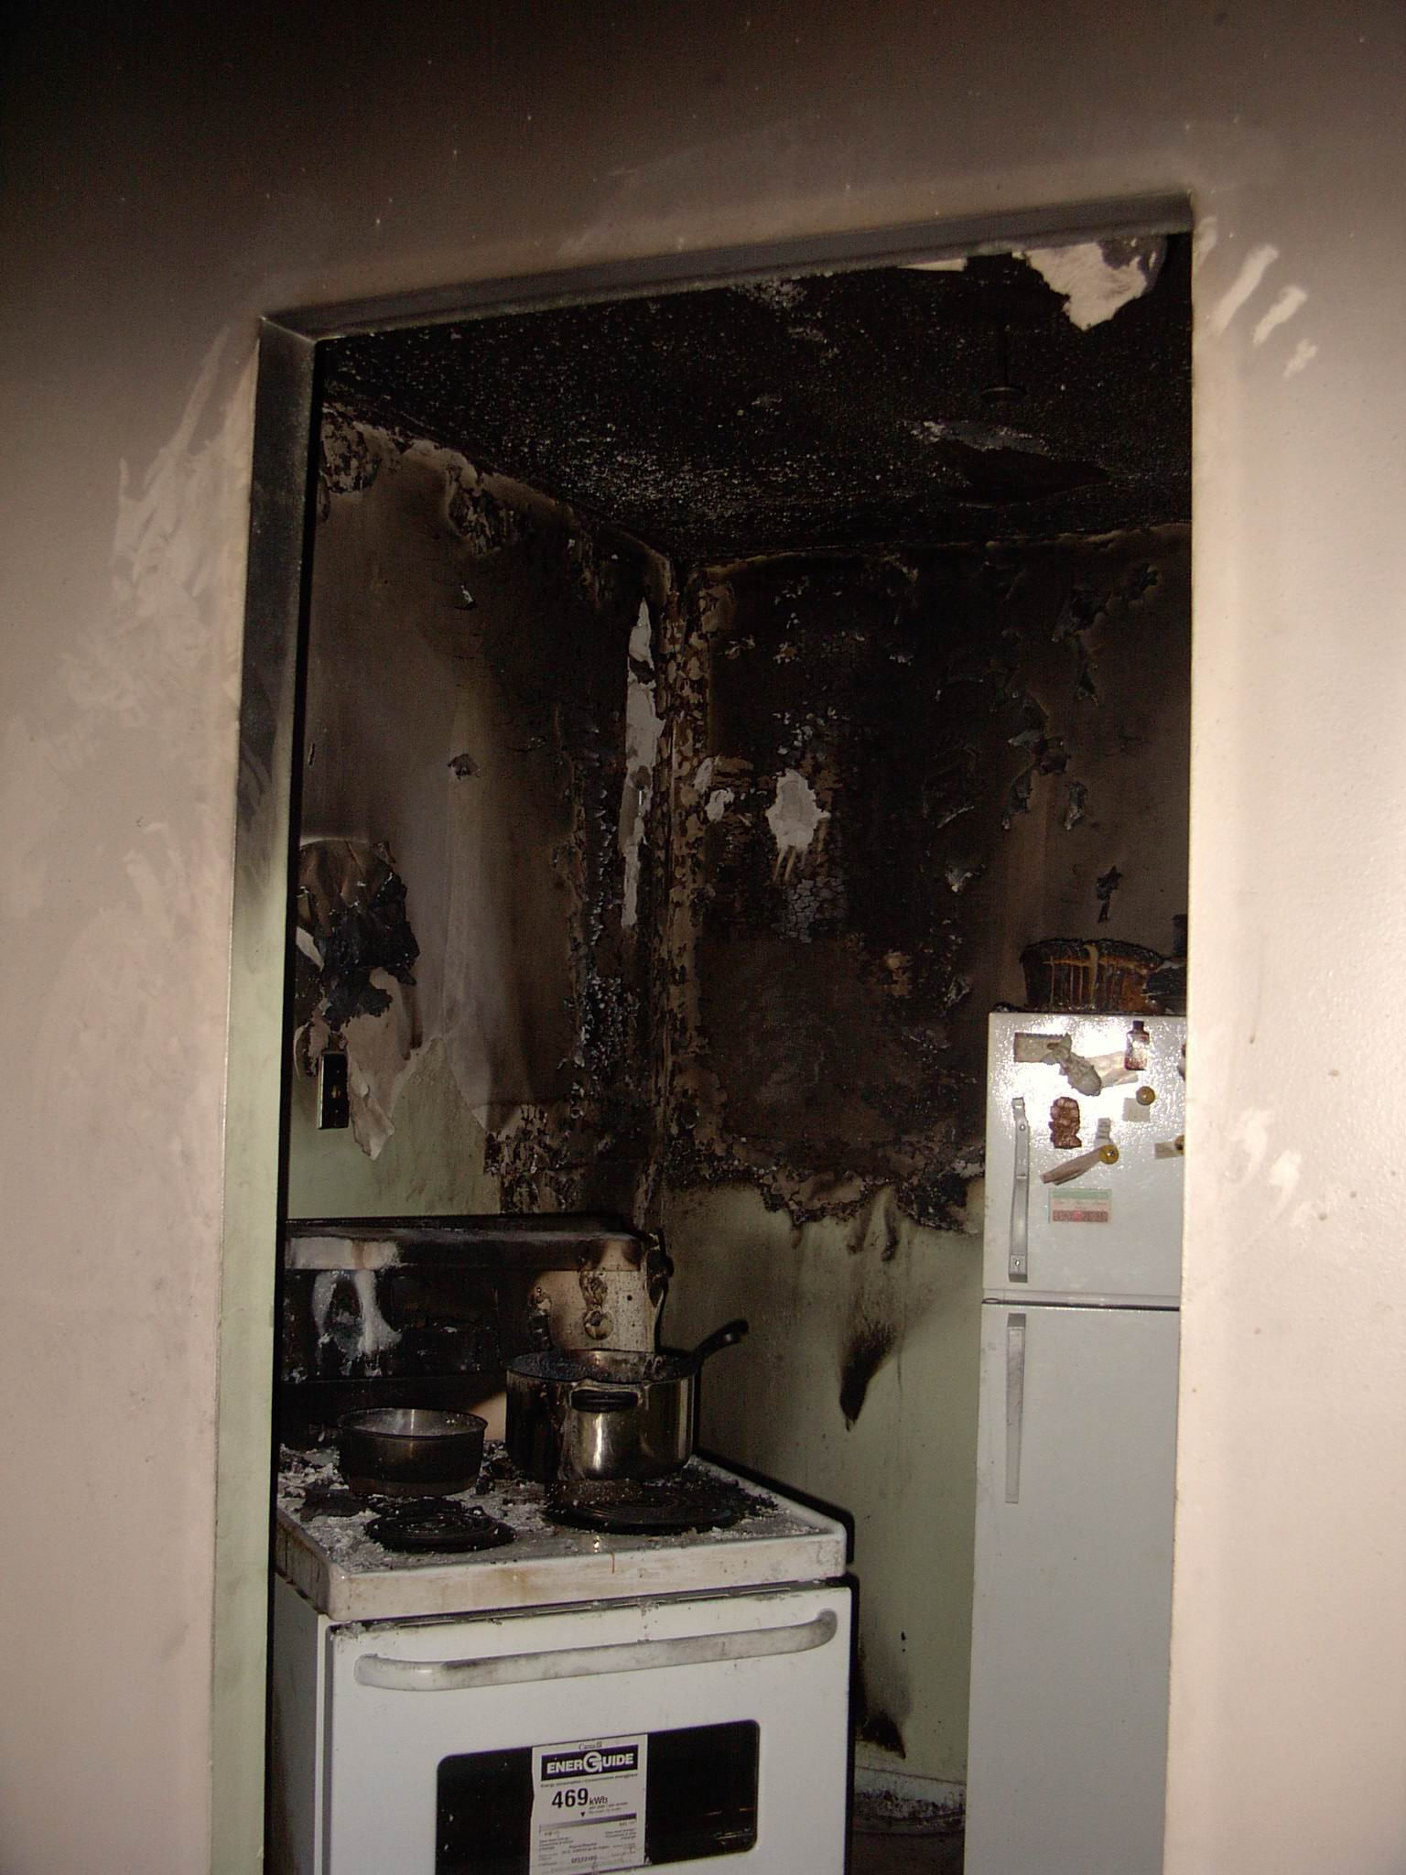
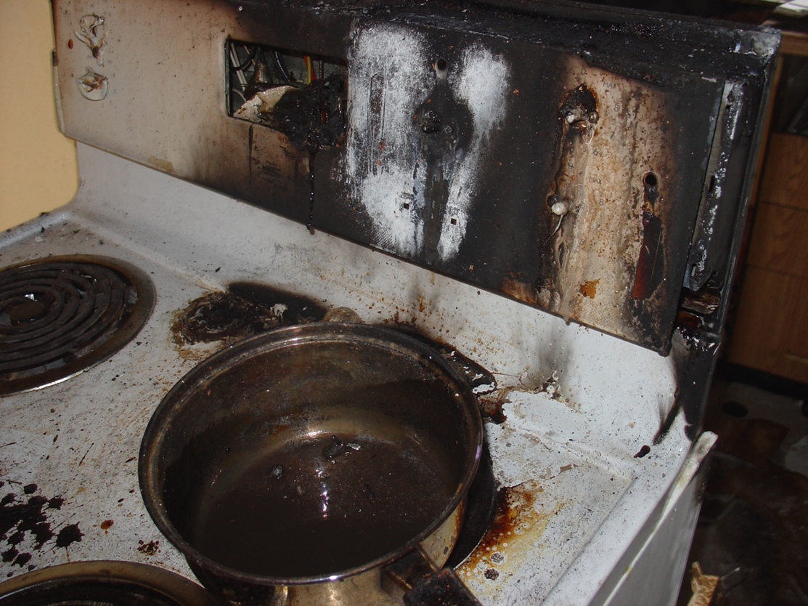
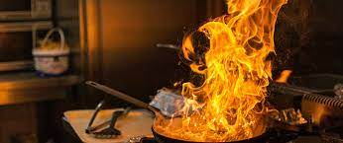
Kitchen Fires
They can happen fast
No deep fat frying on a stove top
Keep the area clean, no grease build up
Have a serviced fire extinguisher readily available.
Consider having a fire blanket near the cooking area

Slide 10
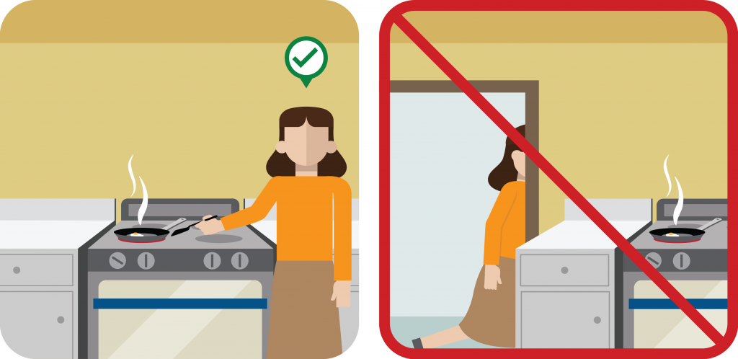
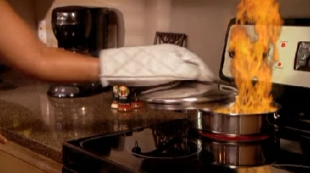
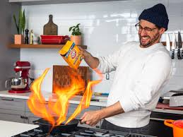
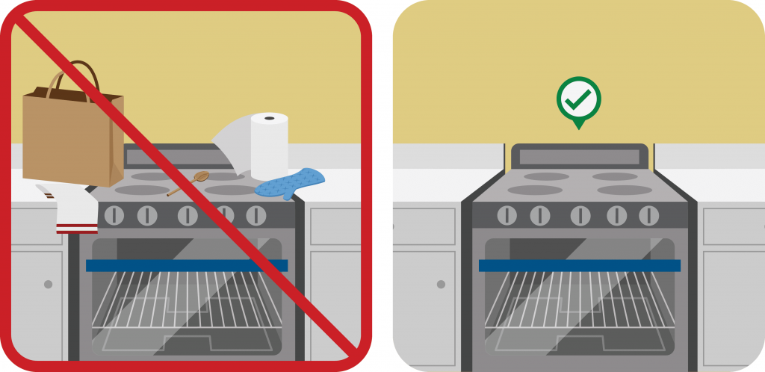
Additional best practice tips for Kitchen fire prevention
The use of baking soda is good for small grease fires.
Use a metal lid, not glass to extinguish the fire.
Do not store combustible materials on or near a stove top
Do not leave cooking materials unattended.

Slide 11
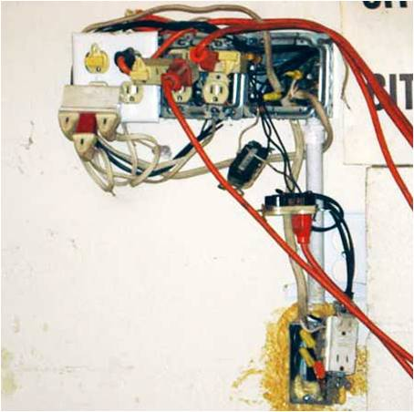
Electrical
Some things are easier seen than others….
The use of extension cords increases the chance of fire from overloaded wiring as well as stress on the electrical device that is it providing power too.
Extension cords are meant for temporary use only.

Slide 12
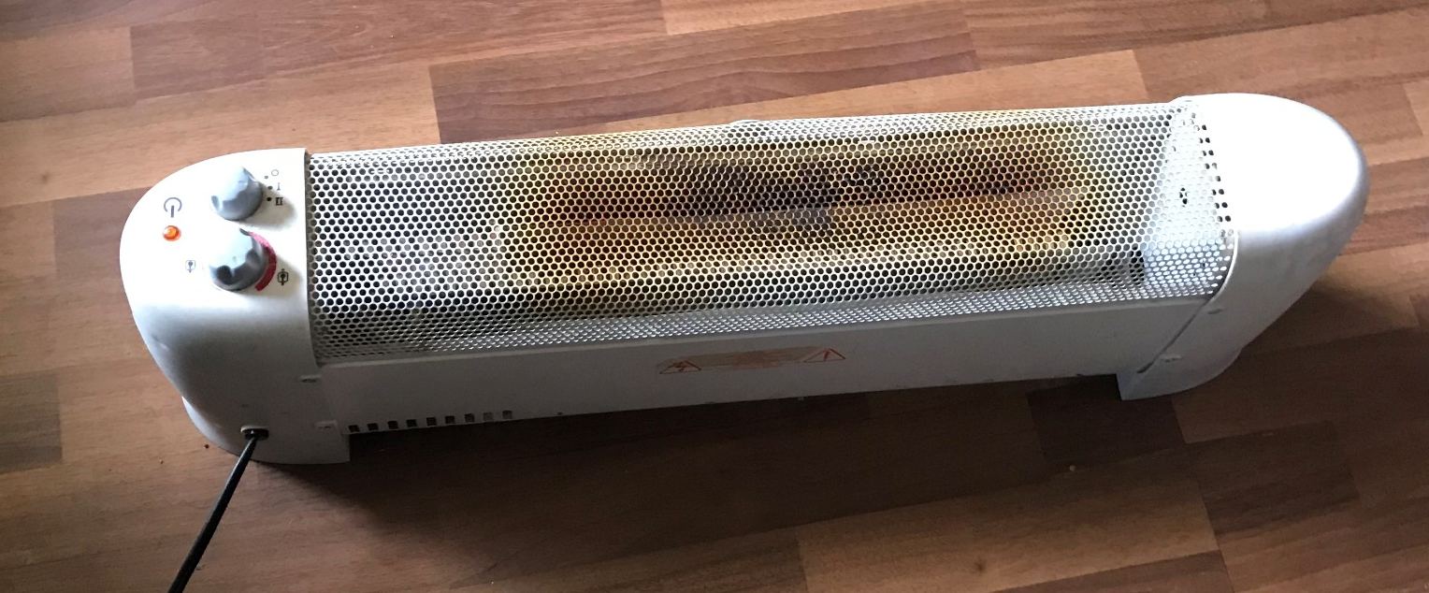
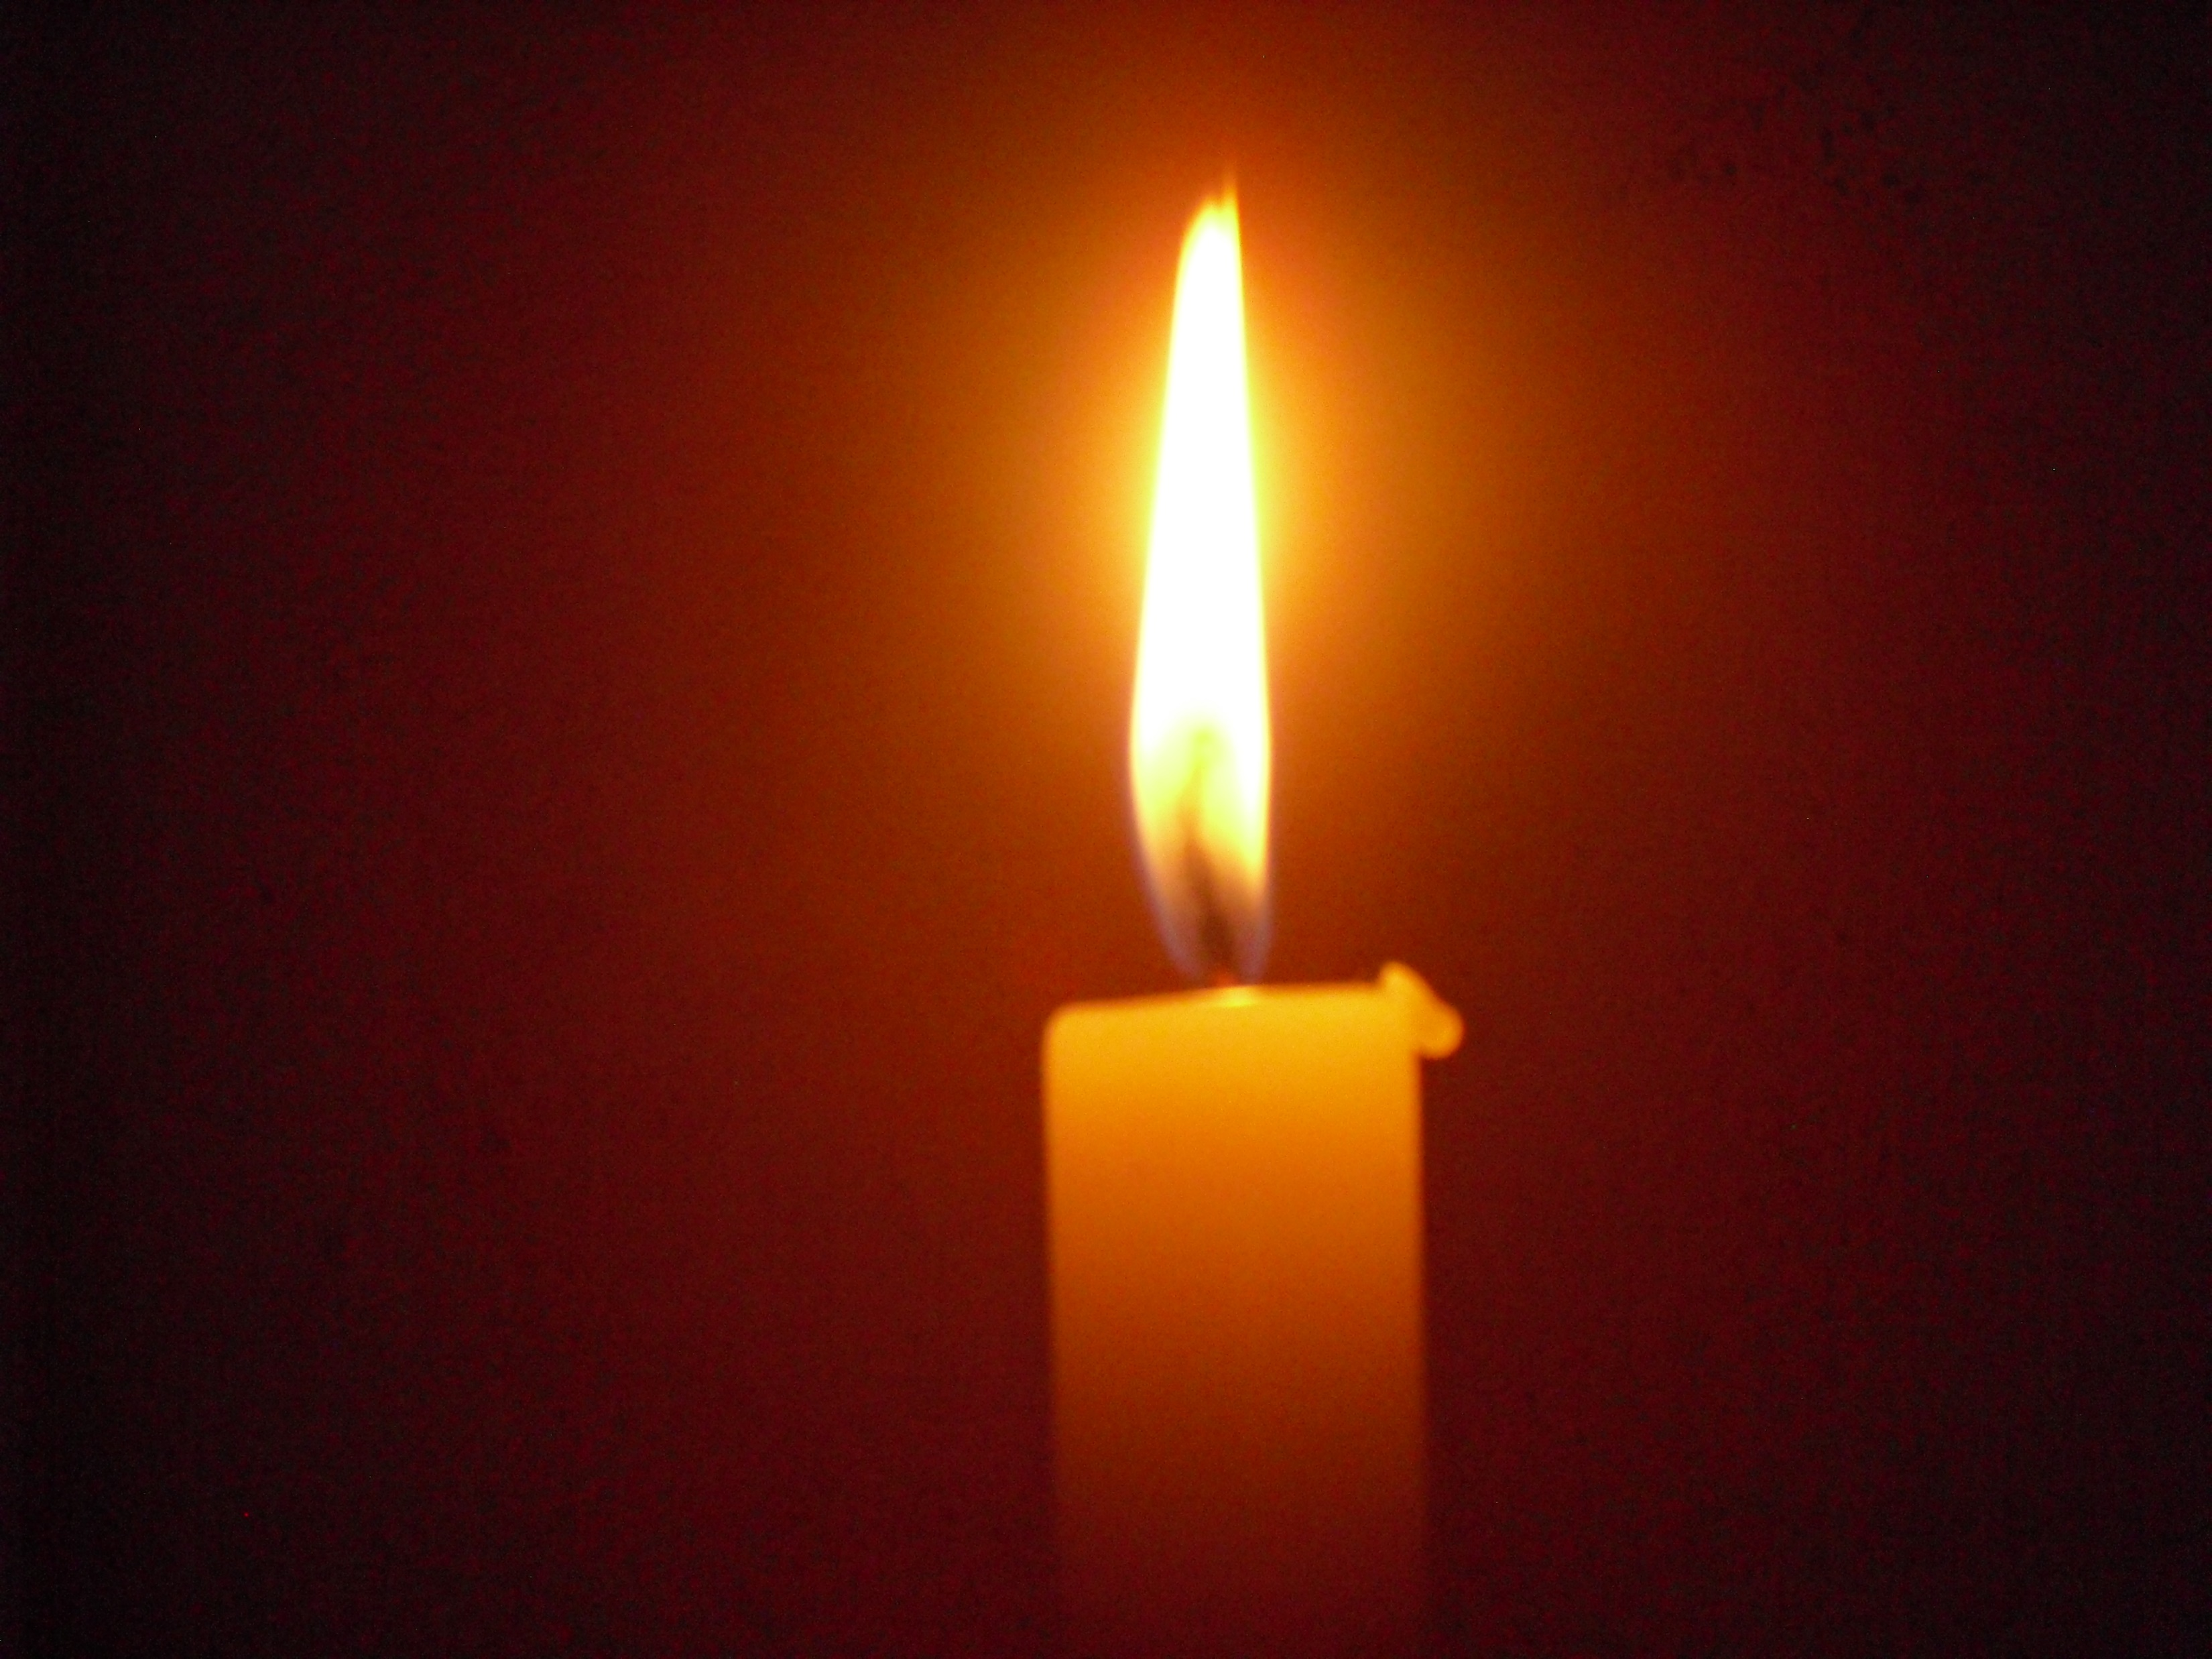
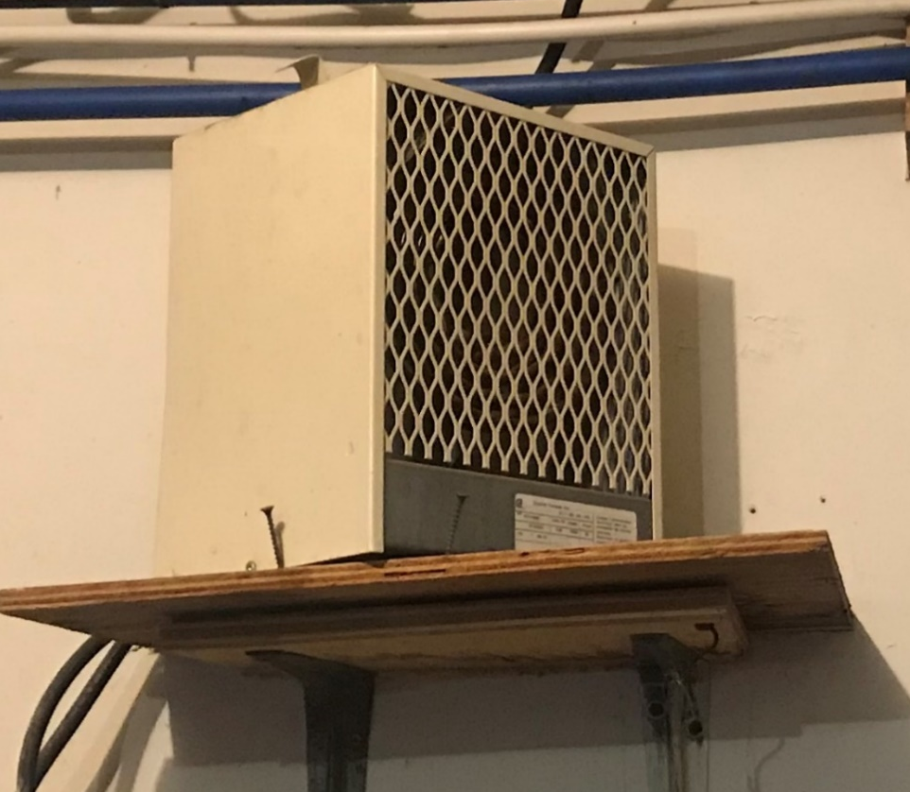
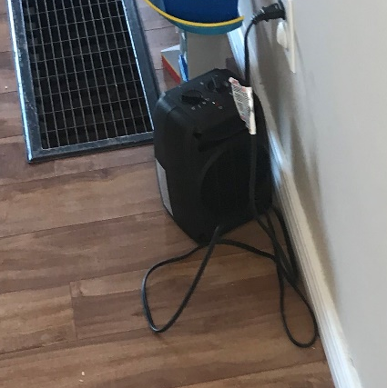
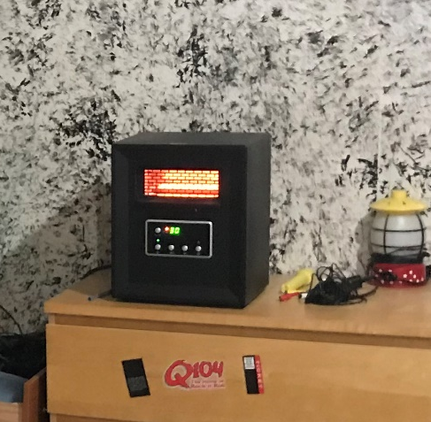
Heating
Know the difference between a Temporary heat source and a Permanent heat source
The distance to combustible materials should always be respected
Keep away from wet environments

Slide 13
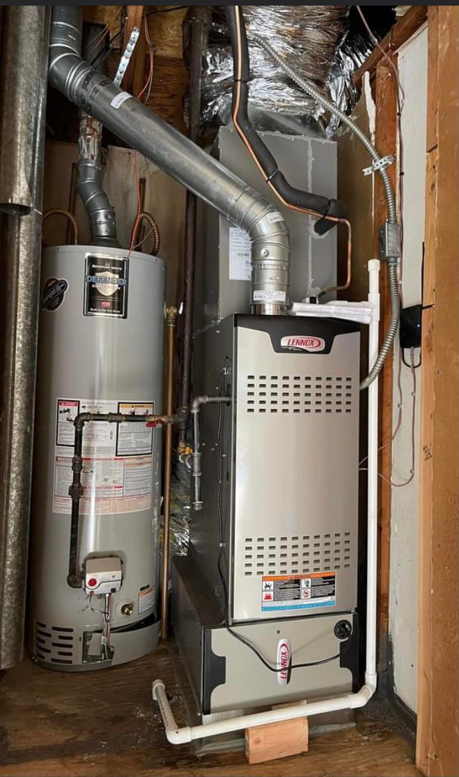
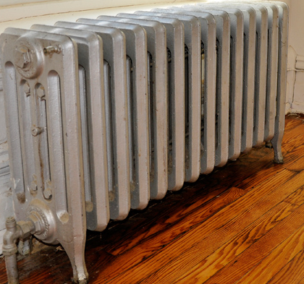
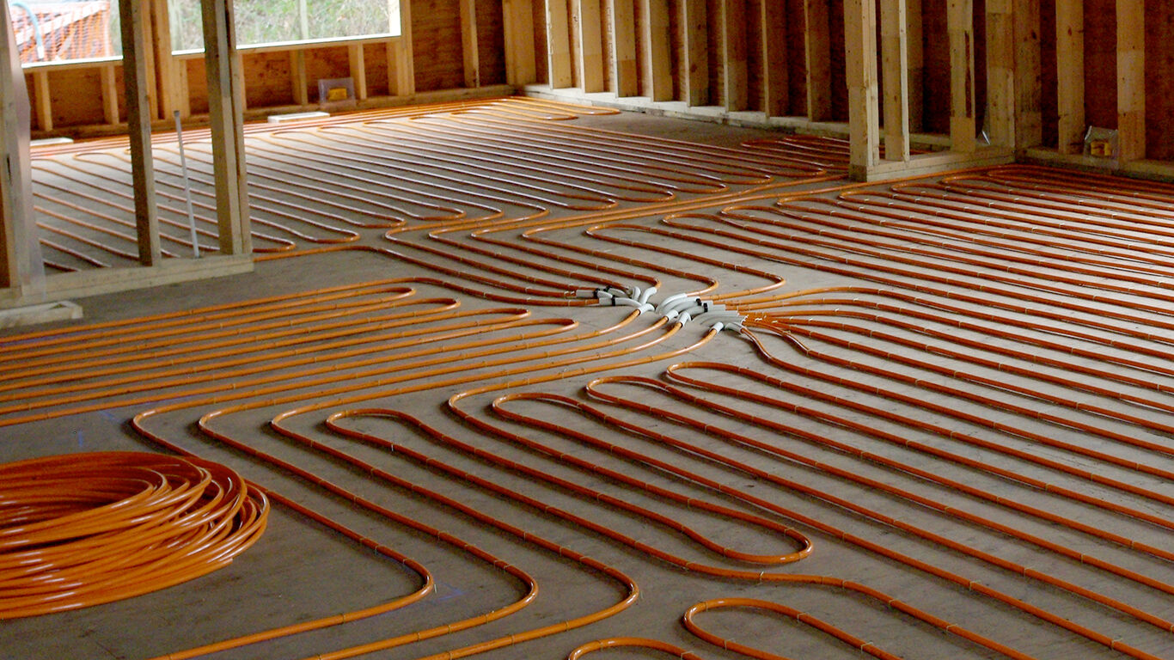
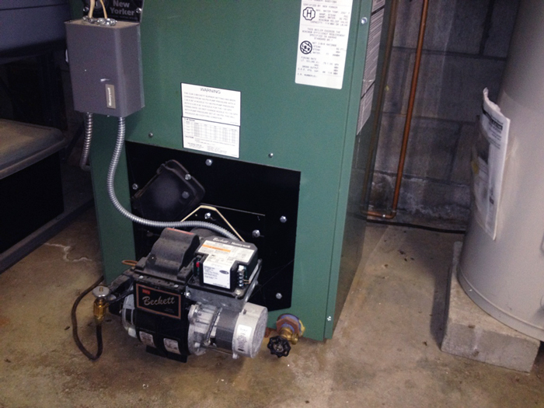
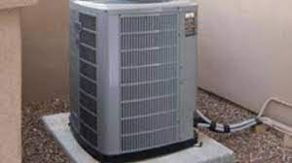
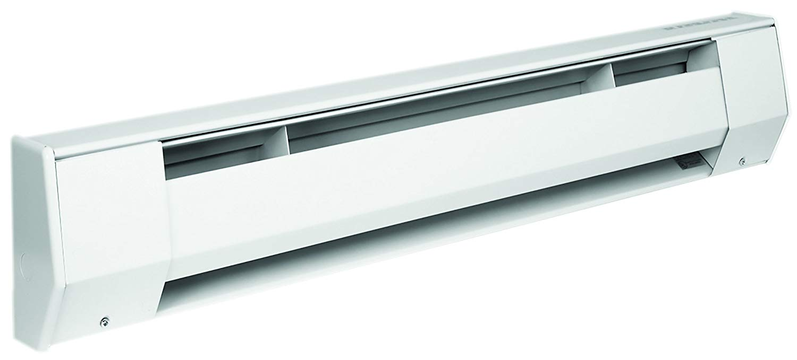
Heating
Types of approved heating systems
Use approved heating devices only.

Slide 14
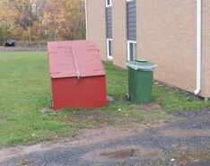
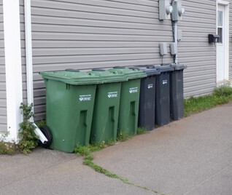
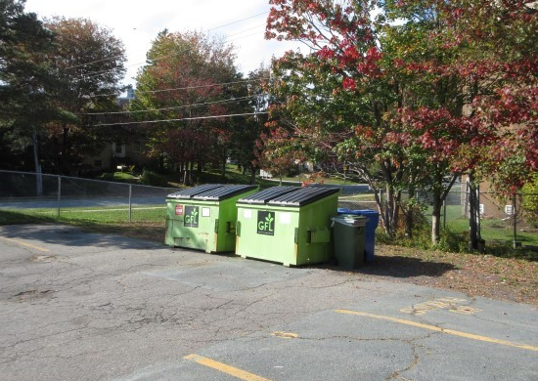
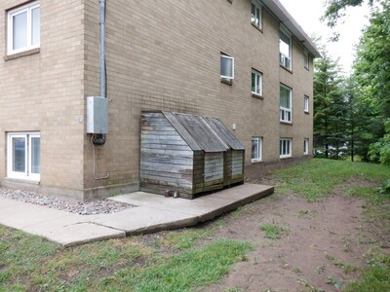
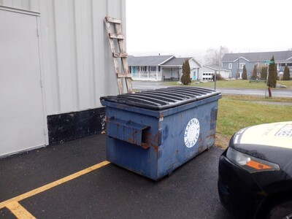
Arson
Good yard lighting can be very effective in reducing any loitering at night times.
It is important to keep combustible materials a safe distance away from the building.
50 Feet from any buildings is the suggested distance for any type of combustible storage.
Examples of combustible materials are:
  Garbage bin
  Pallet storage
  Tires
  Overgrown vegetation

Slide 15

Additional Fire Prevention/Awareness
Being aware of your surroundings, what can burn, what can spread fire to another area?
  What can you do to help prevent a fire loss?
  Report dangerous activities
  Ensure safe practices are being taken
  Have fire extinguishers available and accessible
Discourage the use of wax candles.
  If they are approved for use, ensure they are never left unattended.
LED candles are very appealing and safe.
Consider who would be affected by a fire loss if one occurred? It can affect more than just you; it can affect the lives of many.

Slide 16
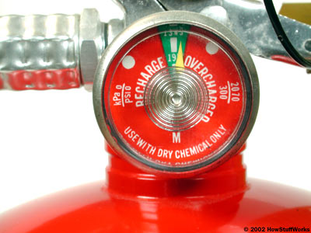
Fire Extinguisher
Types of fire extinguishers
How to use
  PASS
Indications of a properly charged fire extinguisher
Where to install a fire extinguisher

Slide 17
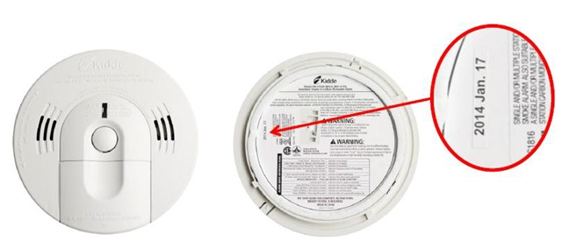
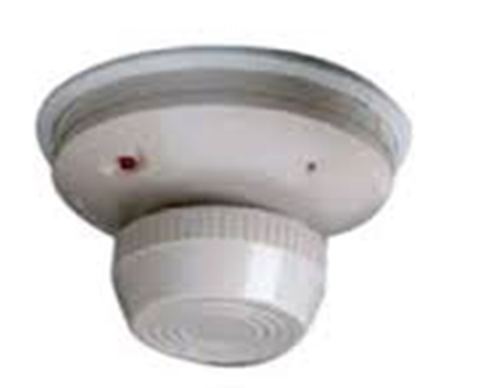
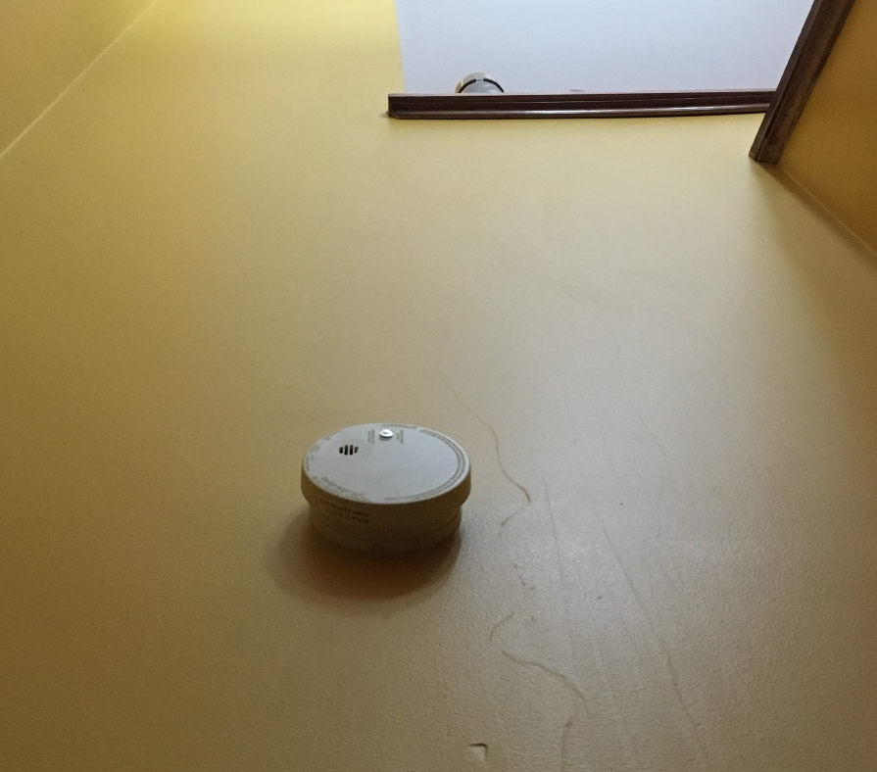
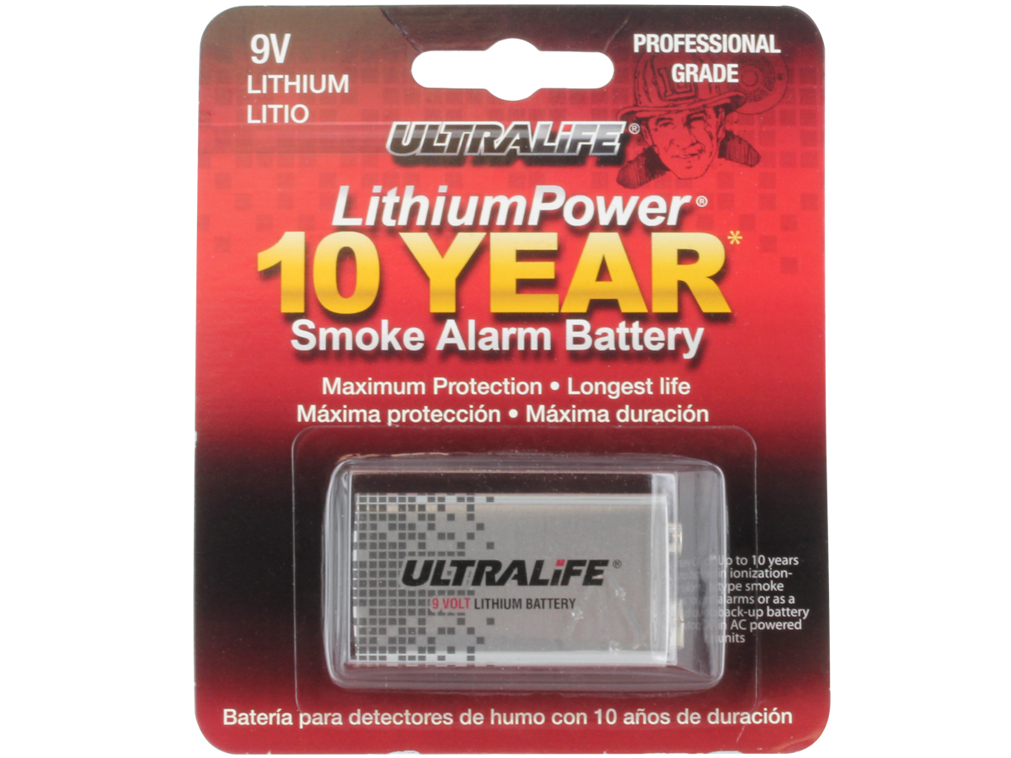
Smoke detectors
All Smoke Detectors have an expiation date – 10 years from manufacturing
They should be tested monthly, and batteries replaced annually unless they are provided with a lifetime battery
Installation of the smoke detector should be on or near the ceiling height
A monitored smoke detector system will help notifying the appropriate people in the event of a fire.

Slide 18
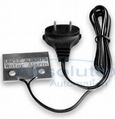
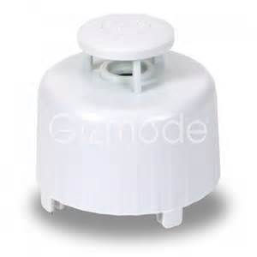
Water Loss Prevention
Water alarms/Early detection devices
Can be monitored off site through the central fire panel or just local audio alarm.
Can helps in reducing the severity of water losses.
Water losses can occur from:
  Overflowing fixtures
  broken or ruptured water lines
  frozen water lines
  hot water tank failures
  Broken drainage system
  Water backup.

Slide 19
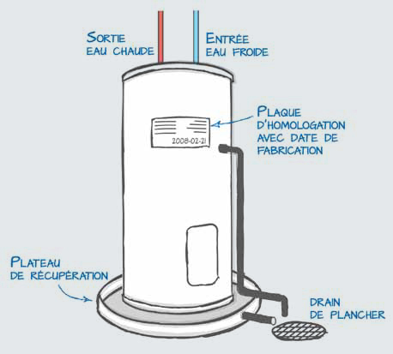
Hot Water Tanks
Water claims are on the rise and the cost of repair is increasing every year.
Many water claims can be avoided or minimized by installing early detection devices.
Consider adding early water detection to areas that are subject to water leaks.
  Hot water tanks
  Under sinks
  Near bathtub or toilet
  Where water lines extend to unheated areas
Tank information tag
Water catch pan
Water Drain

Slide 20
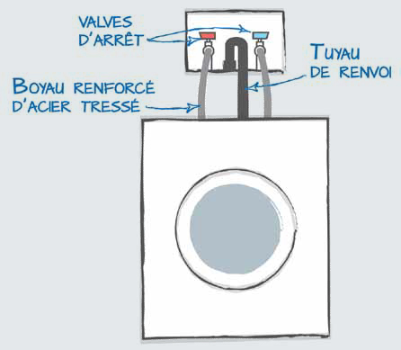
Best Practices for Water
Install signs where the water valves are located with directions on how to turn off after each use if possible.
Visually inspect water lines on a regular basis to ensure no defects in the hose has occurred.
Make sure the drain is in place.
Valves
Water Drain
Water Lines

Slide 21
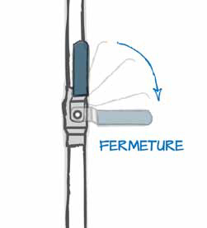
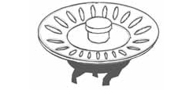
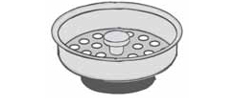
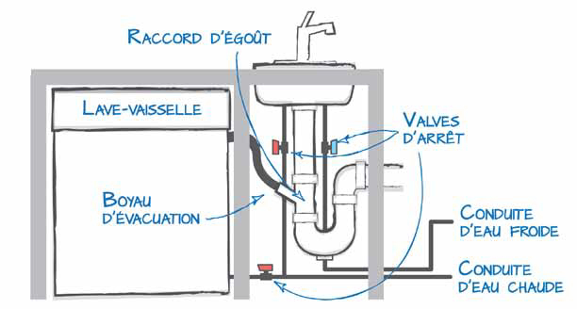
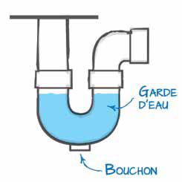
Water and drains
Drainage concerns
Locations of valves
Close the valve
Main drain line
Dishwasher
Water shut off valves
Water Trap
Dishwasher drain line
Cold Water line
Drain Cap
Hot water line

Slide 22
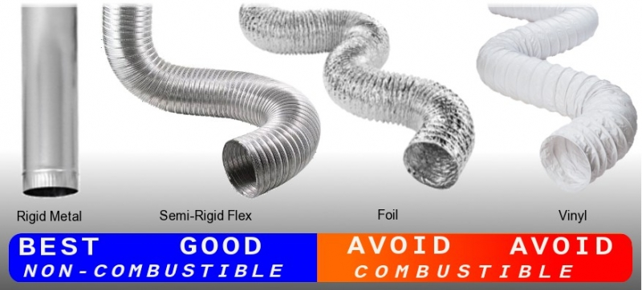
Appliances and the hazards they present
Clothes Dryer
  Dirty/clogged vents
  Blocked screen
Clothes Washing machine
  Water lines
  Drain installed properly
  Water valves accessibility
Window Air conditioner
  Poor installation
  Use of extension cords?
Fridges when supplied with water lines
  Water lines
  Use of extension cords?
Dish Washer
  Water lines
  Drains

Slide 23
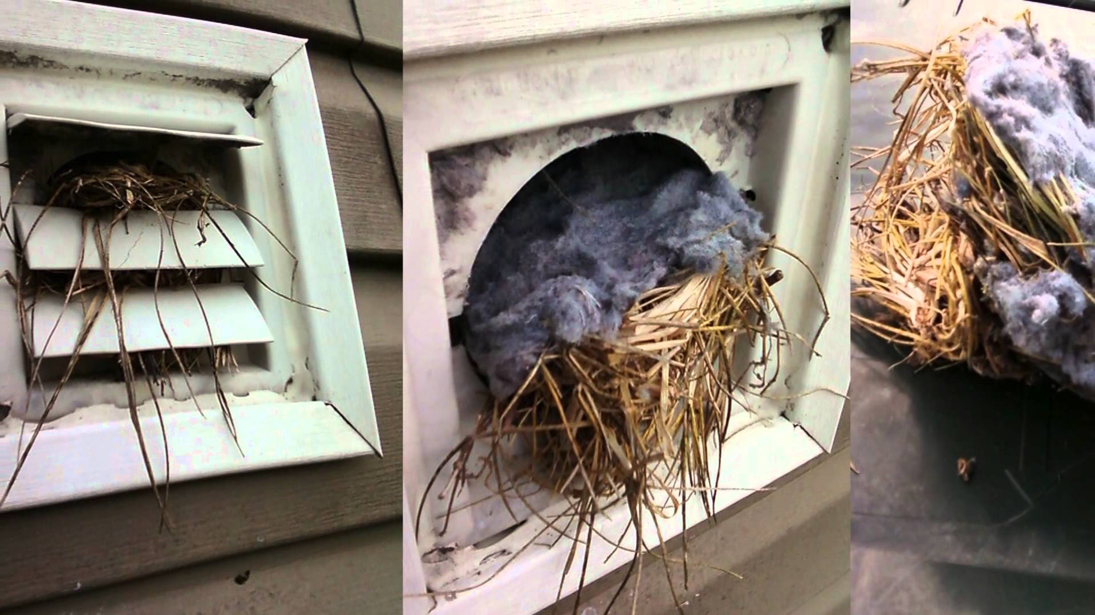
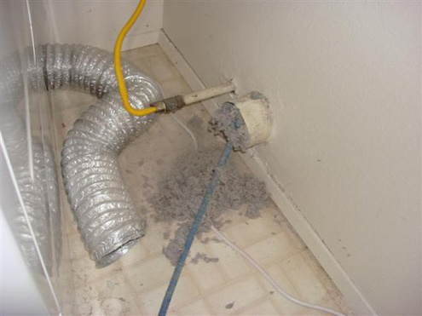
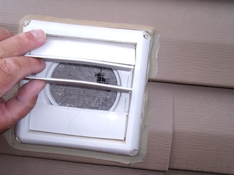
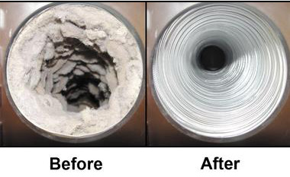
Causes of Fire Loss - Clothes Dryer Venting

Slide 24
Thank you!

